Slide 1
South Sudan Flood Monitoring and Prediction - 2025 Season
FEWS NET Science Team
June 24, 2024

Slide 2
South Sudan Flooding – Key Message
Key Message
The South Sudan Flood task Force should expect and prepare for extensive flooding in 2025, but less than the flooding experienced in 2024.
Supporting Evidence
VIIRS Flood Mapping product analysis
Nile River water levels are higher than 2024
Uganda lake levels are very high
Above-average precipitation is forecast for June – September
NASA LASSO Model Monthly Inundation Forecasts

Slide 3
South Sudan Flooding – VIIRS Analysis
VIIRS Flood Mapping (VFM) product analysis
Time-series VFM monthly composites historically depict the annual minimum in May, and greatest extents in September and October.
The May 2025 VFM minimum is greater than any since 2012, including flood years 2020, 2022, and 2024. Thus, 2025 seasonal flooding has a “head start” compared to previous flooding years.
VFM sub-monthly composites for May 2025 indicate that the annual minimum has been reached and inundated extent is now beginning to increase.

Slide 4
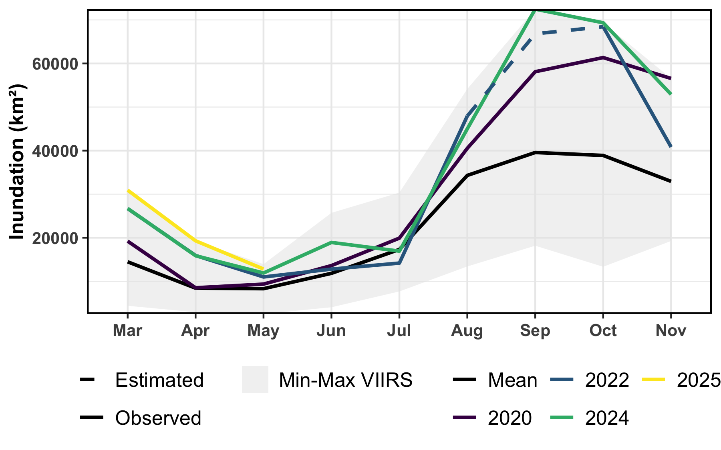
VIIRS Flood Mapping (VFM) Time Series
Time-series VFM monthly composites historically depict the annual minimum in May, and greatest extents in September and October.
The May 2025 VFM (yellow line) minimum is greater than any since 2012, including flood years 2020, 2022, and 2024. Thus, 2025 seasonal flooding has a “head start” compared to previous flooding years.

Slide 5
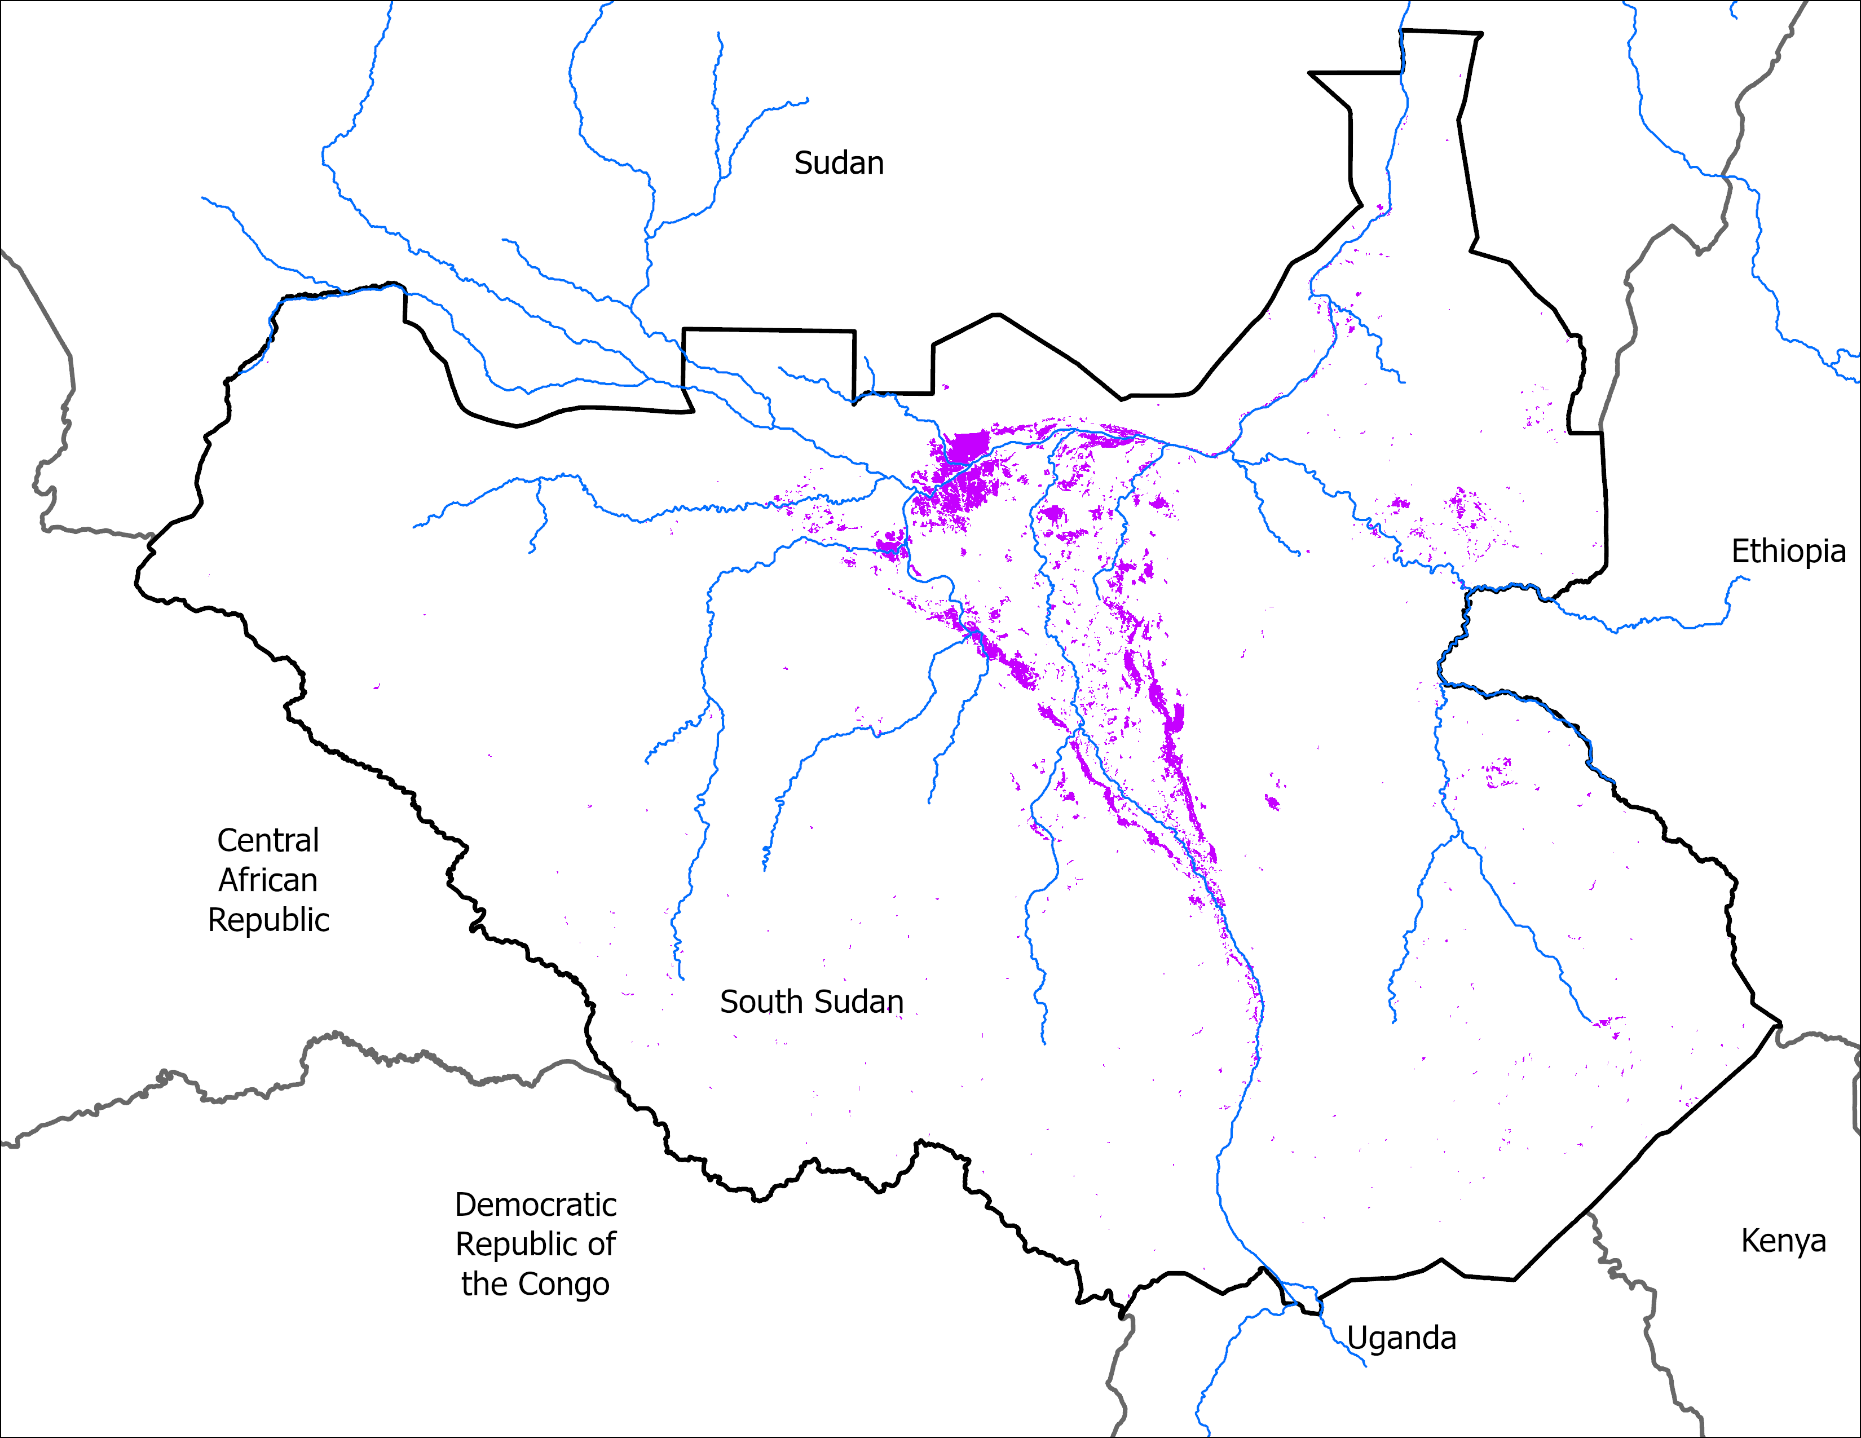
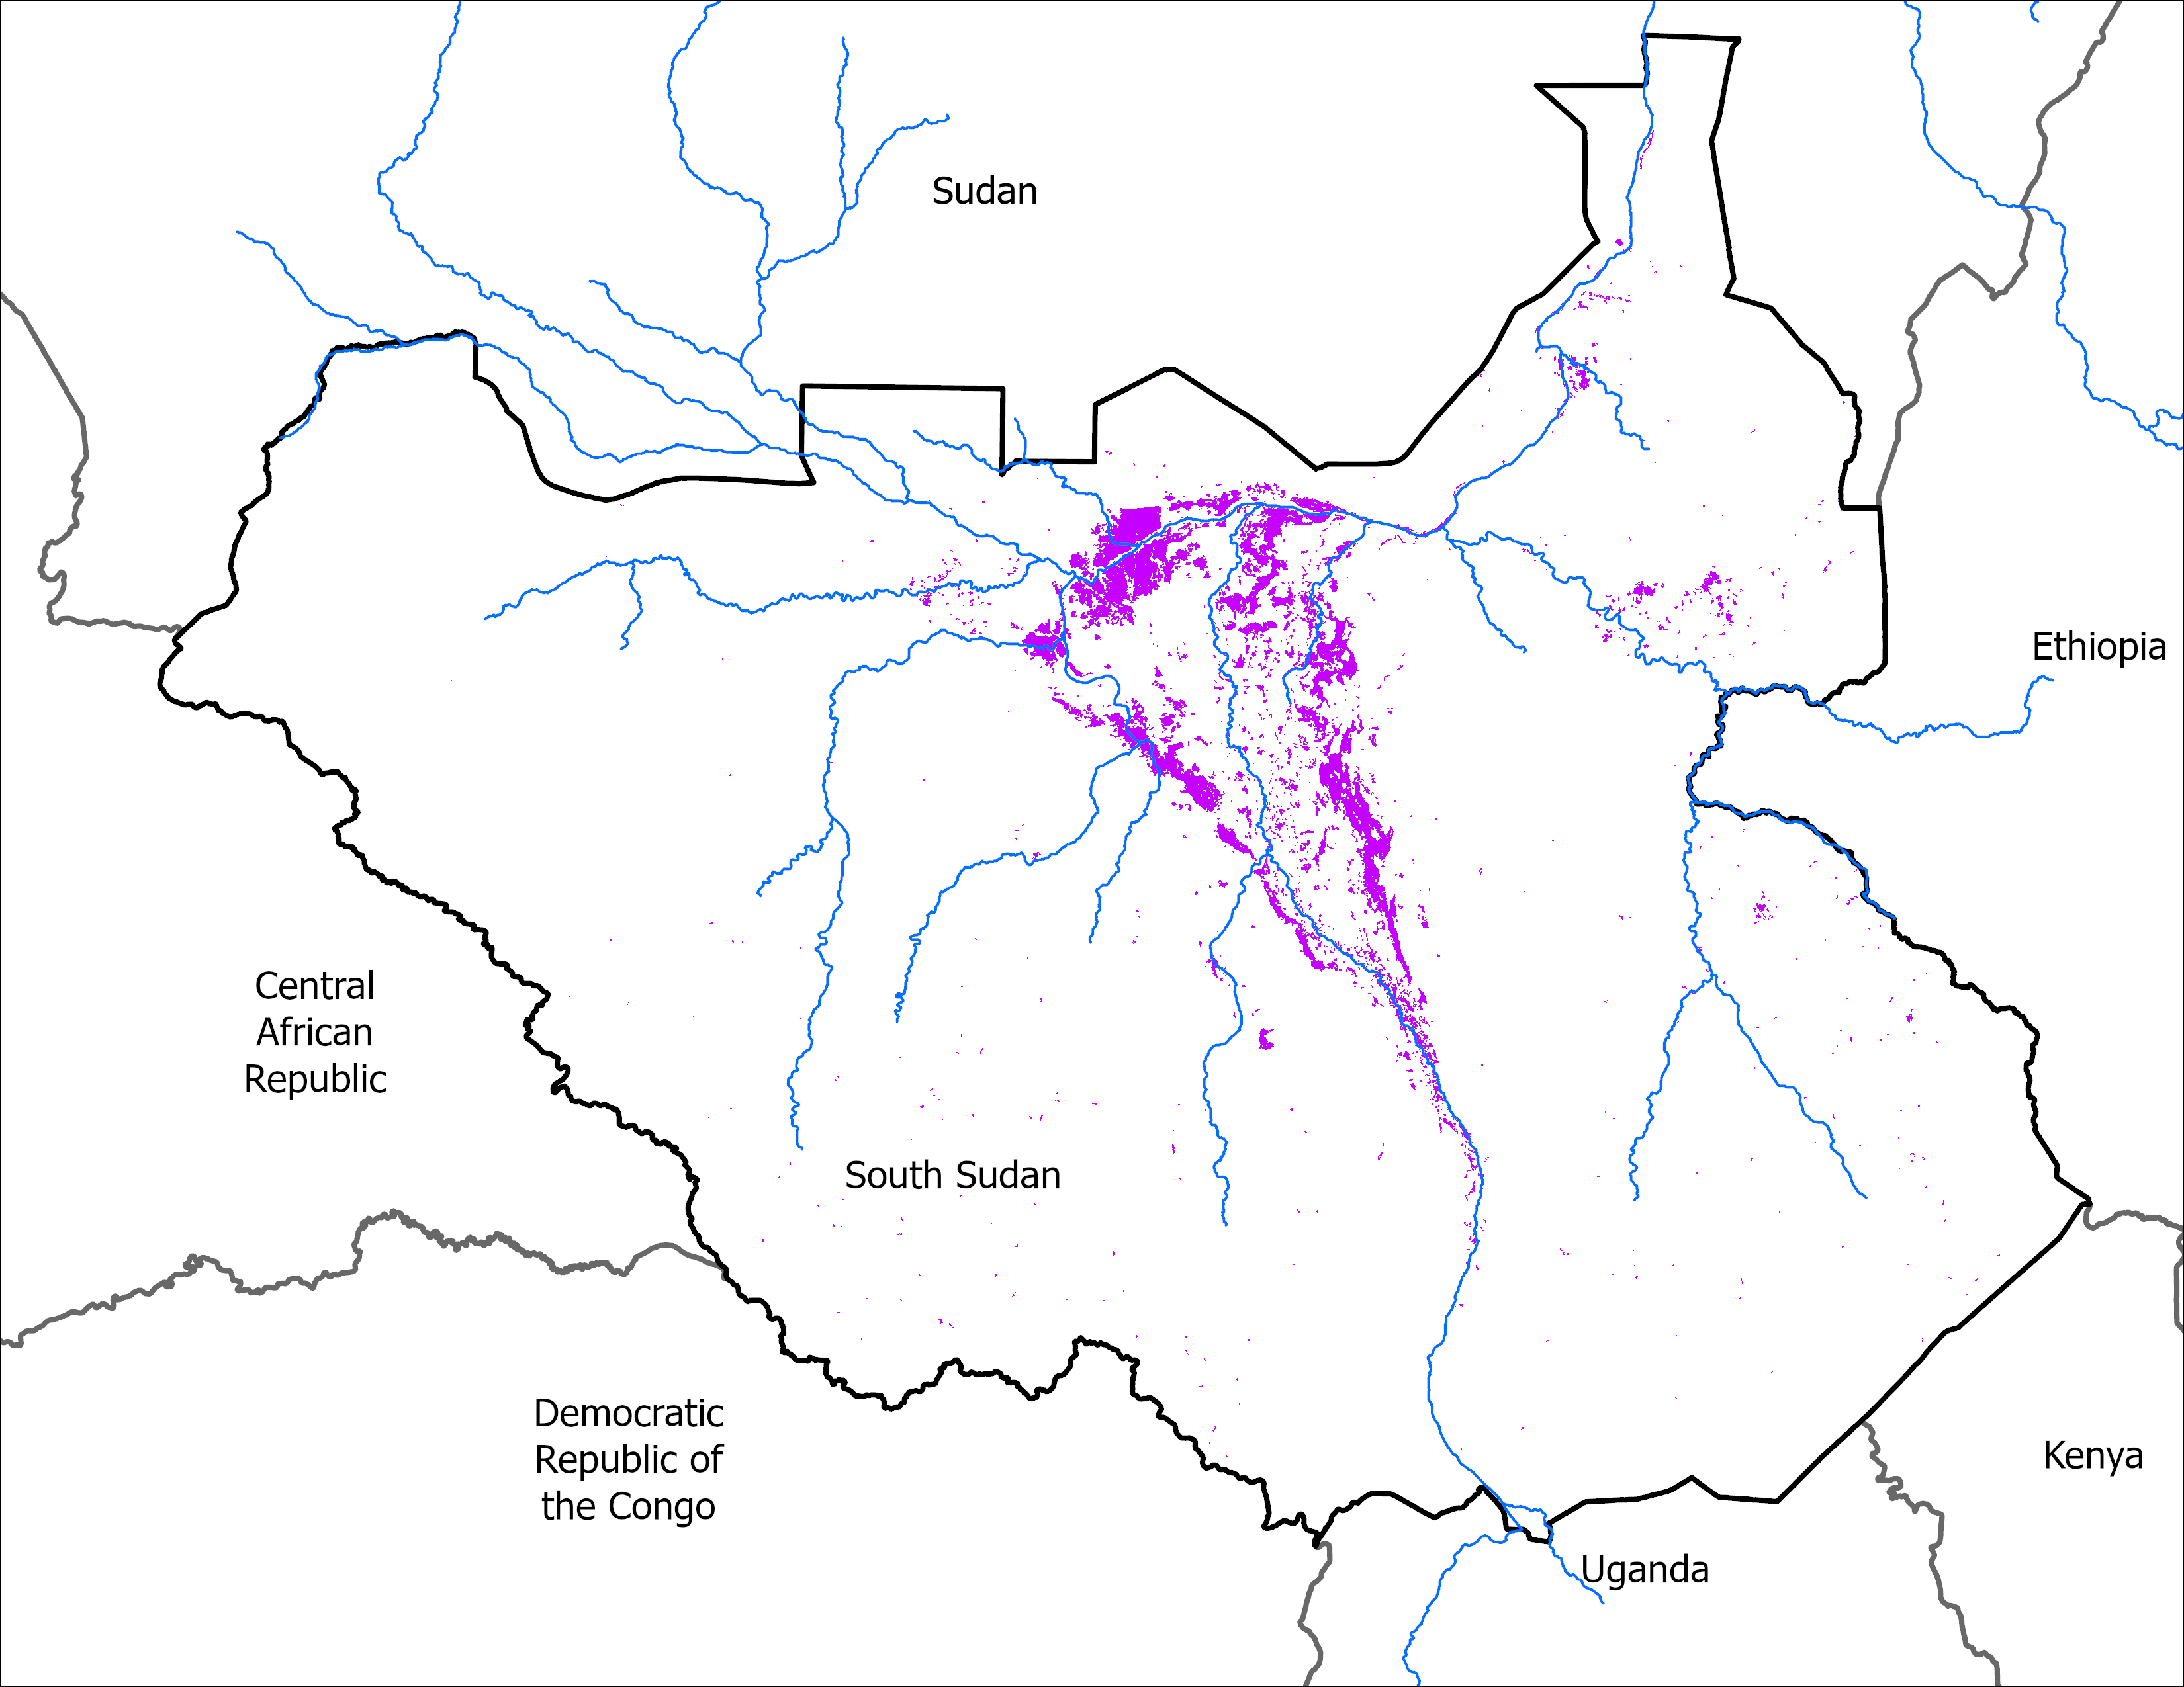
May Initial Conditions
End of May 2024
End of May 2025
VIIRS : 11,907 km²
VIIRS: 14,883 km²
By the End of May 2025, there are slightly more area under water than the same in 2024.

Slide 6
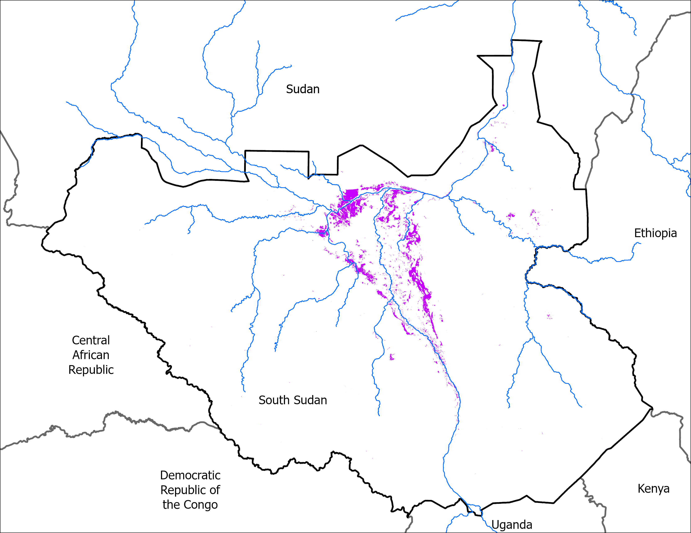
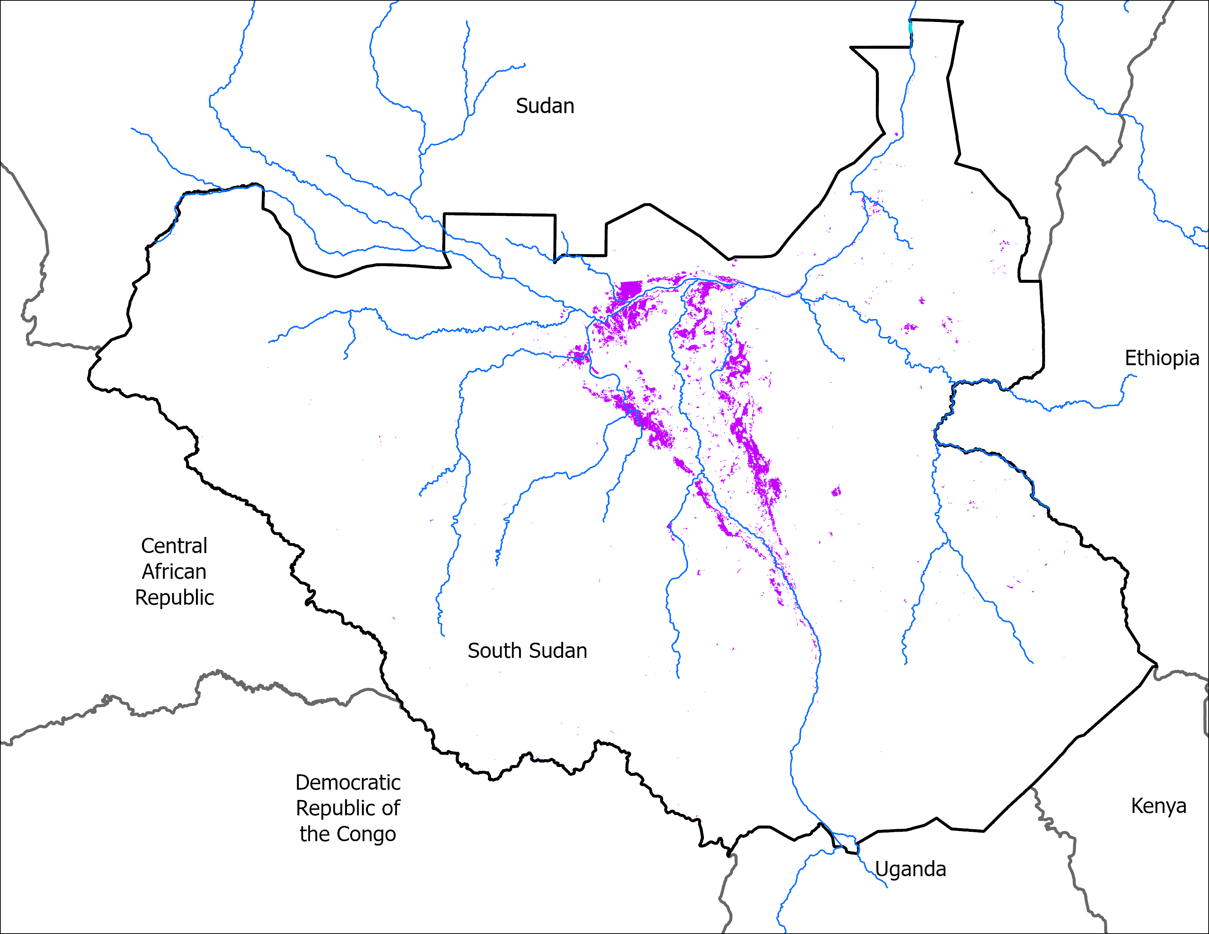
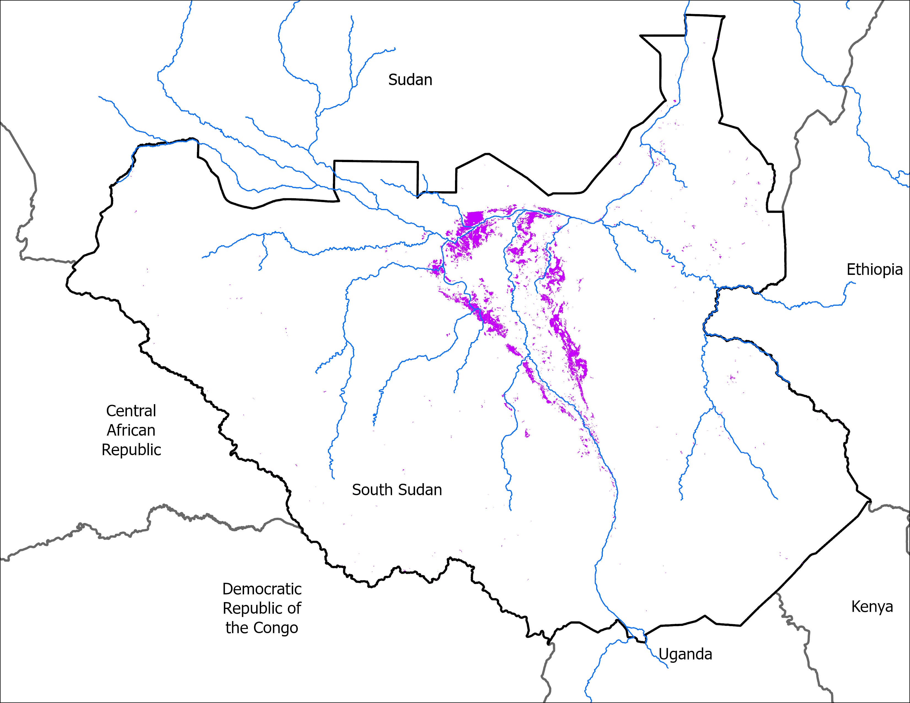
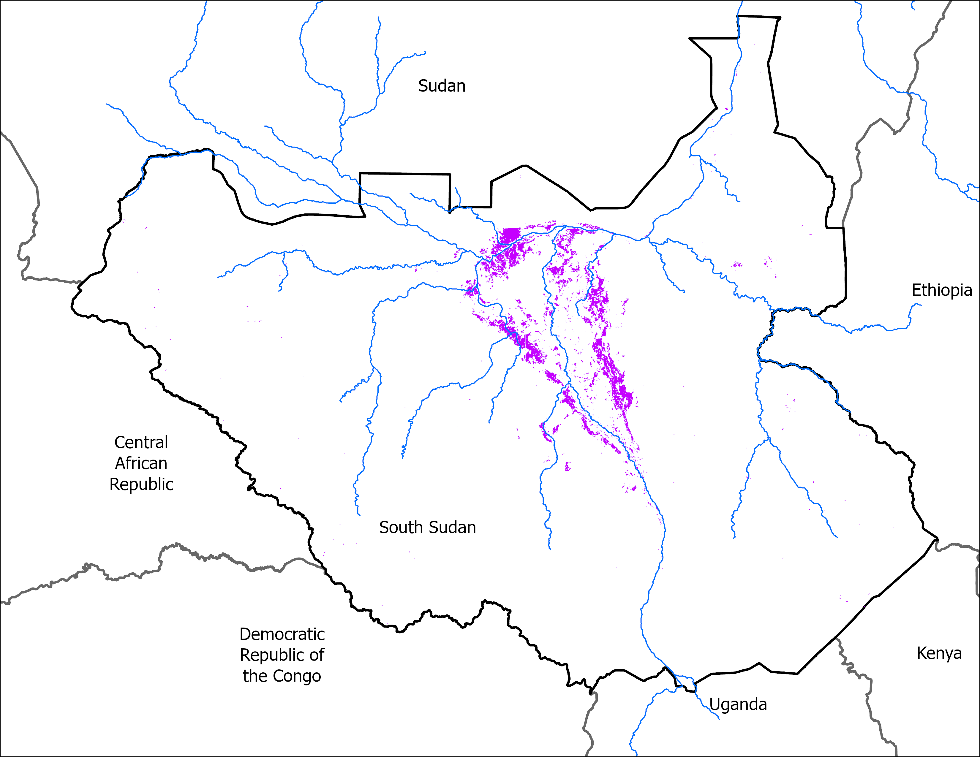
Flooding Progression
04-08 May: 9,860 km²
06-10 Jun: 11,790 km²
11-15 Jun: 11,360 km²
18-22 Jun: 11,100 km²

Slide 7
South Sudan Flooding – SWOT Analysis
Nile River water levels are higher than 2024 and are rising at Juba
Time-series Surface Water and Ocean Topography (SWOT) data at Juba indicate that the Nile reached its annual minimum water level in April and is now rising.
Mid-June 2025 water levels measured by the SWOT satellite altimeter at Juba, Malakal, and just upstream of Nimule are 0.5 to 1 m higher than 2024, providing further evidence that 2025 seasonal flooding has a “head start” compared to previous flooding years.

Slide 8
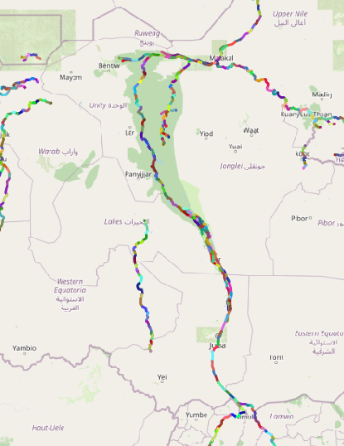
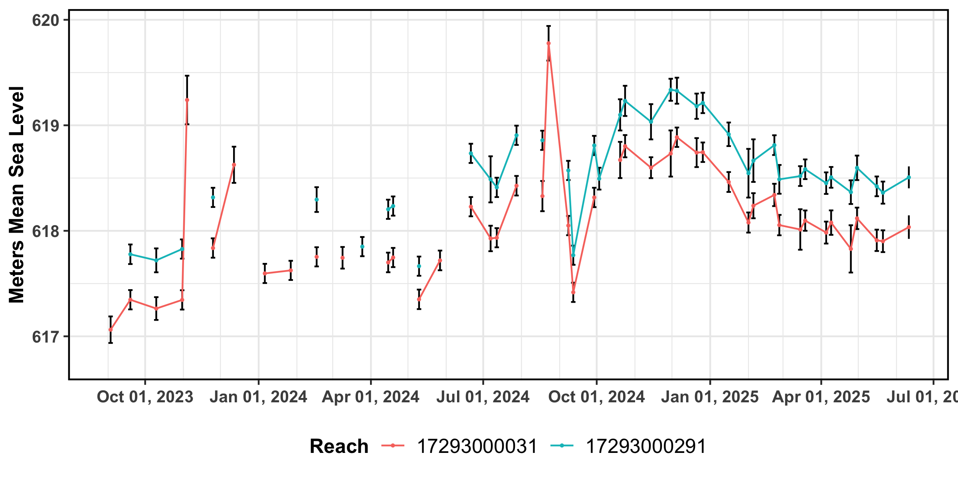
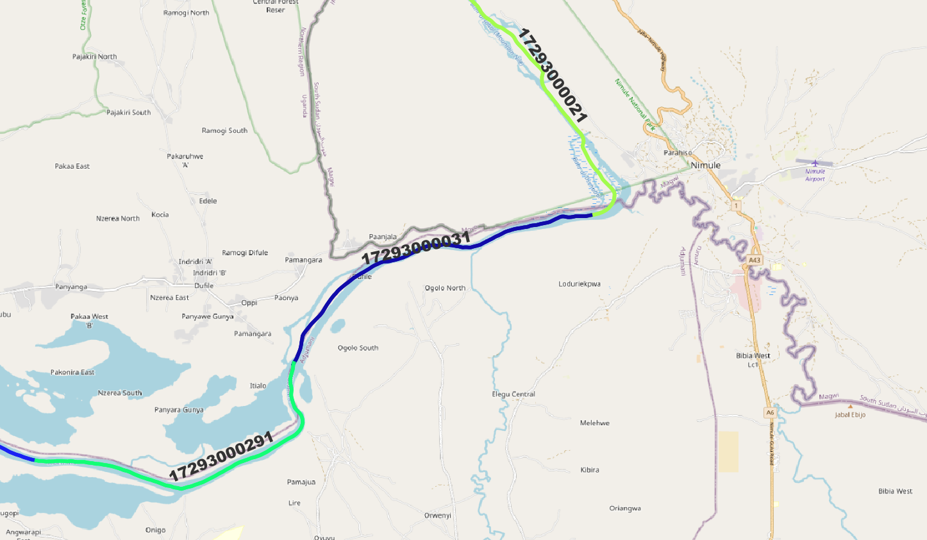
SWOT Satellite Altimetry – Nimule
Mid-June Nile River water levels just upstream of Nimule are ~0.5 meter higher than in 2024 and appear to be at their seasonal low (have stopped falling).
Notes:
SWOT dataset was filtered to remove data points with >0.25 m uncertainty and outliers.
Error bars represent uncertainty.
Data citation: Frank Greguska, Nikki Tebaldi, Victoria McDonald, Vanesa, & Cassie Nickles. (2024). podaac/hydrocron: 1.3.0a5 (1.3.0a5). Zenodo. https://doi.org/10.5281/zenodo.11193245, accessed 23 June 2025.

Slide 9
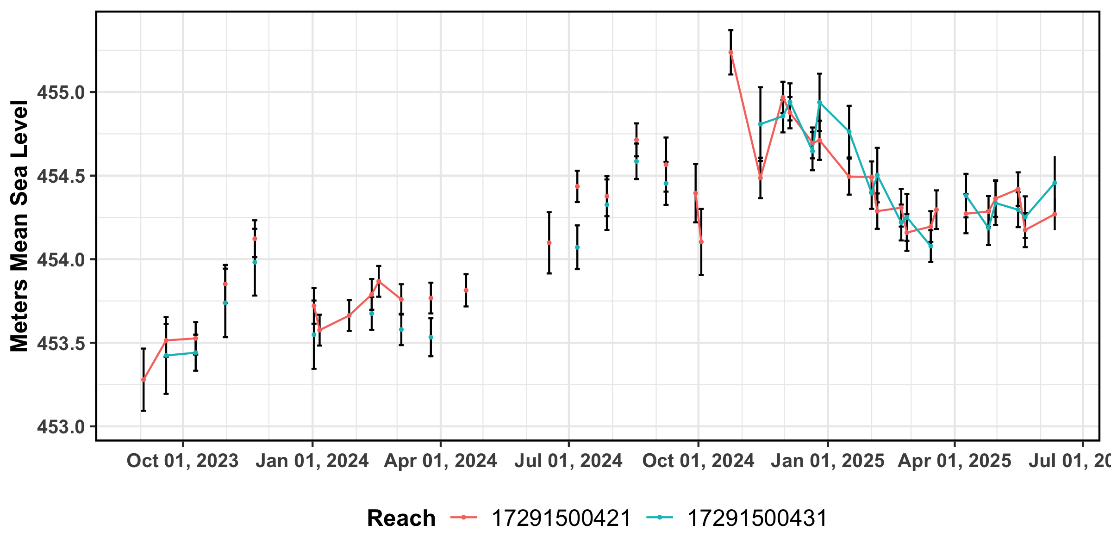
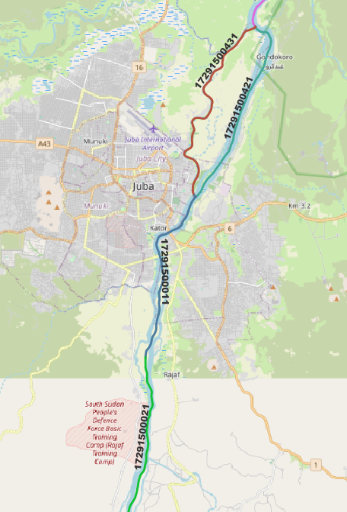
SWOT Satellite Altimetry – Juba
Mid-June Nile River water levels at Juba are ~0.5 meters higher than in 2024 and are rising.
Notes:
SWOT dataset was filtered to remove data points with >0.25 m uncertainty and outliers.
Error bars represent uncertainty.
Data citation: Frank Greguska, Nikki Tebaldi, Victoria McDonald, Vanesa, & Cassie Nickles. (2024). podaac/hydrocron: 1.3.0a5 (1.3.0a5). Zenodo. https://doi.org/10.5281/zenodo.11193245, accessed 23 June 2025.

Slide 10
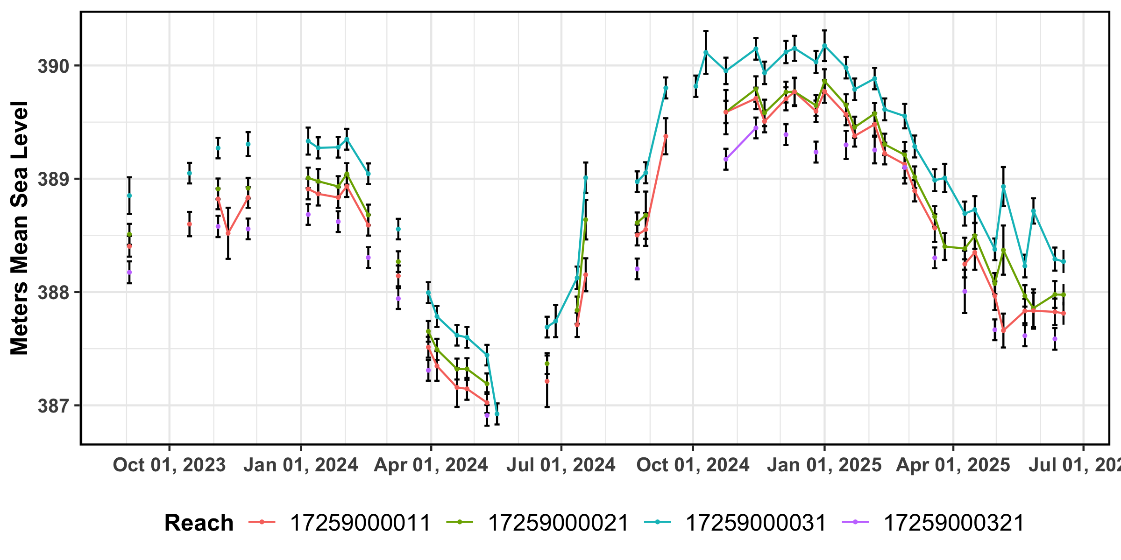
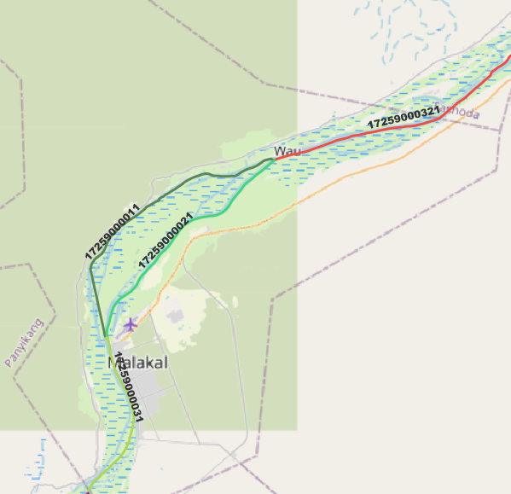
SWOT Satellite Altimetry - Malakal
Nile River water levels at Malakal are higher than in 2024 and appear to be at their seasonal low (have stopped falling).
Notes:
SWOT dataset was filtered to remove data points with >0.25 m uncertainty and outliers.
Error bars represent uncertainty.
Data citation: Frank Greguska, Nikki Tebaldi, Victoria McDonald, Vanesa, & Cassie Nickles. (2024). podaac/hydrocron: 1.3.0a5 (1.3.0a5). Zenodo. https://doi.org/10.5281/zenodo.11193245, accessed 23 June 2025.

Slide 11
South Sudan Flooding – Uganda Lakes
Uganda lake levels are very high
Lake Albert level is above its 2024 level and well in excess of its historical 90th percentile rank.
Lake Victoria and Lake Kyoga water levels are below that of 2024, but still very high at the 90th percentile rank.
High lake levels imply high White Nile flows from Uganda to South Sudan, a principal source of water for the annual expansion of the Sudd wetland.

Slide 12
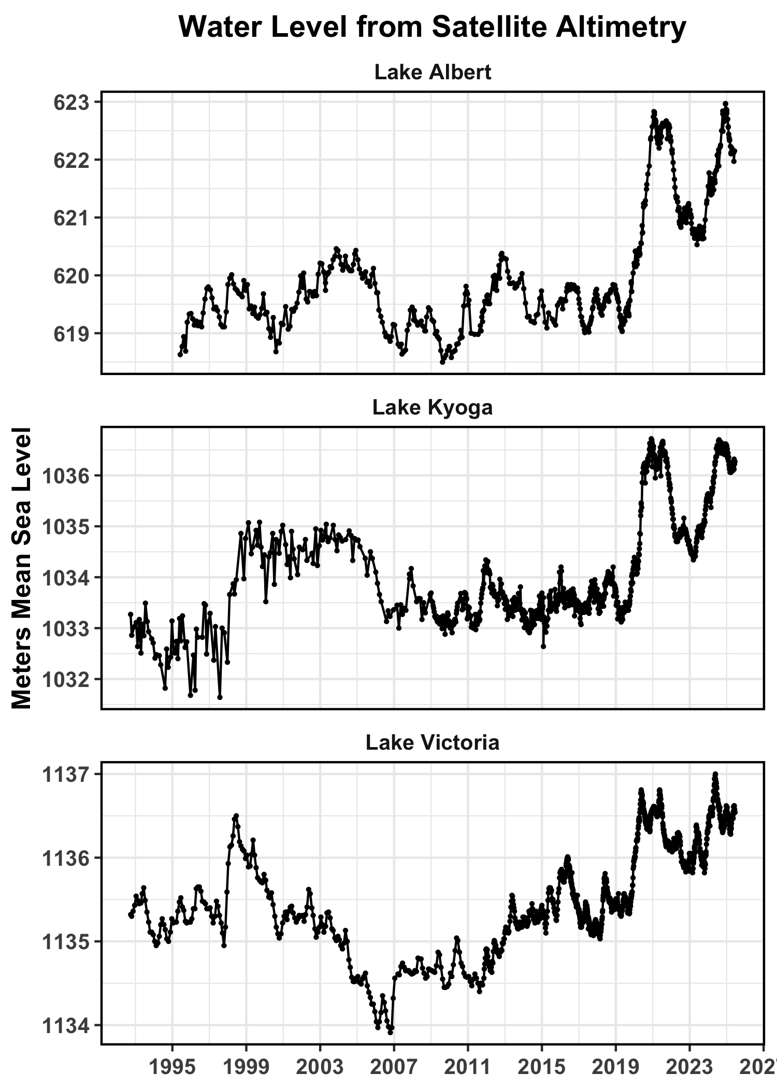
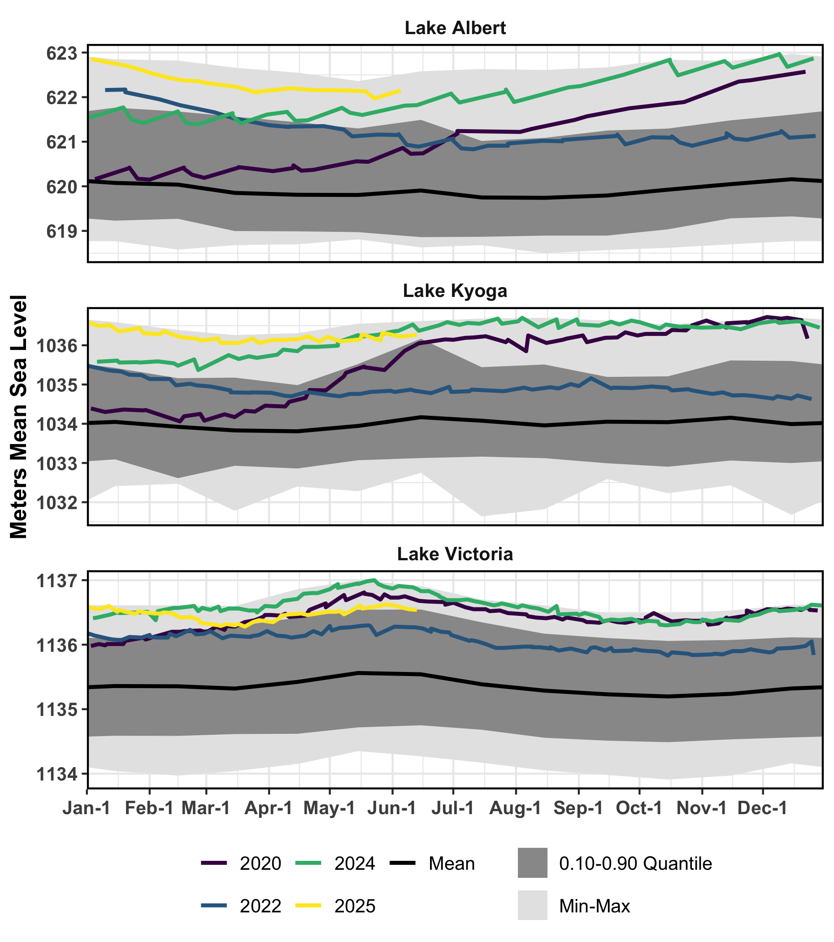
Uganda Lakes Satellite Altimetry
2025 Lake Victoria, Lake Kyoga, and Lake Albert levels (yellow line) are above the historical 90th percentile rank.
High lake levels imply high White Nile flows from Uganda to South Sudan, a principal source of water for the annual expansion of the Sudd wetland.
Data from Hydroweb, accessed 23 June 2025.

Slide 13
South Sudan Flooding – Precip. Forecasts
In South Sudan, below-average precipitation is expected for June
June-initialized model forecasts continue to show strong agreement for above-average July to September precipitation
European (C3S), North American (NMME), and International (WMO) multi-model forecast ensembles are in agreement.
Should these forecasts verify, above-average rainfall and runoff would significantly increase flooding.

Slide 14
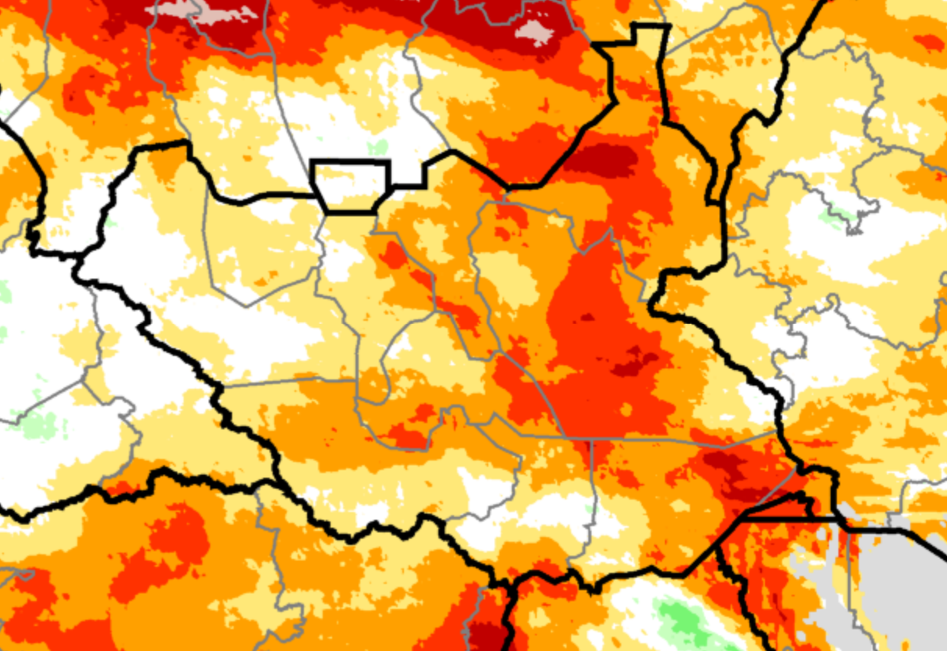
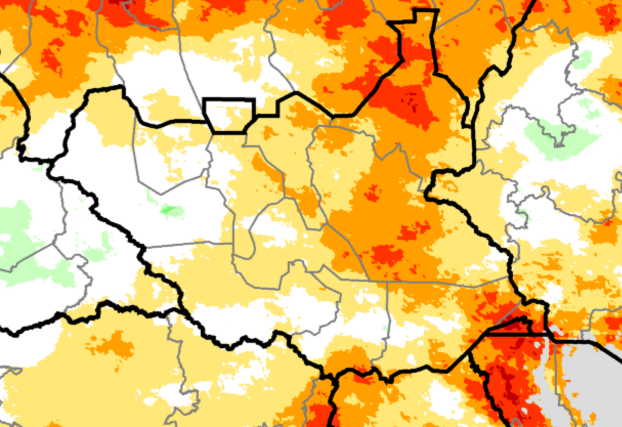

Seasonal Rainfall – June 2025
Data: CHIRPS Preliminary and CHIRPS-GEFS from June 21st
June 1-20, 2025 (observed)
June 1- July 5, 2025 (observed + forecast)
Percent of average
June 1-20 (left) saw widespread below-average rainfall.
These rainfall deficits are expected to improve (right), based on forecast wetter conditions with average to above-average rainfall from late June.

Slide 15
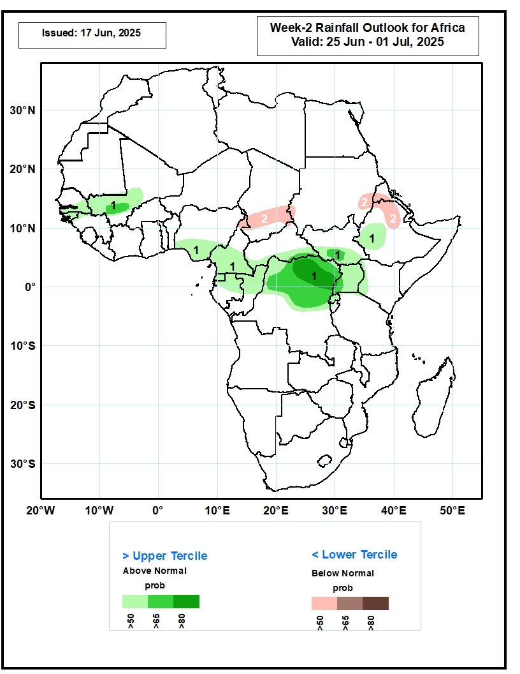
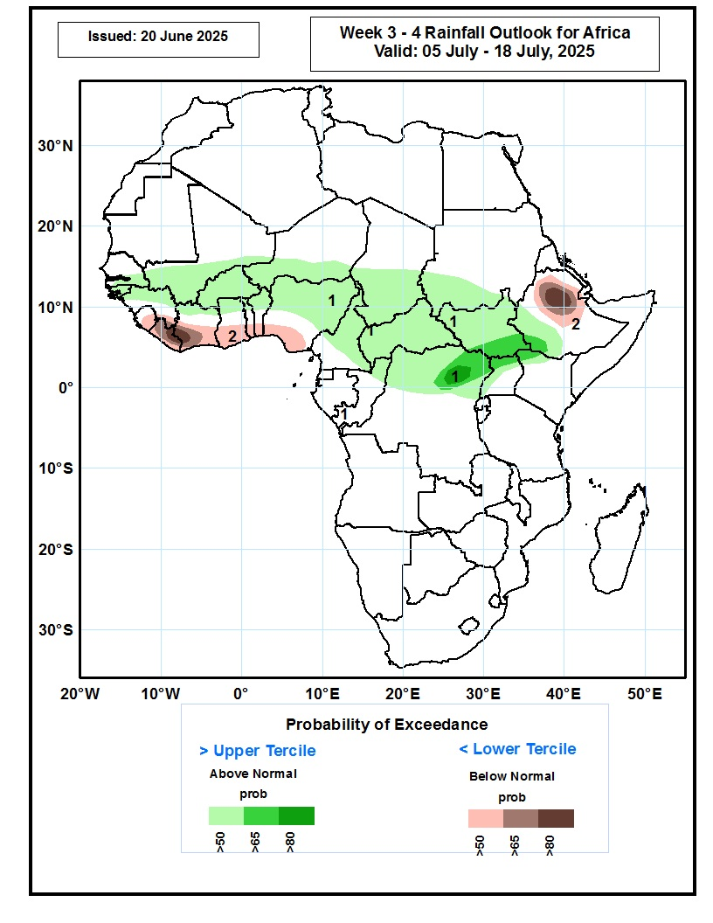
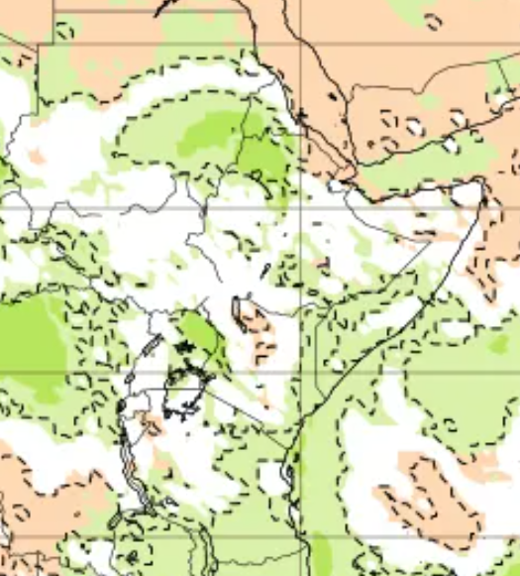
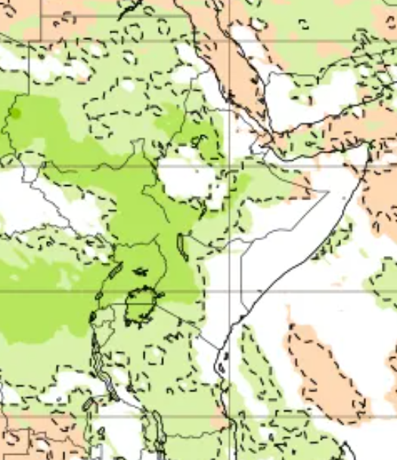
Seasonal Rainfall – late June - July 2025
June 25th-July 1st
July 5th-July 18th
June 30th-July 7th
July 7th-July 14th
Sub seasonal rainfall outlooks from NOAA CPC (left) and ECMWF (right): A transition toward above-average rainfall in late June through mid-July

Slide 16
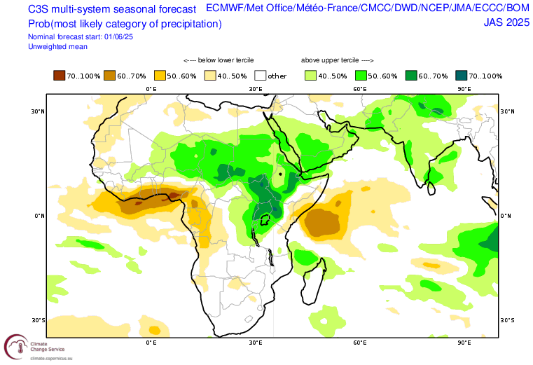
Seasonal Rainfall – July-September 2025
Above-average rainfall is forecast for July-September 2025 by European (C3S) (above), North American, and WMO multi-model ensembles

Slide 17
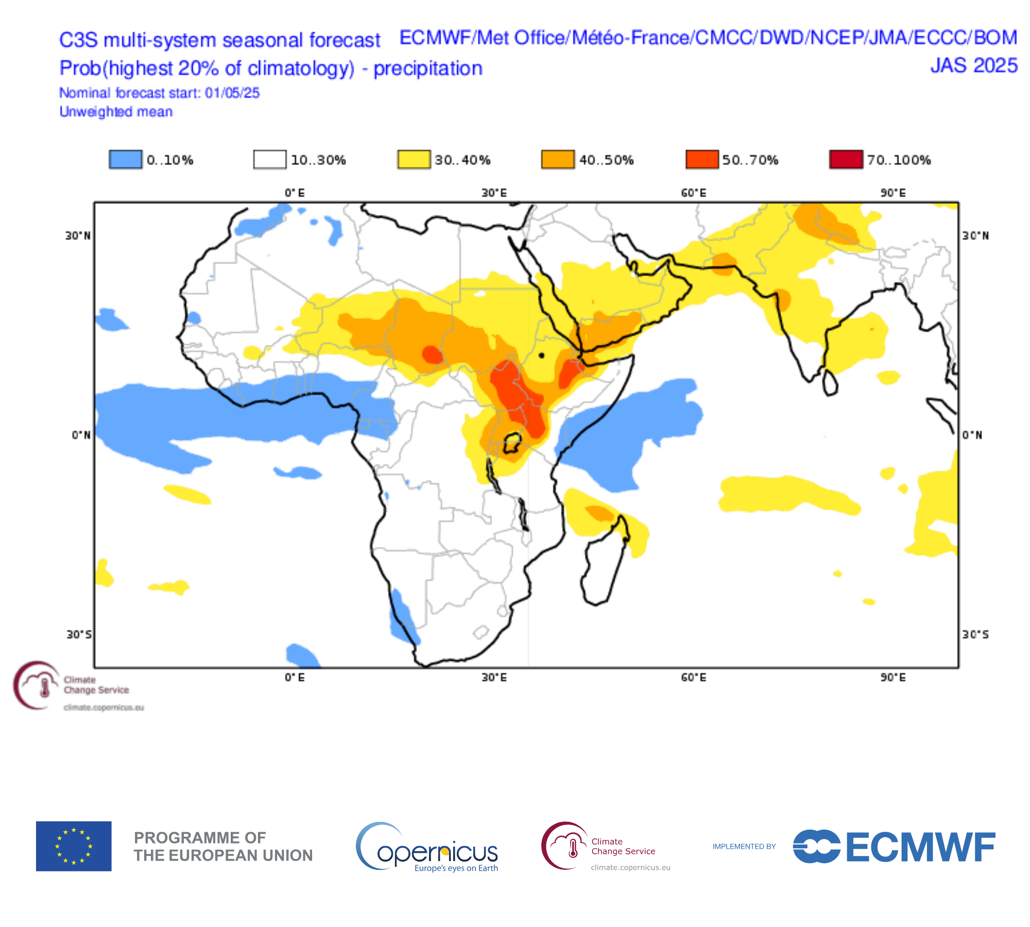
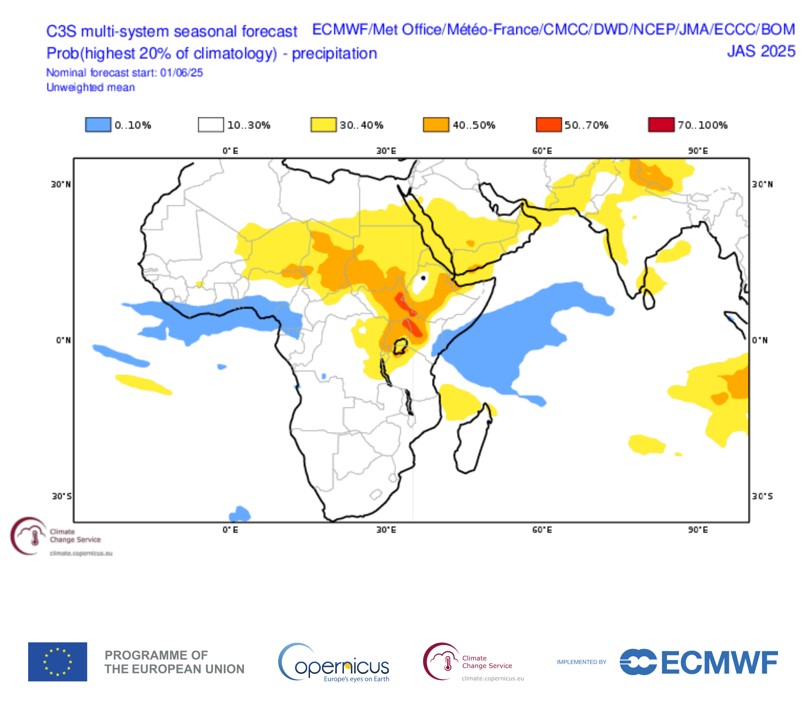
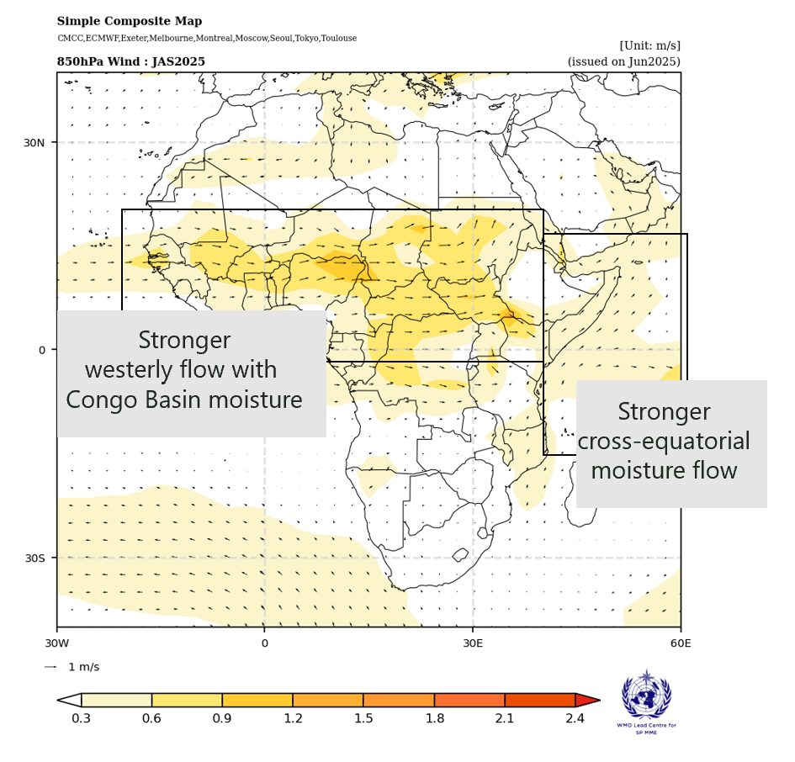
Seasonal Rainfall – July to September 2025
C3S ensemble JAS 2025 highest 20th percentile rainfall
Forecast released in May 2025 Forecast released in June 2025
WMO ensemble JAS 2025
850 mb wind anomaly
C3S models continue to indicate relatively high chances of an especially wet season. The chances of JAS 2025 rainfall being in the upper 20th percentile are forecast to be 2 to 3 times higher than usual.
The ensemble forecast in June (middle) is similar to May (left) in this regard, though the odds have slightly lessened. Models continue to forecast regional conditions conducive to enhanced moisture (right).

Slide 18
South Sudan Flooding – LASSO Forecasts
NASA LASSO Model Monthly Inundation Forecasts
The LASSO model forecasts VIIRS Flood Mapping (VFM) monthly inundation extents based on recent and forecast precipitation, runoff, and Uganda lake levels.
Using inputs available in May, the LASSO model forecasts VFM maximum extents in September and October 2025 that are above average, but lower than those experienced in 2024. However, there is a low bias in the LASSO forecasts.

Slide 19
LASSO Model
LASSO Model Covariates:
FLDAS-Forecast Open Loop: Retrospective runoff and precipitation; by subbasin and aggregated over nested basins.
FLDAS-Forecast NMME-based Forecasts: Ensemble mean forecasts of streamflow, runoff, and precipitation; by subbasin and aggregated over nested basins.
VIIRS Inundation: By basin.
Satellite Altimetry: Water levels for Lake Victoria, Lake Albert, and Lake Kyoga.
Lead and lag months used in current LASSO model forecast. IC (Initial conditions) is the most recent month with complete observational and FLDAS-Forecast Open Loop datasets. It is also the initialization month for the FLDAS-Forecast dataset.
 | Lag 3 | Lag 2 | Lag 1 | IC | Lead 1 | Lead 2 | Lead 3 | Lead 4 | Lead 5 | Lead 6
 | Feb 25 | Mar 25 | Apr 25 | May 25 | Jun 25 | Jul 25 | Aug 25 | Sep 25 | Aug 25 | Sep 25
FLDAS Open Loop | X | X | X | X
FLDAS Forecast |  |  |  |  | X | X | X | X | X | X
VIIRS |  |  |  | X
Altimetry | X | X | X | X
LASSO Forecast |  |  |  |  | X | X | X | X | X | X

Slide 20
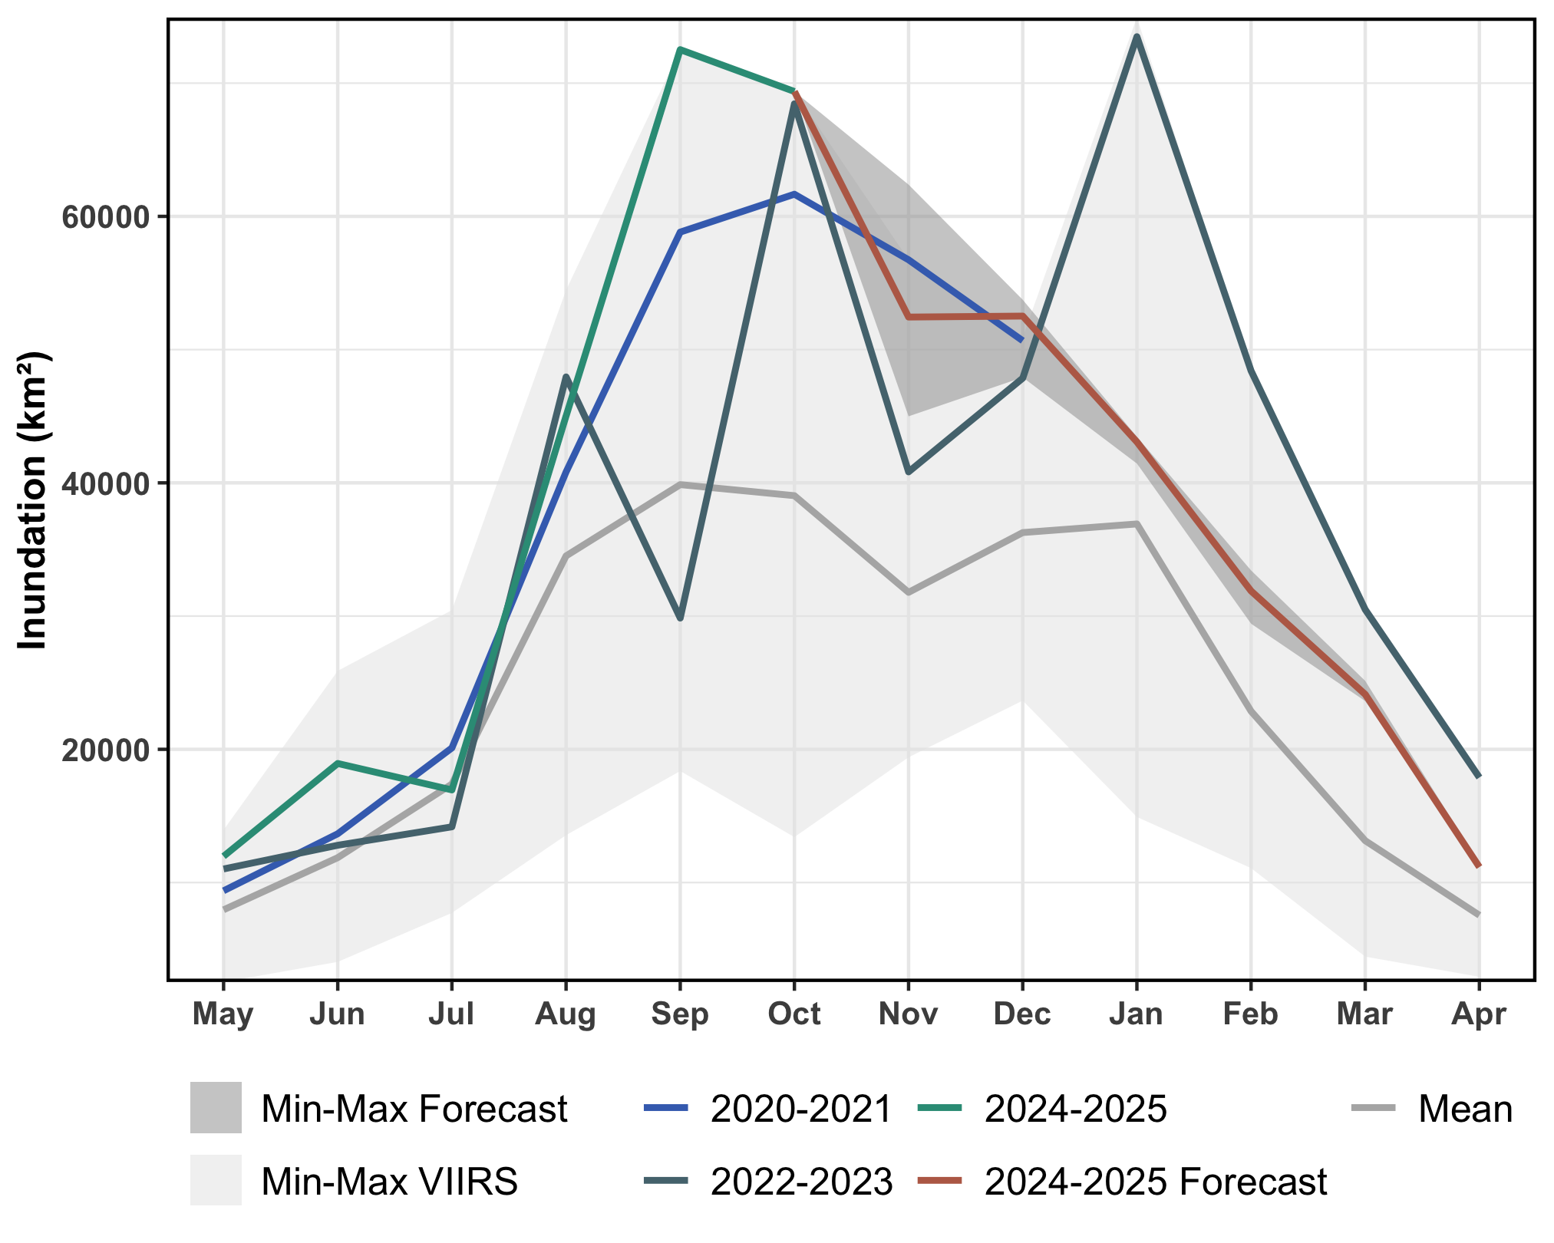
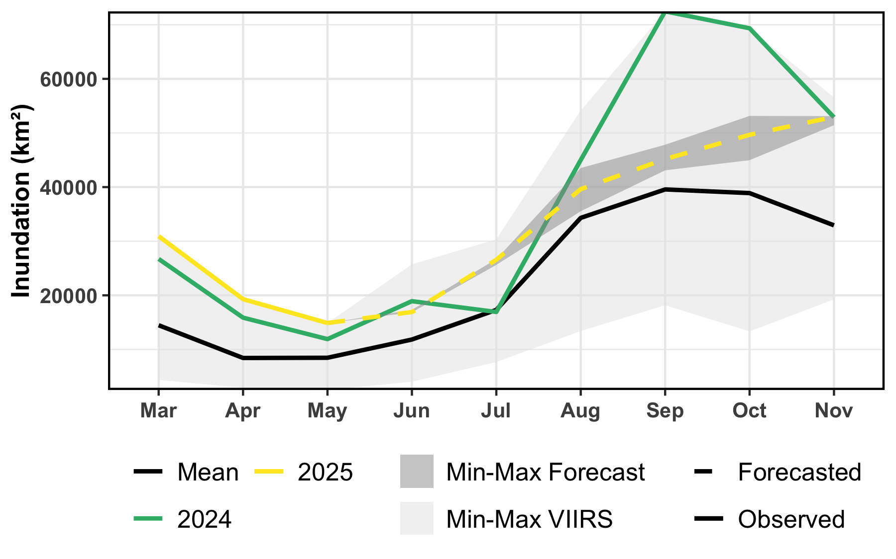
LASSO Inundation Forecasts – June 2025
Using inputs available in June 2025, the LASSO model forecasts VIIRS Flood Mapping maximum extents in September and October 2025 that above average, but lower than those experienced in 2024. The reduction relative to the May forecasts may be attributed to lower runoff. The low inundation prediction seems to be due to a low bias in the May initialization of the LASSO forecast. We’re assessing potential methods for bias-correction.
Leave-one-out cross validation correlation calculated for each model lead ranges from 0.86 to 0.90.

Slide 21
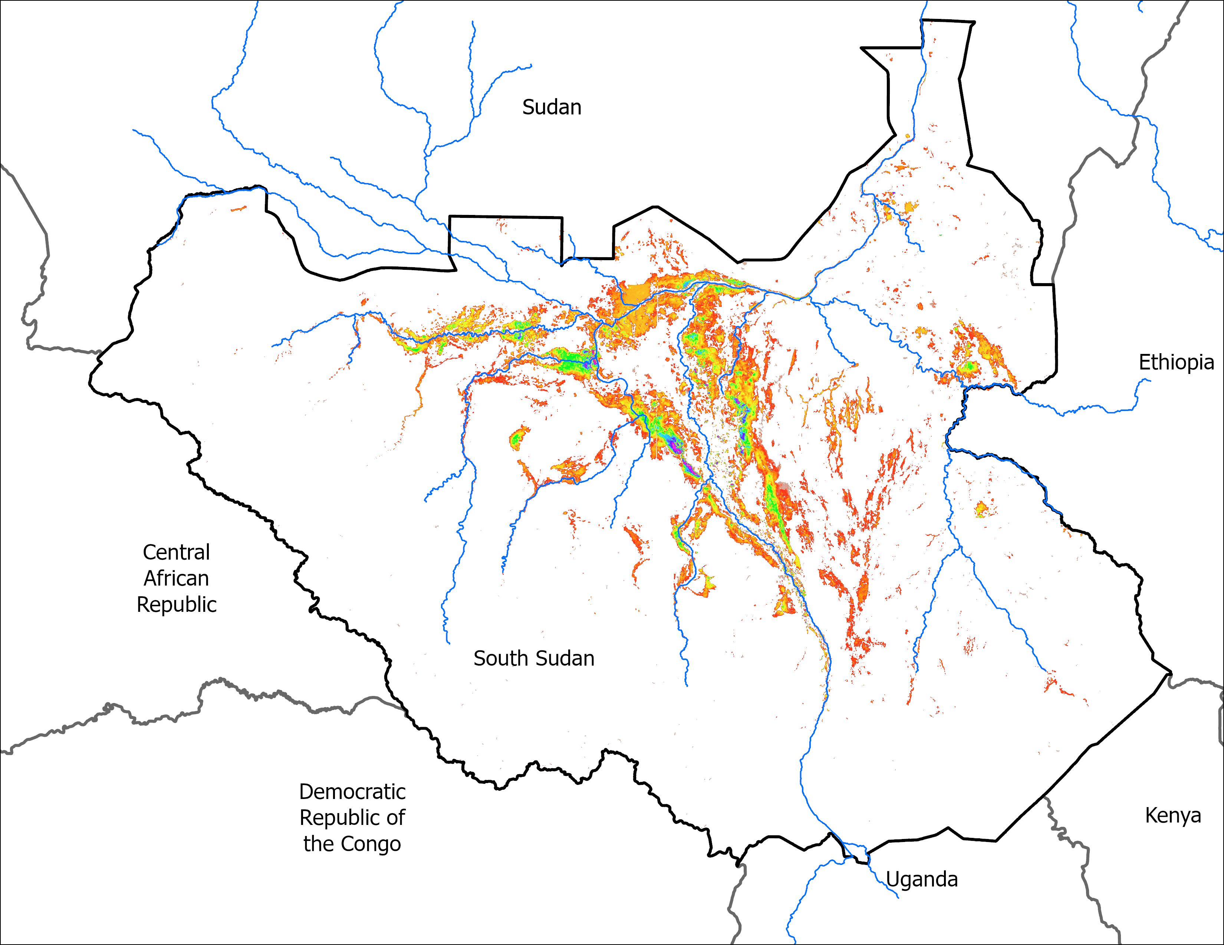
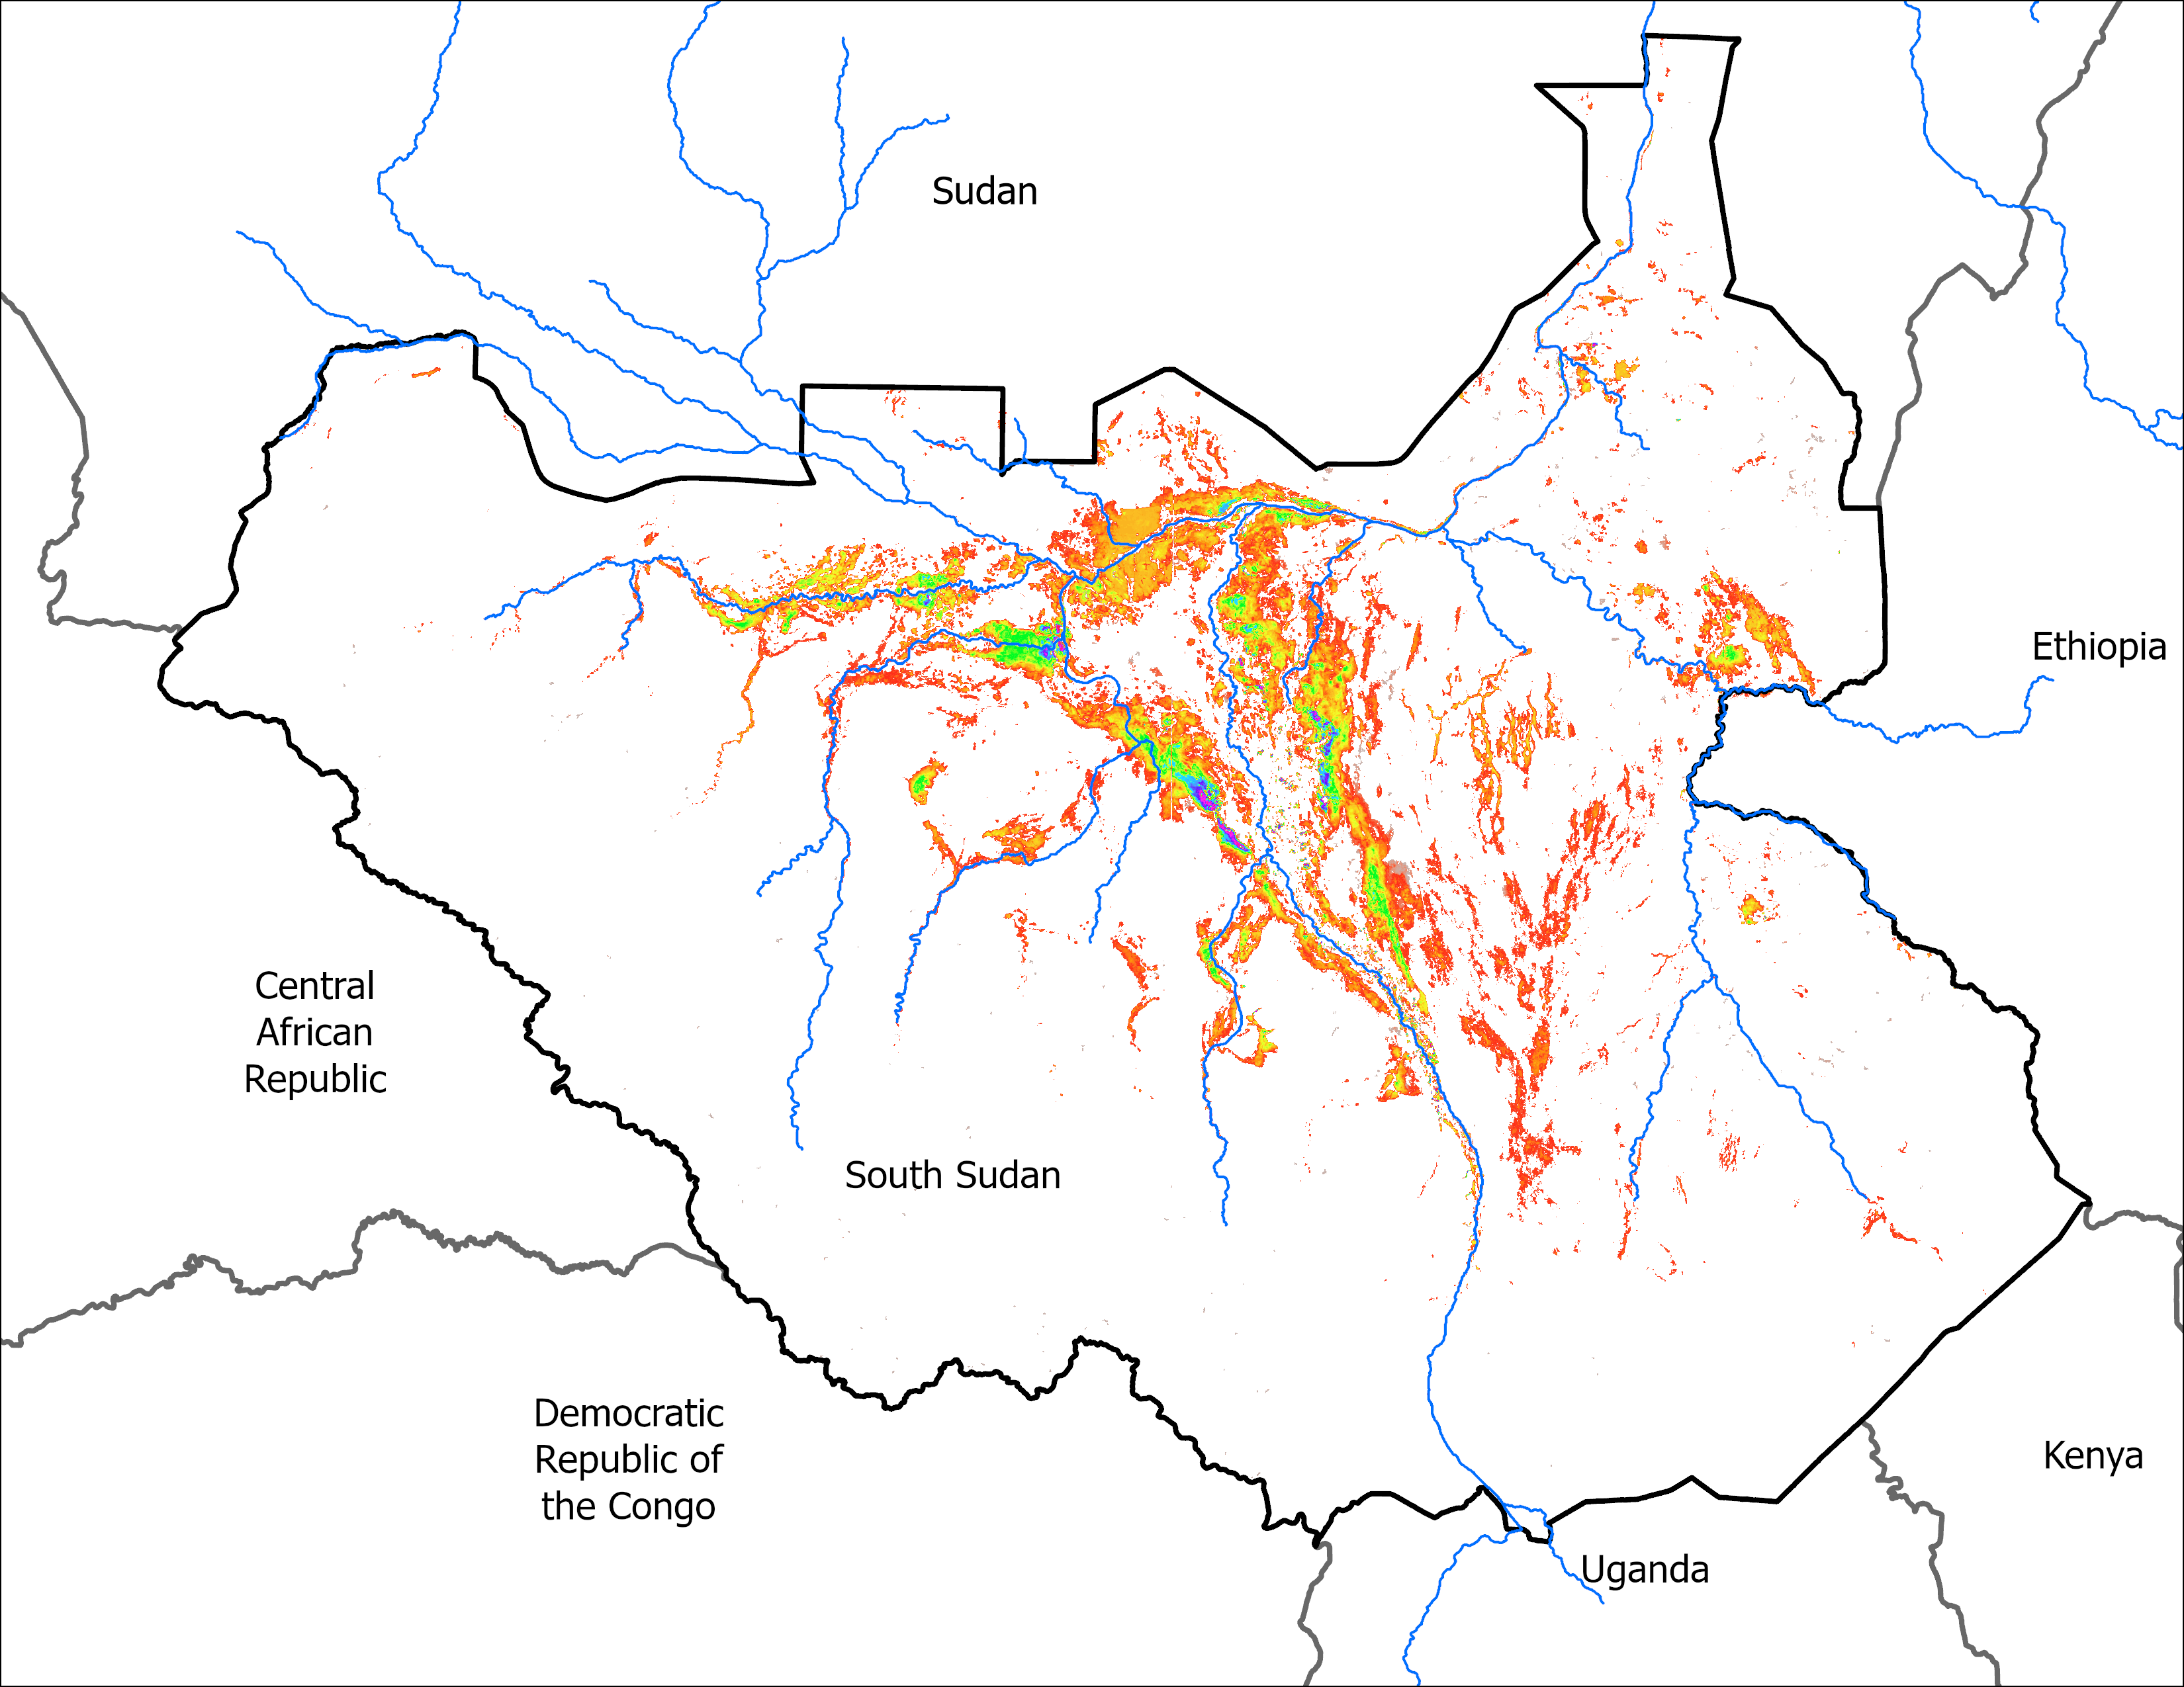
LASSO Predicted Maps
Predicted : SEP 2025 with Mid JUN IC
Predicted : OCT 2025 with Mid JUN IC
50,916 km²
56,822 km²

Slide 22
Thank you

