Slide 1
South Sudan Flood Monitoring and Prediction - 2025 Season
FEWS NET Science Team
May 22, 2024

Slide 2
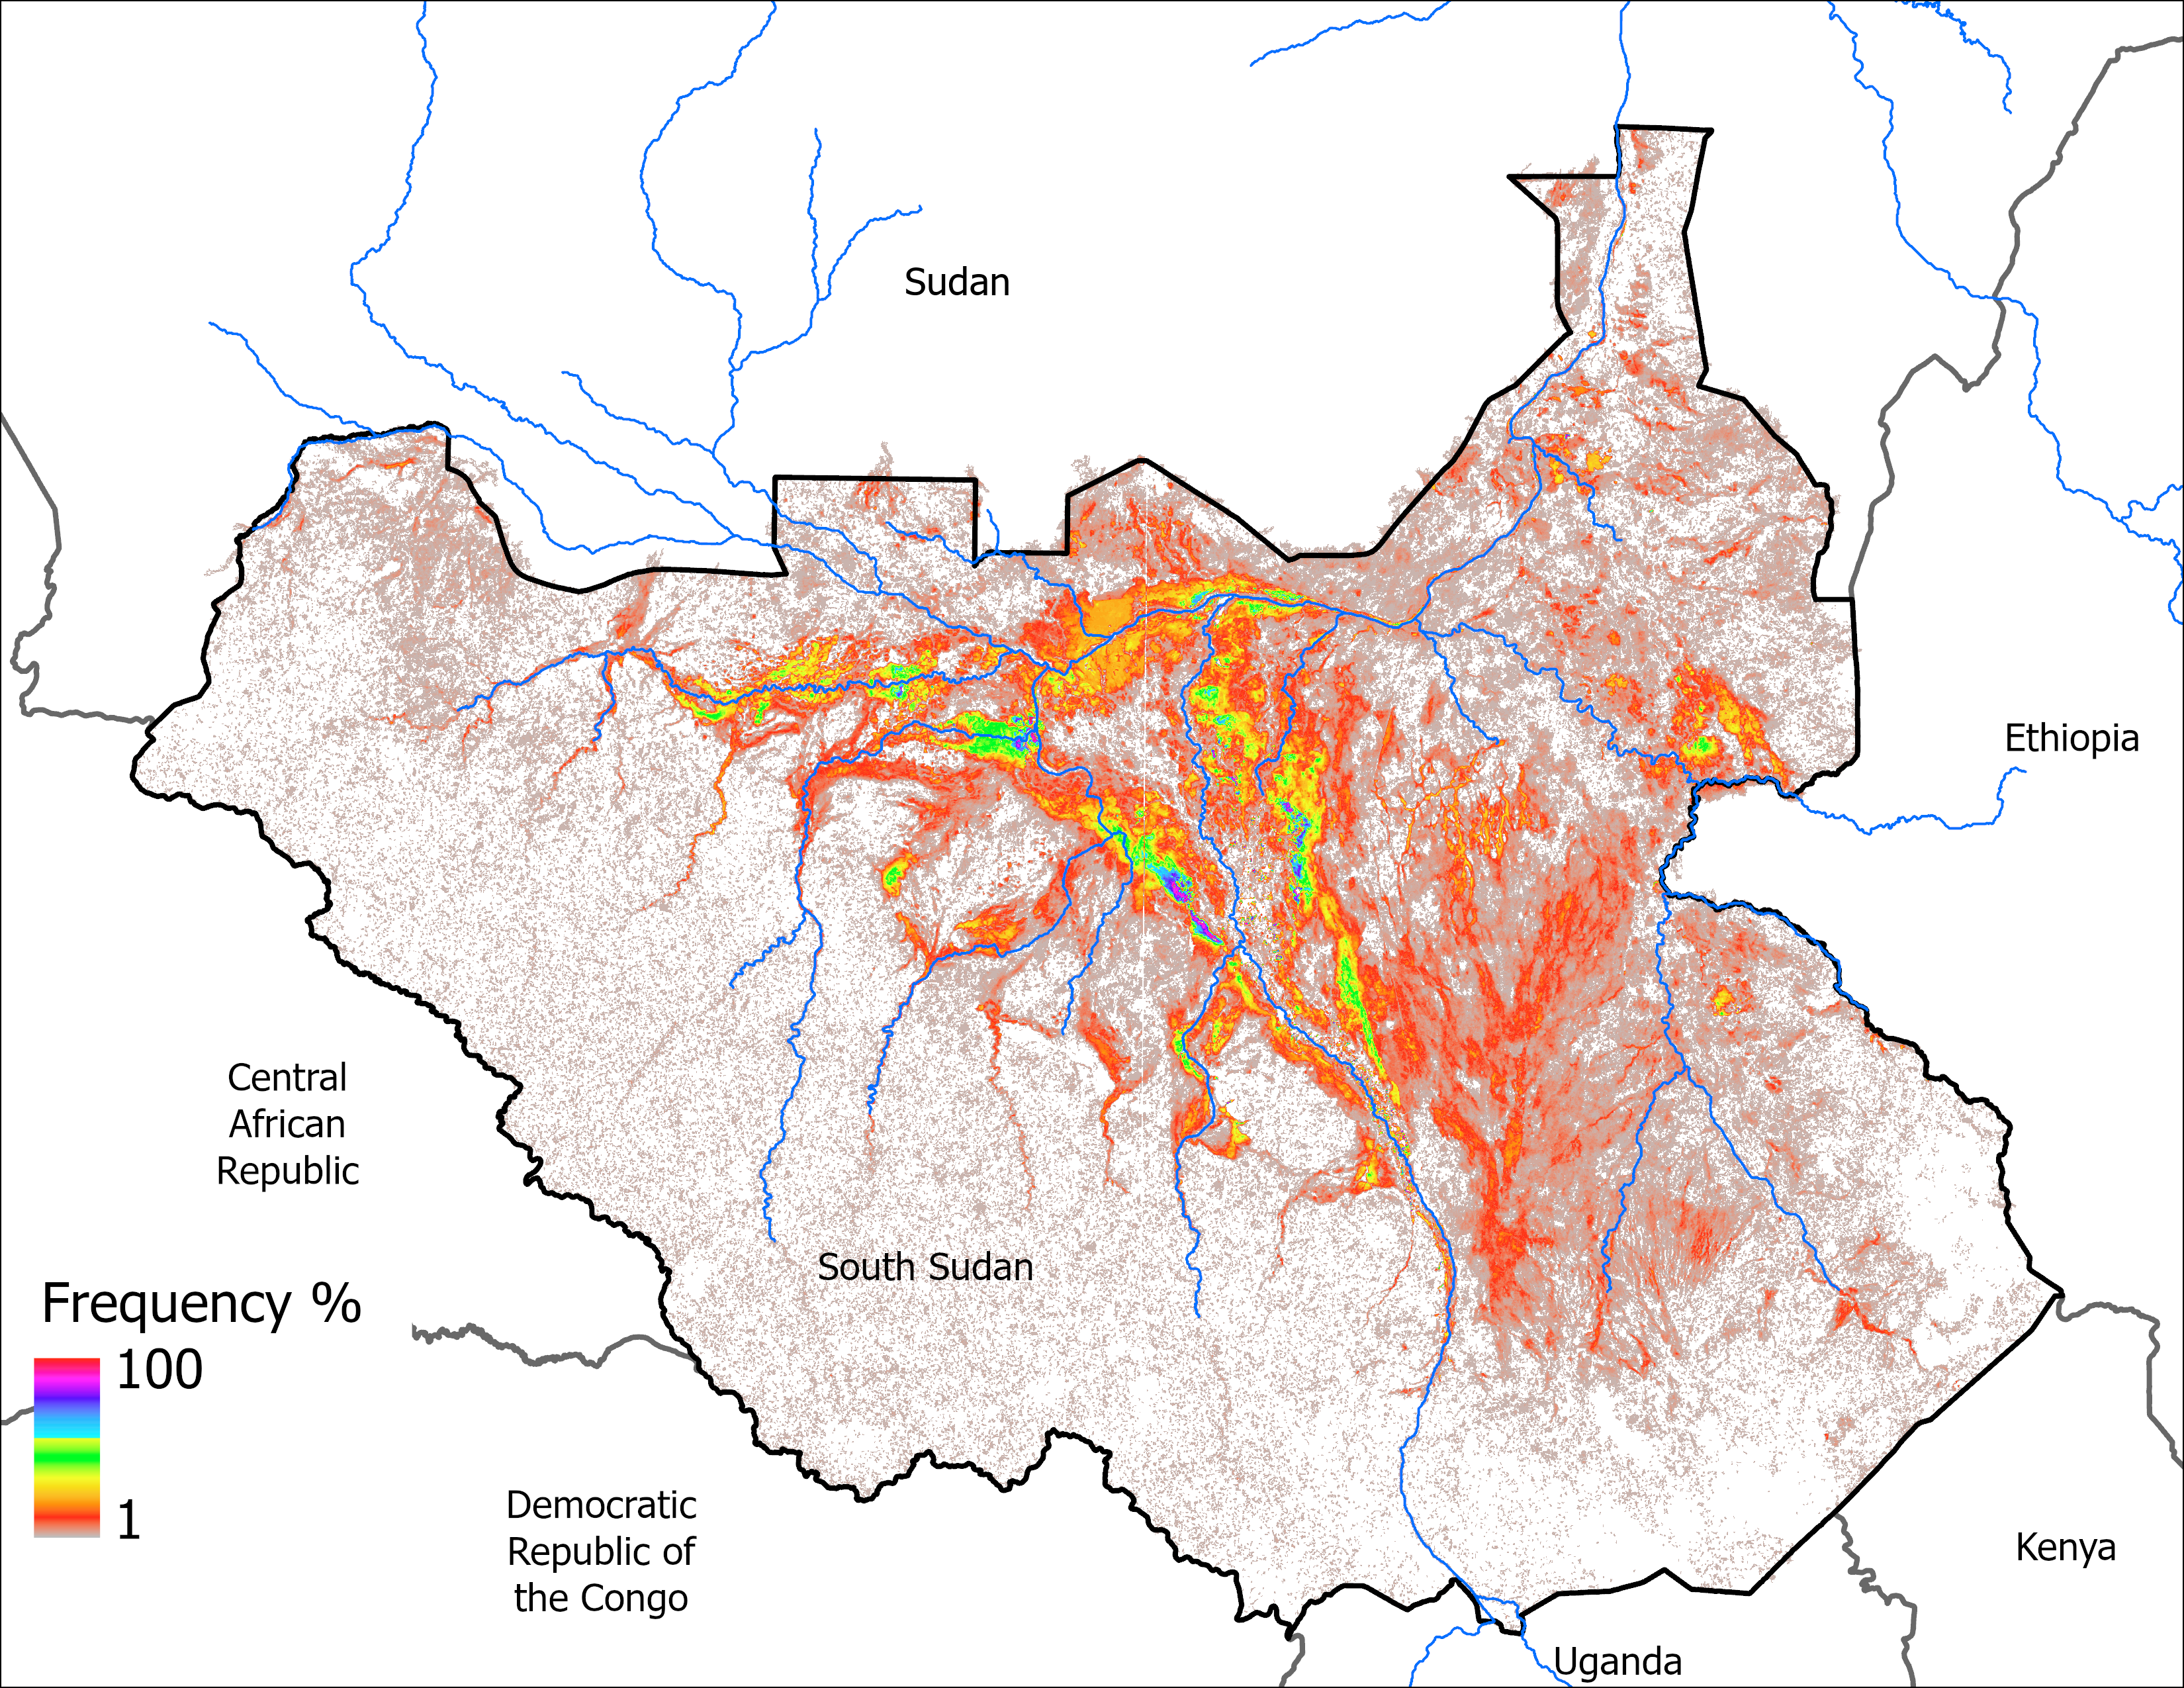
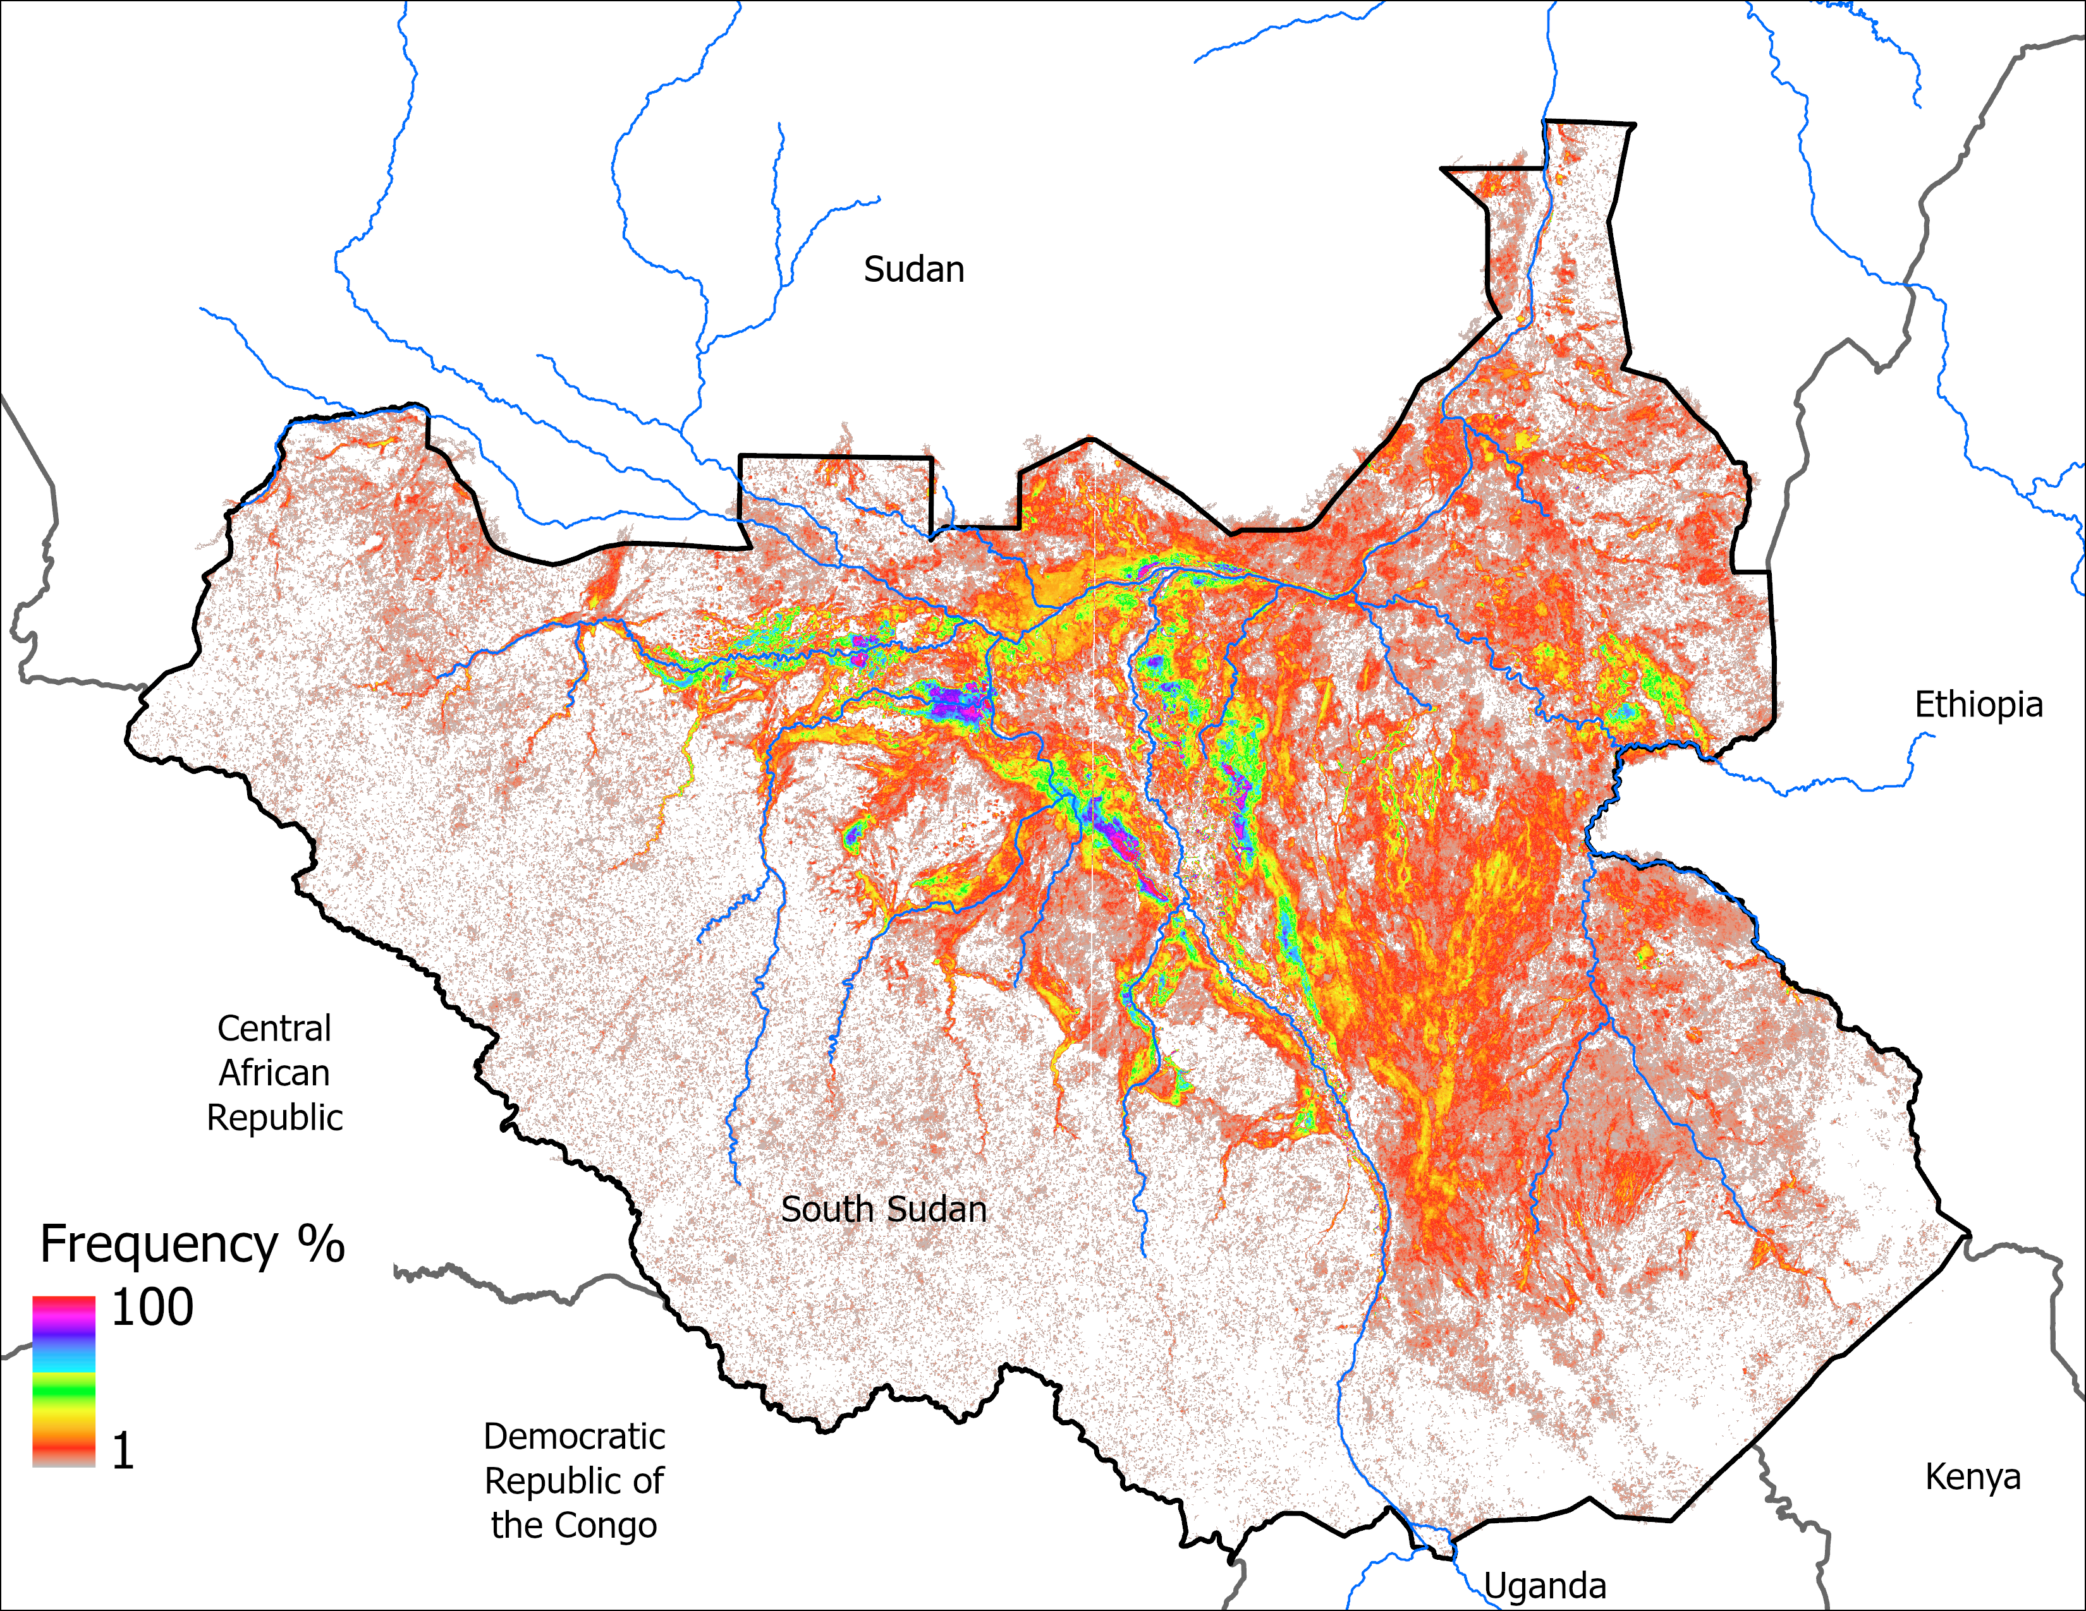
VIIRS Flood Frequency Map
Bi-monthly Apr2Nov Frequency (191 grids)
Monthly Jul2Dec Frequency (68 grids)
Better spatial pattern shown in frequency map using bi-monthly data.

Slide 3
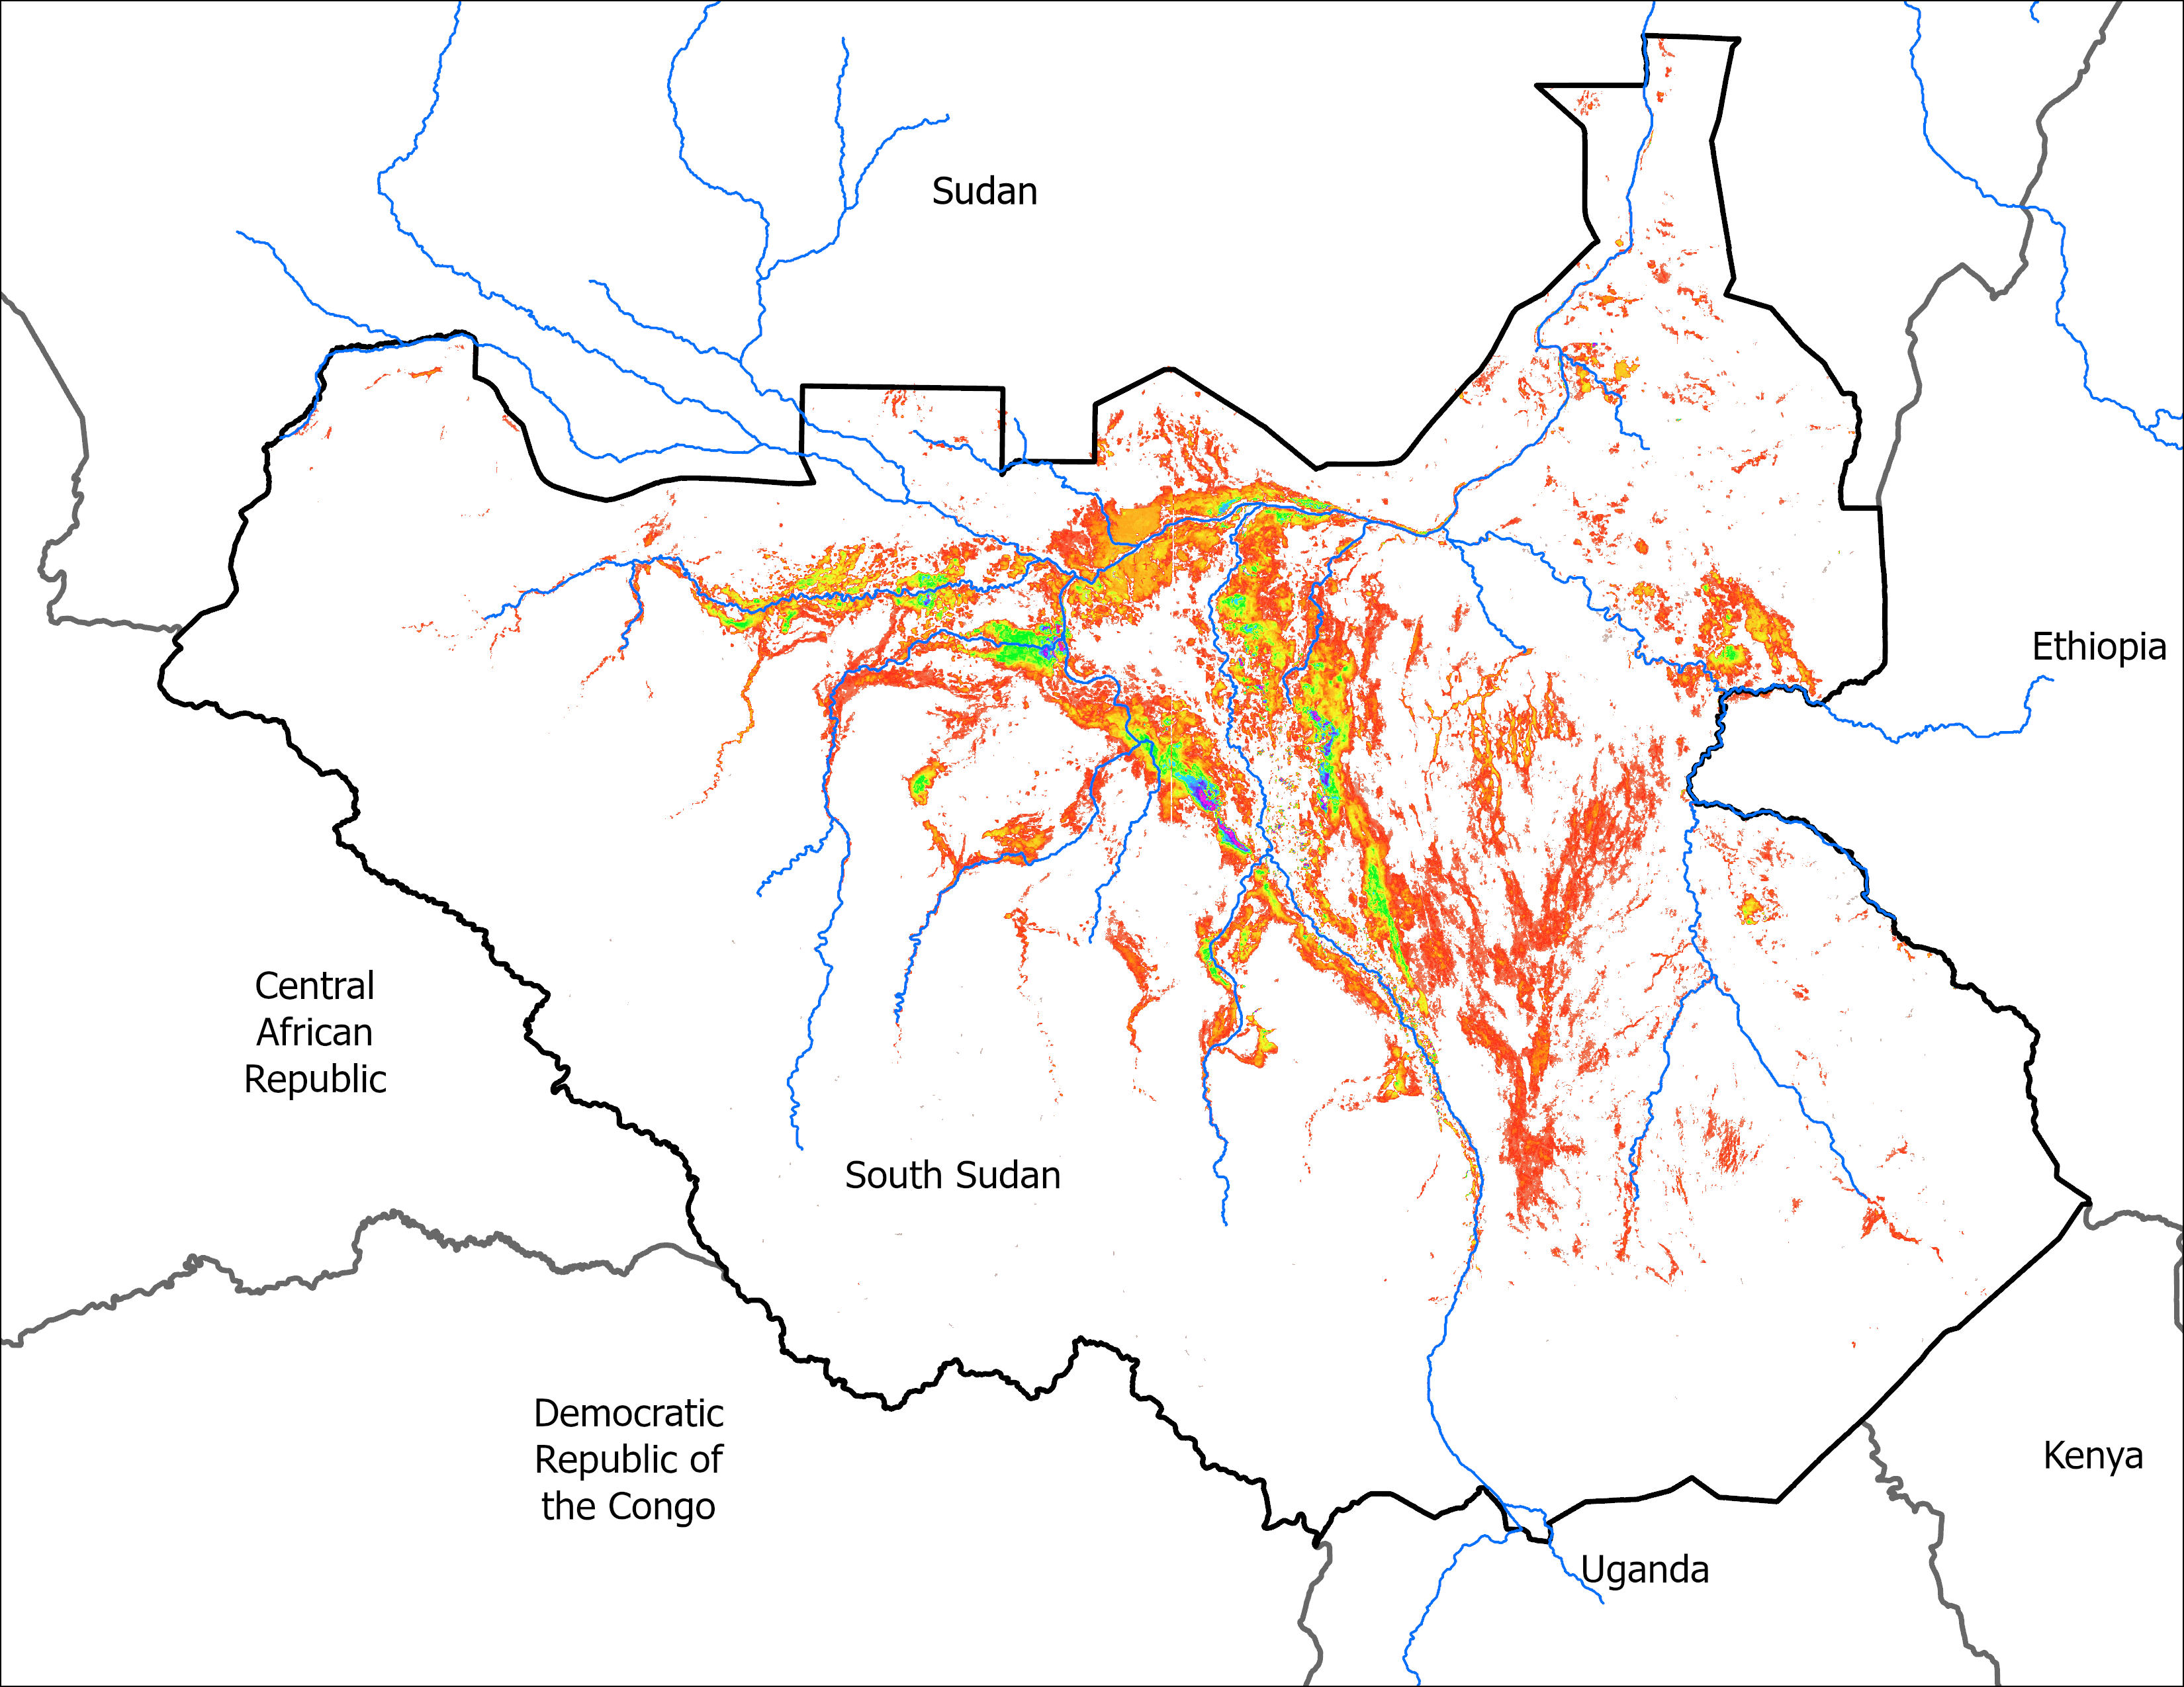
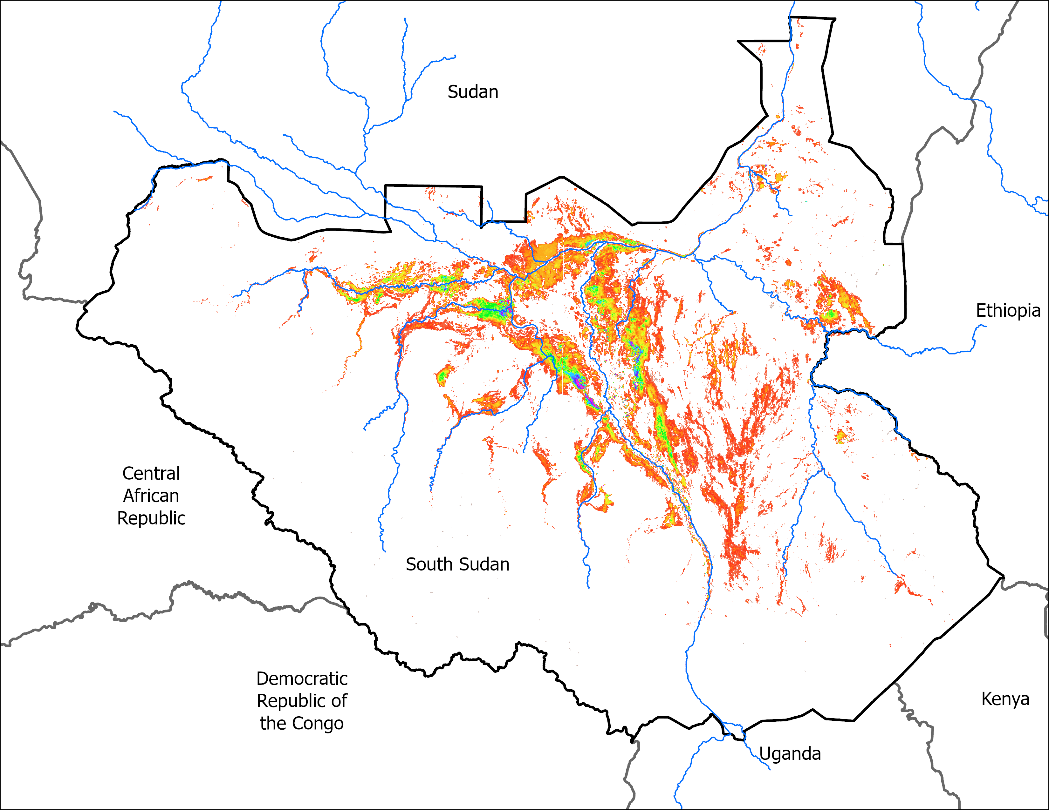
Predicted Flood Map
LASSO predicted inundation for September of 2025: 72,205 km²
SEP 2025
SEP 2025
81,428 km² (with index 8)
71,257 km² (with index 7, the nearest lower number than target)

Slide 4
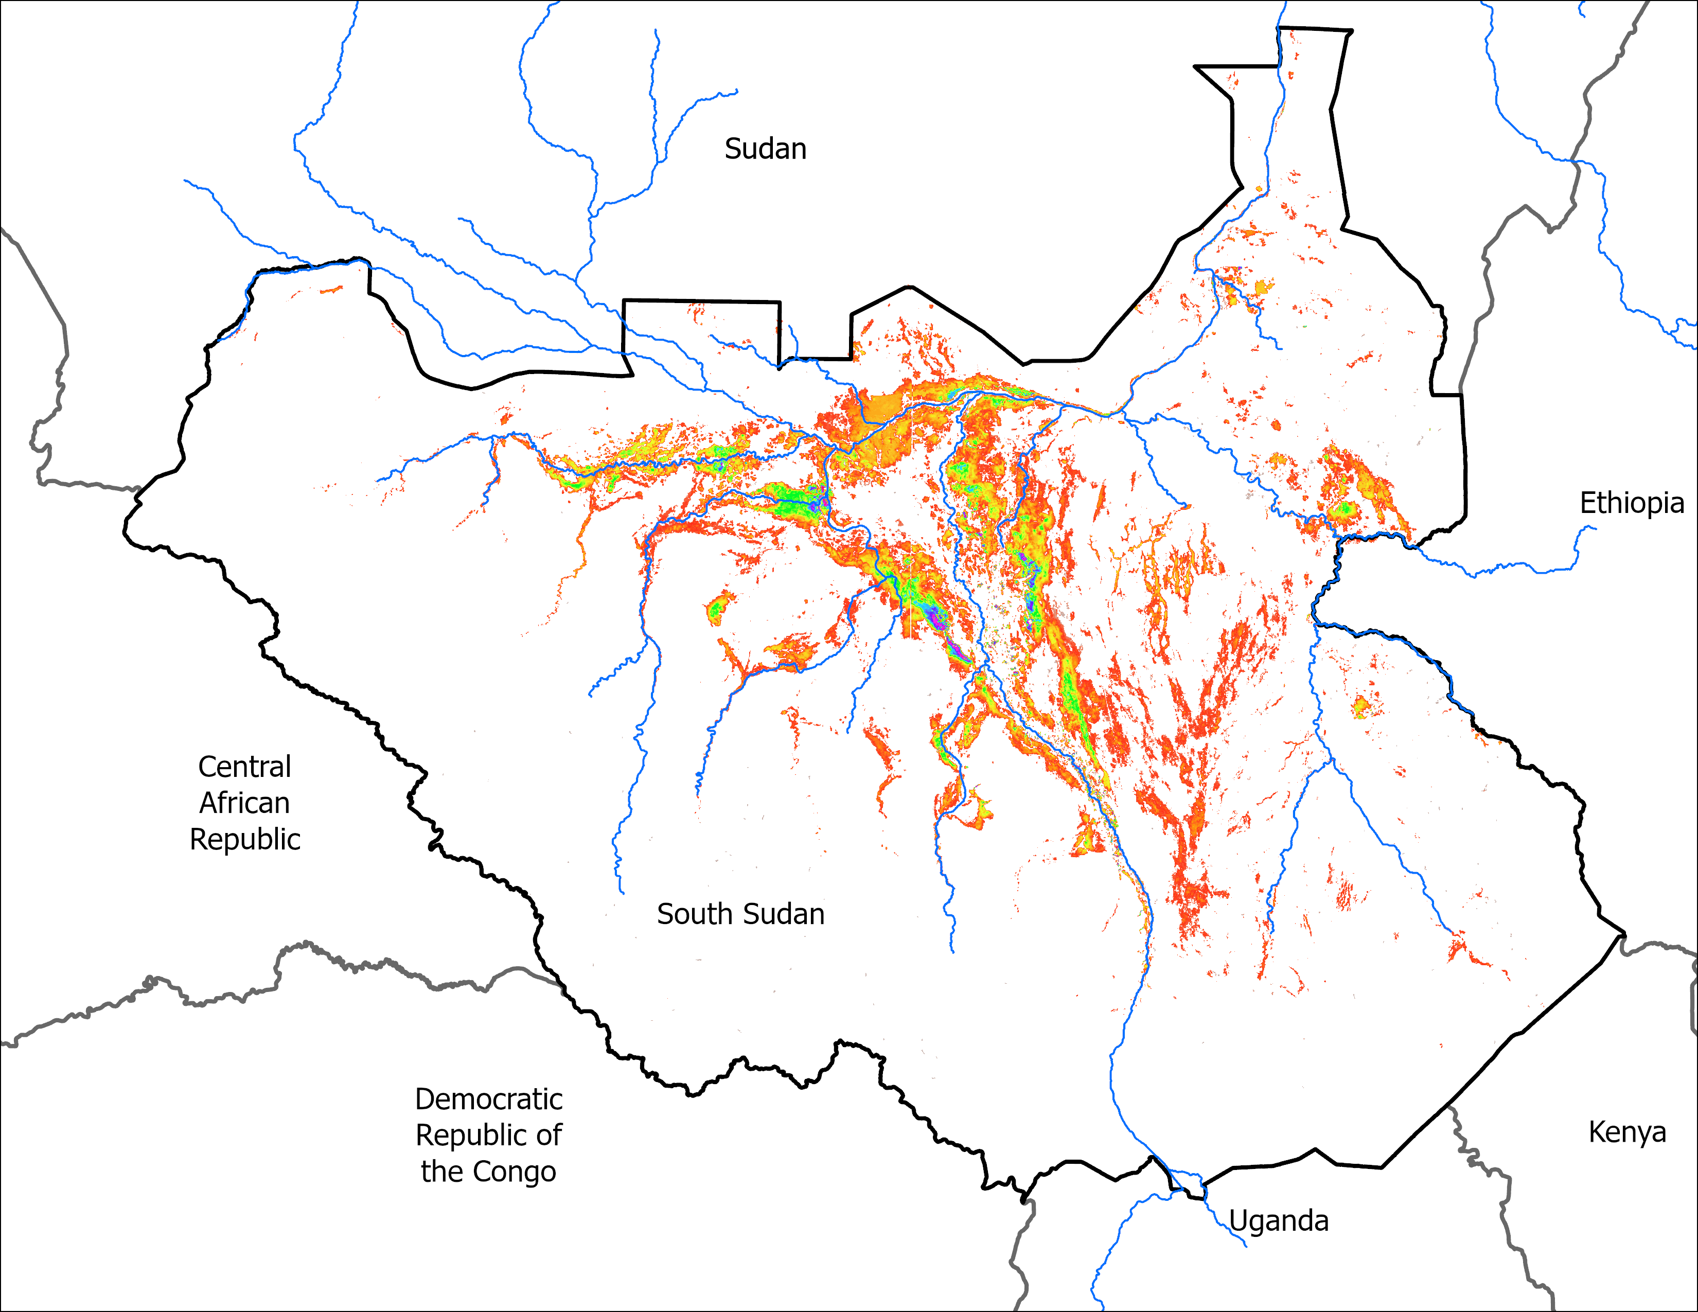
Predicted Flood Map
LASSO predicted inundation for October of 2025: 62,055 km²
OCT 2025
62,922 km²

Slide 5
Thank you

