Slide 1
South Sudan Flood Monitoring and Prediction - 2025 Season
FEWS NET Science Team
May 09, 2024

Slide 2
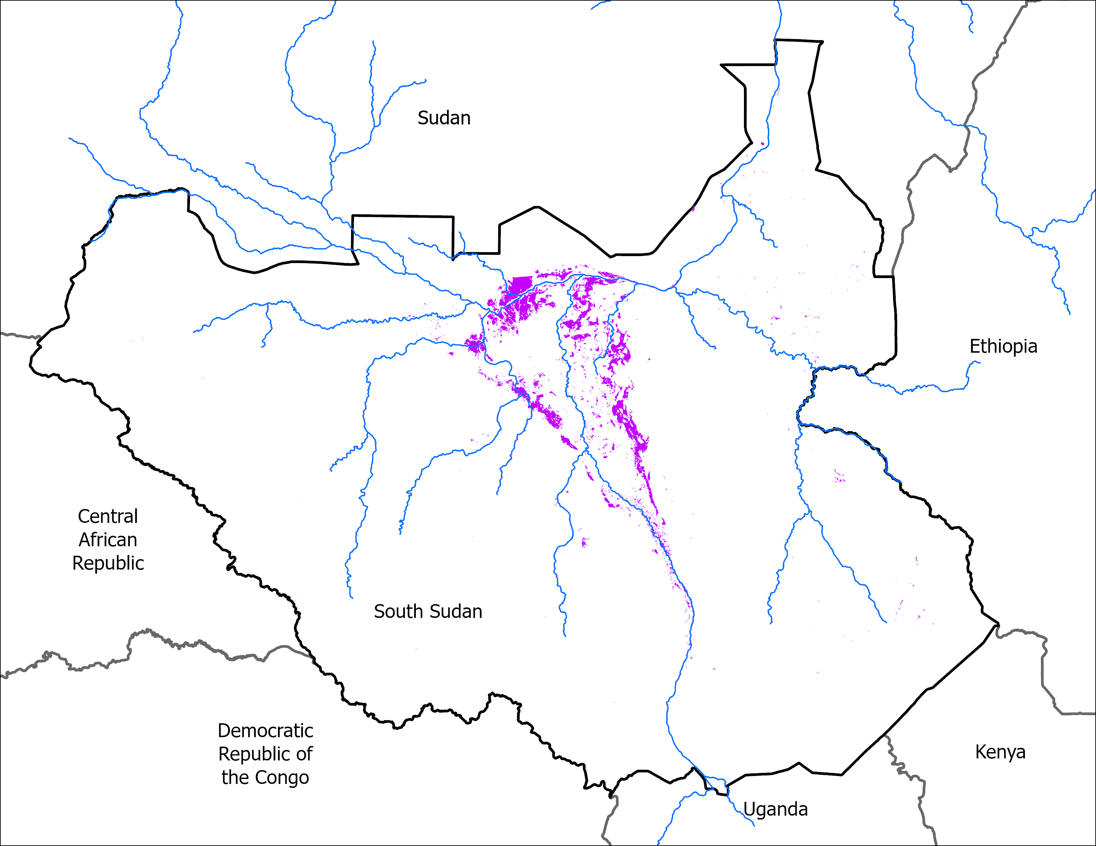
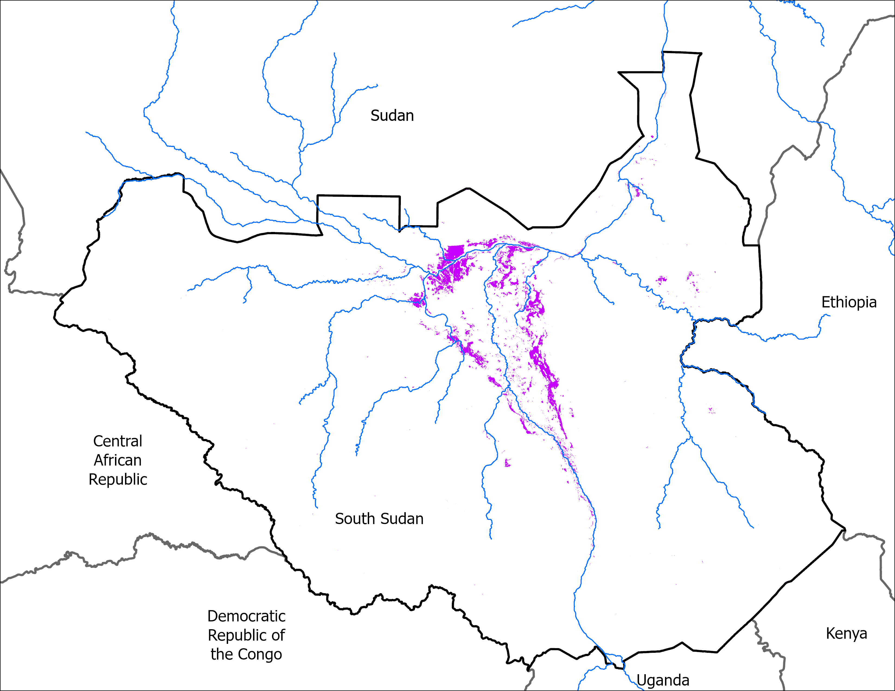
Flooding Progression
27 April 2025
08 May 2025
VIIRS 23-27 April: 10,162 km²
VIIRS 04-08 May comp: 9,859 km²
Marginal decrease in Inundation.

Slide 3
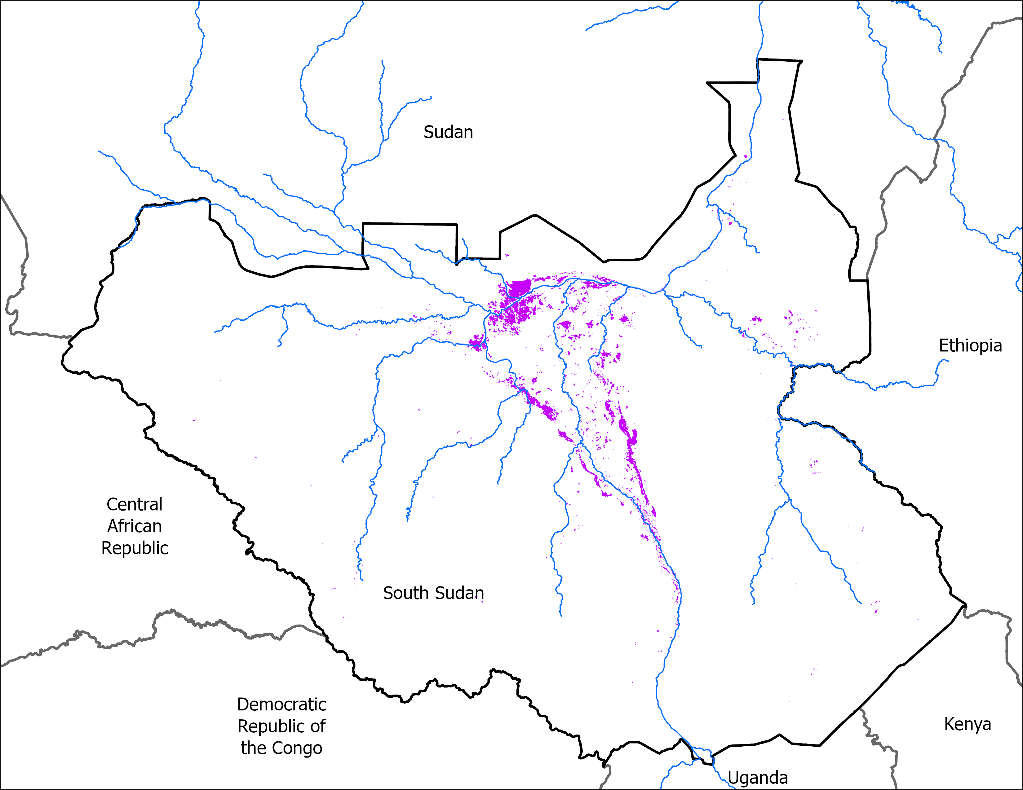
May Initial Conditions
05 May 2024
08 May 2025
VIIRS 01-05, 2024 : 8,738 km²
VIIRS 04-08 May comp: 9,859 km²
At the beginning of May 2025 has slightly more area under water than the same in 2024.

Slide 4
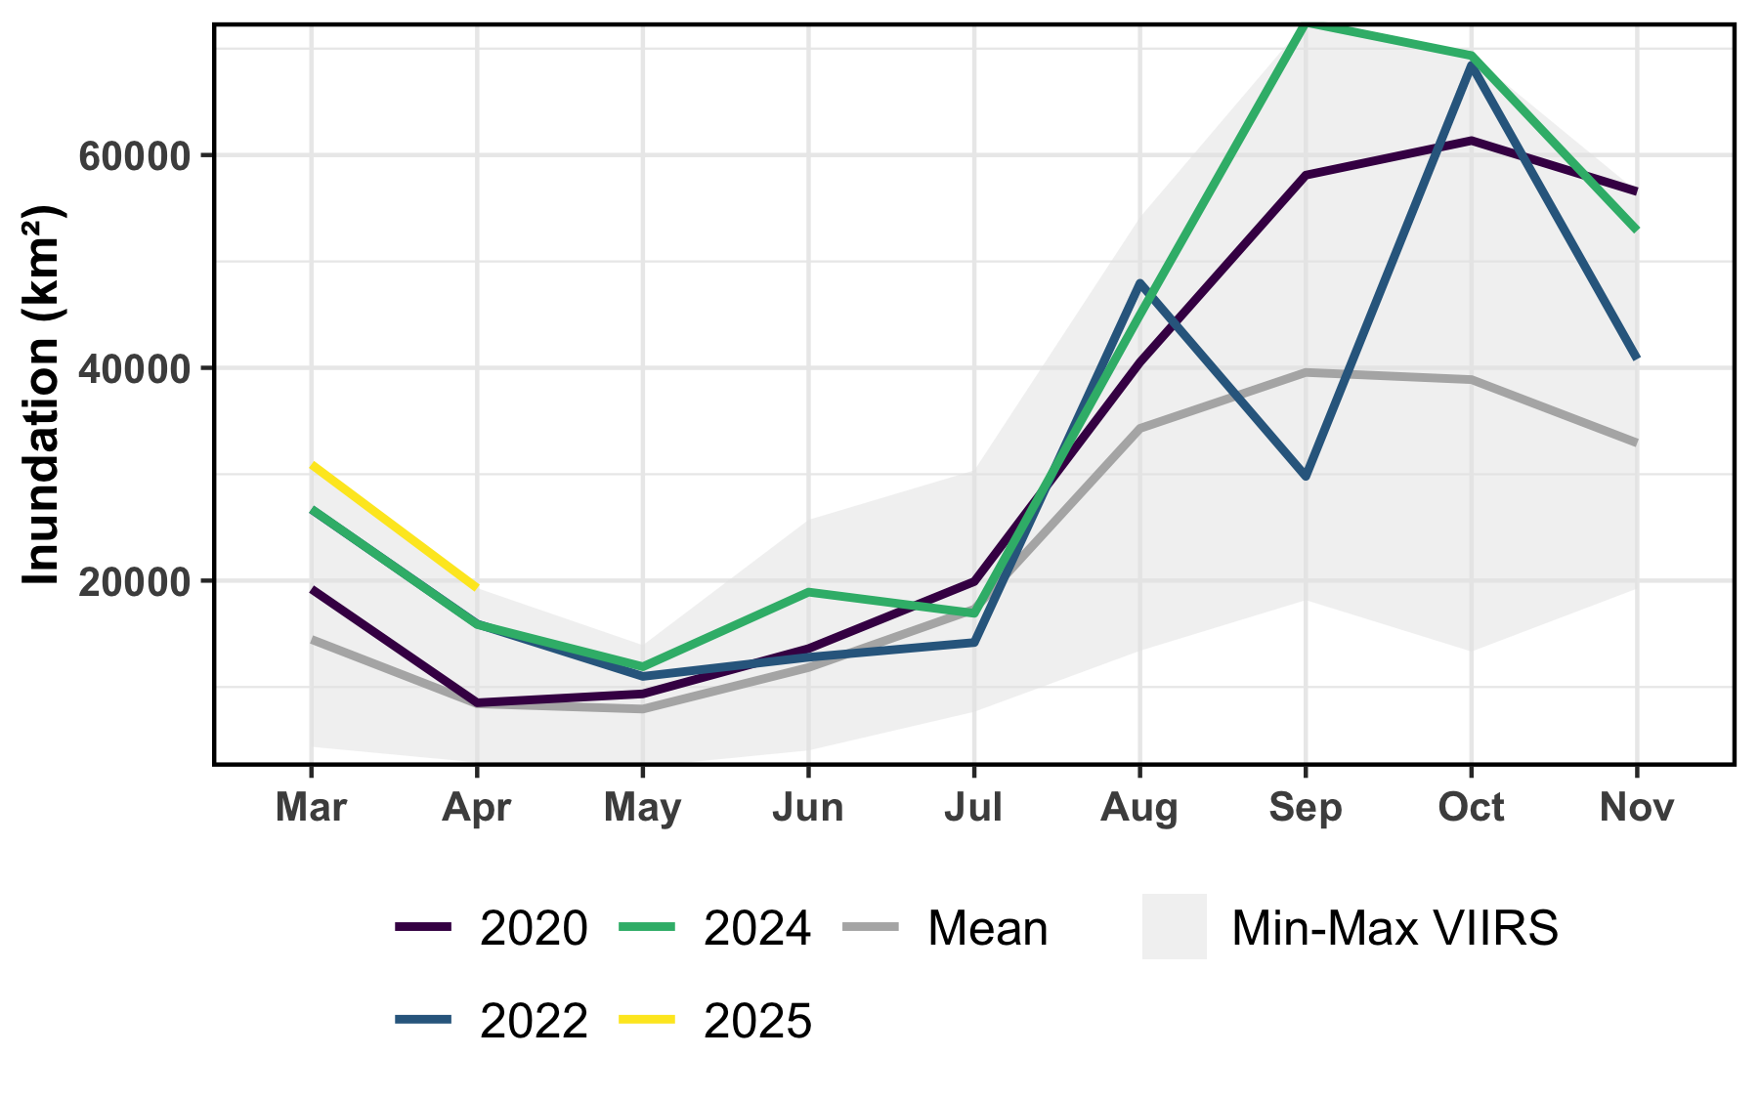
VIIRS Time Series
Inundation is currently receding, which is typical for the season.
April 2025 VIIRS inundation (yellow line) is the highest on record.

Slide 5
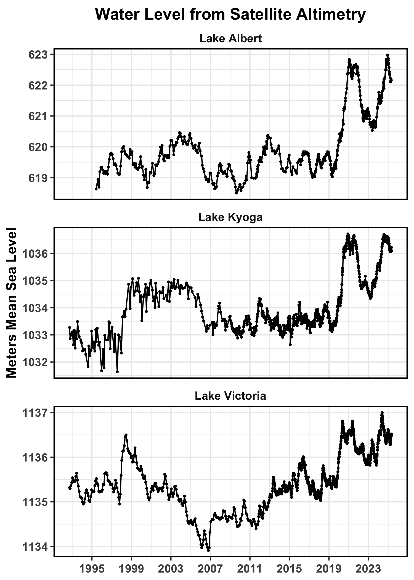
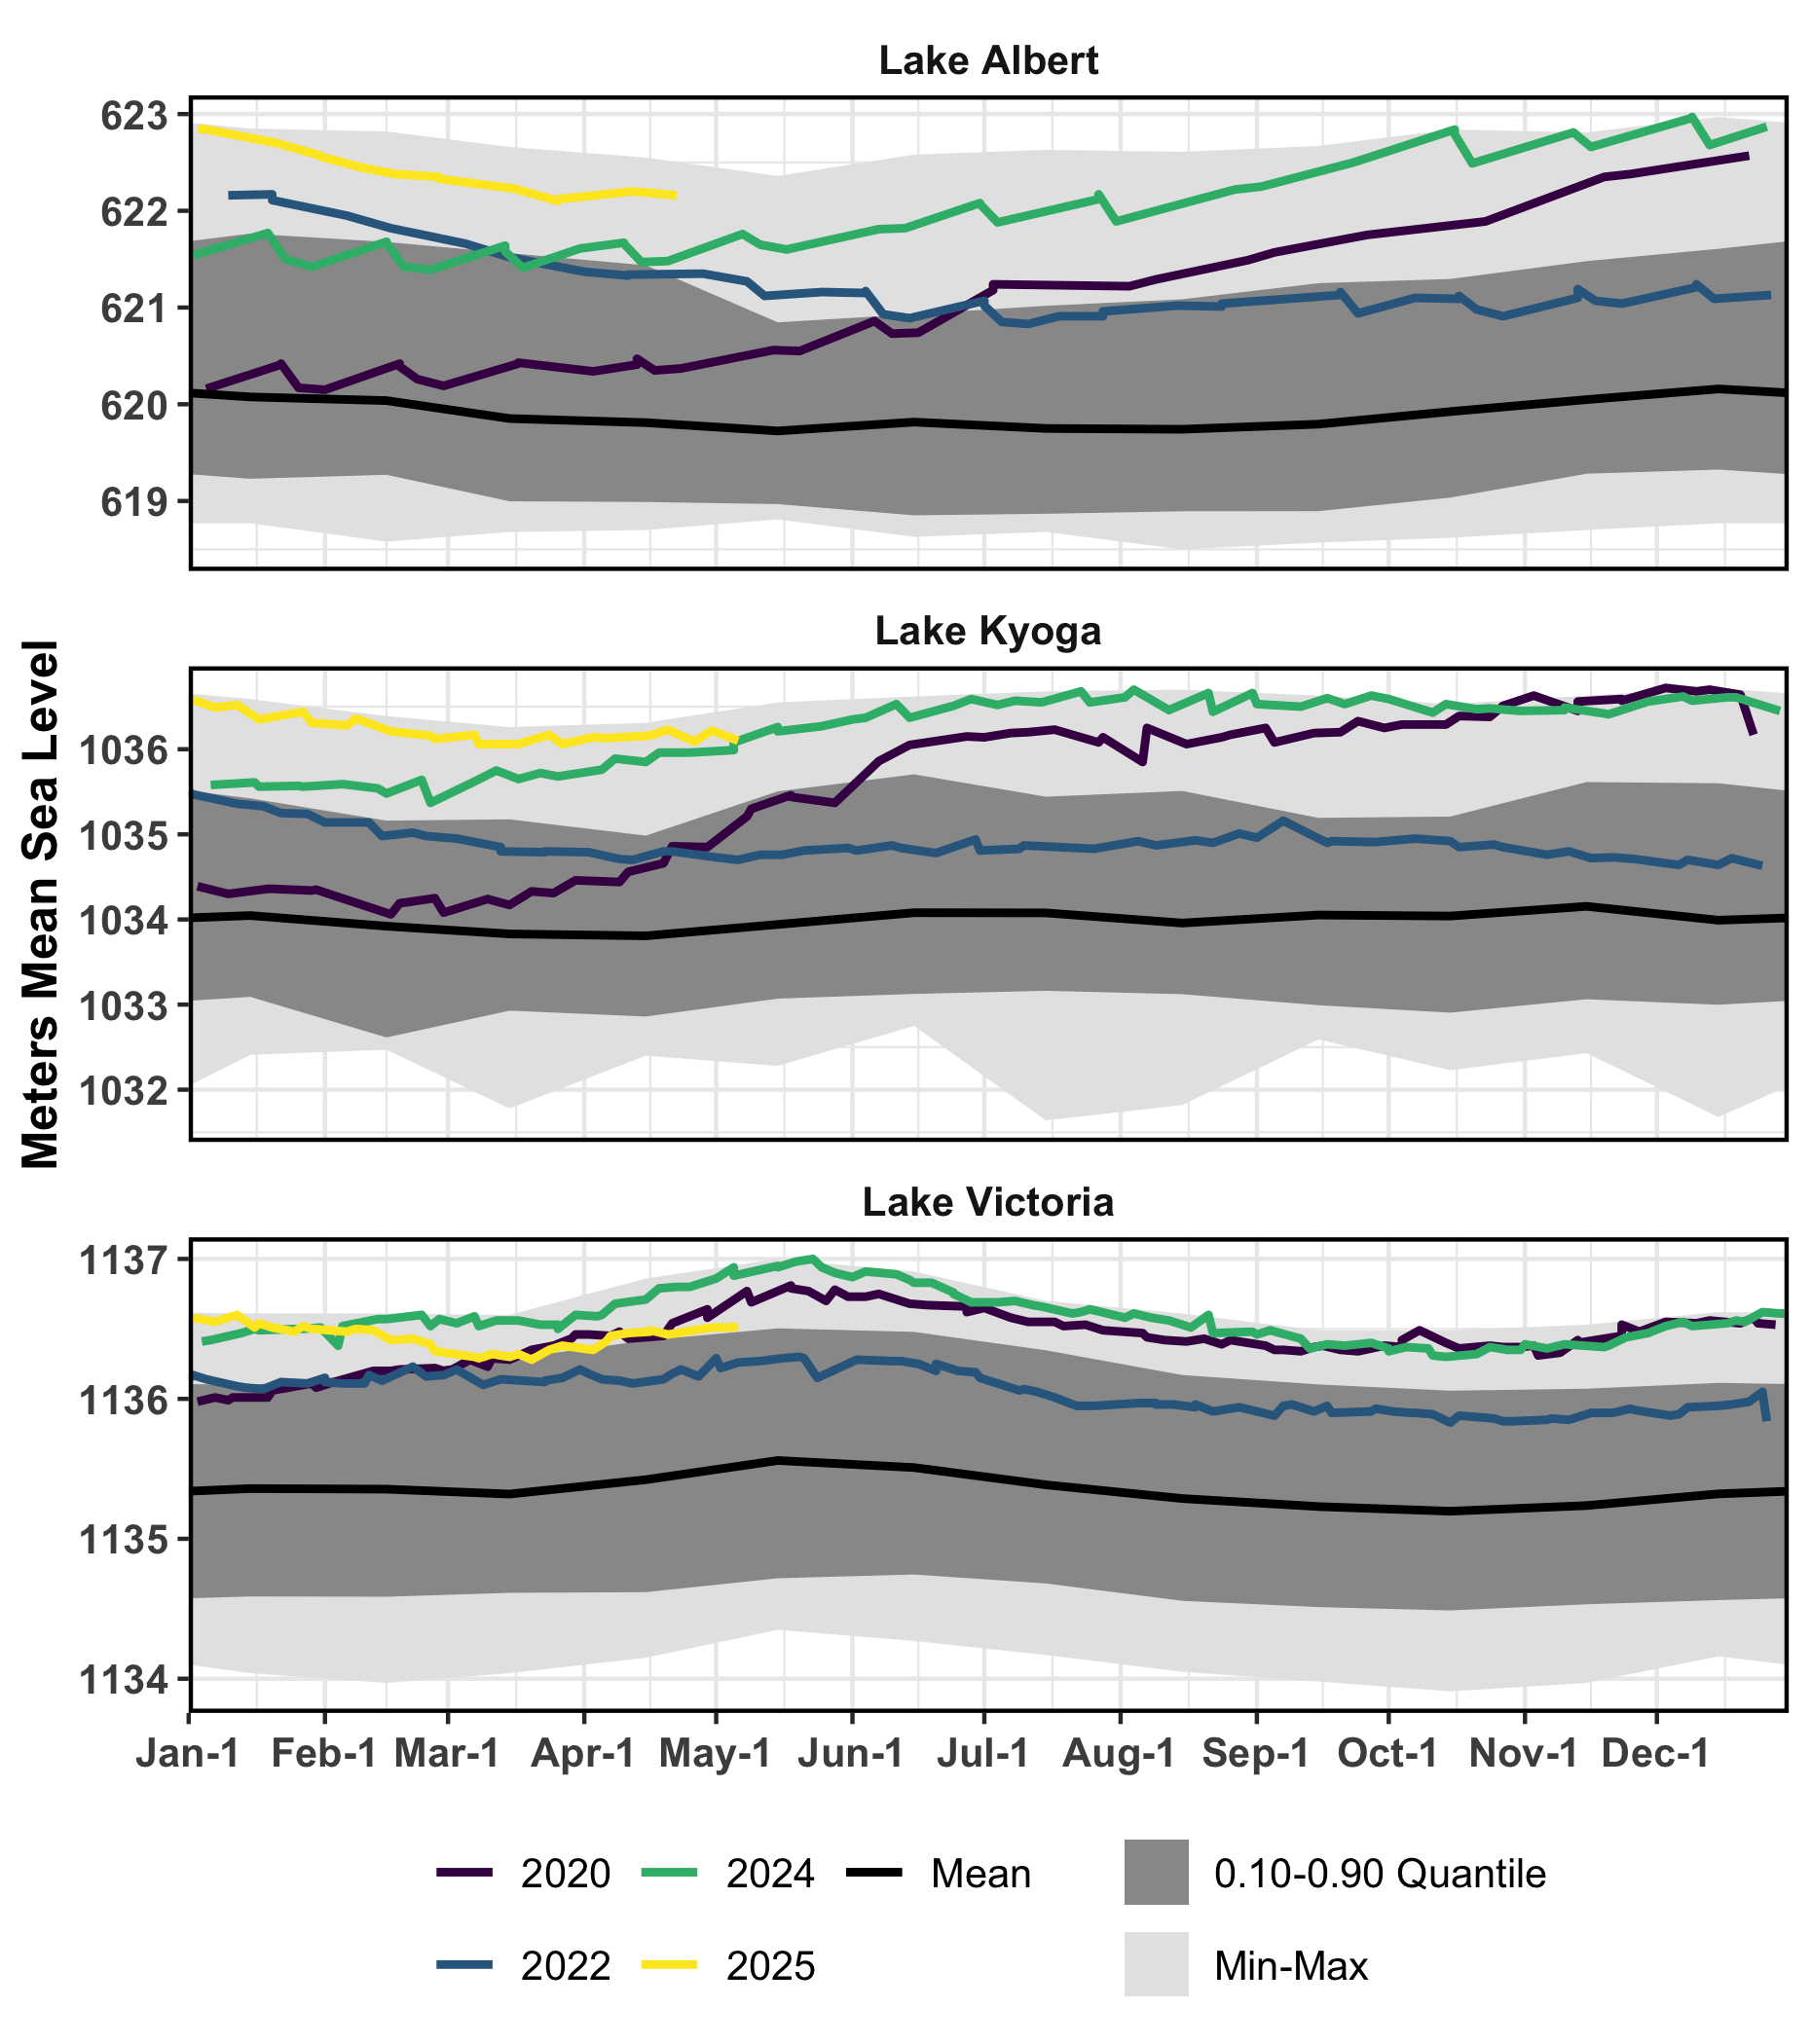
Uganda Lakes Satellite Altimetry
Uganda Lakes remain at historically high levels, though early May2025 (yellow line), though water levels in Lake Victoria are lower than last year.
Data from Hydroweb, accessed 9 May 2025.

Slide 6
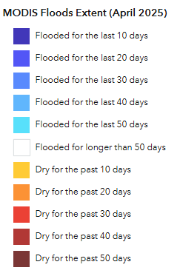
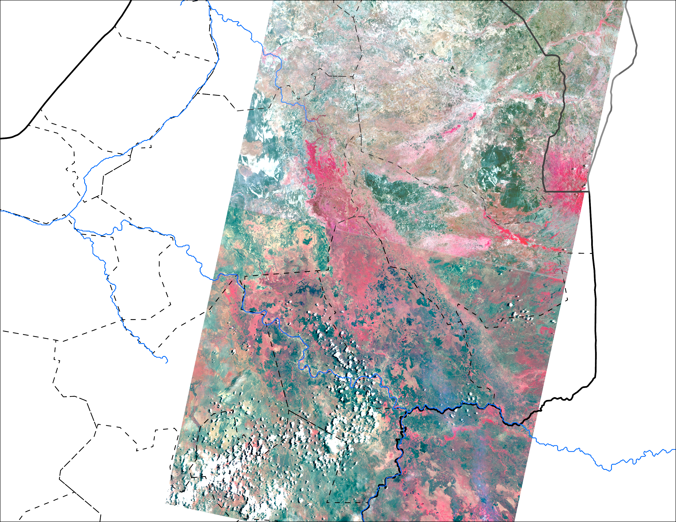
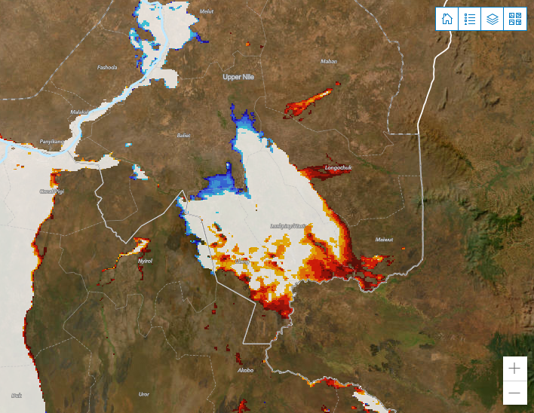
Flooding in the Upper Nile State
Vegetation appears red with 5-4-3 color composite.
WFP Dashboard: MODIS Temp. difference-based flooding, data from 1 – 11 of April 2025
Bands 5-4-3 (Near Infrared-R, Red-G, Green-B) Landsat from 18 of April 2025.
There appears to be some vegetation in the area that is flooded for longer than 50 days in MODIS.

Slide 7
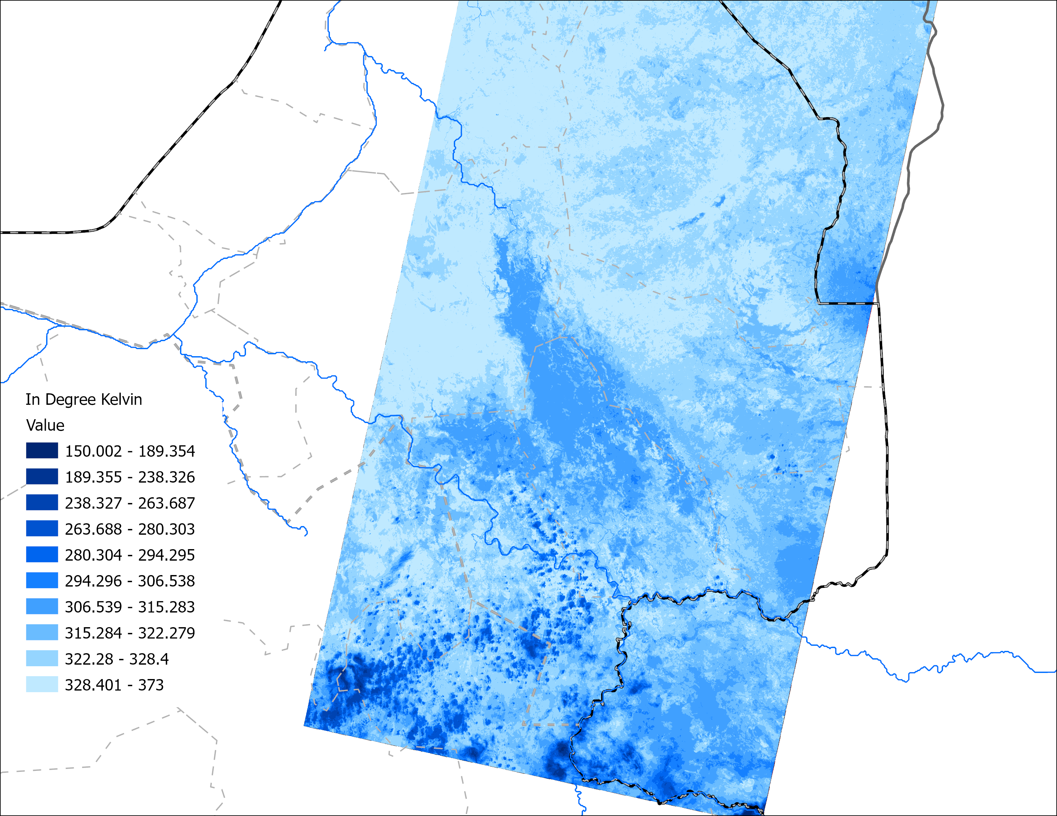
Landsat Optical vs LST Signals
Vegetation appears red with 5-4-3 color composite.
Bands 5-4-3 (Near Infrared-R, Red-G, Green-B) Landsat from 18 of April 2025
Landsat Land Surface Temperature (LST) in °Kelvin 18 of April 2025
That area could be with floating vegetation or very wet soil with vegetation.

Slide 8
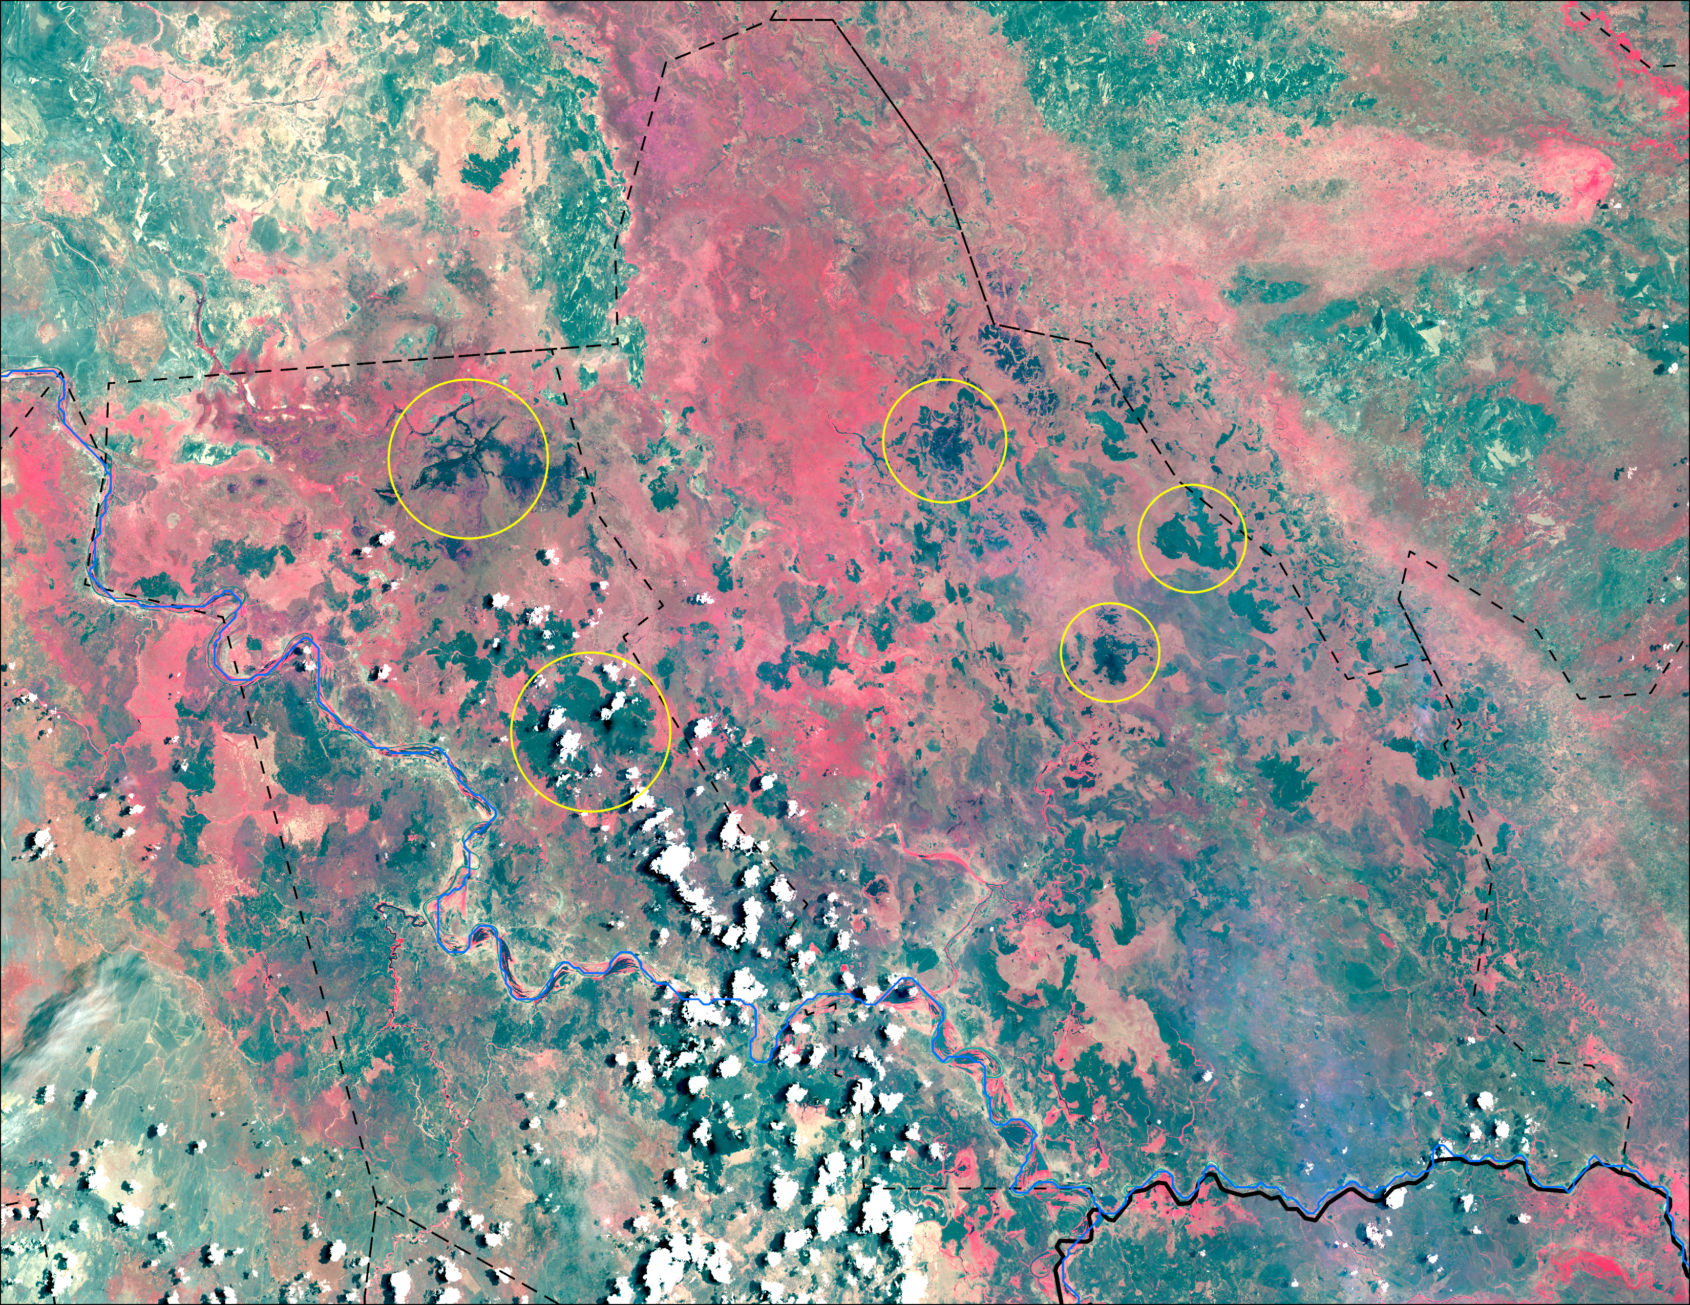
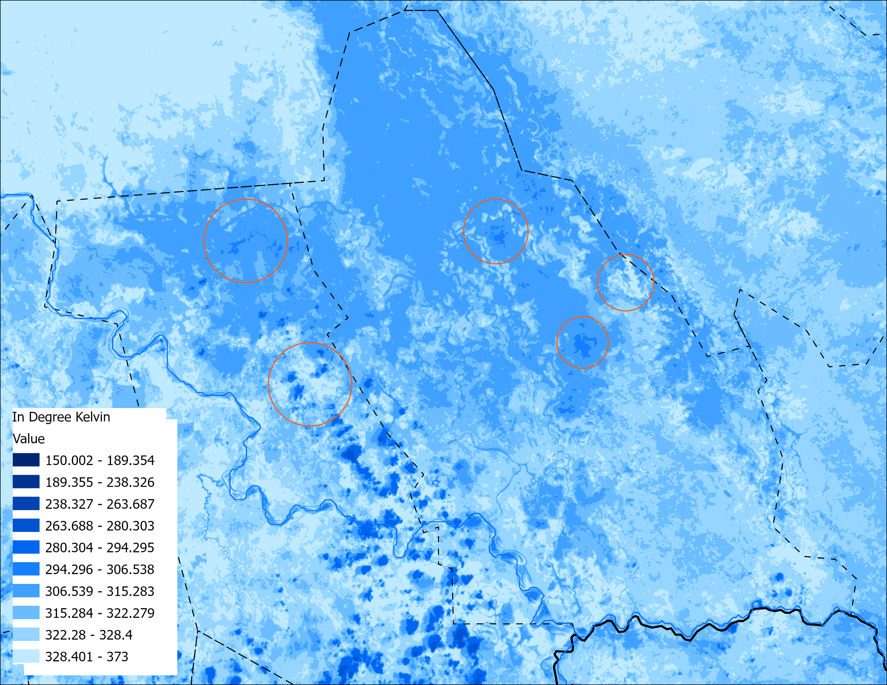
Landsat Optical & Land Surface Temperature
Possibly Wet soil with vegetation
Possibly Wet soil with vegetation
Water
Water
Water
Water
Burn scar
Burn scar
Cloud &
Burn scar
Water
Cloud &
Burn scar
Water
Vegetation appears red with 5-4-3 color composite.
Bands 5-4-3 (Near Infrared-R, Red-G, Green-B) Landsat from 18 of April 2025
Landsat Land Surface Temperature (LST) in °Kelvin 18 of April 2025
Difference in LST suggests, it could be more like very wet soil with vegetation.

Slide 9
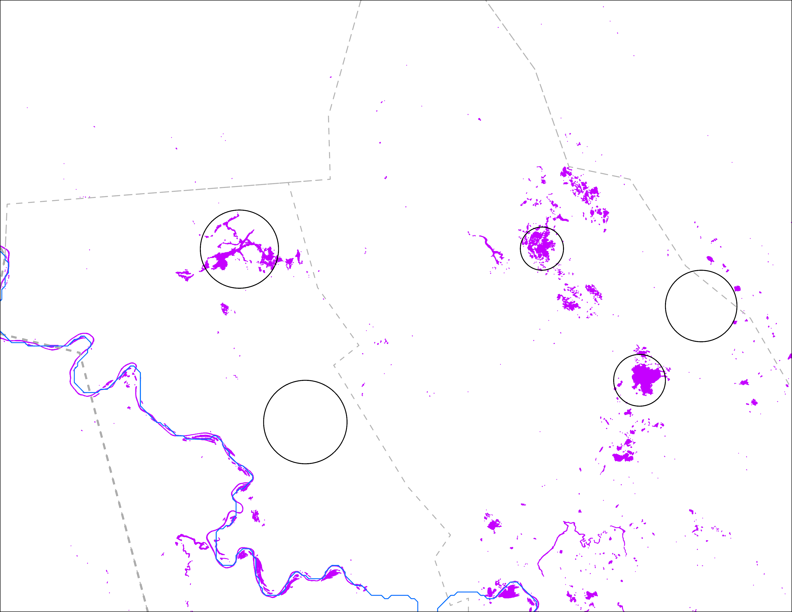
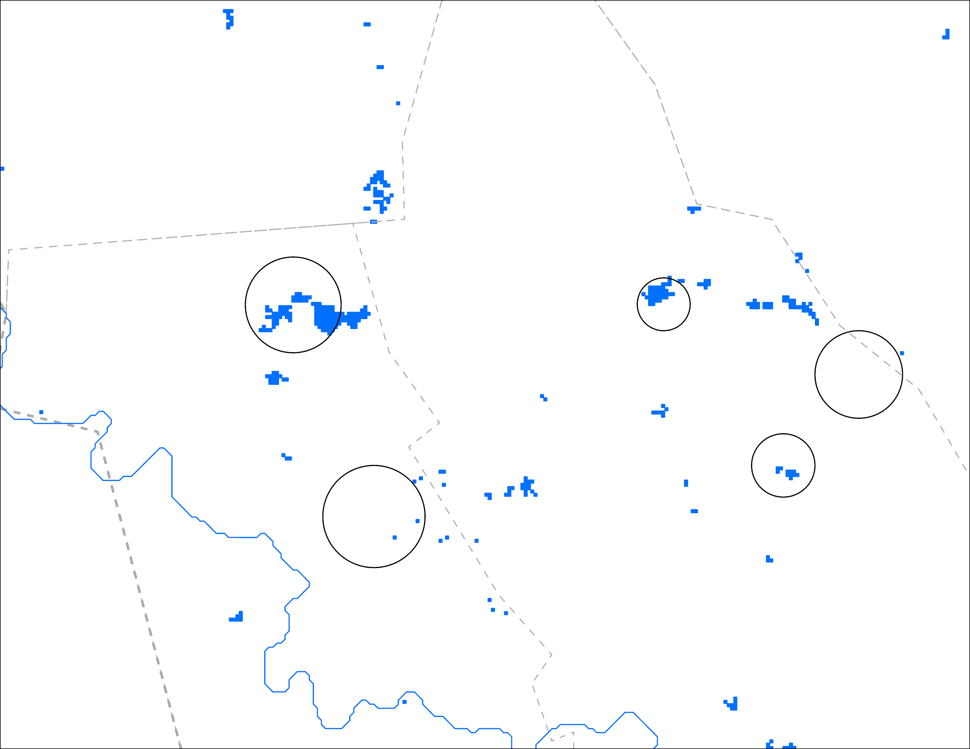
LS vs VIIRS Inundation
Possibly Wet soil with vegetation
Possibly Wet soil with vegetation
Water
Water
Water
Water
Burn scar
Burn scar
Water
Water
Cloud &
Burn scar
Cloud &
Burn scar
Landsat-based inundation: 18 April 2025
VIIRS inundation: 23 – 27 April 2025
Landsat captured open water quite well, VIIRS also captured water relatively well. Neither VIIRS nor LS identified burn scars as water. That wet soil with vegetation area was not classified as water.

Slide 10
Thank you

