Slide 1
Flood Monitoirng and Forecast Assumptions—West Africa
FEWS NET Science Team
September 16, 2026
Notes:
Default title slide

Slide 2
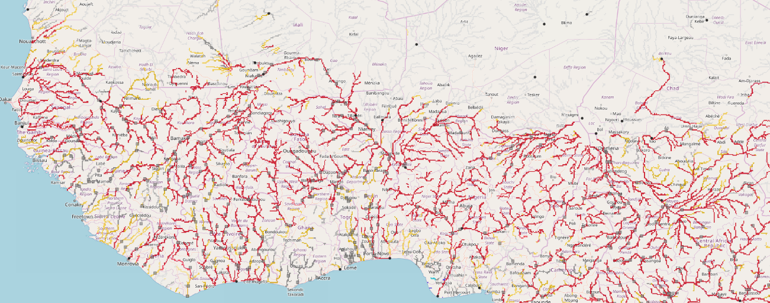
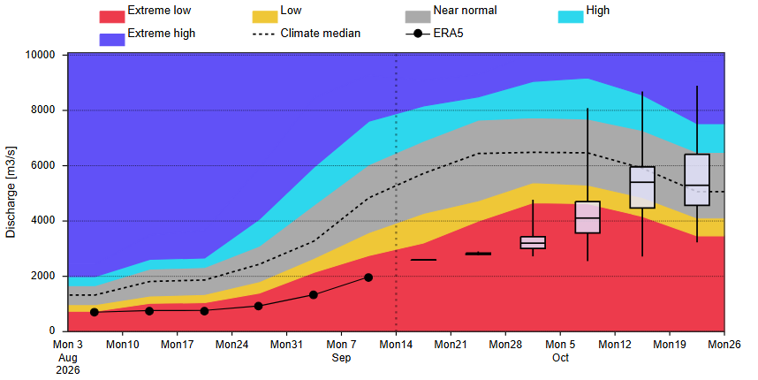
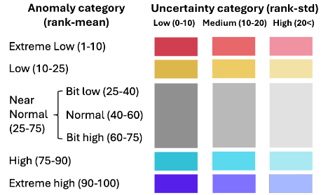
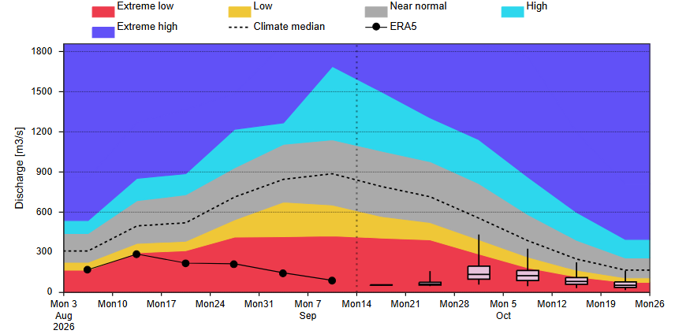
Sub-seasonal Streamflow Forecast
@ point A: Niger in central Mali
Senegal
A
Niger
@point A, on the River in northern Togo
Komadugu
B
Sokoto
@ point B: Komadugu in Nigeria
Logone
Niger
C
Benue
GloFAS Sub-seasonal forecast: Sep 14 – Oct 26, 2026
@ point C: Benue in Nigeria
Discharges are extremely low across all major rivers in west Africa.
GloFAS: Sep 14 – Oct 26, 2026

Slide 3
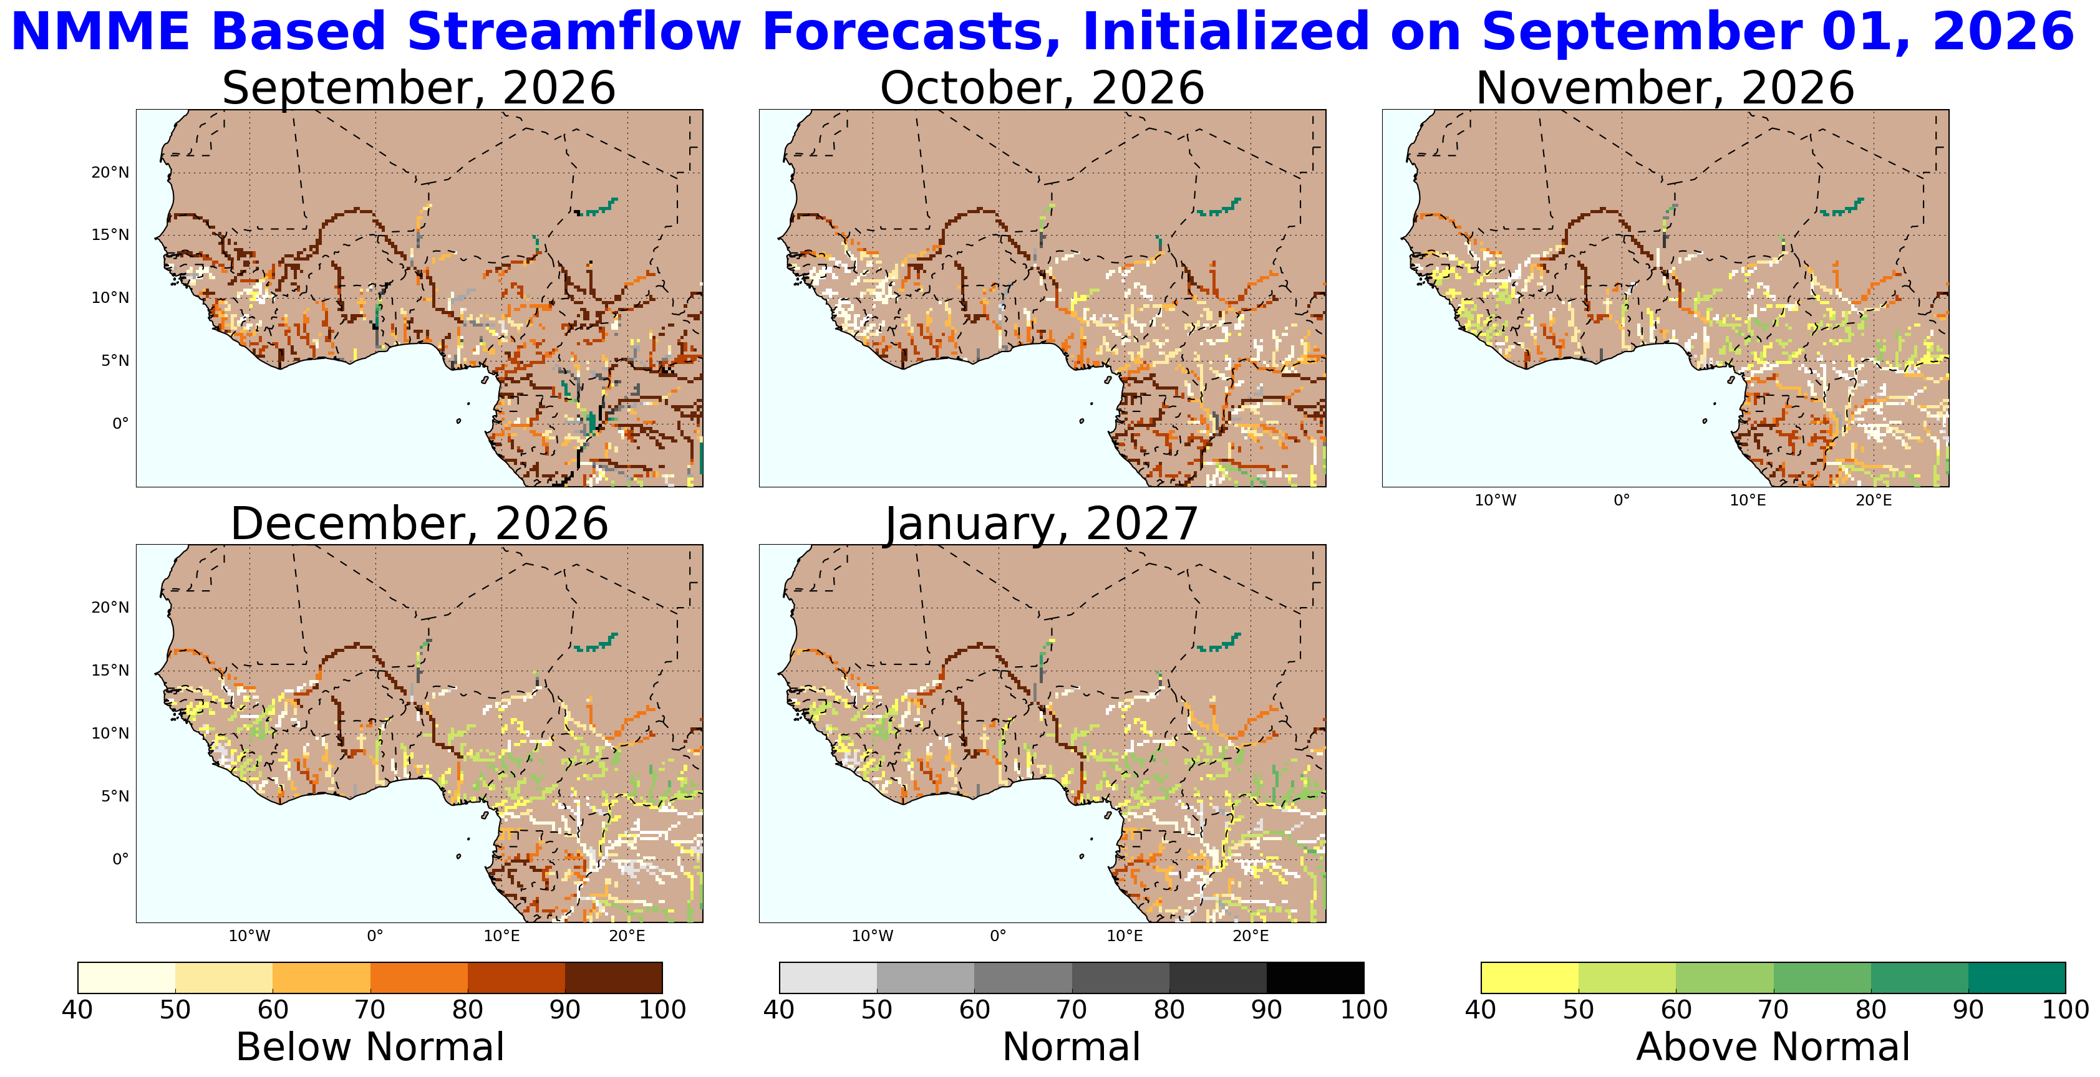

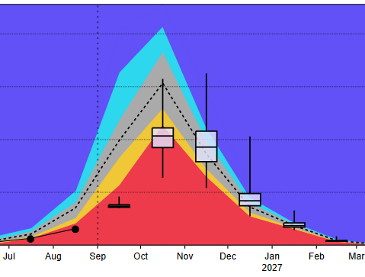

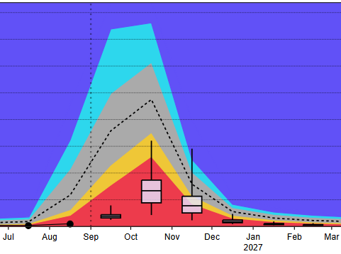
Seasonal Streamflow Forecast
@point A on upstream Niger in Niamey
@point B on Logone in Chad
A
B
NHyFAS seasonal forecast Sep – Jan 2027
GloFAS seasonal forecast Sep 2026 – Mar 2027
Both NHyFAS and GloFAS models are converging for well below average flow during the peak flow season of September and October in all major Rivers in West Africa. Streamflow are expected to be at extremely low (1 to 10 percentile range), therefore, less likelihood of flooding in West Africa till the end of the season.

Slide 4
Assumption
Based on the extended streamflow forecast, the likelihood of flooding along the major Rivers in West Africa is extremely low till the end of the season. below average. However, there is a likelihood of flooding along the western coastal countries, central Mali, southern Niger, and northern Nigeria during the September-October period.

