Slide 1
Flood Monitoirng and Forecast Assumptions—West Africa
FEWS NET Science Team
May 19, 2026
Notes:
Default title slide

Slide 2
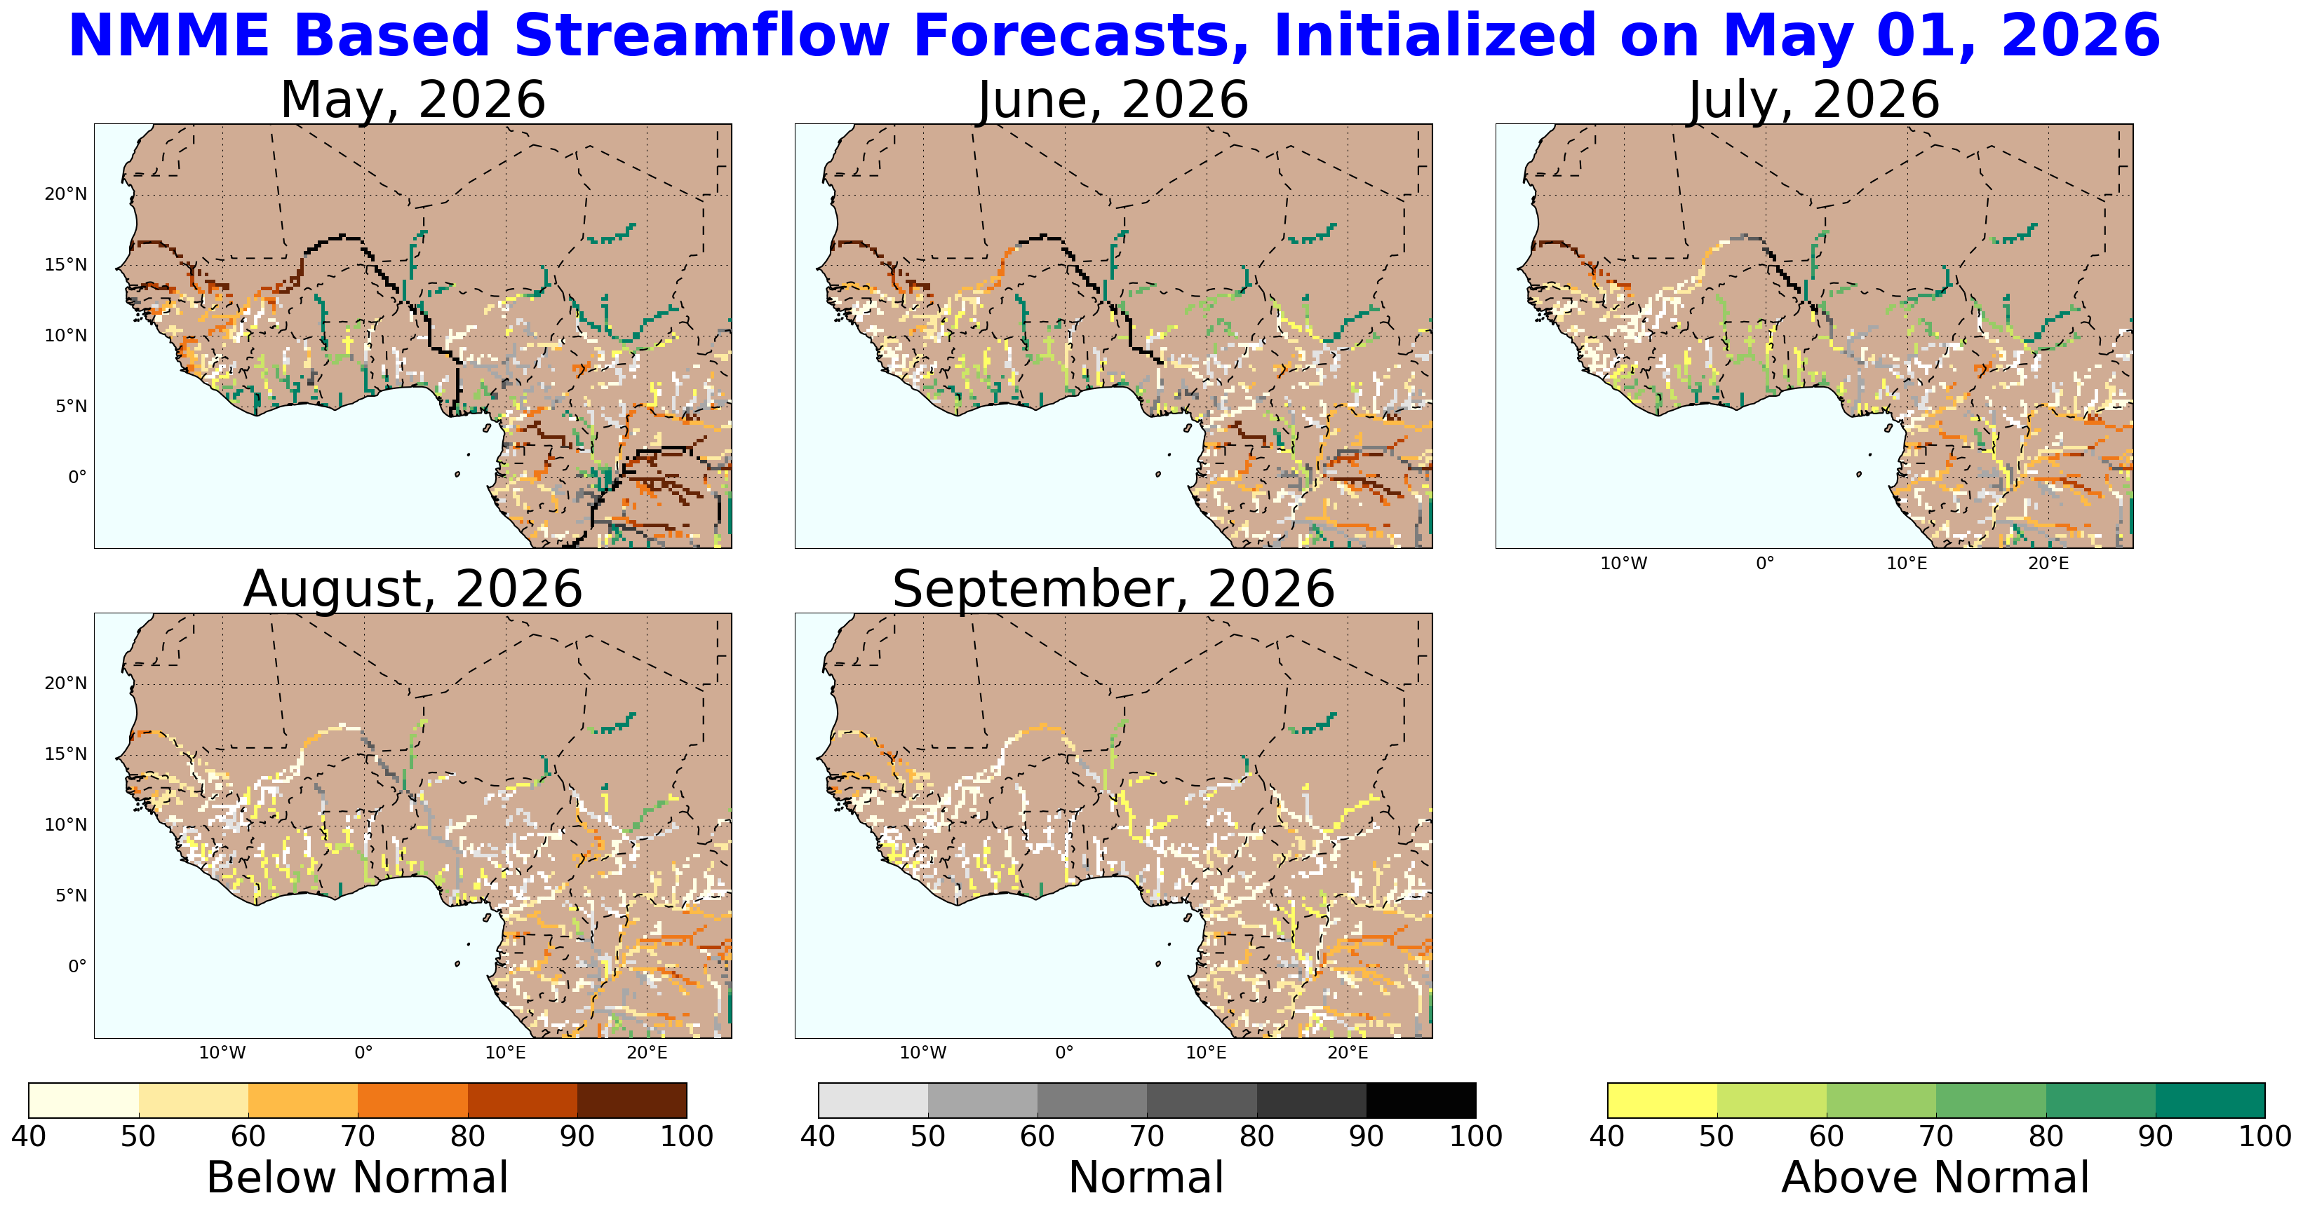
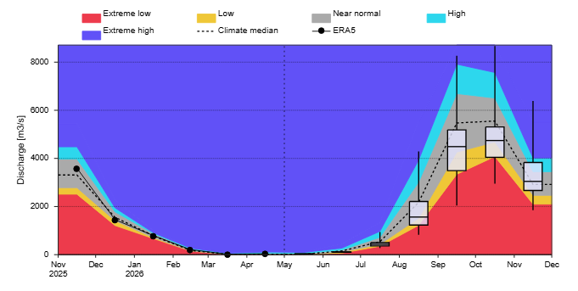
NMME Based Streamflow Forecast
@point A on Niger River in near Niamey, Niger
A
GloFAS seasonal forecast May – Nov 2026
Although some major and coastal rivers are showing above average conditions during Jun-Aug, this is still climatologically low flow season and above average conditions during low flow season typically are not conducive to flooding.

Slide 3
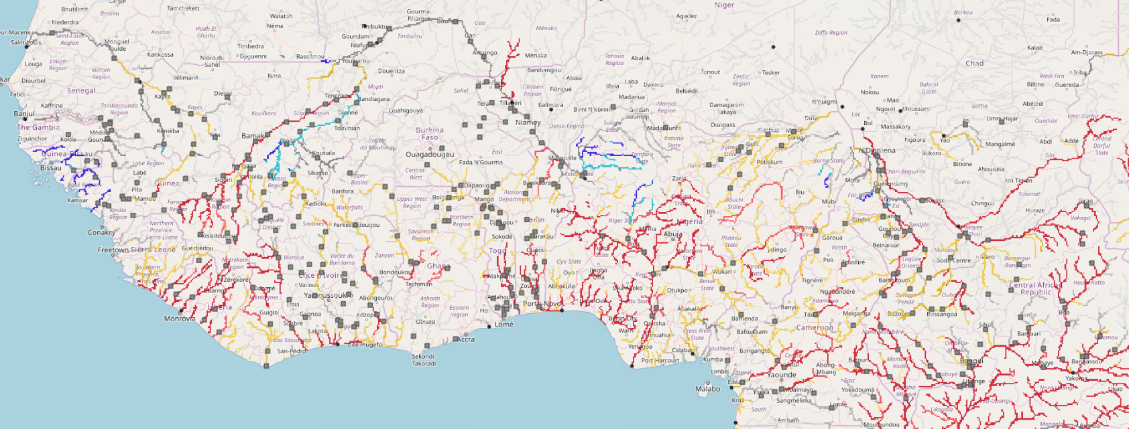
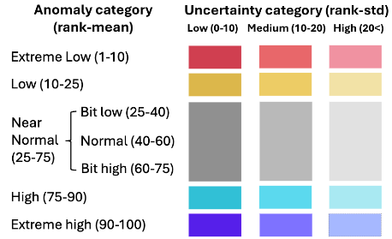
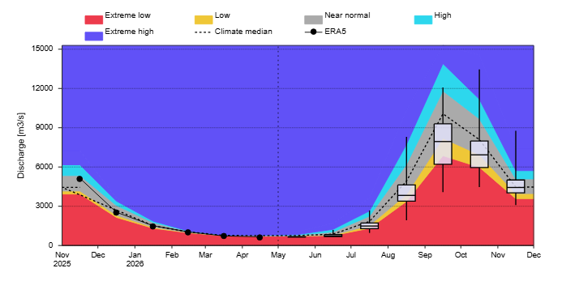
Seasonal Forecast
@point A on Niger River in Nigeria
Senegal
Niger
On the Niger River at point A
Sokoto
Komadugu
A
Niger
Logone
Benue
GloFAS Seasonal forecast: May – Nov 2026
GloFAS: May – Nov 2026
Discharges are expected to be above average in Guinea Bissau, parts of upstream Niger in Mali, and Sokoto Rivers.
There is likelihood of flooding along western coastal countries, central Mali, and northern Nigeria during September-October period.

Slide 4
Assumption
Based on the NMME Streamflow forecast, above-average river flows are likely on the rivers in the region through August. Localized flooding is expected in Chad (Logone river), Niger, and Nigeria (Komadugu-Yobe river). May through August is still in the low flow season and less likely to experience flooding in the region. Though, extended forecast suggest likelihood of flooding along western coastal countries, central Mali, and northern Nigeria during September-October period. However, there is uncertainty due to the long-range nature of the forecast.

