Slide 1
Flood Monitoirng and Forecast Assumptions—West Africa
FEWS NET Science Team
June 15, 2026
Notes:
Default title slide

Slide 2
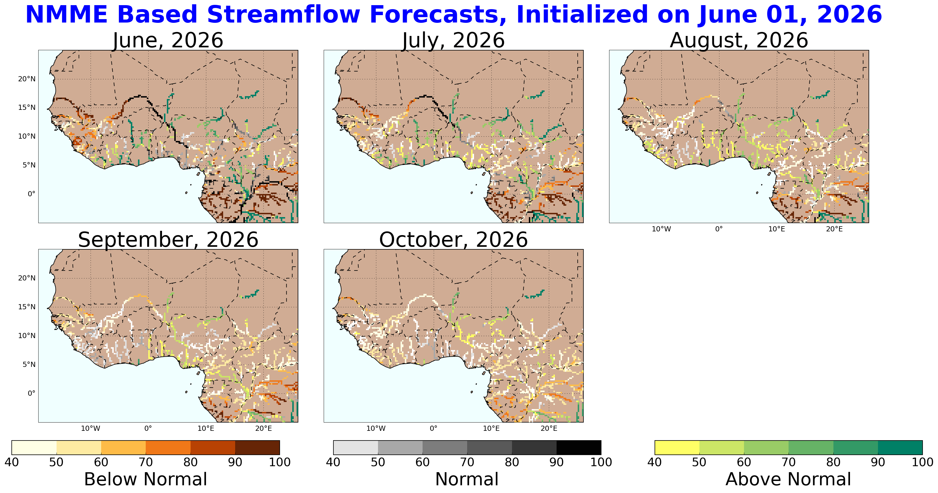

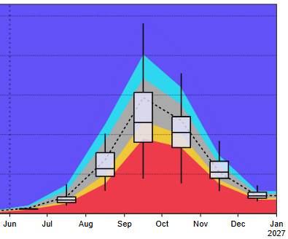

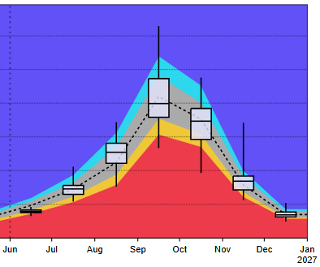
Seasonal Streamflow Forecast
@point A on upstream Niger
@point B on Niger Outlet
A
B
NHyFAS seasonal forecast Jun – Oct 2026
GloFAS seasonal forecast Jun – Dec 2026
Streamflow across the West Africa just started to experience seasonal increase. Good convergence between the forecast models suggesting average flow during the peak season of September-October across the West Africa with few rivers expecting above average flow.

Slide 3
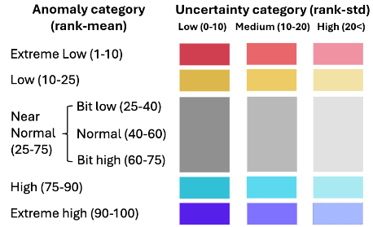

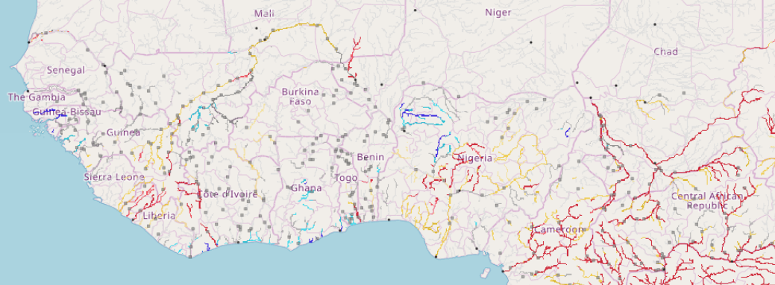


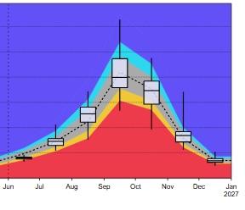
Seasonal Streamflow Forecast
Senegal
Niger
On the Niger River at point A
@point A on Niger River in Nigeria
Sokoto
Komadugu
Niger
Logone
Benue
A
GloFAS Seasonal forecast: Jun – Dec 2026
GloFAS: Jun – Dec 2026
Discharges are expected to be above average in Guinea Bissau, parts of upstream Niger in Mali, and Sokoto Rivers.
There is likelihood of flooding along western coastal countries, central Mali, and northern Nigeria during September-October period.

Slide 4
Assumption
Based on the extended forecast, there is a likelihood of flooding along the western coastal countries, central Mali, and northern Nigeria during the September-October period. However, there is uncertainty due to the long-range nature of the forecast.
-No change

