Slide 1
Flooding in Southern Africa
FEWS NET Science Team
May 19, 2026
Notes:
Default title slide

Slide 2

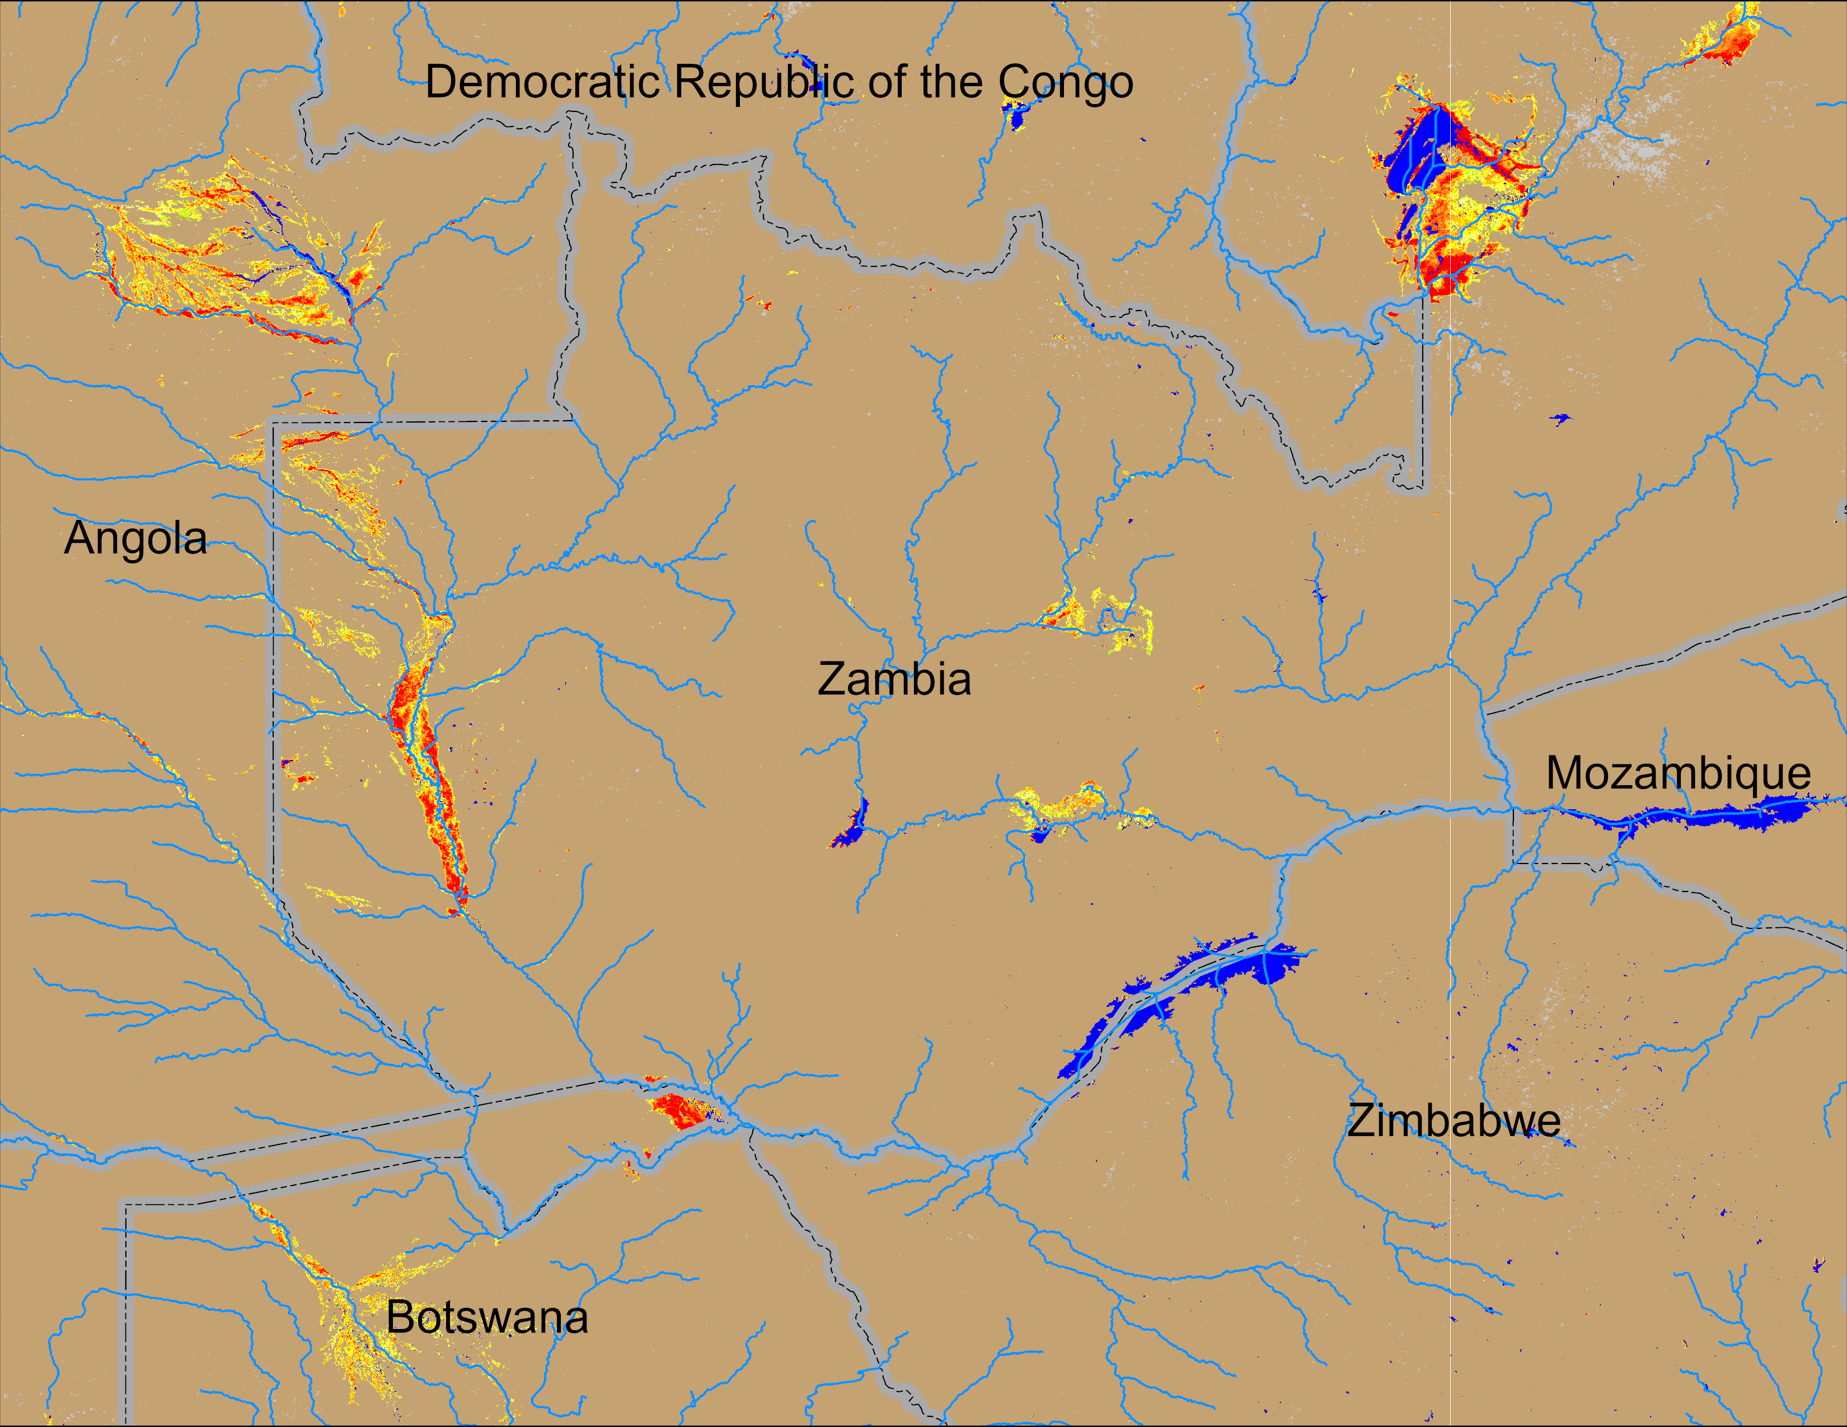
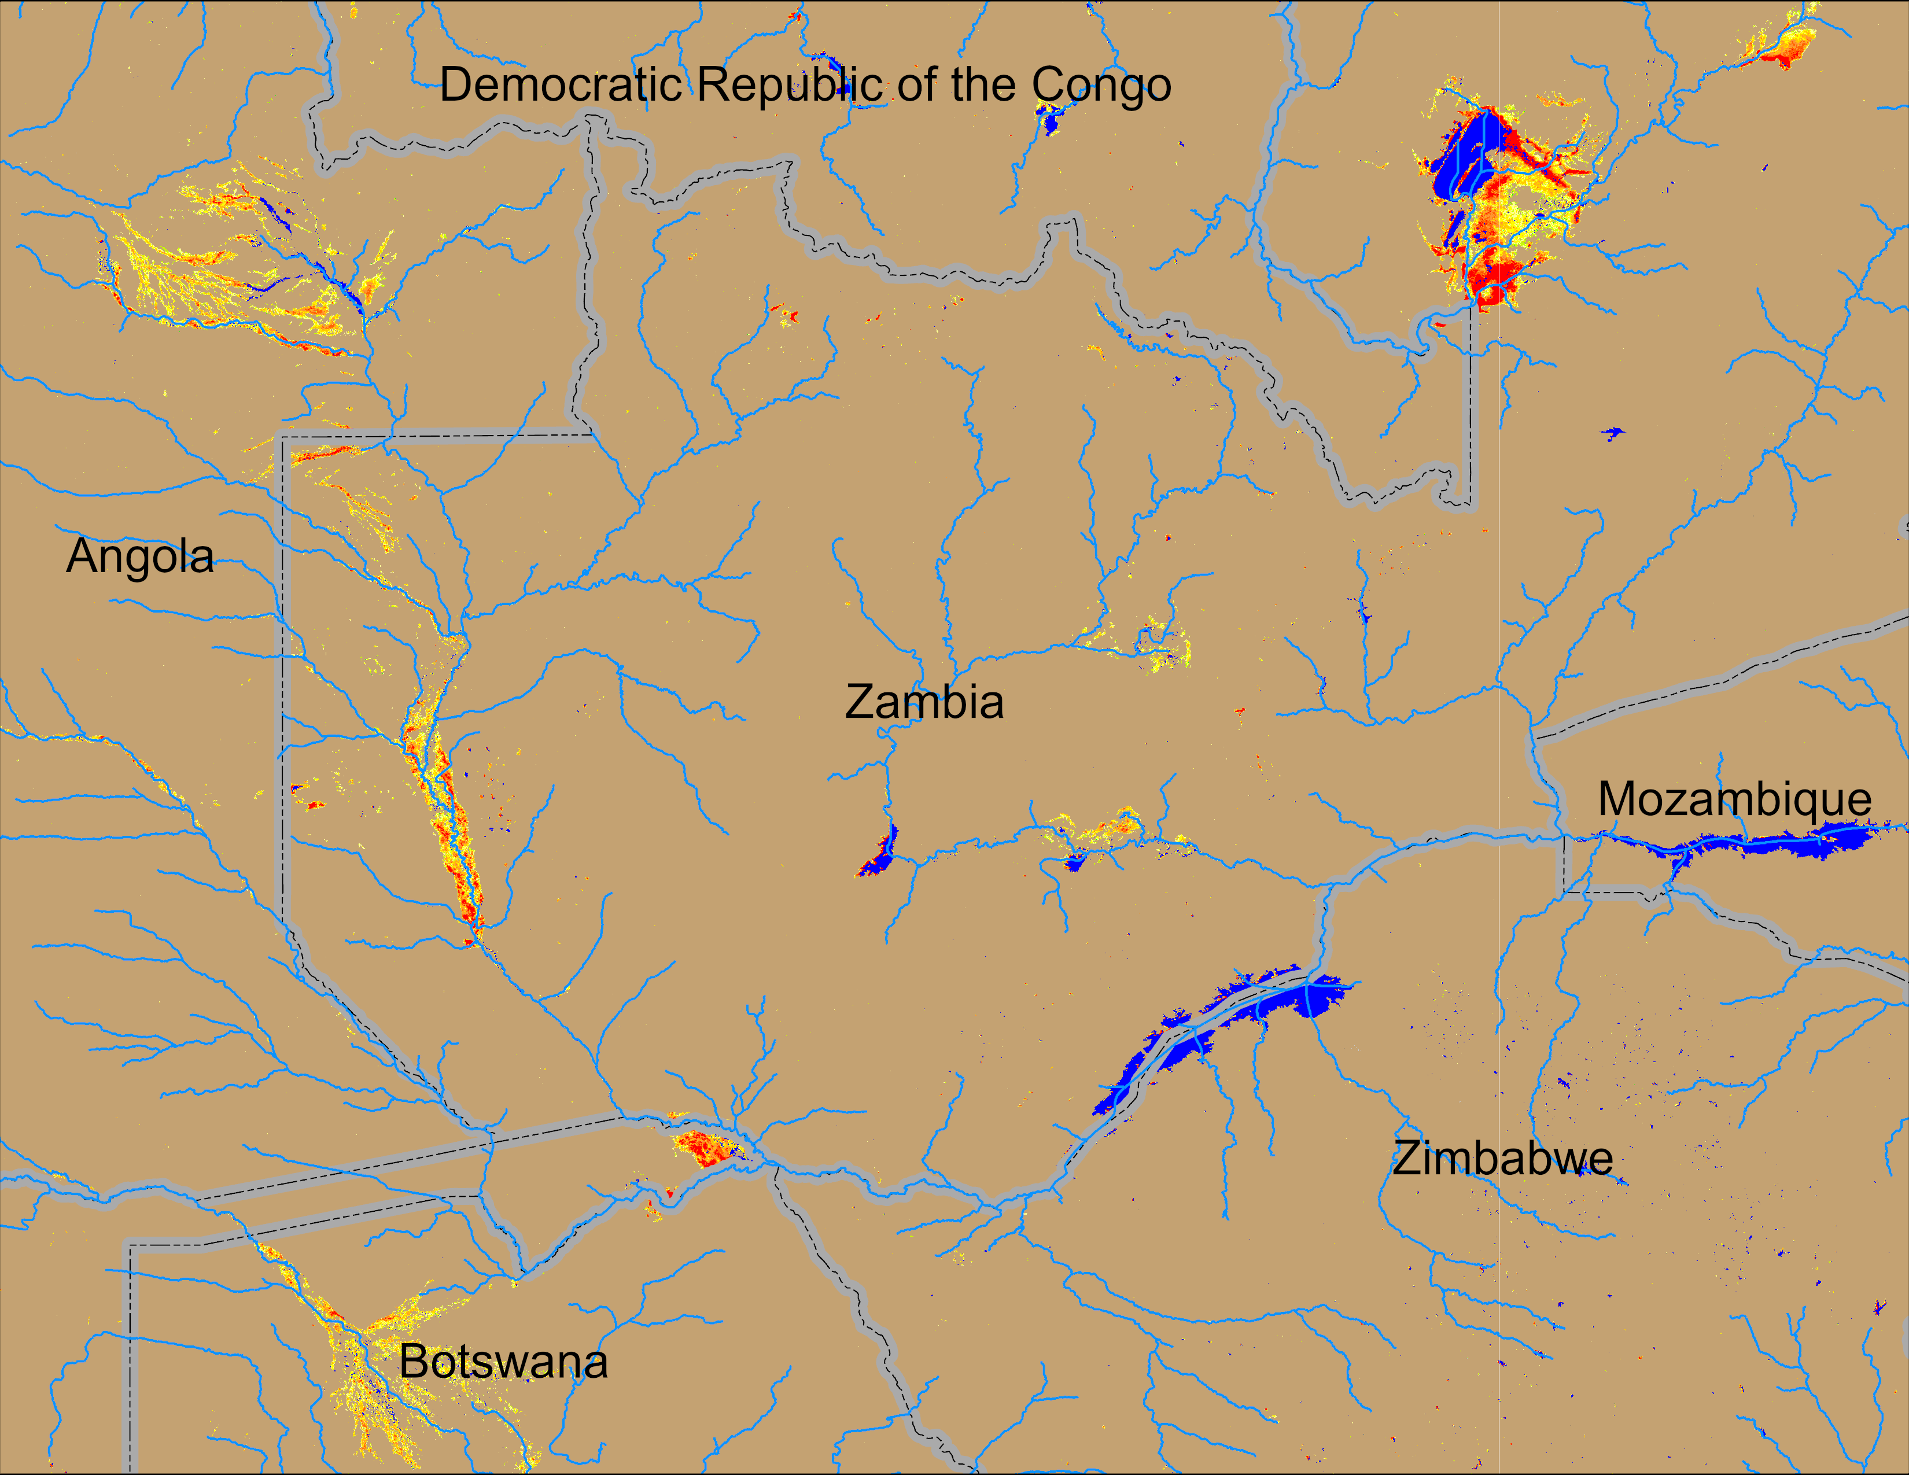
Flooding Conditions in Zambia
NOAA VIIRS 5-day comp.: 26 – 30 Apr 2026
NOAA VIIRS 5-day comp.: 13 – 17 May 2026
Flooding subsided substantially in Angola and Zambai, but still lingering in northern Botswana.

Slide 3
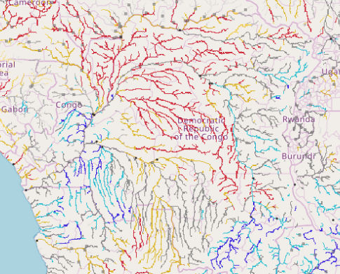
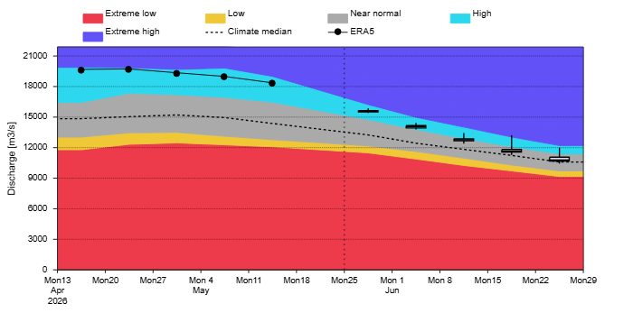
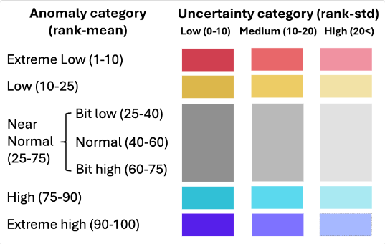
Streamflow Forecast Across DRC
Congo River
GloFAS forecast: 13 Apr – 29 Jun 2026
GloFAS sub-seasonal forecast: 5-6 Weeks from now.
Discharges are expeted to be quite high in the upstream of the Congo river in the east and in the down stream of the river in central DRC. Evidence in support of Assumption 1b

Slide 4
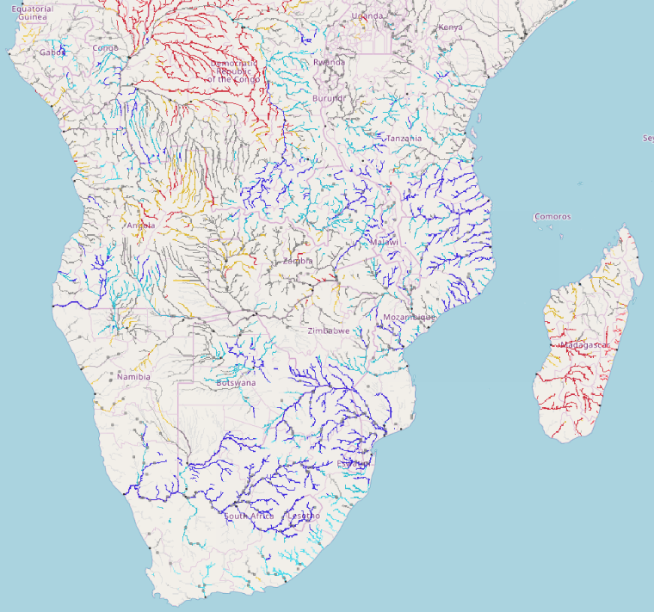
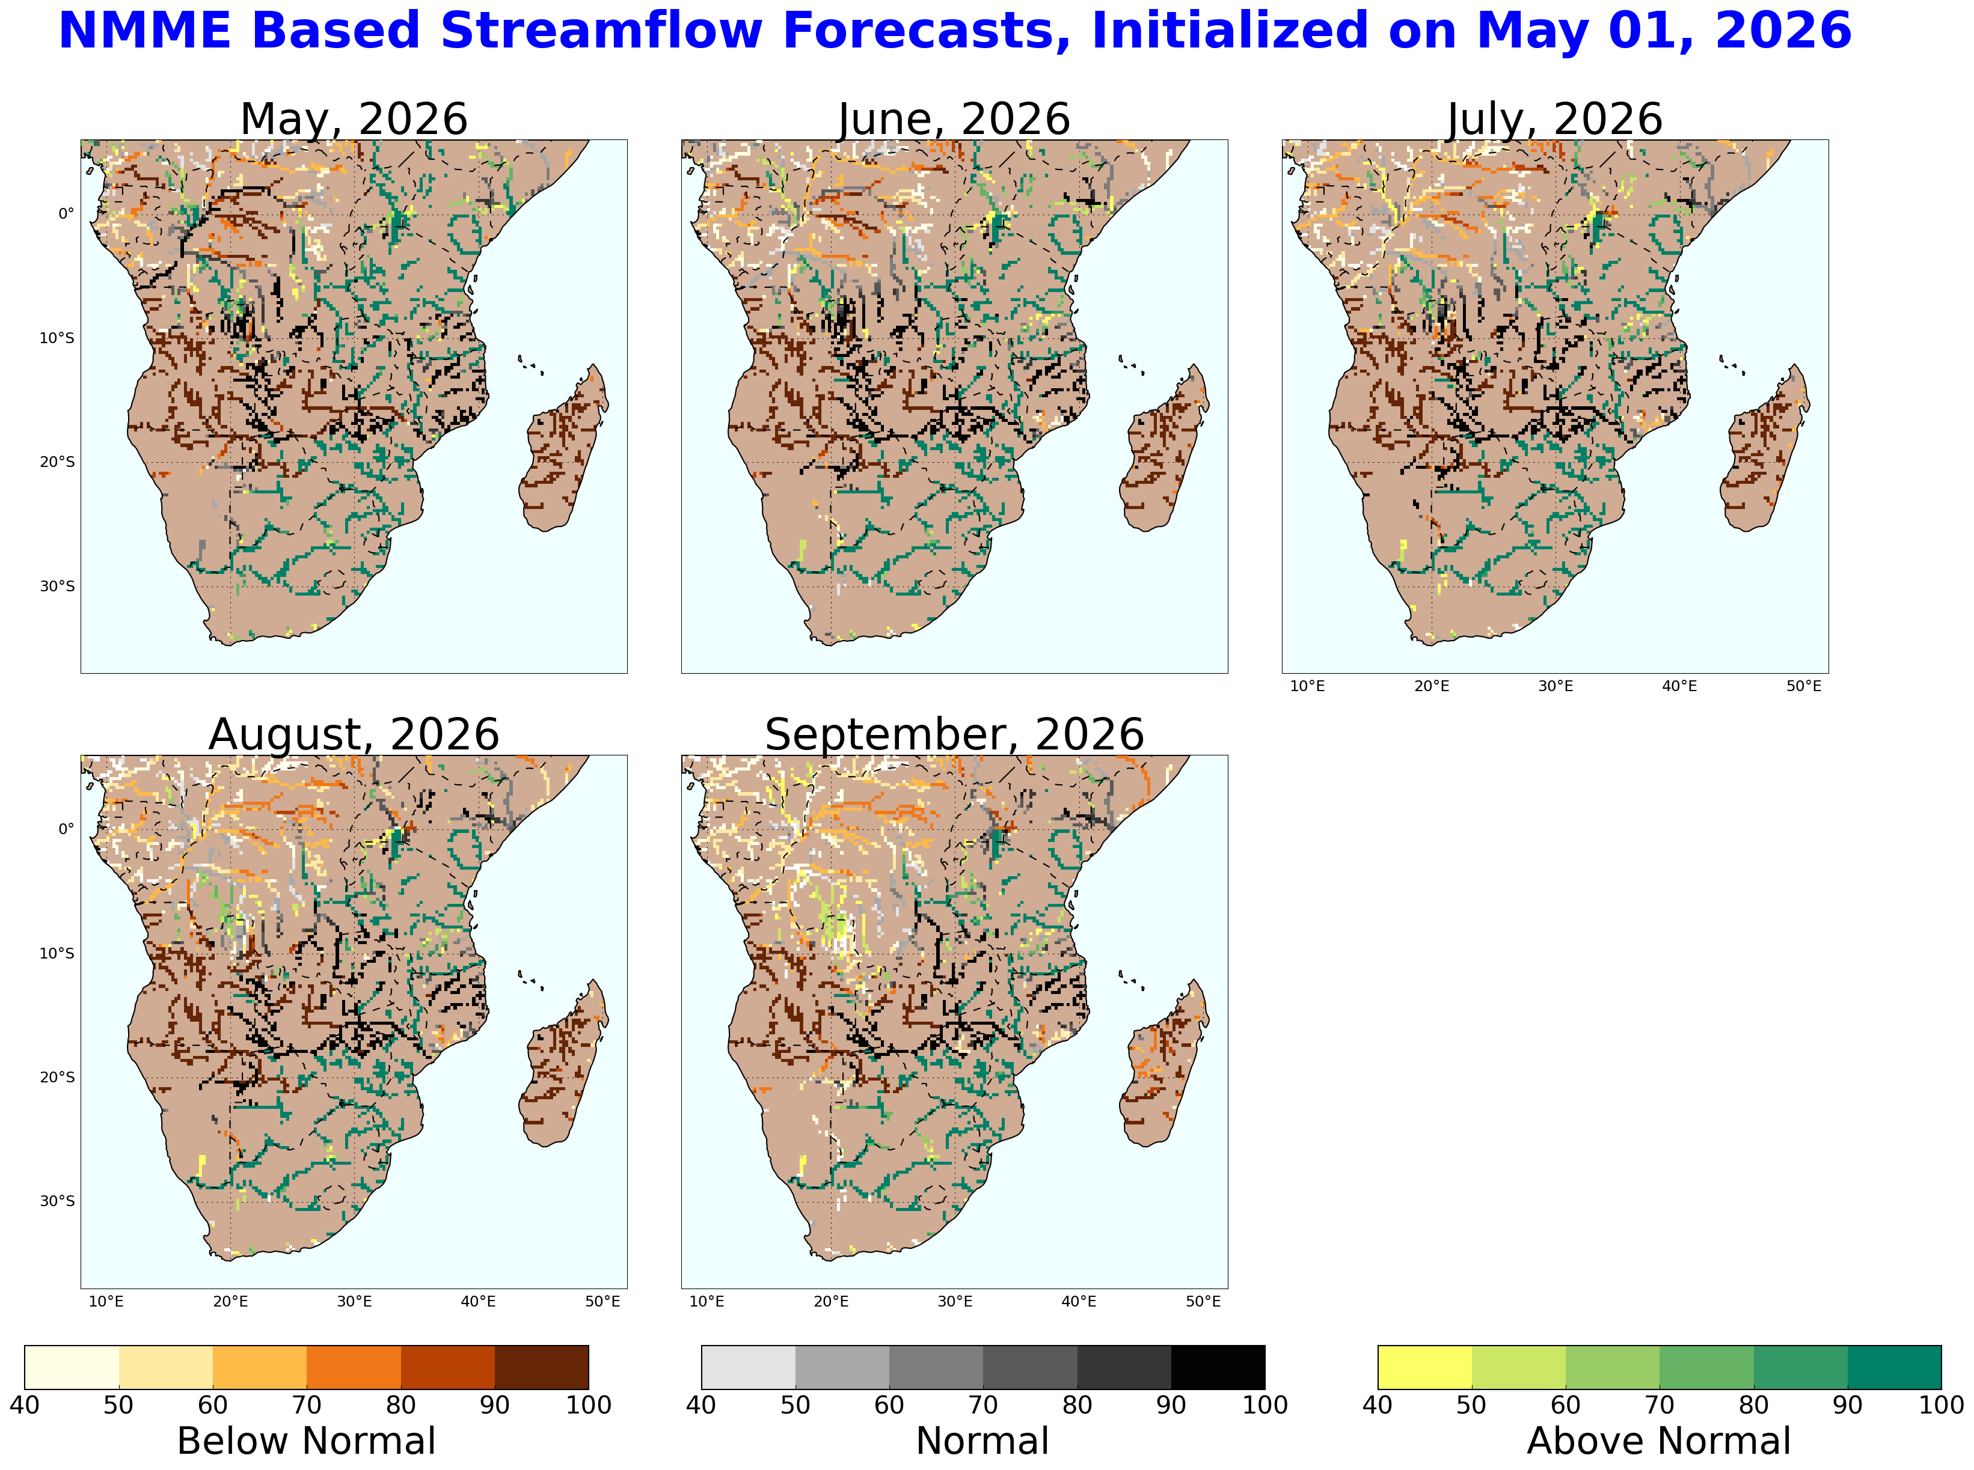
Seasonal Streamflow Forecast
GloFAS monthly forecast: Mar – Sep 2026
GloFAS seasonal forecast: May – Nov 2026
Good agreement between the GloFAS and NHyFAS outputs suggesting above average flow in South Africa and below average flow in Madagascar.

