Slide 1
Flooding in Southern Africa
FEWS NET Science Team
March 17, 2026
Notes:
Default title slide

Slide 2
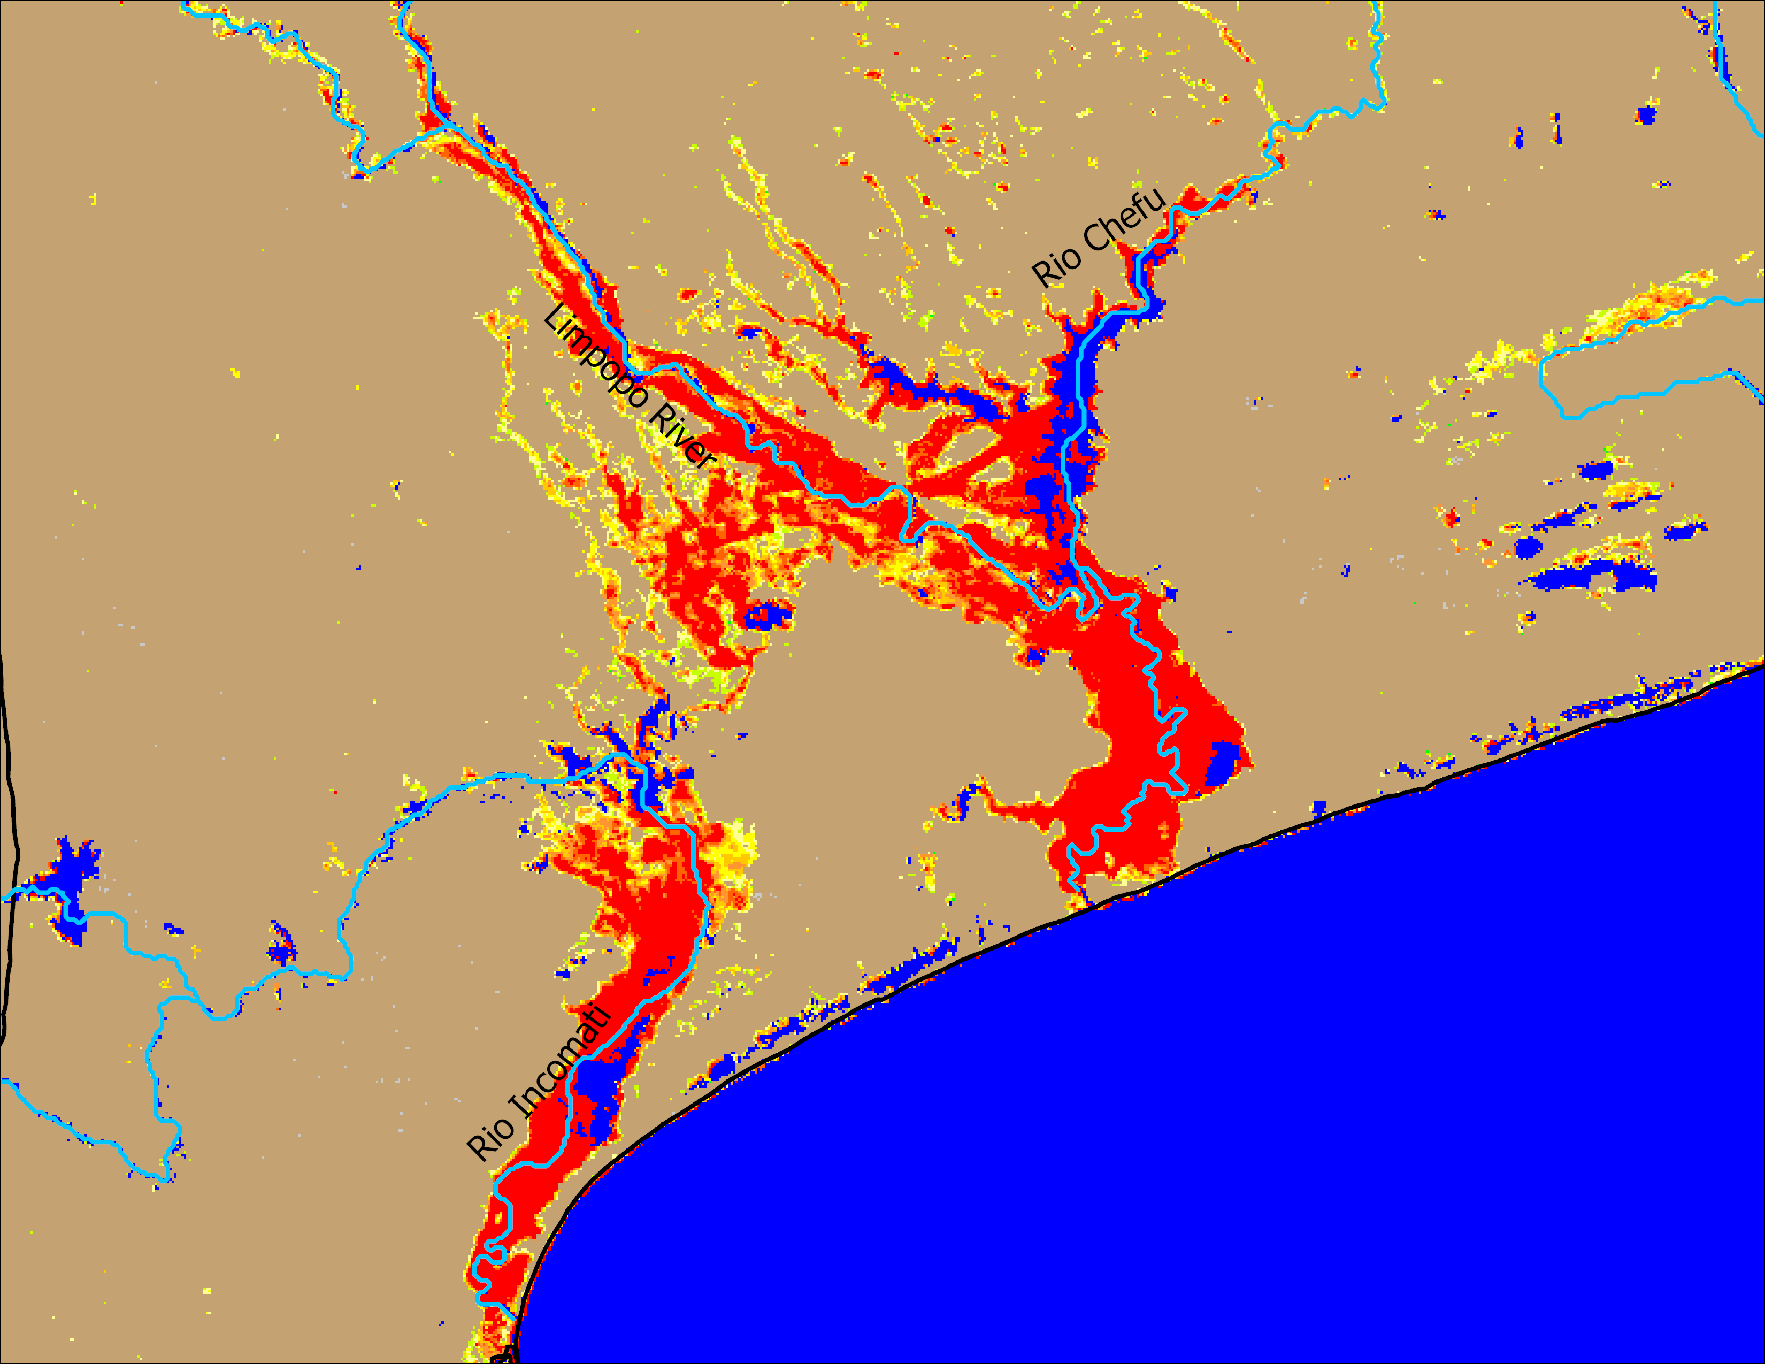
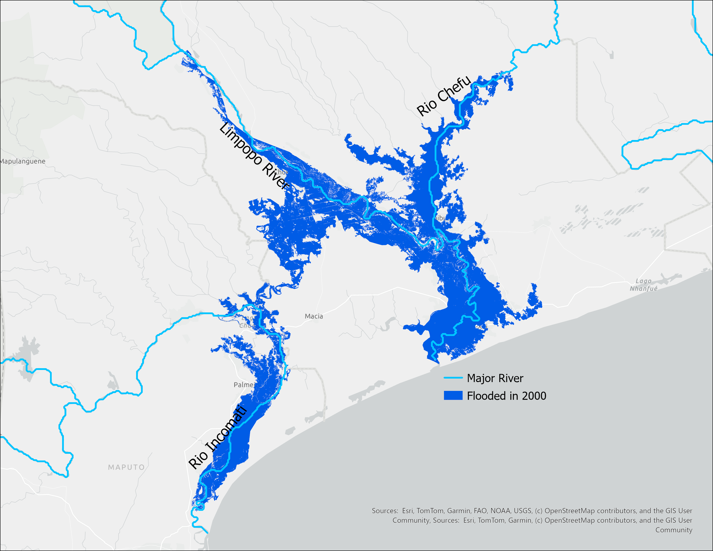

Flooding in Southern Mozambique
NOAA VIIRS flood product: 21-25 Jan 2026
Landsat 7: March 01, 2000
January 2026 flooding was comparable to the historic flooding of 2000 in southern Mozambique. However, inundation subsided completely due to recent dry spells in the region.

Slide 3
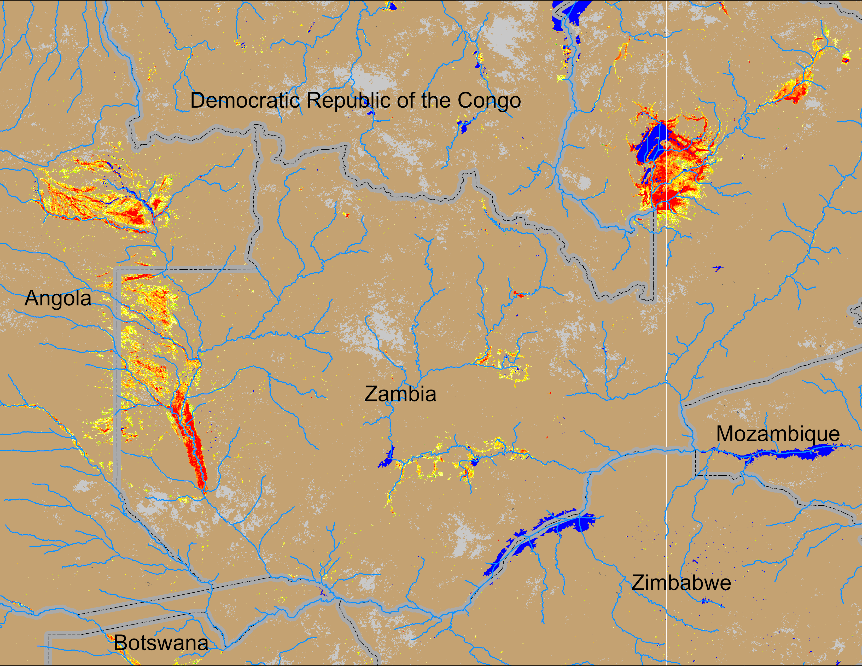
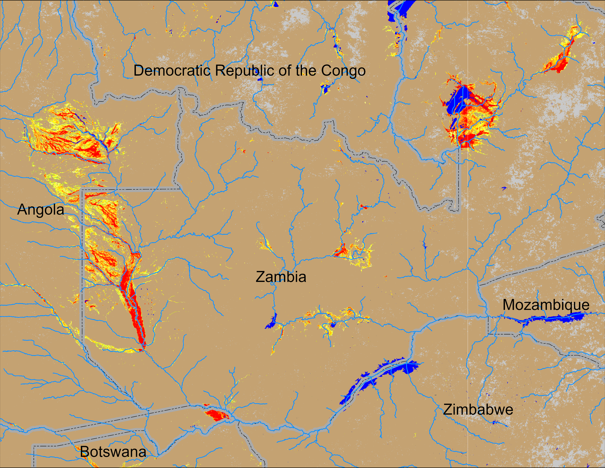
Flooding Conditions in Zambia
NOAA VIIRS 5-day comp.: 04 – 08 Mar 2026
NOAA VIIRS 5-day comp.: 12 – 16 Mar 2026
Flooding conditions deteriorating across Zambia.

Slide 4
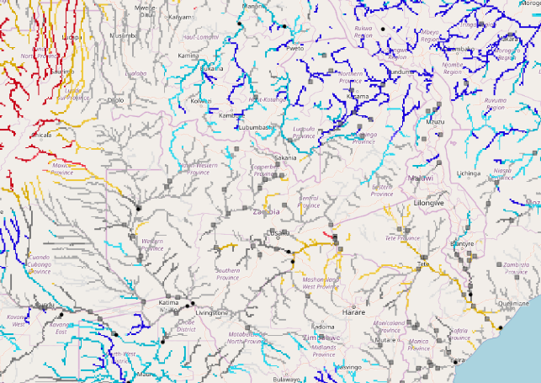
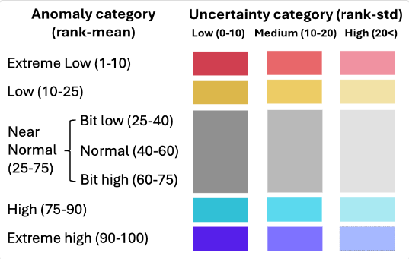
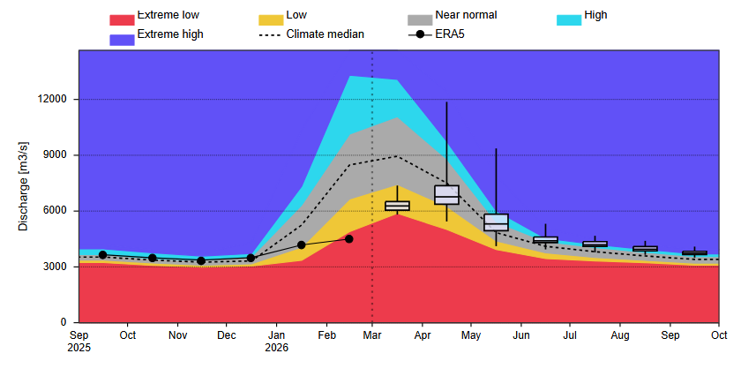
Zambazi Streamflow Forecast
Zambezi River
GloFAS seasonal forecast: Mar – Sep Mar 2026
GloFAS monthly forecast: Mar – Sep 2026
Despite some flooding in the upstream currently, discharges are expected to be near normal during its peak period in April. Less likelihood of flooding in the downstream in Zambia and Mozambique.

