Slide 1
Flooding in Southern Africa
FEWS NET Science Team
June 15, 2026
Notes:
Default title slide

Slide 2
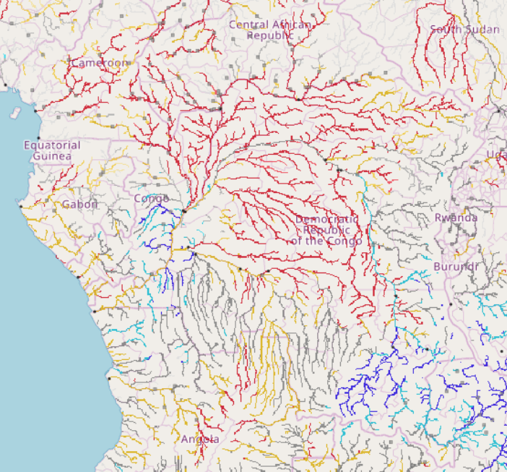
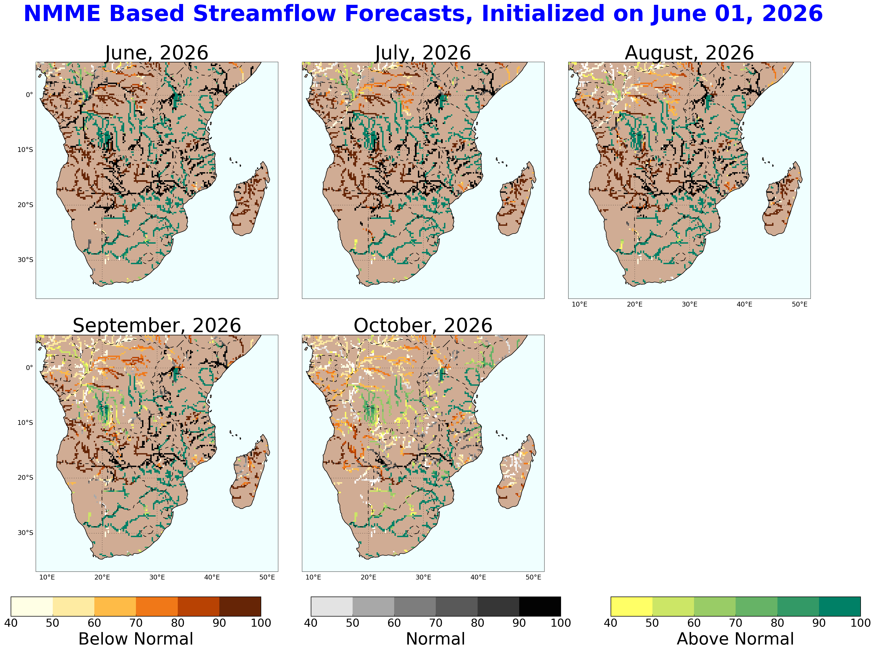
Seasonal Streamflow Forecast
GloFAS seasonal forecast: Jun – Dec 2026
NHyFAS forecast: Jun – Oct 2026
Good convergence between NHyFAS and GloFAS over DRC suggesting above average flow in the eastern and below average flow in the central and northwestern parts of the country.

Slide 3
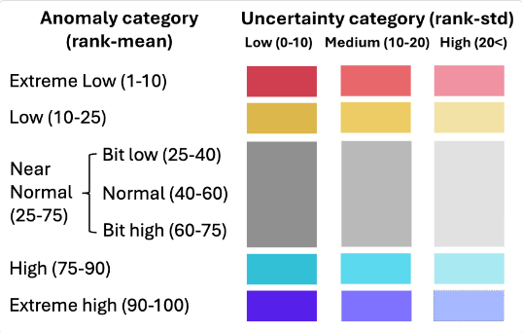
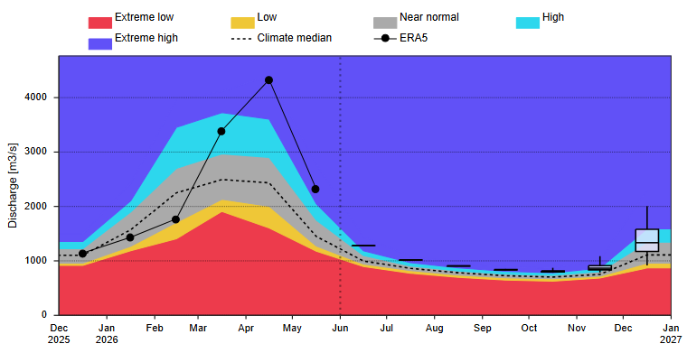
Streamflow Forecast Across DRC
Congo River
A
GloFAS seasonal forecast: Jun – Dec 2026
GloFAS forecast: Jun – Dec 2026
Streamflow is diminishing and entering to seasonally low flow season in the eastern and central parts of the country.
Assumption 1b: Concerns about flash flooding remain, given the erratic rainfall patterns observed in recent years. However, riverine flooding less likely. Streamflow levels across DRC are forecast to be above average from June to September in the eastern and central parts of the country, but they will be below average in the central and north-west parts of the country.

