Slide 1
Floodin in Southern Africa
FEWS NET Science Team
February 17, 2026
Notes:
Default title slide

Slide 2

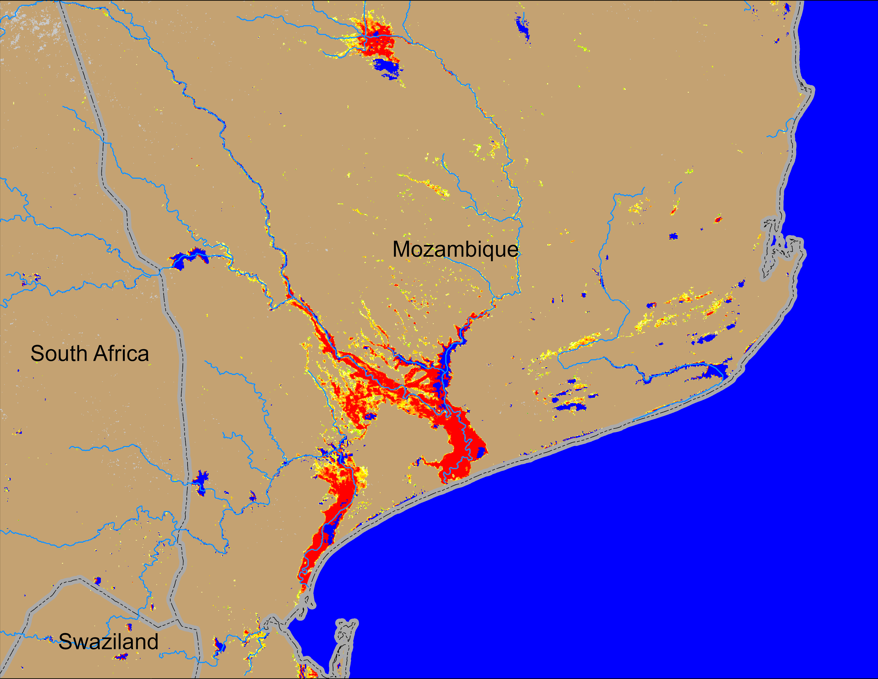
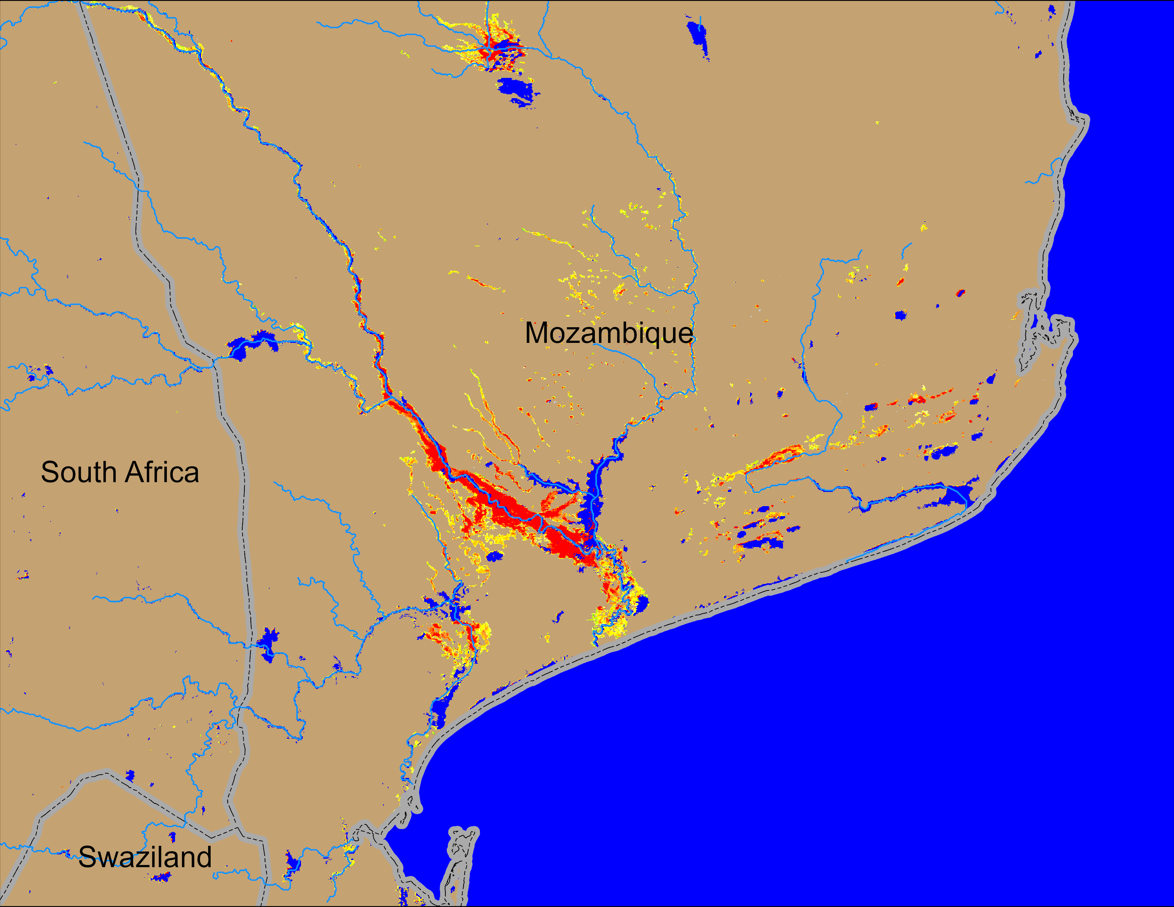
Flooding Conditions in Mozambique
NOAA VIIRS 5-day comp.: 21 – 25 Jan 2026
NOAA VIIRS 5-day comp.: 21 – 25 Jan 2013
Some of the past worst floods in Southern Mozambique occurred in 2000, 2008, and in 2013.
January 2026 flooding was much worse than flooding in January 2013.

Slide 3
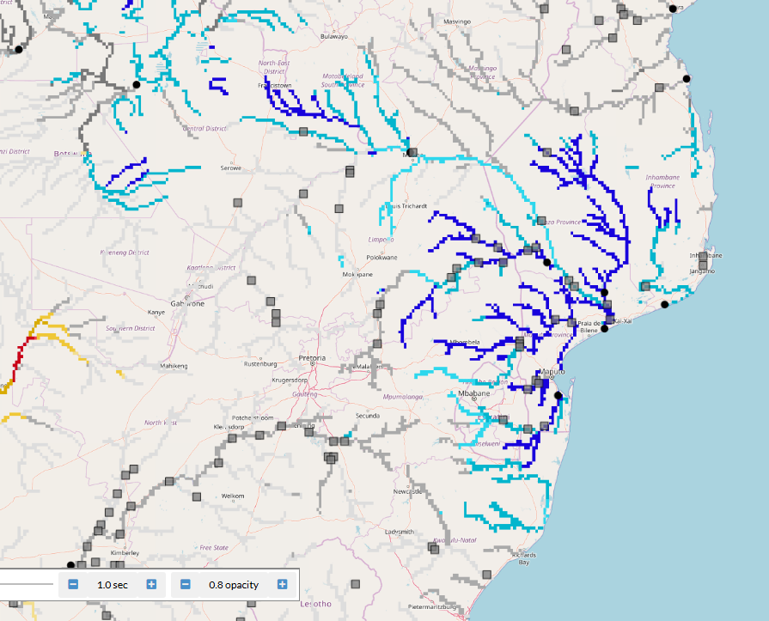
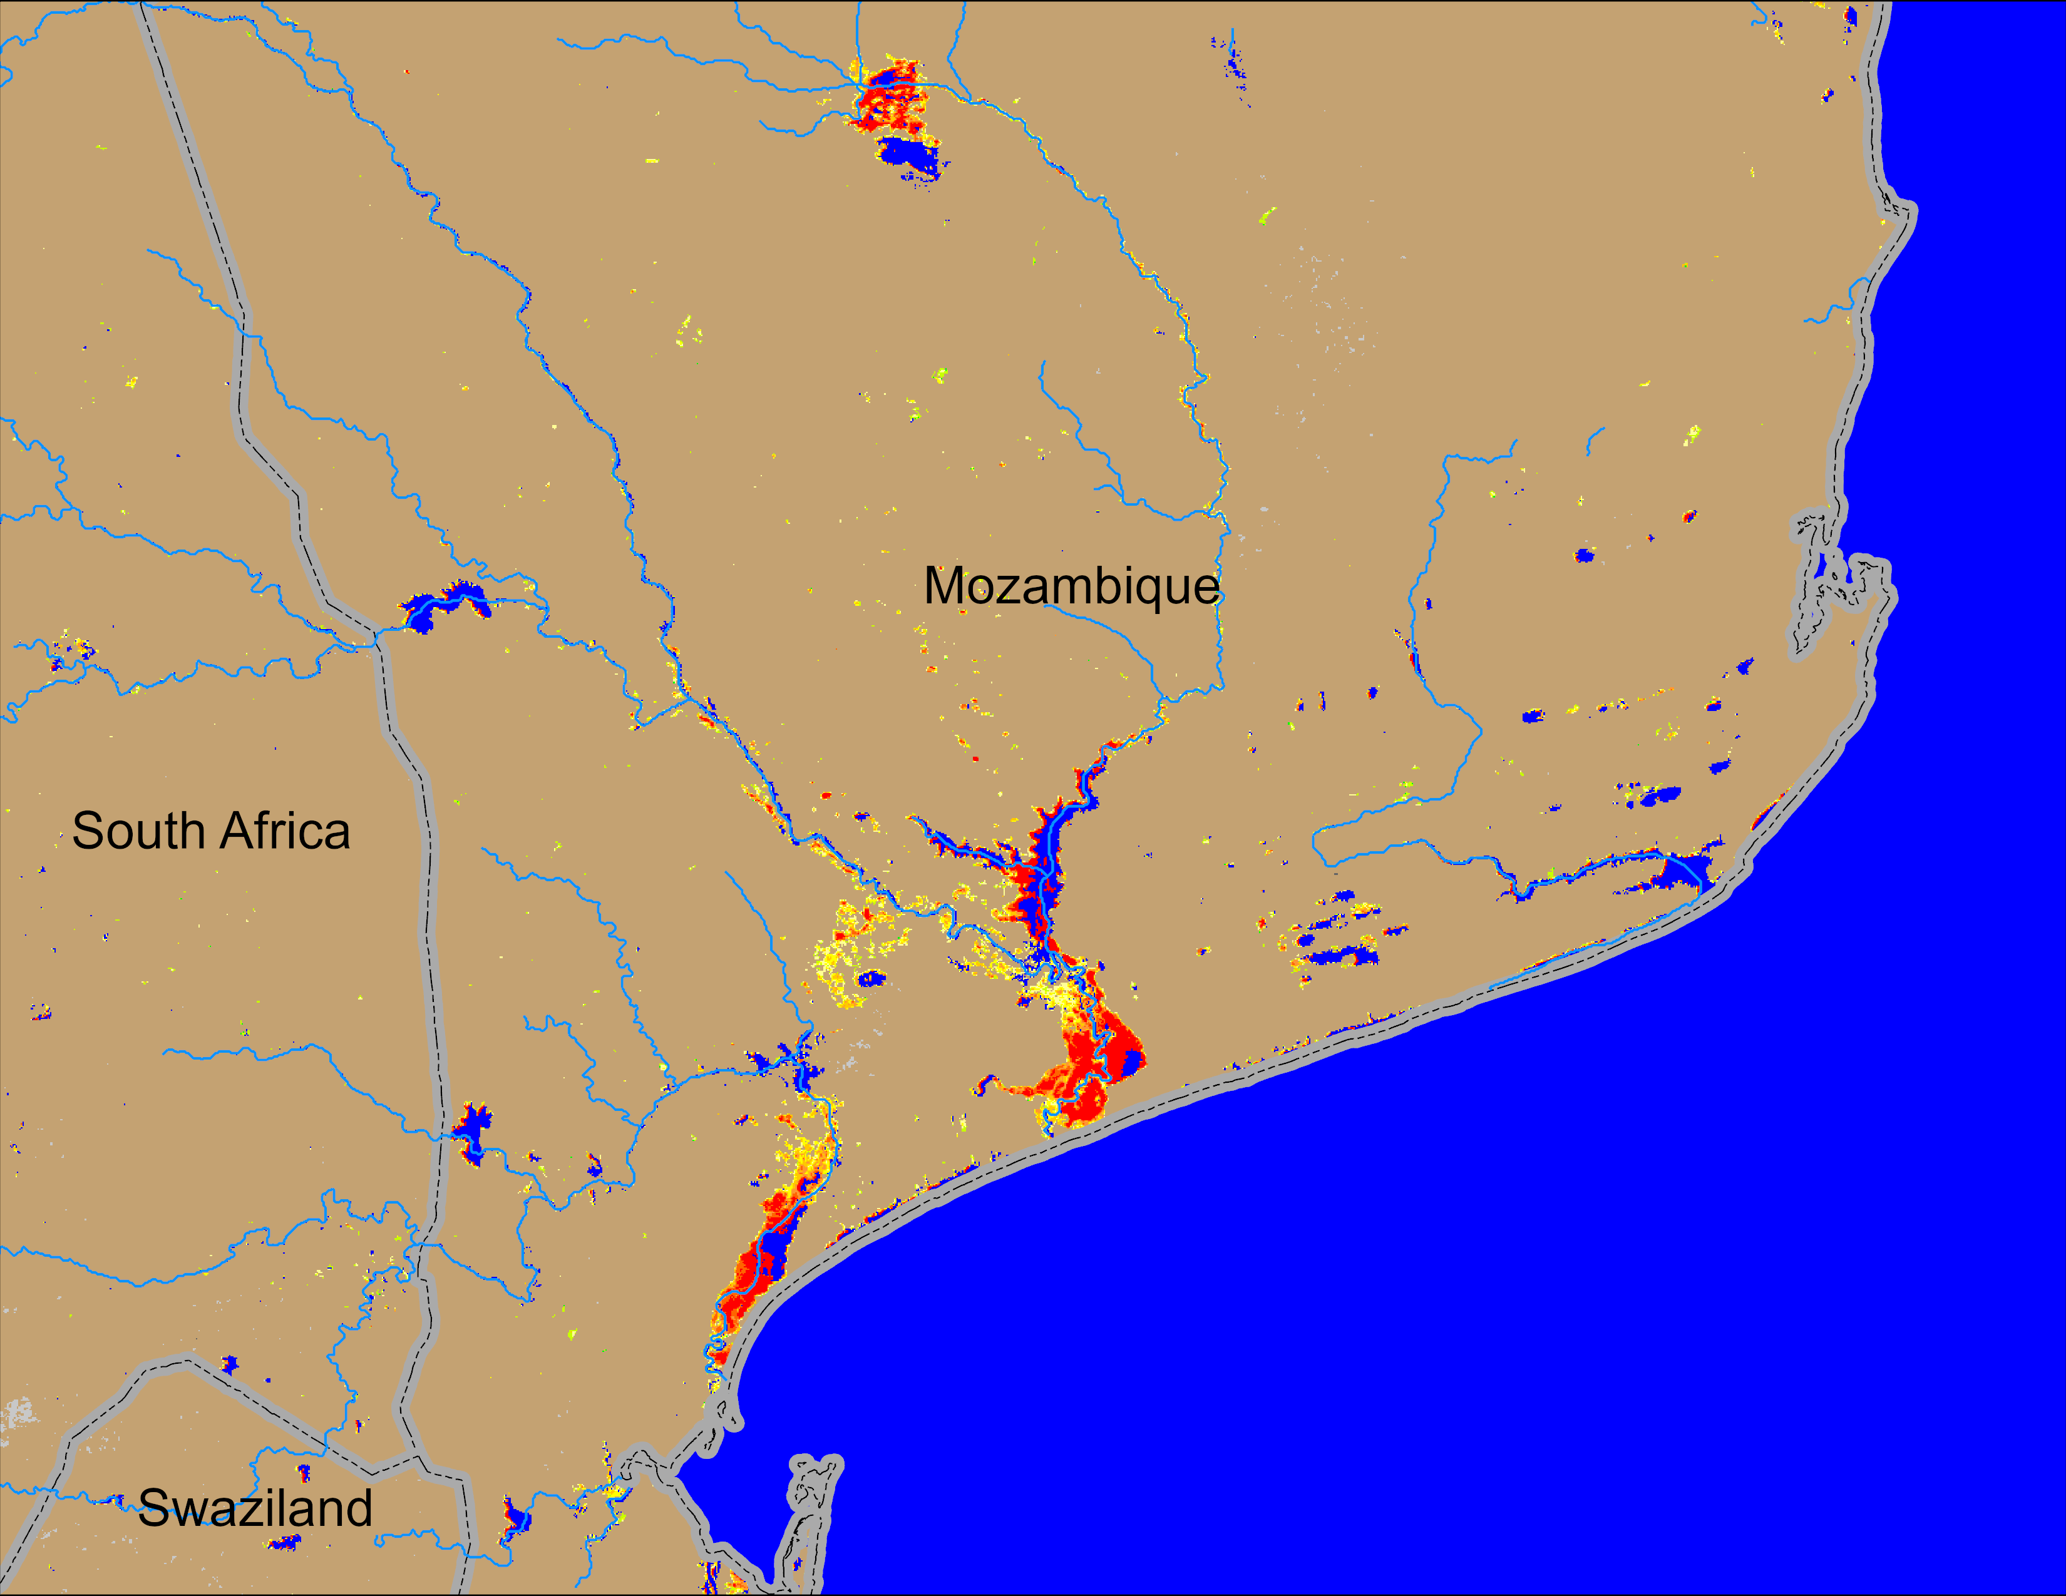
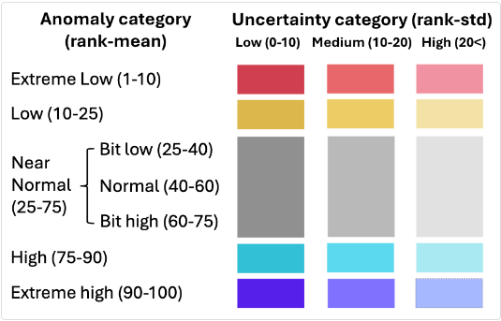
Flooding Conditions in Mozambique
NOAA VIIRS 5-day comp.: 12 – 16 Feb 2026
GloFAS Seasonal Forecast : Feb – Jul 2026
Flooding conditions improving gradually in the downstream of Limpopo River, but river discharges expected to be at high level till July of 2026.

Slide 4
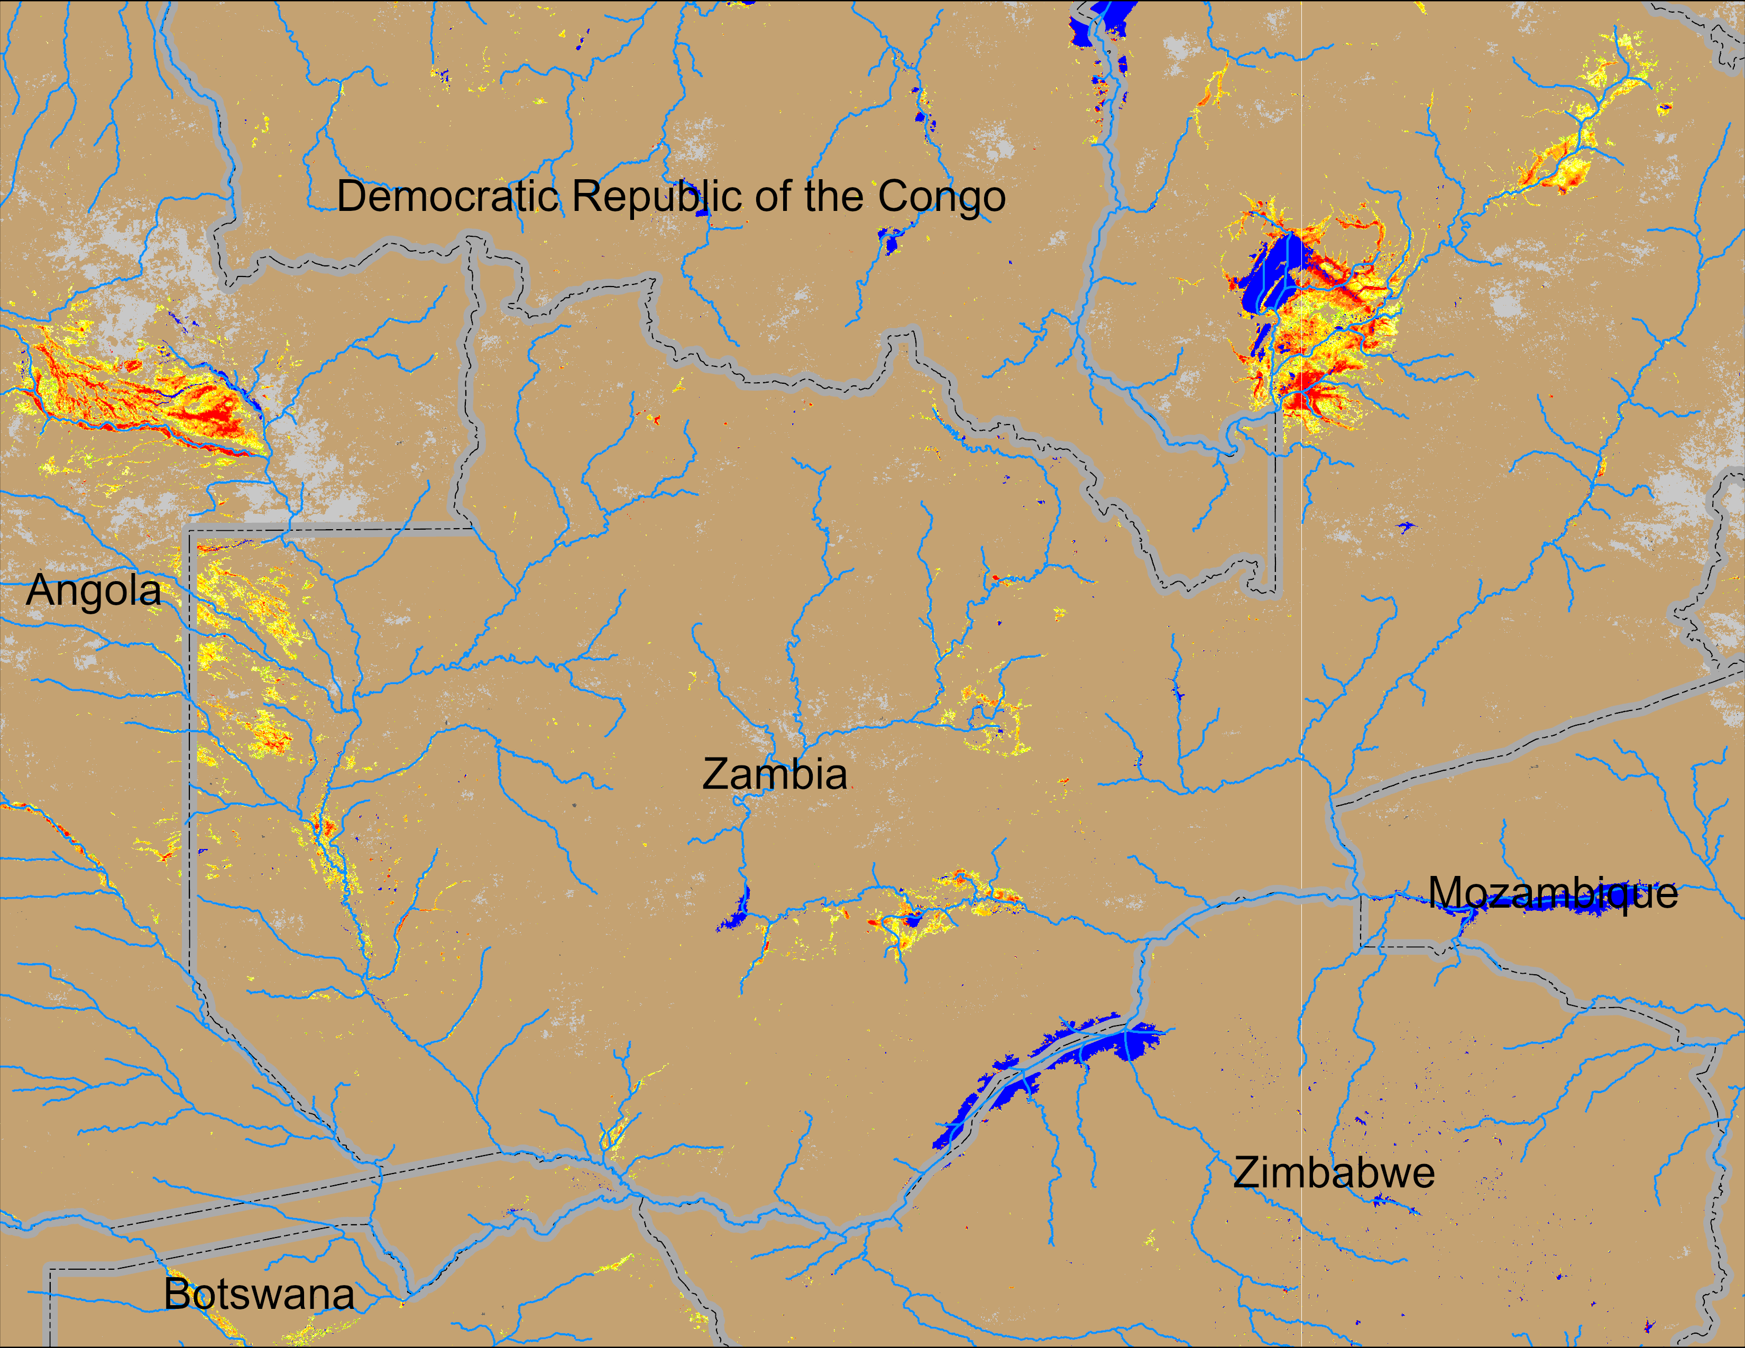
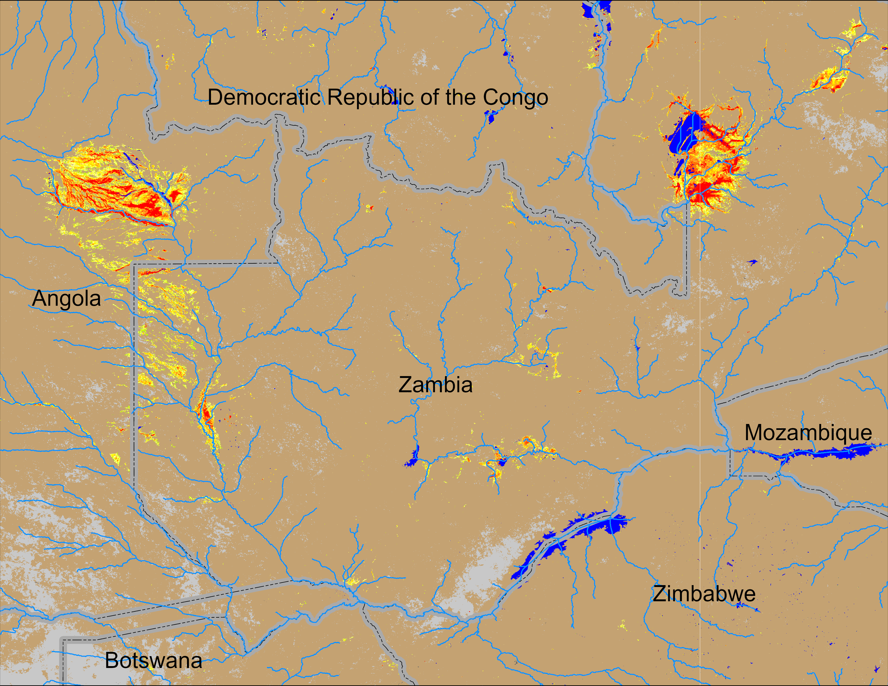
Flooding Conditions in Zambia
NOAA VIIRS 5-day comp.: 04 – 08 Feb 2026
NOAA VIIRS 5-day comp.: 12 – 16 Feb 2026
Flooding conditions deteriorating in western Zambia but remained unchanged in the central Zambia.

Slide 5
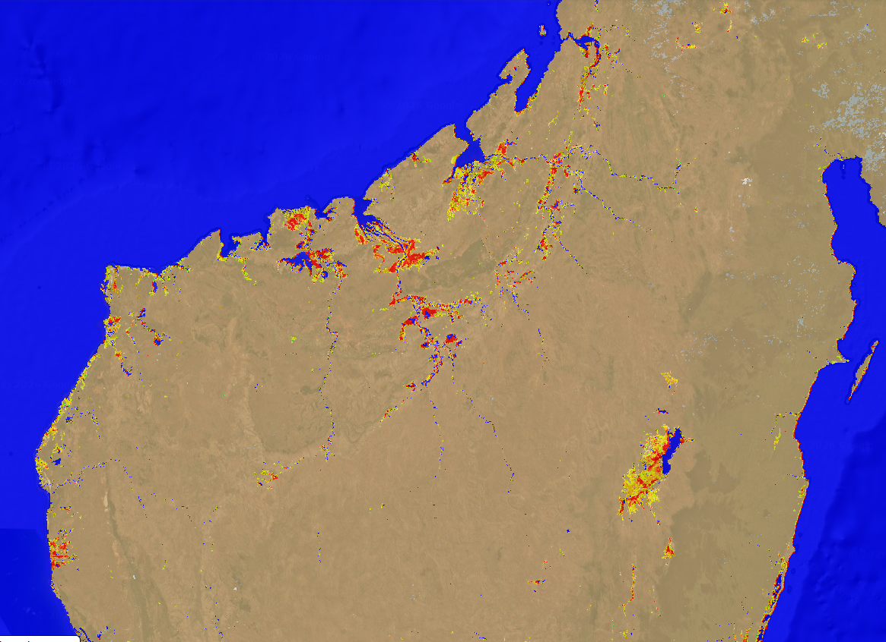
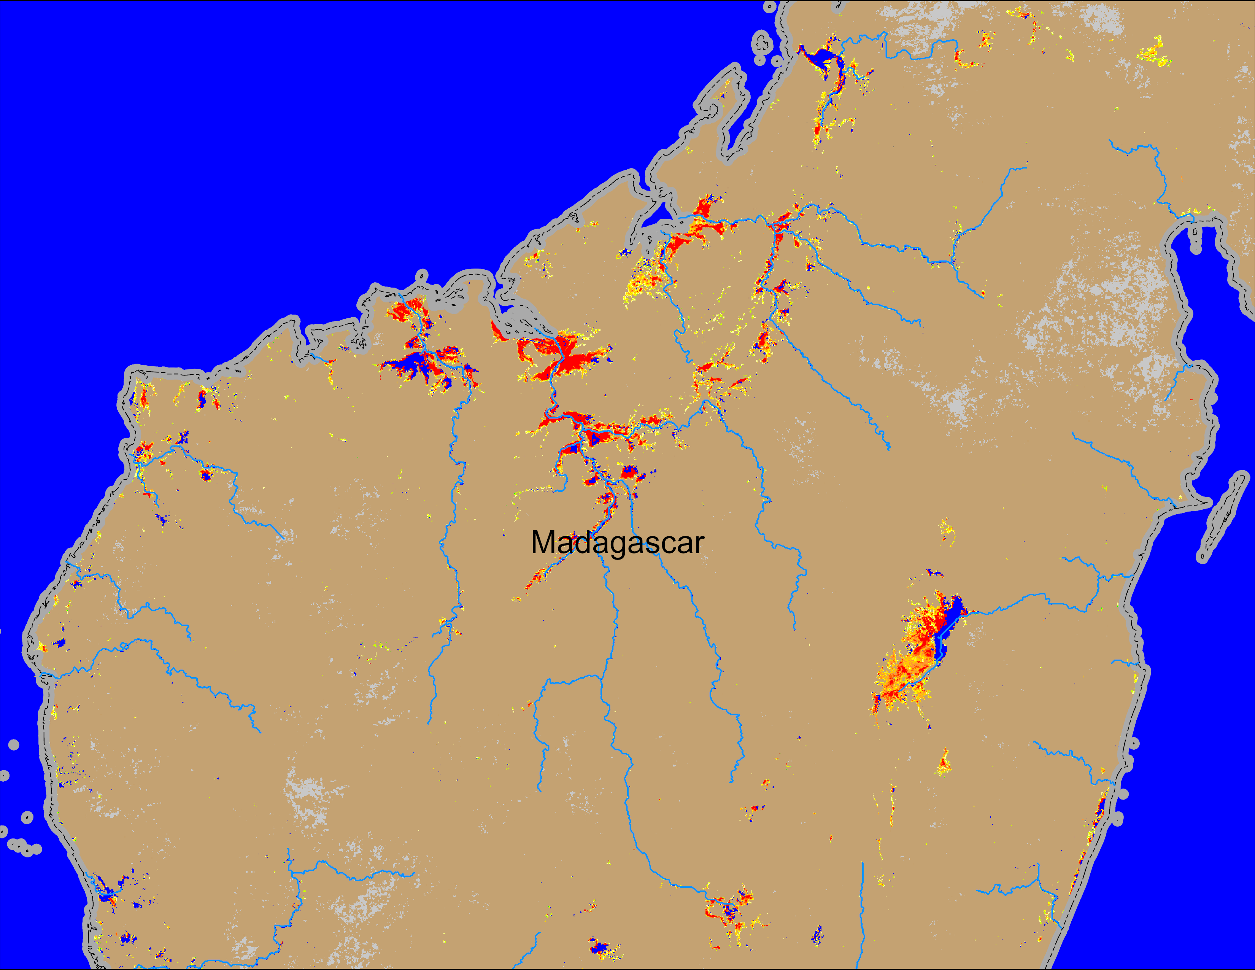
Flooding Conditions in Madagascar
NOAA VIIRS 5-day comp.: 04 – 08 Feb 2026
NOAA VIIRS 5-day comp.: 12 – 16 Feb 2026
Significant increase in flooding due to TC GEZANI in northern Madagascar.

