Slide 1
Flood Monitoirng and Forecast Assumptions—Levant
FEWS NET Science Team
Apr 13, 2026
Notes:
Default title slide

Slide 2
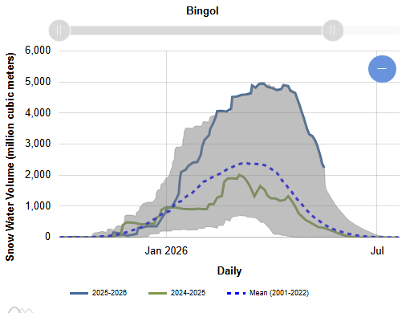
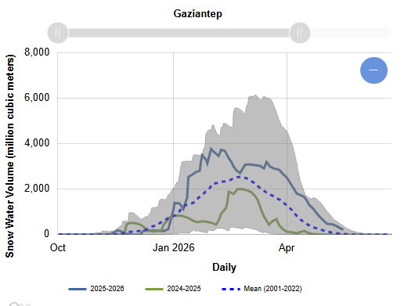
Snow Water Equvalent in the Euphrates Headwater
Seasonal snowpack melting sharply in the upstream areas of Euphrates and expected to last a week or two later than average.

Slide 3
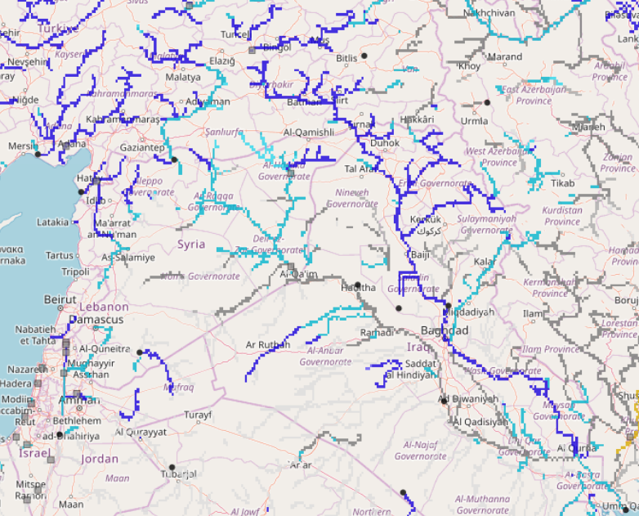
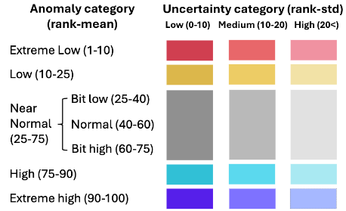
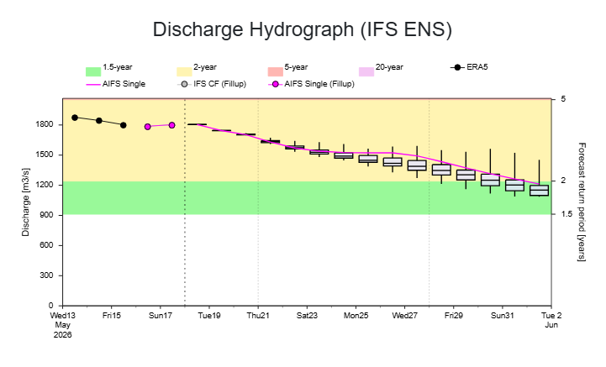
Sub-seasonal Streamflow Forecast
A
Euphrates
Tigris
On the Tigris River at point A
GloFAS Sub-seasonal forecast: 18 May – 29 Jun 2026
AIFS 15-day forecast: 18 May – 02 Jun 2026
Although currently at 2-yr return period level, river discharges are expected to decline seasonally toward low-flow period in eastern Syria.
Likelihood of flooding in the eastern Syria is diminishing.

