Slide 1
Flood Monitoirng and Forecast Assumptions—Levant
FEWS NET Science Team
June 15, 2026
Notes:
Default title slide

Slide 2
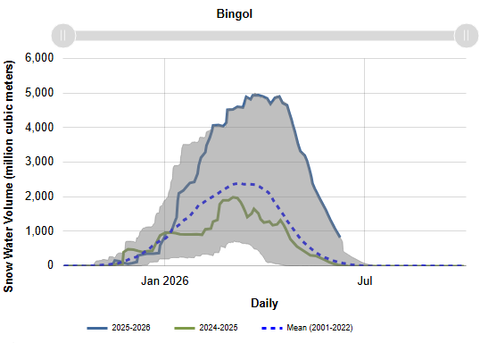
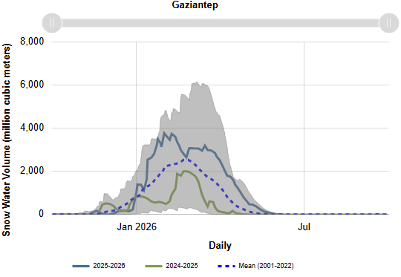
Snow Water Equvalent in the Euphrates Headwater
Snow melt concluded in most of the basin area which was delayed by a week or two.

Slide 3
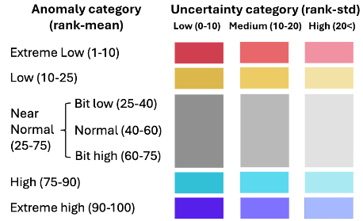
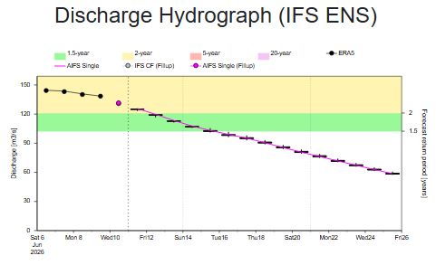
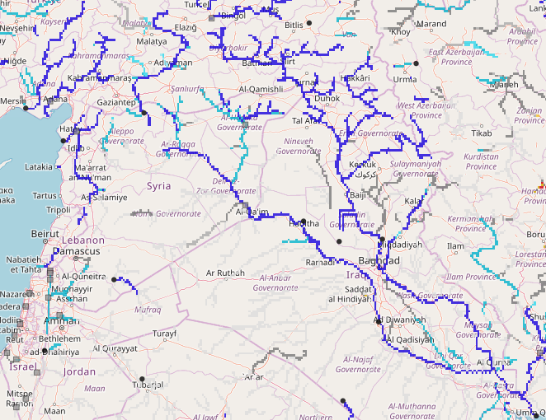
Syria: Sub-seasonal Streamflow Forecast
A
Euphrates
Tigris
GloFAS Sub-seasonal forecast: 15 Jun – 27 July 2026
AIFS 15-day forecast: 11 - 26 Jun 2026 at point A on the Tigris River
River discharges are diminishing sharply towards seasonally low-flow period in the region.
Likelihood of flooding across the region is diminishing.

Slide 4
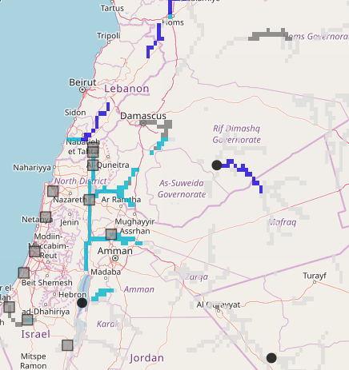
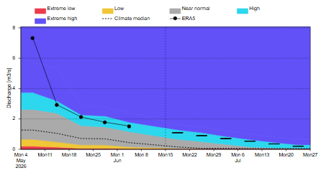
Lebanon: Sub-seasonal Streamflow Forecast
A
GloFAS Sub-seasonal forecast: 15 Jun – 27 July 2026
GloFAS forecast: 15 Jun - 27 Jul 2026 at point A
River discharges are diminishing sharply towards seasonally low-flow period.
Likelihood of flooding across the region is diminishing.

Slide 5
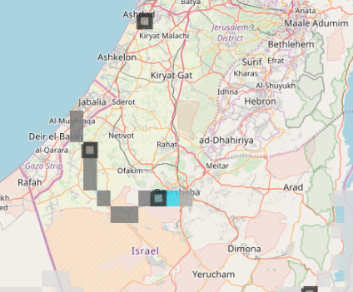
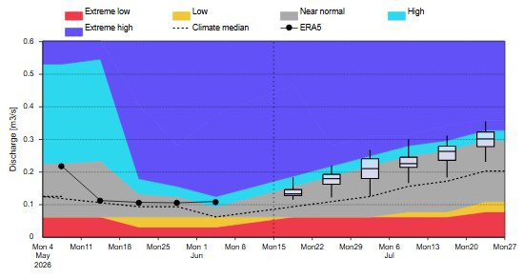
Gaza: Sub-seasonal Streamflow Forecast
A
GloFAS Sub-seasonal forecast: 15 Jun – 27 July 2026
GloFAS forecast: 15 Jun - 27 Jul 2026 at point A
Above average discharges are expected.
There is moderate likelihood of flooding especially in Al-Mufhraqa and Nuseirat areas which may get exacerbated by after war infrastructure damages.

