Slide 1
Flood Monitoirng and Forecast Assumptions—Levant
FEWS NET Science Team
Apr 13, 2026
Notes:
Default title slide

Slide 2
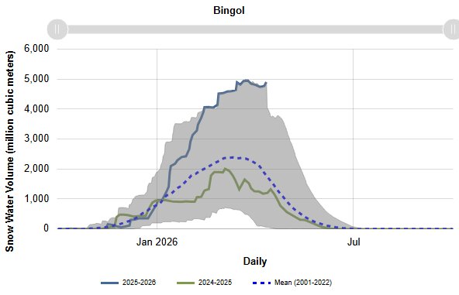
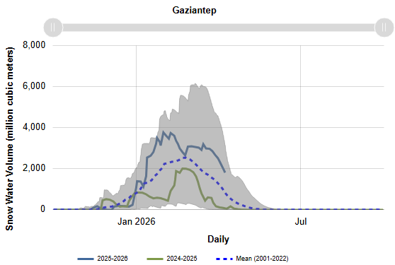
Snow Water Equvalent in the Euphrates Headwater
Record high seasonal snowpack in some parts of upstream areas of Euphrates, for others melting process began in early April.

Slide 3
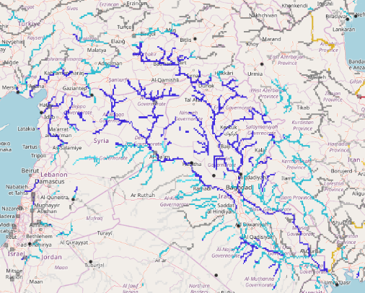
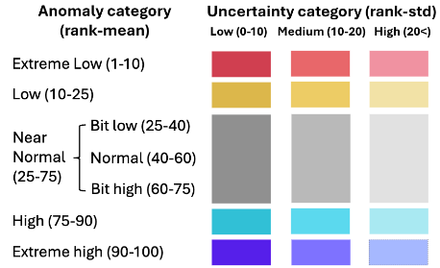
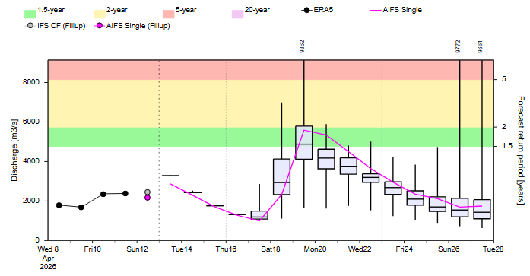
Sub-seasonal Streamflow Forecast
On the Euphrates River at point A
Tigris
Euphrates
A
GloFAS Sub-seasonal forecast: 08 – 28 Apr 2026
Sub-seasonal forecast: 08 – 28 Apr 2026
Although river discharges could reach 1.5-year return period In easter Syria.
Likelihood of flooding in the eastern Syria is diminishing.

Slide 4
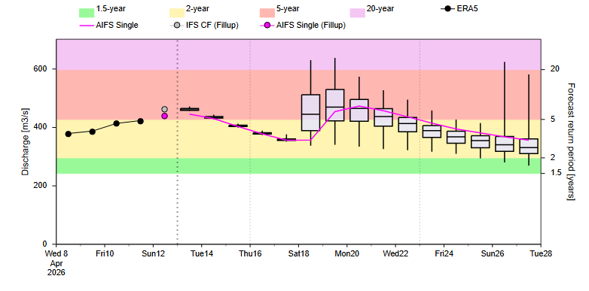
Sub-seasonal Streamflow Forecast
On the Tigris River at point B
B
Tigris
Euphrates
GloFAS Sub-seasonal forecast: 08 – 28 Apr 2026
Sub-seasonal forecast: 08 – 28 Apr 2026
River discharges are at 2 to 5-year return period along the upstream of Tigris in far eastern Syria.
High likelihood of flooding in the far eastern Syria although diminishing.

