Slide 1
Flood Monitoirng and Forecast Assumptions—West Africa
FEWS NET Science Team
Apr 13, 2026
Notes:
Default title slide

Slide 2
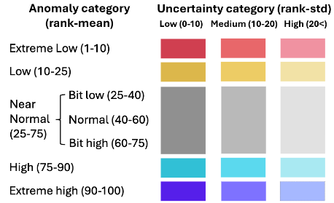
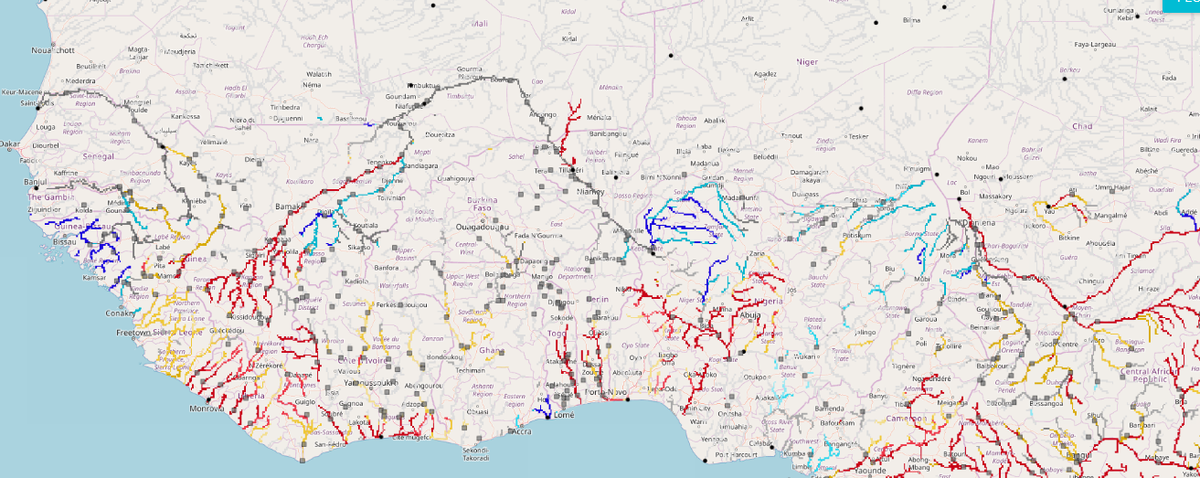
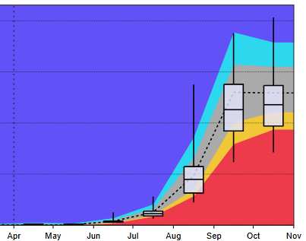
Seasonal Forecast
@point A on Niger River in Nigeria
Senegal
Niger
On the Niger River at point A
Sokoto
Komadugu
A
Niger
Logone
Benue
GloFAS Seasonal forecast: Apr – Oct 2026
Seasonal forecast: Apr – Oct 2026
Discharges are expected to be above average in Sokoto, Komadugu Rivers in Nigeria, and in the Rivers along the western coastal countries.
There is likelihood of flooding along the western coastal countries, in Nigeria during July-September period.

Slide 3
Assumption
Based on the above-average rainfall forecast, there is a high likelihood of flooding in Niger, Nigeria, and Chad in July-September 2026. However, there is uncertainty due to the long-range nature of the forecast.
Change:
Based on the above-average rainfall forecast, there is a high likelihood of flooding in Niger, Nigeria, and Chad in July-September 2026. However, there is uncertainty due to the long-range nature of the forecast.

