Slide 1
FEWS NET Enhanced Flood Monitoring and Forecast Assumptions—West Africa
FEWS NET Science Team
19 May, 2025

Slide 2
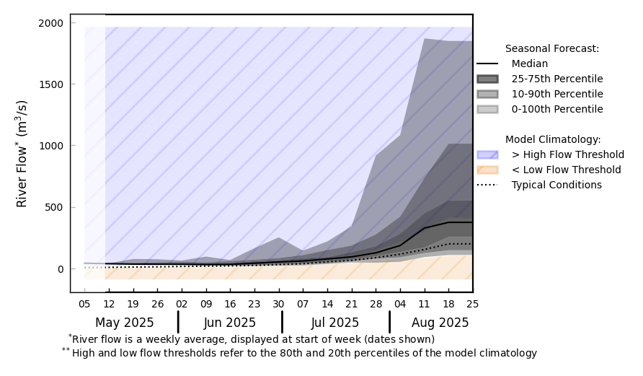
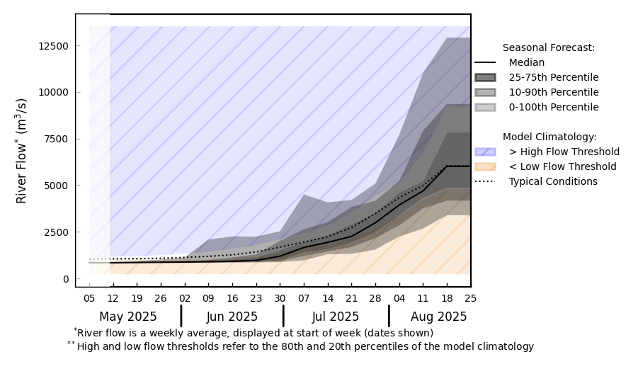
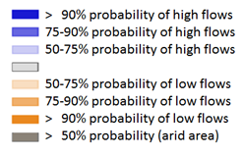
Streamflow Forecast in West Africa
@ point A: Sokoto
B
Sokoto
Komadugu
Niger
A
@ point B: Niger
GloFAS streamflow forecast: May – Aug 2025
Above average streamflow is expected in Sokoto River
However, Niger and Komadugu Rivers are expected to be at average conditions.
GloFAS monthly forecast: May – Aug 2025

Slide 3
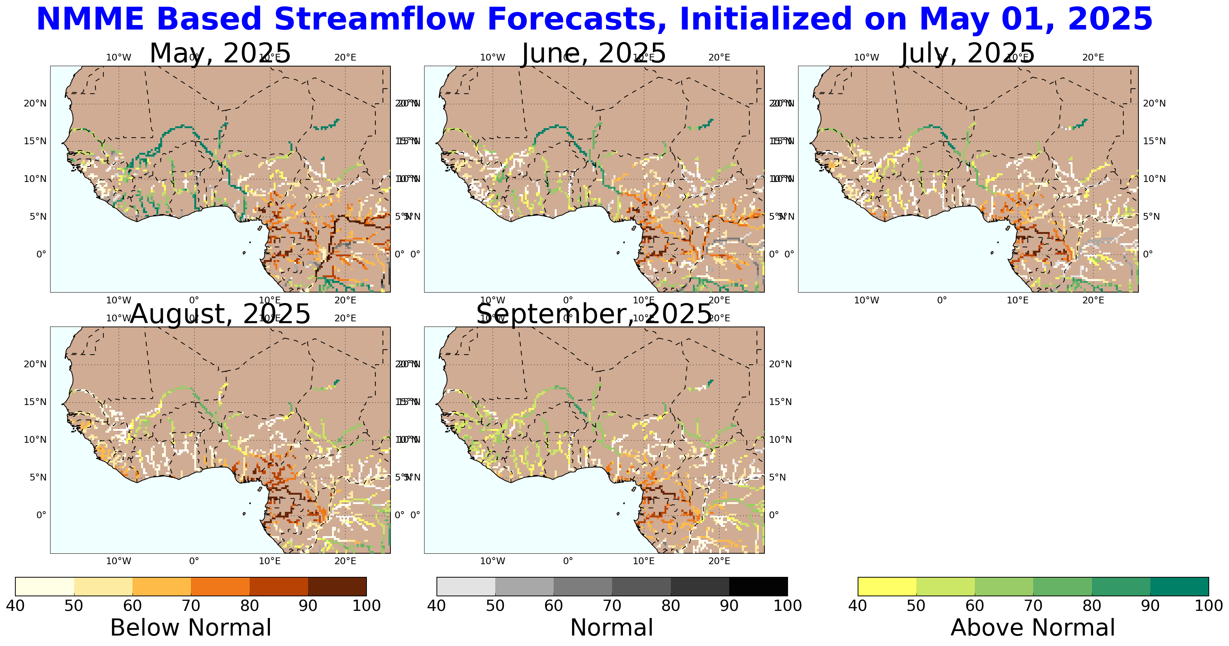
Streamflow Forecast in West Africa
NHyFAS streamflow forecast: May – Sep 2025
NHyFAS forecast suggest portion of the Niger River with above average forecast early in the season but diminishes to average during the peak season.

