Slide 1
FEWS NET Enhanced Flood Monitoring and Forecast Assumptions—Southern Africa
FEWS NET Science Team
Feb 19, 2025

Slide 2
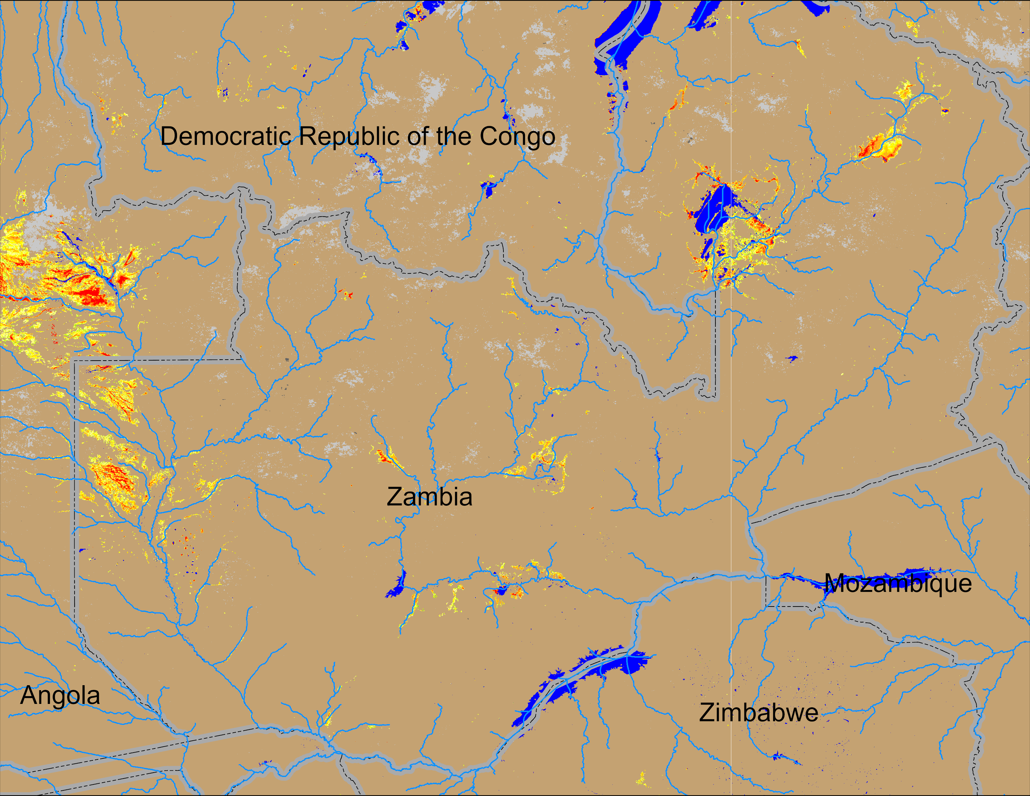
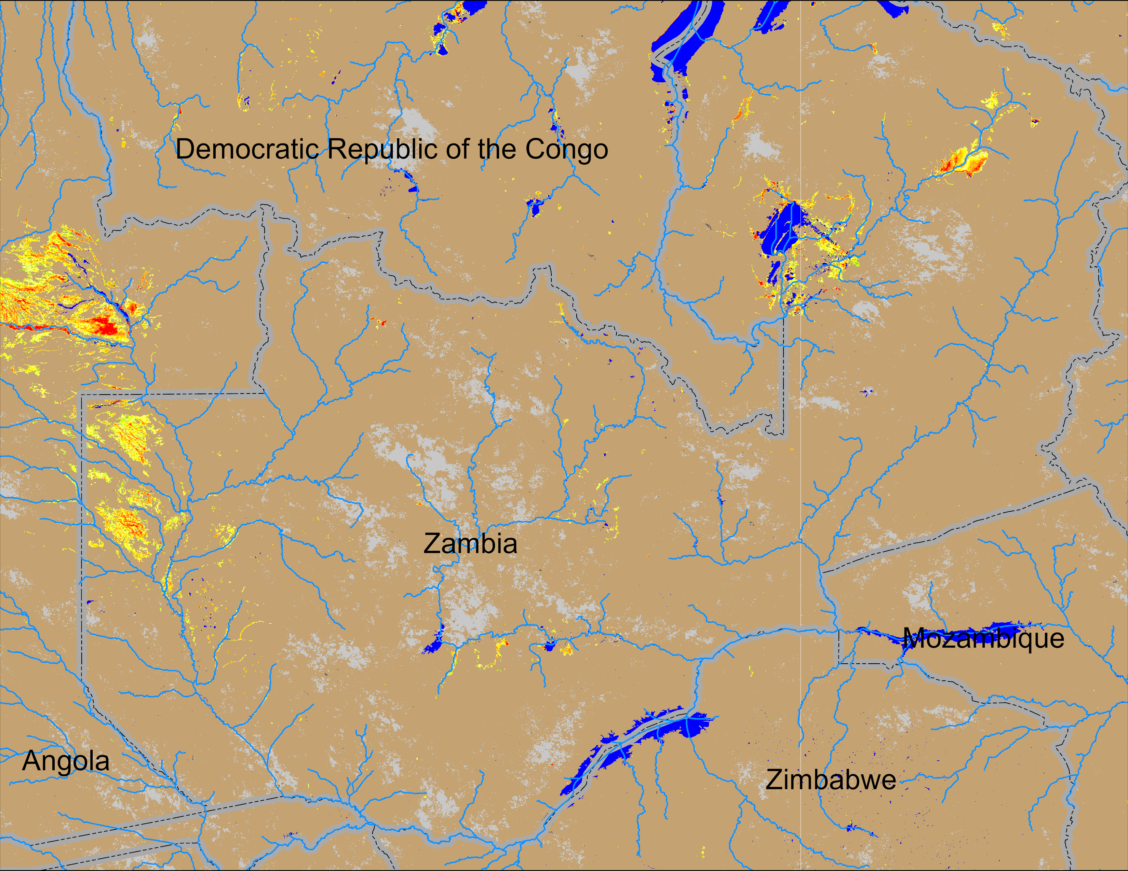
Flooding Conditions in Zambia
(% of the pixel)
(% of the pixel)
NOAA VIIRS 5-day comp.: 05 – 09 Feb 2025
NOAA VIIRS 5-day comp.: 11 – 15 Feb 2025
Flooding is gradually intensifying in eastern Angola and western Zambia.

Slide 3
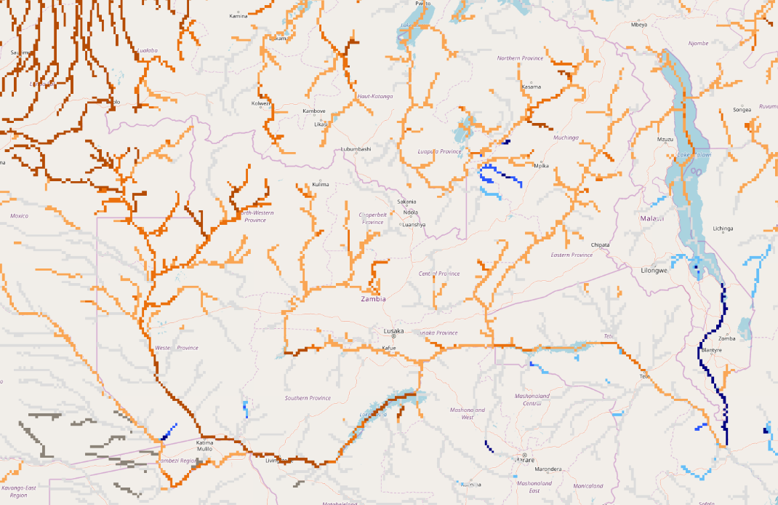
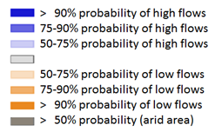
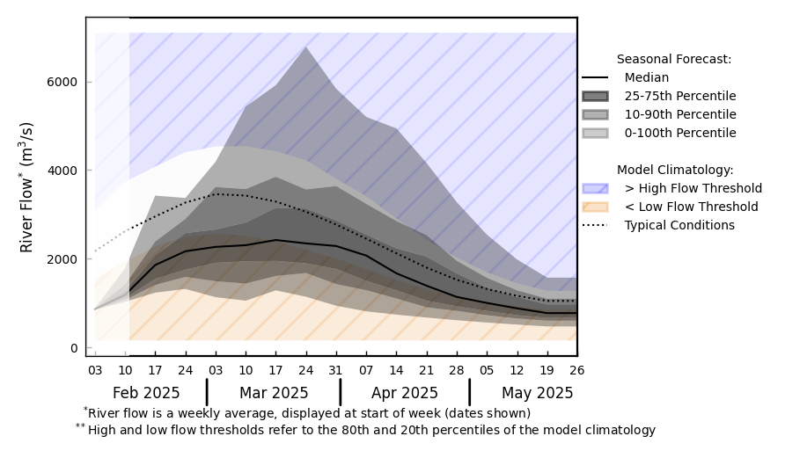
GloFAS Seasonal Forecast
@ point A: on Zambezi River, upstream of Lake Kariba
A
GloFAS seasonal forecast (Feb - May 2025)
GloFAS monthly forecast (Feb – May 2025)
Although river discharges are on the rise, below average is the forecast during the peak period in March.

Slide 4
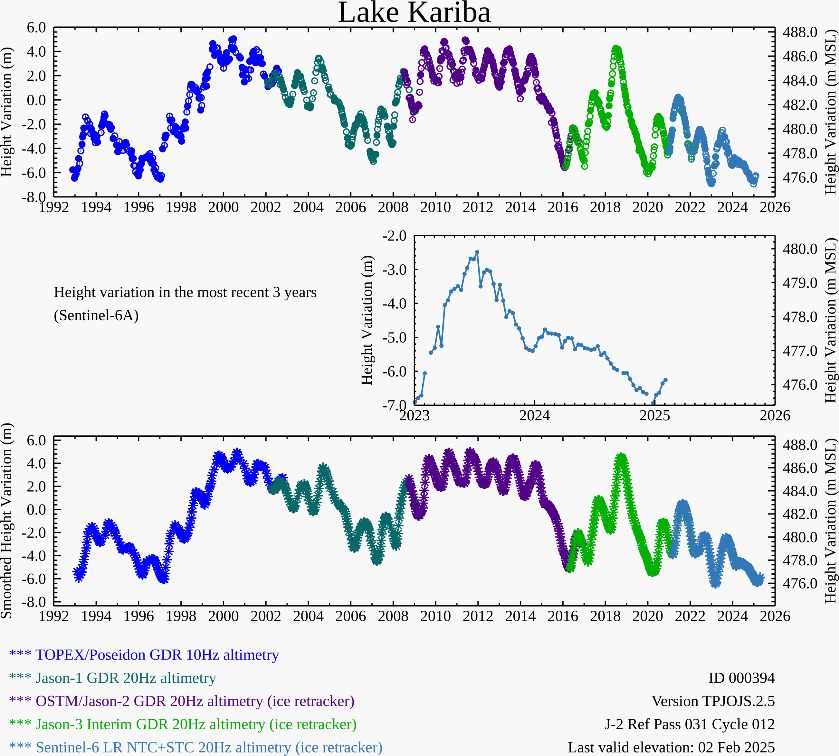
Lake Kariba Water Level
Water level is increasing in Lake Kariba, but long way to recover.

Slide 5
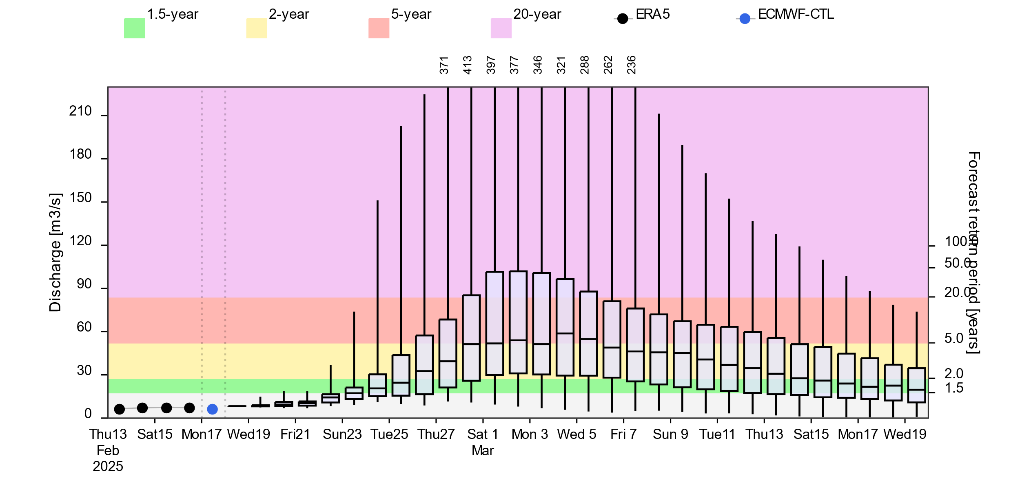
Flooding in Madagascar
@ point A: on a River in western Madagascar
A
2- (yellow), 5- (red) and 20-year (purple) exceedance probabilities
ADAM 10-day forecast (17-27 Feb 2025)
GloFAS 30-day forecast (19 Feb – 19 Mar 2025)
Moderate likelihood of increased discharges in the rivers across central Madagascar in the coming few weeks. Flooding possible especially along the coastal regions of west-central Madagascar.

Slide 6
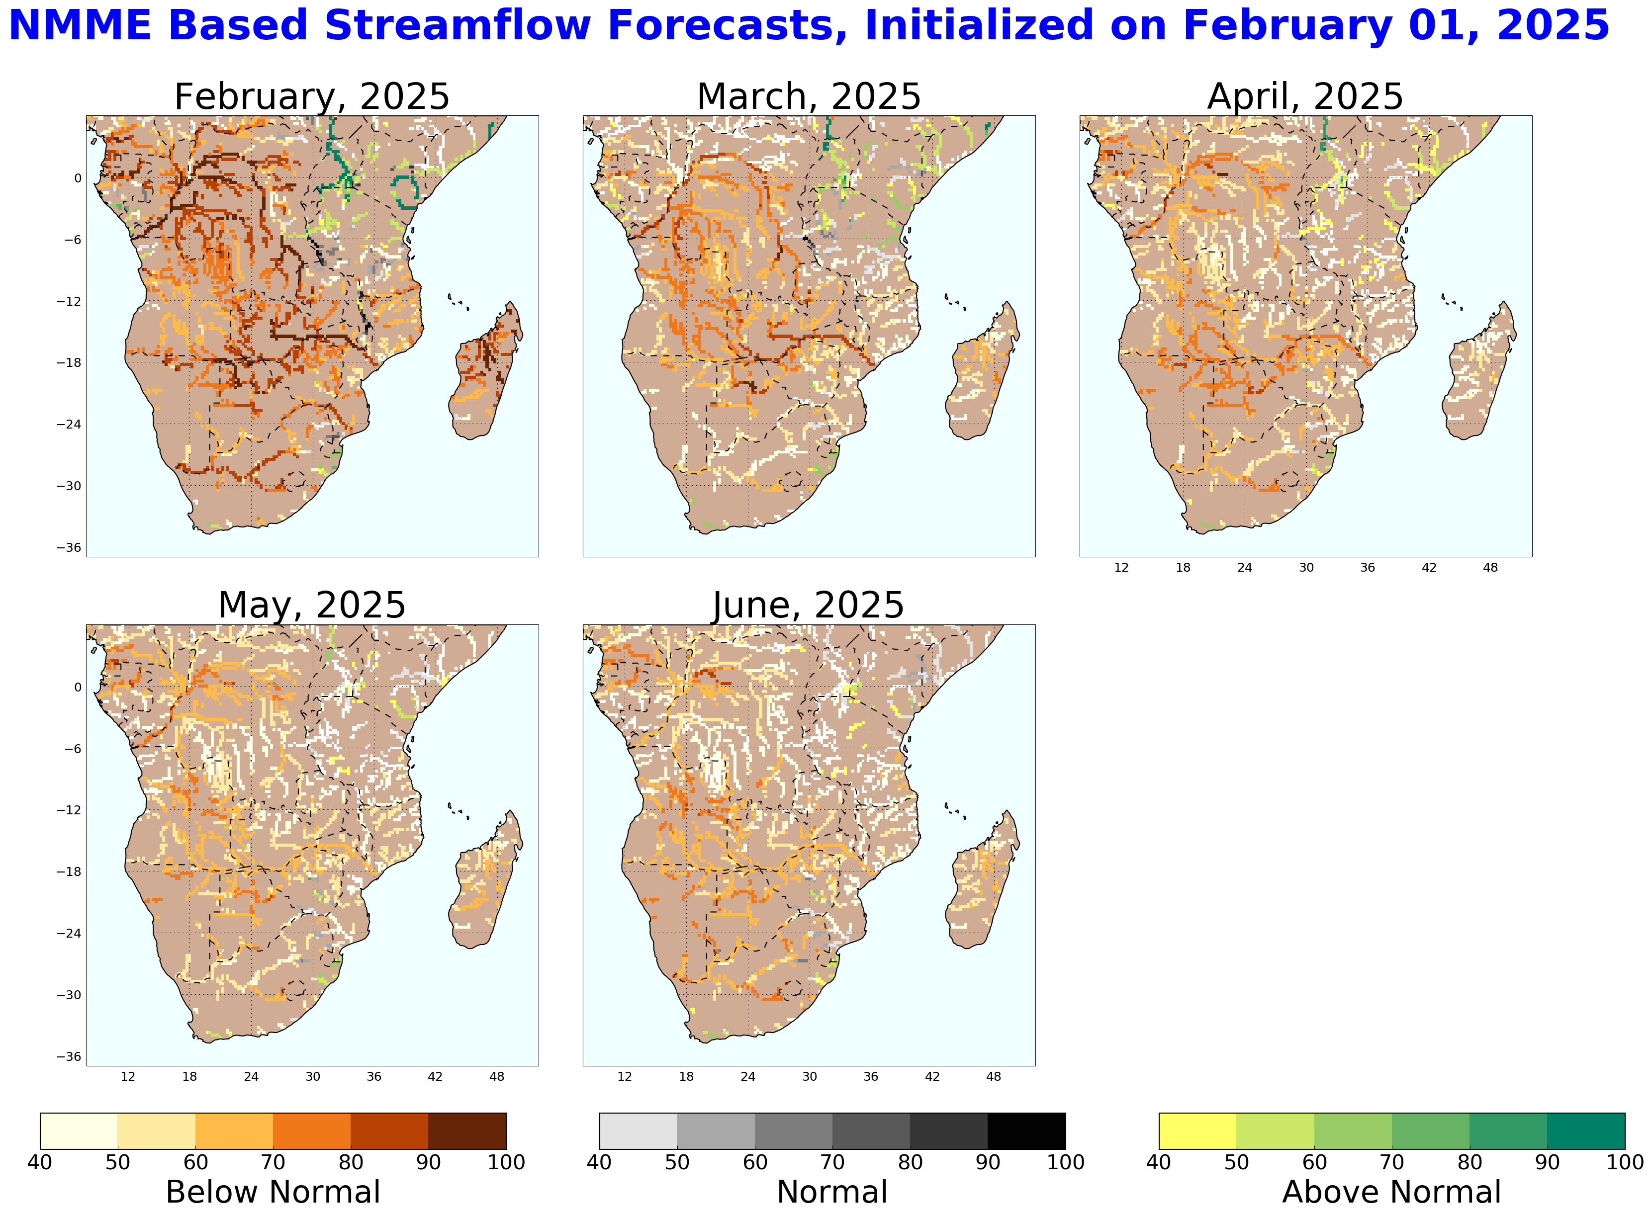
NHyFAS Forecast
In agreement with GloFAS, NHyFAS shows below average forecast in the Zambezi River and average forecast in the central Madagascar and Zambezi catchment in Zimbabwe.

Slide 7
Thank you
spervez@usgs.gov

