Slide 1
South Sudan Flood Monitoring and Prediction - 2025 Season
FEWS NET Science Team
May 19, 2024

Slide 2
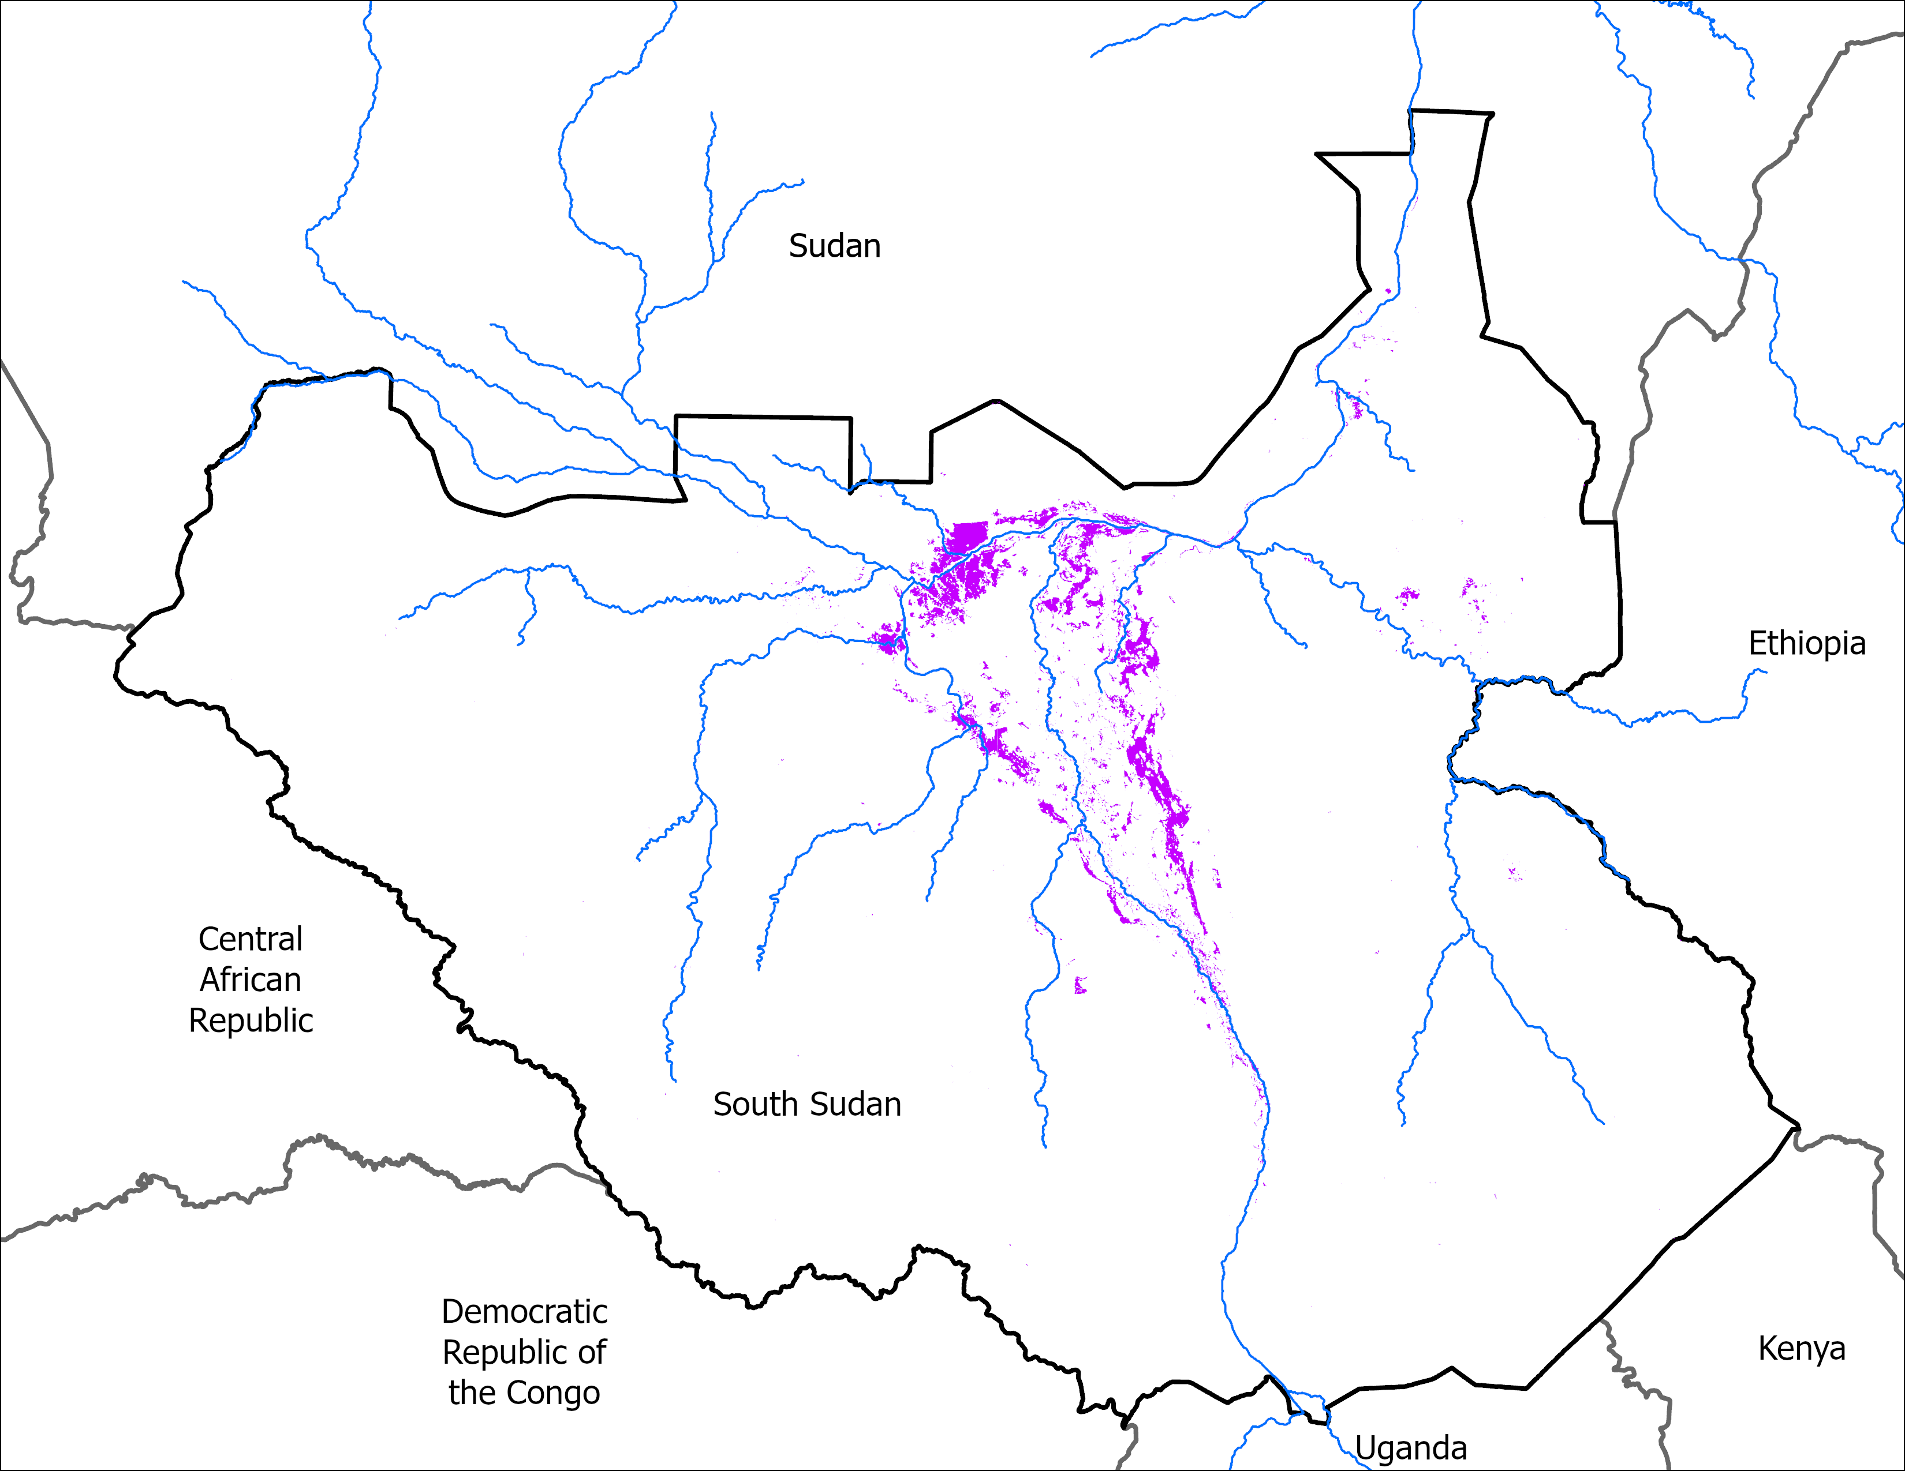
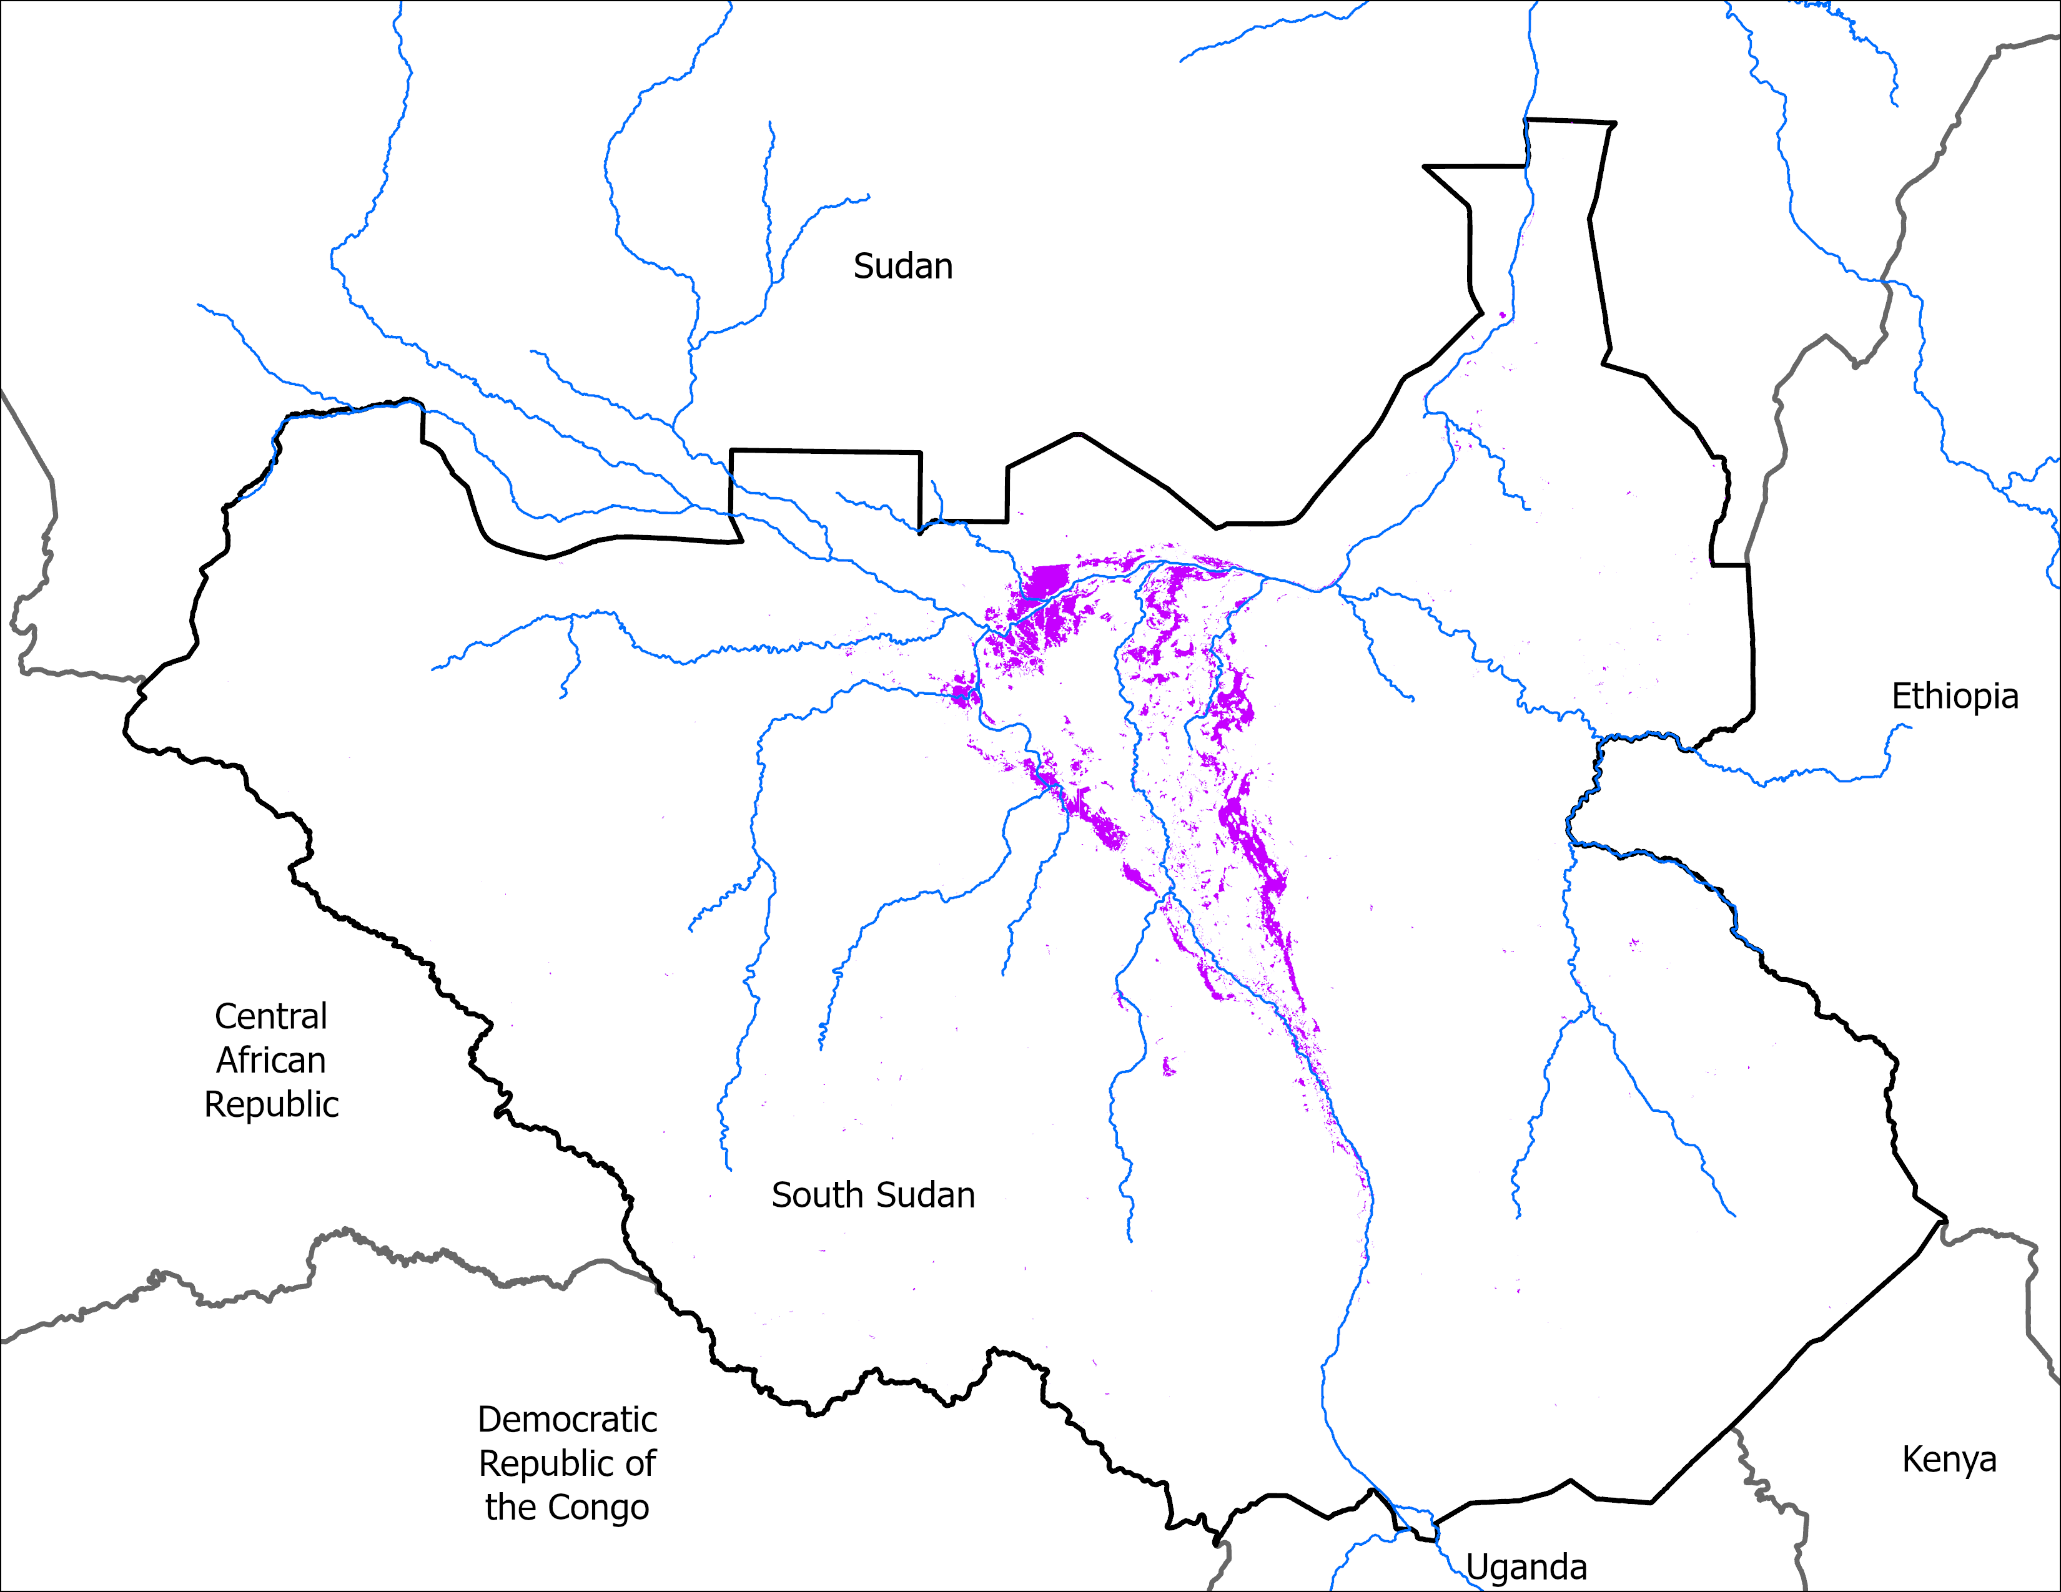
Flooding Progression
08 May 2025
15 May 2025
VIIRS 04-08 May: 9,859 km²
VIIRS 11-15 May comp: 10,524 km²
Marginal increase in Inundation.

Slide 3
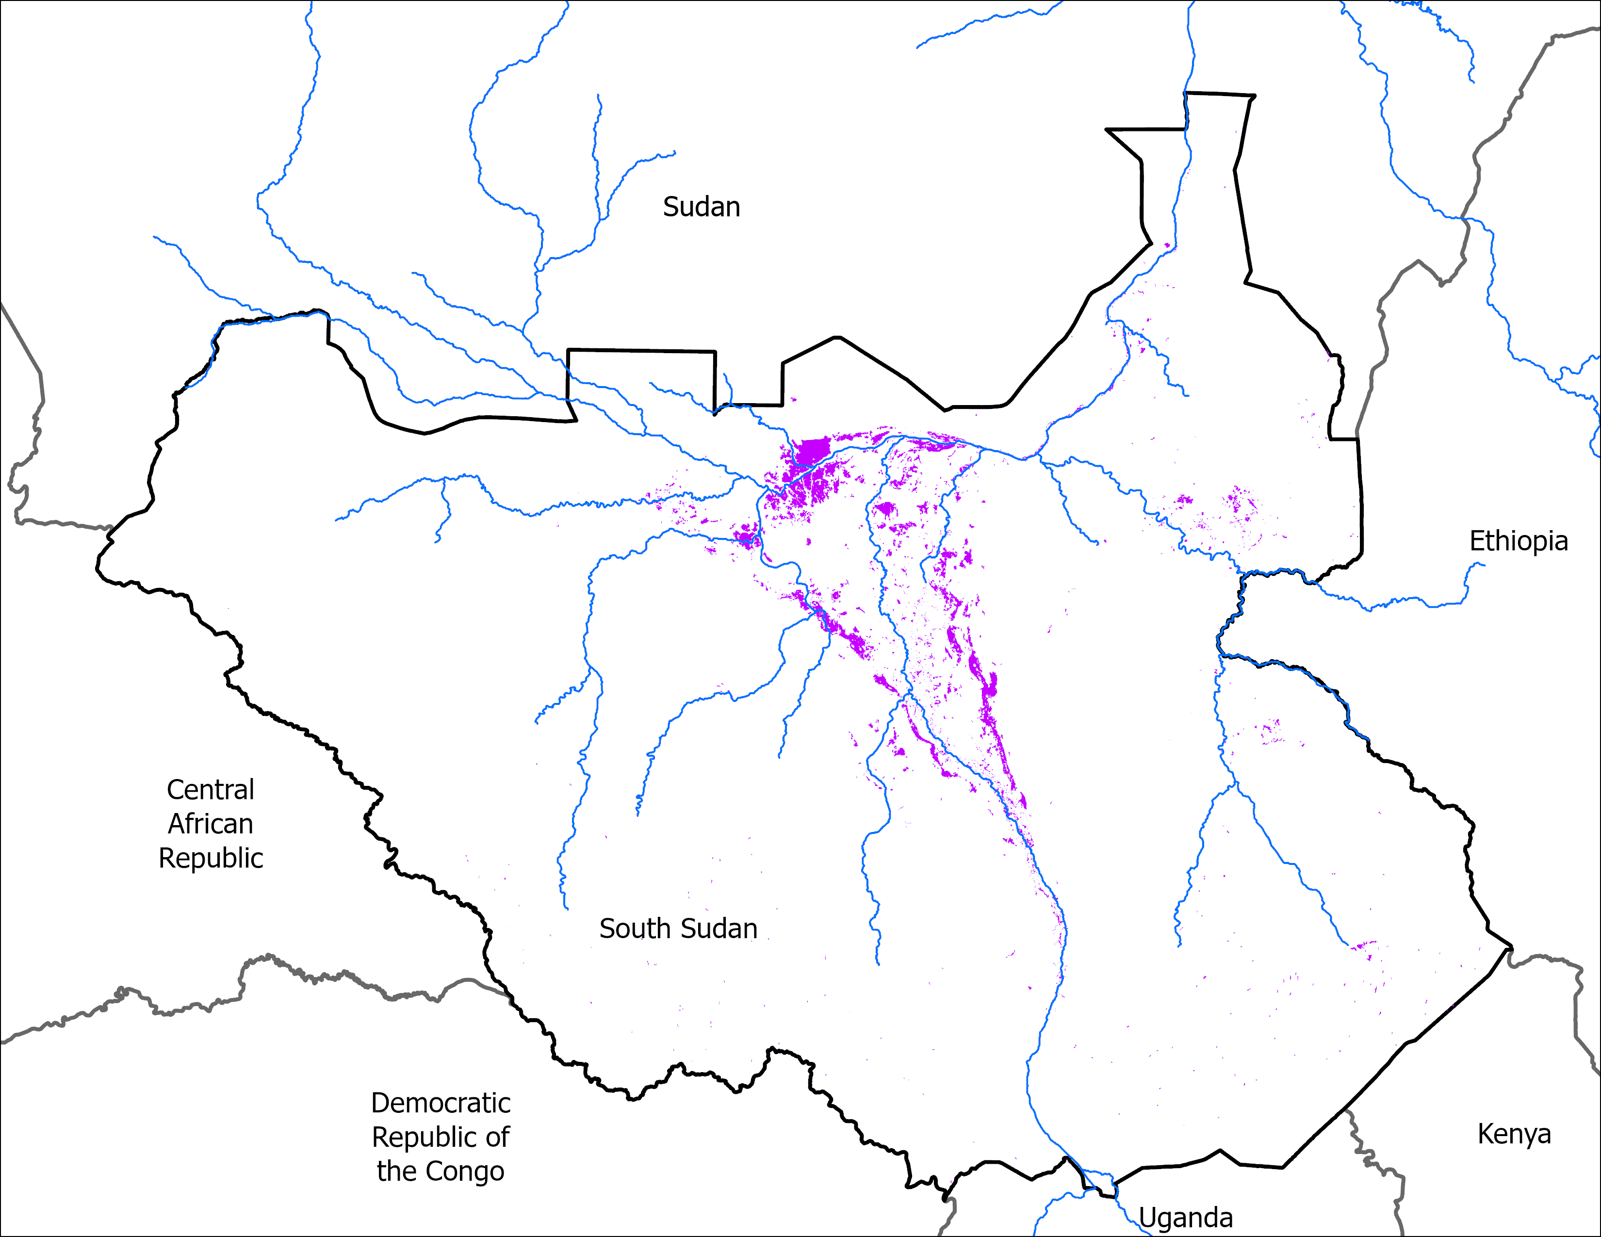
May Initial Conditions
13 May 2024
15 May 2025
VIIRS 09-13, 2024 : 9,631 km²
VIIRS 11-15 May comp: 10,524 km²
By mid May 2025, there are slightly more area under water than the same in 2024.

Slide 4
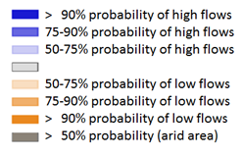
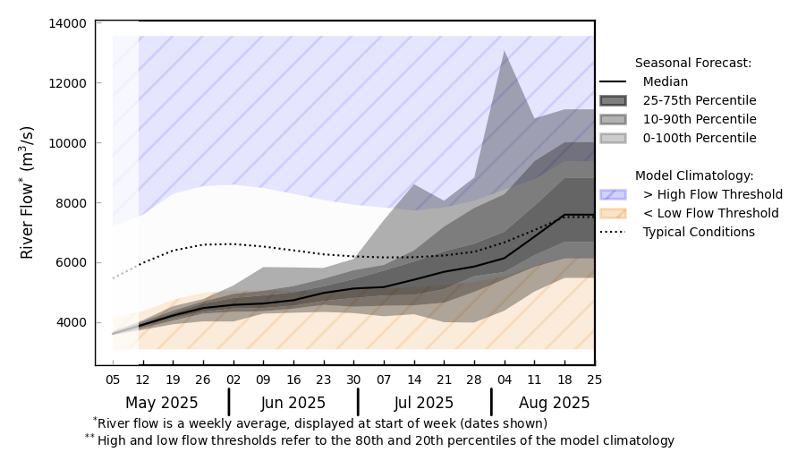
Streamflow Forecast
@point A on White Nile
A
GloFAS monthly streamflow forecast: May – Aug 2025
GloFAS streamflow forecast: May – Aug 2025
Streamflow expected to increase from June onwards.
Even at 4 months in advance, above average is the forecast especially in Sobet-Akobo-Pibor region.

Slide 5
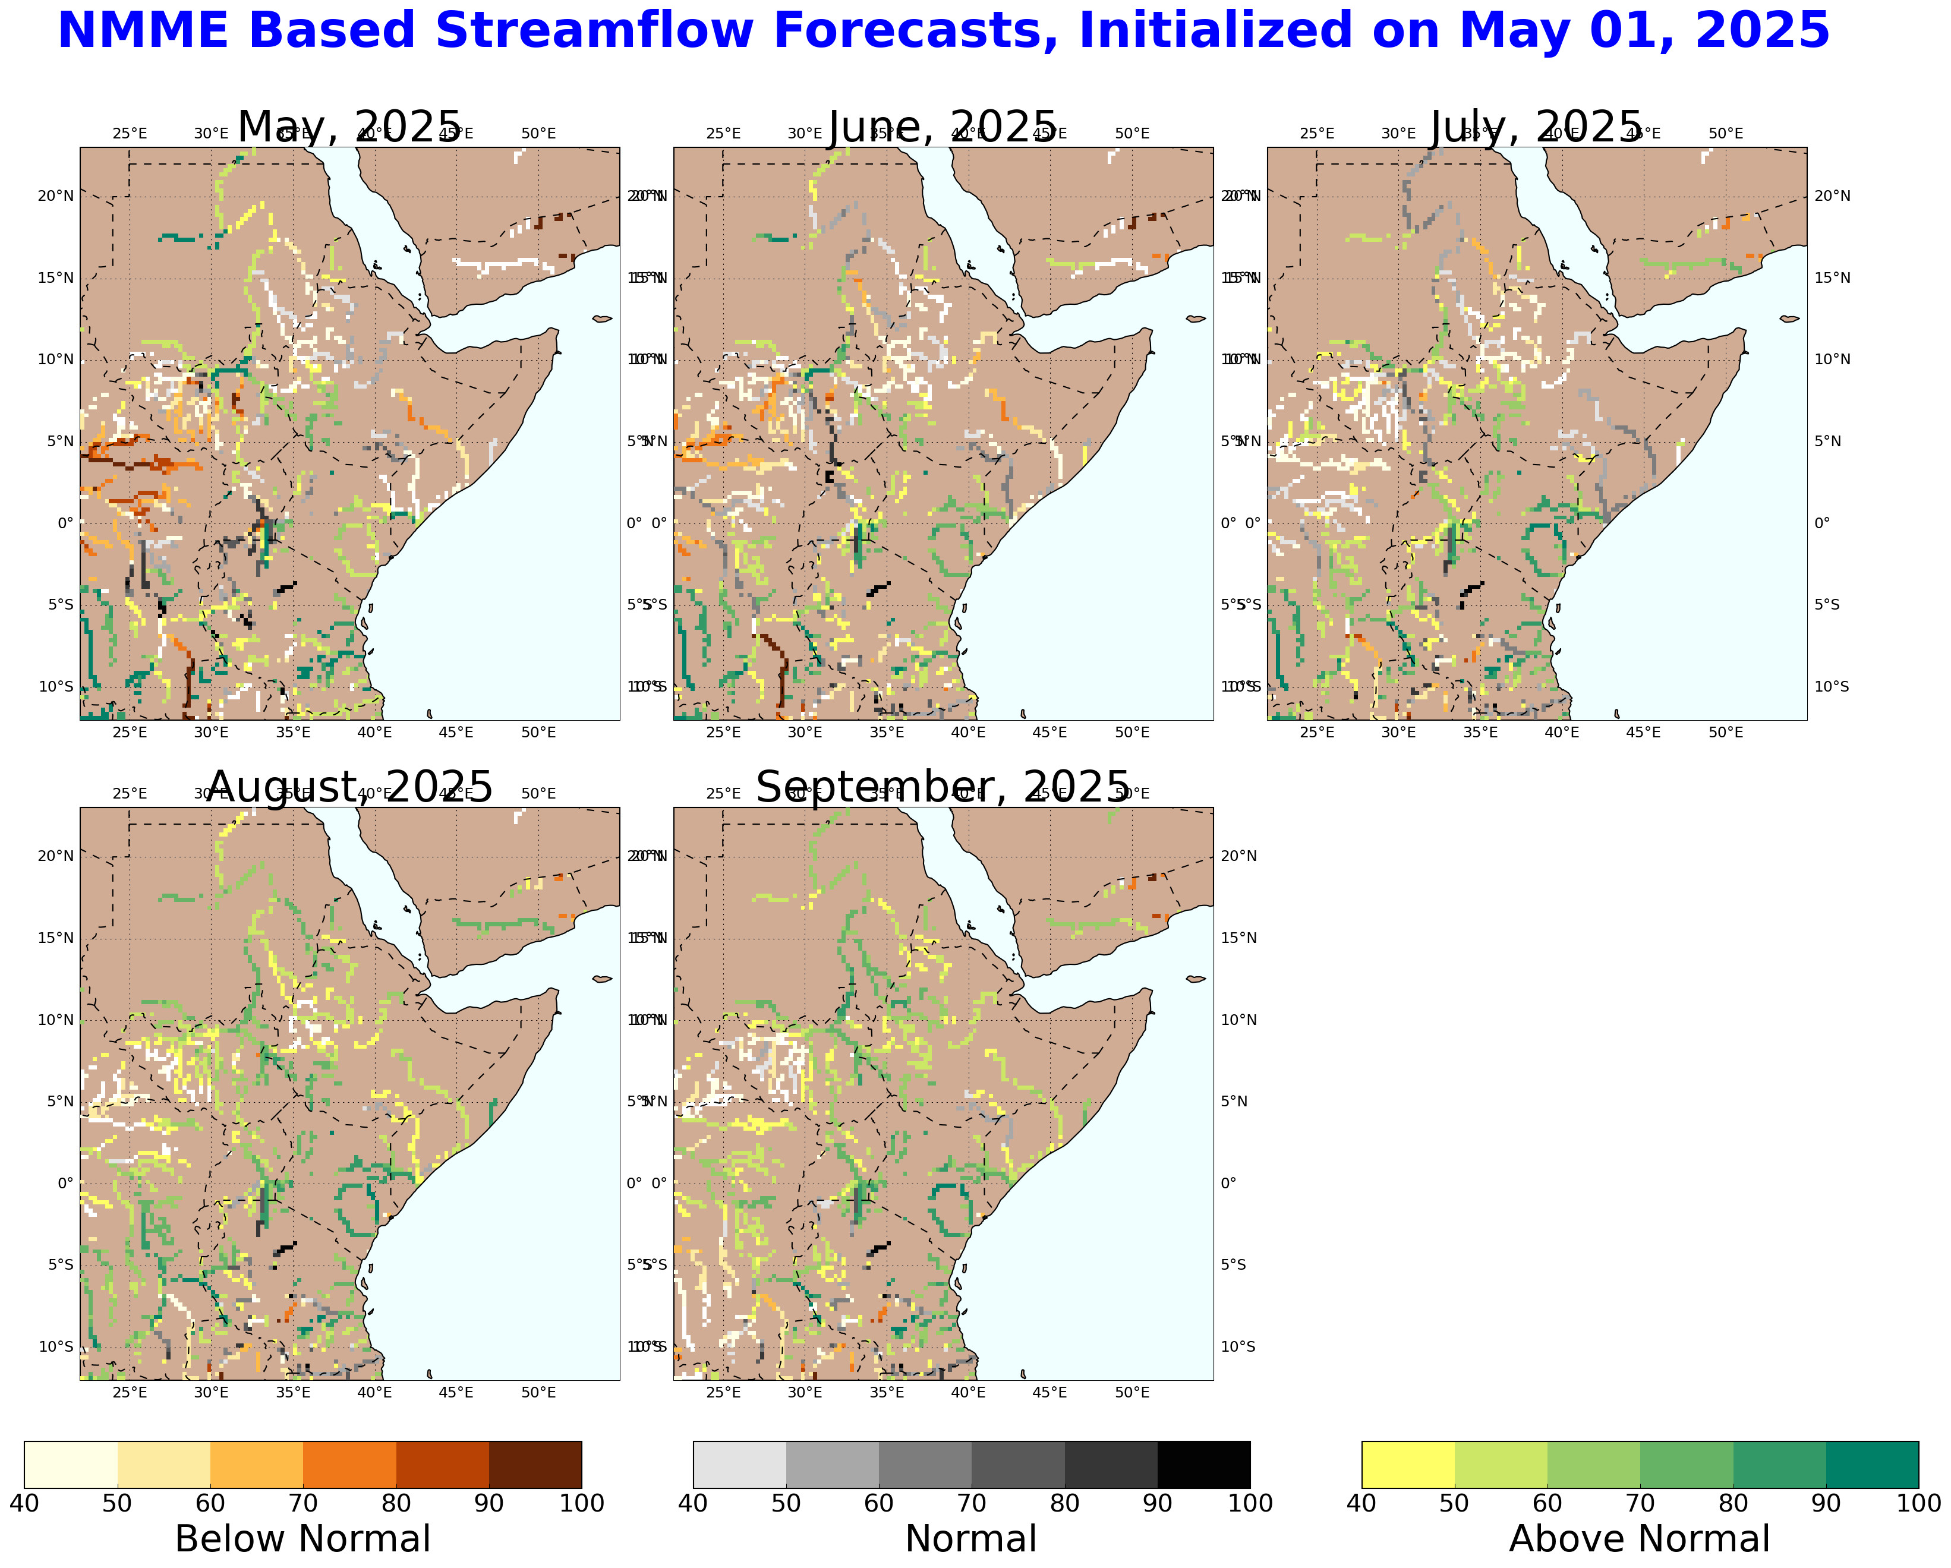
Streamflow Forecast
Streamflow expected to increase from June onwards in Eastern Africa.
Above average is the forecast in White Nile and its tributaries in South Sudan and in Nile in Sudan.

Slide 6
Thank you

