Slide 1
FEWS NET Enhanced Flood Monitoring and Forecast Assumptions—Afghanistan
FEWS NET Science Team
Feb 19, 2025

Slide 2
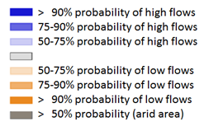
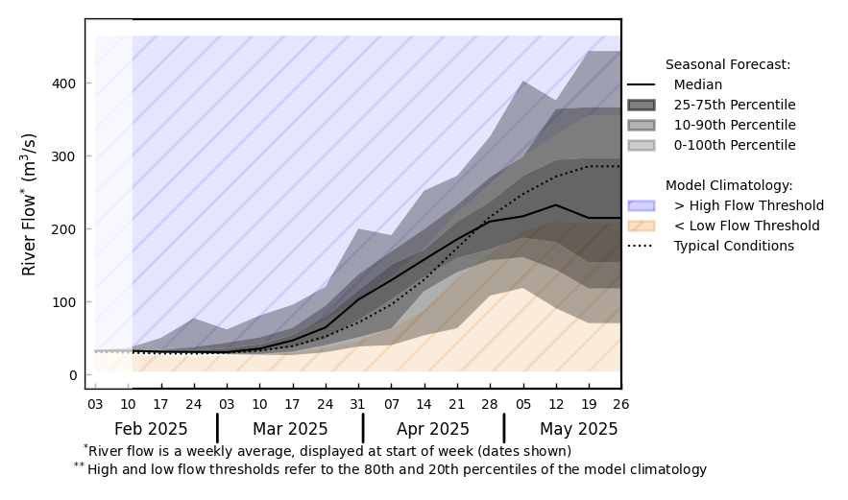
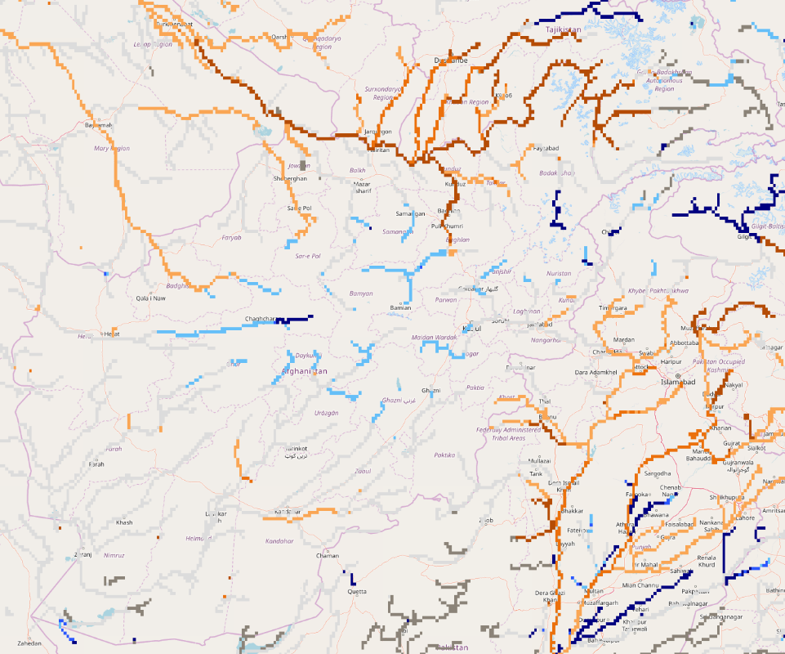
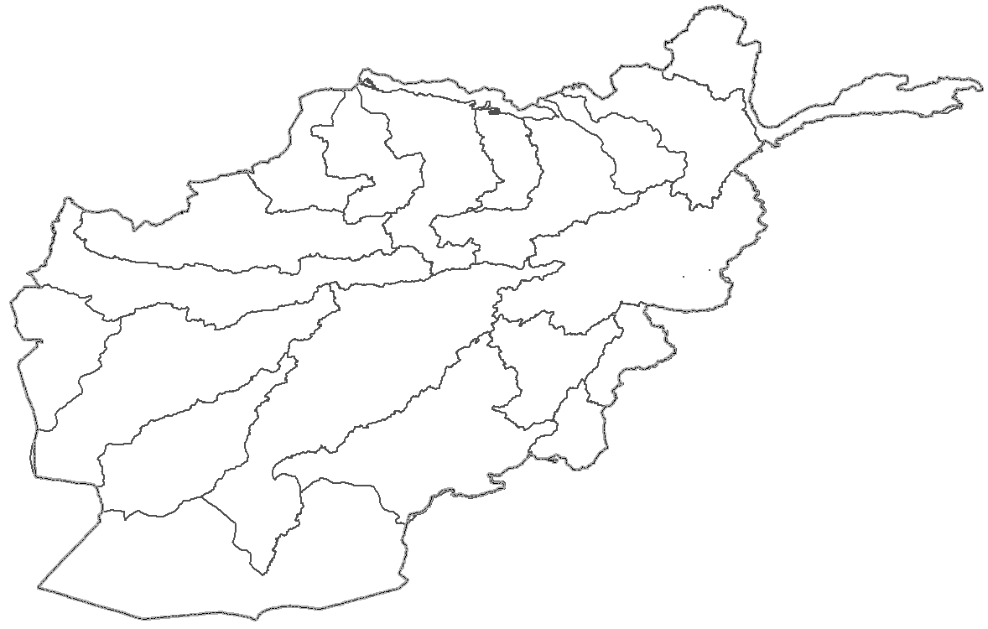
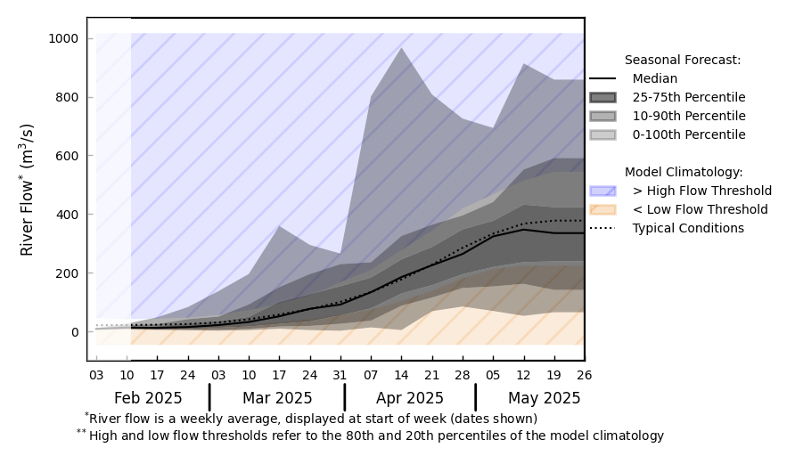
GloFAS Seasonal Forecast
@ point A: on the Harirod River
A
B
@ point B: on the Kabul River
GloFAS seasonal forecast (Feb - May 2025)
GloFAS monthly forecast (Feb – May 2025)
Average river discharges are the forecast across Afghanistan except along the Amu Darya River in the northeast.

Slide 3
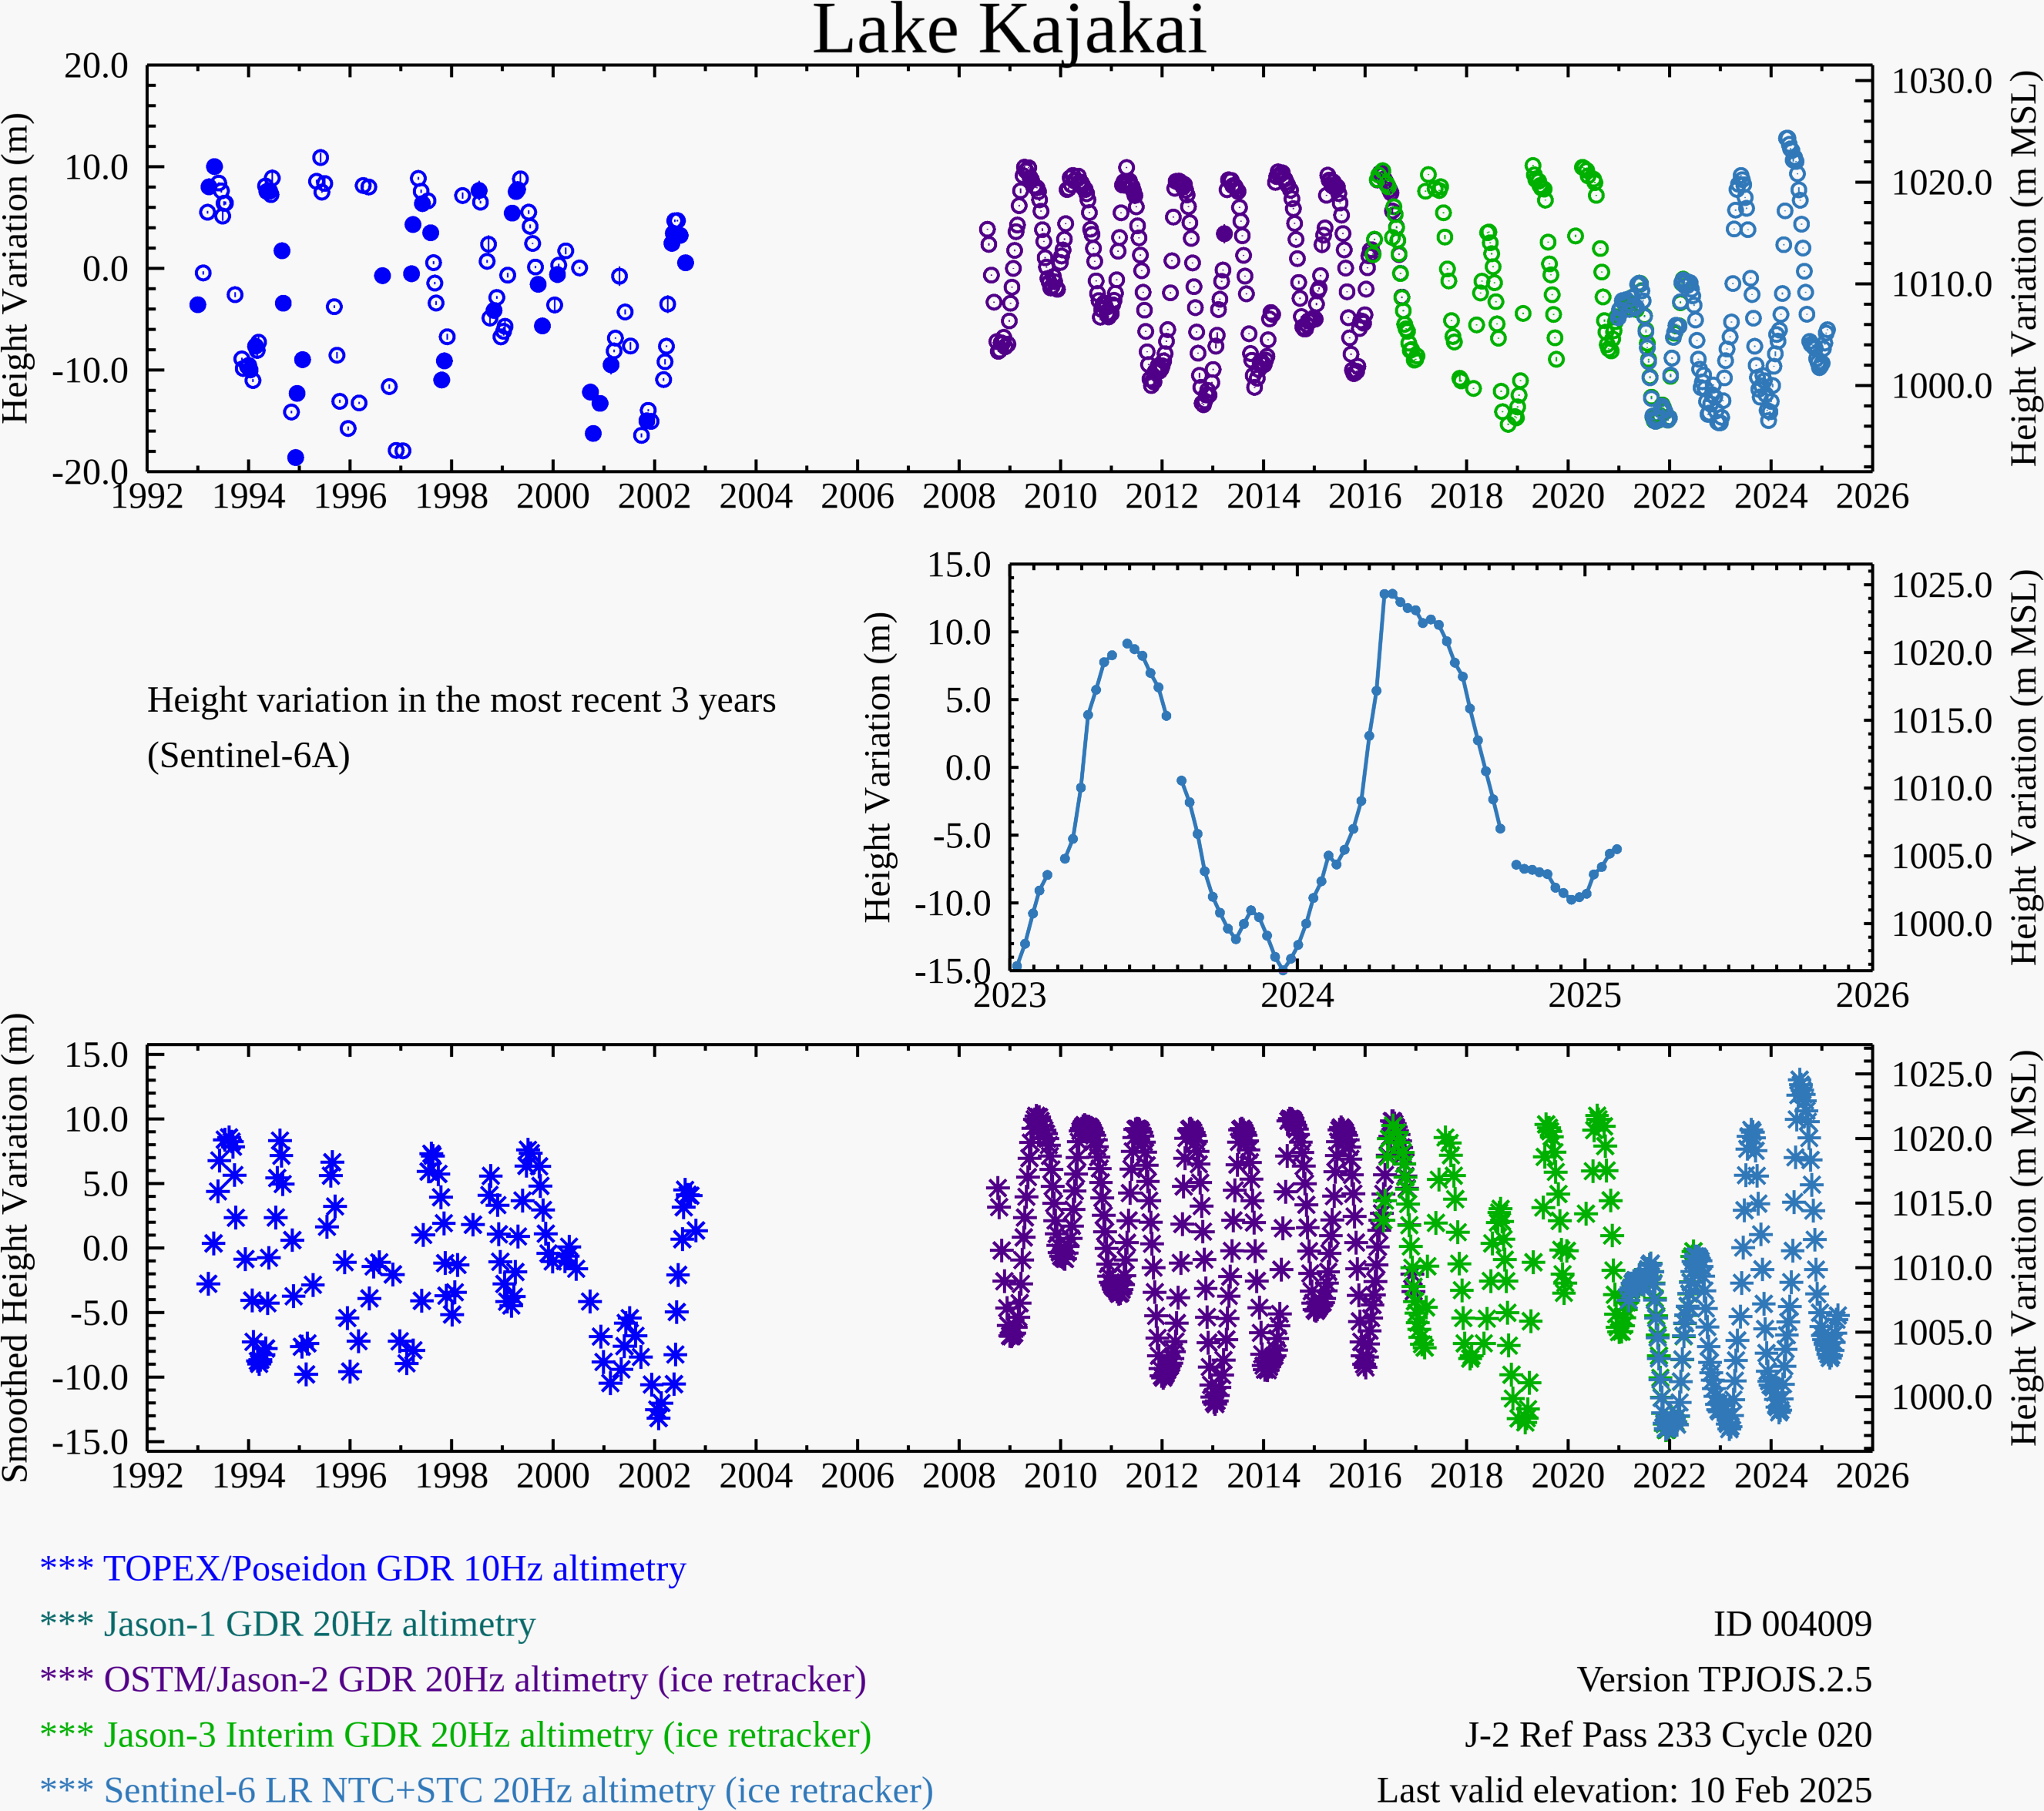
Lake Kajakai Water Level
Water level is increasing in Lake Kajakai.

Slide 4
Thank you
spervez@usgs.gov

