Slide 1
FEWS NET Enhanced Flood Monitoring and Forecast Assumptions—West Africa
FEWS NET Science Team
Aug 18, 2024

Slide 2
Flooding Conditions in West Africa
According to BERM high risk of flooding persist in southern Mauritania, central and eastern Mali, southern Niger and northern and southern Chad.
Notes:
VIIRS inundation map compares well with high resolution FloodBase inundation map for July.

Slide 3
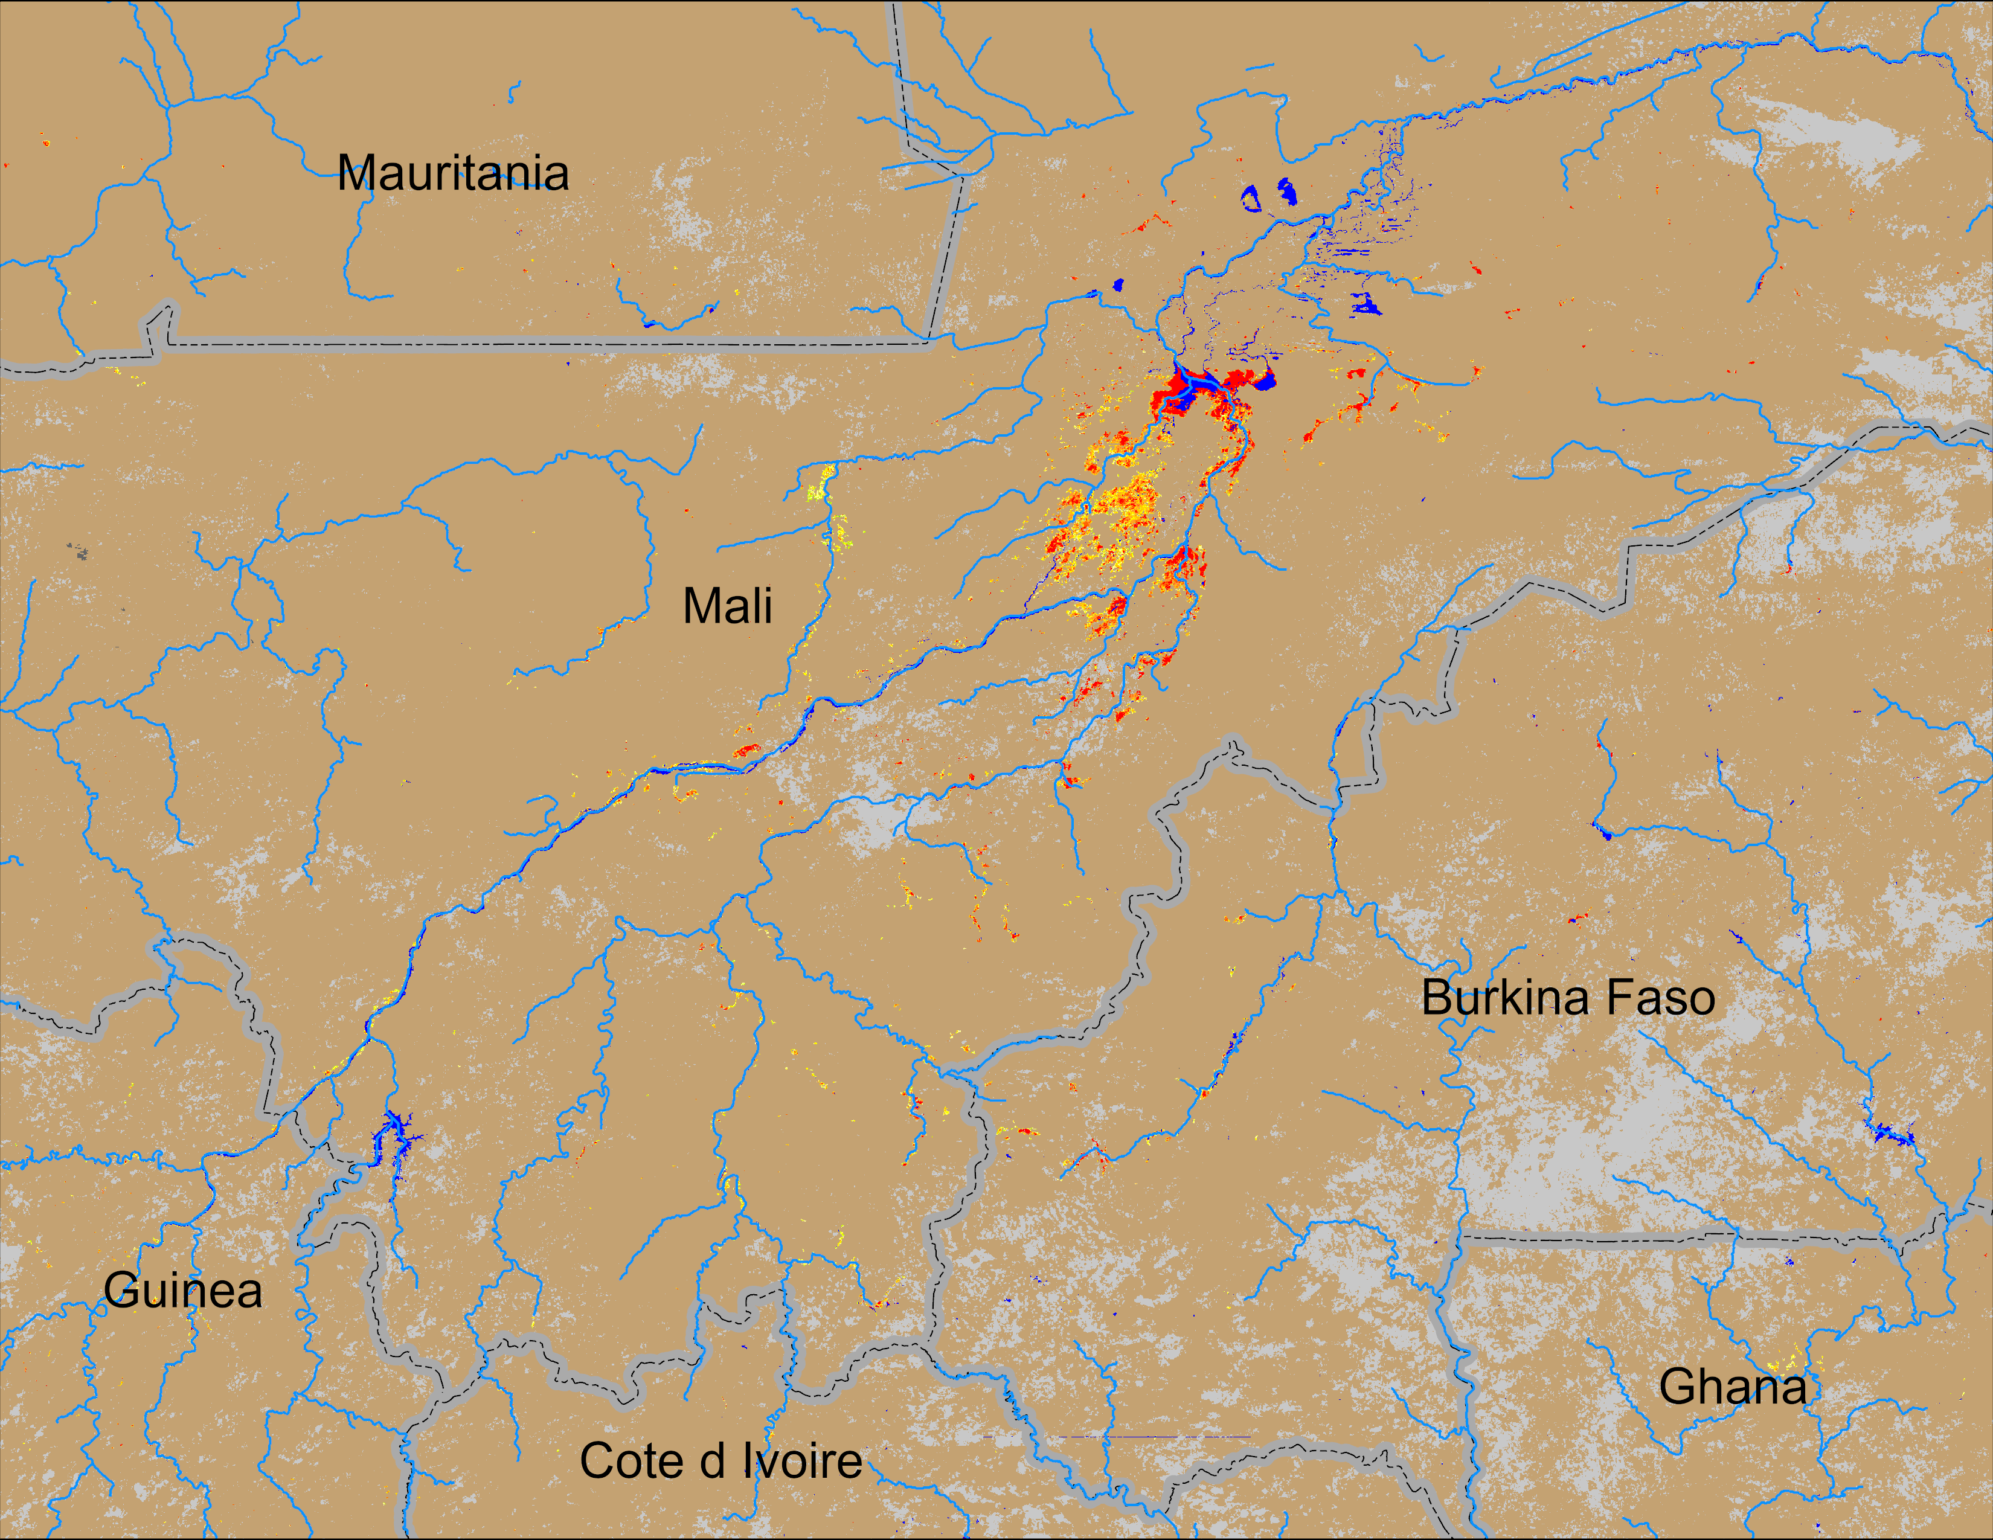
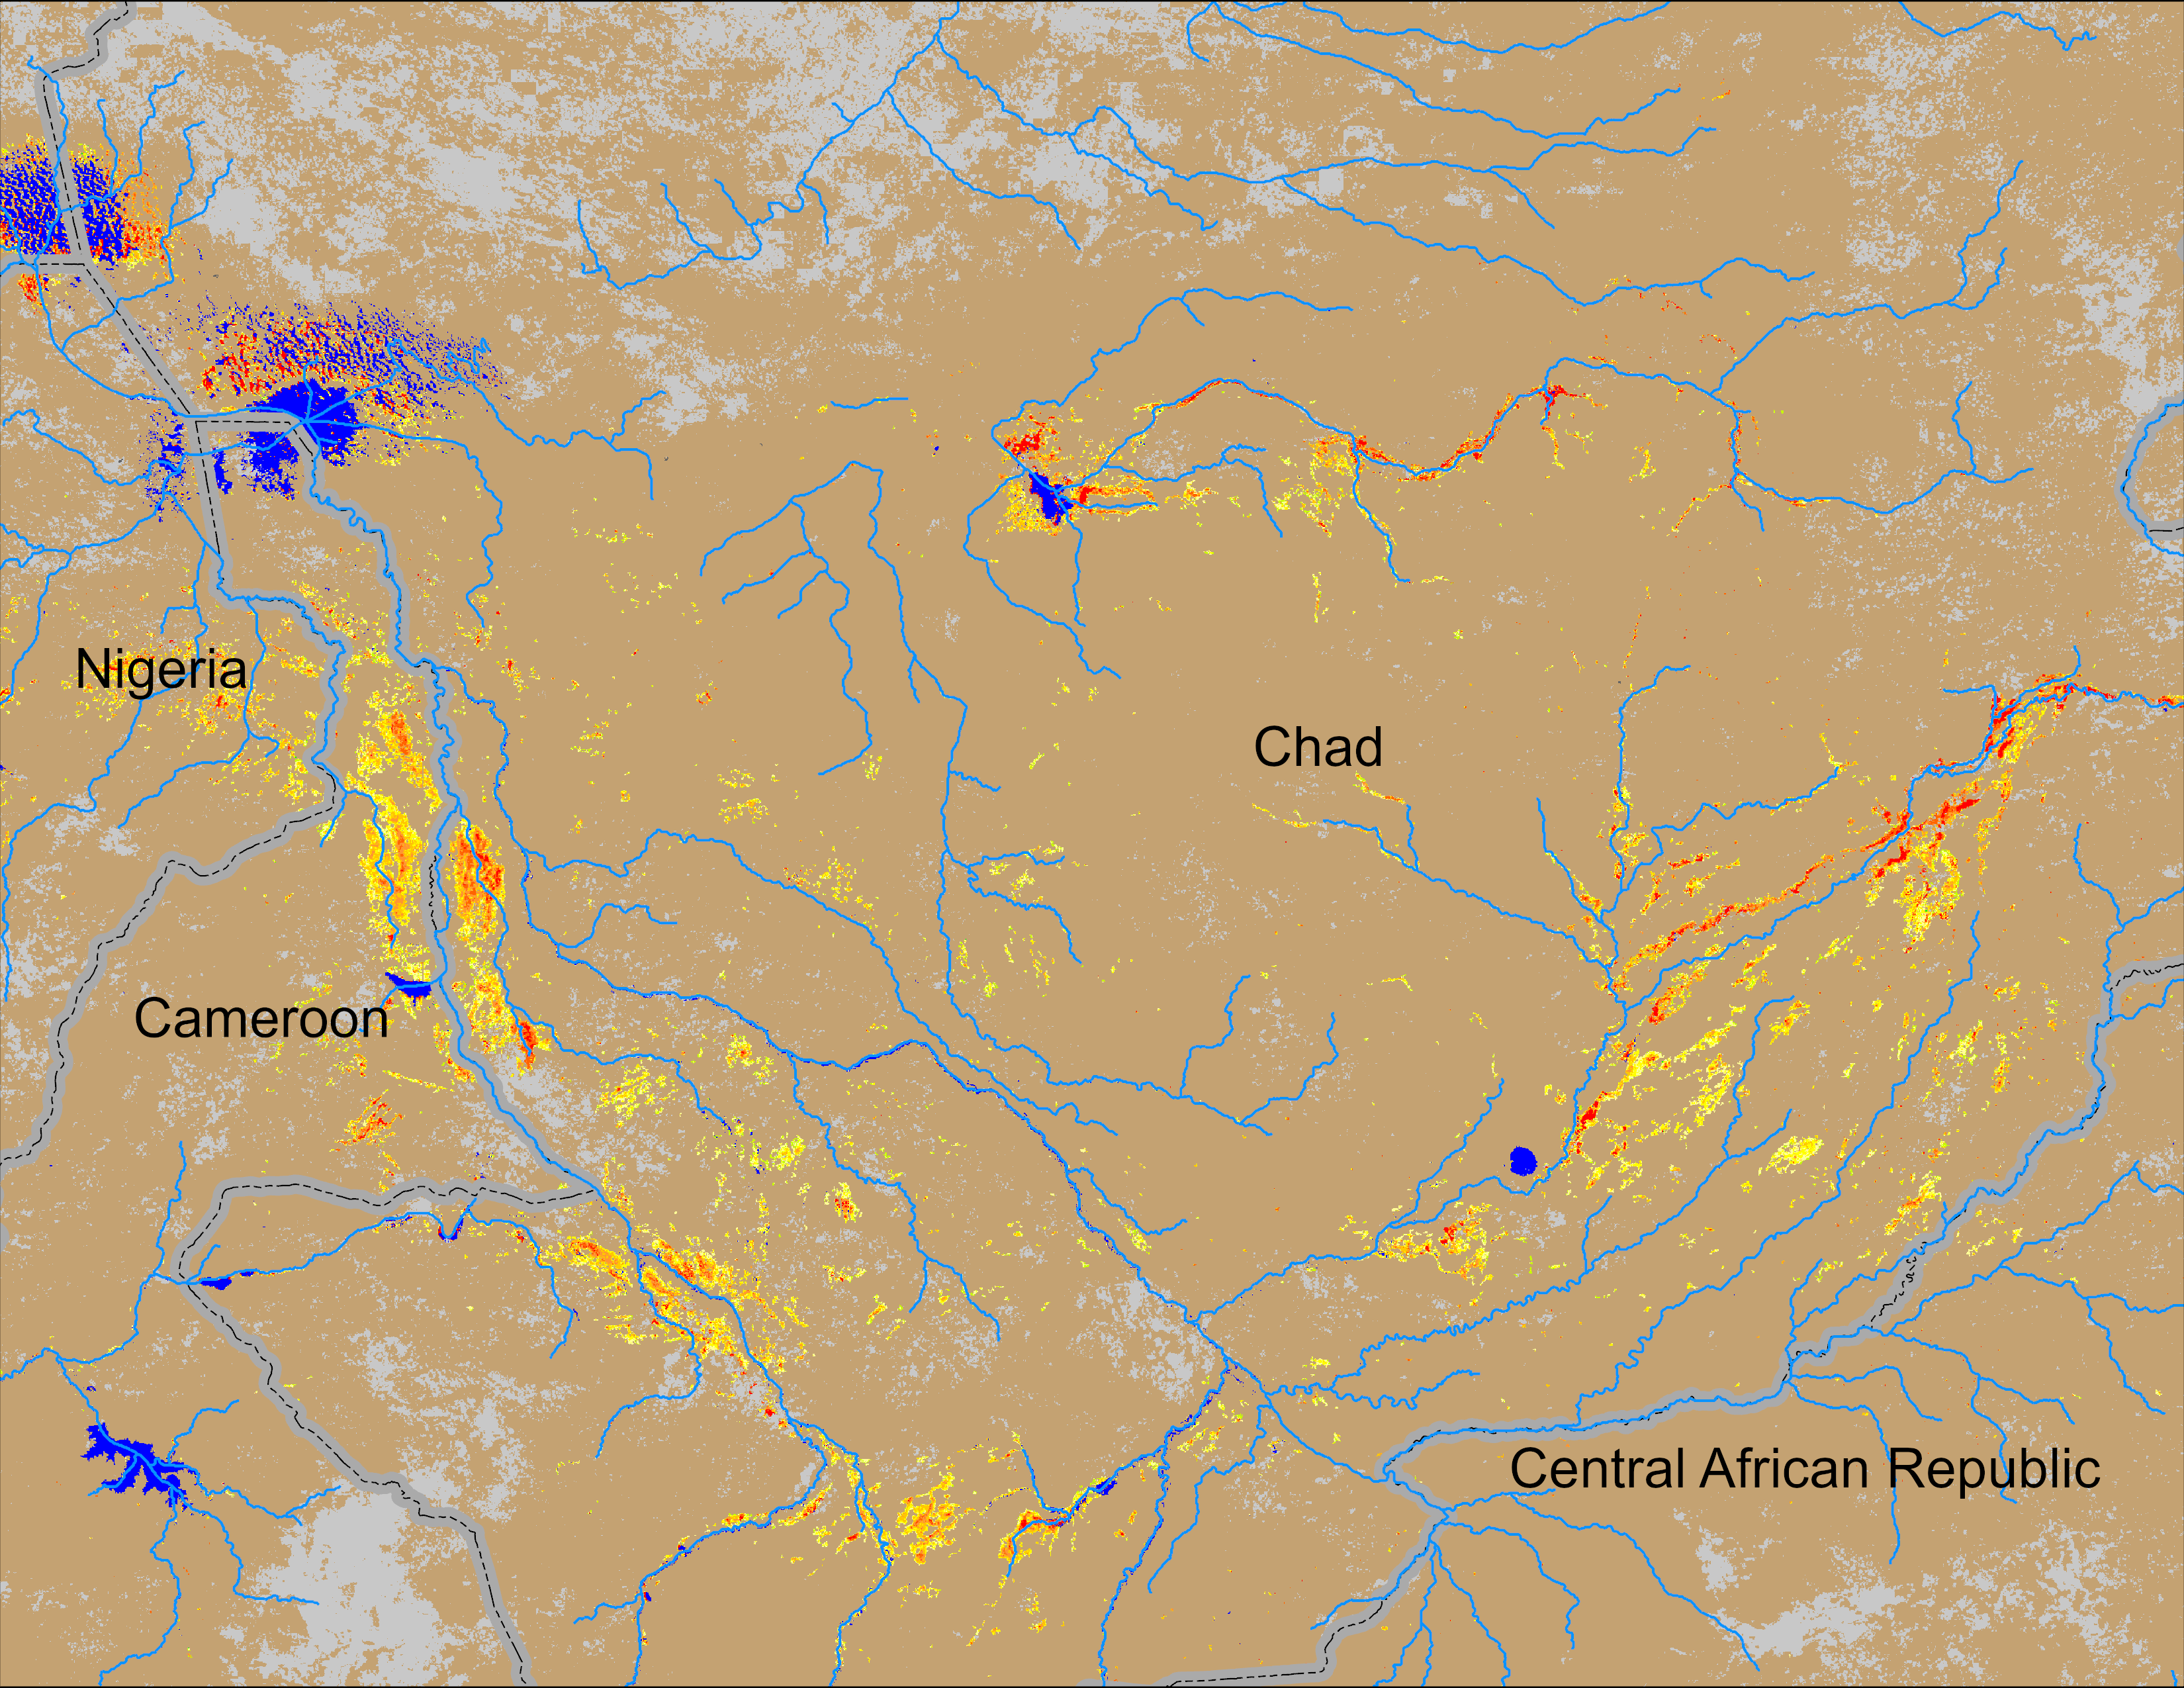
Flooding Conditions in Mali and Chad
(% of the pixel)
(% of the pixel)
NOAA VIIRS 5-day comp.: 13 – 17 Aug 2024
NOAA VIIRS 5-day comp.: 13 – 17 Aug 2024
Widespread flooding can be seen in central Mali and southern Chand.

Slide 4
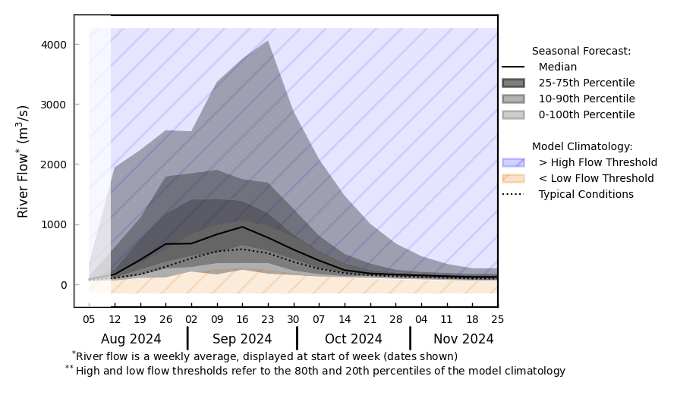
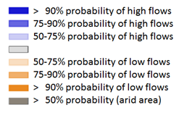
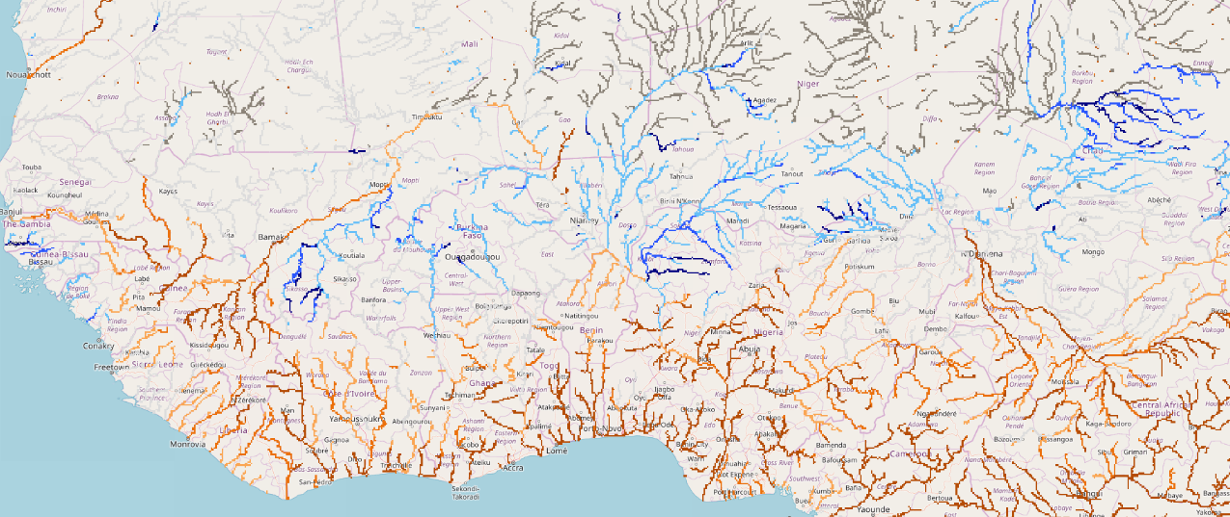
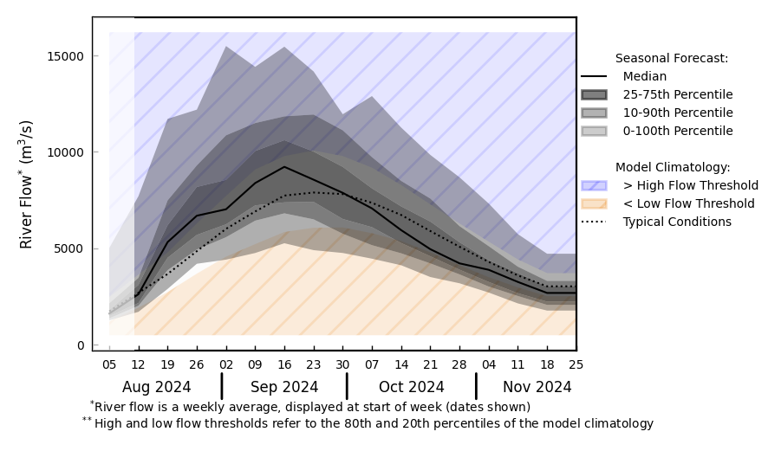
Streamflow Forecast in West Africa
@ point A
Niger
Komadugu
A
Logone
B
@ point B
Volta
GloFAS streamflow forecast: Aug – Nov 2024
Above average streamflow is expected in the Niger River in central Mali and Niger, Volta and Komadugu Rivers.
GloFAS forecast: Aug – Nov 2024

Slide 5
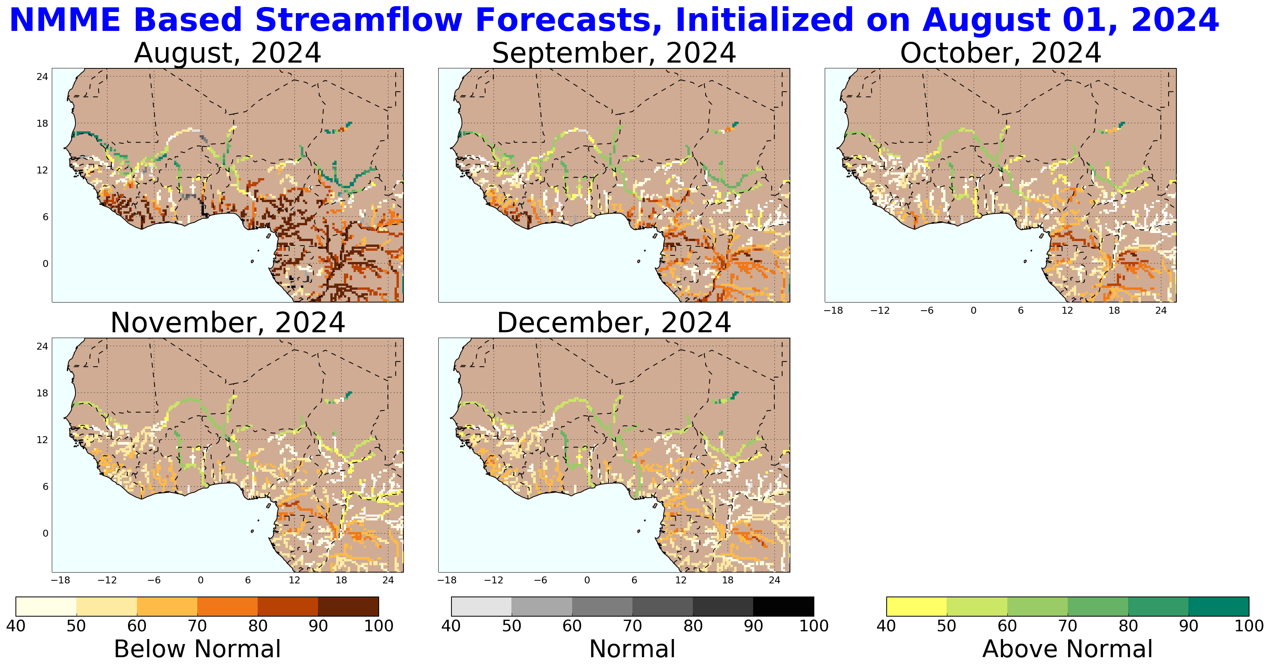
Streamflow Forecast in West Africa
NHyFAS streamflow forecast: Aug – Dec 2024
NHyFAS forecast also suggest similar above average streamflow in the Niger River in central Mali and Niger, Volta, Komadugu and Logone Rivers.
High likelihood of localized flooding along these rivers.

