Slide 1
FEWS NET Enhanced Flood Monitoring and Forecast Assumptions—West Africa
FEWS NET Science Team
September 17, 2024

Slide 2
Flooding Conditions in West Africa
BERM depicts very high risk of flooding across the Sahel

Slide 3
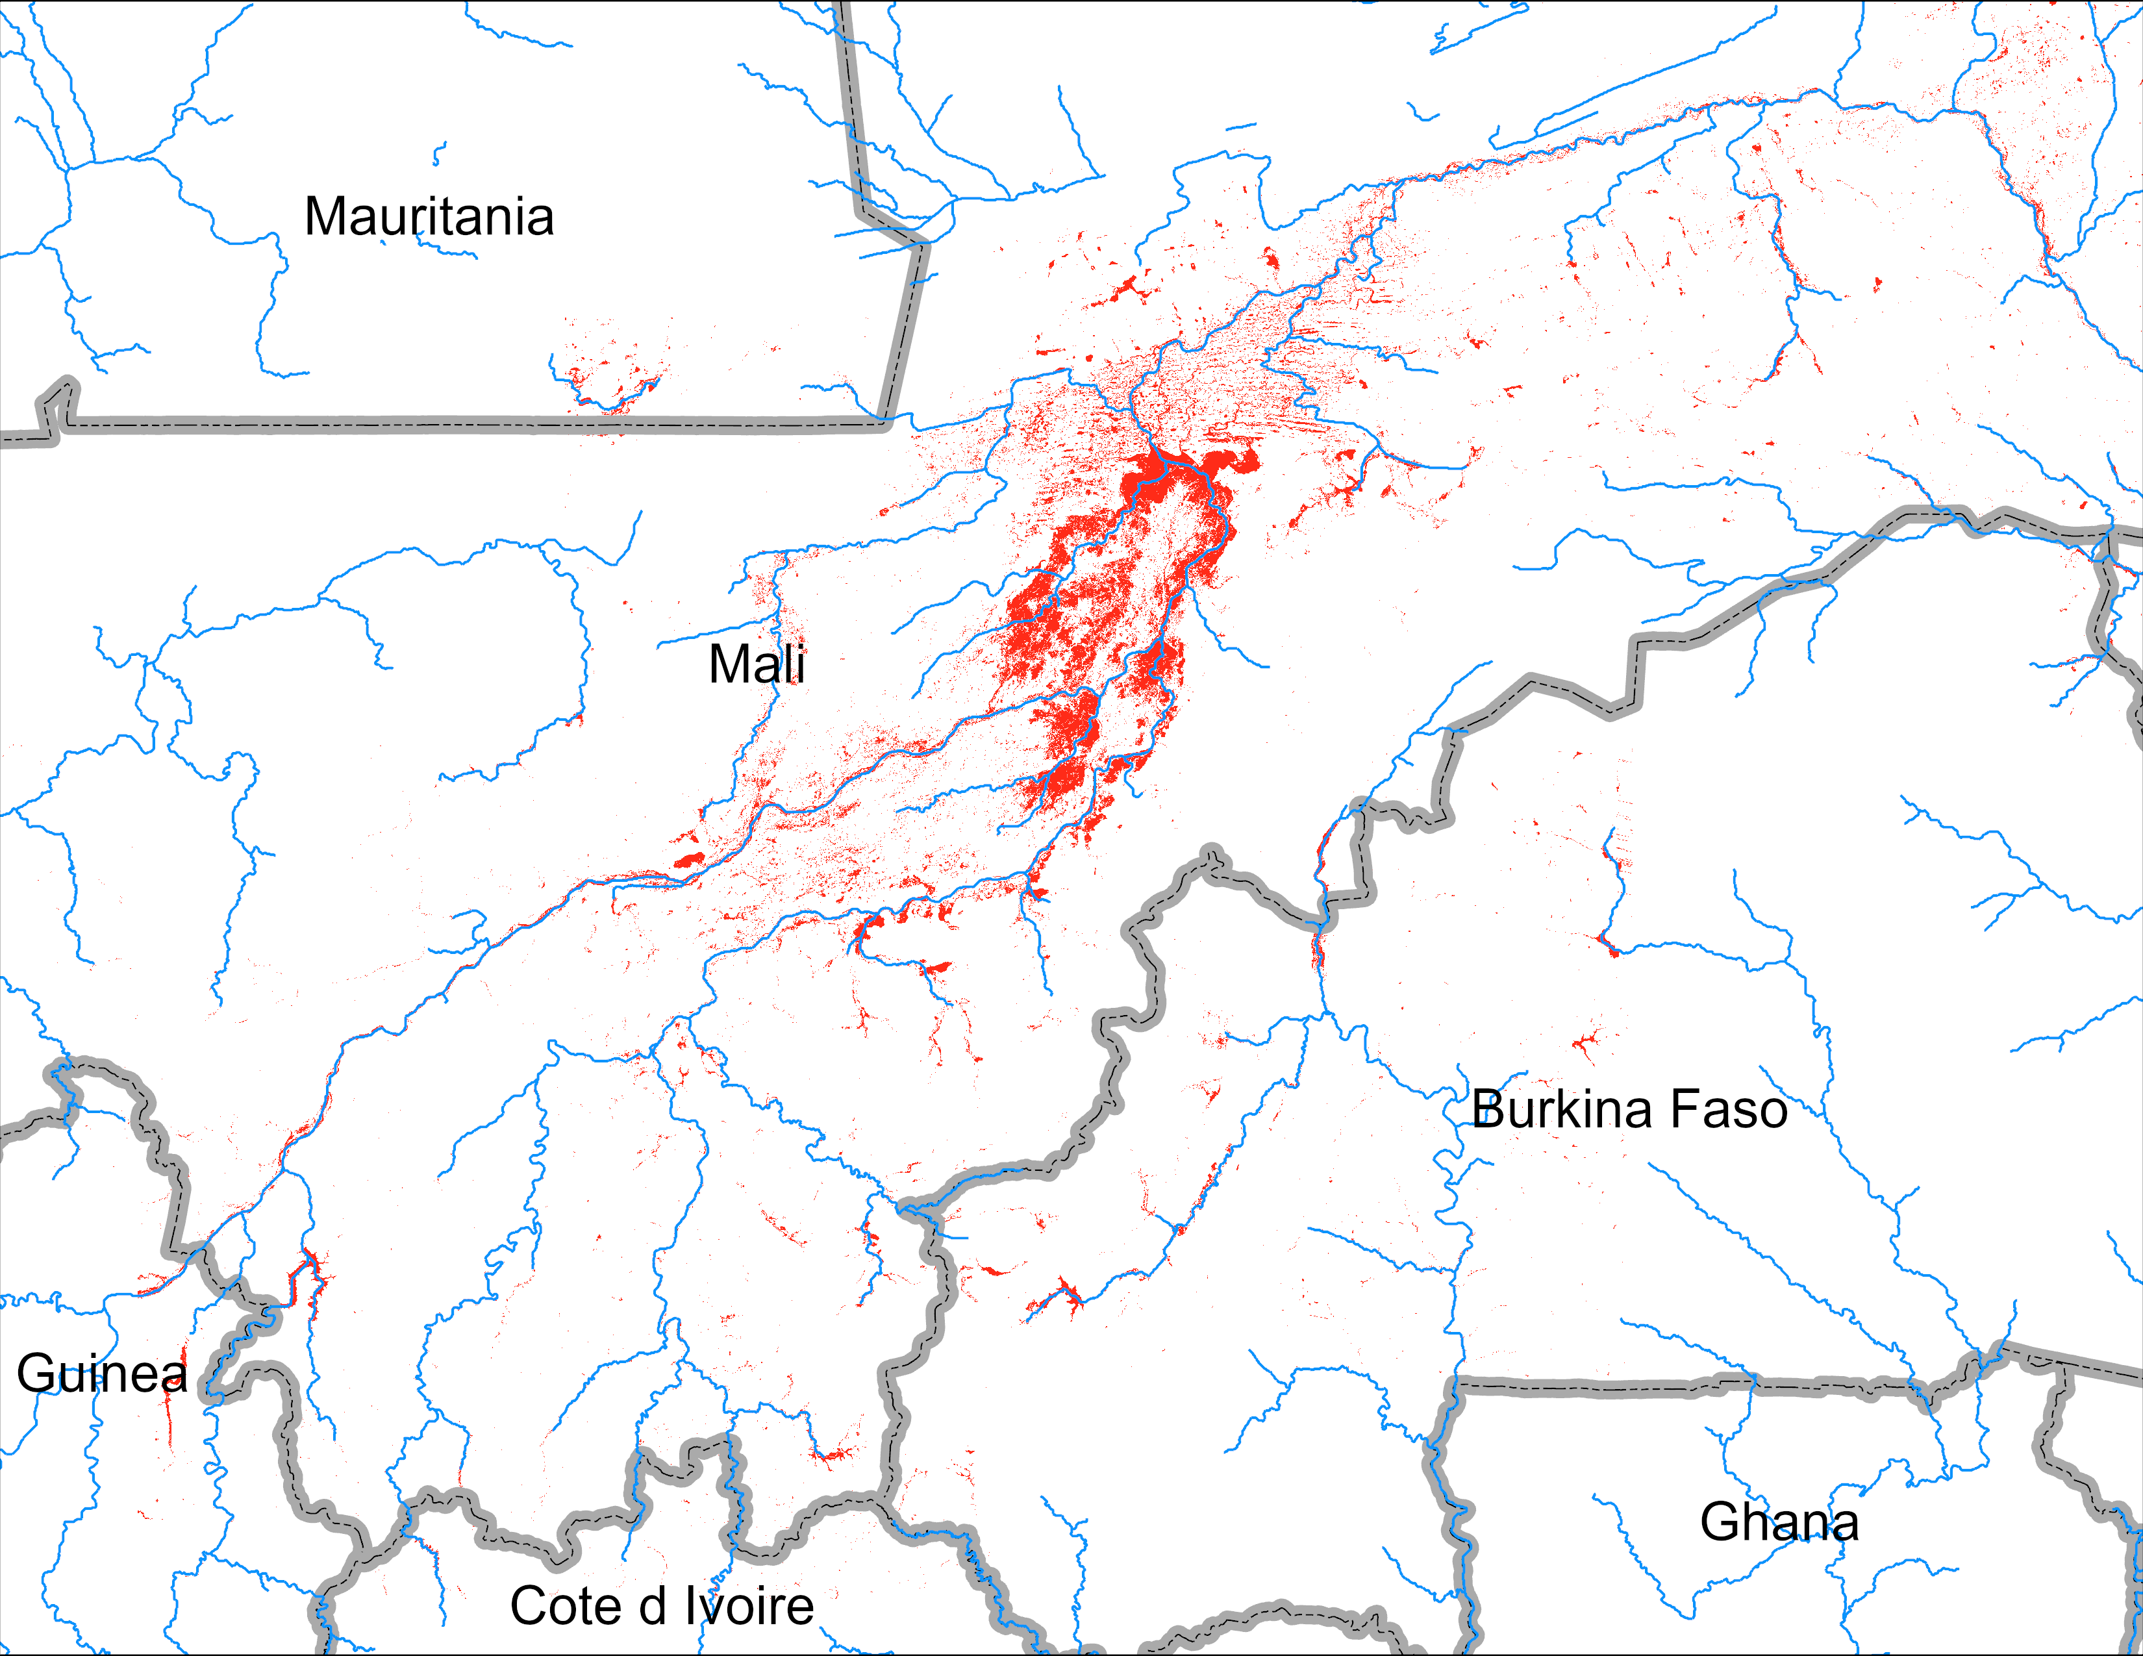
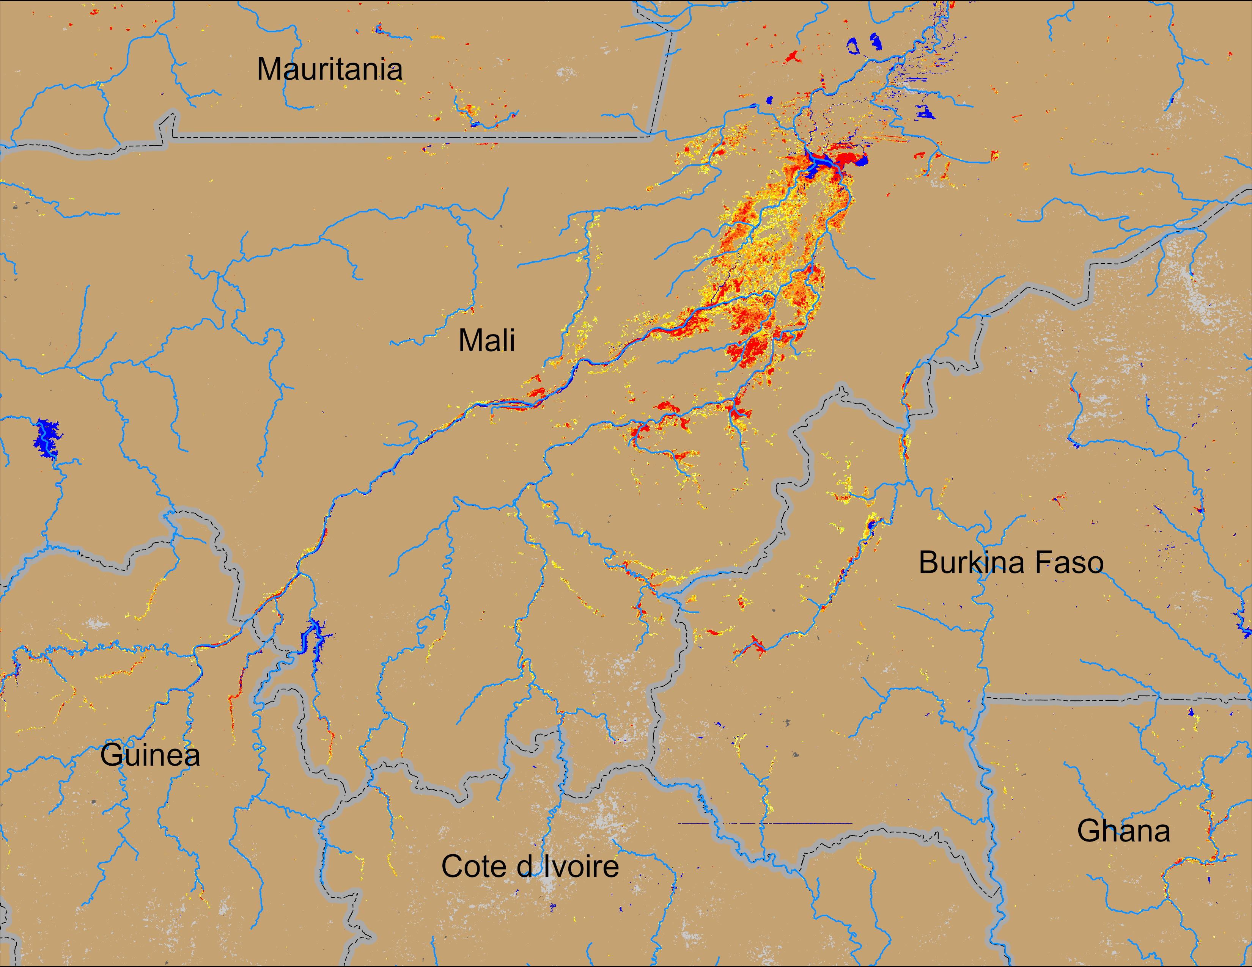
Flooding Conditions in Mali
(% of the pixel)
FloodBase flood map: August 2024
NOAA VIIRS 5-day comp.: 11 – 15 Sep 2024
Flooding conditions worsening in Mali and spreading into Guinea and Burkina Faso.

Slide 4
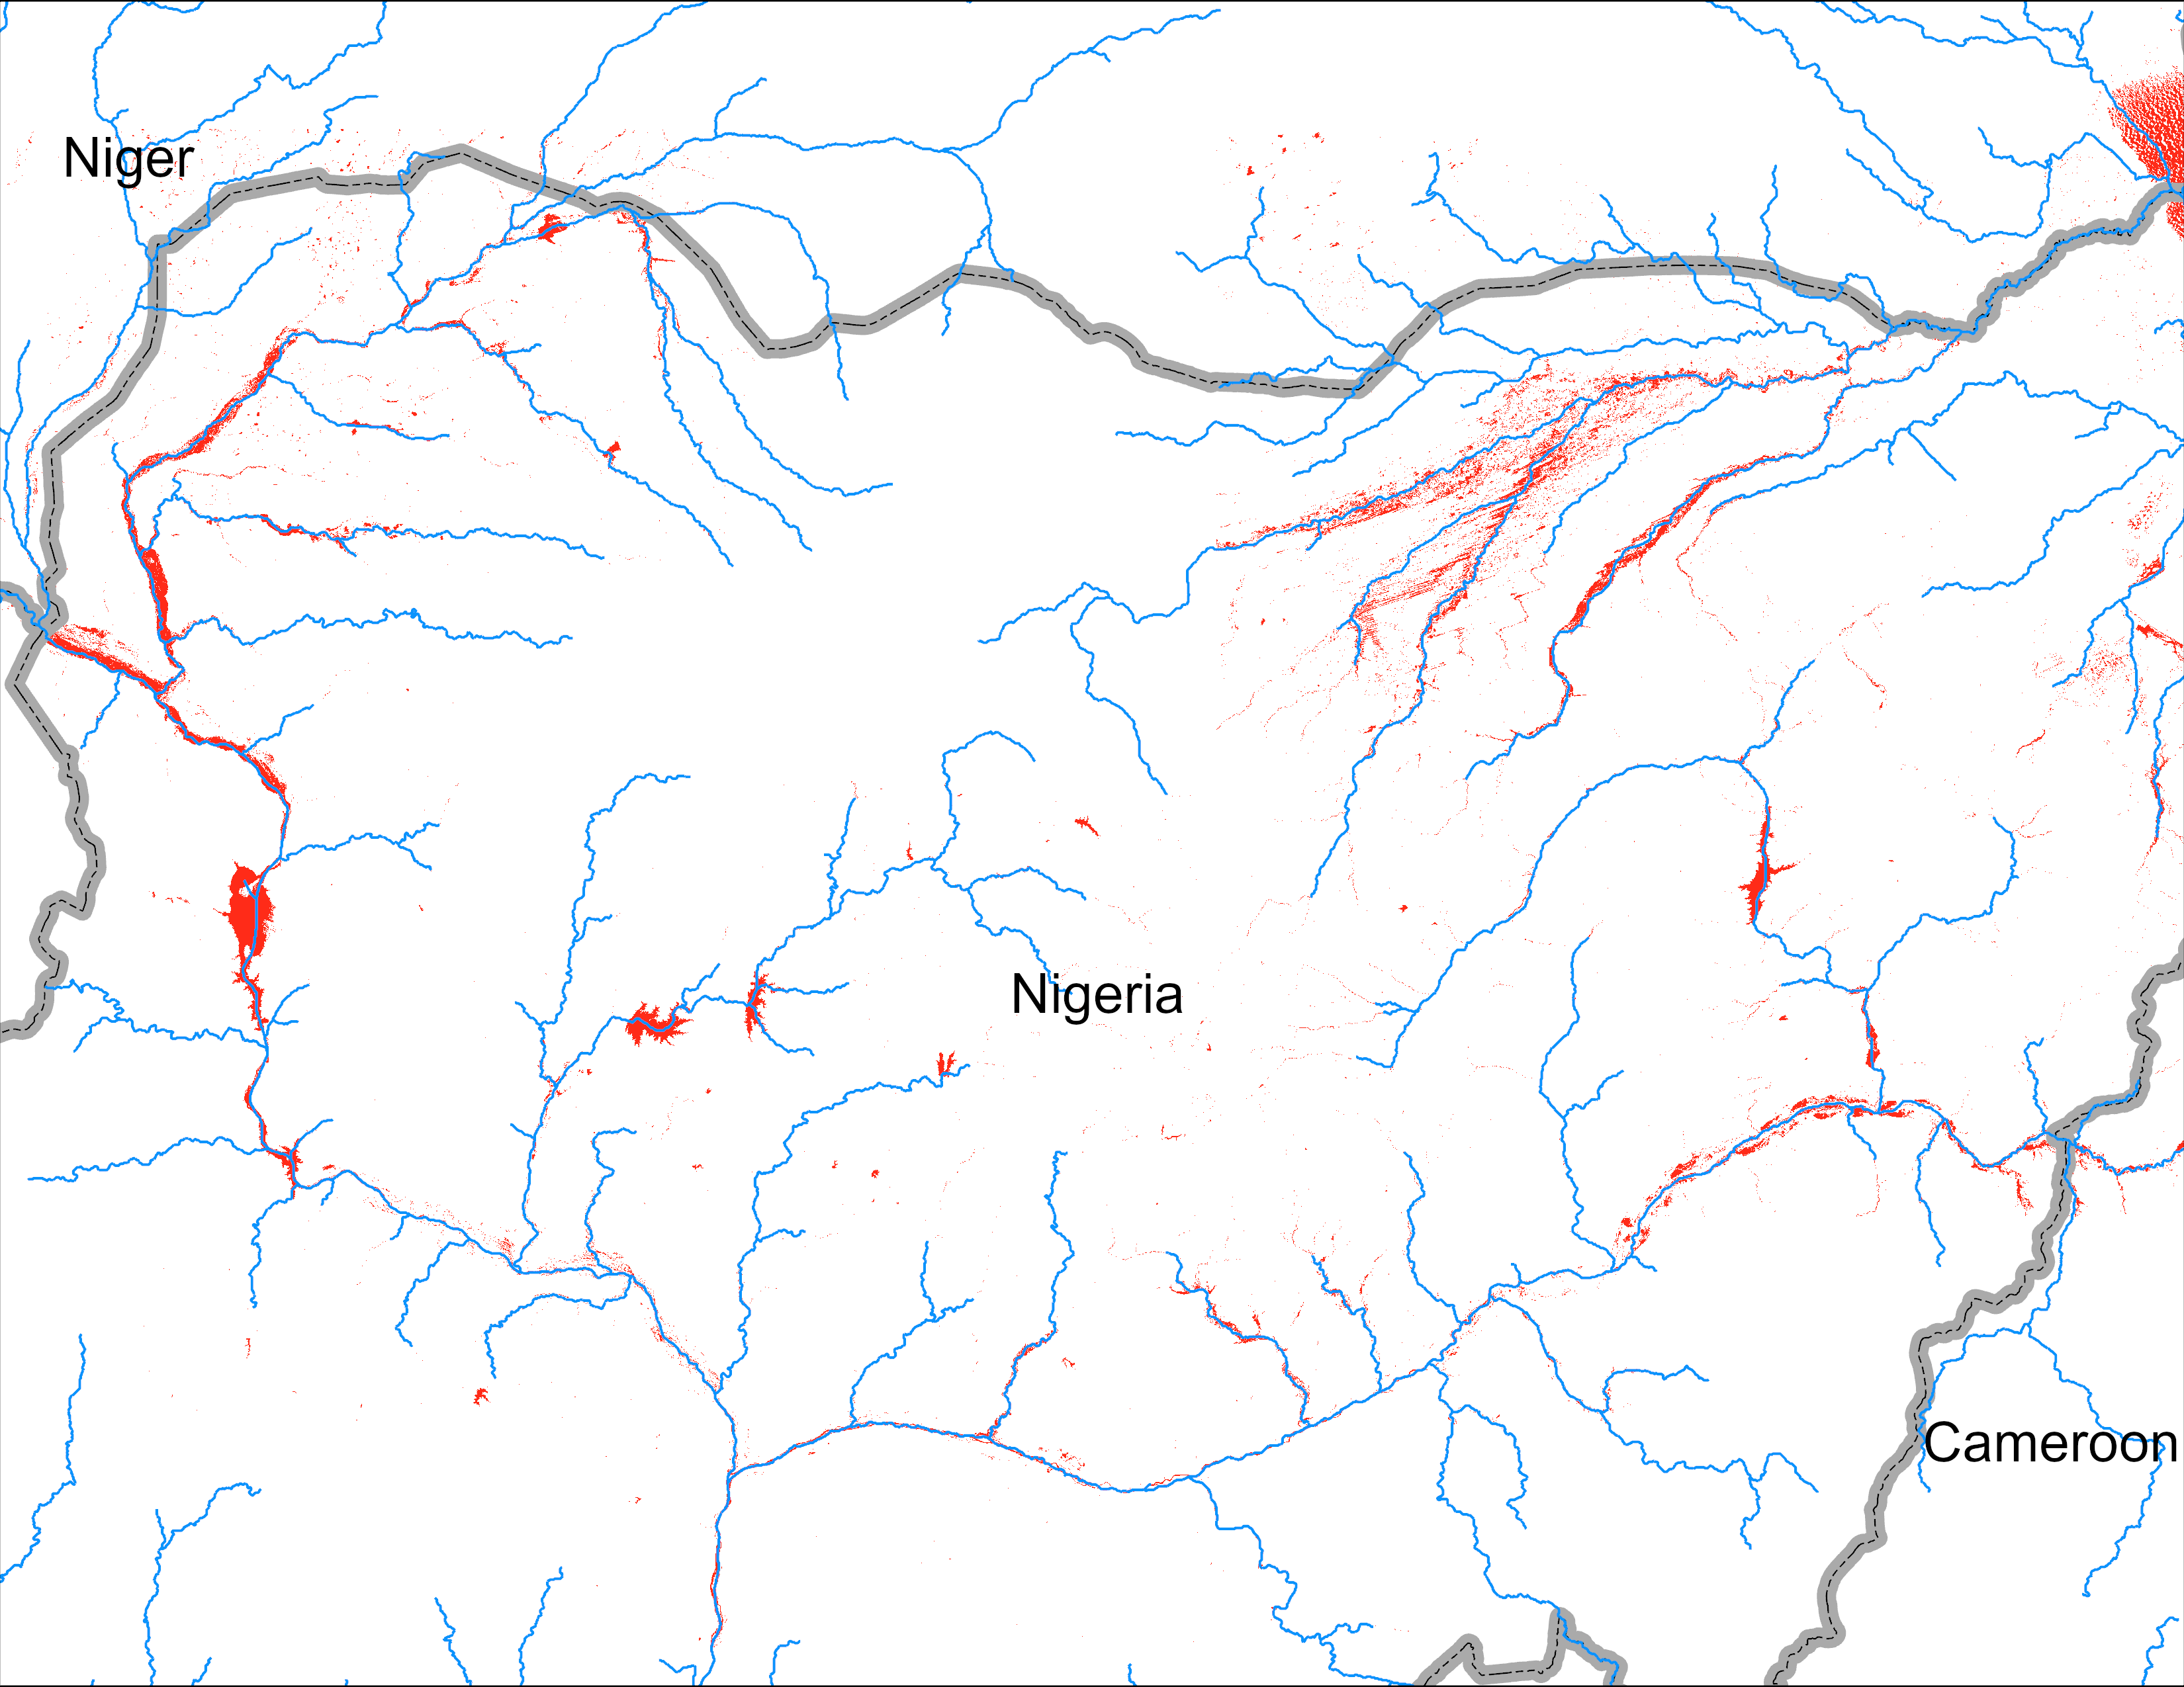
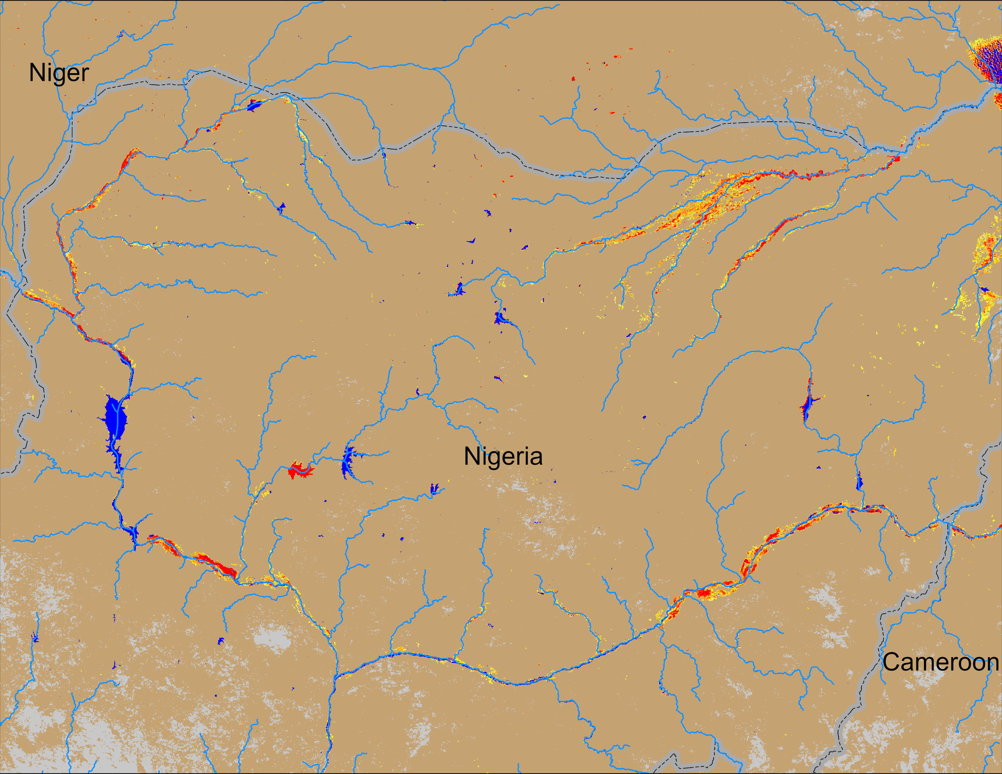
Flooding Conditions in Nigeria
(% of the pixel)
FloodBase flood map: August 2024
NOAA VIIRS 5-day comp.: 11 – 15 Sep 2024
All four major River systems started experiencing flooding in Nigeria with worsening conditions in recent days.

Slide 5
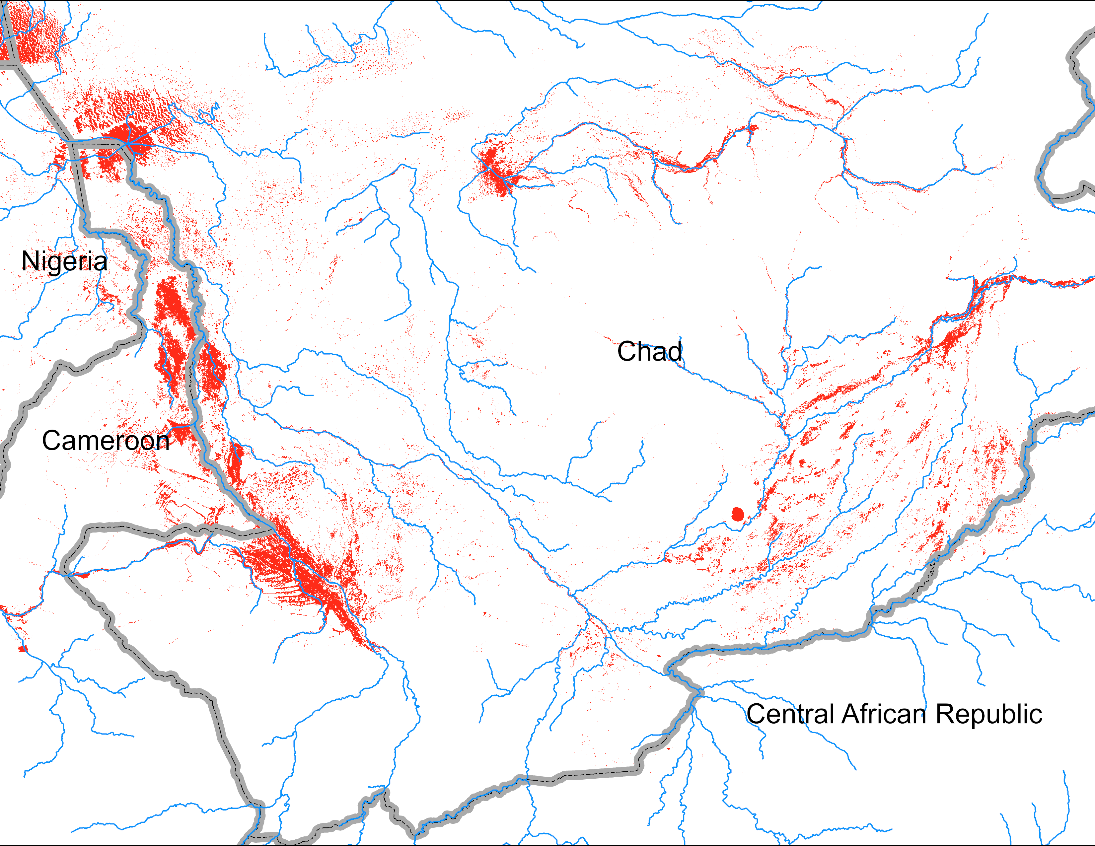
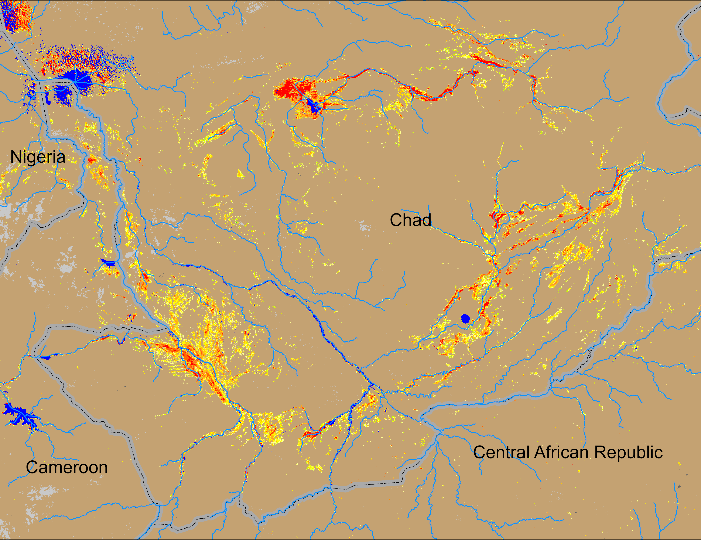
Flooding Conditions in Chad
(% of the pixel)
FloodBase flood map: August 2024
NOAA VIIRS 5-day comp.: 11 – 15 Sep 2024
Flooding conditions have significantly deteriorated across Chad.

Slide 6
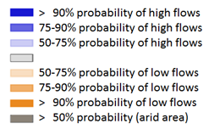
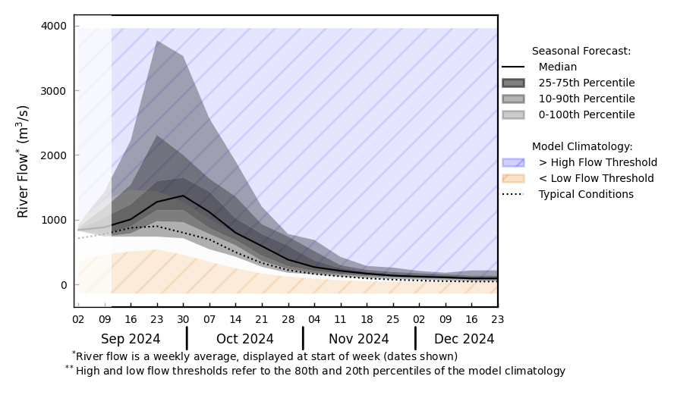
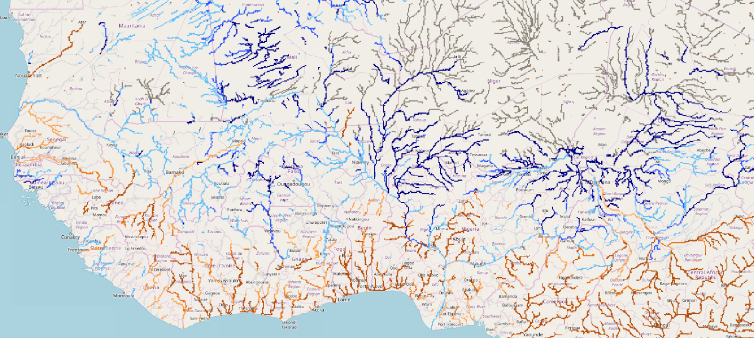
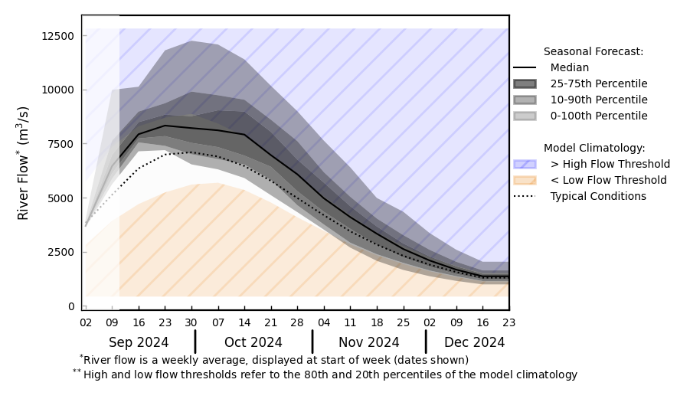
Streamflow Forecast in West Africa
@ Volta in Ghana
Komadugu
Volta
B
Sokoto
Chari
A
Logone
@ Niger in Niamey
Niger
GloFAS streamflow forecast: Sep – Dec 2024
Rivers across Sahel are expected to have above average flow.
High risk of flooding along Senegal, upstream of Niger in Guinea and Mali, Volta in Ghana, Niger in Niger, Sokoto, Komadugu, Benue, Niger in Nigeria and Logone and Chari in Chad.
GloFAS forecast: Sep – Dec 2024

Slide 7
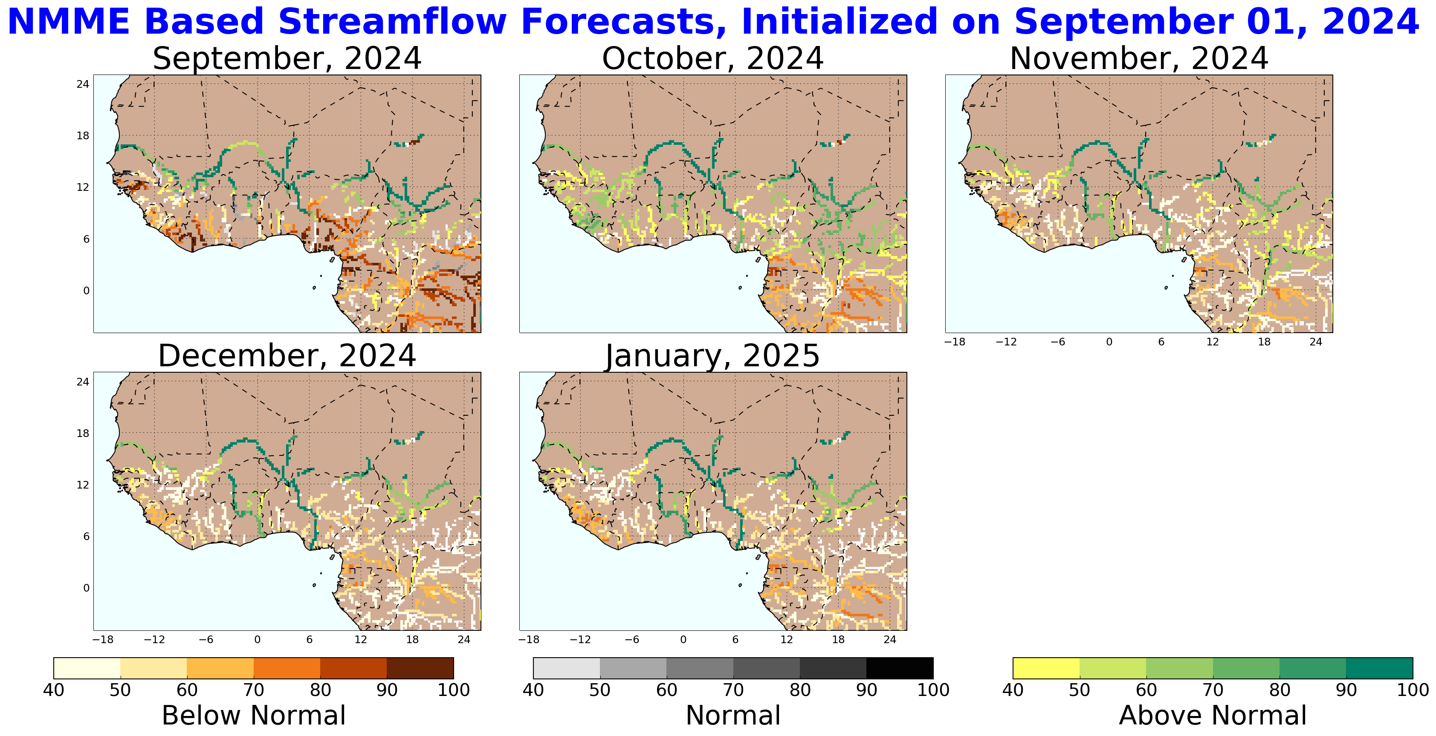
Streamflow Forecast in West Africa
NHyFAS streamflow forecast: Sep 2024 – Jan 2025
NHyFAS forecast also suggest similar above average streamflow in the Rivers across Sahel.

