Slide 1
FEWS NET Enhanced Flood Monitoring and Forecast Assumptions-Ukraine
March 2024 Seasonal Forecast
FEWS NET Science Team:
USGS, NASA, NOAA, UCSB+Regional Scientists

Slide 2
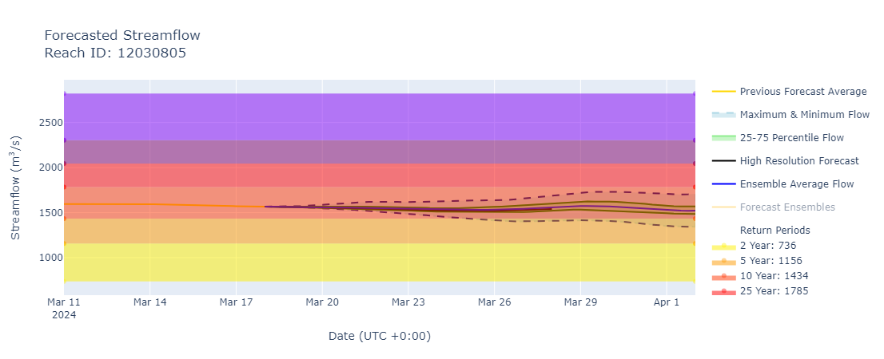
The Desna and the Dnieper Streamflow Forecast
@ point A: Desna River (north of Kiev)
A
B
@ point B: Dnieper River (south of Kiev)
GEOGloWS streamflow forecast (Mar 18 – Apr 2, 2024)
Discharges on the Desna and Dnieper Rivers are at 10-year return period level.
Flooding possible along their paths especially in the areas north of Kiev.

Slide 3
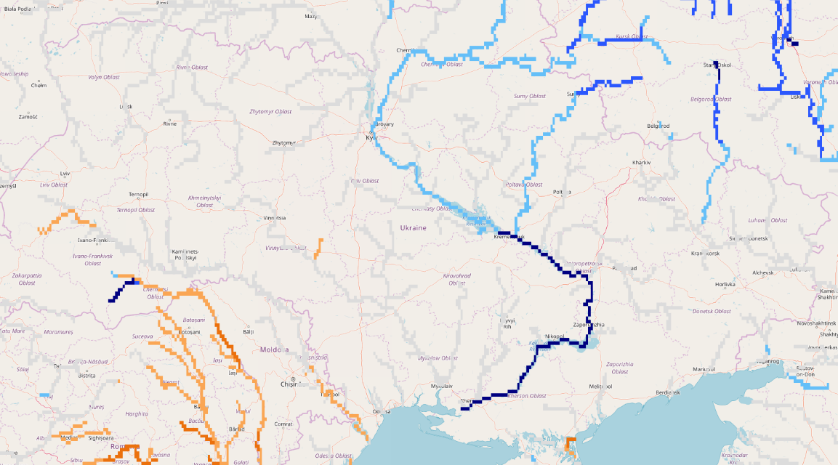
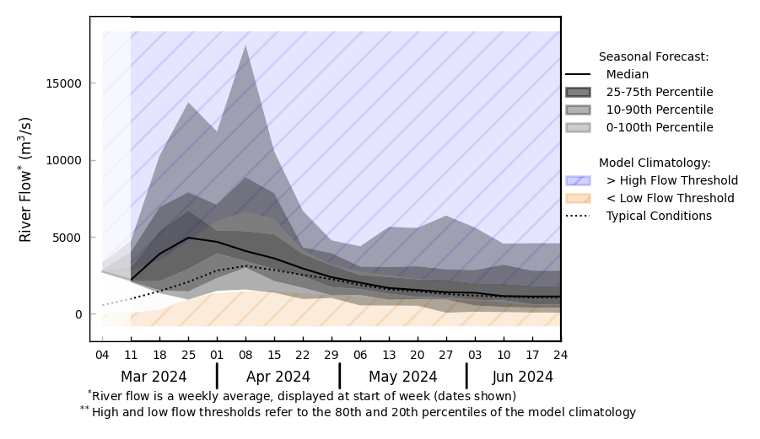
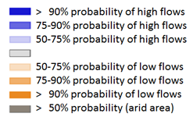
Seasonal Streamflow Forecast
@ point A: On the Dnieper River (south of Kiev)
A
GloFAS streamflow forecast: Mar – Jun 2024
GloFAS streamflow forecast: Mar – Jun 2024
The high discharges in the Dnieper River are expected to continue until early May of 2024.

