Slide 1
FEWS NET Enhanced Flood Monitoring and Forecast Assumptions-Ukraine
February 2024 Seasonal Forecast
FEWS NET Science Team:
USGS, NASA, NOAA, UCSB+Regional Scientists

Slide 2
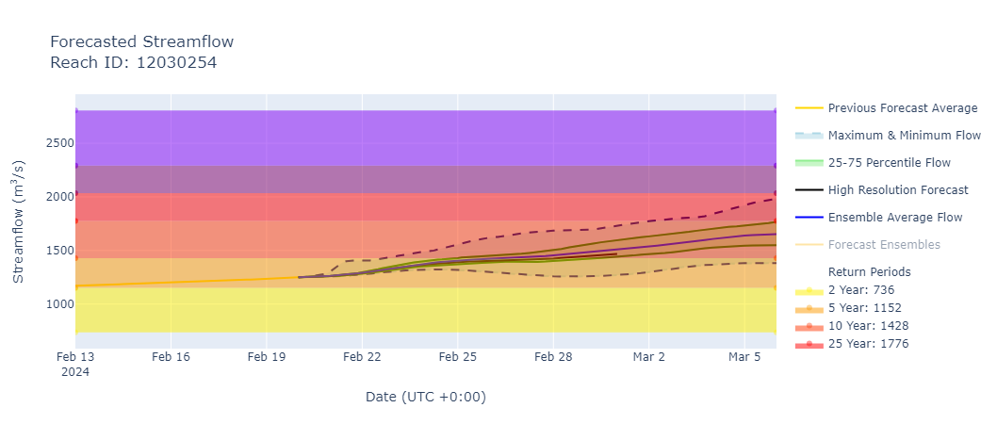
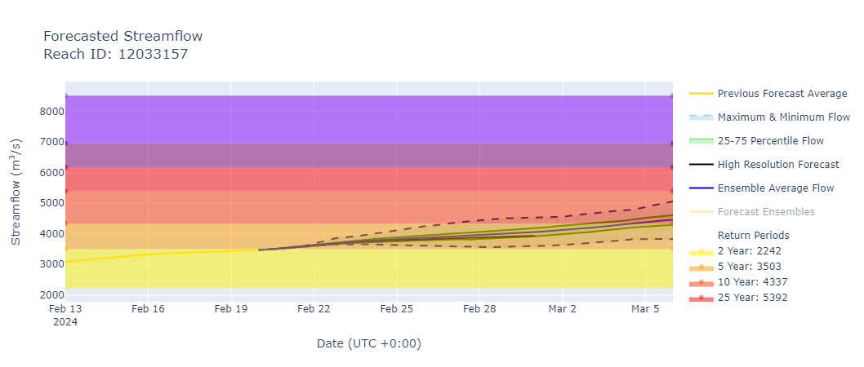
The Desna and the Dnieper Streamflow Forecast
@ point A: Desna River (north of Kiev)
A
B
@ point B: Dnieper River (south of Kiev)
GEOGloWS streamflow forecast (Feb 20 – Mar 5, 2024)
Discharges on the Desna and Dnieper Rivers are on the rise and could reach a 10-year return period level in early March.
Flooding possible along their paths especially in the areas north of Kiev.

