Slide 1
FEWS NET Enhanced Flood Monitoring and Forecast Assumptions-Ukraine
May 2024 Seasonal Forecast
FEWS NET Science Team:
USGS, NASA, NOAA, UCSB+Regional Scientists

Slide 2
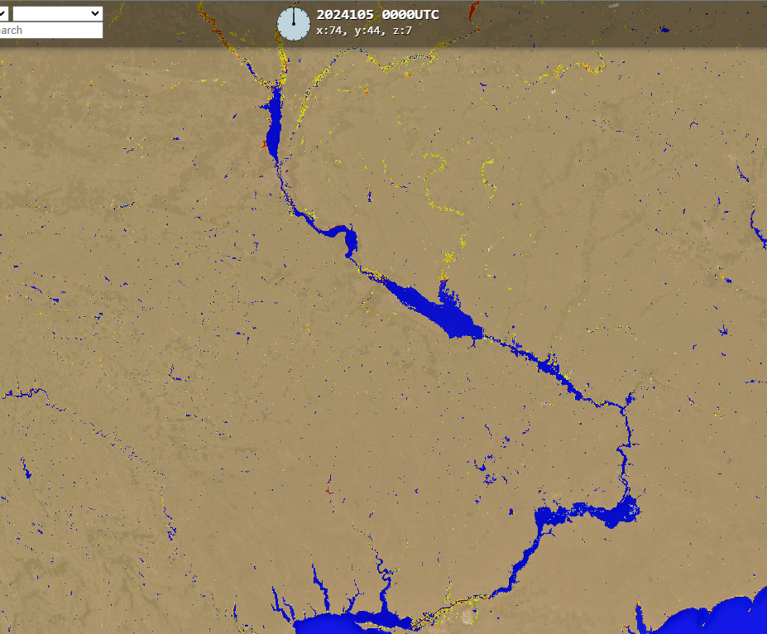
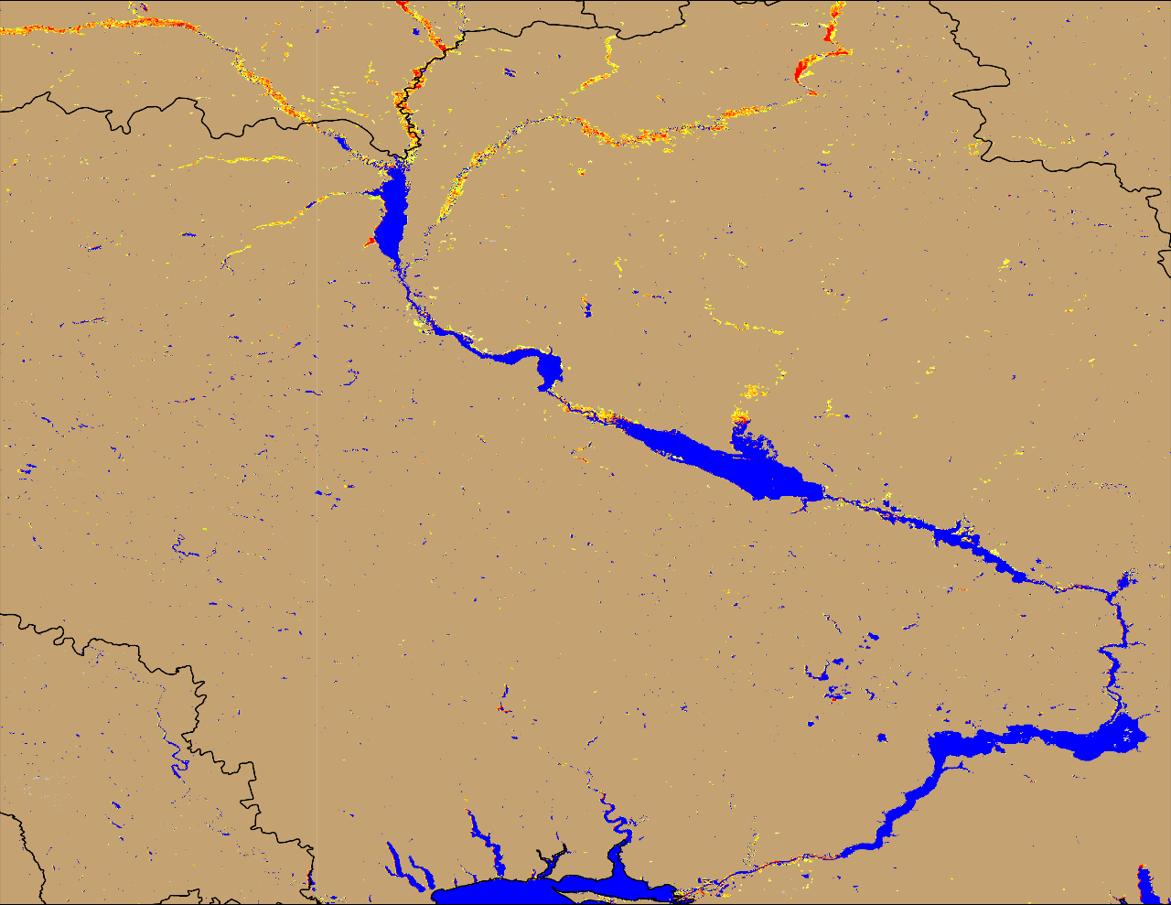
Flooding in Ukraine
Desna
Desna
Sula
Sula
Dnieper
Dnieper
(% of the pixel)
NOAA VIIRS 5-day comp.: 10 – 14 Apr 2024
NOAA VIIRS 5-day comp.: 08 – 12 May 2024
Inundation became more pronounced especially along Desna River.

Slide 3
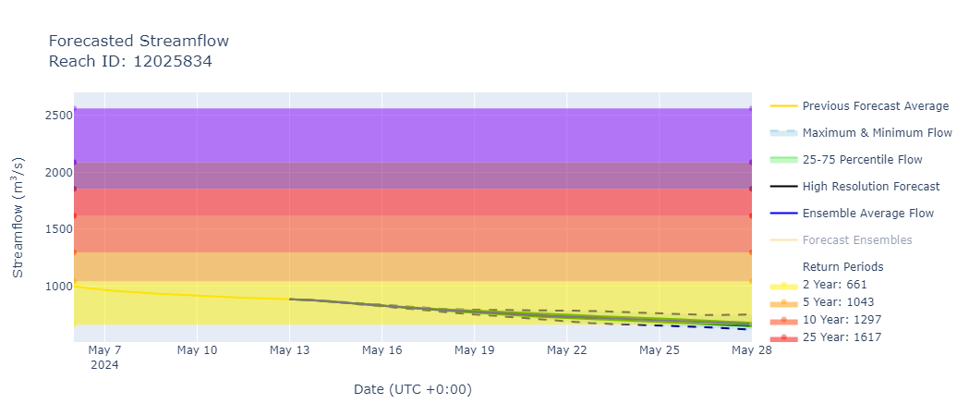
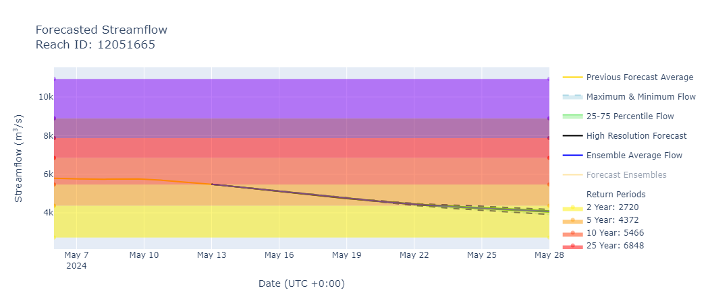
The Desna and the Dnieper Streamflow Forecast
@ point A: Desna River (north of Kiev)
A
@ point B: Lower Dnieper River
B
GEOGloWS streamflow forecast (May13 – 28, 2024)
Discharges are on the decline along the major rivers in Ukraine.

Slide 4
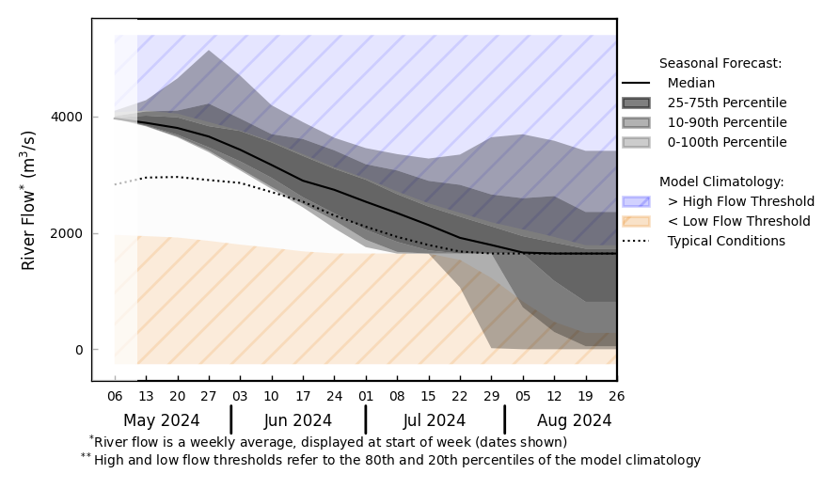
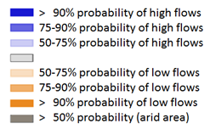
Seasonal Streamflow Forecast
@ point A: On the Dnieper River
A
GloFAS streamflow forecast: May – Aug 2024
GloFAS streamflow forecast: May – Aug 2024
Average discharges are expected across all major rivers in Ukrine.

