Slide 1
FEWS NET Enhanced Flood Monitoring and Forecast Assumptions-Ukraine
April 2024 Seasonal Forecast
FEWS NET Science Team:
USGS, NASA, NOAA, UCSB+Regional Scientists

Slide 2
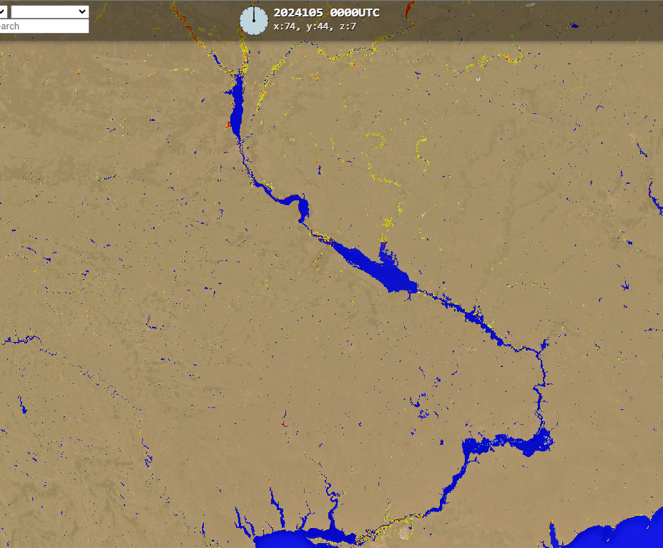
Flooding in Ukraine
Flooding can be seen along Desna and Sula Rivers in Ukraine.
Desna
Sula
Dnieper
(% of the pixel)
NOAA VIIRS 5-day comp.: 10 – 14 Apr 2024

Slide 3
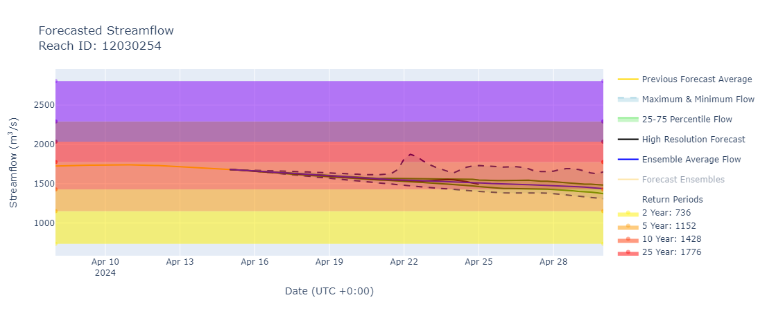
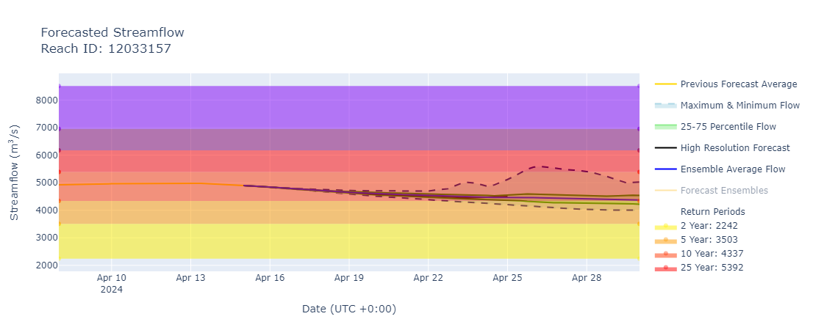
The Desna and the Dnieper Streamflow Forecast
@ point A: Desna River (north of Kiev)
A
B
@ point B: Dnieper River (south of Kiev)
GEOGloWS streamflow forecast (Apr15 – Apr 30, 2024)
High discharges at a 10-year return period level continue in the Desna and Dnieper Rivers.
Flooding possible along their paths especially in the areas north of Kiev.

Slide 4
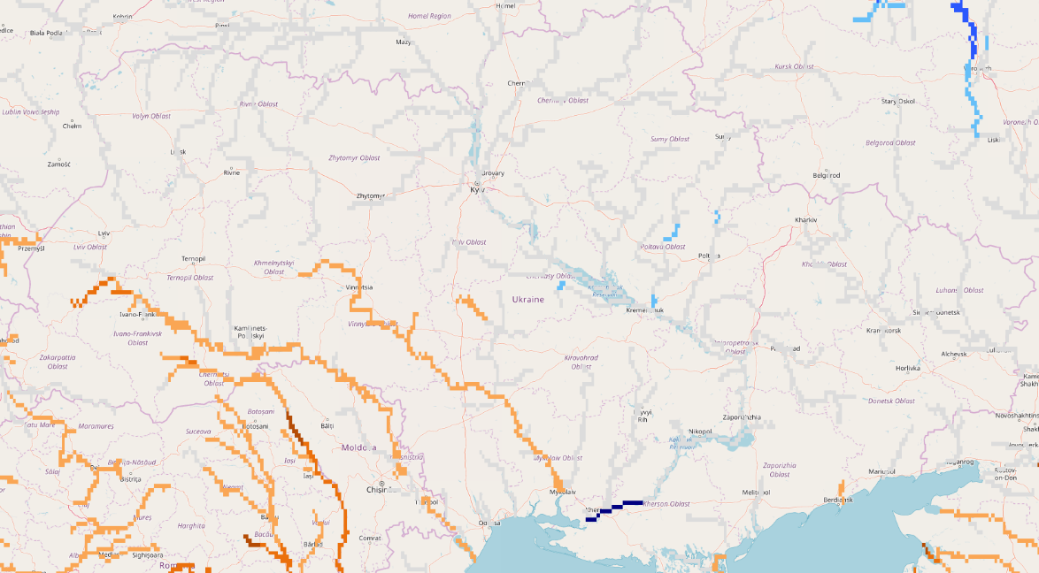
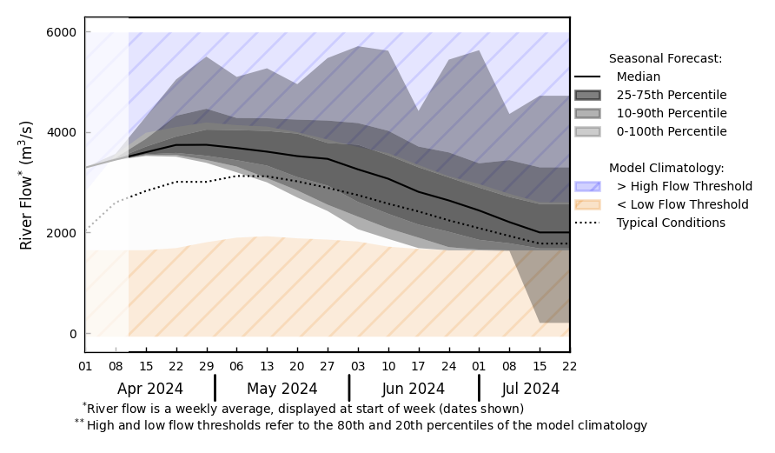
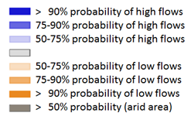
Seasonal Streamflow Forecast
@ point A: On the Dnieper River
A
GloFAS streamflow forecast: Apr – Jul 2024
GloFAS streamflow forecast: Apr – Jul 2024
Discharges in all major rivers in Ukraine are expected to diminish starting in May.

