Slide 1
FEWS NET Enhanced Flood Monitoring and Forecast Assumptions - Southern Africa
March 2024 Seasonal Forecast
FEWS NET Science Team:
USGS, NASA, NOAA, UCSB+Regional Scientists

Slide 2
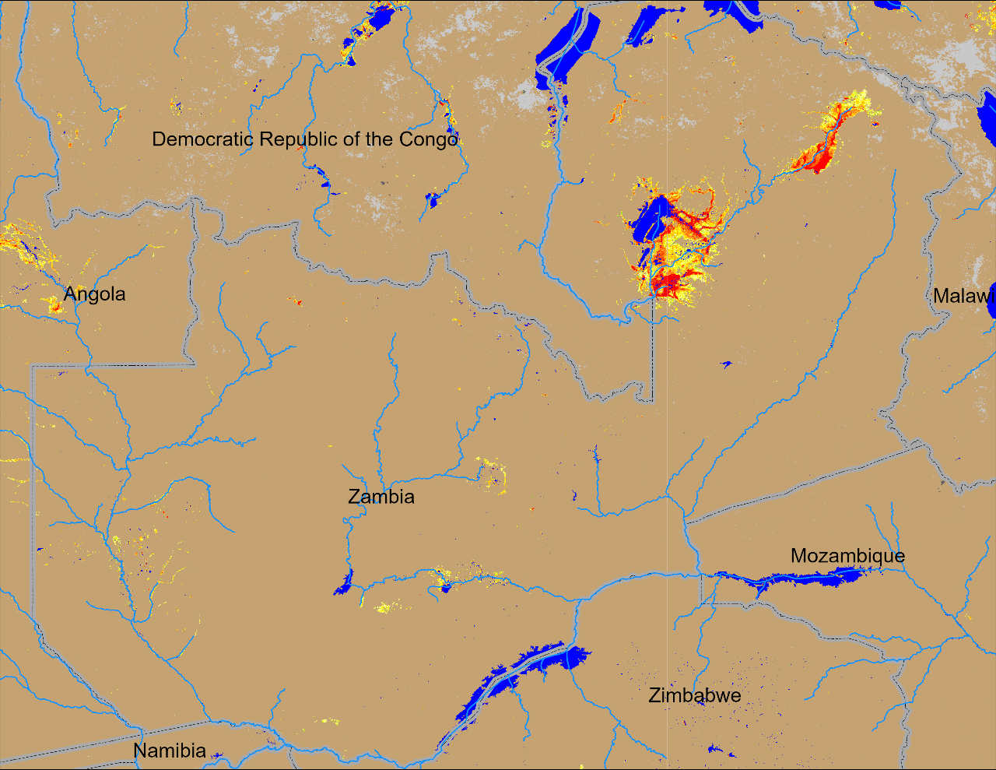
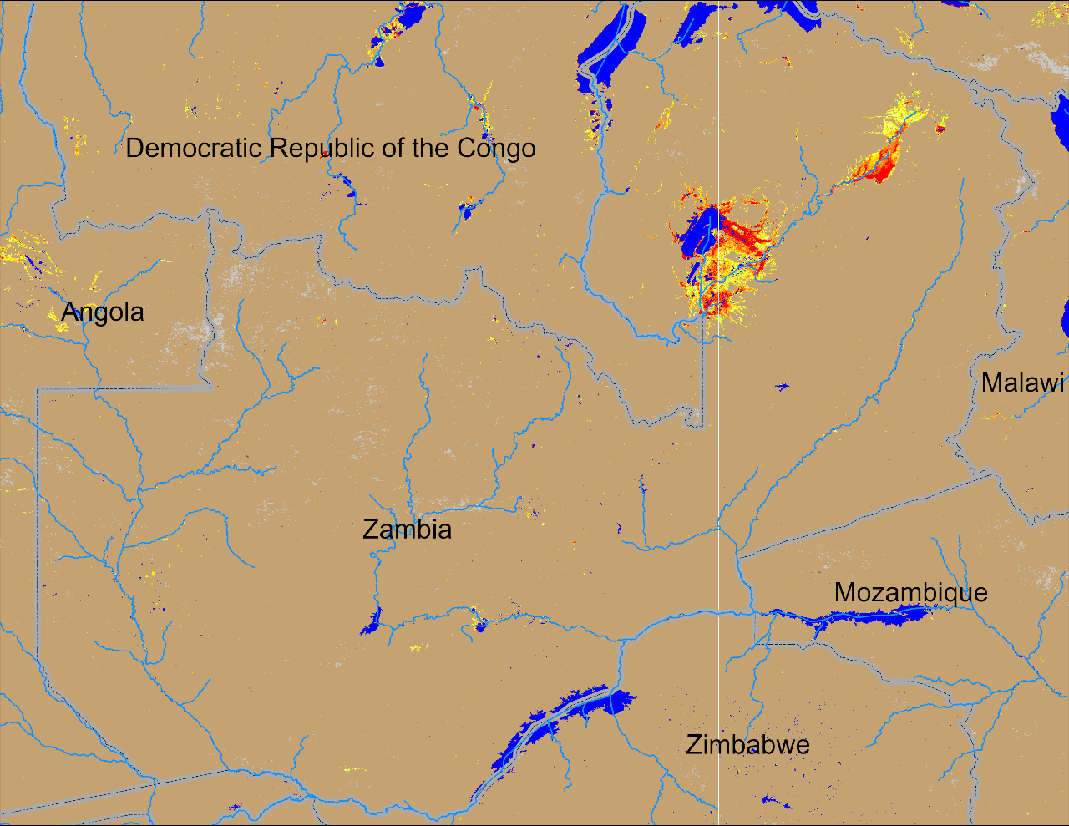
Flooding in Zambia
(% of the pixel)
(% of the pixel)
NOAA VIIRS 5-day comp.: 15 – 19 Feb 2024
NOAA VIIRS 5-day comp.: 13 – 17 Mar 2024
Inundated areas remain unchanged in northern Zambia.

Slide 3
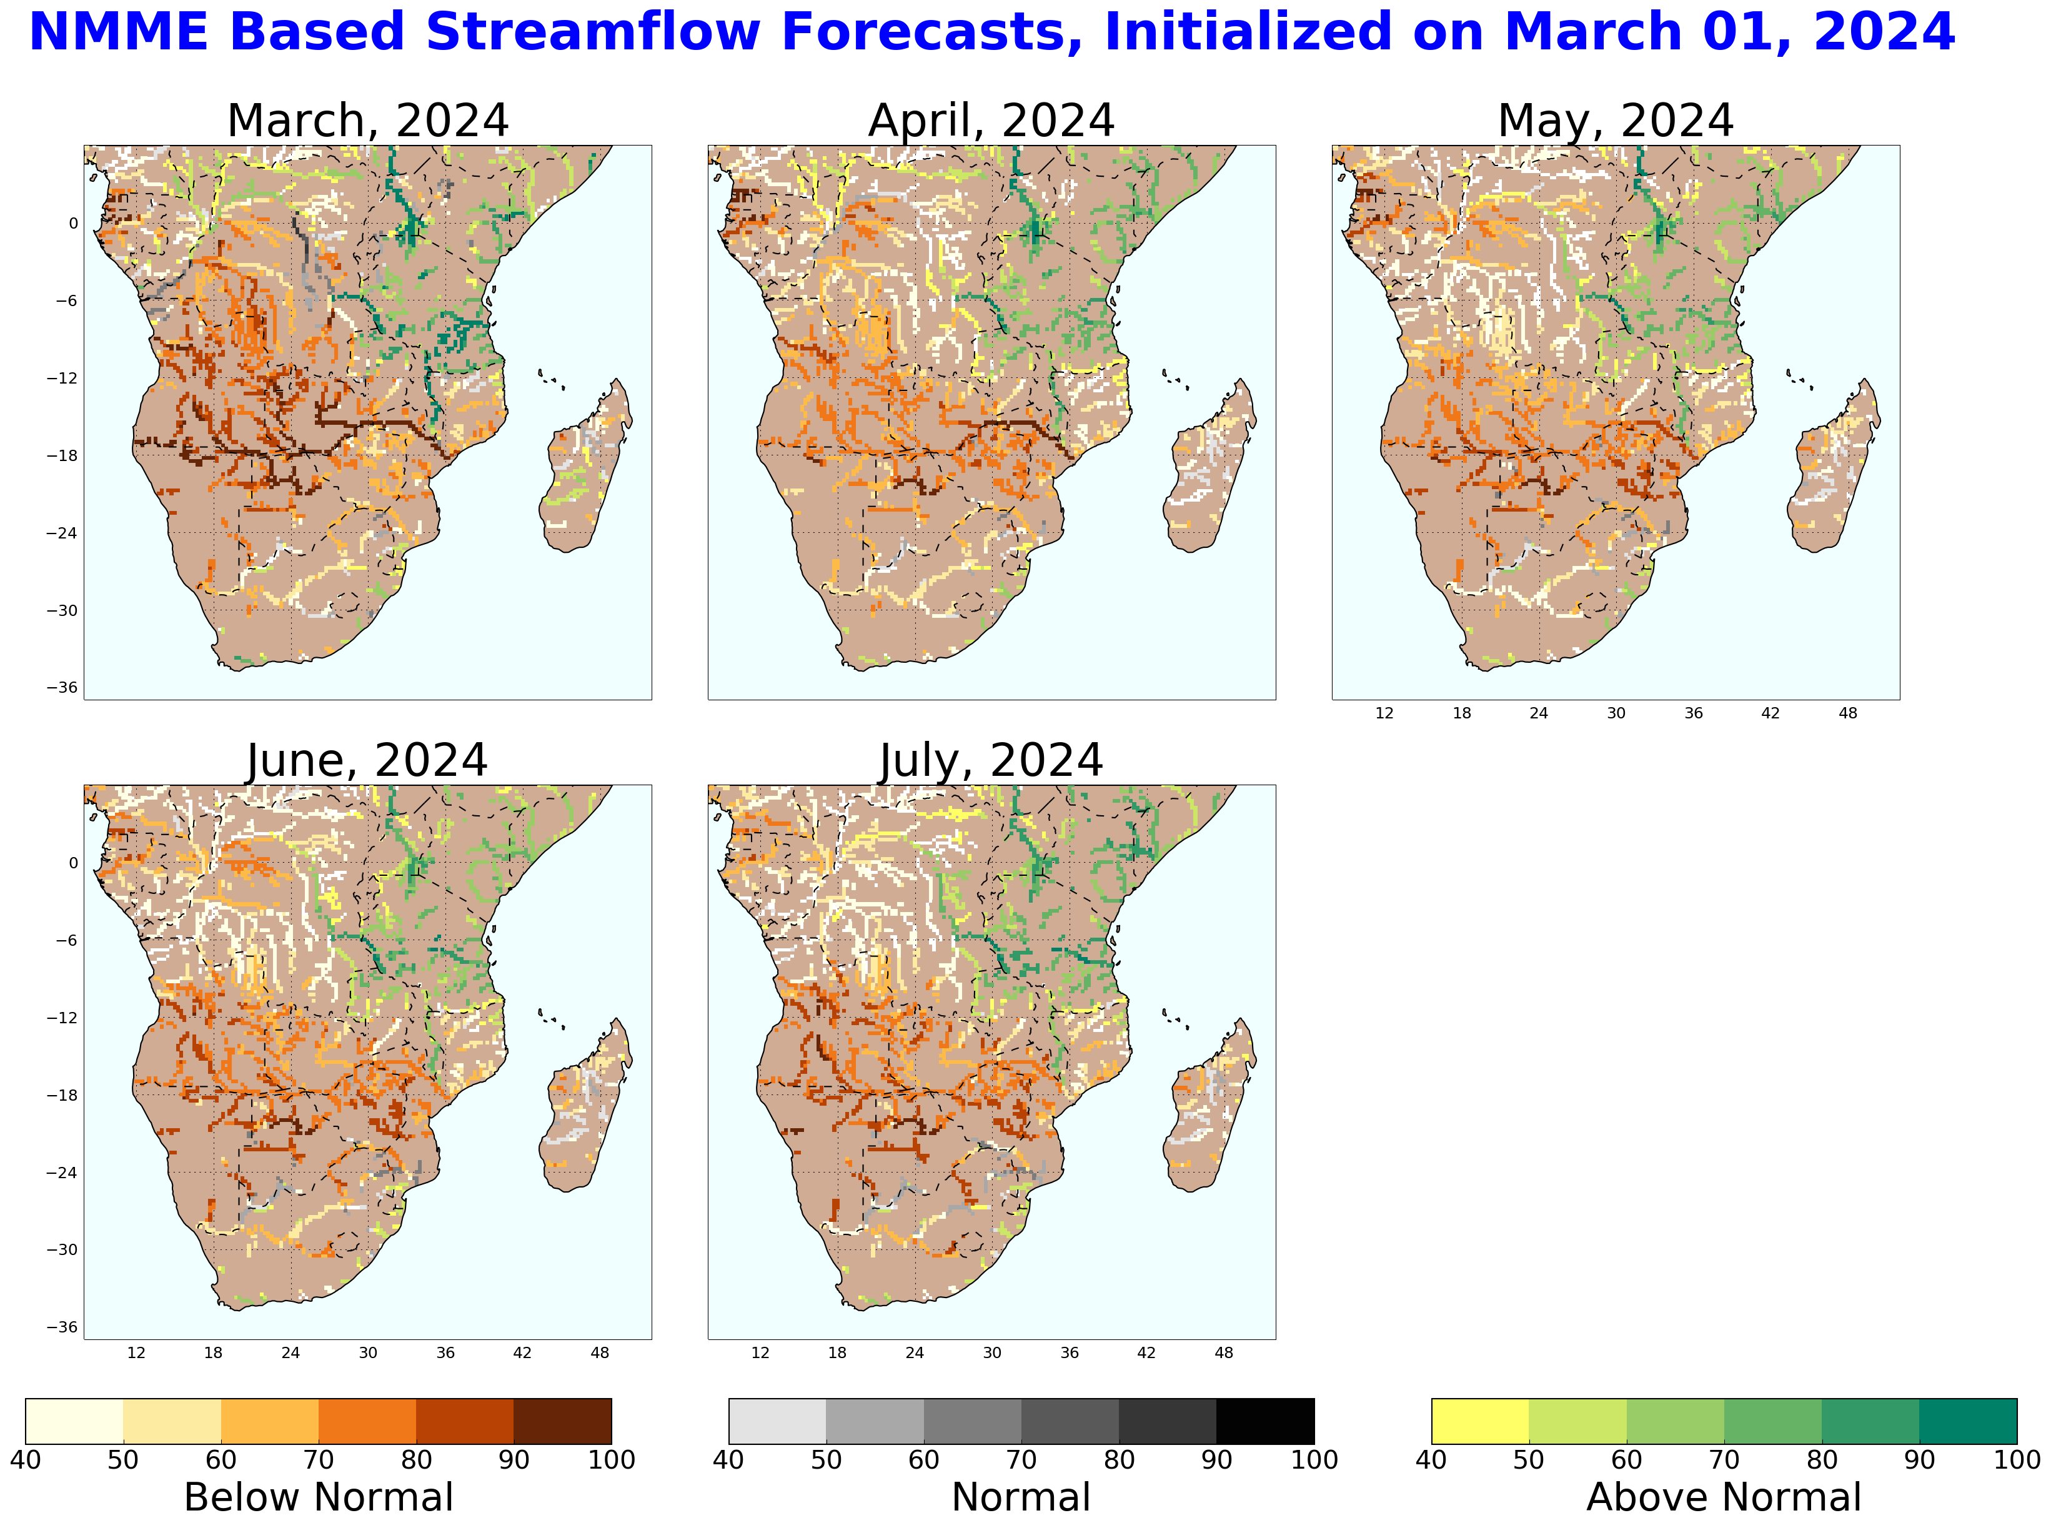
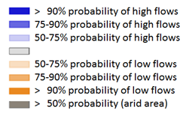
Seasonal Streamflow Forecast
GloFAS seasonal forecast Mar - Jun 2024
NHyFAS monthly forecast Mar - July 2024
Average to below average streamflow is expected across much of Southern Africa except the Shire River.

Slide 4
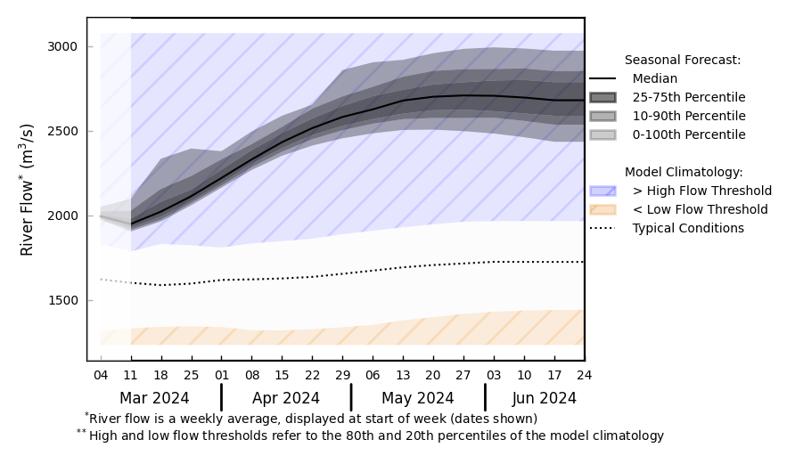
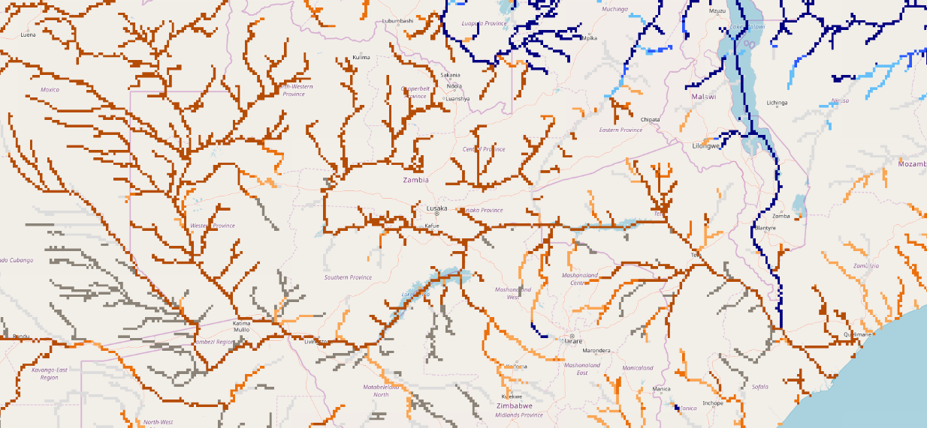
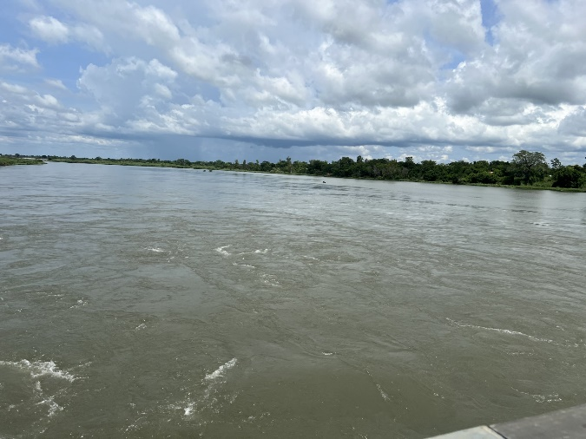
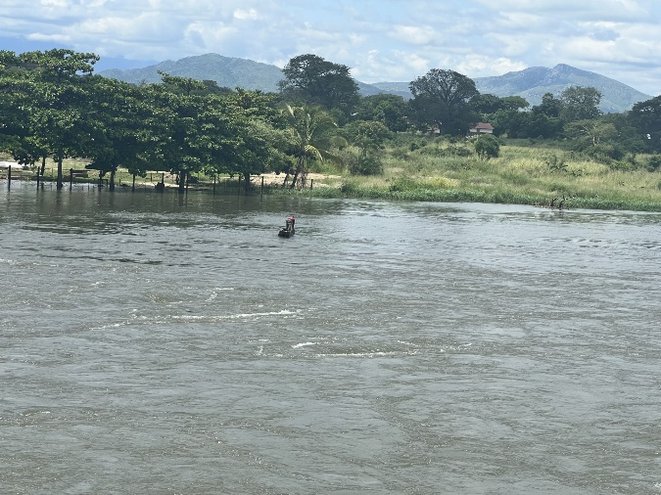
Seasonal Streamflow Forecast
@ point A: Sheri River near Blantyre
Luangwa
Shire
Kafue
A
Zambezi
GloFAS monthly forecast (Mar – Jun 2024)
GloFAS seasonal forecast Mar - Jun 2024
Well below average streamflow in the upstream of Zambezi River. Not good for Lake Kariba water level recovery.
Well above average streamflow in the Shire River. Flooding possible in southern Malawi.
Shire River: photos taken on Mar 13 by Mike Budde during Crop Tour 2024

Slide 5
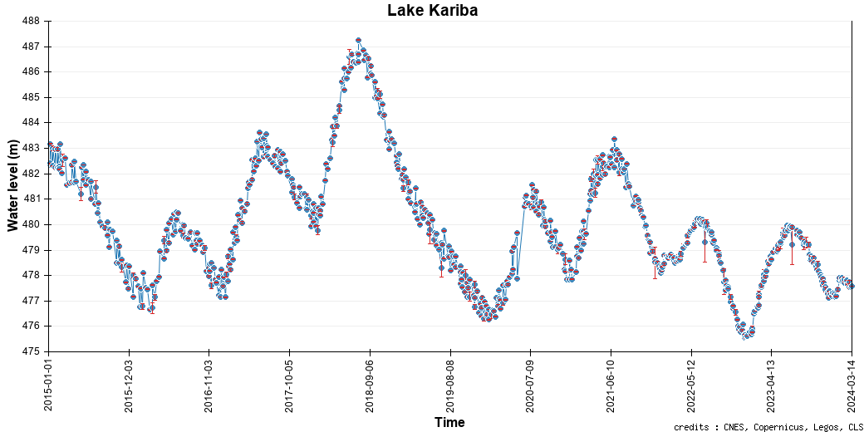
Lake Kariba Water Level
Current water level in Lake Kariba is on the decline when it suppose to be raising.

