Slide 1
FEWS NET Enhanced Flood Monitoring and Forecast Assumptions - Southern Africa
January 2024 Seasonal Forecast
FEWS NET Science Team:
USGS, NASA, NOAA, UCSB+Regional Scientists

Slide 2
1St Dekad of January Conditions
According to January 1-10, 2024, basin excess rainfall map, concerns for flooding exist in northern Zambia.

Slide 3
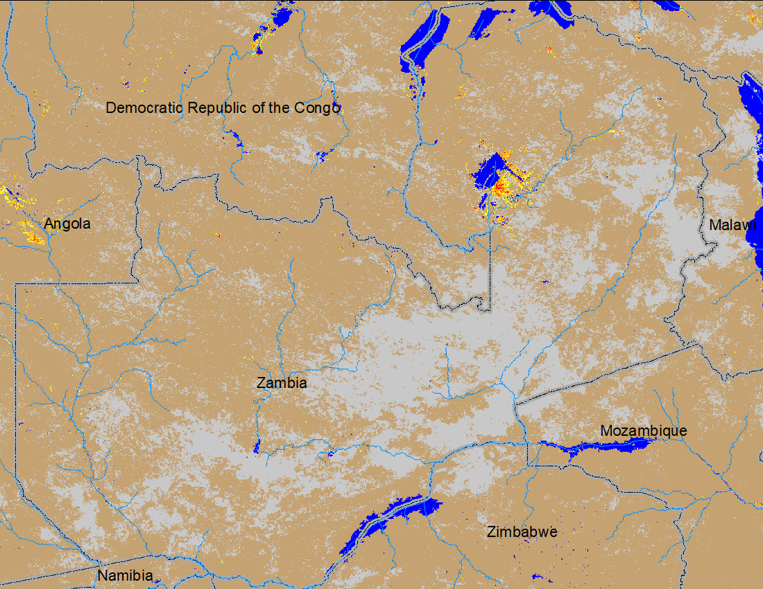
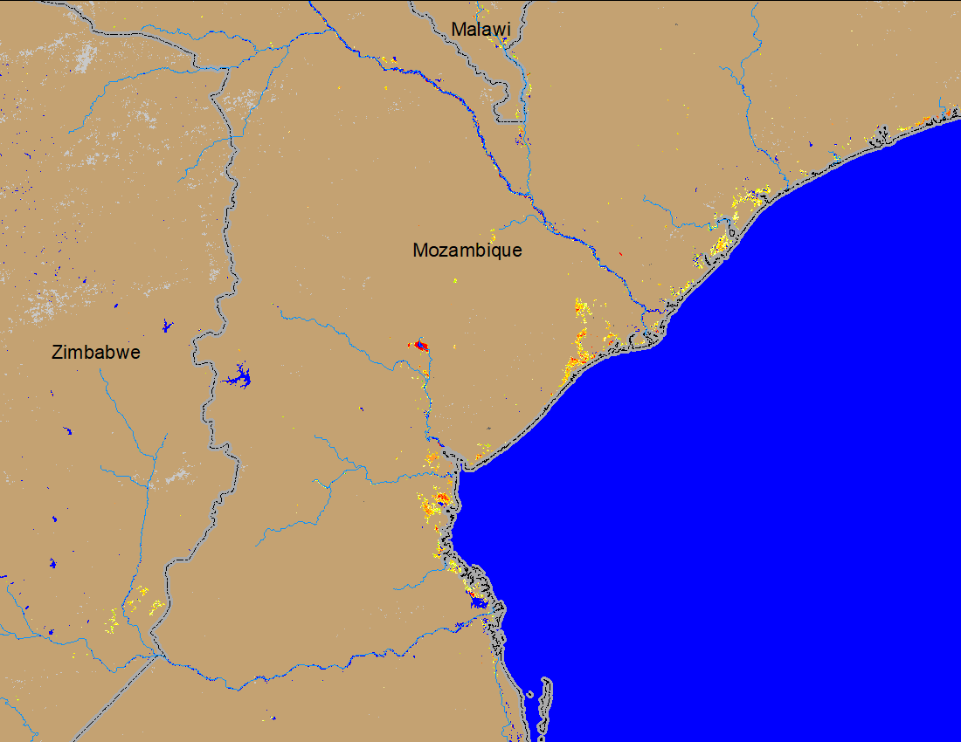
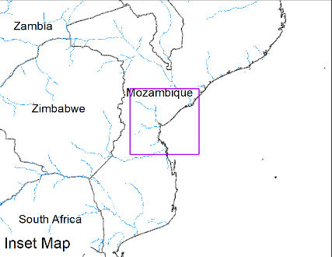
Flooding in Zambia & Mozambique
(% of the pixel)
(% of the pixel)
NOAA VIIRS 5-day comp.: 11 – 15 Jan 2024
NOAA VIIRS 5-day comp.: 11 – 15 Jan 2024
Currently minor flooding occurring in northern Zambia and central Mozambique.

Slide 4
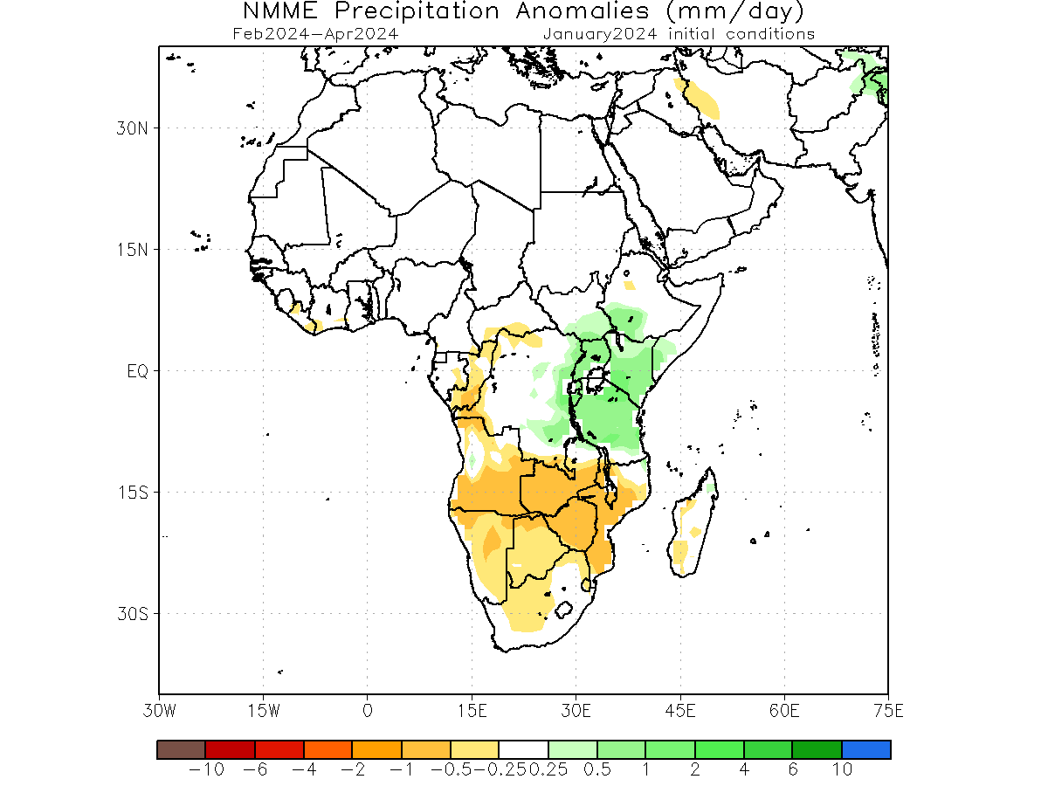
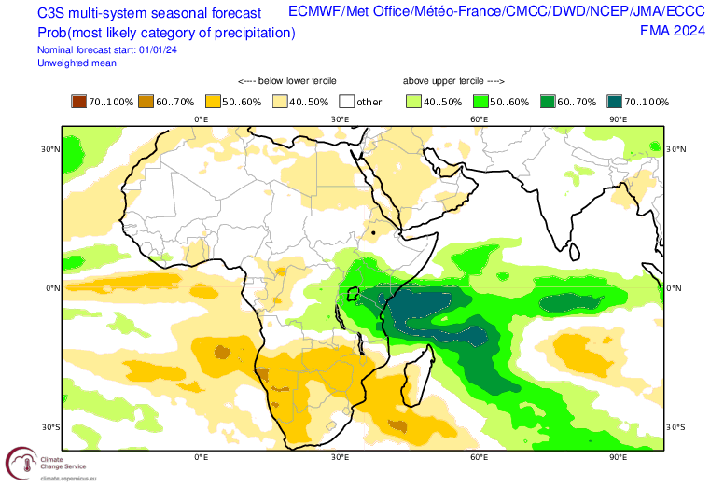
Seasonal Rainfall Forecast
Models are suggesting below average rainfall across Southern Africa During Feb-Apr 2024 except over Tanzania and southern DRC.

Slide 5
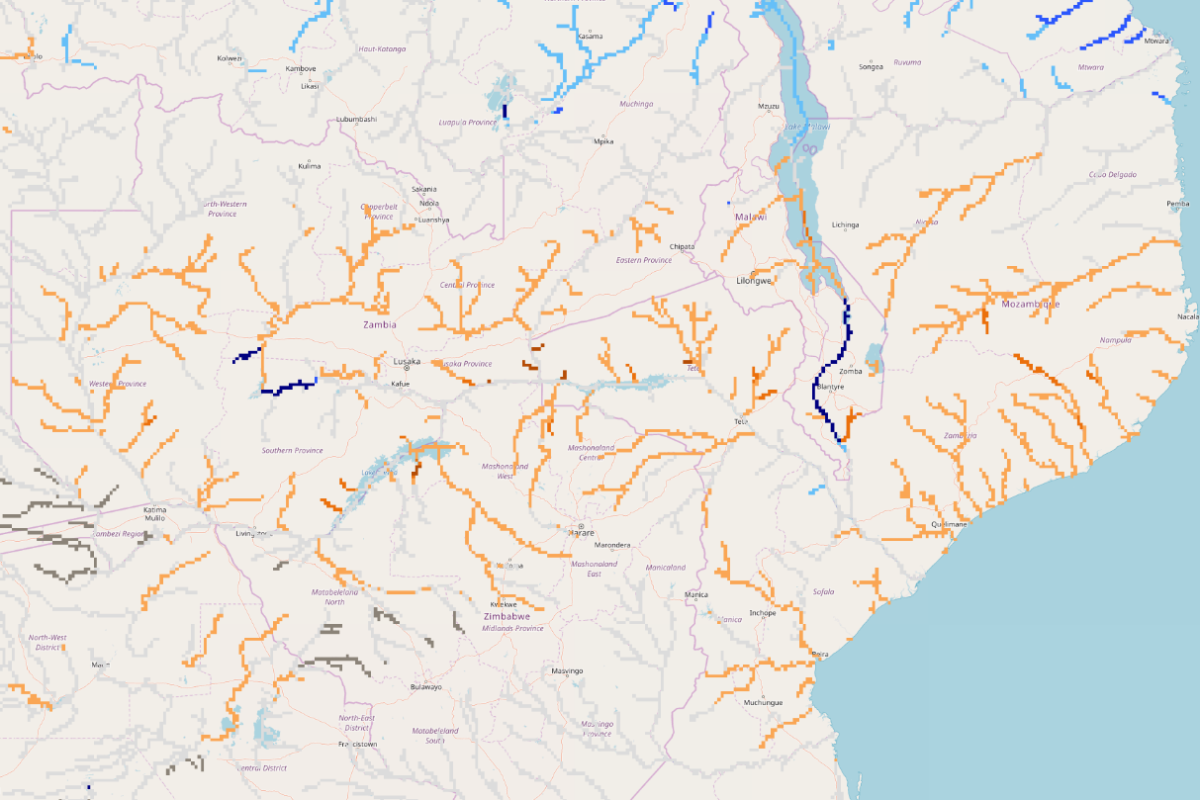
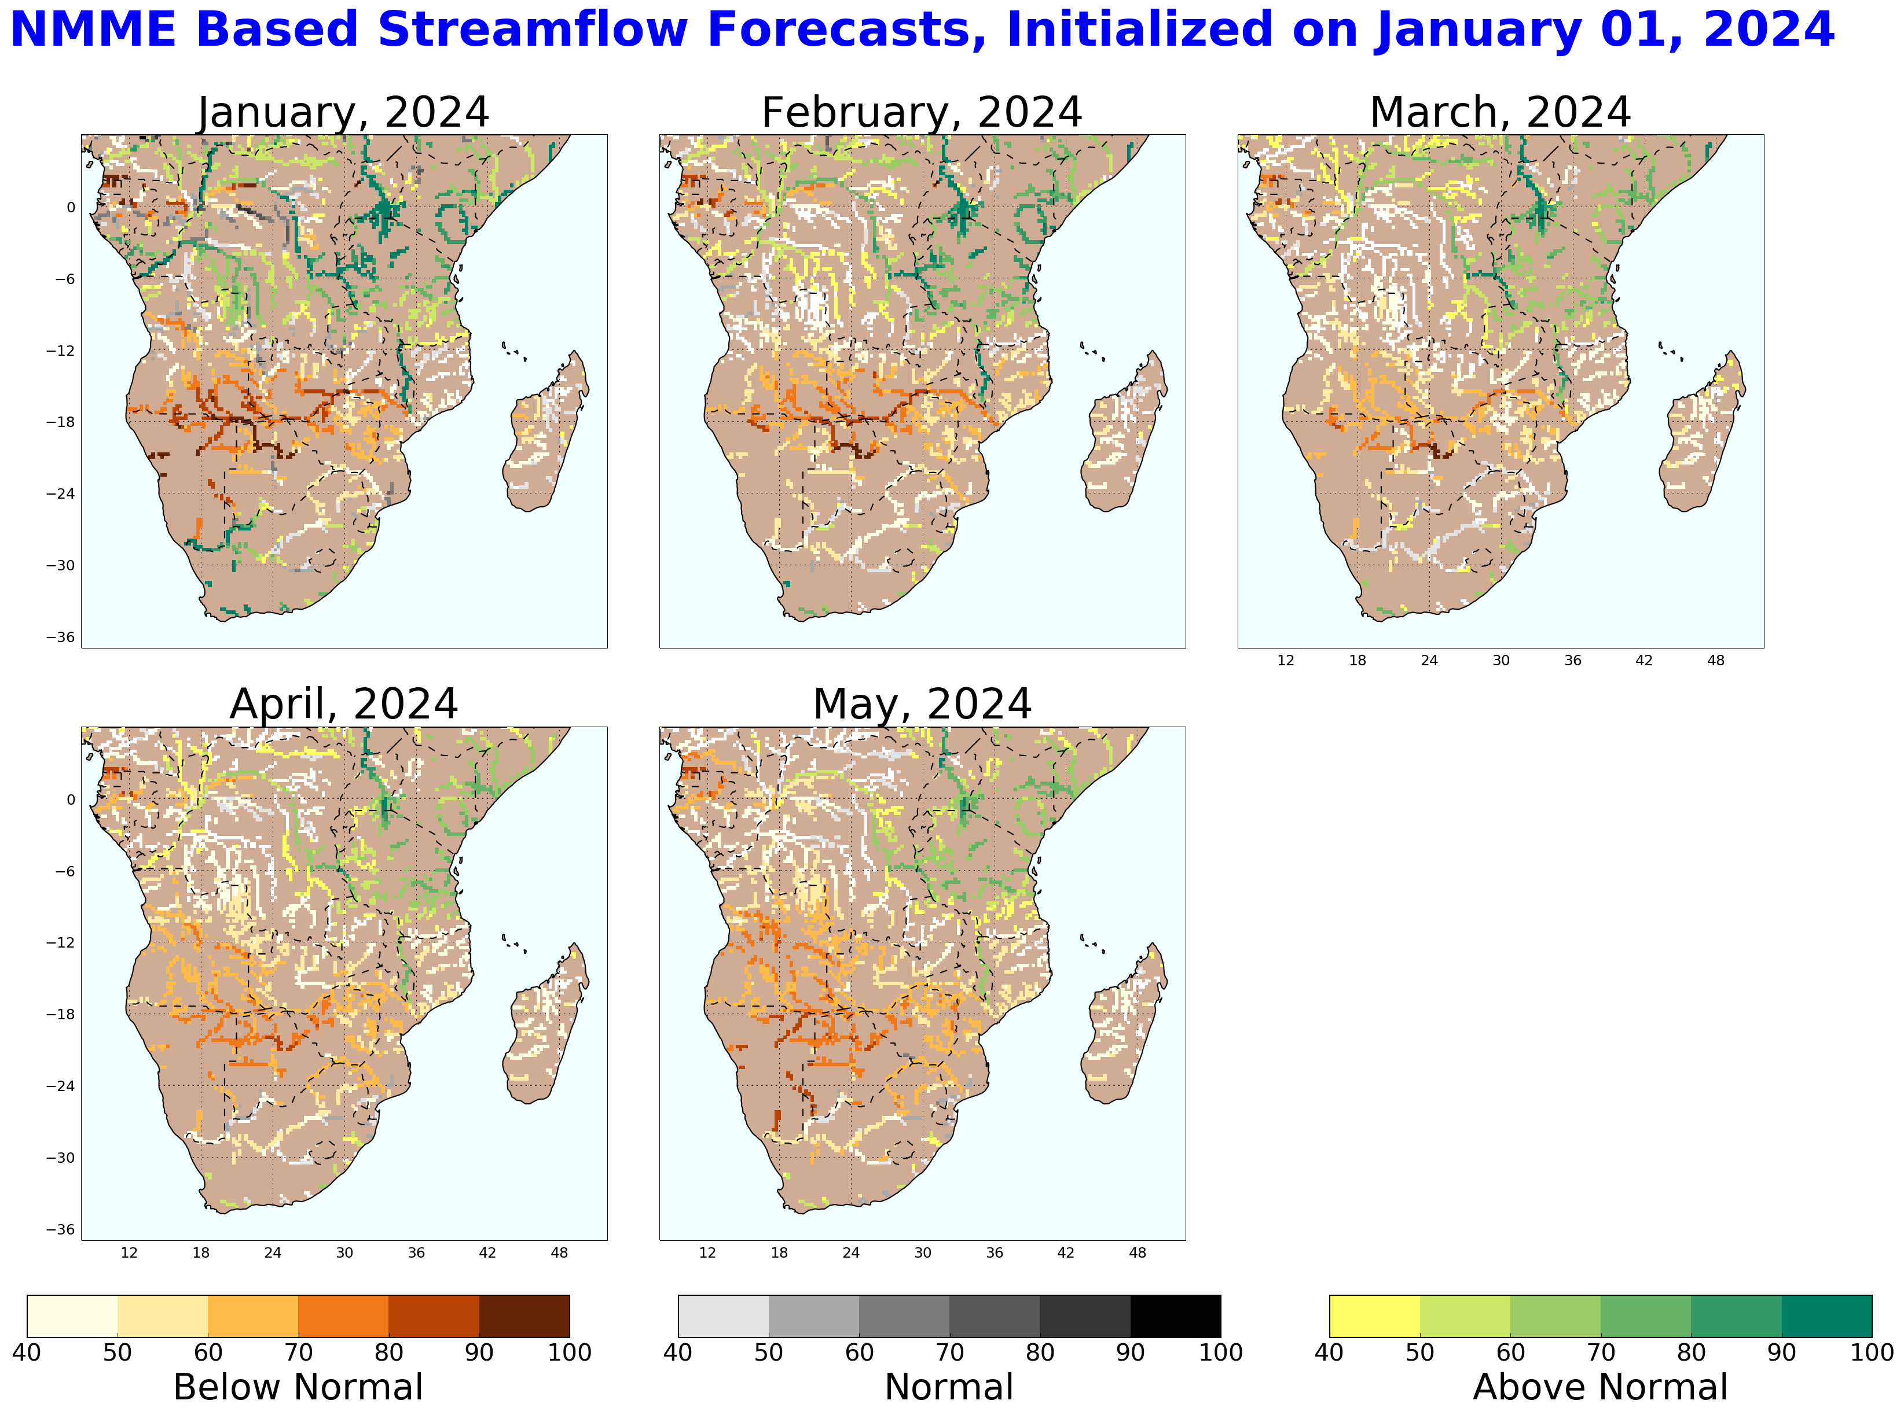
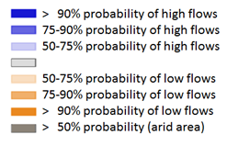
GloFAS Seasonal Streamflow Forecast (Jan – Apr 2024)
Luangwa
Kafue
Zambezi
Sheri
GloFAS seasonal forecast Jan - Apr 2024
NHyFAS monthly forecast Jan - May 2024
Streamflow for Zambezi including its tributaries are expected to be average to below average.
Streamflow in the Sheri River is expected to be well above average, mostly due to runoff from the northern catchment of Lake Malawi (Tanzania).

Slide 6
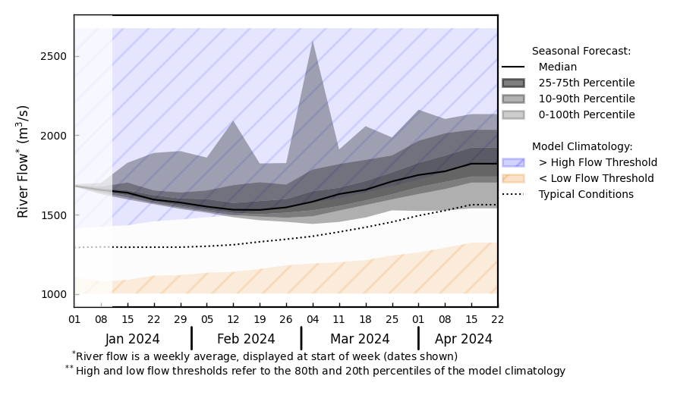
GloFAS Seasonal Streamflow Forecast (Jan – Apr 2024)
@ point A: Sheri River near Blantyre
Luangwa
Kafue
Zambezi
Sheri
A
GloFAS seasonal forecast Jan - Apr 2024
GloFAS monthly forecast (Jan – Apr 2024)
Above average streamflow in the Sheri River.
Flooding may occur in southern Malawi (same areas affected by flooding in March of 2023 due to TC Freddy).

Slide 7
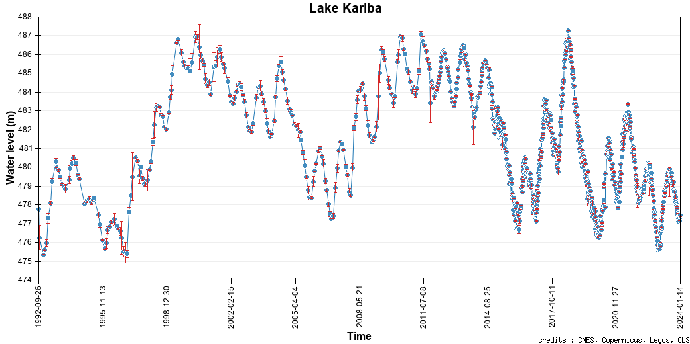
Lake Kariba Water Level
Current water level of Lake Kariba.

