Slide 1
FEWS NET Enhanced Flood Monitoring and Forecast Assumptions - Southern Africa
February 2024 Seasonal Forecast
FEWS NET Science Team:
USGS, NASA, NOAA, UCSB+Regional Scientists

Slide 2
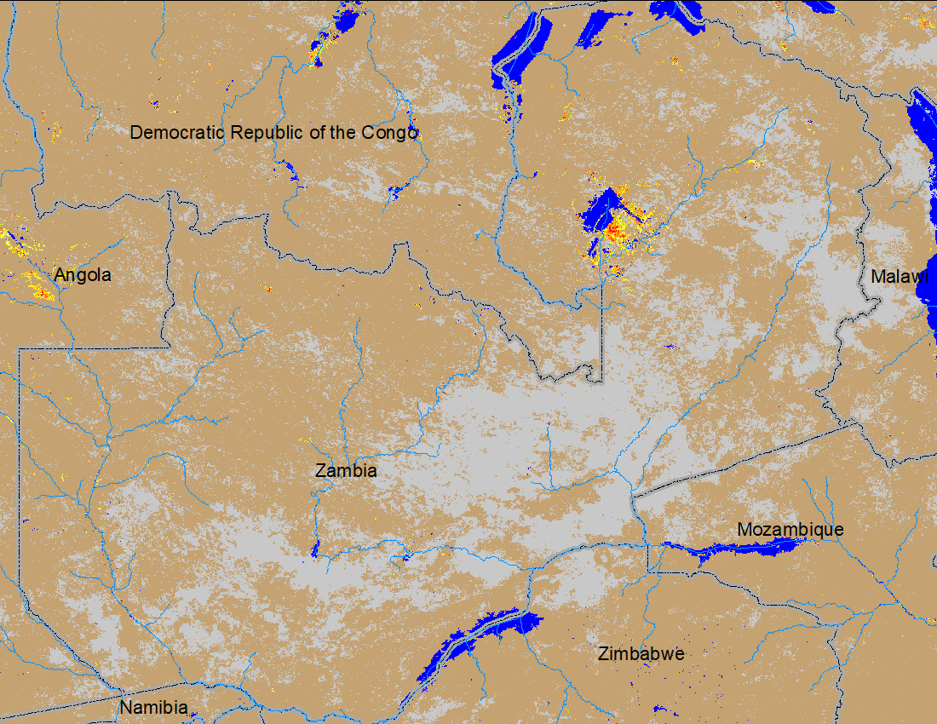
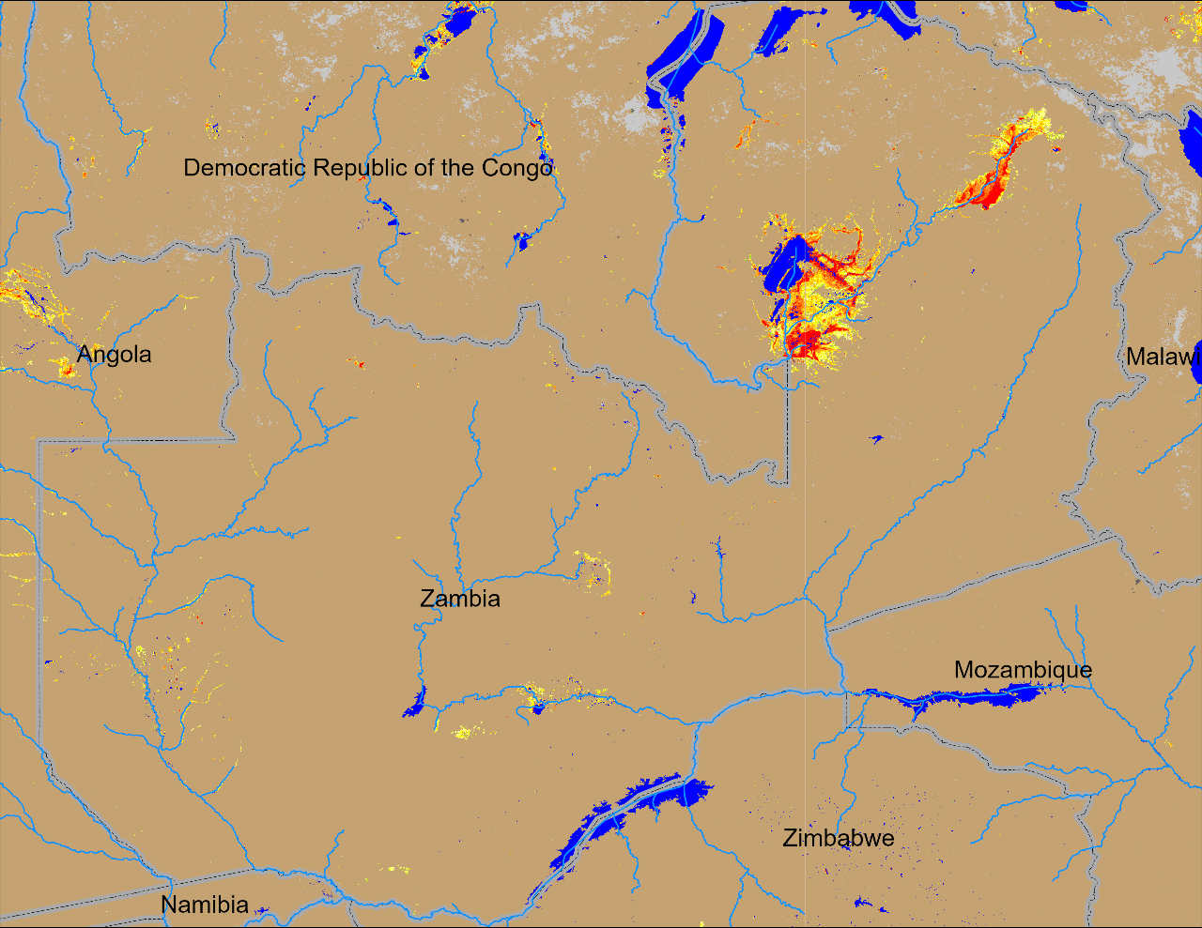
Flooding in Zambia
(% of the pixel)
(% of the pixel)
NOAA VIIRS 5-day comp.: 11 – 15 Jan 2024
NOAA VIIRS 5-day comp.: 15 – 19 Feb 2024
Inundated areas increased substantially in northern Zambia.

Slide 3
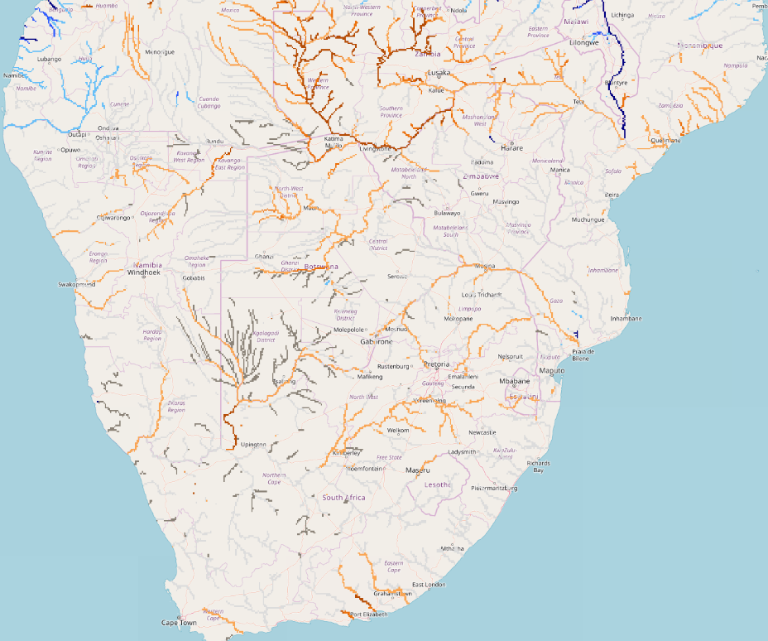
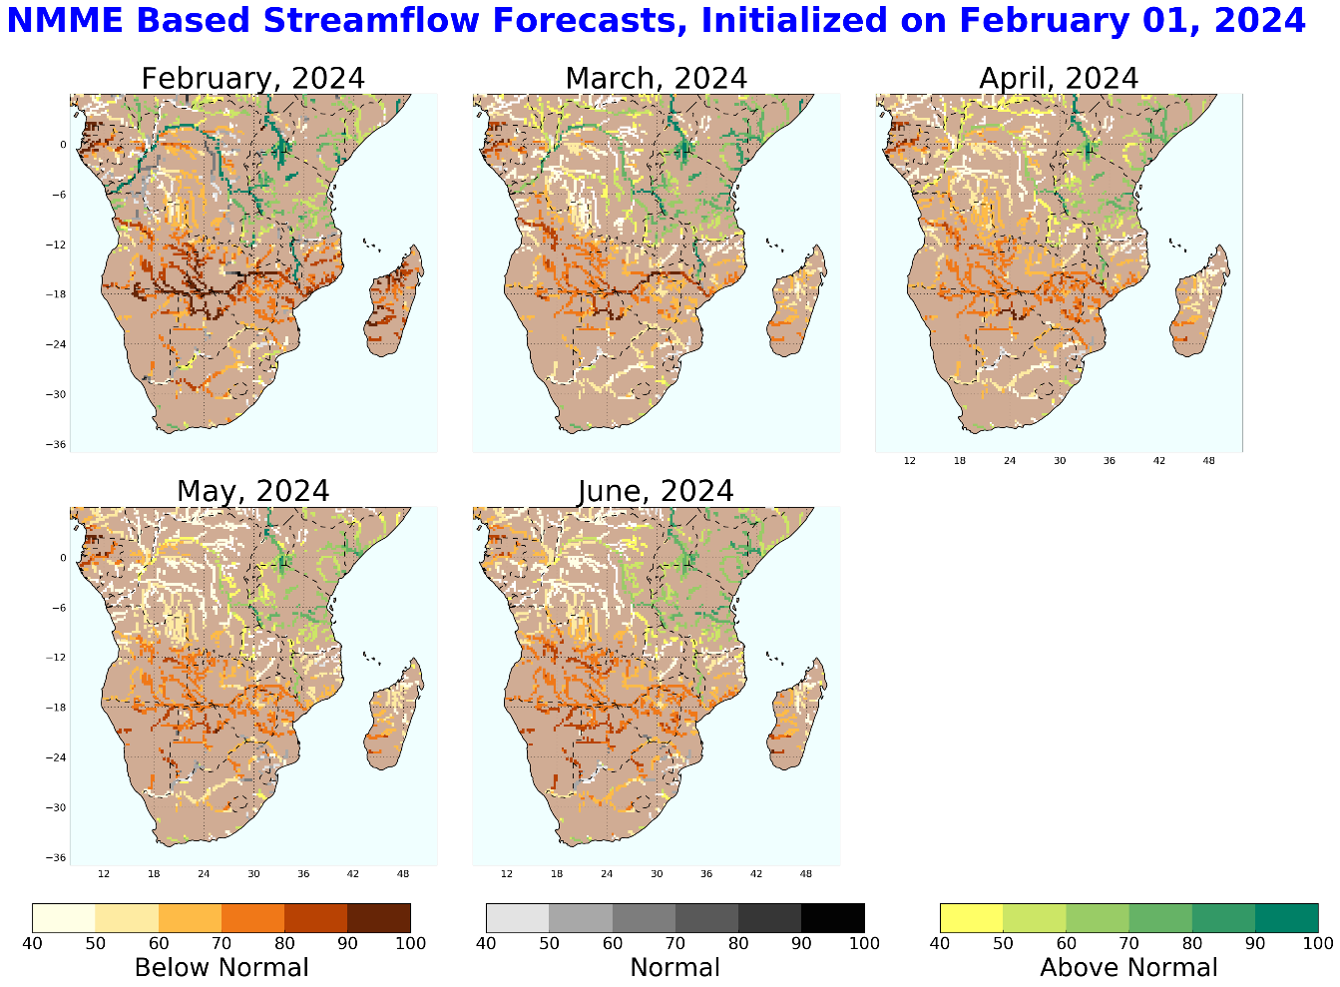
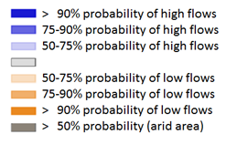
GloFAS Seasonal Streamflow Forecast (Feb – May 2024)
GloFAS seasonal forecast Feb - May 2024
NHyFAS monthly forecast Feb - Jun 2024
Average to below average streamflow is expected across much of Southern Africa except the Sheri River.

Slide 4
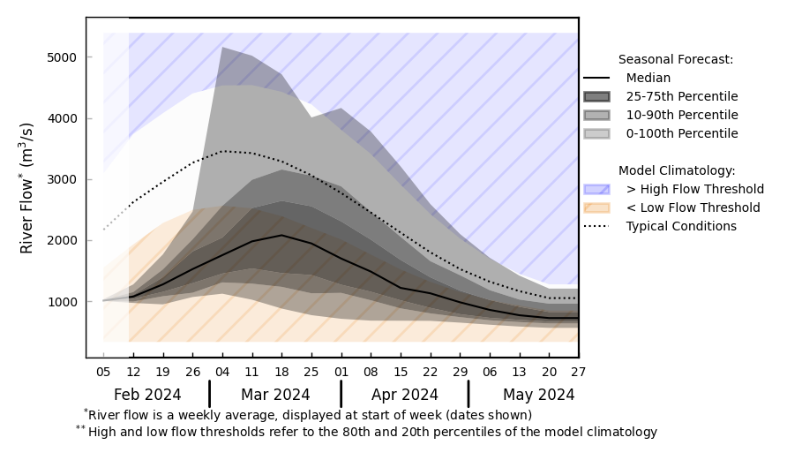
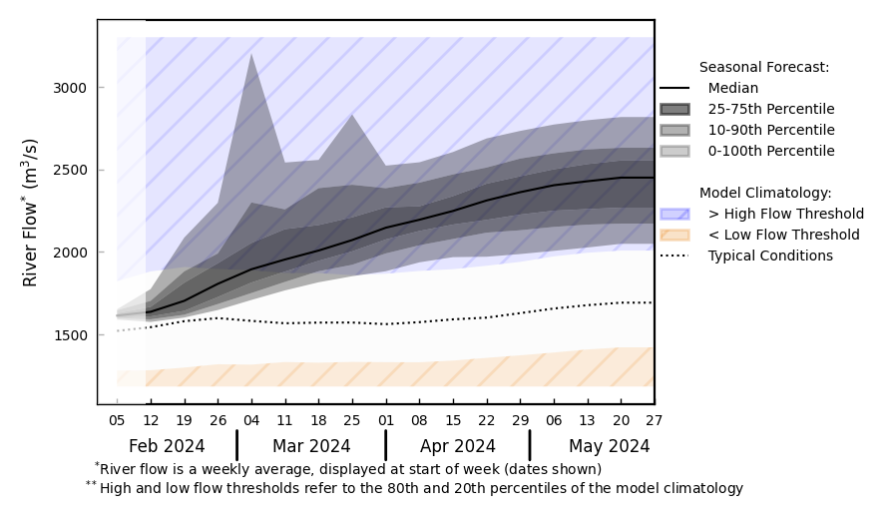
GloFAS Seasonal Streamflow Forecast (Feb – May 2024)
@ point A: Zambezi River before Lake Kariba
Luangwa
Sheri
Kafue
B
A
Zambezi
@ point B: Sheri River near Blantyre
GloFAS seasonal forecast Feb - May 2024
Well below average streamflow in the upstream of Zambezi River. Not good for Lake Kariba water level recovery.
Above average streamflow in the Sheri River. Flooding possible in southern Malawi.
GloFAS monthly forecast (Feb – May 2024)

Slide 5
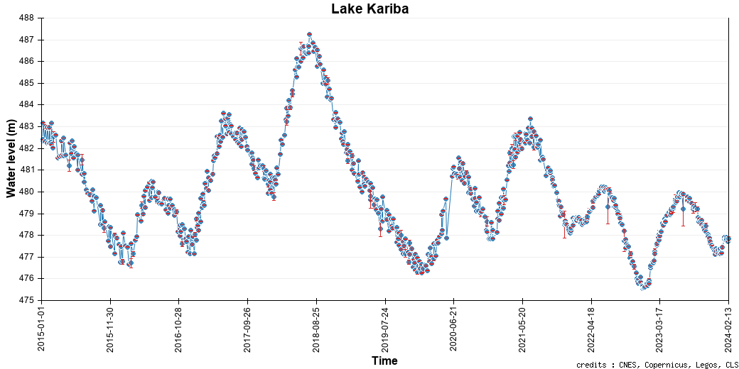
Lake Kariba Water Level
Current water level of Lake Kariba.

