Slide 1
FEWS NET Enhanced Flood Monitoring and Forecast Assumptions—Southern Africa
FEWS NET Science Team
Dec 16, 2024

Slide 2
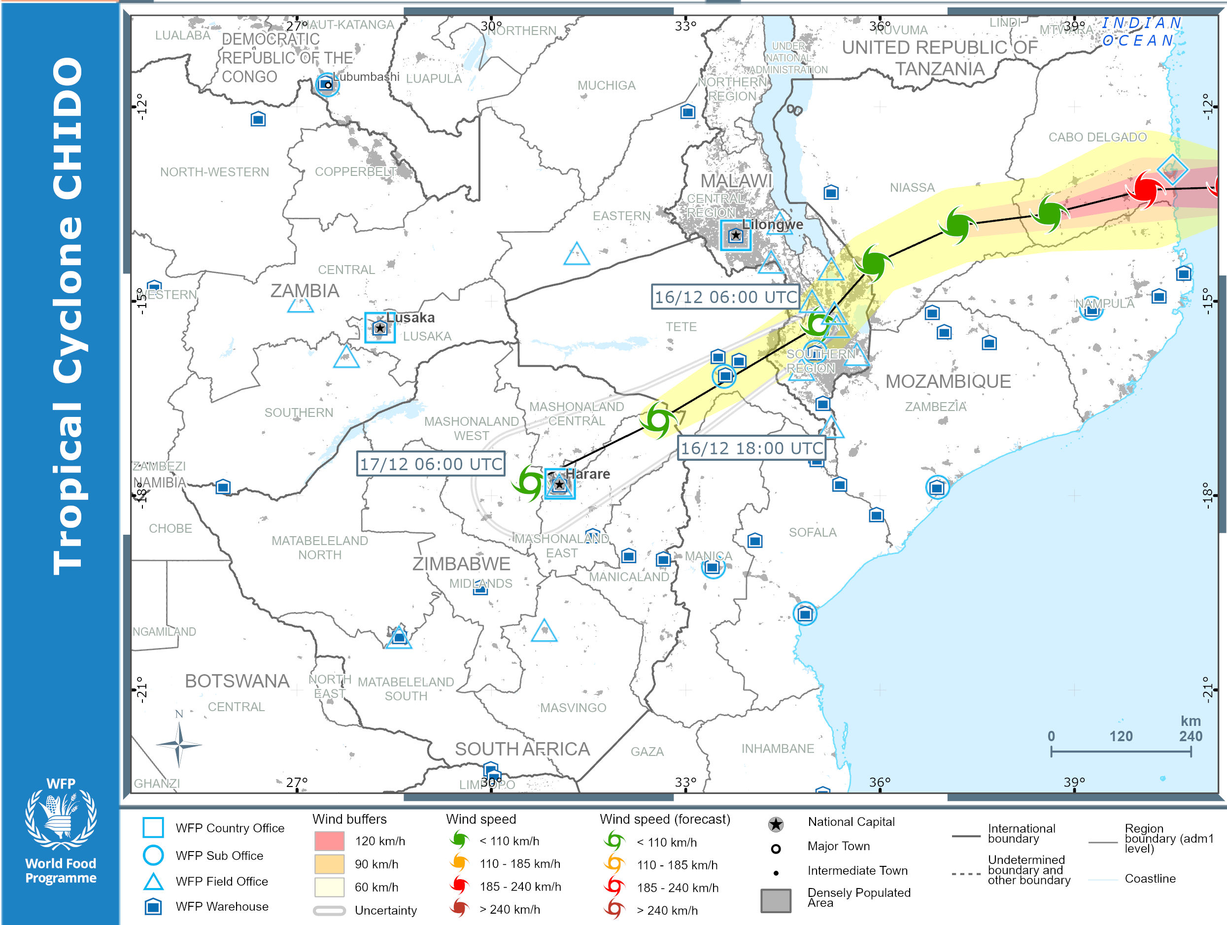
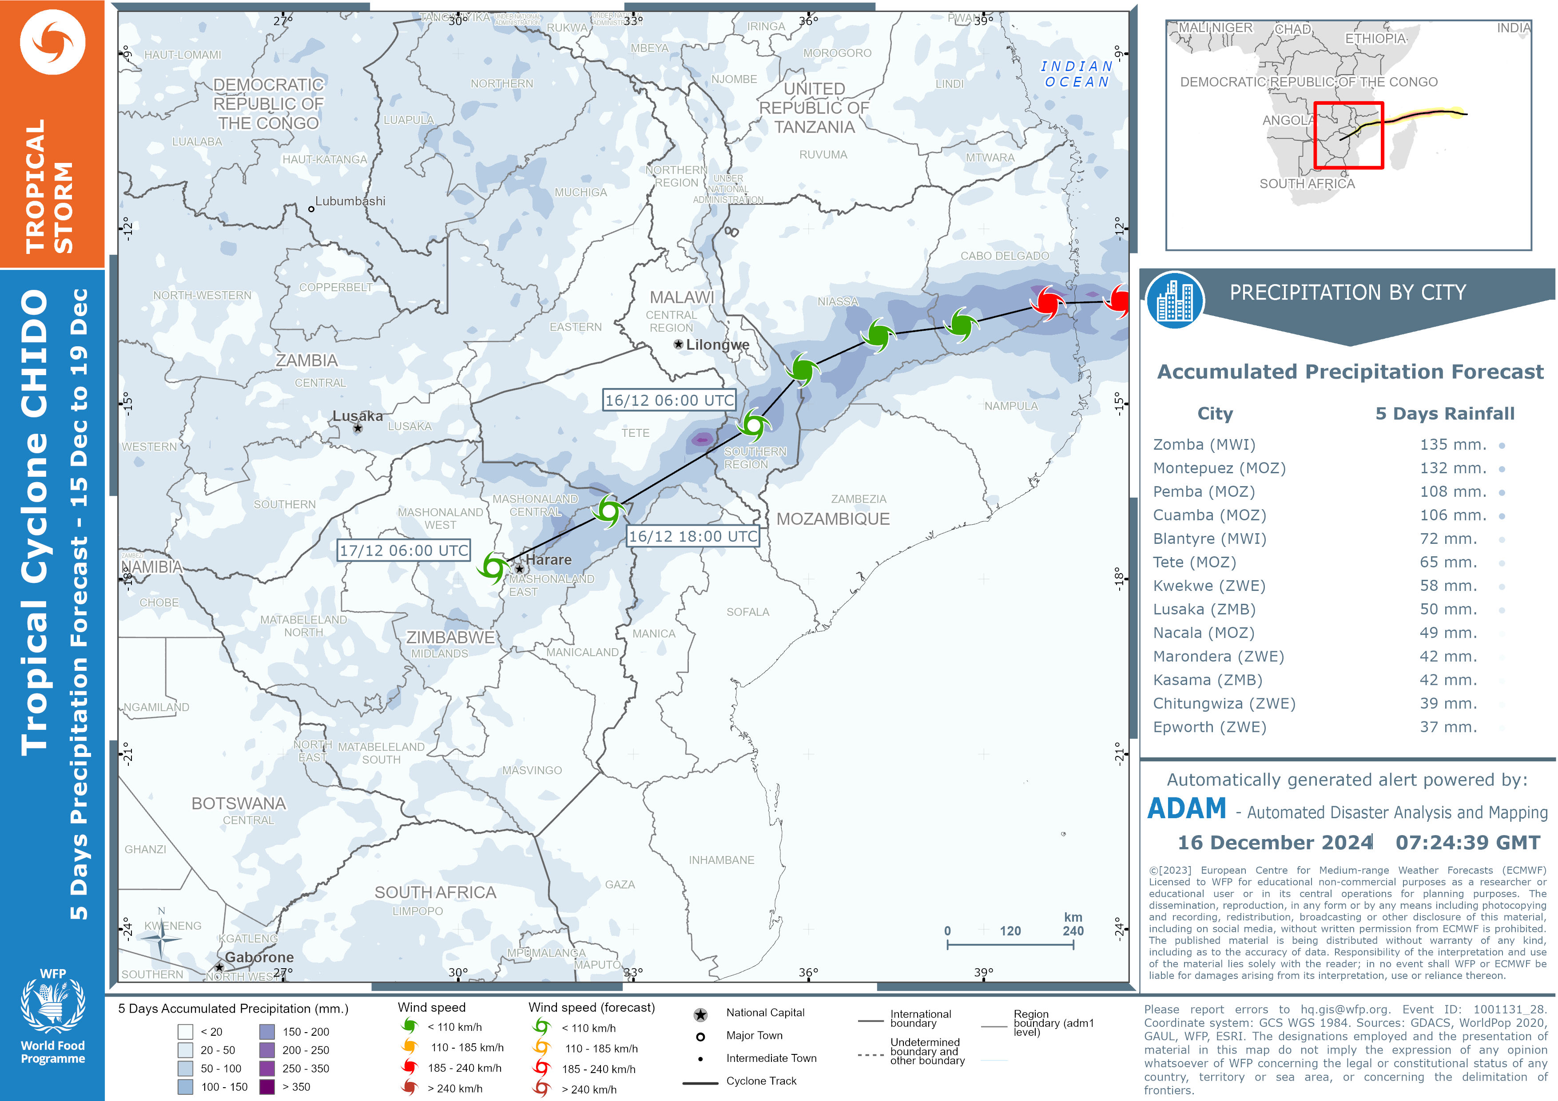
TC CHIDO Path and Rainfall
As of December 16, 2024
Notes:
VIIRS inundation map compares well with high resolution FloodBase inundation map for July.

Slide 3
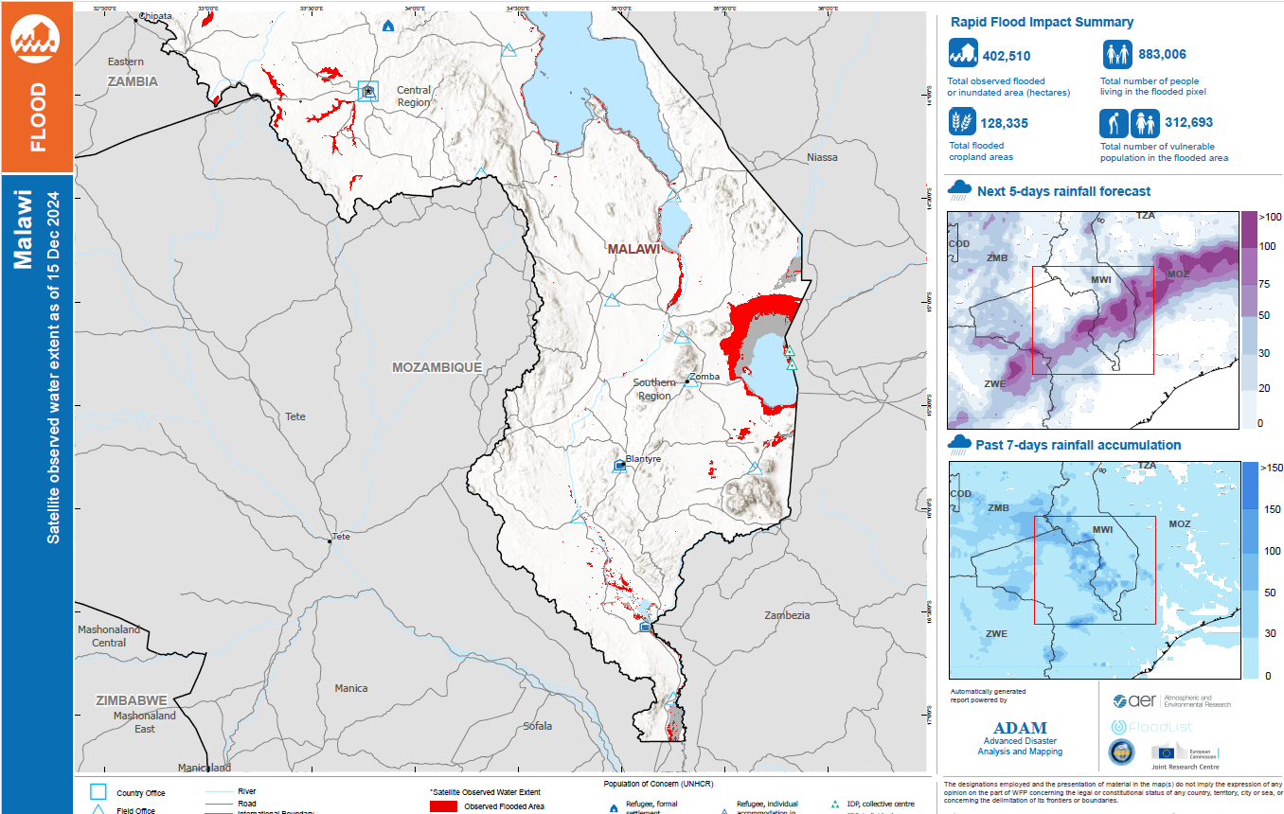
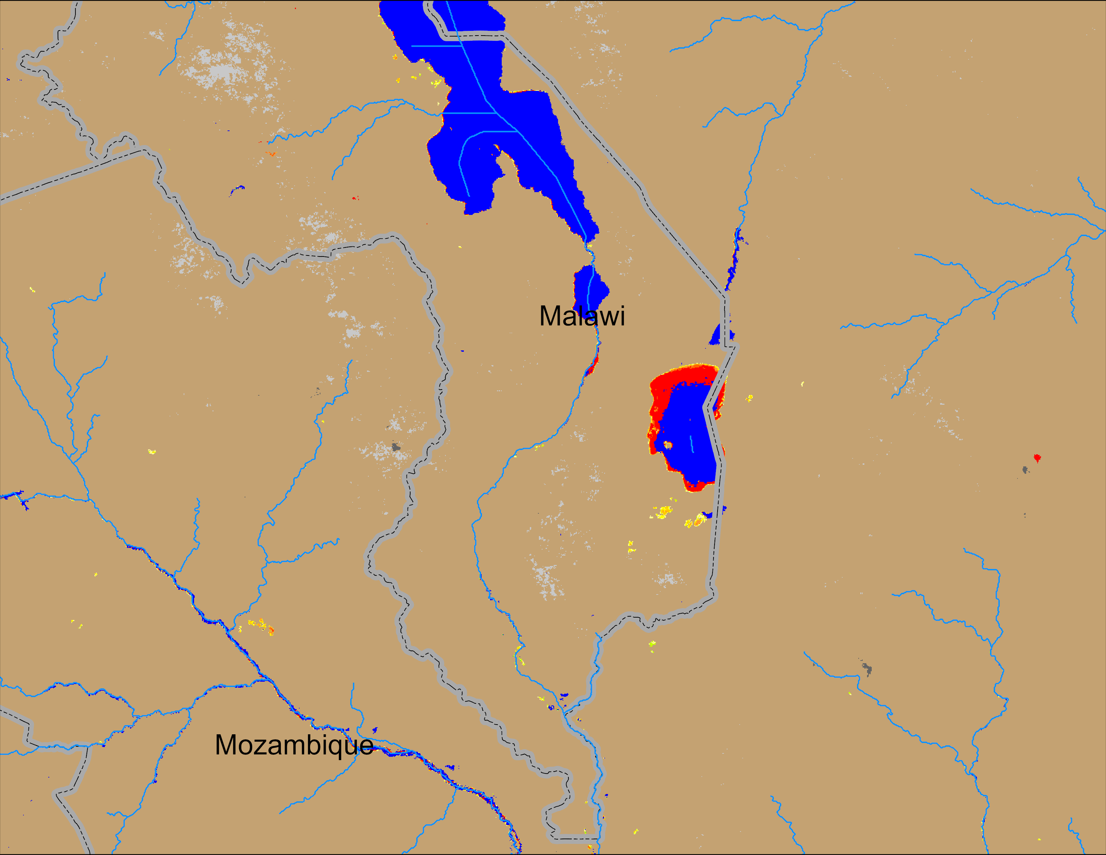
Flooding Conditions in Malawi
(% of the pixel)
ADAM Flood : 15 Dec 2024
NOAA VIIRS 5-day comp.: 11 – 15 Dec 2024
The TC CHIDO is crossing southern Malawi now, more flooding to show up in next few days.

Slide 4
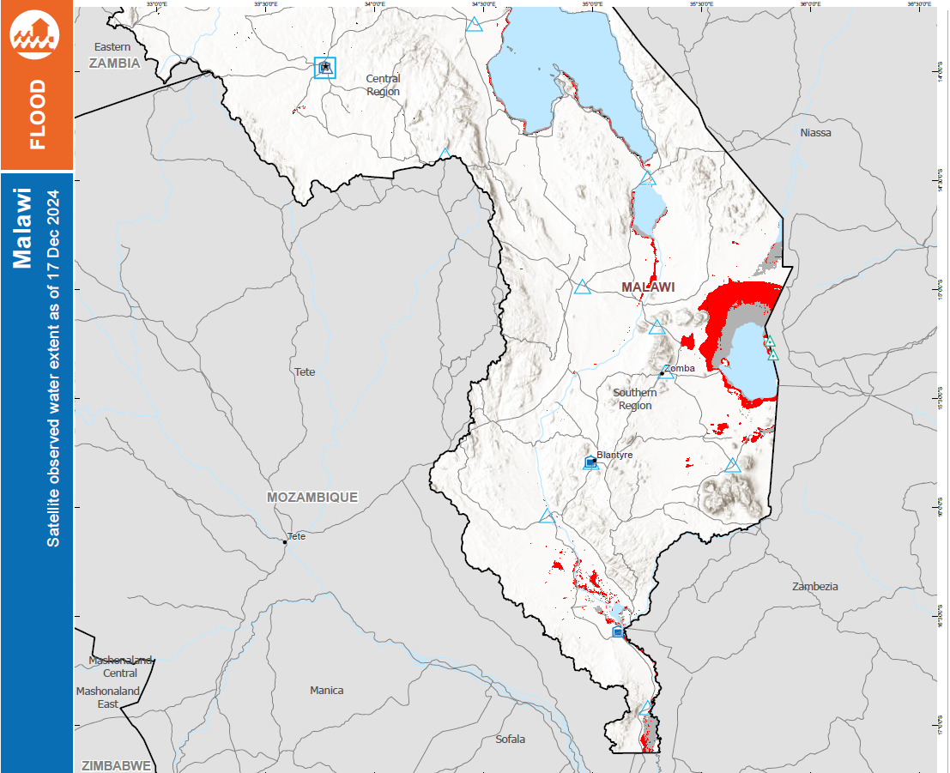
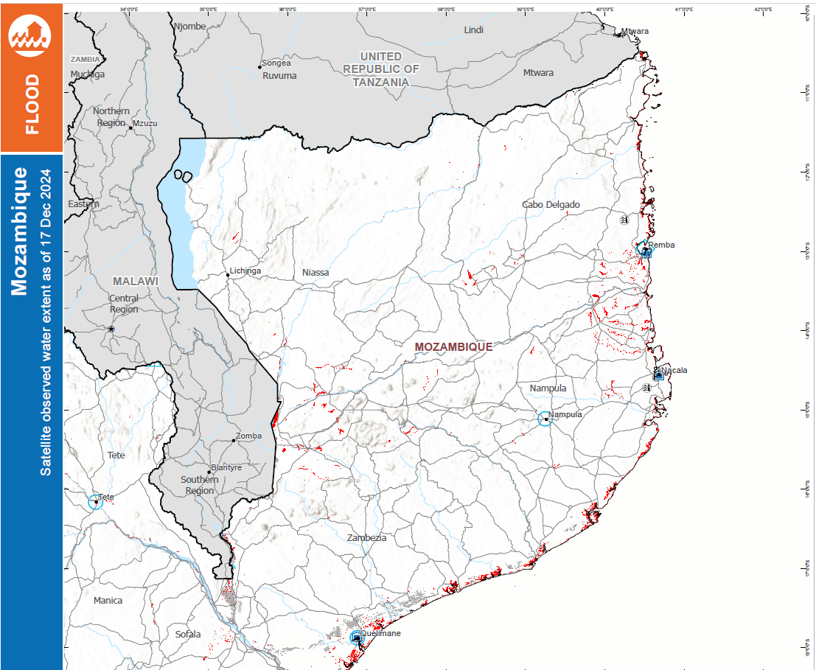
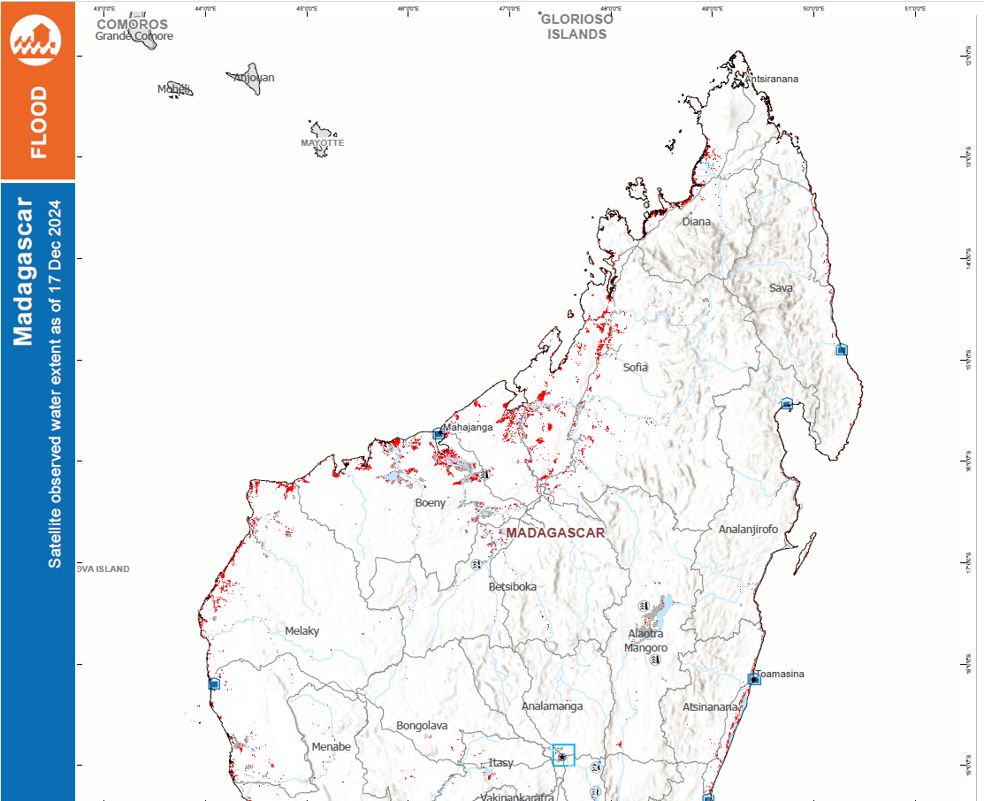
TC CHIDO Flooding
ADAM Flood : 17 Dec 2024 in Southern Malawi, Mozambique, and Madagascar.

Slide 5
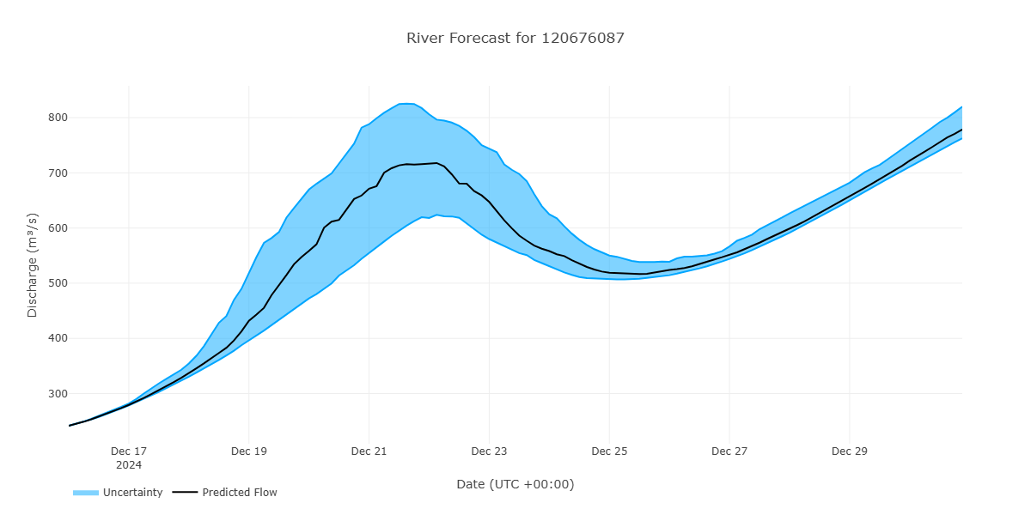
Flood Forecast in Malawi
GEOGLOWS River forecast: 15 – 31 Dec 2024
Hydrography location
Shire River in southern Malawi expect to peak around Dec 22, 2024.

Slide 6
Thank you
spervez@usgs.gov

