Slide 1
FEWS NET Enhanced Flood Monitoring and Forecast Assumptions - Southern Africa
October 2024 Seasonal Forecast
FEWS NET Science Team:
USGS, NASA, NOAA, UCSB+Regional Scientists

Slide 2
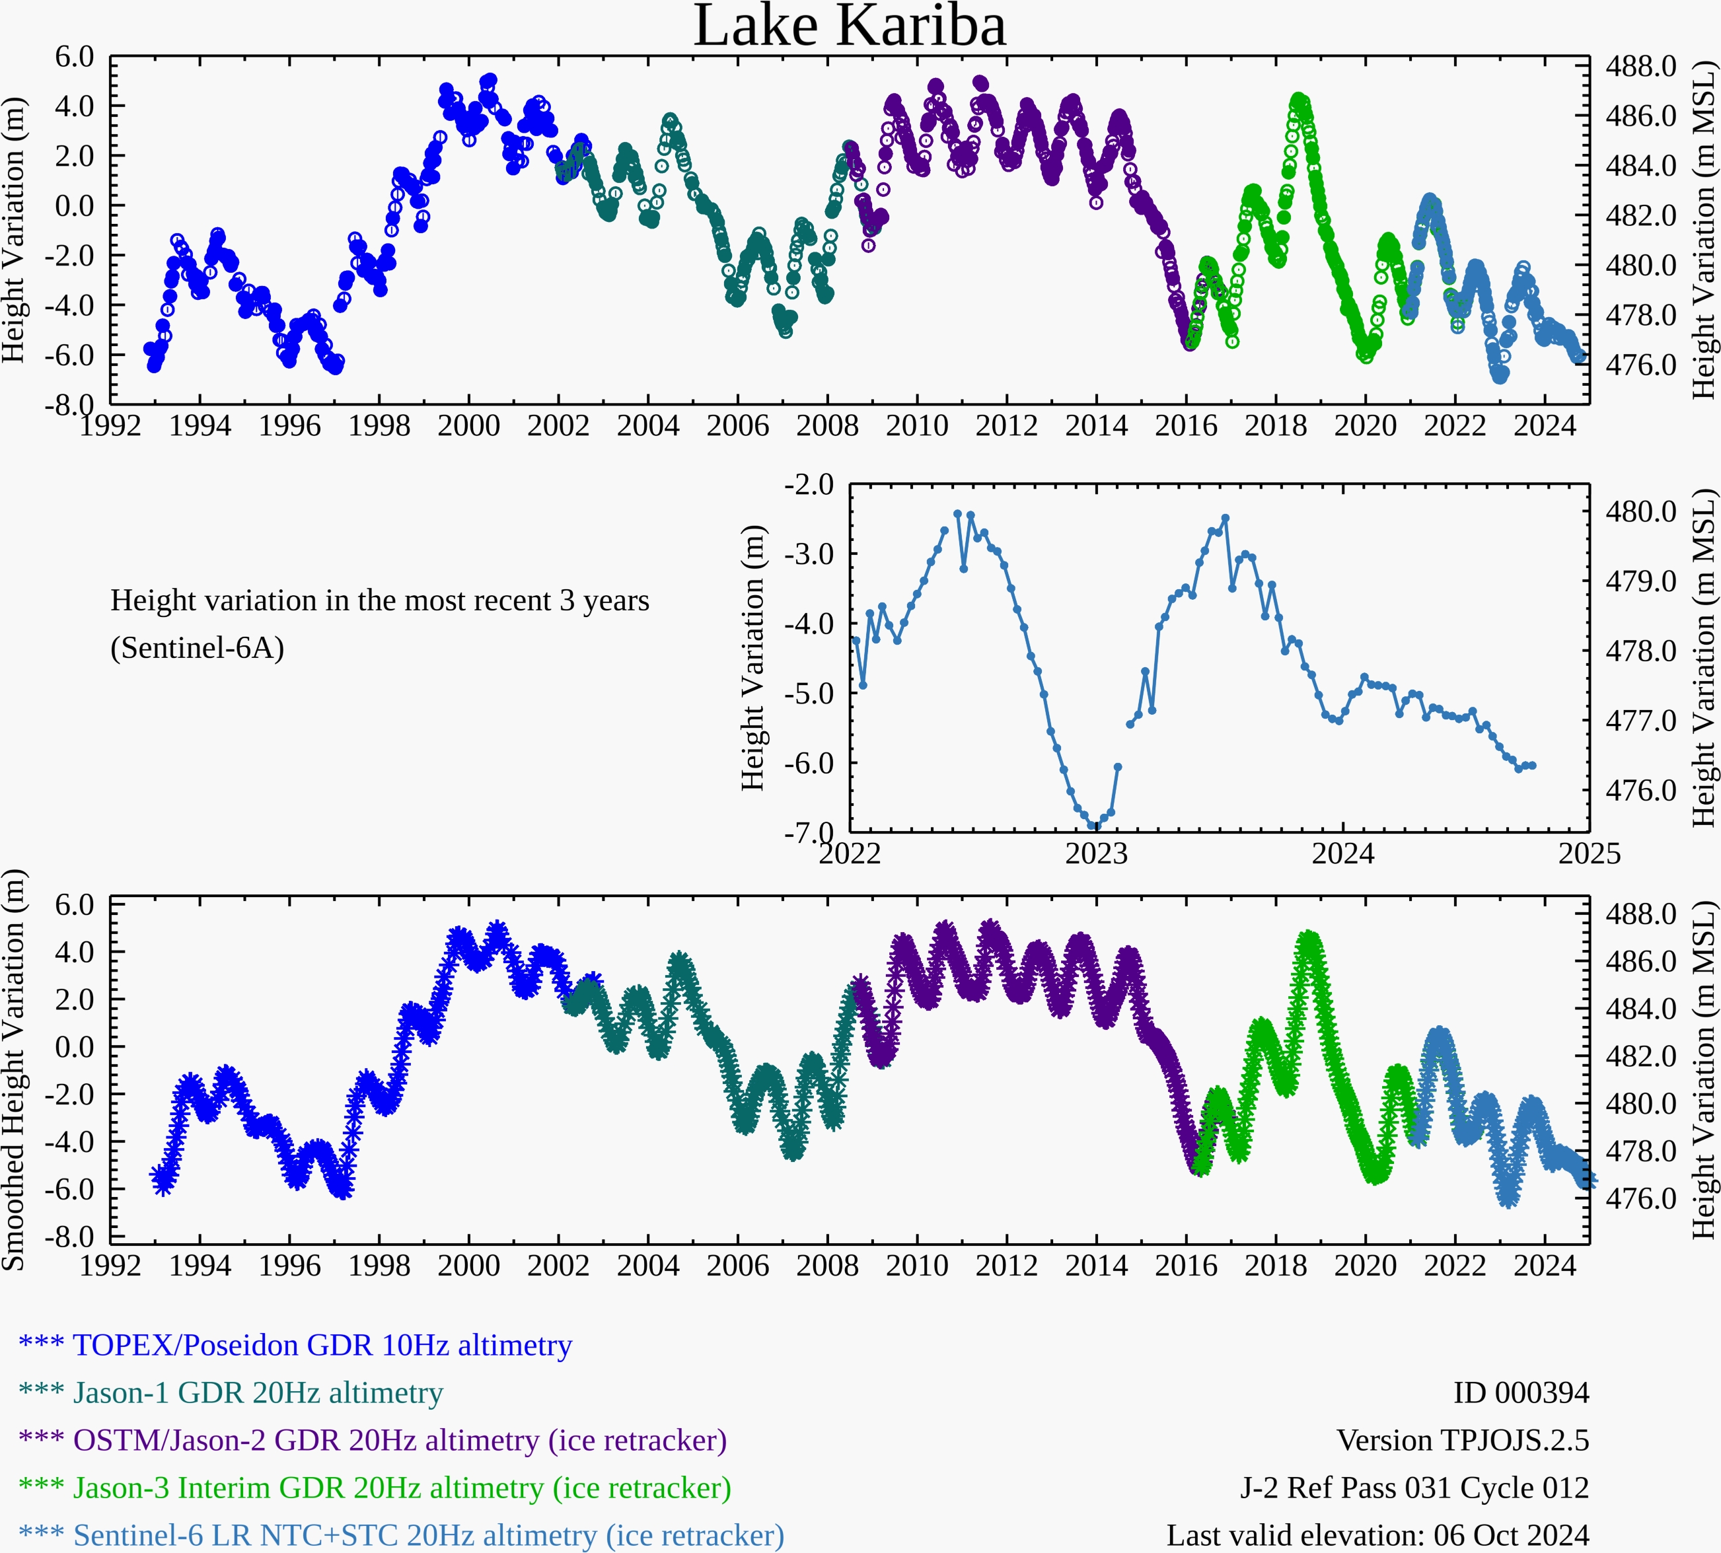
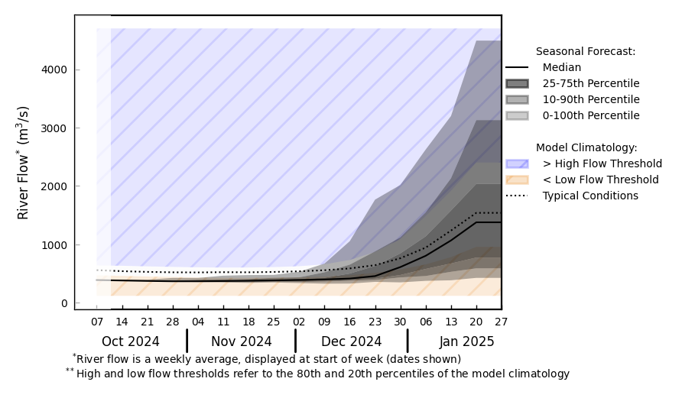
Lake Kariba Water Level and Input Flow Forecast
@ point A: Zambezi River
A
GloFAS monthly streamflow forecast (Oct 2024 – Jan 2025)
Water level in Lake Kariba is still well below average level with below average upstream contribution to the lake is expected in the incoming rainfall period.

Slide 3
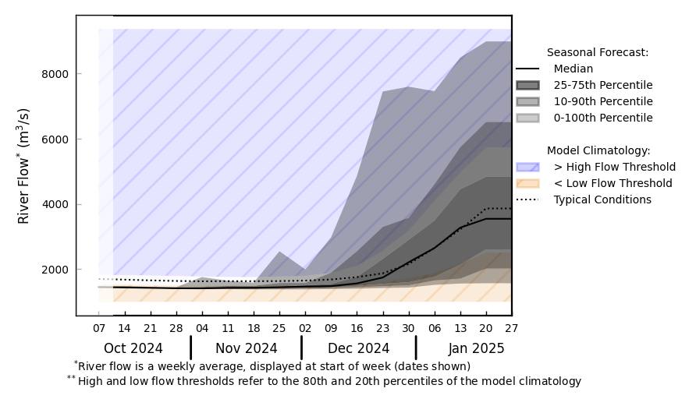
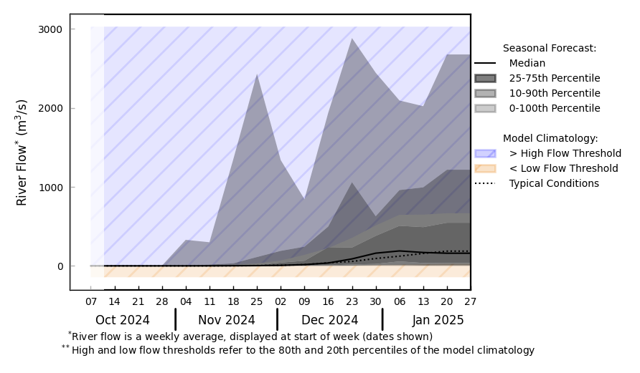
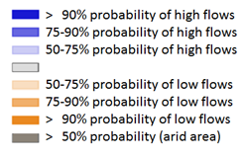
Seasonal Streamflow Forecast
@ point A: Zambezi River
Luangwa
A
Shire
Kafue
B
Zambezi
@ point B: on a river in Gokwe district
GloFAS seasonal forecast Oct 2024 - Jan 2025
Average streamflow is expected across Zimbabwe including norther Zambezi valley, Tsholotsho and Gokwe districts. Typical flooding is expected.
GloFAS monthly streamflow forecast (Oct 2024 – Jan 2025)

Slide 4
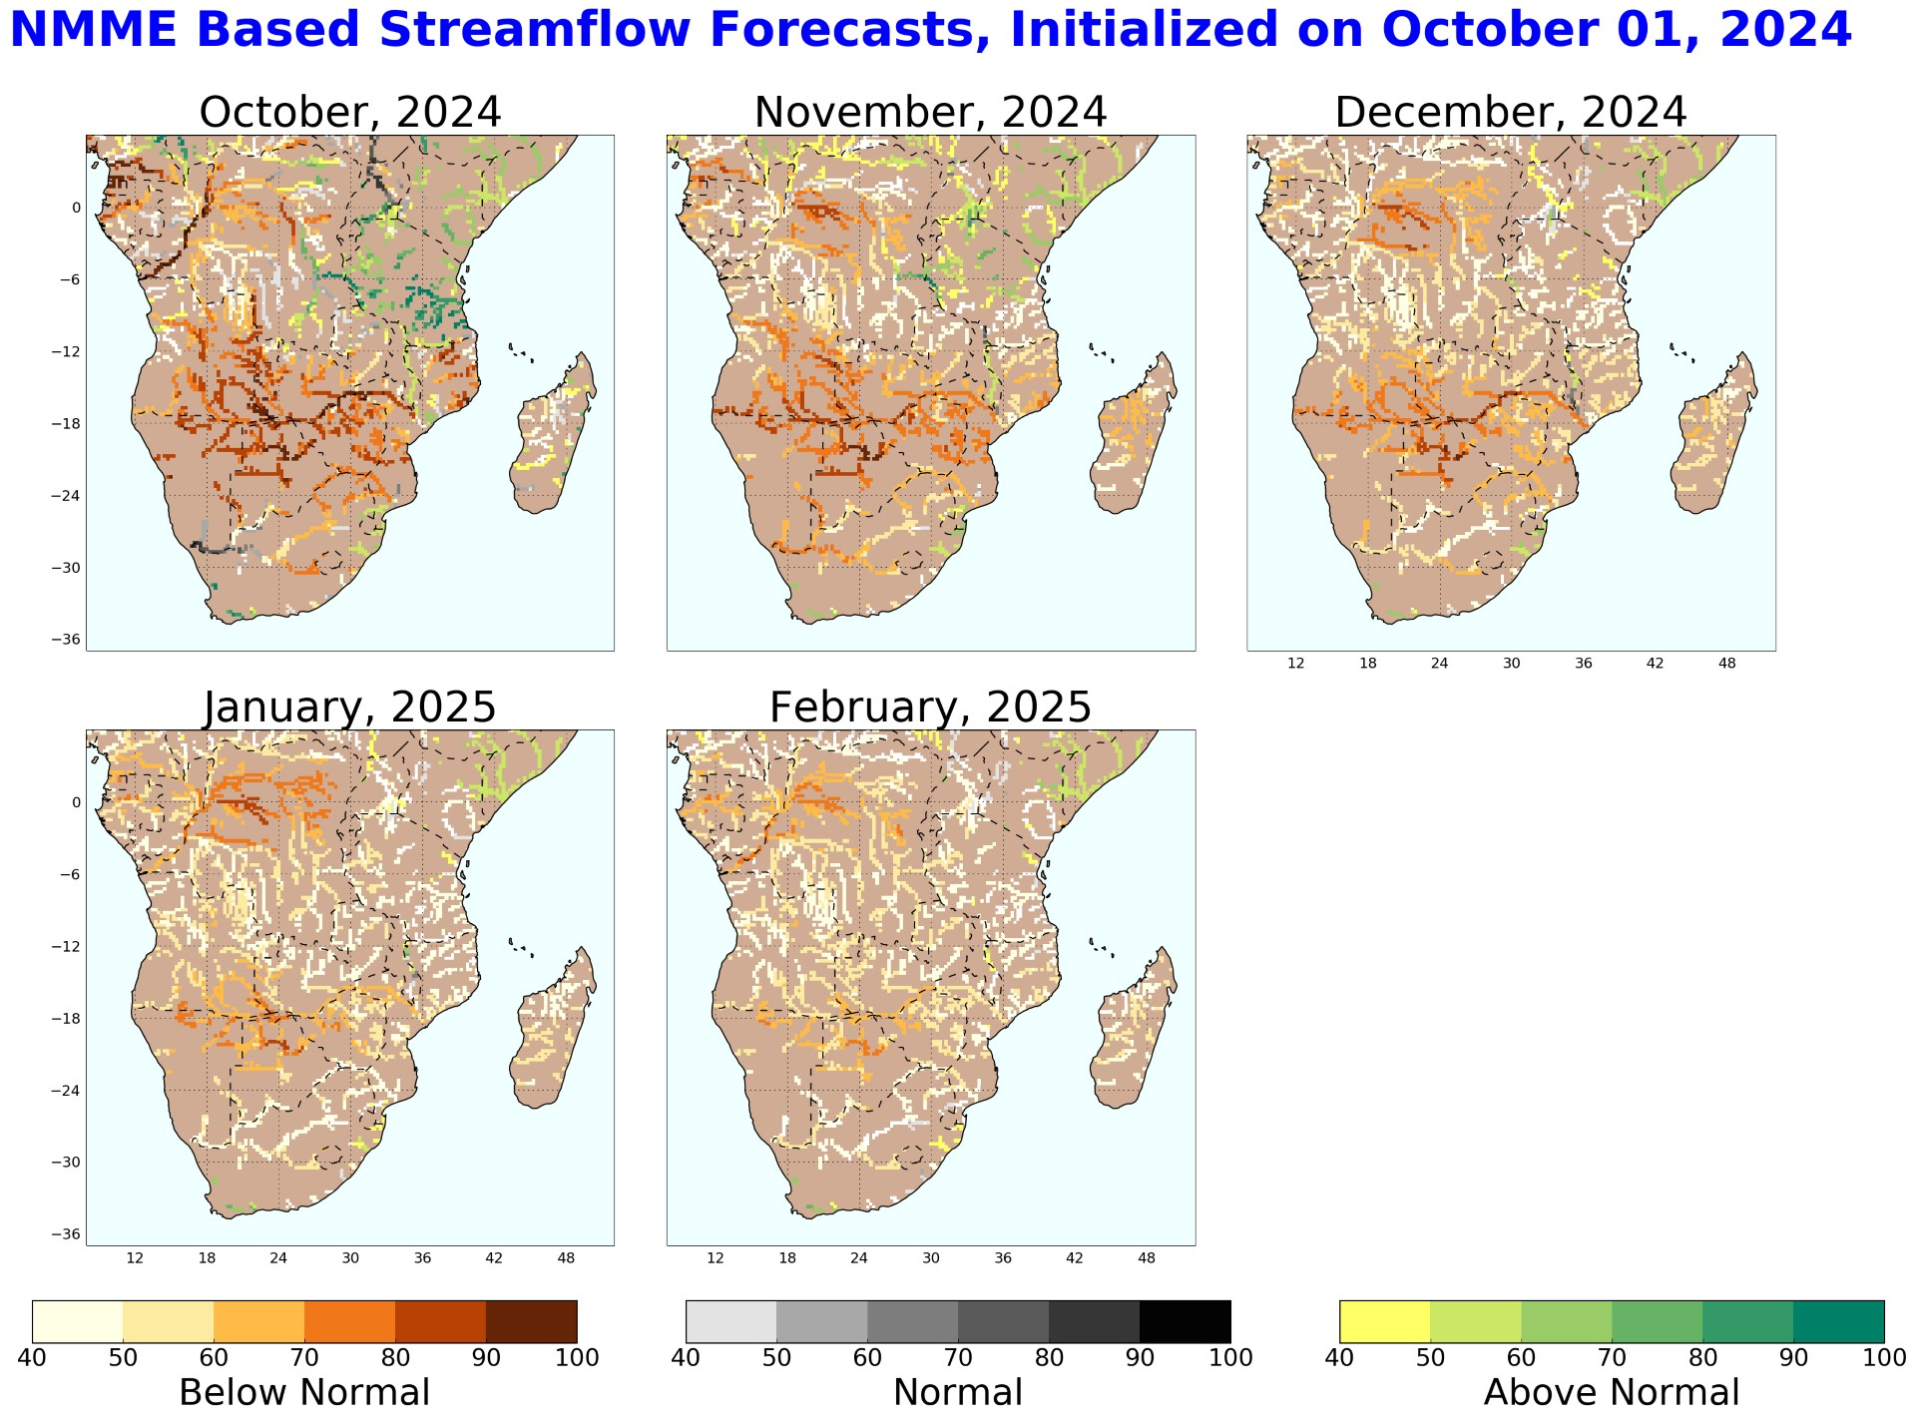
Seasonal Streamflow Forecast
Average to below average streamflow is expected across northern Zambezi valley, Tsholotsho and Gokwe districts in Zimbabwe.

