Slide 1
FEWS NET Enhanced Flood Monitoring and Forecast Assumptions - Southern Africa
April 2024 Seasonal Forecast
FEWS NET Science Team:
USGS, NASA, NOAA, UCSB+Regional Scientists

Slide 2
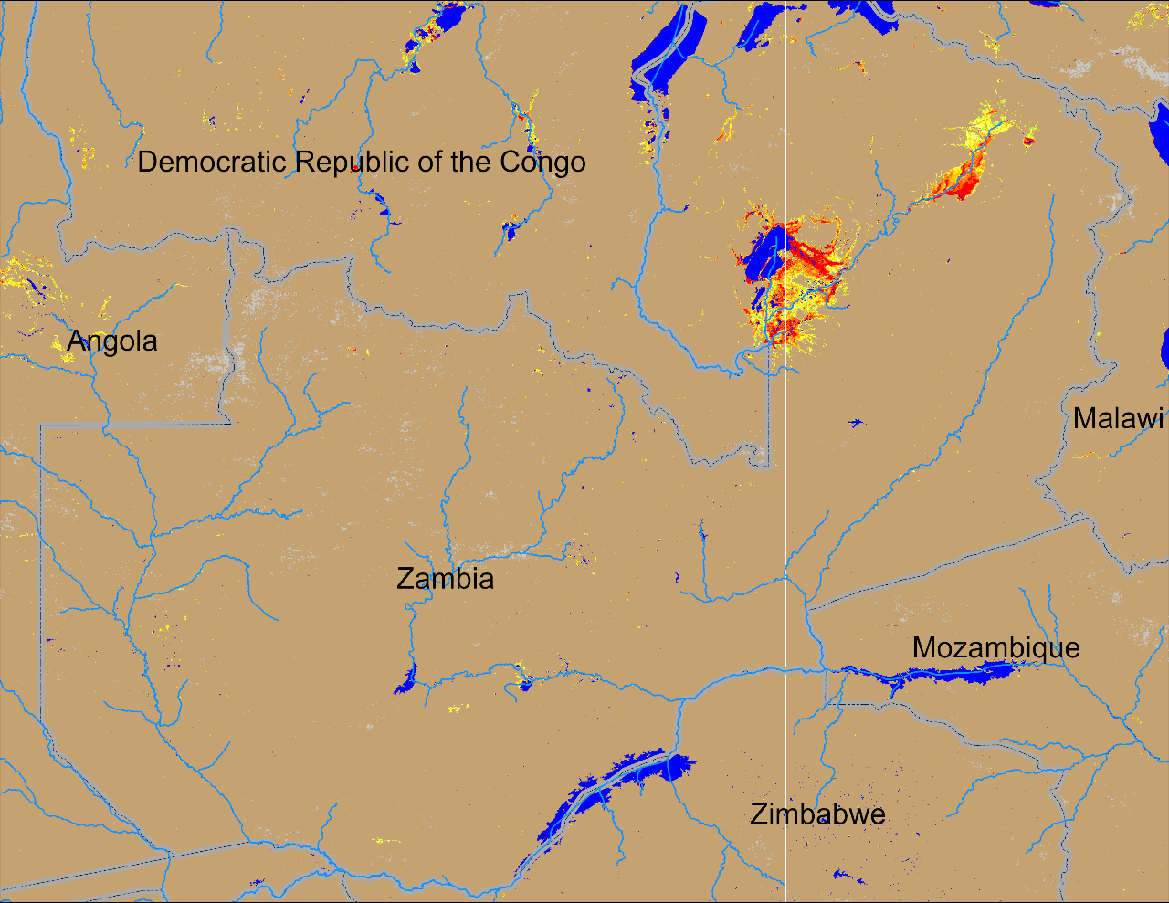
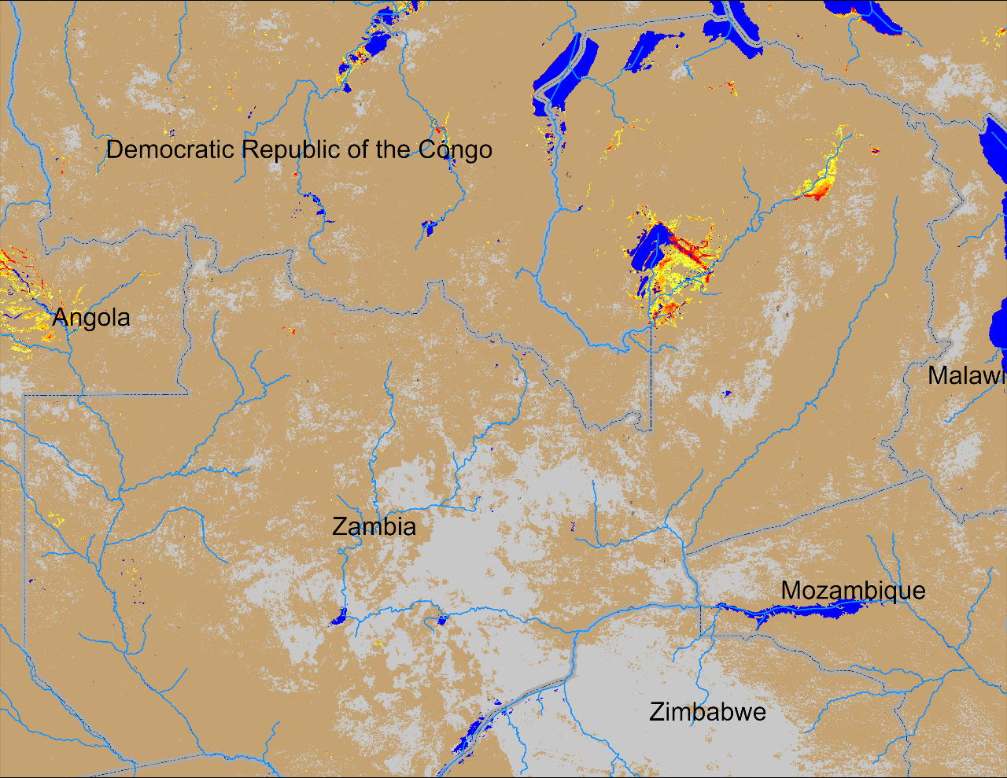
Flooding in Zambia
(% of the pixel)
(% of the pixel)
NOAA VIIRS 5-day comp.: 13 – 17 Mar 2024
NOAA VIIRS 5-day comp.: 10 – 14 Apr 2024
Flooding conditions have improved in northern Zambia, however, more inundated areas have emerged in the upstream of Zambezi River in Eastern Anogla.

Slide 3
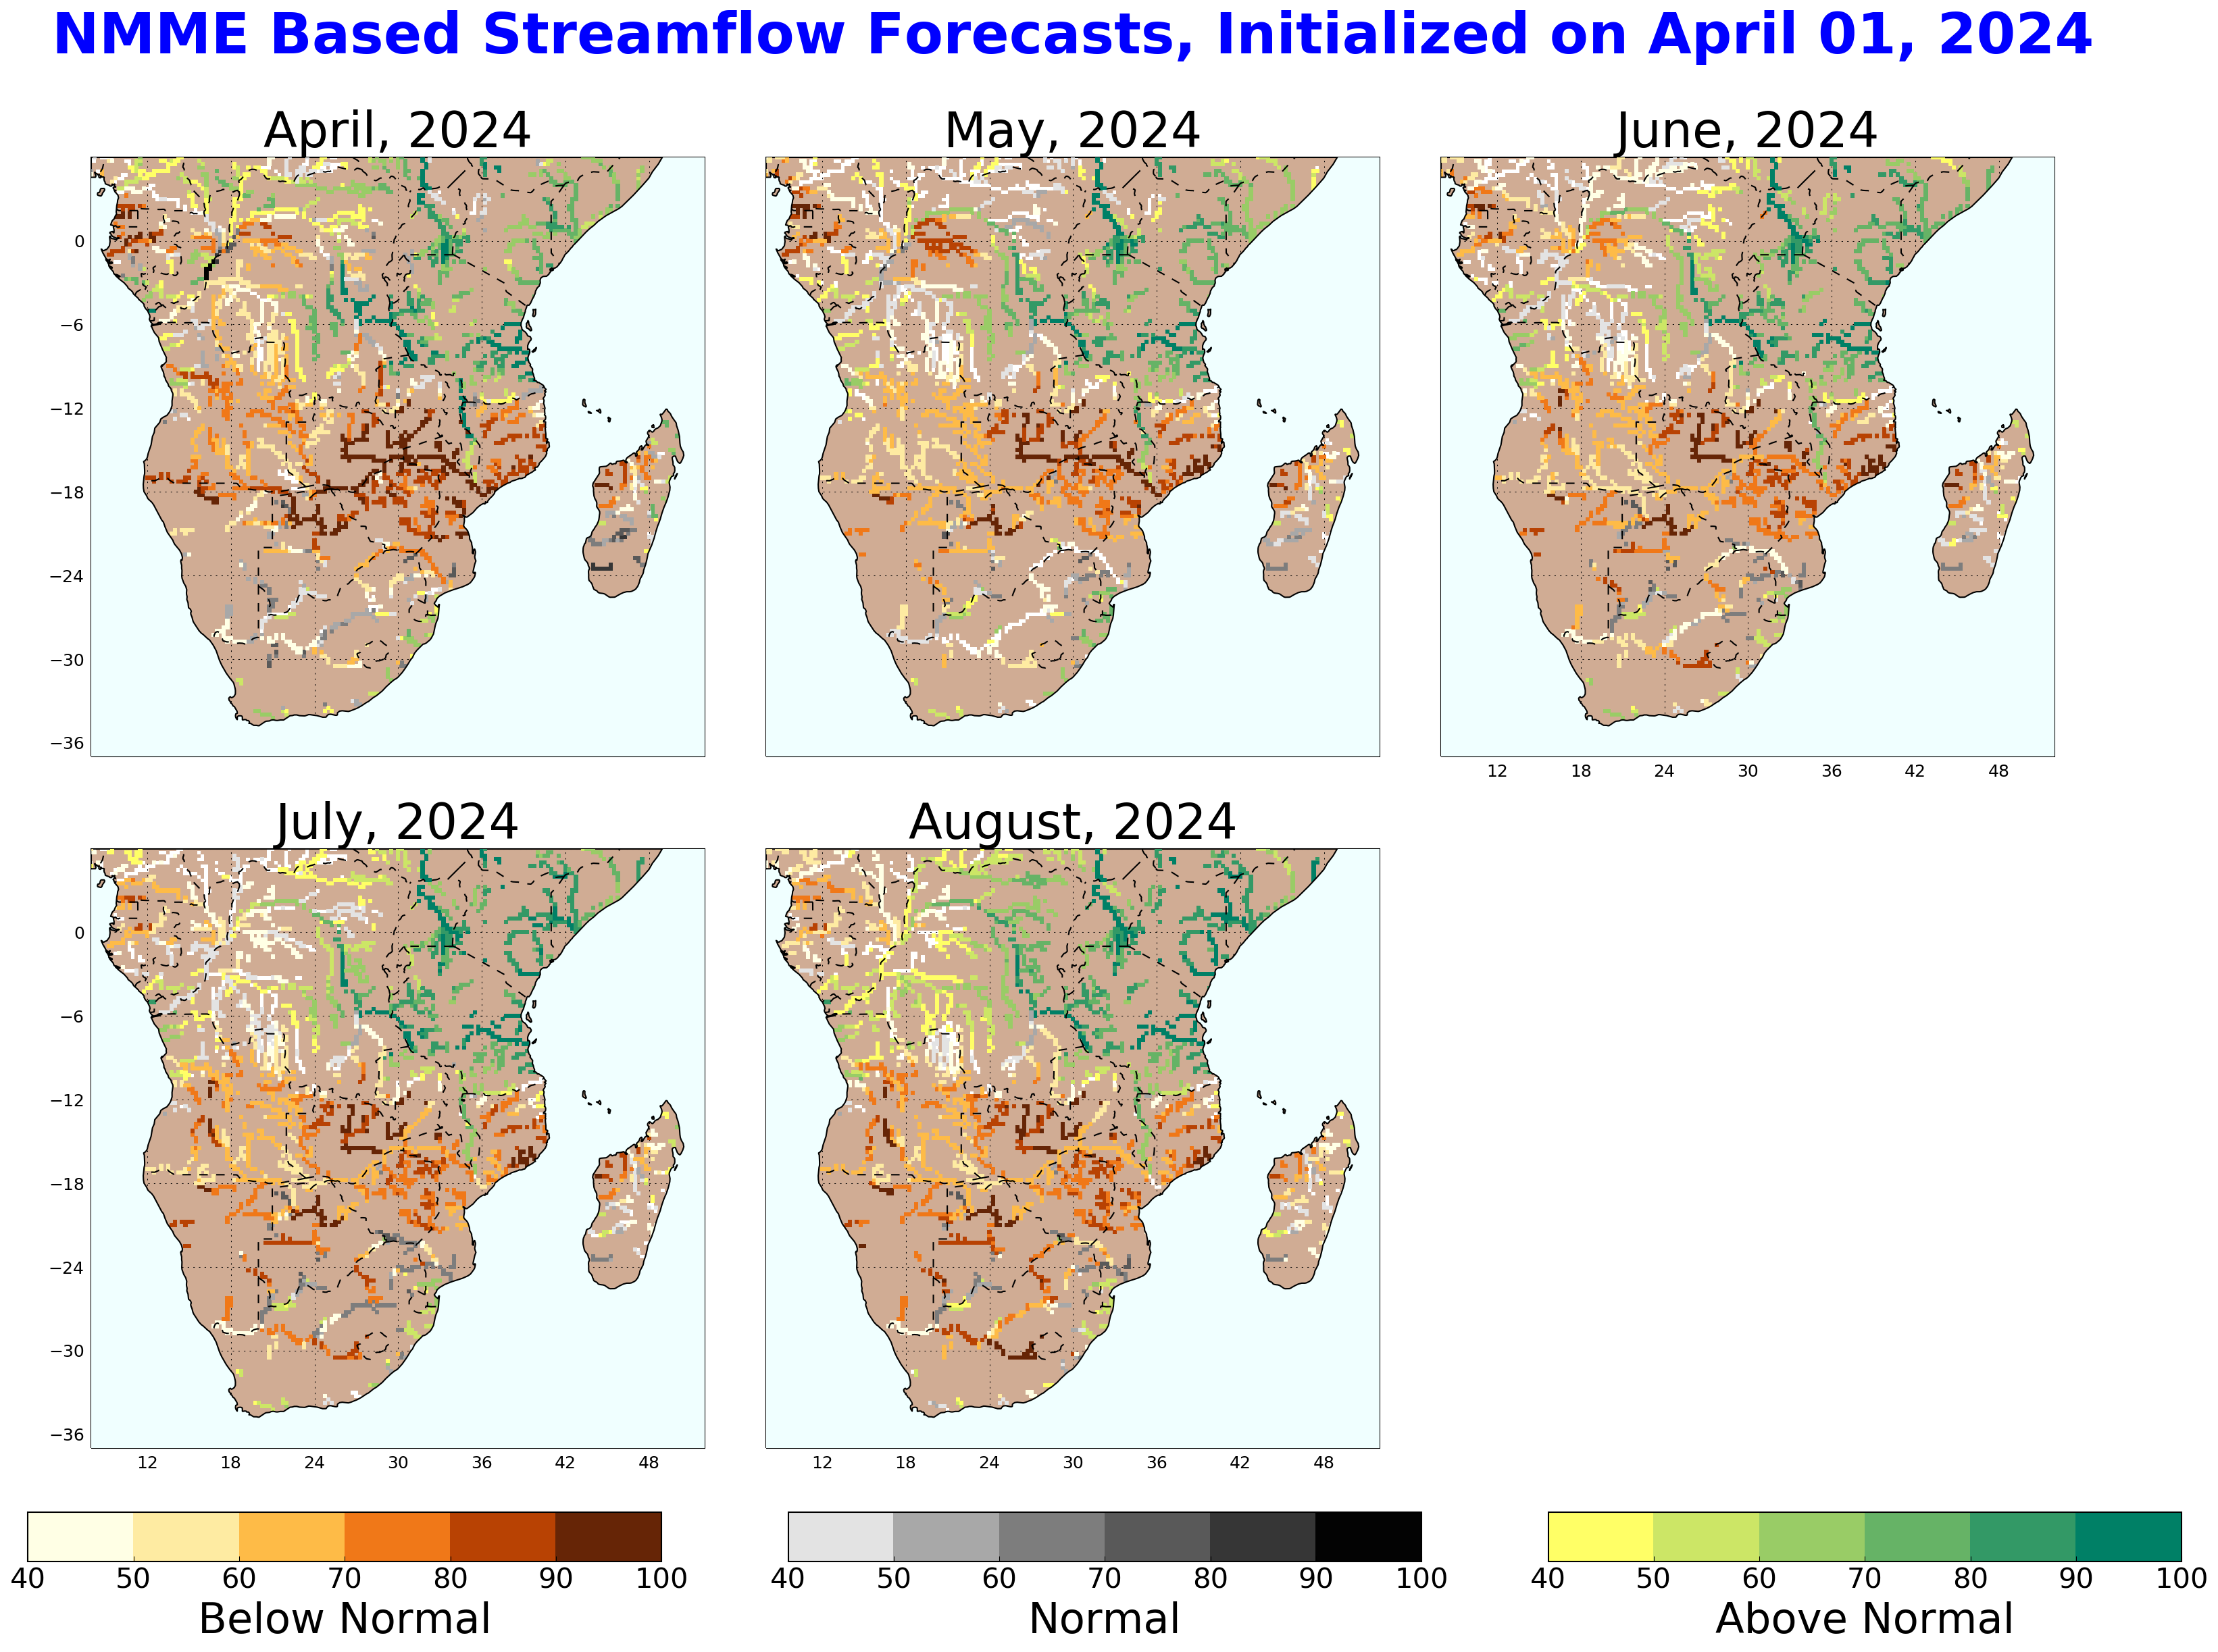
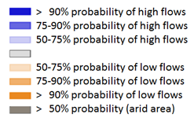
Seasonal Streamflow Forecast
GloFAS seasonal forecast Apr - July 2024
NHyFAS monthly forecast Apr - Aug 2024
Average to below average streamflow is expected across much of Southern Africa except the Shire River.

Slide 4
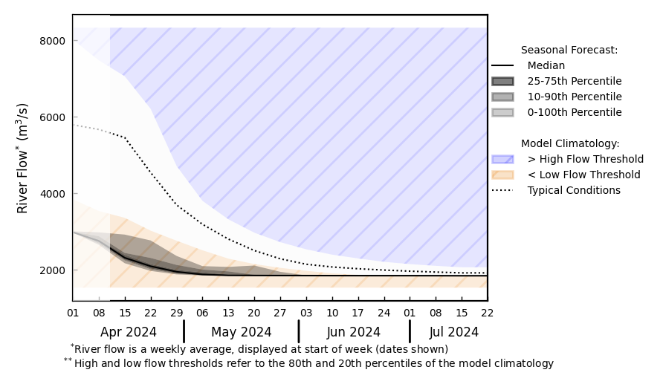
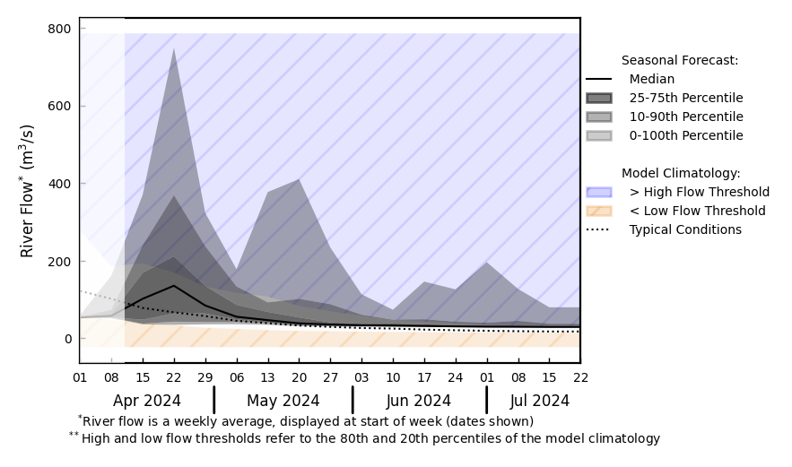
Seasonal Streamflow Forecast
@ point A: Zambezi River
Luangwa
Kafue
Shire
Zambezi
A
@ point B: Limpopo River
B
GloFAS seasonal forecast Apr - Jul 2024
Well below average streamflow in the Zambezi River.
And Limpopo might get late increase in discharges just before the start of the dry season.
GloFAS monthly forecast (Mar – Jun 2024)

Slide 5
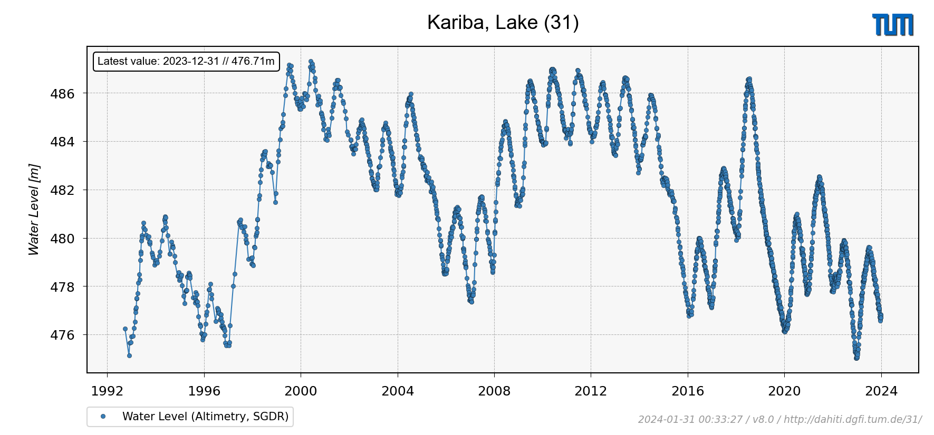
Lake Kariba Water Level
Current water level in Lake Kariba kept declining.

