Slide 1
FEWS NET Enhanced Flood Monitoring and Forecast Assumptions-East Africa and Yemen
March 2024 Seasonal Forecast
FEWS NET Science Team:
USGS, NASA, NOAA, UCSB+Regional Scientists

Slide 2
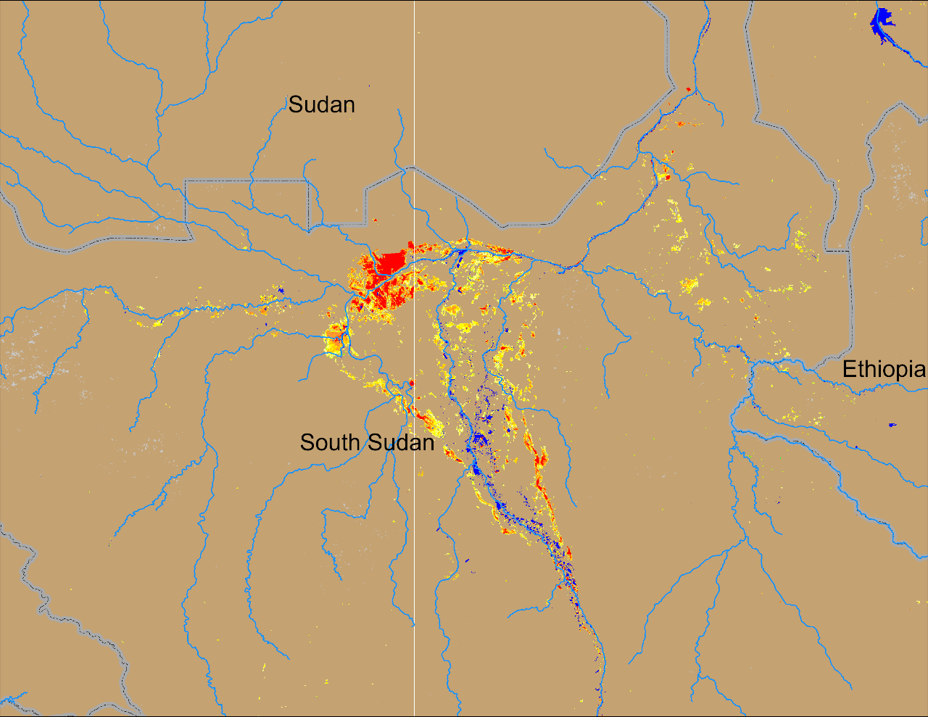
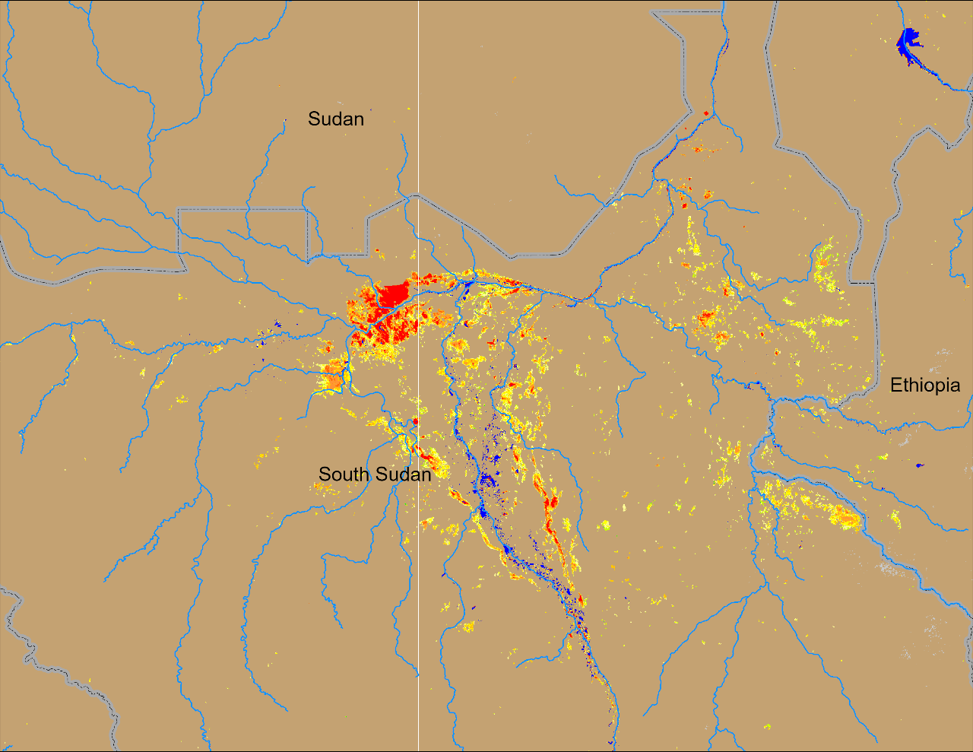
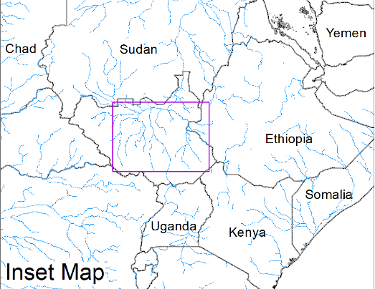
Flooding Conditions in South Sudan
(% of the pixel)
(% of the pixel)
Sobet
Khawr
Sobet
Khawr
Akobo
Akobo
Pibor
Pibor
NOAA VIIRS 5-day comp.: 15 – 19 Feb 2024
NOAA VIIRS 5-day comp.: 13 – 17 Mar 2024
Many of the areas in the Sobet, Akobo, Pibor and Khawr River catchments have dried out during last 30 days.

Slide 3
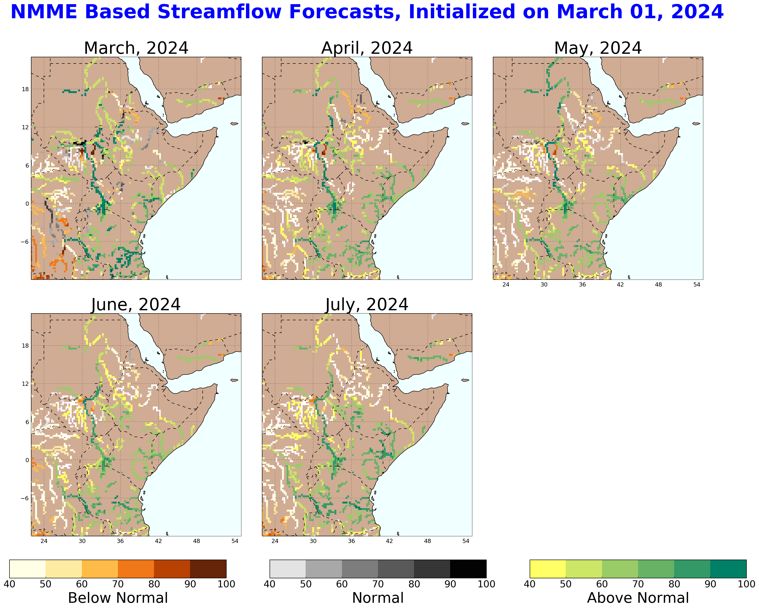
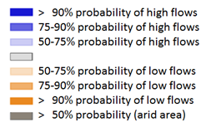
Seasonal Streamflow Forecast
A
B
NHyFAS streamflow forecast: Mar – July 2024
GloFAS streamflow forecast: Mar – Jun 2024
Both NHyFAS and GloFAS suggest above average discharges in Juba, Shabelle, Lak Dera and Tana Rivers during April to June

Slide 4
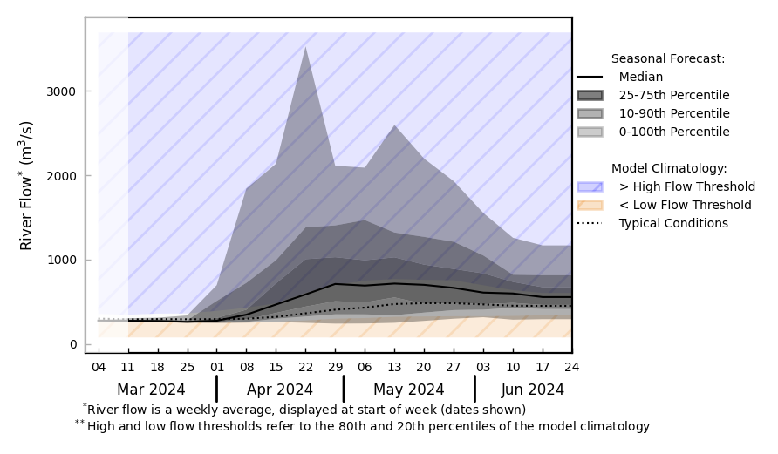
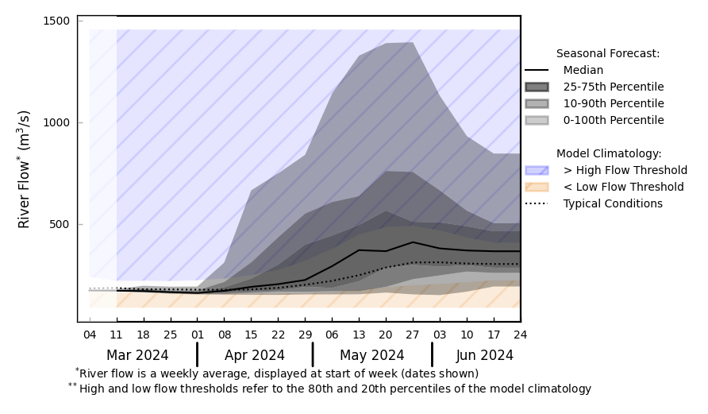
Timing of Flood Risk
@ point A: near Mogadishu (Shabelle)
A
B
@ point B: Juba (before the Juba Shabelle confluence)
GloFAS streamflow forecast: Mar – Jun 2024
Above average discharges in Shabelle from Apr to Jun
Above average discharges in Juba during May and Jun
GloFAS streamflow forecast: Mar – Jun 2024

Slide 5
Flooding Risk (seasonal forecast)
Discharges in Juba, Shabelle, Lak Dera and Tana Rivers are expected to be above-average during April to June.
Above-average risk of flooding in Shabelle during late April and May.
Whereas above-average risk of flooding in Juba, Lak Dera and Tana Rivers in May and June.
3a: NMME-based rootzone soil moisture forecasts indicate that soil moisture will remain above average in much of the greater horn through at least April/May 2024, and among the highest on record in parts of Somalia and southeastern Ethiopia. Given this and expectations for average to above-average rainfall during the March-May/April-June long rains season in the Horn, an above-average risk of flooding exists during late April and May in Shabelle and during May and June in Juba, Lak Dera and Tana River catchments.

