Slide 1
FEWS NET Enhanced Flood Monitoring and Forecast Assumptions—East Africa and Yemen
FEWS NET Science Team
Aug 18, 2024

Slide 2
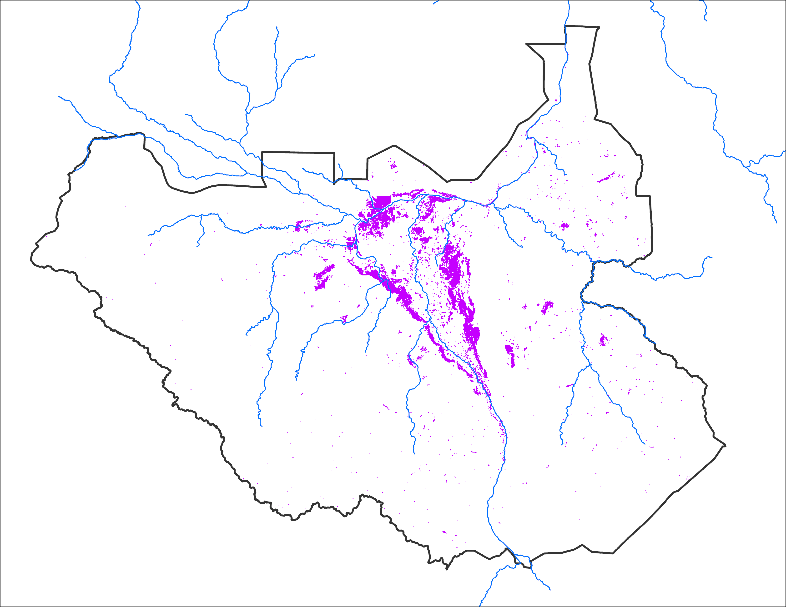
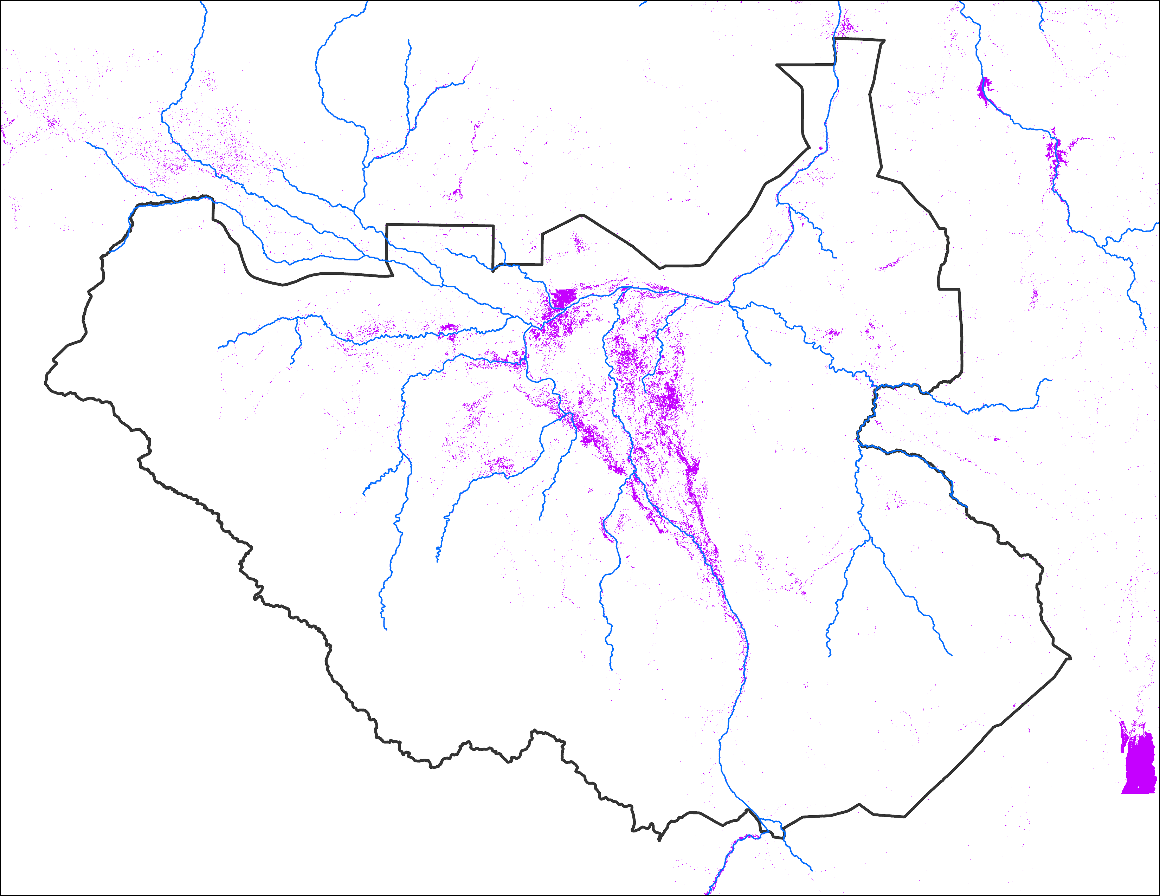
July Inundation Map Comparison
July 2024 VIIRS (375 m)
July 2024 FloodBase (10 m)
Notes:
VIIRS inundation map compares well with high resolution FloodBase inundation map for July.

Slide 3
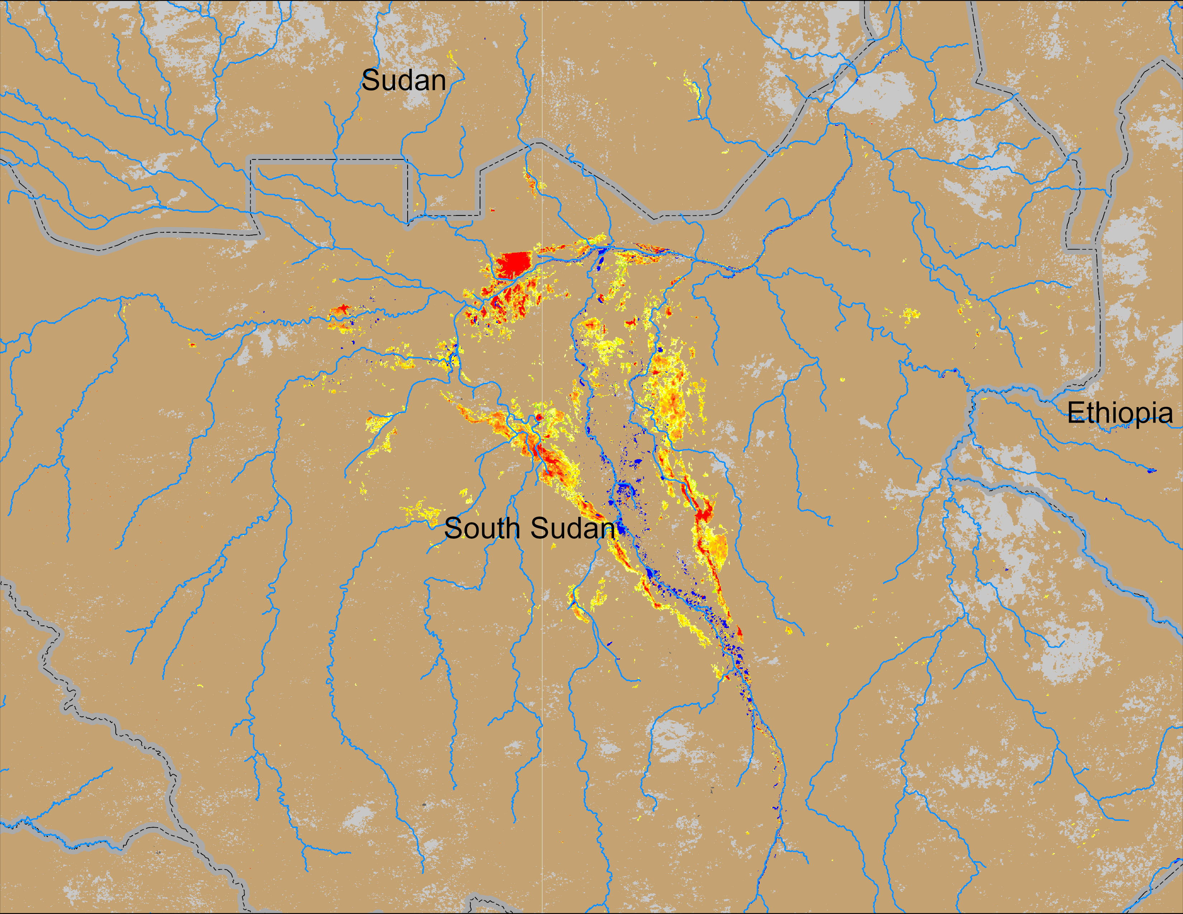
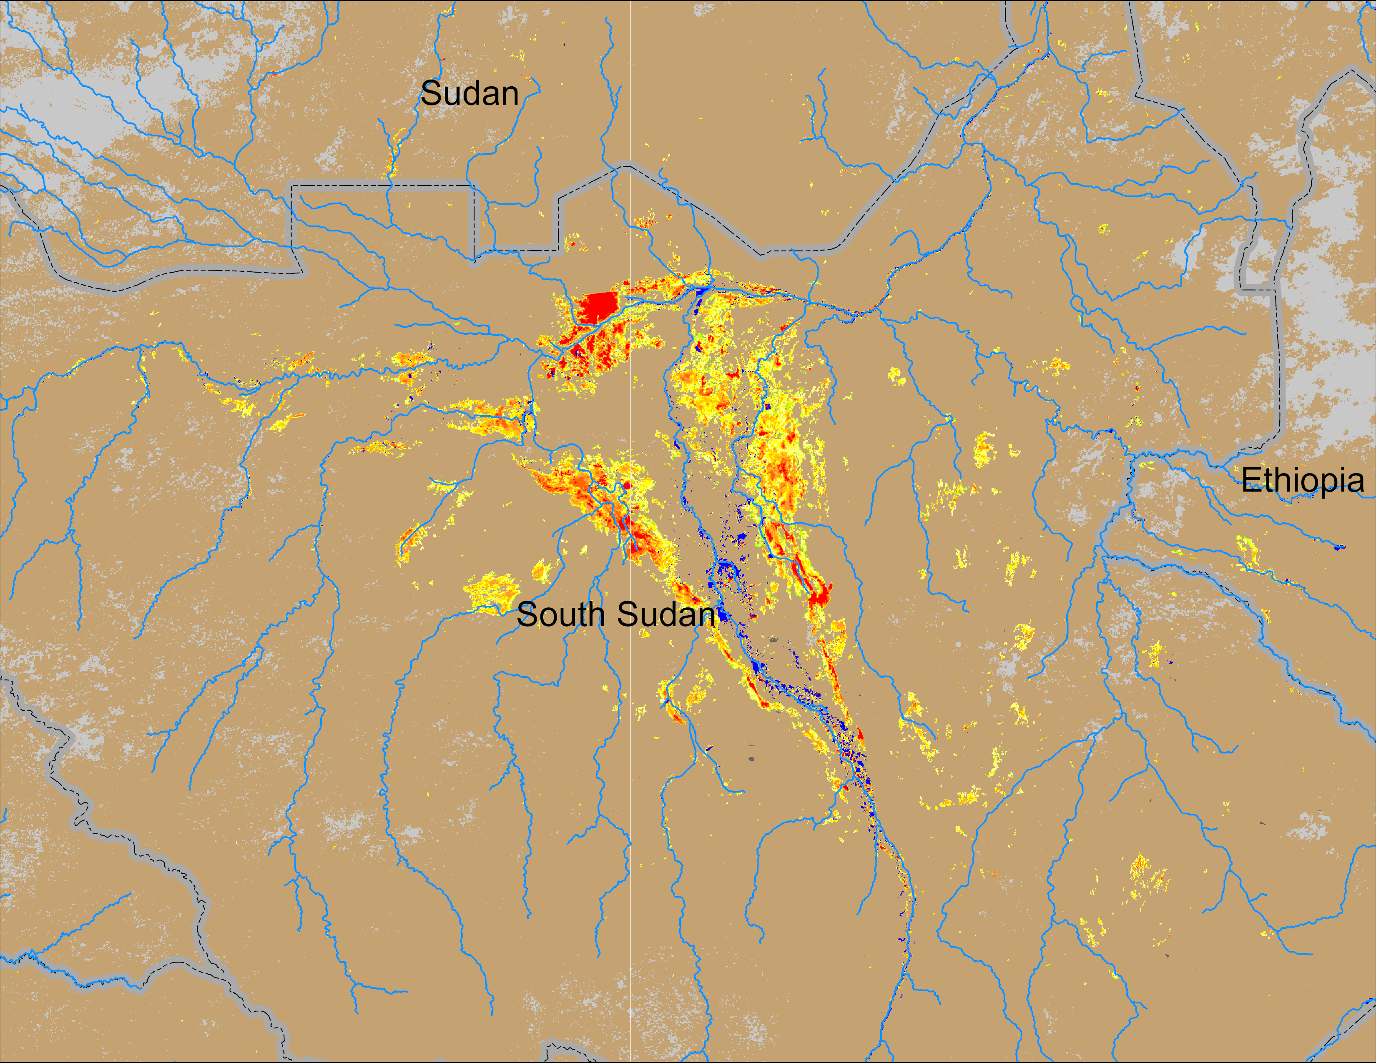
Flooding Conditions in South Sudan
(% of the pixel)
(% of the pixel)
Sobet
Sobet
Akobo
Akobo
Pibor
Pibor
NOAA VIIRS 5-day comp.: 11 – 15 Jul 2024
NOAA VIIRS 5-day comp.: 11 – 15 Aug 2024
Inundated areas have increased in August in South Sudan.

Slide 4
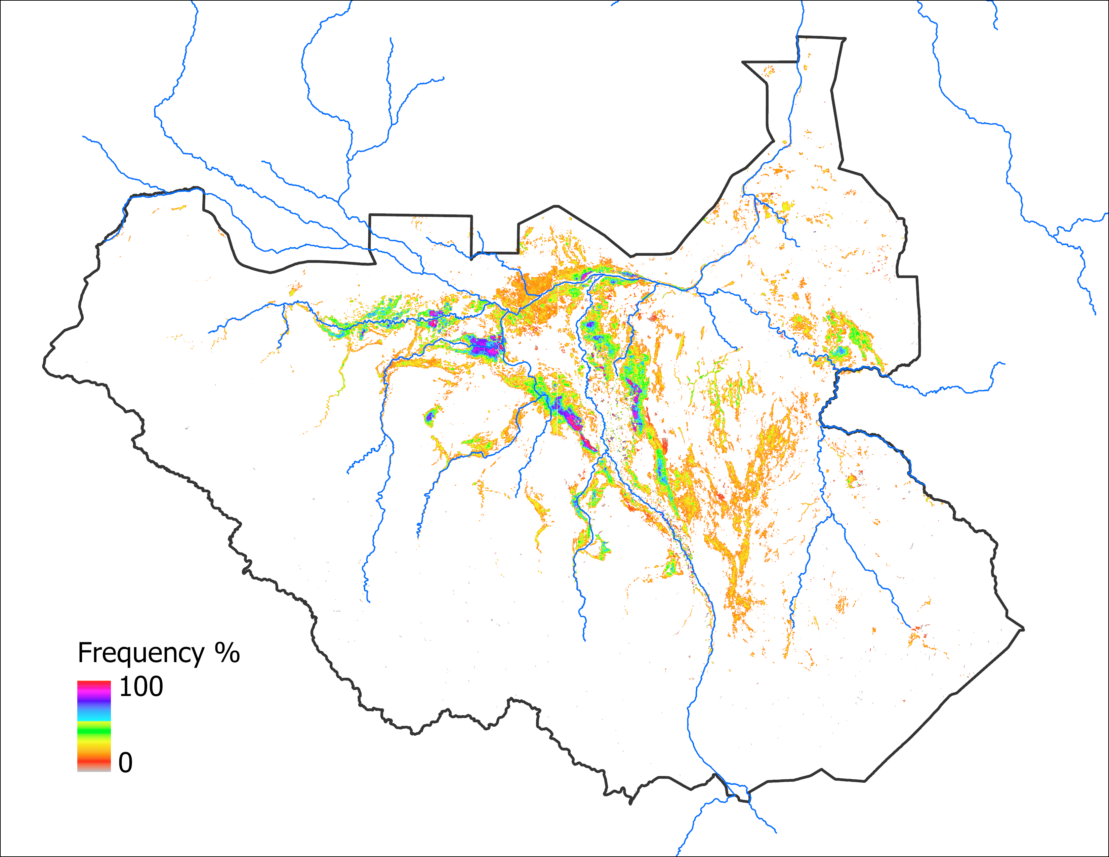
Predicted Inundation Map
Sep 2024 with May IC
Oct 2024 with May IC
63,330 km²
63,330 km²
Notes:
Because of the insignificant difference (only 51 km²) in LASSO predicted estimates for Sep and Oct, the mapped areas are the same for 2024.

Slide 5
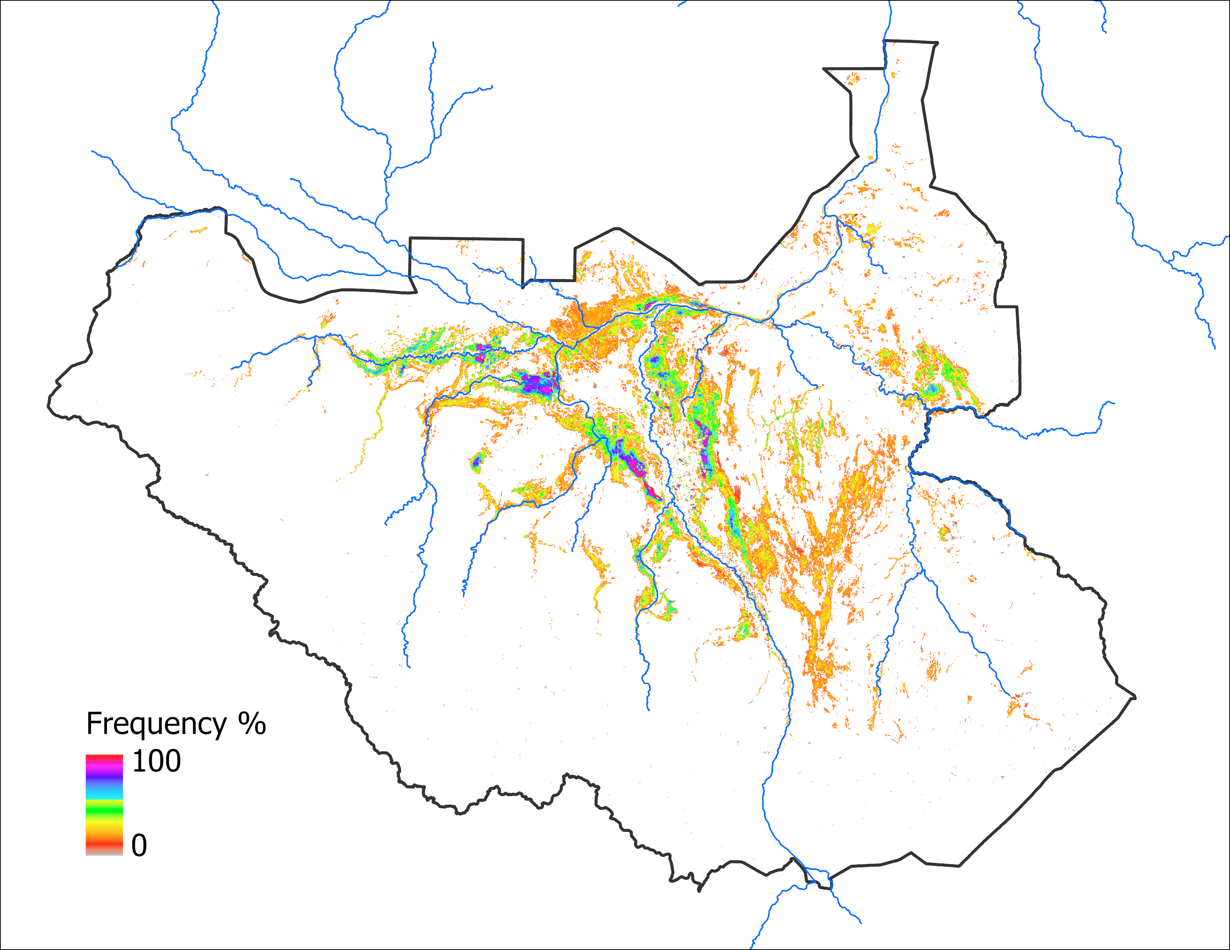
Analog Based Inundation Map
Sep 2024 with May IC
Oct 2024 with May IC
63,330 km²
70,805 km²

Slide 6
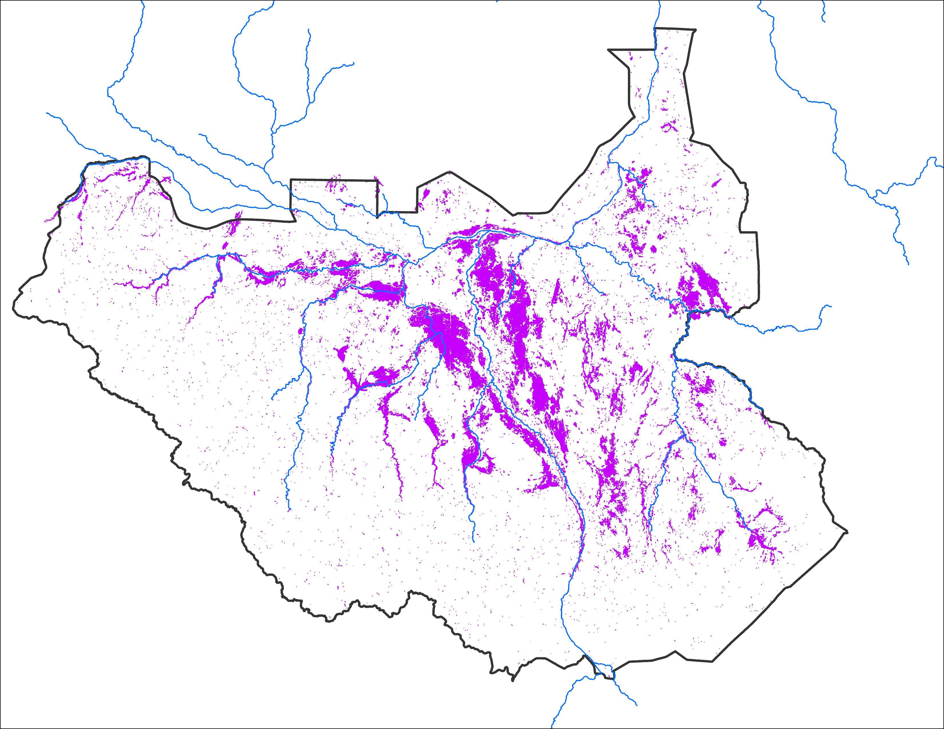
Comparison with 2020
Sep 2024 with May IC
Sep 2024 with May IC
Sep 2020
63,330 km²
Based on LASSO model
63,330 km²
Based on analog year
Observed: 58,820 km²

Slide 7
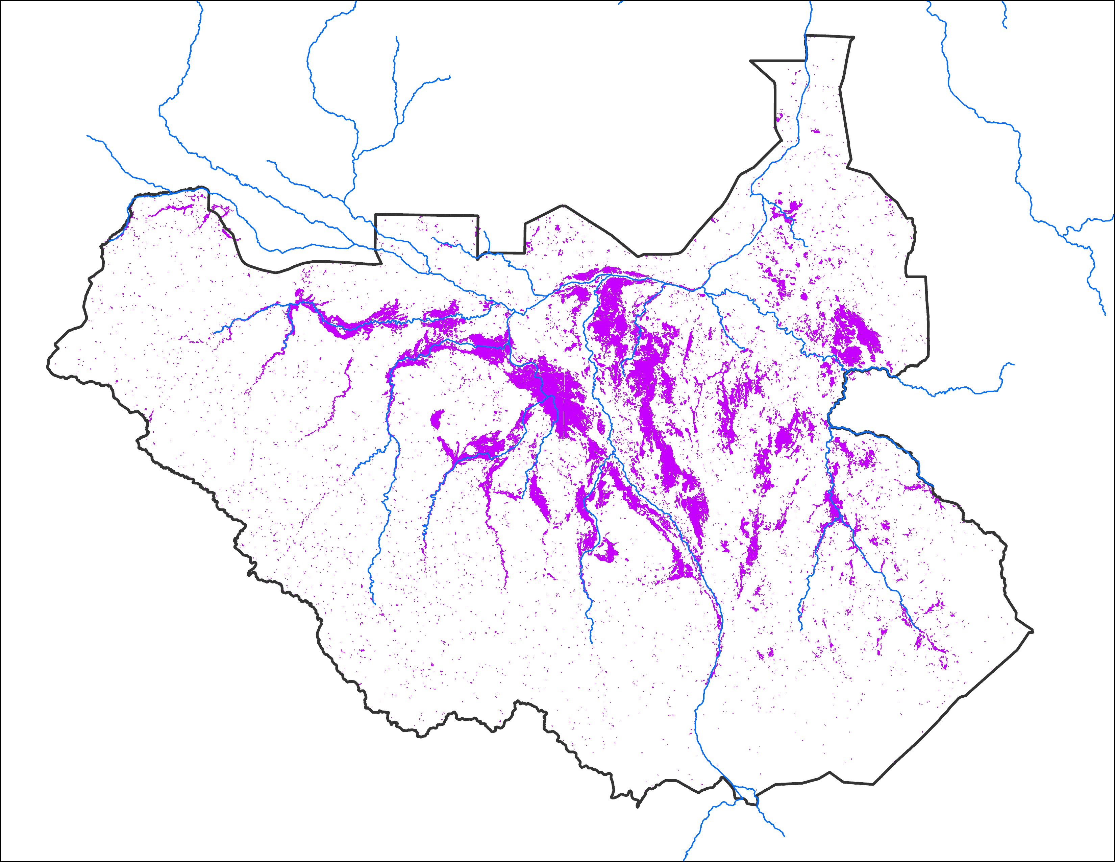
Comparison with 2020
Oct 2024 with May IC
Oct 2024 with May IC
Oct 2020
63,330 km²
Based on LASSO model
70,805 km²
Based on analog year
Observed: 61,664 km²

Slide 8
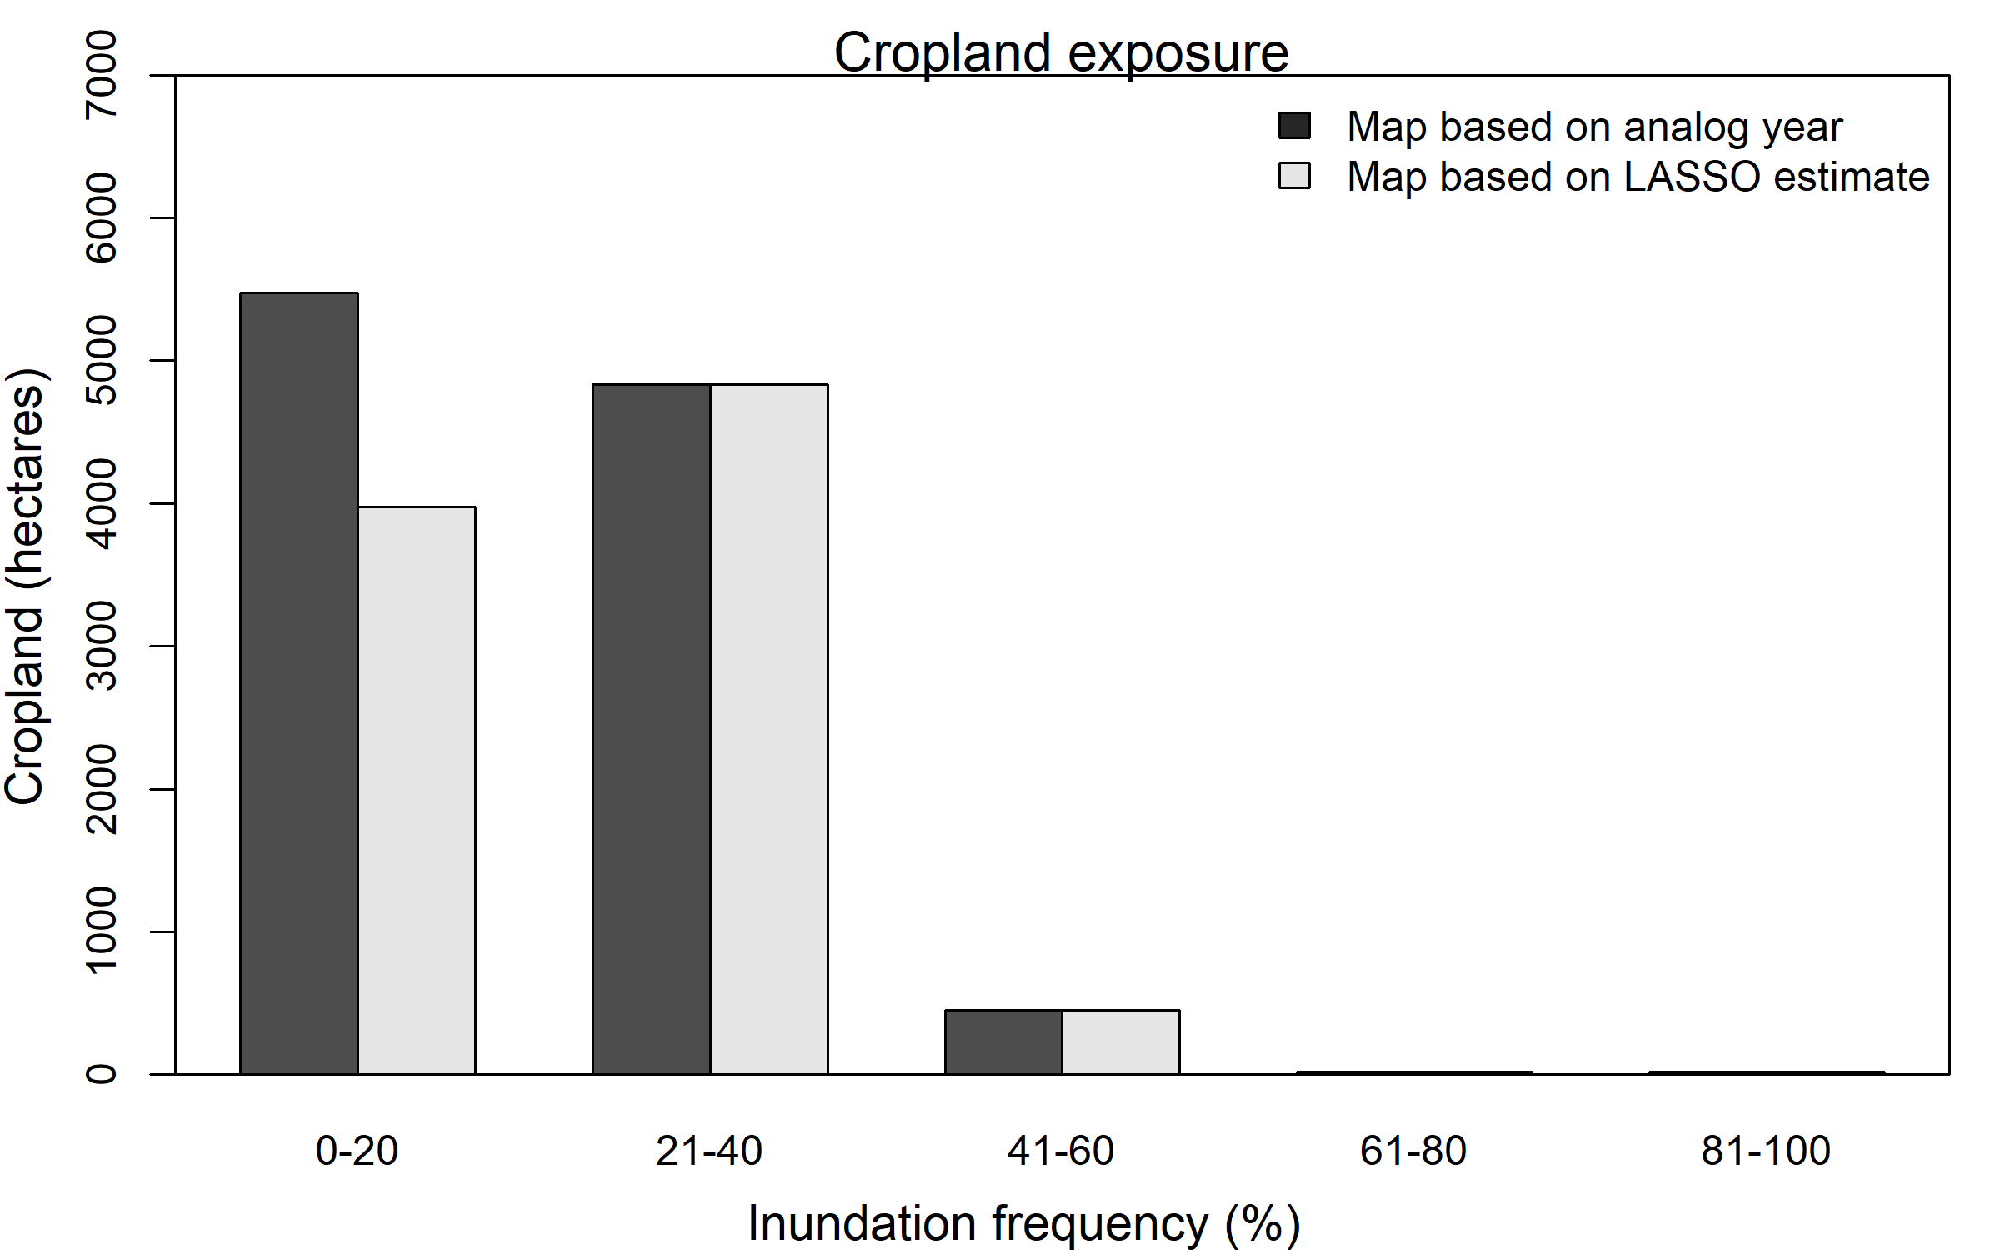
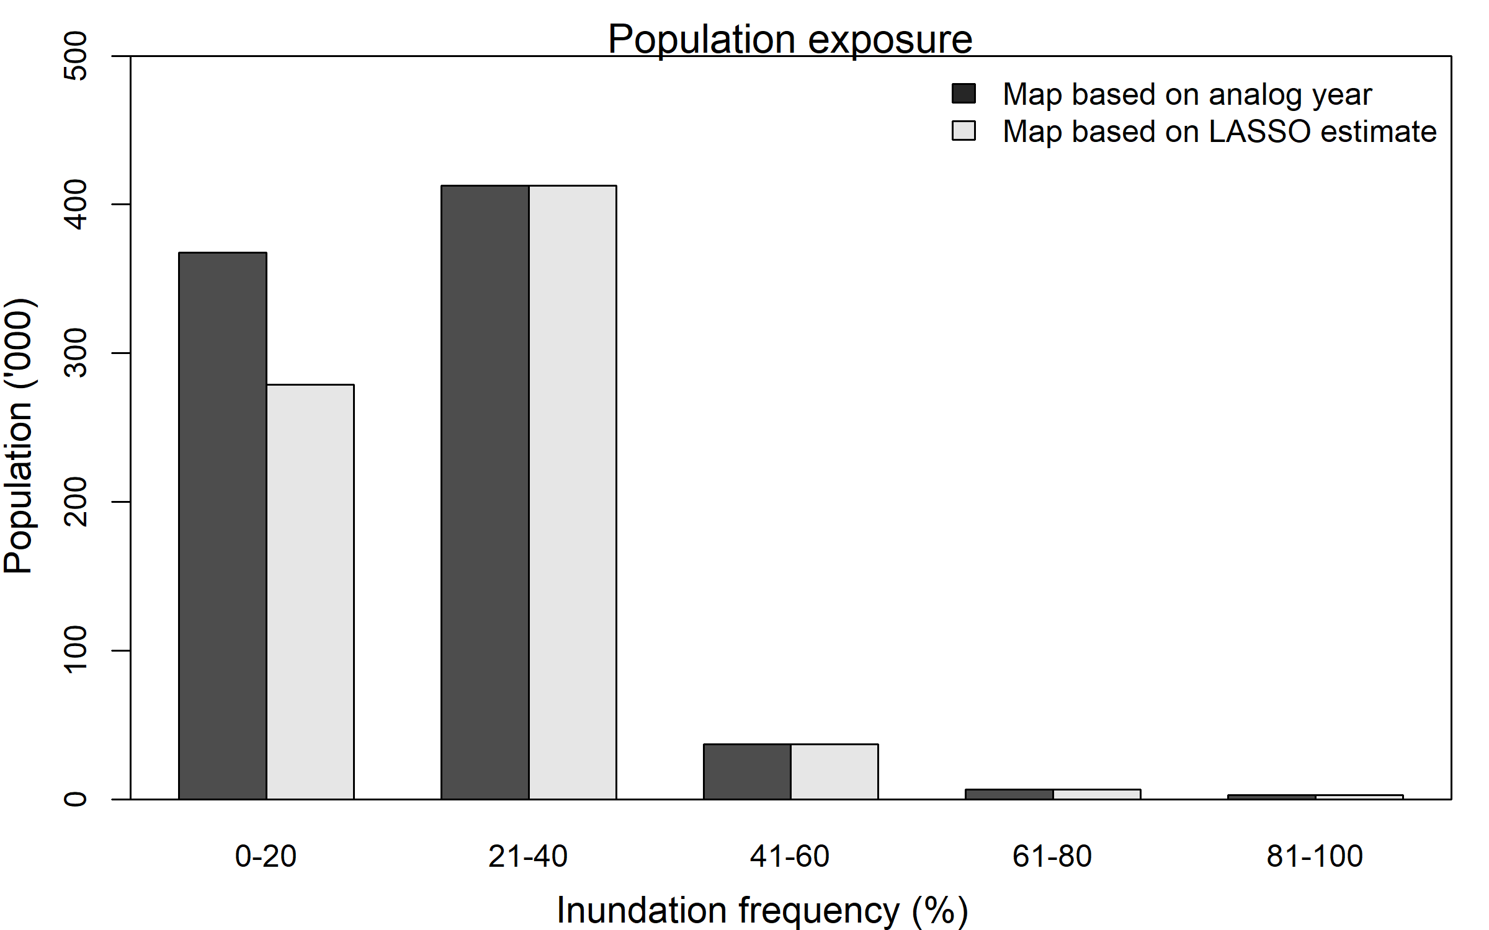
Impact Assessment
~828,000 people are vulnerable to flooding in October of 2024.
Out of 11.2 million
Not including displaced people moving in from Sudan
Cropland vulnerable to flooding in October of 2024: ~10,790 hectares
Out of total 289,364 hectares (entire country)

Slide 9
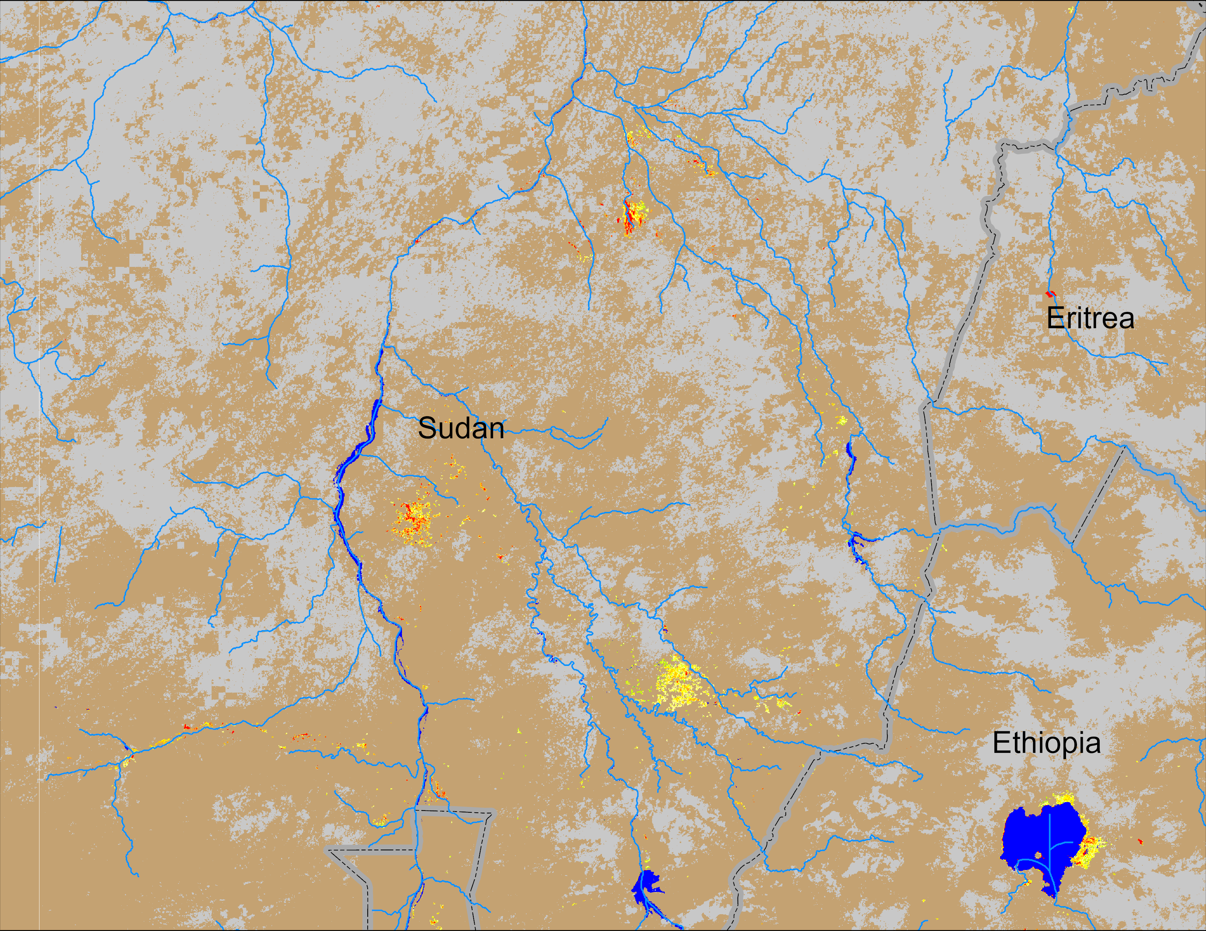
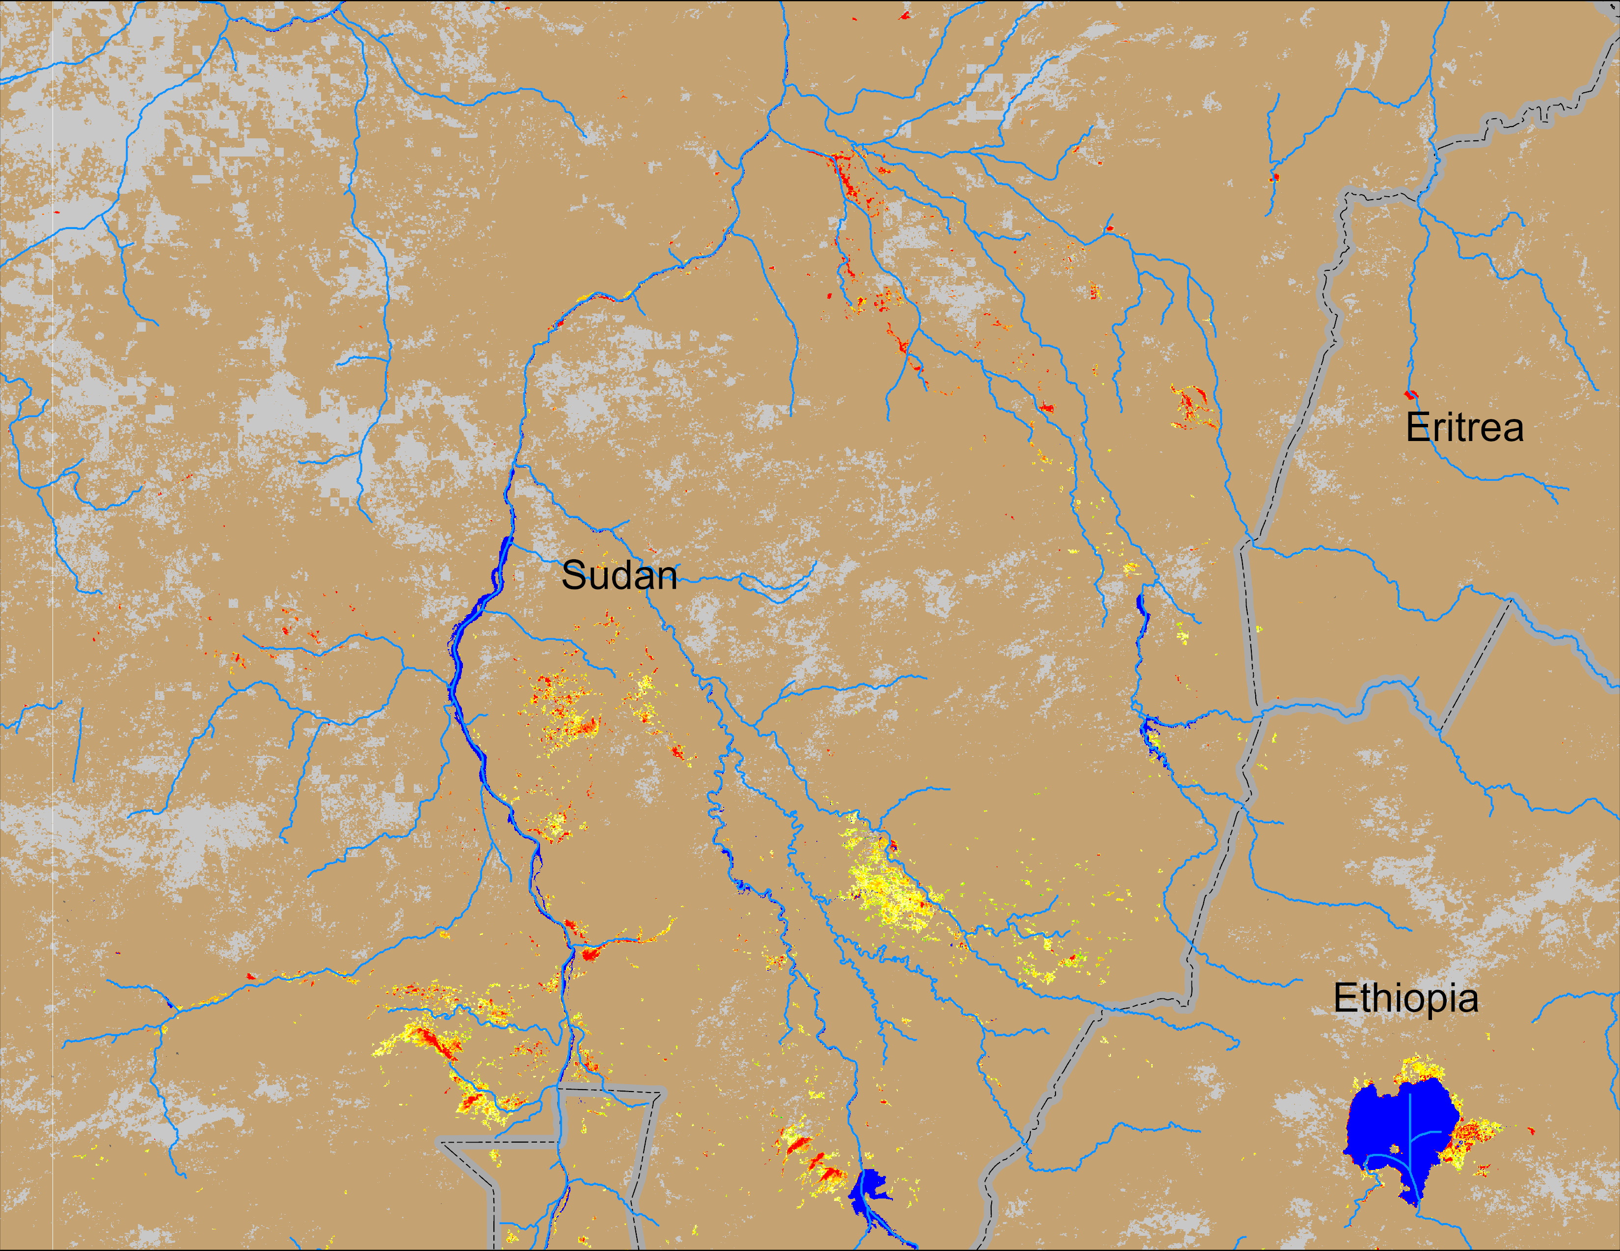
Flooding Conditions in Sudan
(% of the pixel)
(% of the pixel)
Atbara
Atbara
Blue Nile
Blue Nile
White Nile
White Nile
NOAA VIIRS 5-day comp.: 31 Jul – 04 Aug 2024
NOAA VIIRS 5-day comp.: 07 – 11 Aug 2024
Noticeable flooding detected along White Nile, Blue Nile and Atbara Rivers in eastern Sudan.

Slide 10
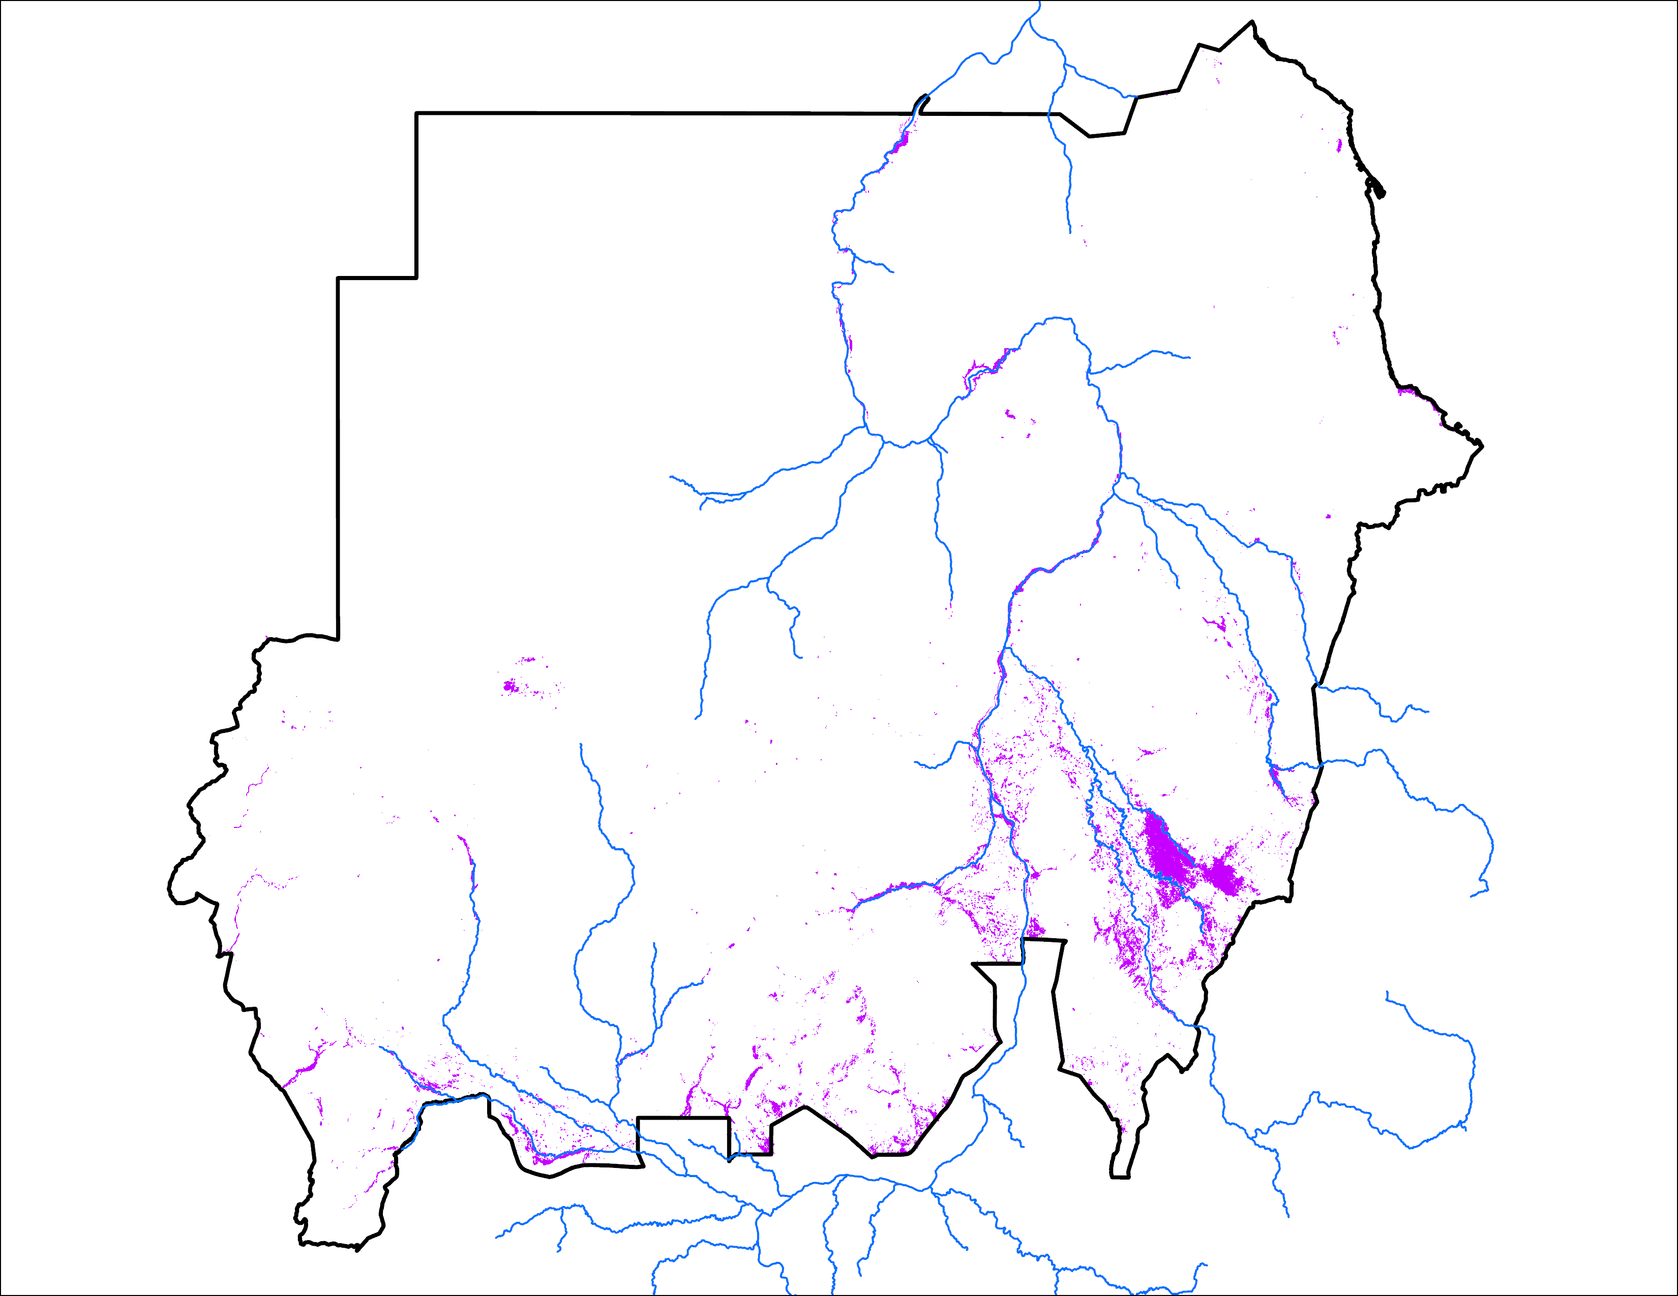
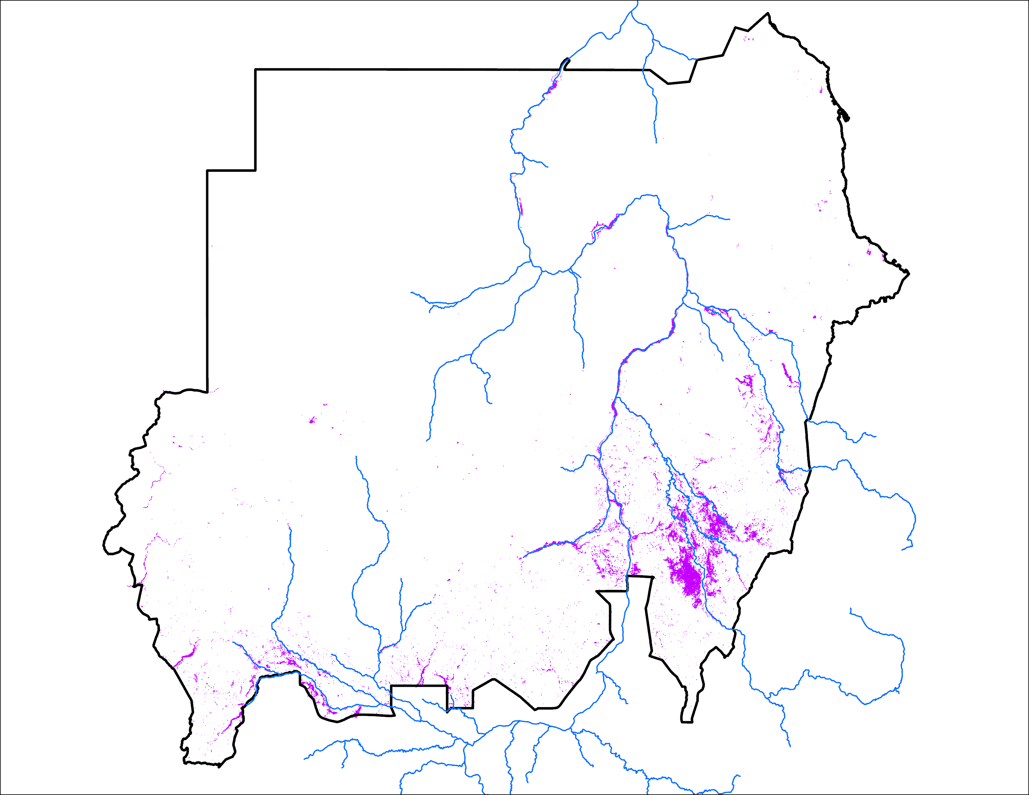
Analog Based Predicted Inundation Map
Predicted Sep 2024
Observed Sep 2020
34,557 km²
32,734 km²

Slide 11
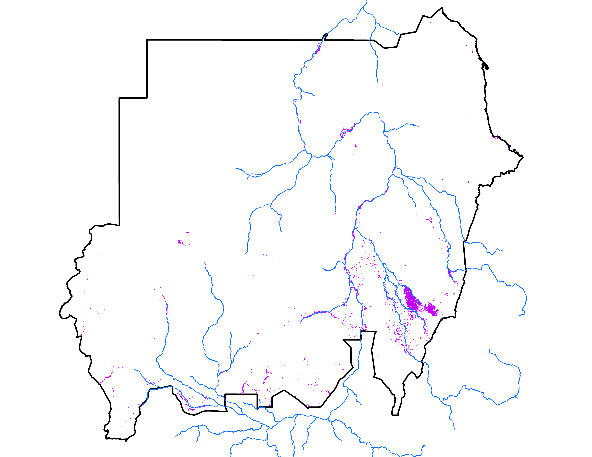
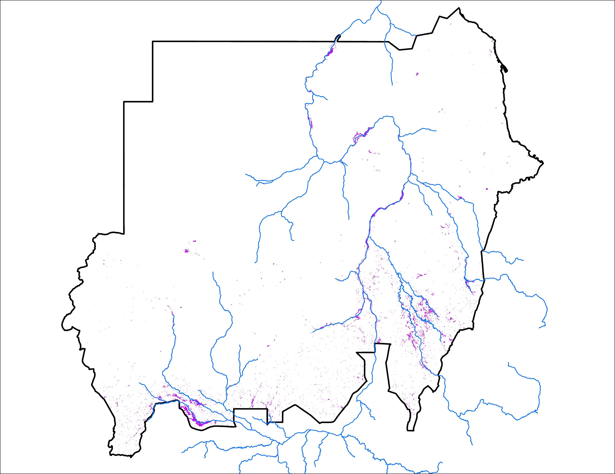
Analog Based Predicted Inundation Map
Predicted Oct 2024
Observed Oct 2020
20,040 km²
17,197 km²

Slide 12
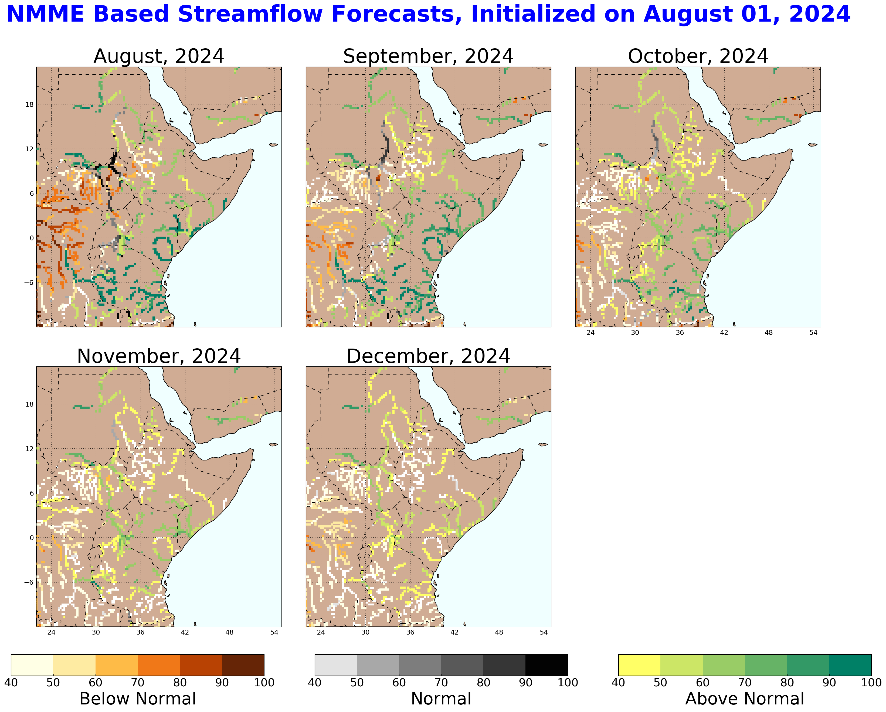
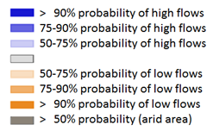
Streamflow Forecast in Sudan
Atbara
Blue Nile
White Nile
GloFAS streamflow forecast: Aug – Nov 2024
NHyFAS streamflow forecast: Aug – Dec 2024
Above average streamflow is expected along the tributaries of White Nile, Blue Nile and Atbara.

Slide 13
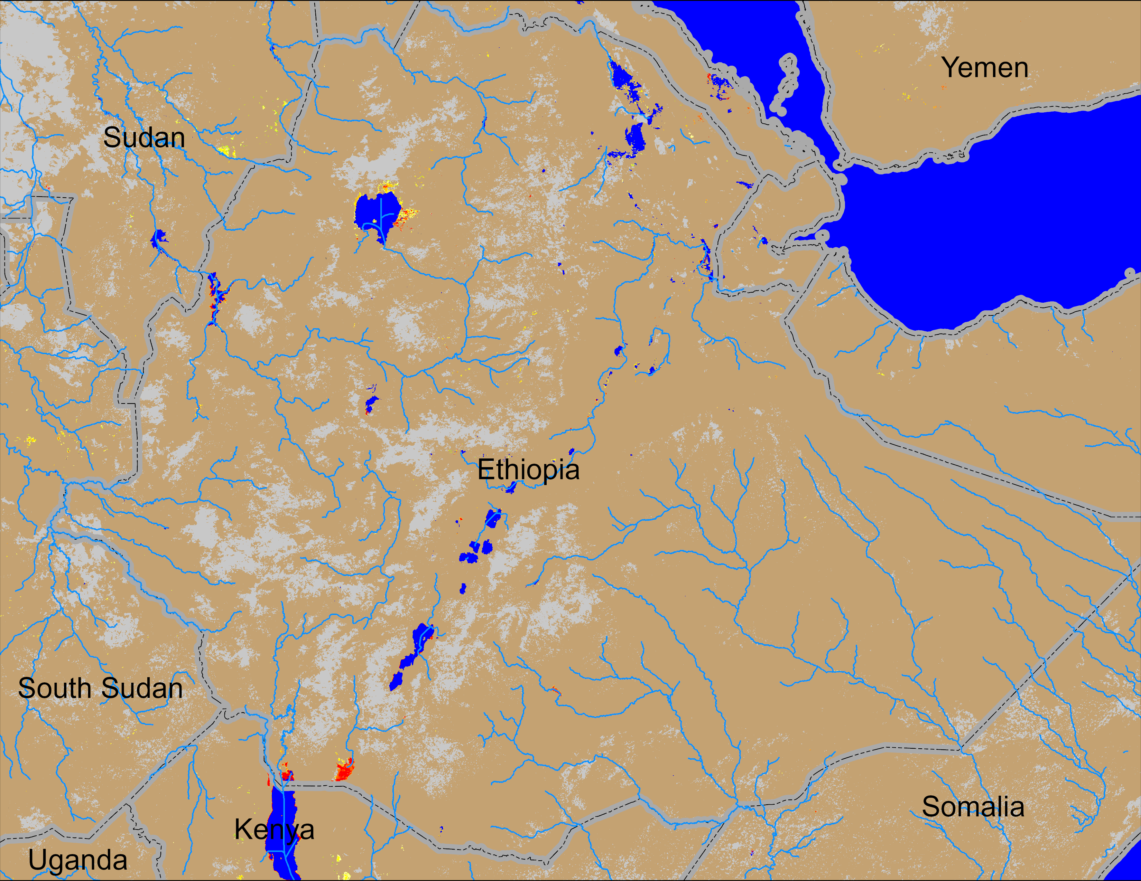
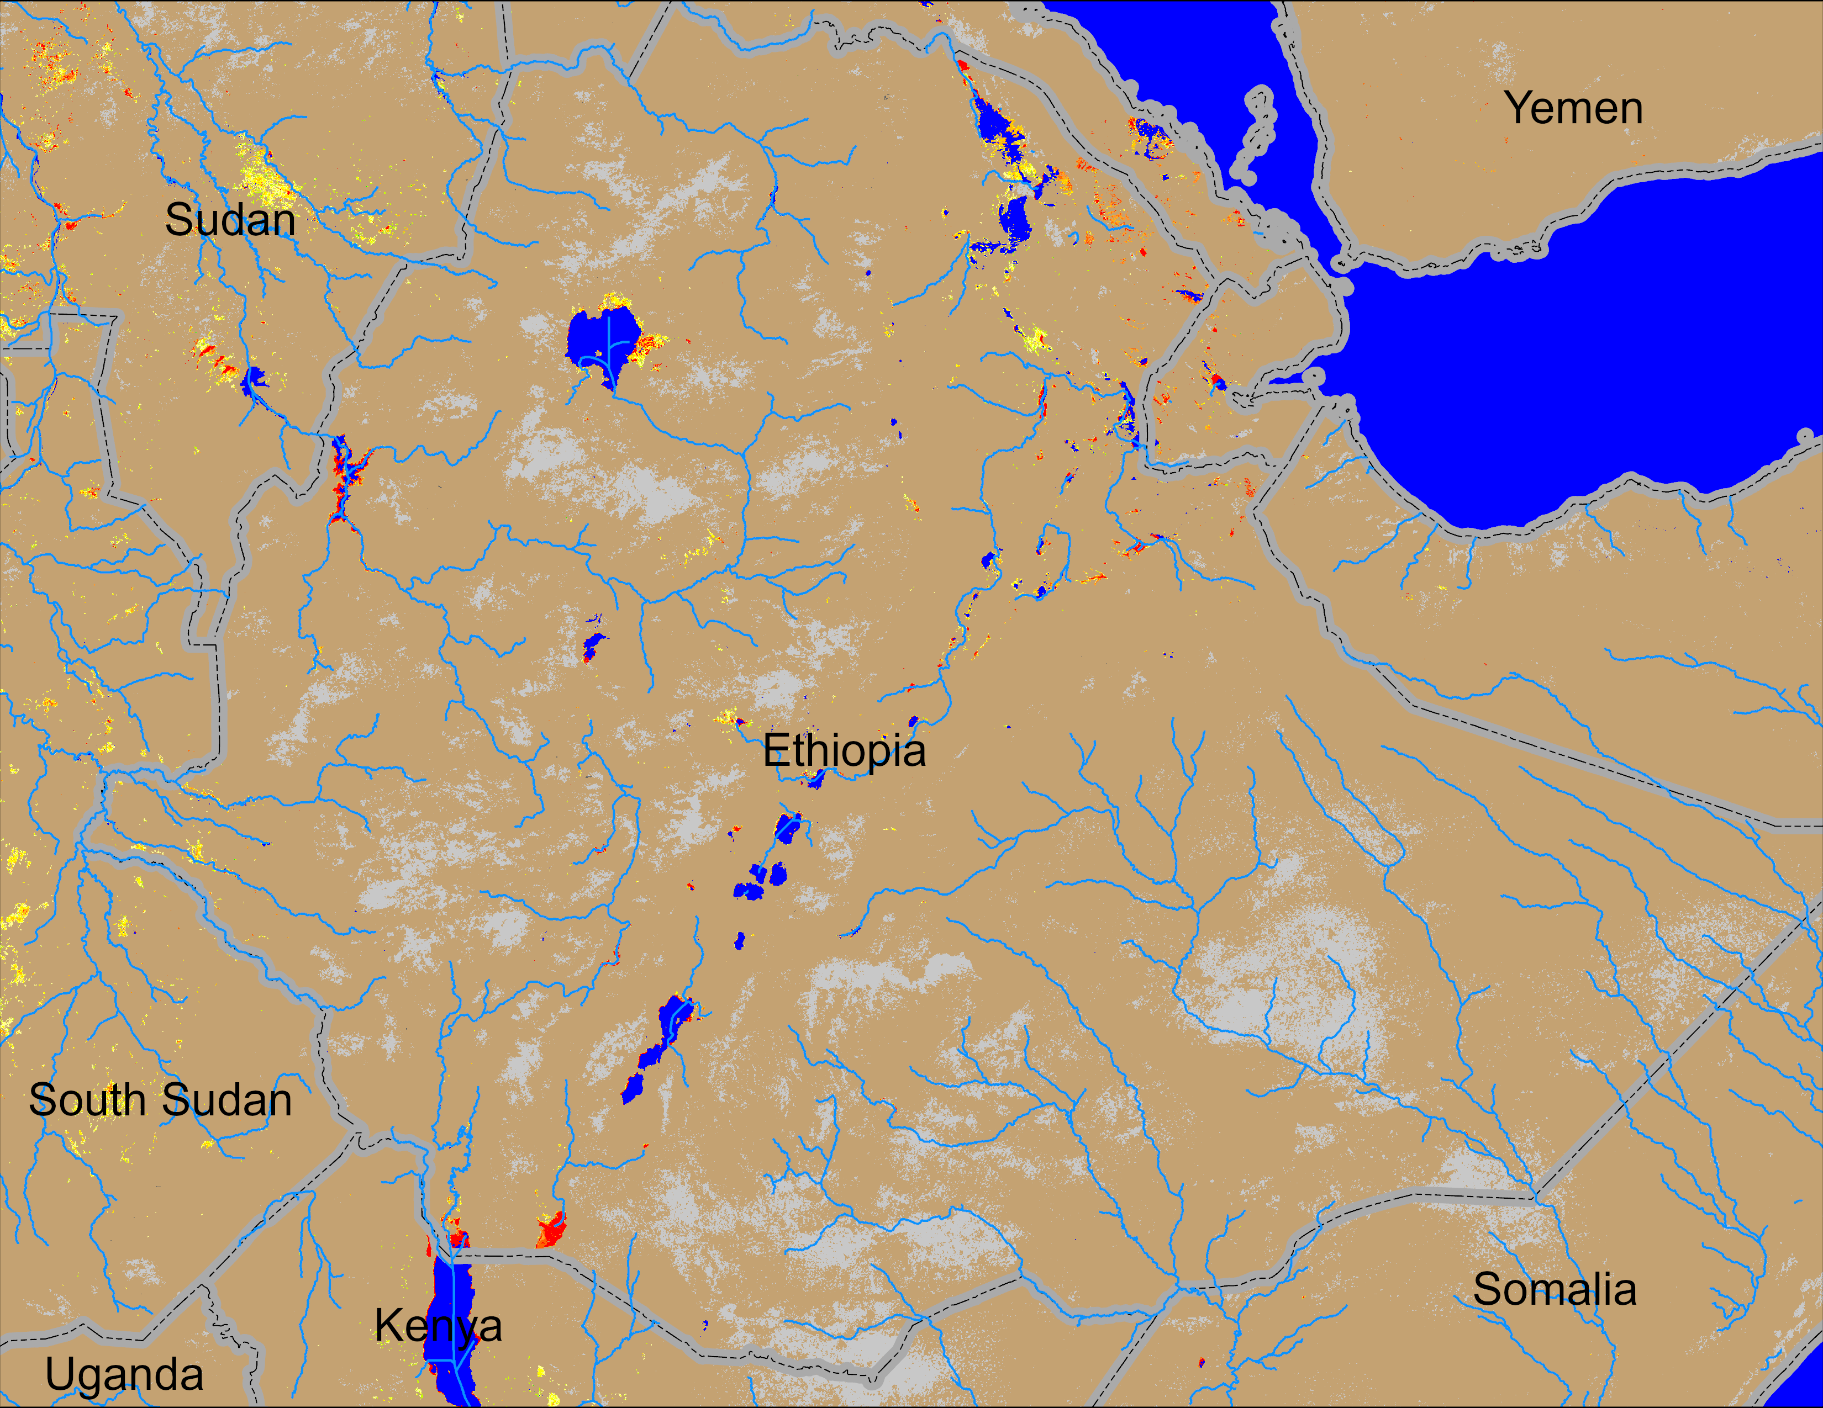
Flooding Conditions in Ethiopia
(% of the pixel)
(% of the pixel)
NOAA VIIRS 5-day comp.: 11 – 15 Jul 2024
NOAA VIIRS 5-day comp.: 07 – 11 Aug 2024
Some inundated areas have been observed in northeastern Ethiopia.

Slide 14
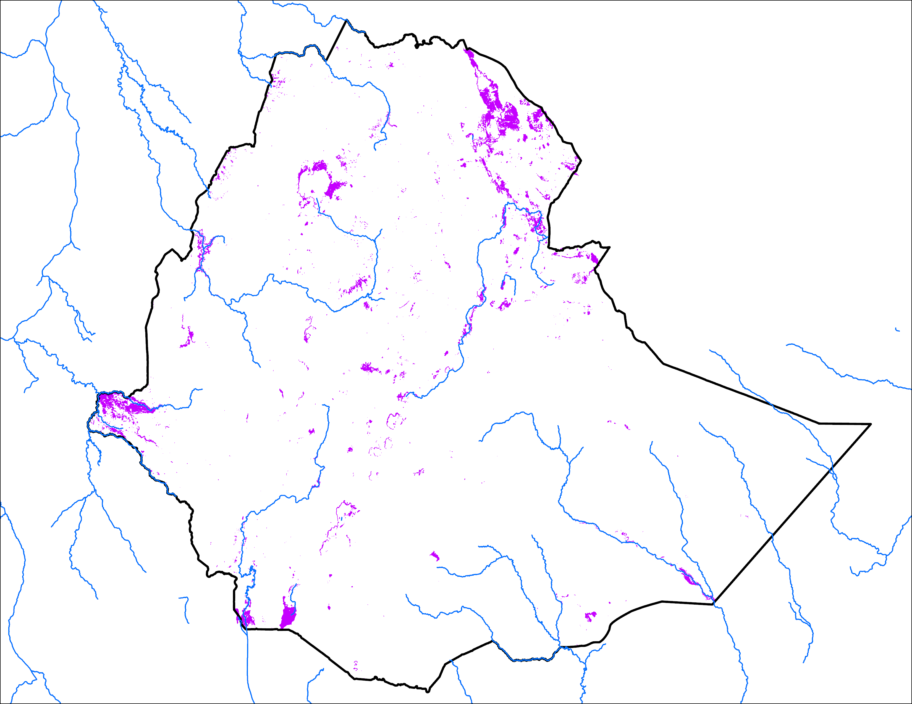
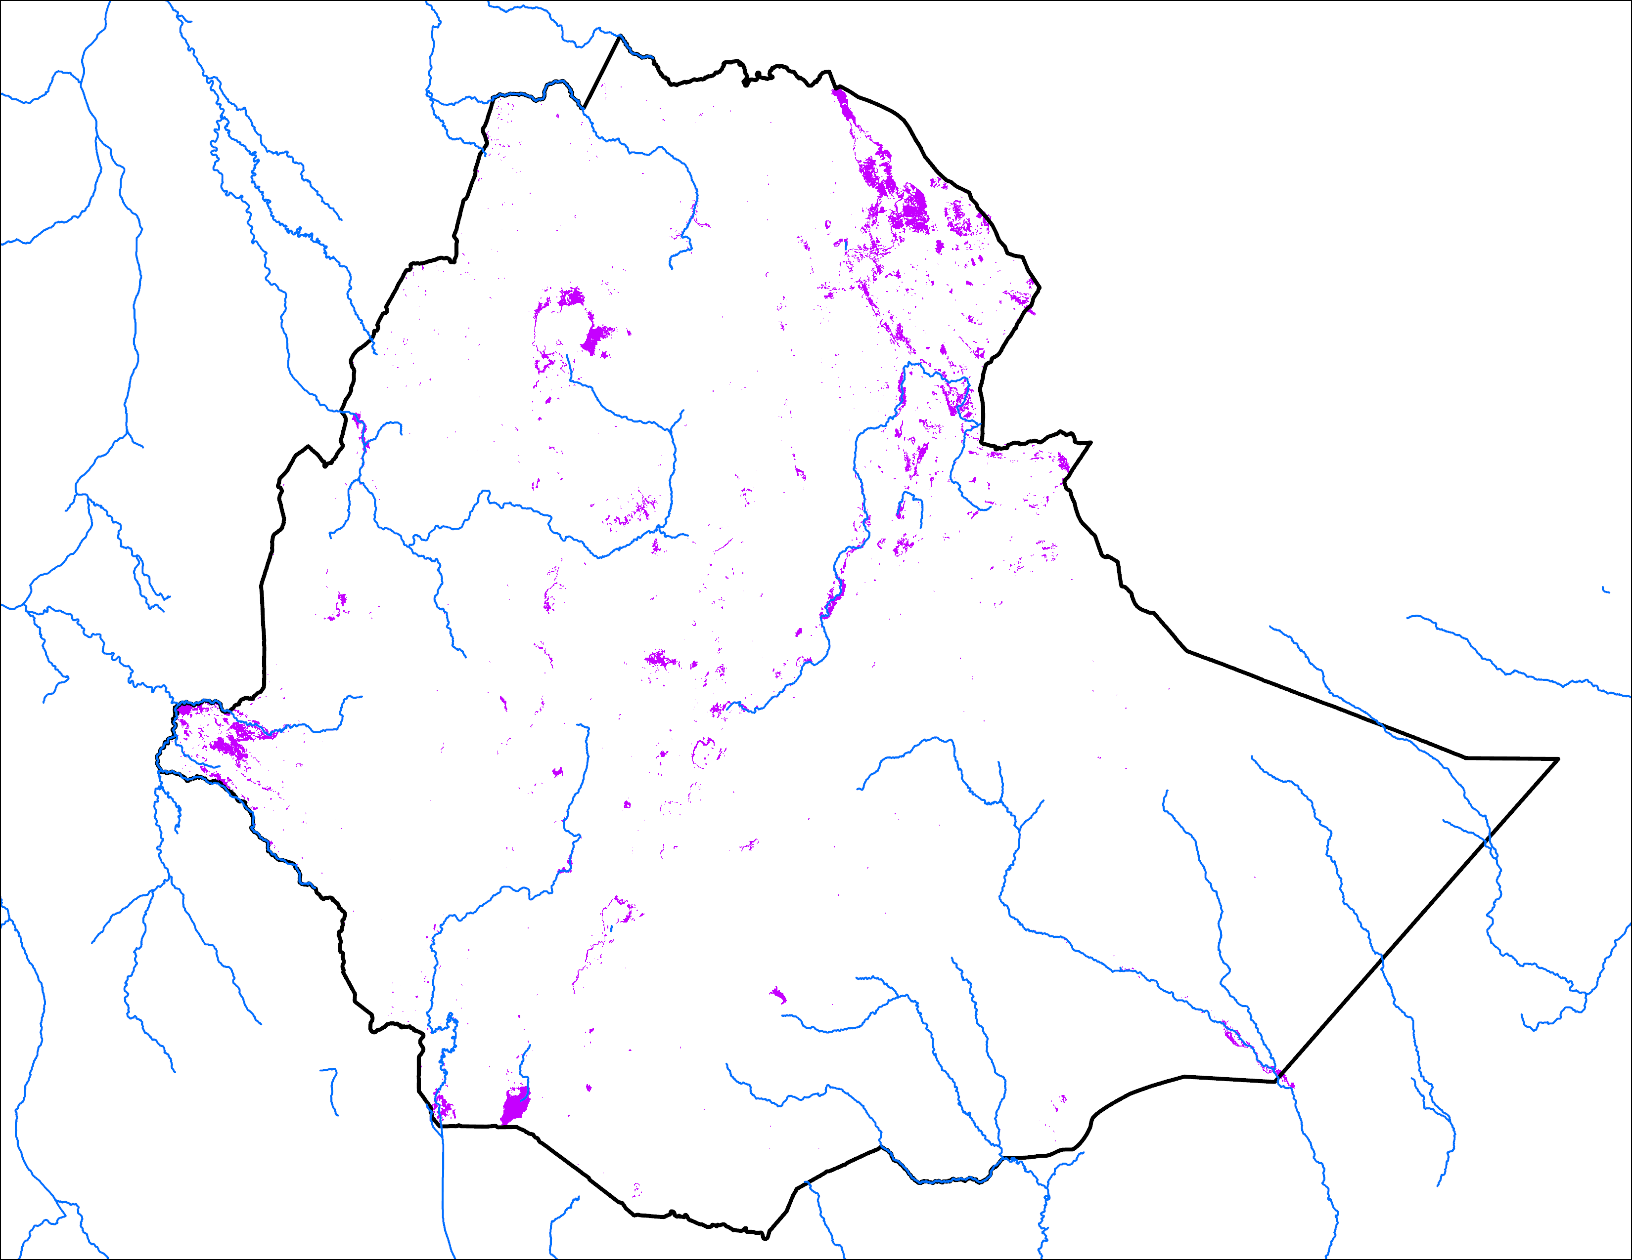
Analog Based Predicted Inundation Map
Predicted Sep 2024
Observed Sep 2020
25,573 km²
19,848 km²

Slide 15
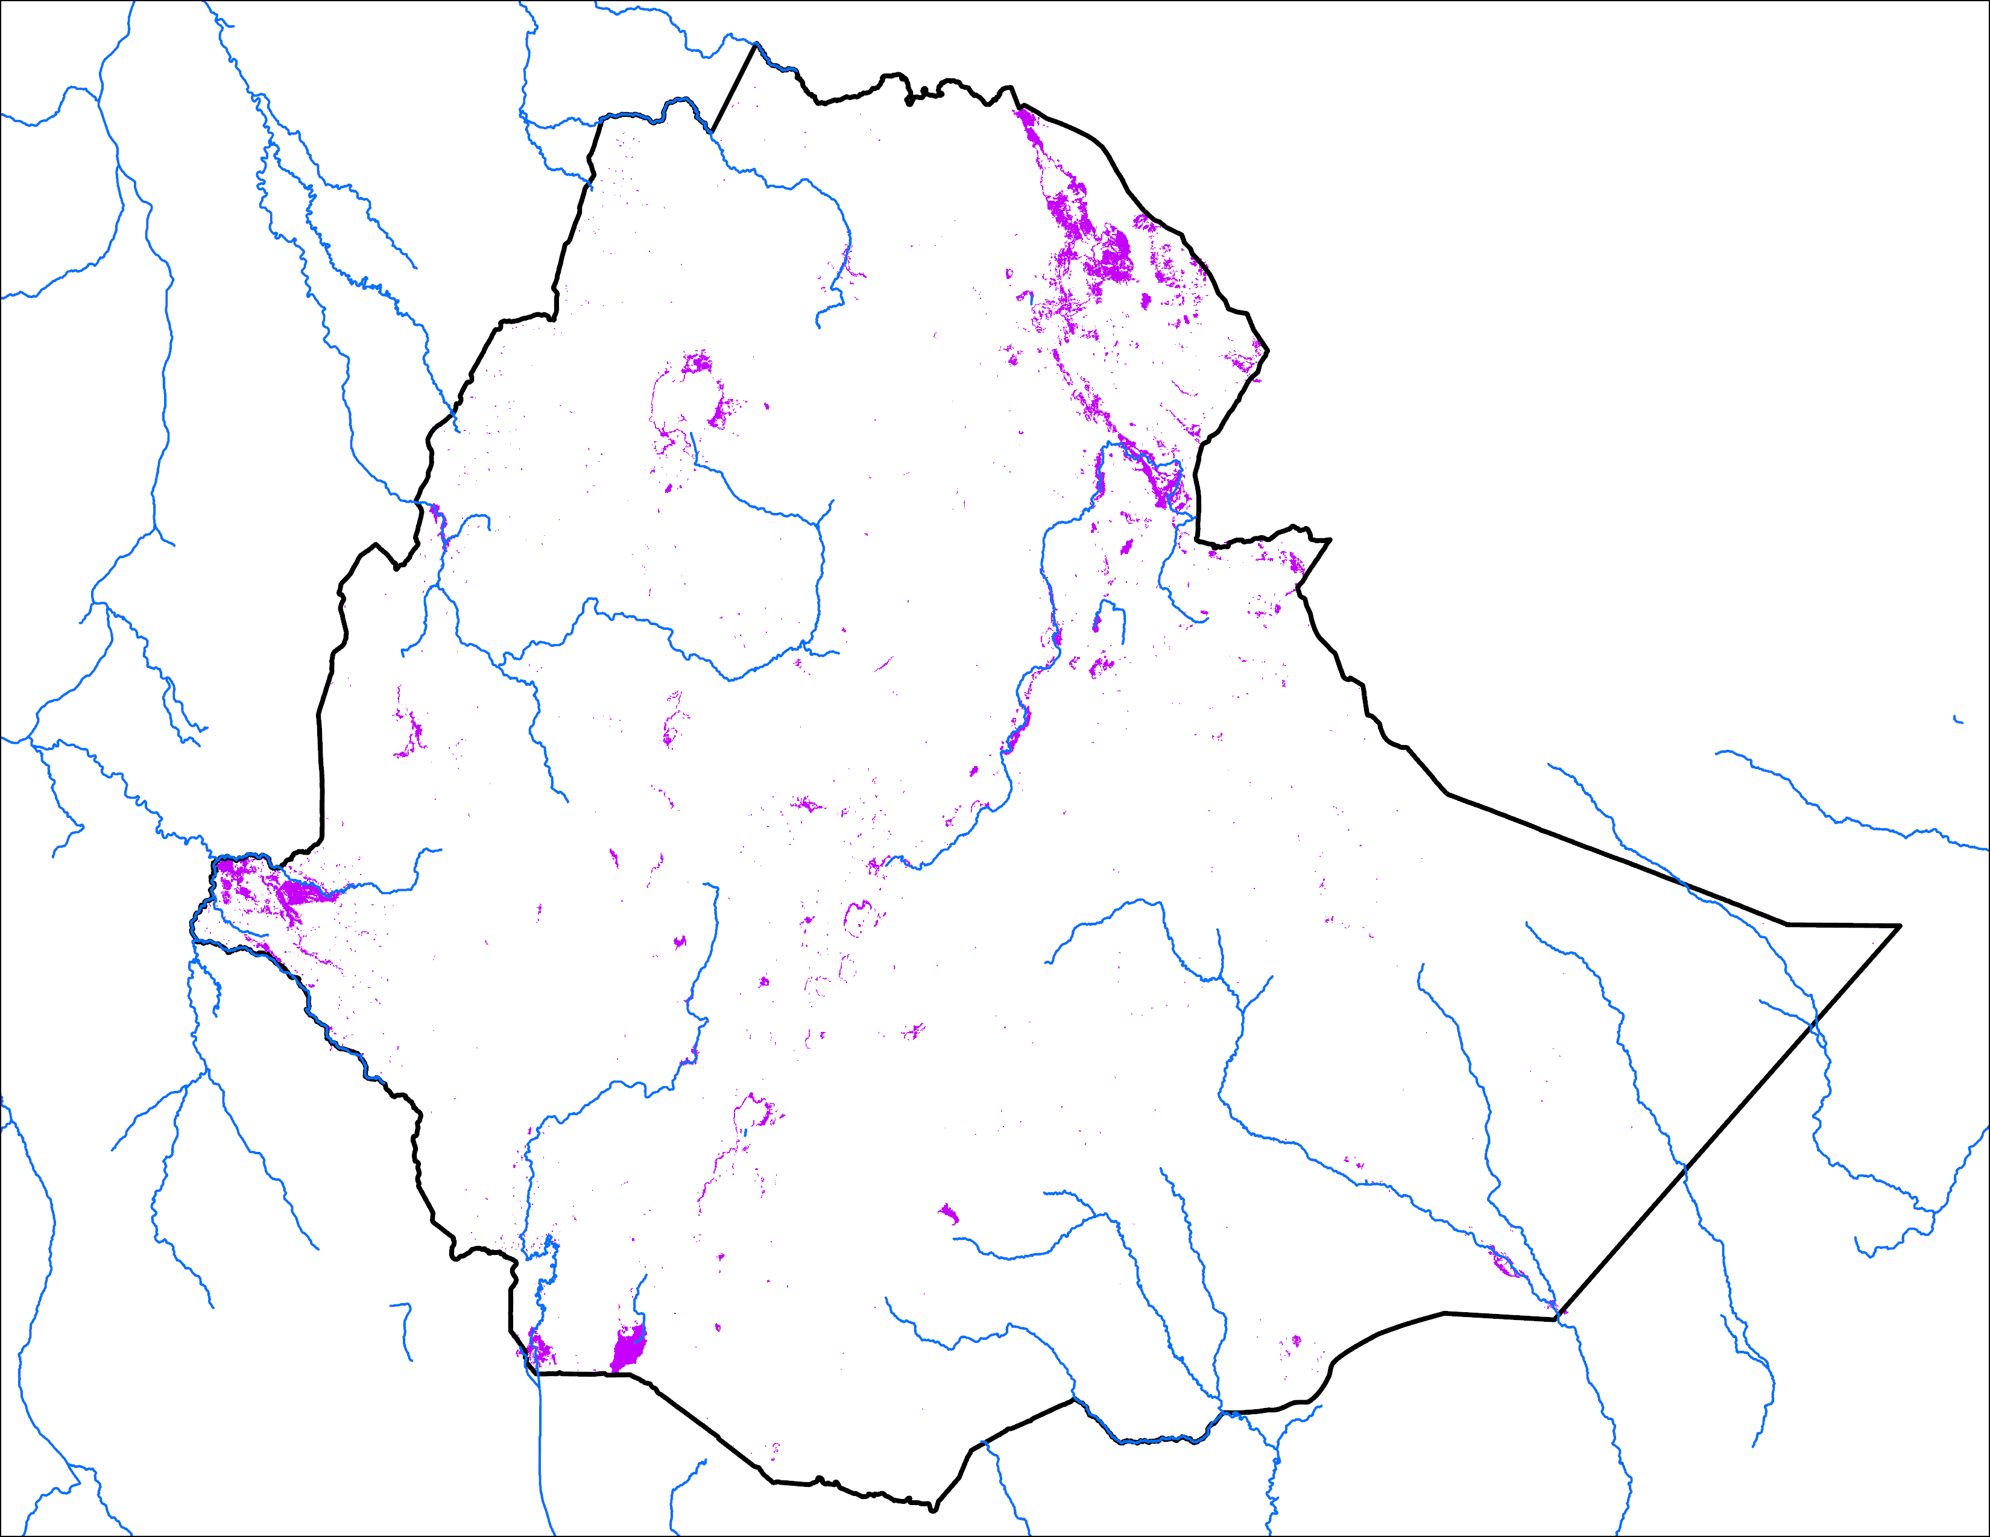
Analog Based Predicted Inundation Map
Predicted Oct 2024
Observed Oct 2020
25,573 km²
18,648 km²

Slide 16
Streamflow Forecast in Ethiopia
Atbara
Awash
GloFAS streamflow forecast: Aug – Nov 2024
NHyFAS streamflow forecast: Aug – Dec 2024
Average to above average streamflow is expected along northern and southern Ethiopia.

Slide 17
Thank you
spervez@usgs.gov

