Slide 1
FEWS NET Enhanced Flood Monitoring and Forecast Assumptions-East Africa and Yemen
May 2024 Seasonal Forecast
FEWS NET Science Team:
USGS, NASA, NOAA, UCSB+Regional Scientists

Slide 2
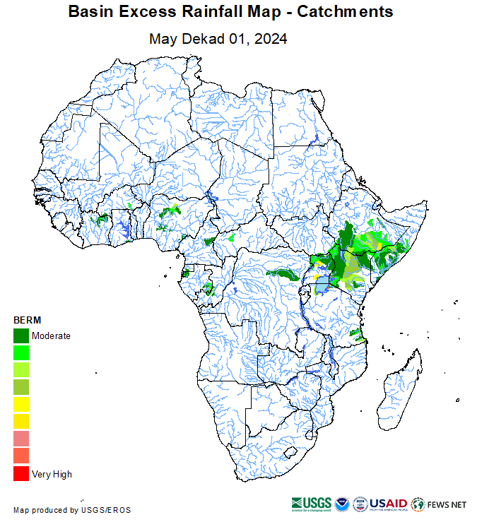
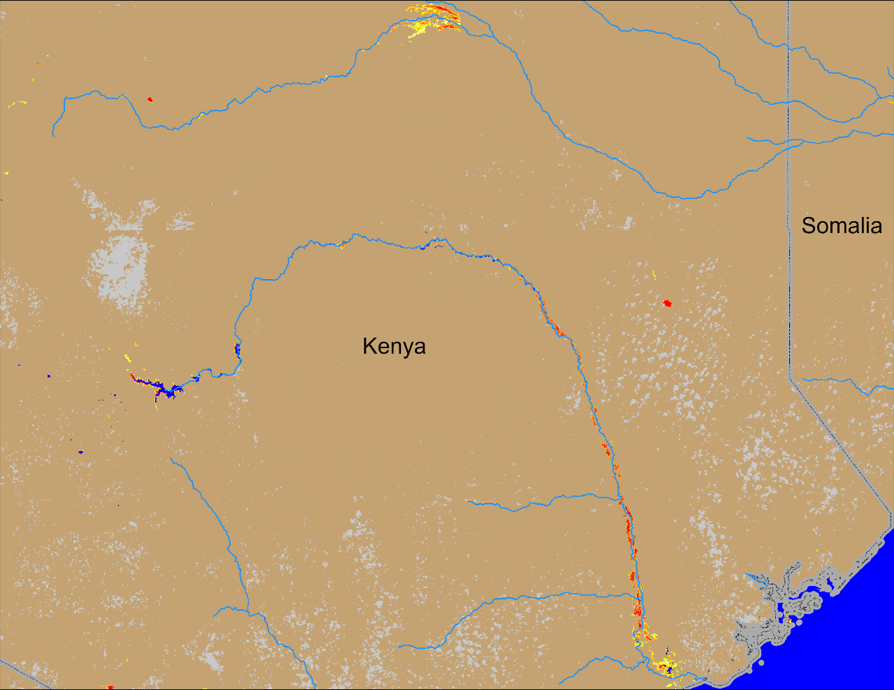
Flooding Conditions in Kenya, Ethiopia, and Somalia
Lag Dera
Tana
(% of the pixel)
BERM: 01 – 10 May 2024
NOAA VIIRS 5-day comp.: 08 – 12 May 2024
Flooding along Tana and Lag Dera Rivers continue in Kenya

Slide 3
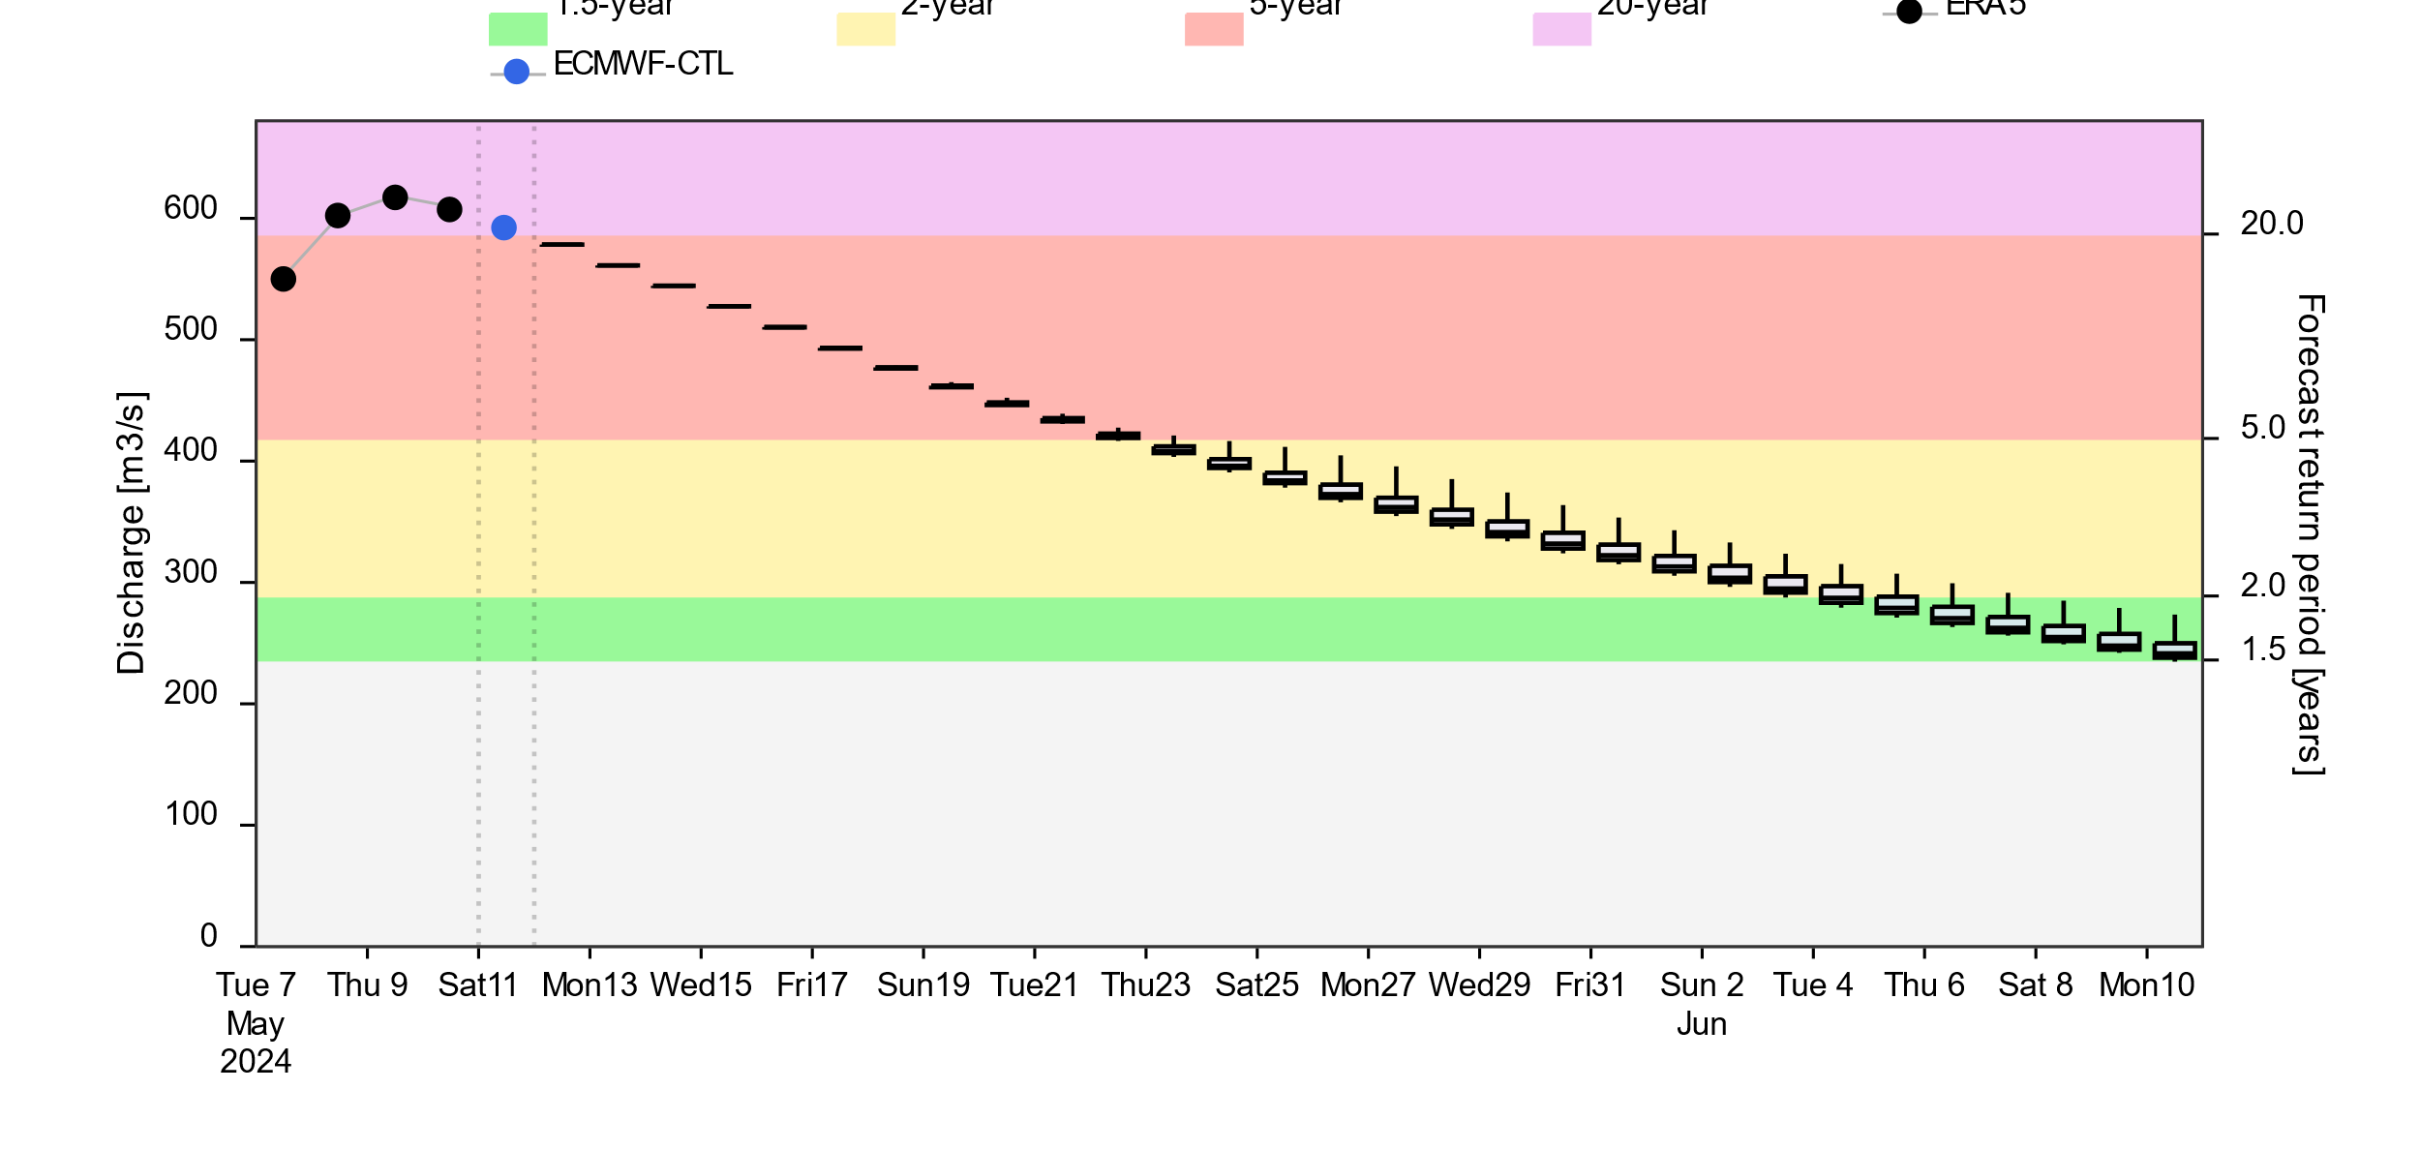
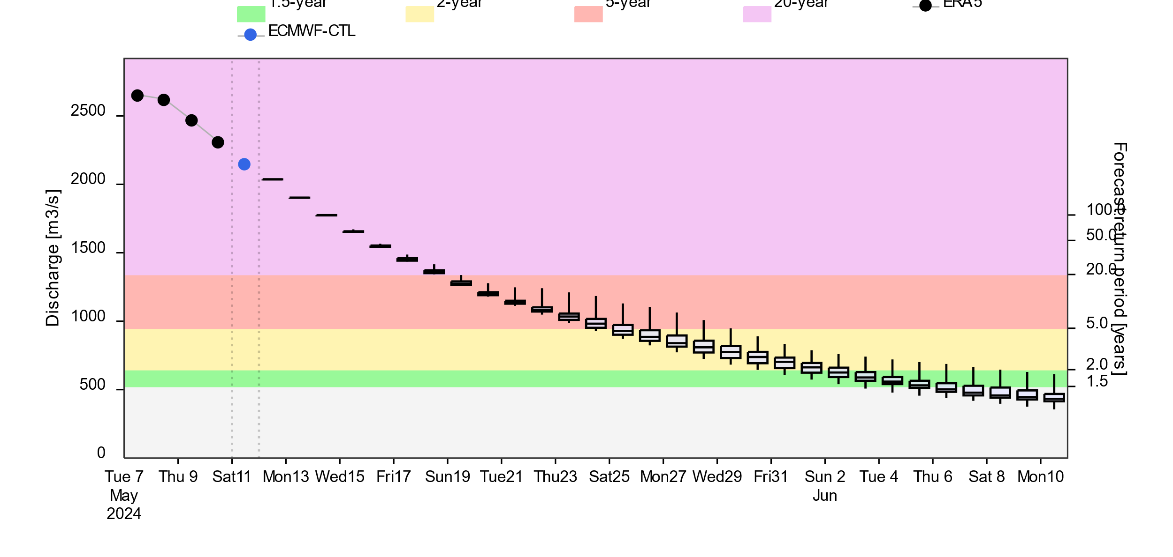
Flooding Conditions in Kenya, Ethiopia, and Somalia
@ point A: Lag Dera
@ point B: Tana
A
B
2-yr 5-yr 20-yr
GloFAS forecast: 11 May – 10 Jun 2024
GloFAS forecast: 11 May – 10 Jun 2024
Streamflow passed the peak in Southern Kenya and are on the decline. However, discharges are still at 5 to 20-yr return period level. Flooding expected to continue till end of May.

Slide 4
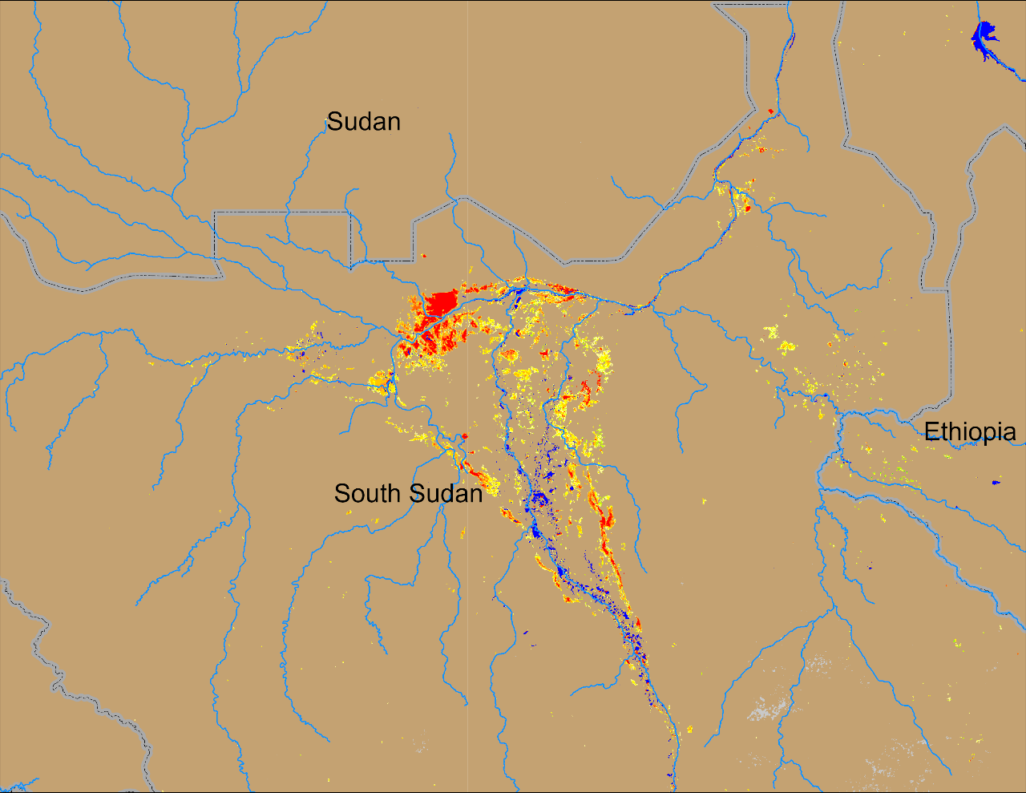
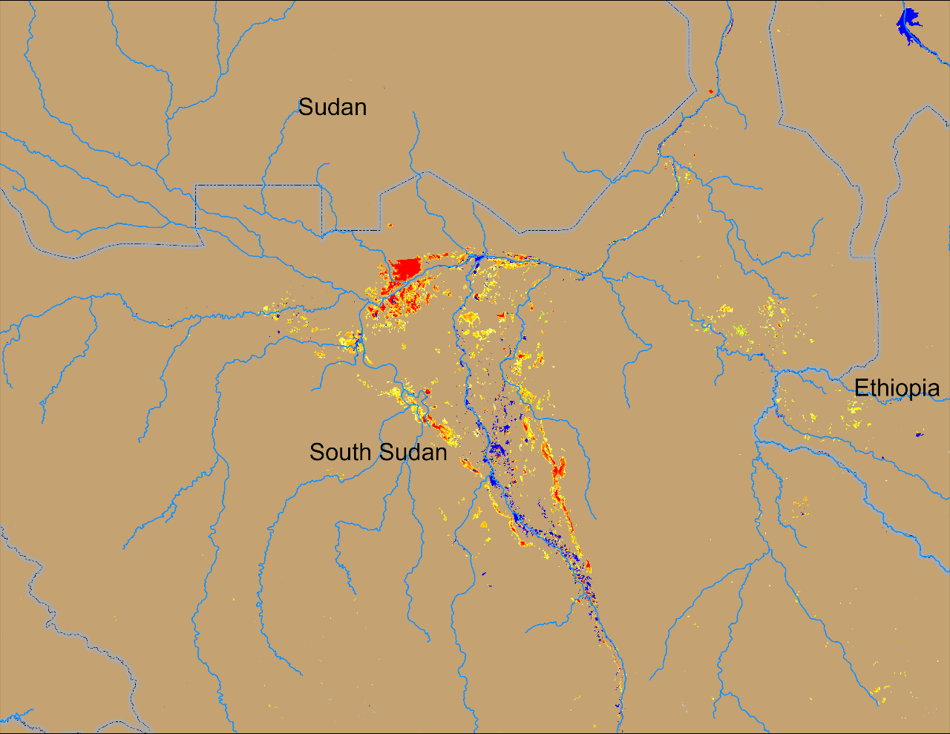
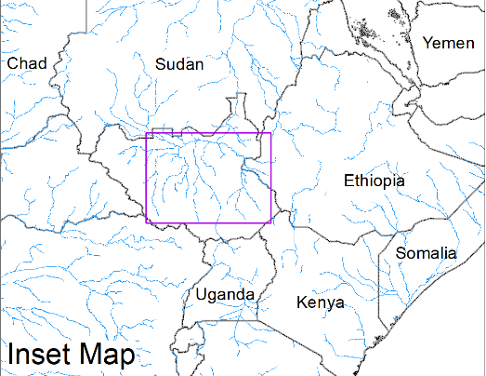
Flooding Conditions in South Sudan
(% of the pixel)
(% of the pixel)
Sobet
Khawr
Sobet
Khawr
Akobo
Akobo
Pibor
Pibor
NOAA VIIRS 5-day comp.: 10 – 14 Apr 2024
NOAA VIIRS 5-day comp.: 08 – 12 May 2024
Consistent coverage of extended inundated areas continues through the pre-rainfall period.

Slide 5
Flooding Conditional in South Sudan
Lag Correlation at National level inundated area
In summary
3
at 3-month lag over the entire region
But can be at 1&2-month lag for SAP and upper White Nile basins.
at 3-month lag
2
Lag (m)
1
at 1-month lag over the entire region
+ for MN, UWN and SAP basins.
0
No reasonable correlation over the entire basin
but
at 0-month lag for SAP discharge
Rainfall
Runoff
Streamflow
LV Water Level
Variables

Slide 6
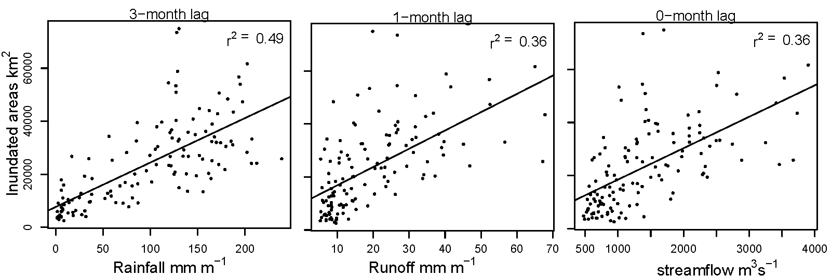
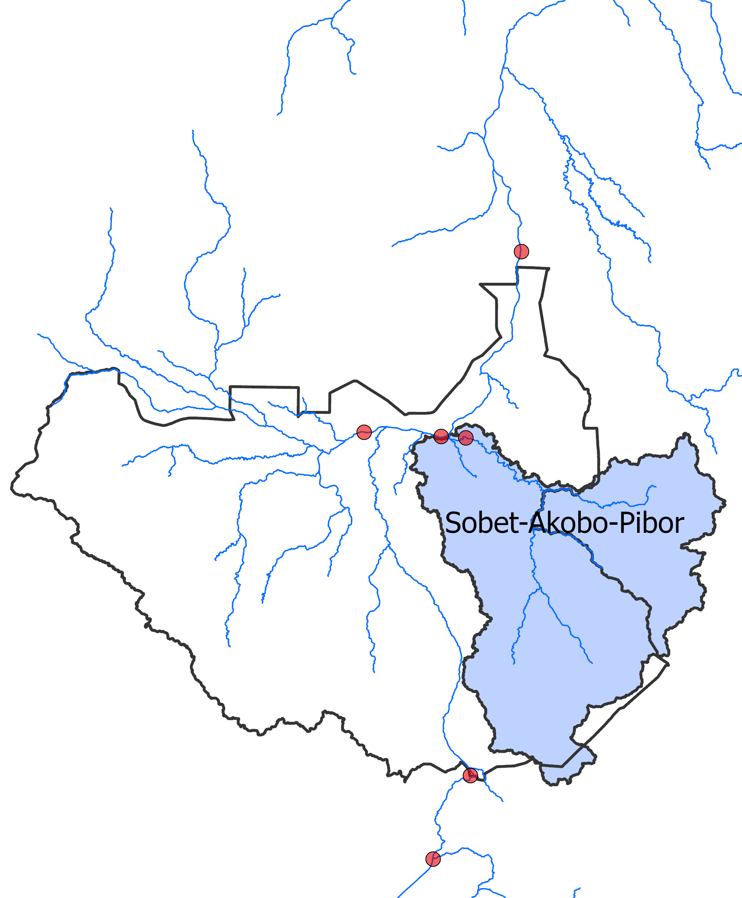
Flooding Conditional in South Sudan
Lag Correlation at National level inundated area
National inundated area vs Sobet-Akobo-Pibor Rainfall, Runoff and Streamflow
This is another evidence how complex the flooding is in the Sudd Wetlands
It suggests contribution of cross-boundary flow for flooding

Slide 7
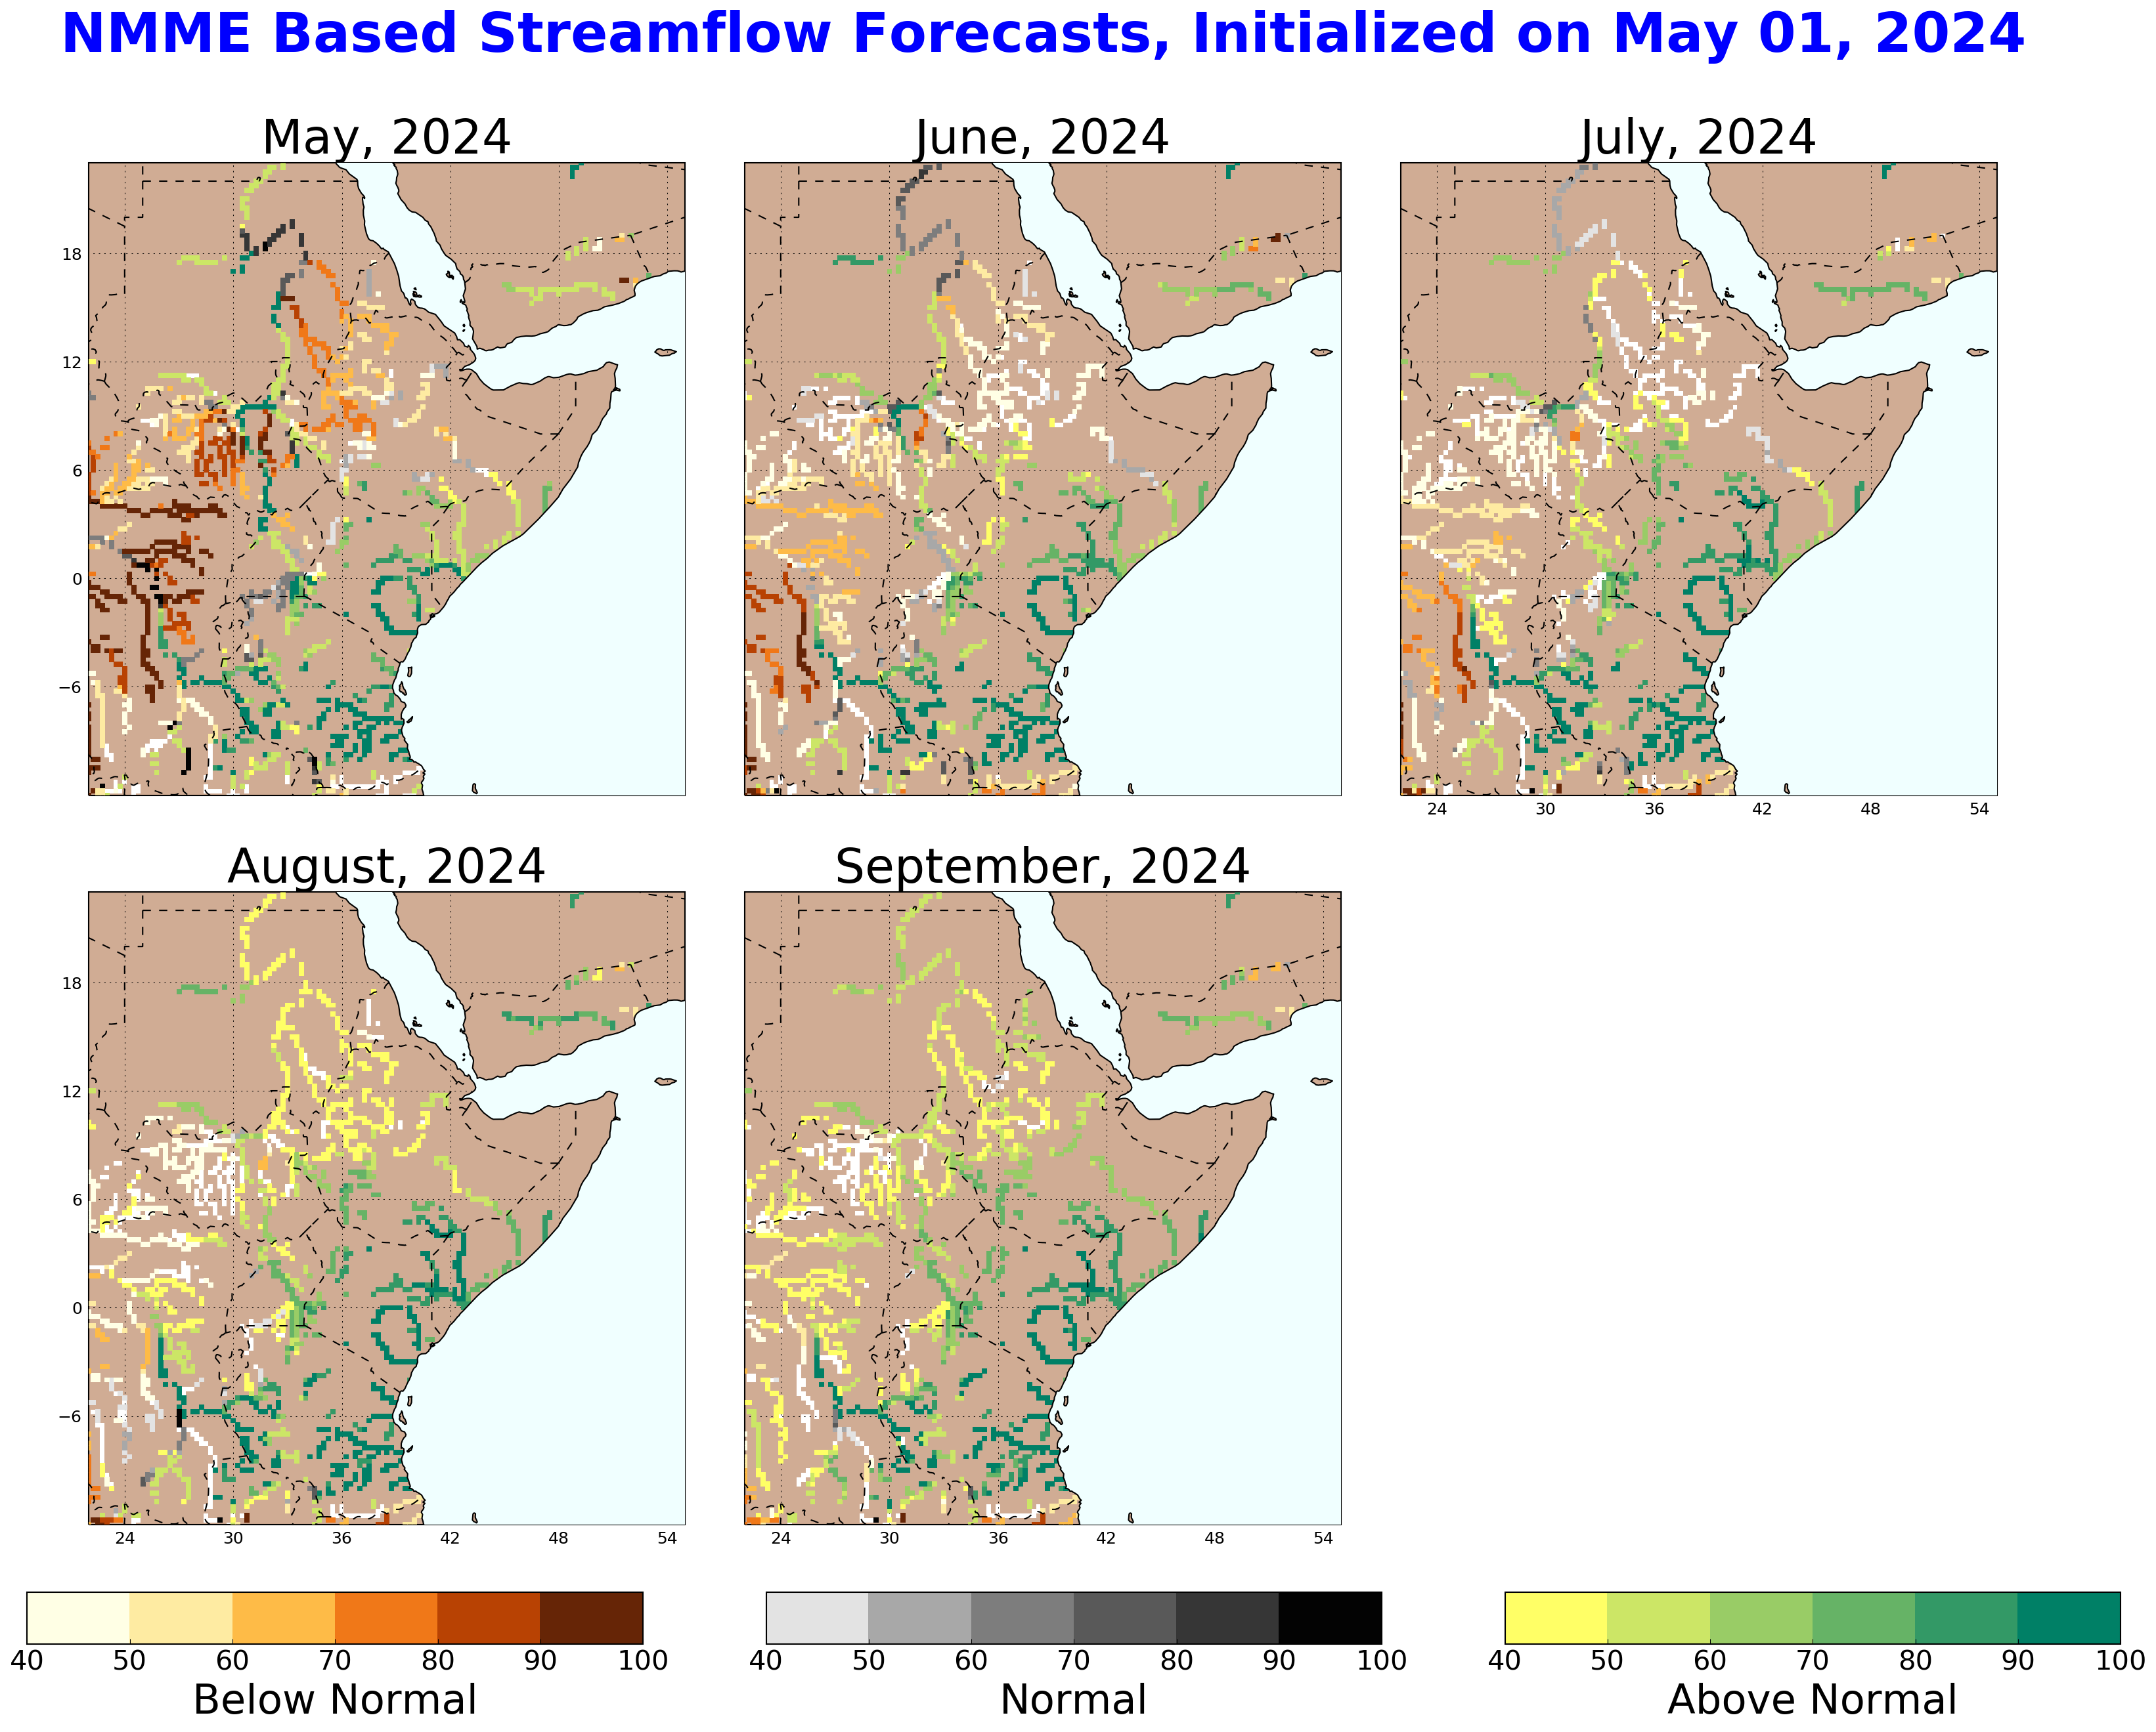
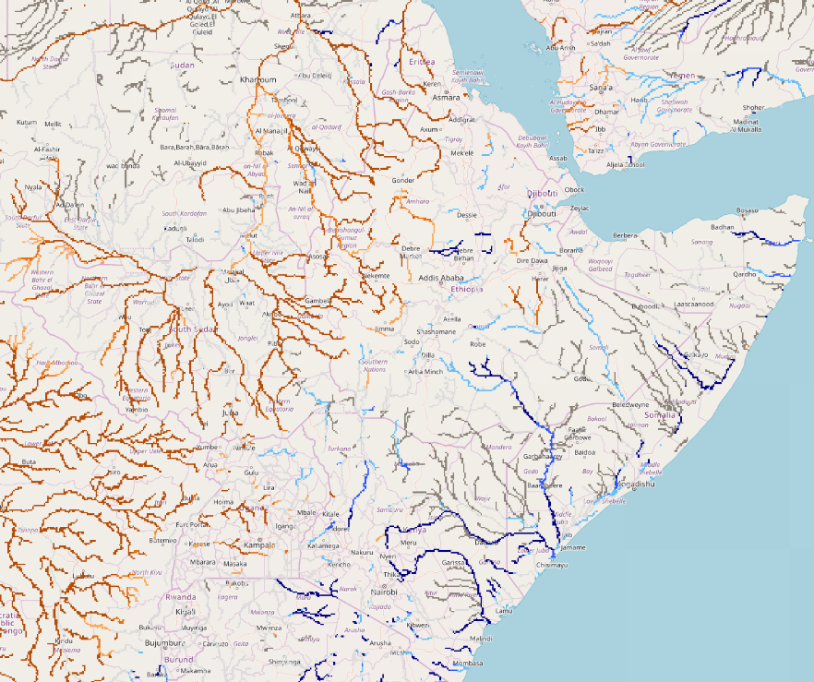
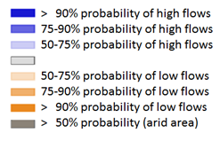
Seasonal Streamflow Forecast
A
B
NHyFAS streamflow forecast: May – Sep 2024
GloFAS streamflow forecast: May – Aug 2024
Both NHyFAS and GloFAS suggest above average discharges to continue during the rainfall season in Juba, Shabelle, Lak Dera and Tana Rivers.

Slide 8
Flooding Risk (seasonal forecast)
Discharges are on the decline but still expected to be above average in Juba, Shabelle, Lak Dera and Tana Rivers during the coming rainfall season.
Above-average risk of flooding in Tana, Lak Dera and Juba catchments until end of May.
- no change to flooding related assumptions in 2b, 4a and 4b.

