Slide 1
FEWS NET Enhanced Flood Monitoring and Forecast Assumptions-East Africa and Yemen
April 2024 Seasonal Forecast
FEWS NET Science Team:
USGS, NASA, NOAA, UCSB+Regional Scientists

Slide 2
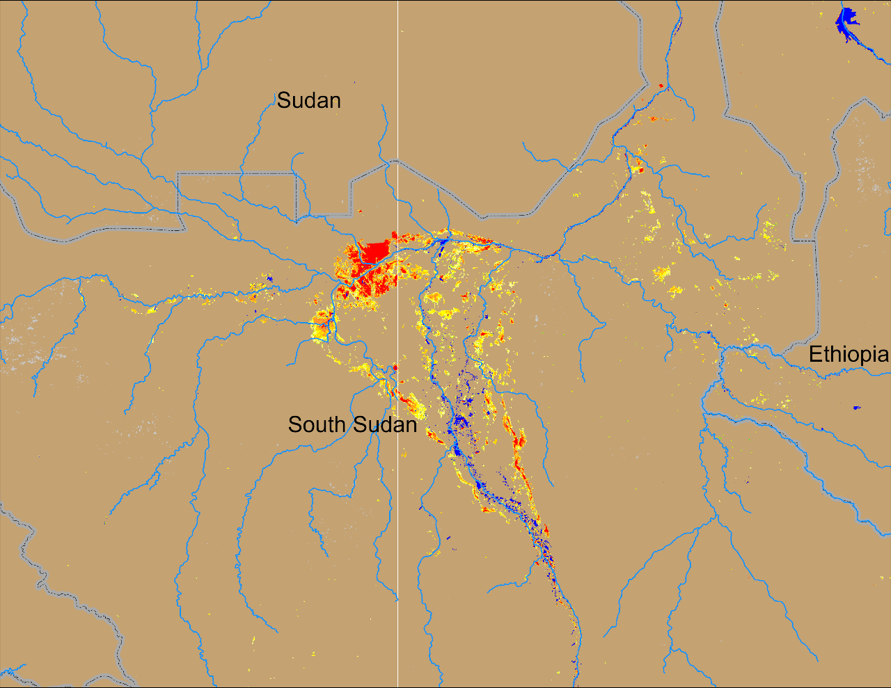
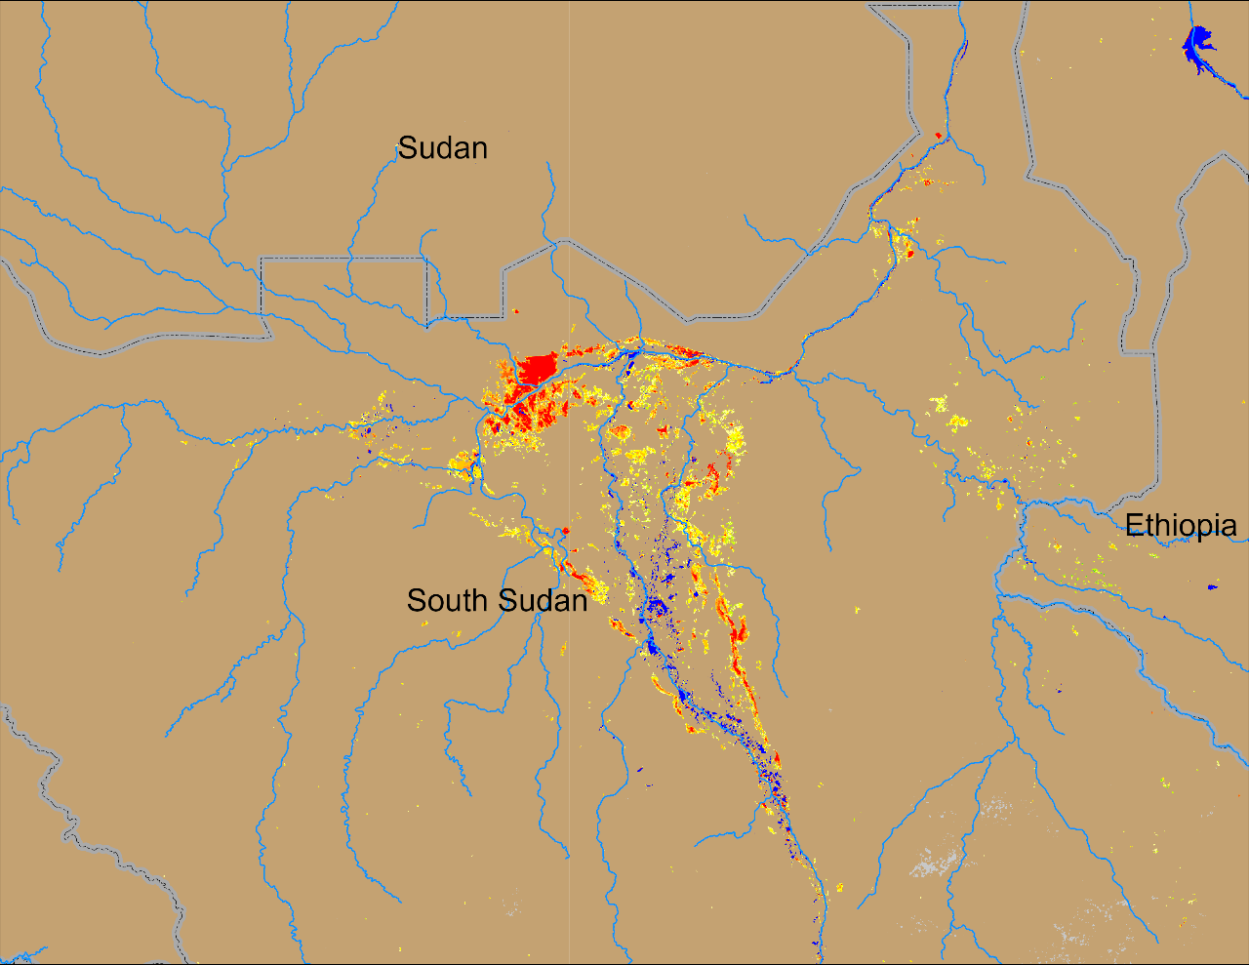
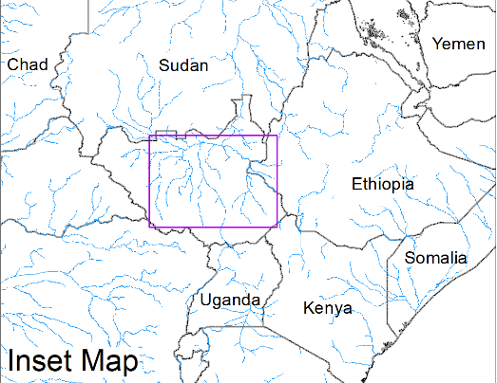
Flooding Conditions in South Sudan
(% of the pixel)
(% of the pixel)
Sobet
Khawr
Sobet
Khawr
Akobo
Akobo
Pibor
Pibor
NOAA VIIRS 5-day comp.: 13 – 17 Mar 2024
NOAA VIIRS 5-day comp.: 10 – 14 Apr 2024
Consistent coverage of extended inundated areas through the dry and pre-rainfall periods.

Slide 3
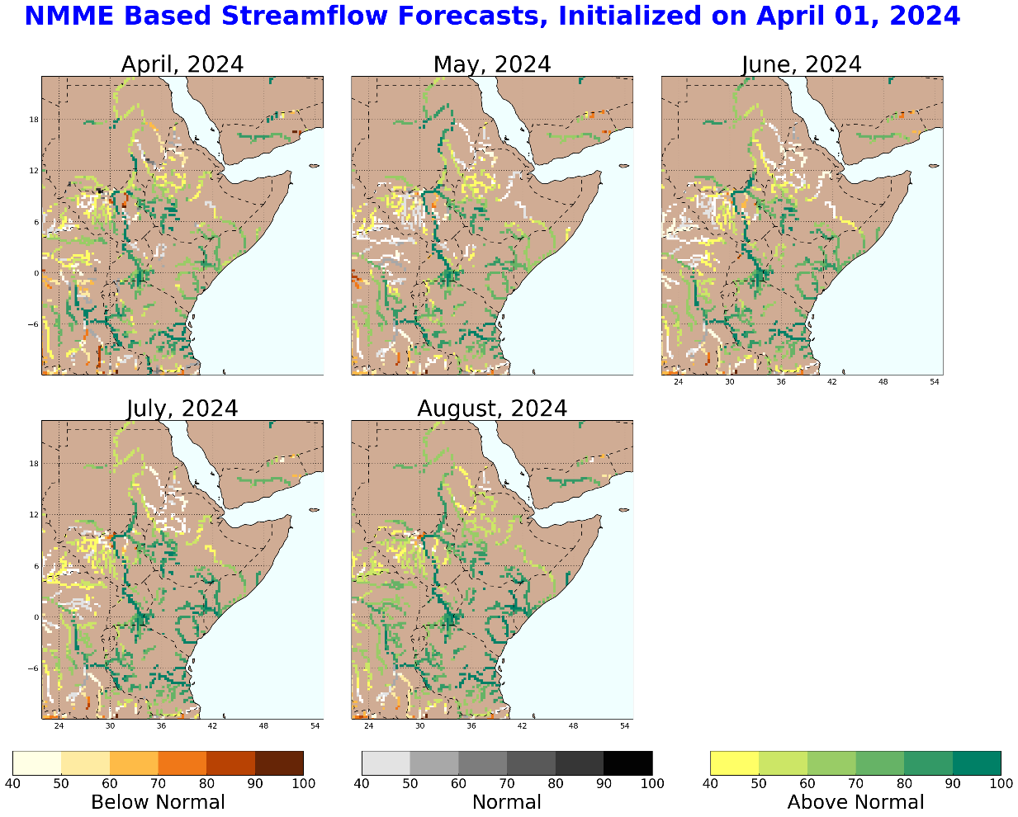
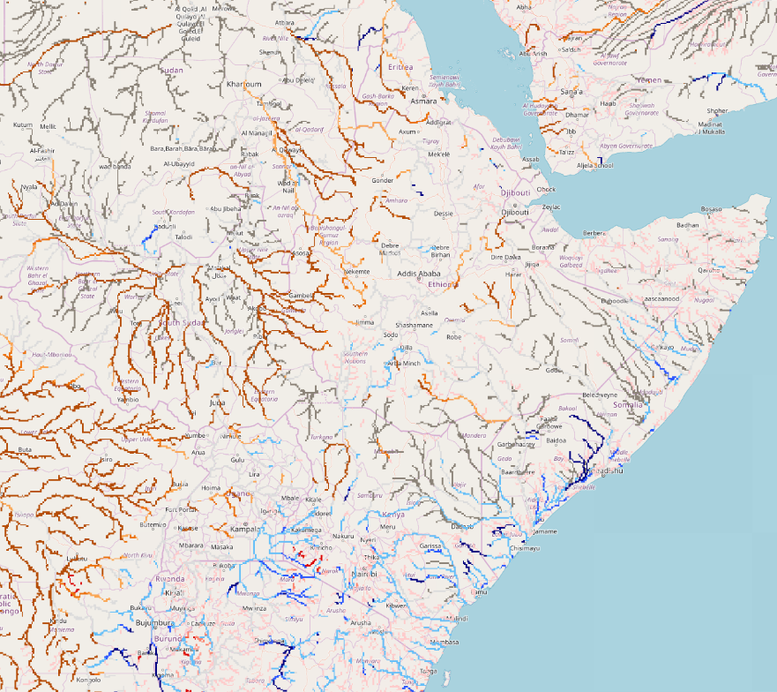
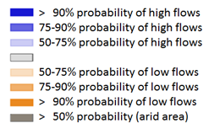
Seasonal Streamflow Forecast
A
B
NHyFAS streamflow forecast: Apr – Aug 2024
GloFAS streamflow forecast: Apr – Jul 2024
Both NHyFAS and GloFAS suggest above average discharges in Juba, Shabelle, Lak Dera and Tana Rivers during April to July

Slide 4
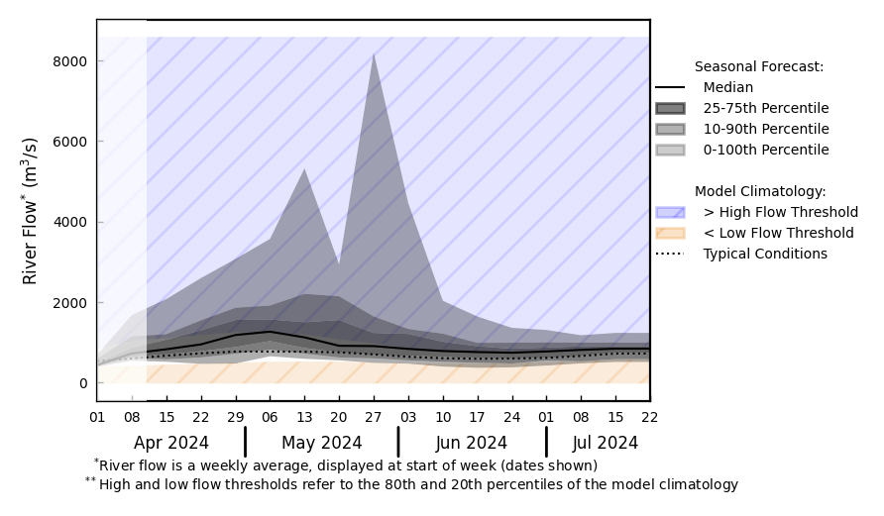
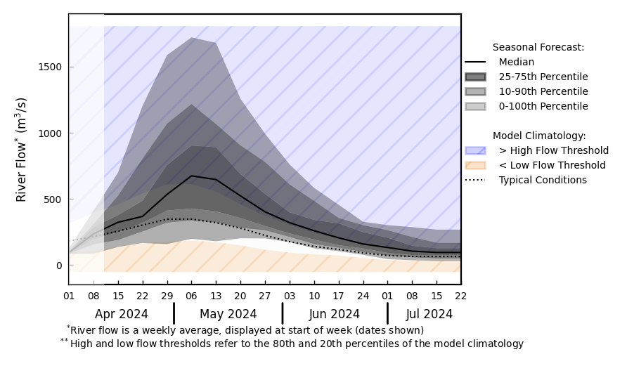
Timing of Flood Risk
@ point A: Juba River
@ point B: Tana River
A
B
GloFAS streamflow forecast: Mar – Jun 2024
Above average discharges in Juba in Apr-May
Well above average discharges in Tana River in May
GloFAS streamflow forecast: Apr – Jul 2024

Slide 5
Flooding Risk (seasonal forecast)
Discharges in Juba, Shabelle, Lak Dera and Tana Rivers are expected to be above-average during April to July.
Above-average risk of flooding in Lak Dera and lower Juba catchments in late April to mid May.
Whereas above-average risk of flooding along Tana River in May.
- I believe, based on the streamflow forecast we could add “high likelihood of flooding along Tana River and in the lower catchment of Juba River in May” in assumption 2d.

