Slide 1
FEWS NET Enhanced Flood Monitoring and Forecast Assumptions-Afghanistan
March 2024 Seasonal Forecast
FEWS NET Science Team:
USGS, NASA, NOAA, UCSB+Regional Scientists

Slide 2
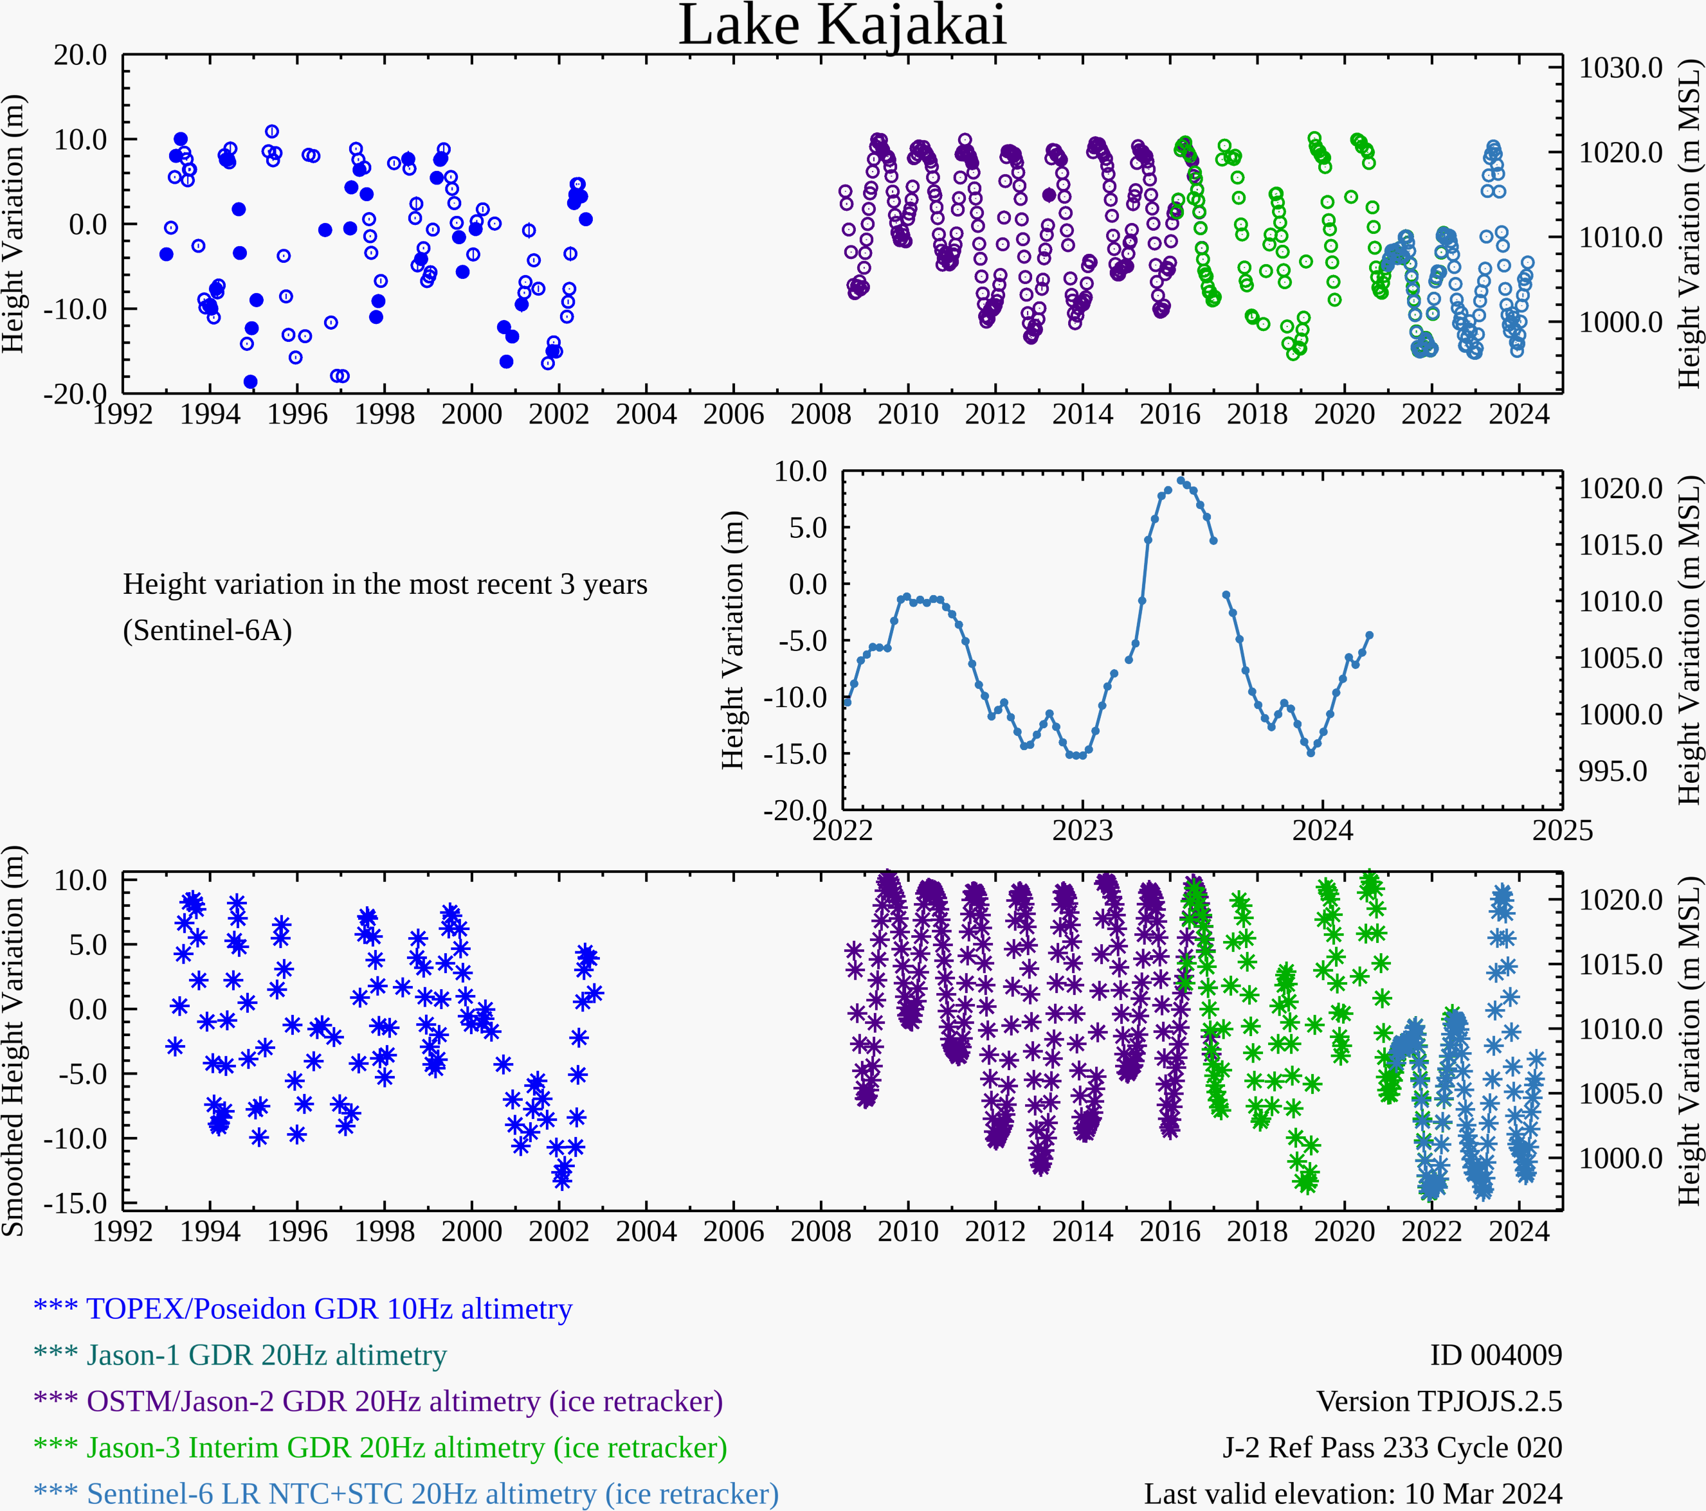
Water Level at Kajakai Reservoir in the Helmand basin (as of Mar 10, 2024)
Zeid
Kajakai
Istadehye
Jehil
Arghandab
USDA monitoring reservoirs
Typical low water level in the Kajakai reservoir during the dry period.

Slide 3
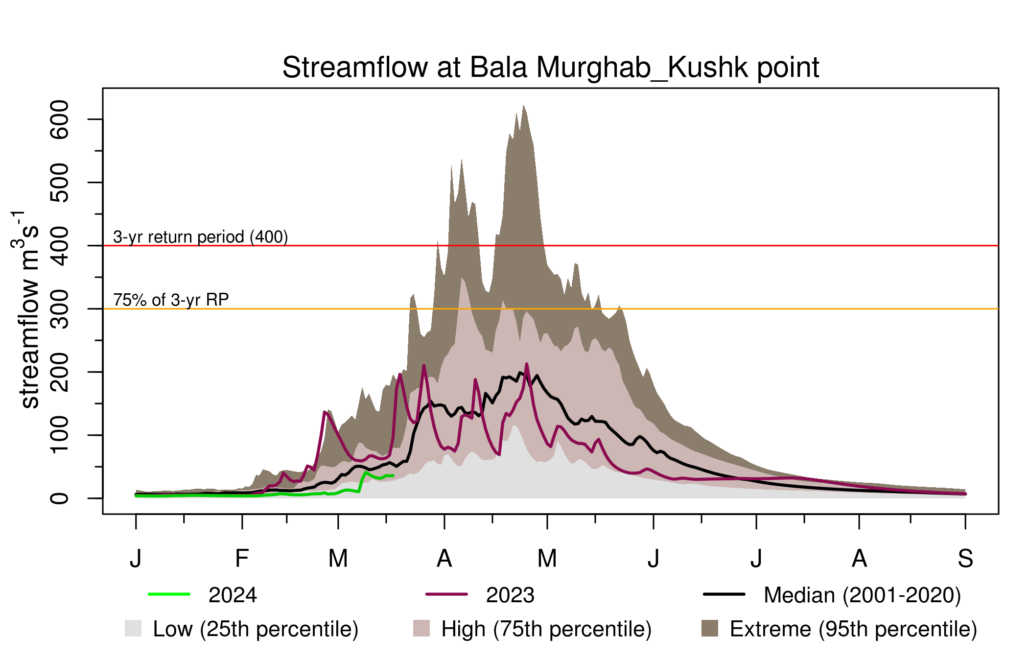
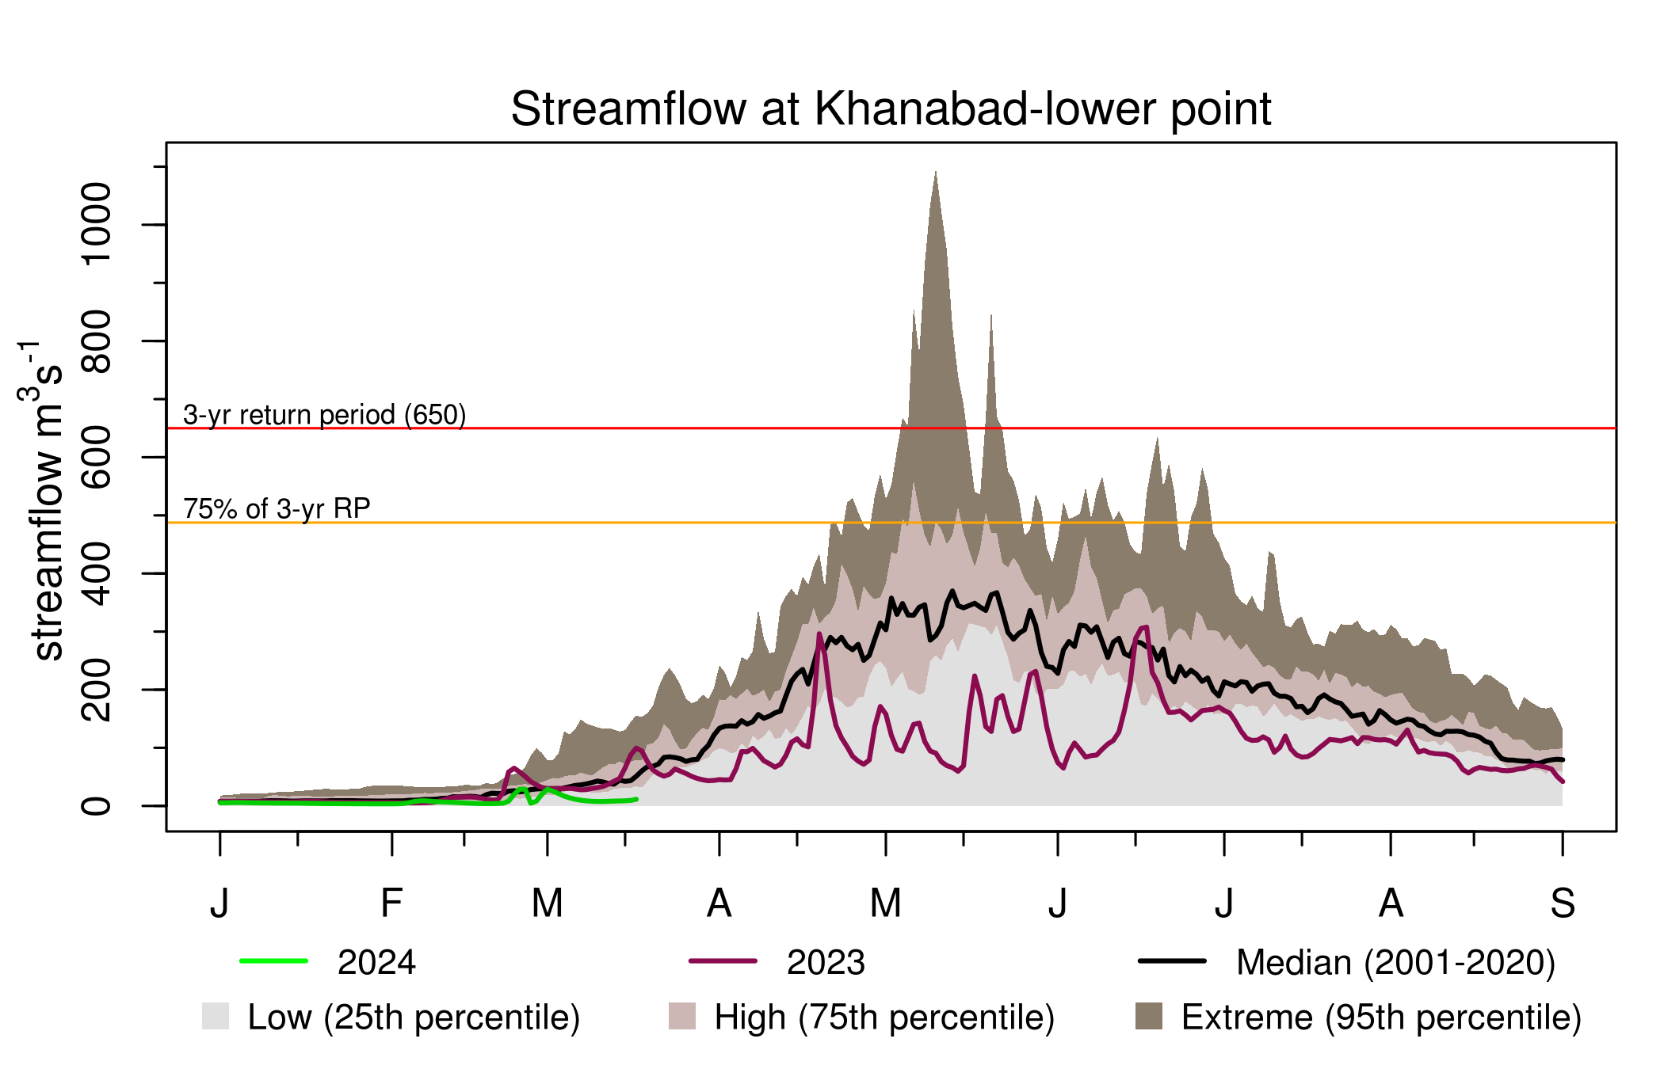
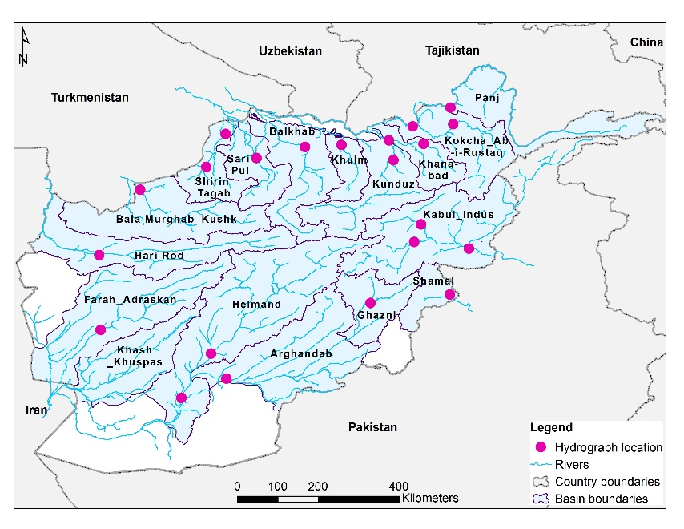
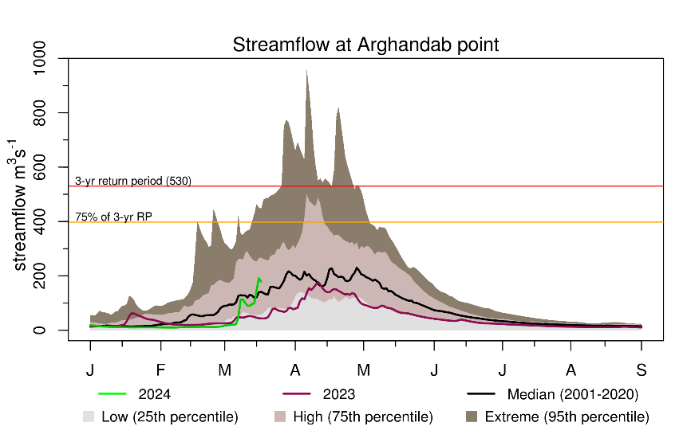
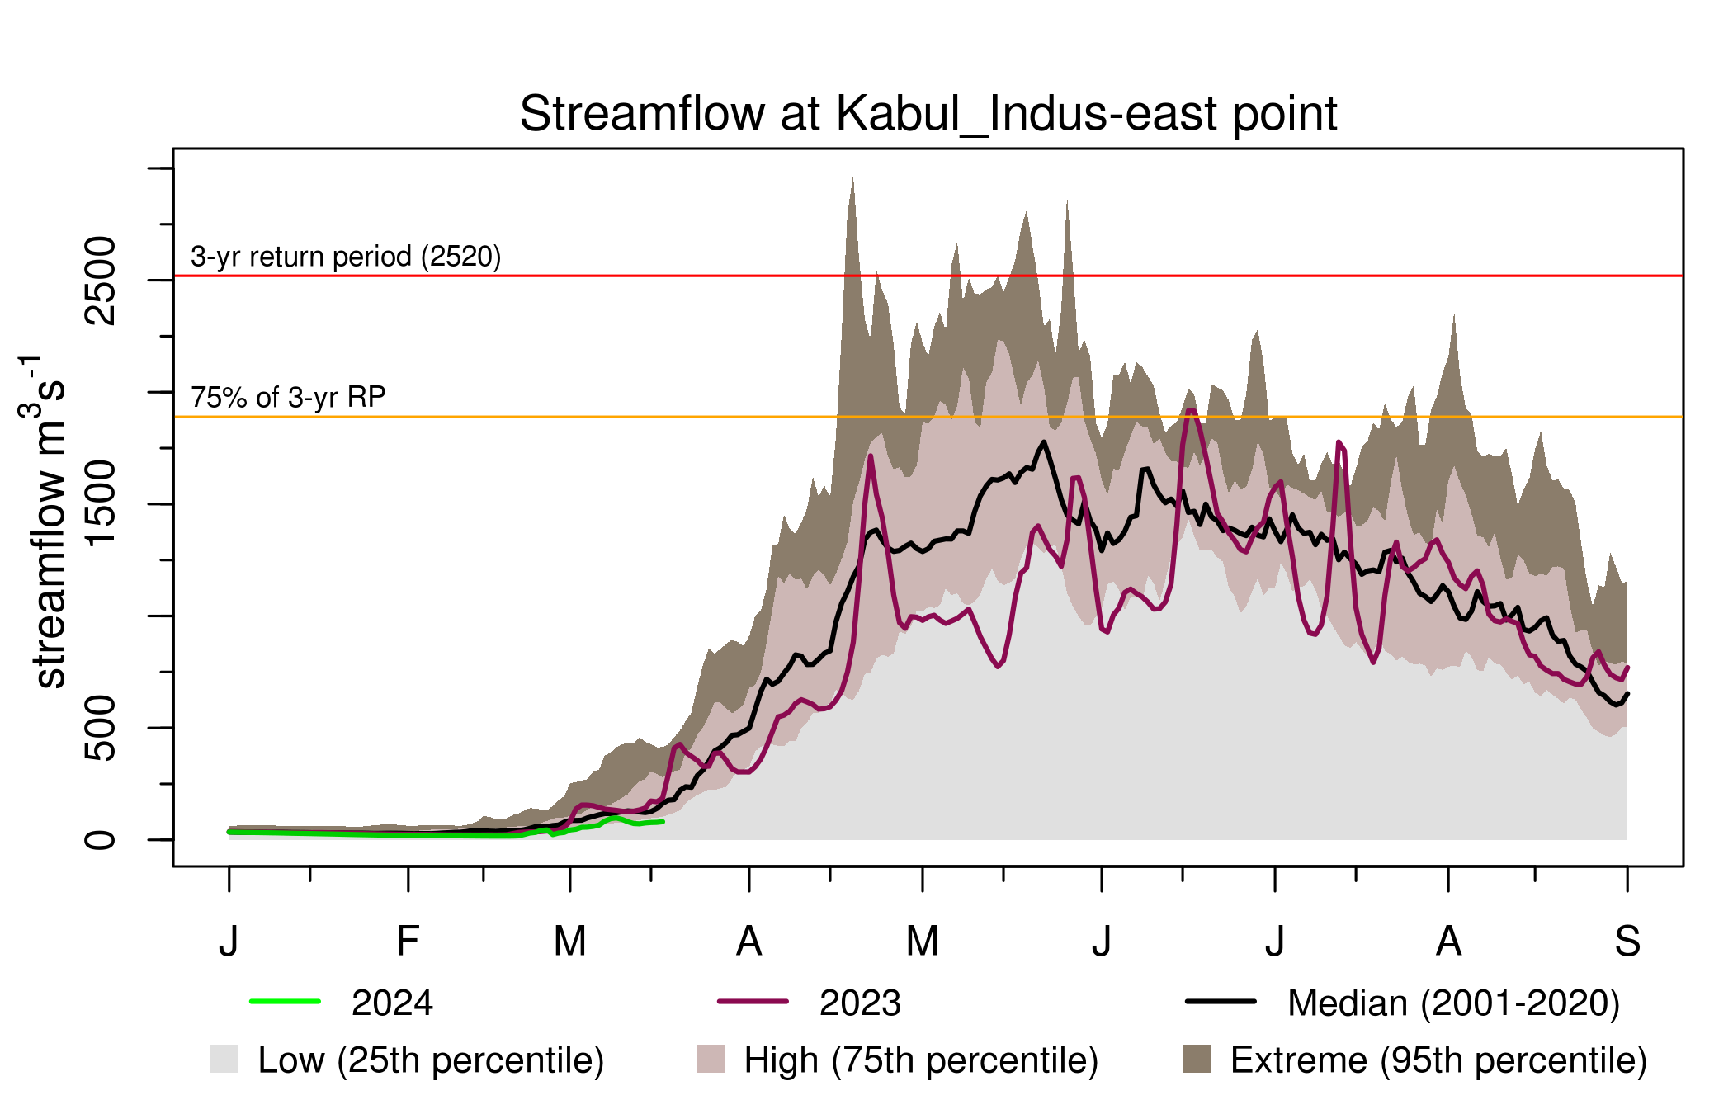
Recent Streamflow

Slide 4
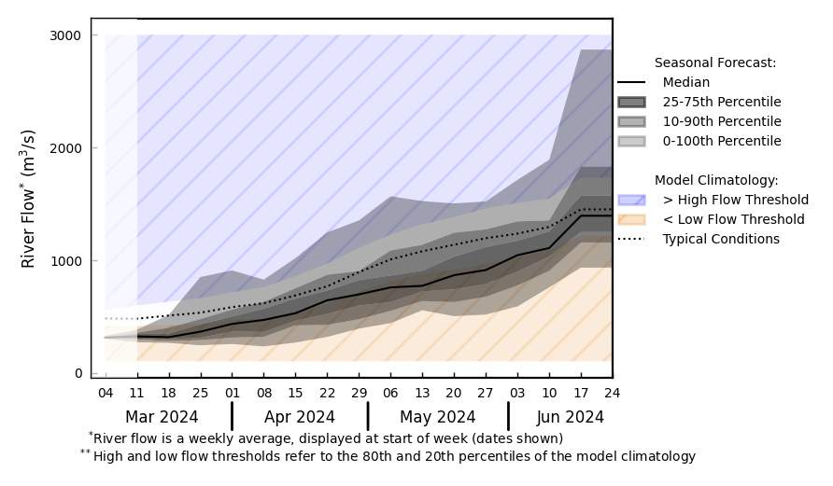
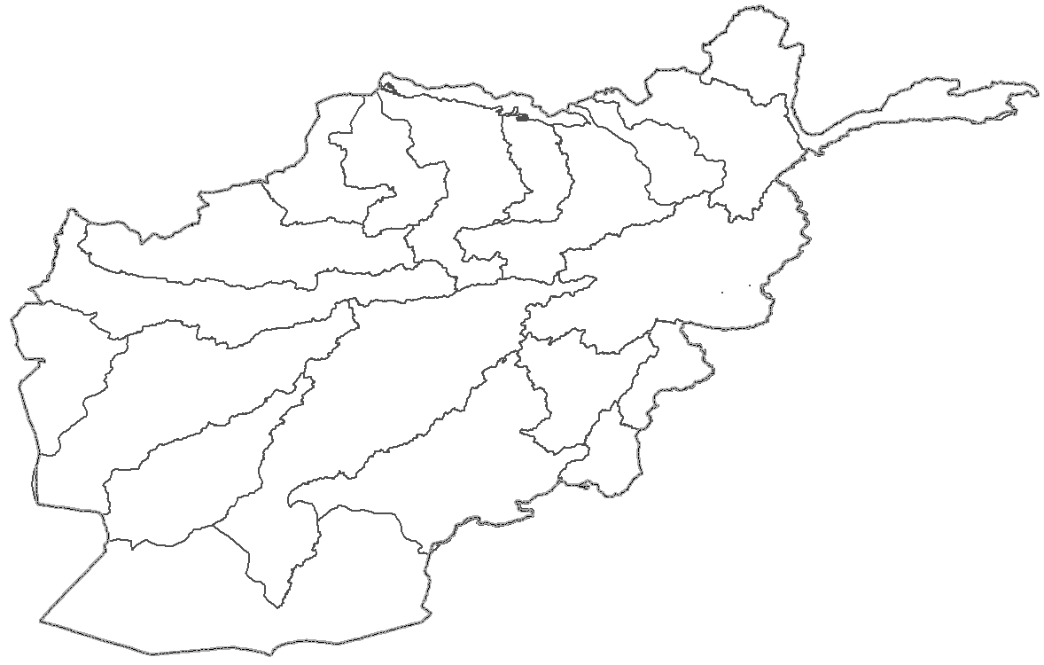
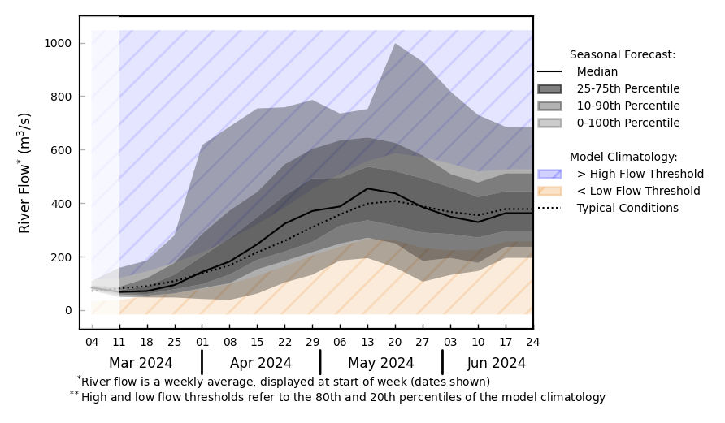
Streamflow Forecast for Afghanistan
@ point A: Amu Darya River
A
B
@ point B: Kabul River
GloFAS seasonal forecast Mar - Jun 2024
Below average streamflow is expected in the northern Rivers
Average to above average streamflow is expected in the East and Southwestern Rivers
GloFAS monthly forecast (Mar – Jun 2024)

