Slide 1
FEWS NET Enhanced Flood Monitoring and Forecast Assumptions-Afghanistan
February 2024 Seasonal Forecast
FEWS NET Science Team:
USGS, NASA, NOAA, UCSB+Regional Scientists

Slide 2
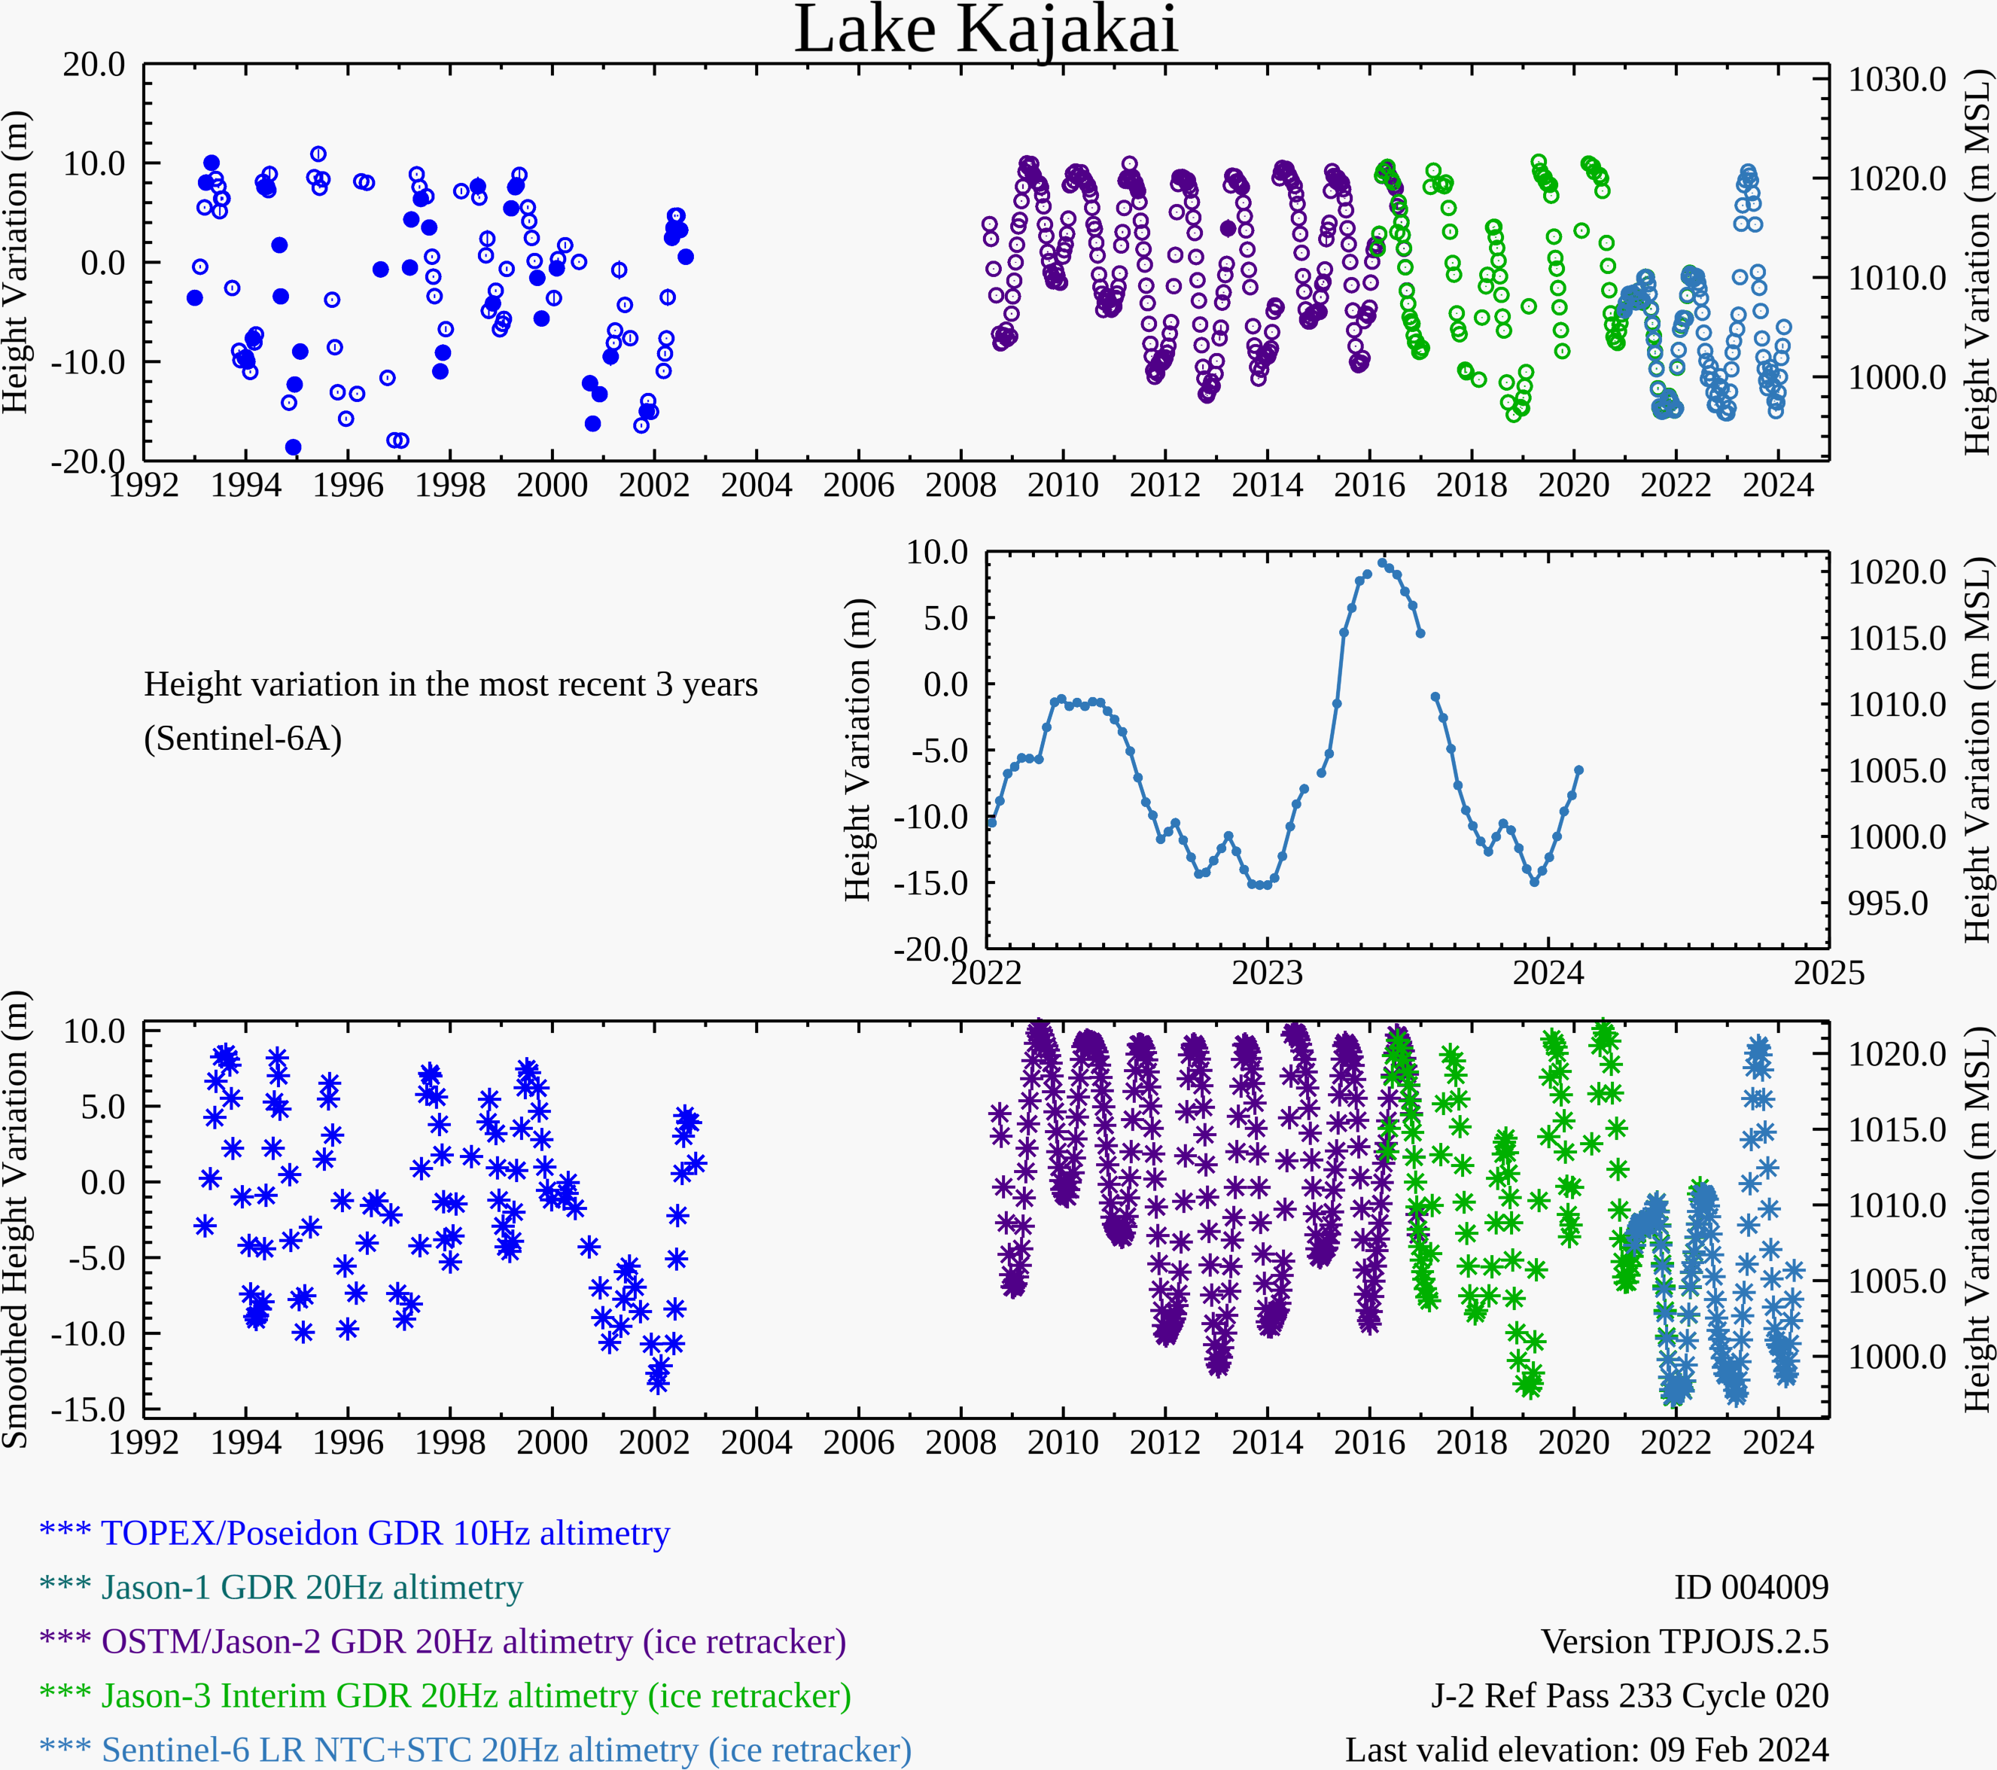
Water Level at Kajakai Reservoir in the Helmand basin (as of Feb 9, 2024)
Zeid
Kajakai
Istadehye
Jehil
Arghandab
USDA monitoring reservoirs
Typical low water level in the Kajakai reservoir during the dry period.

Slide 3
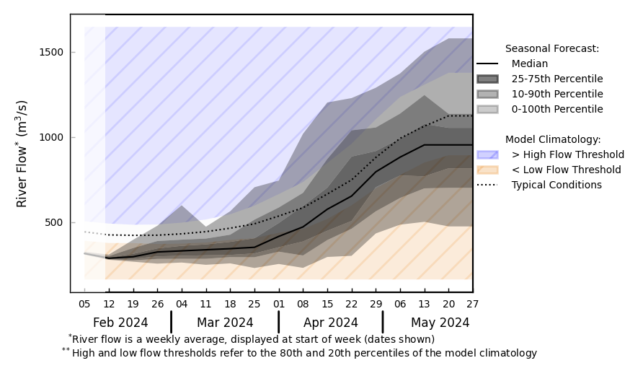
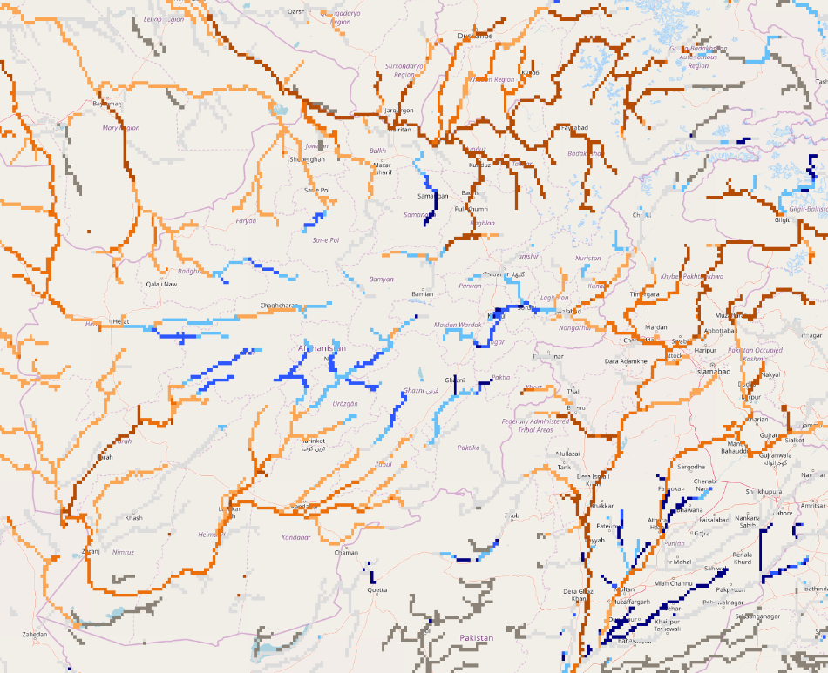
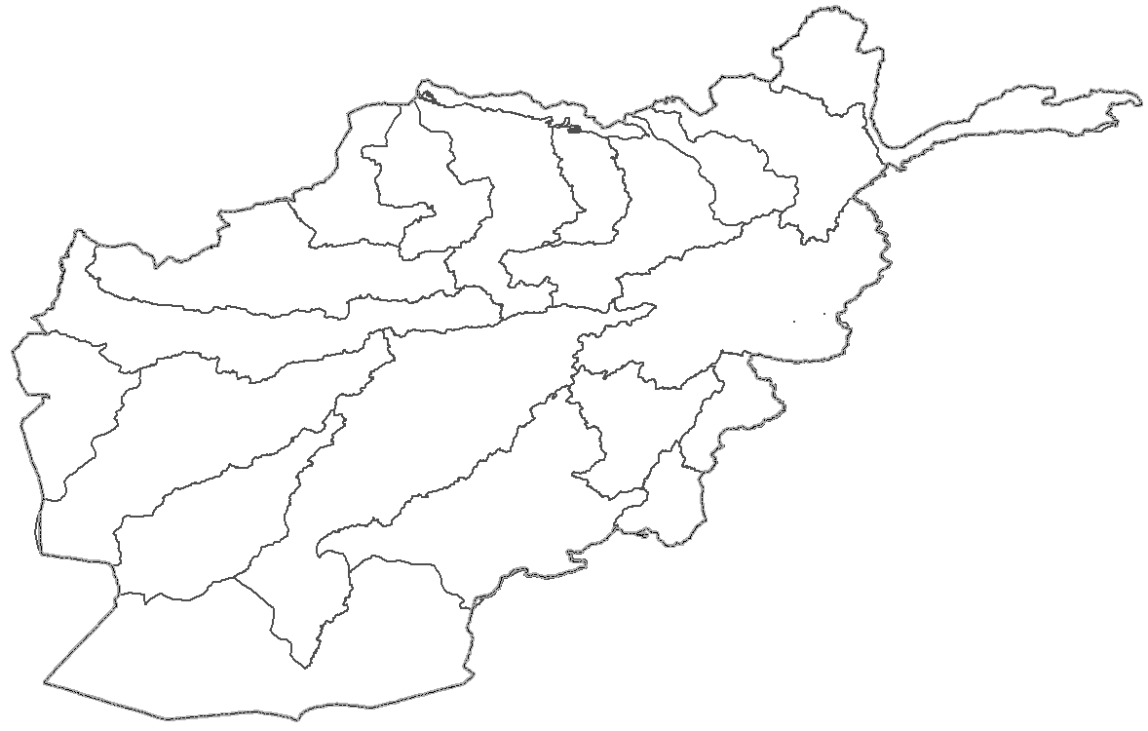
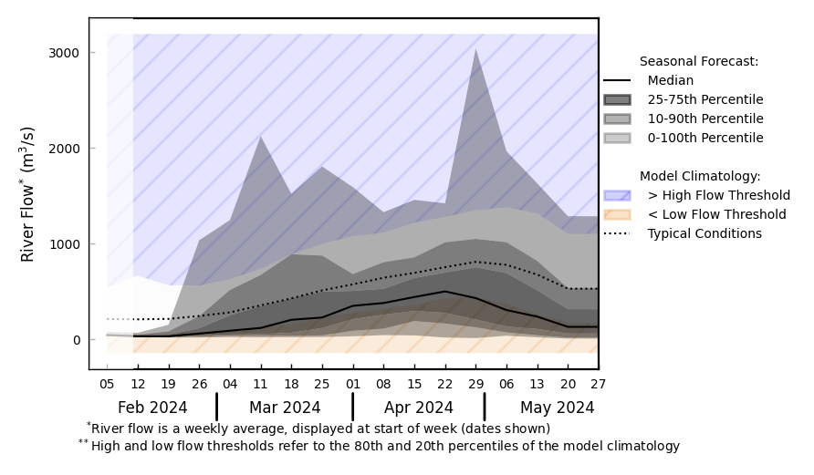
Streamflow Forecast for Afghanistan
@ point A: Amu Darya River
A
@ point B: Helmand River
B
GloFAS seasonal forecast Feb - May 2024
Below average streamflow is expected in the major rivers of Afghanistan.
GloFAS monthly forecast (Feb – May 2024)

