Slide 1
FEWS NET Enhanced Flood Monitoring and Forecast Assumptions-Afghanistan
June 2024 Seasonal Forecast
FEWS NET Science Team:
USGS, NASA, NOAA, UCSB+Regional Scientists

Slide 2
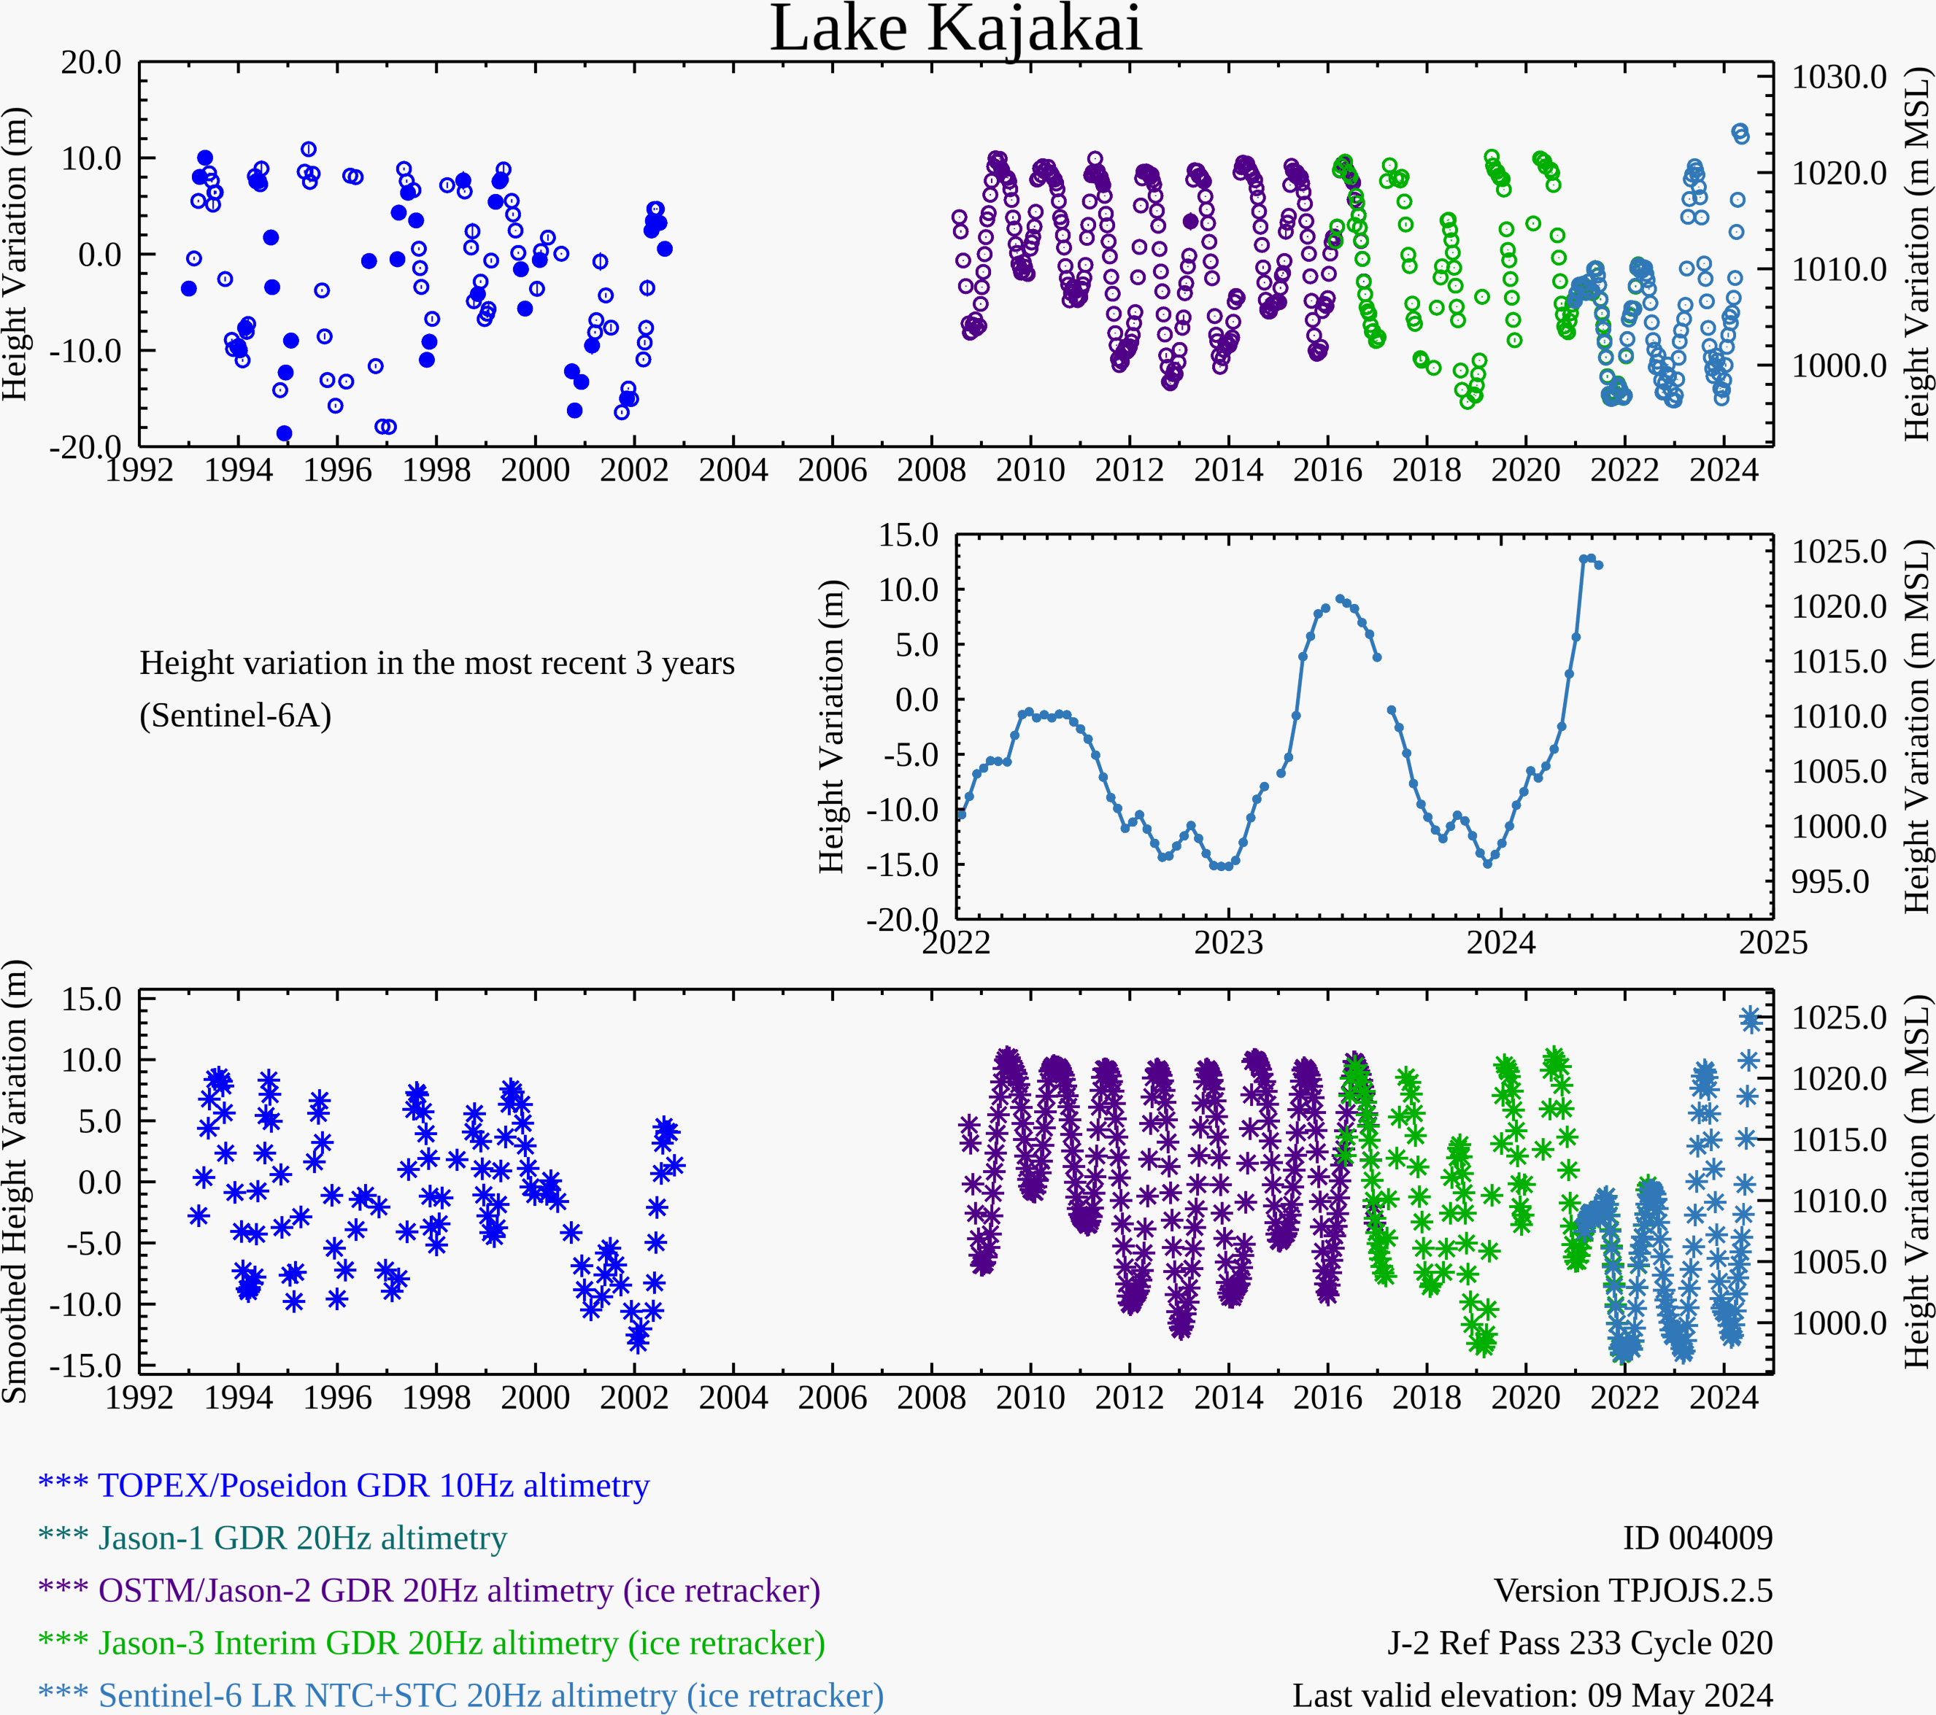
Water Level at the Kajakai Reservoir (as of May 09, 2024)
Zeid
Couldn’t retrieve the water level charts – USDA site not working
Kajakai
Istadehye
Jehil
Arghandab
USDA monitoring reservoirs

Slide 3
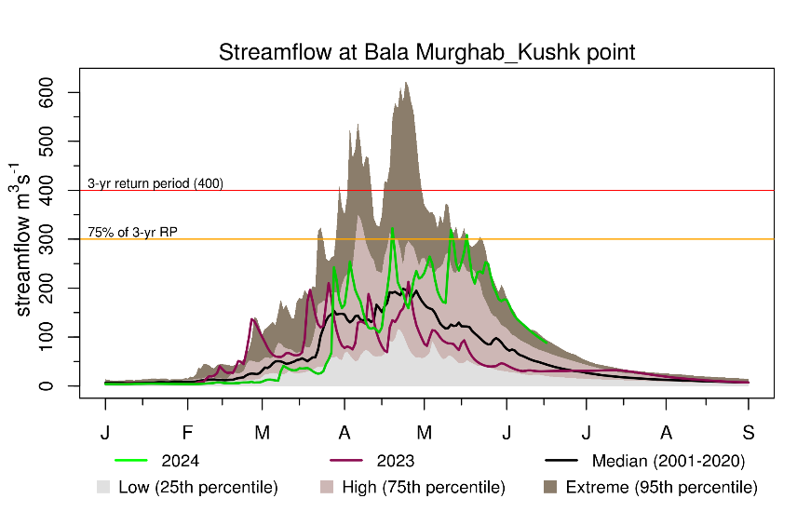
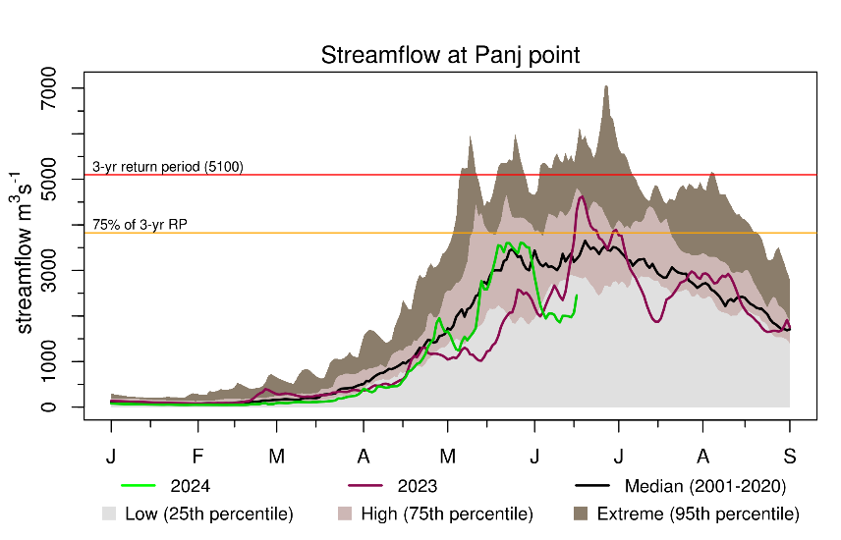
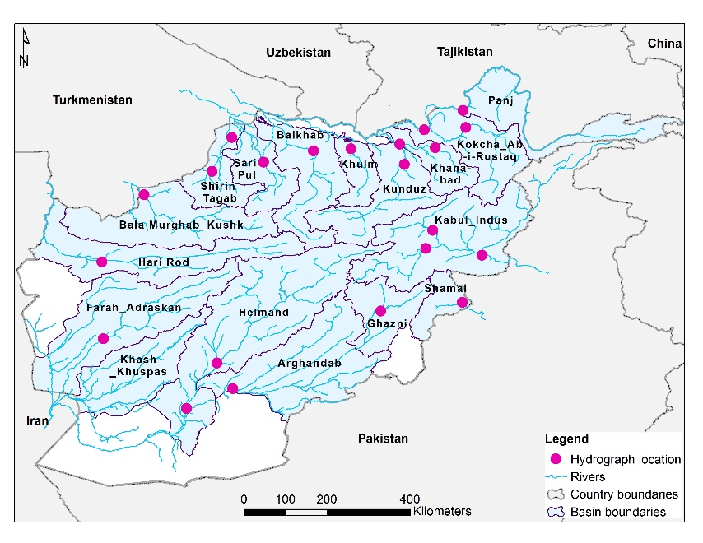
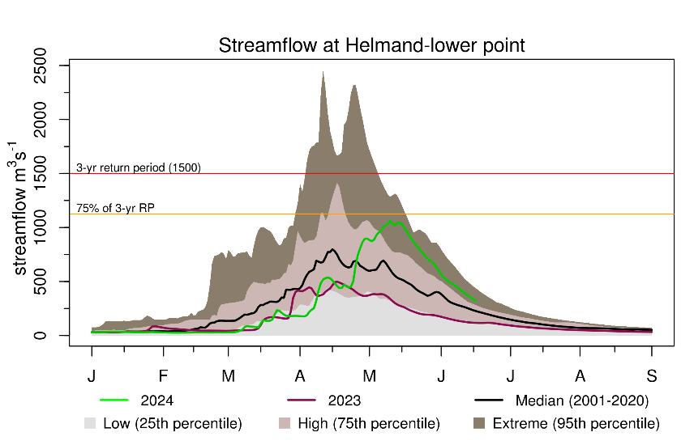
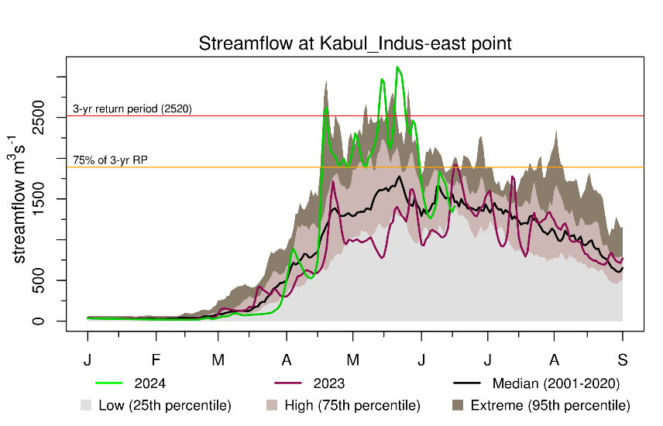
Recent Streamflow
Streams entering low flow season except north and northeast.

Slide 4
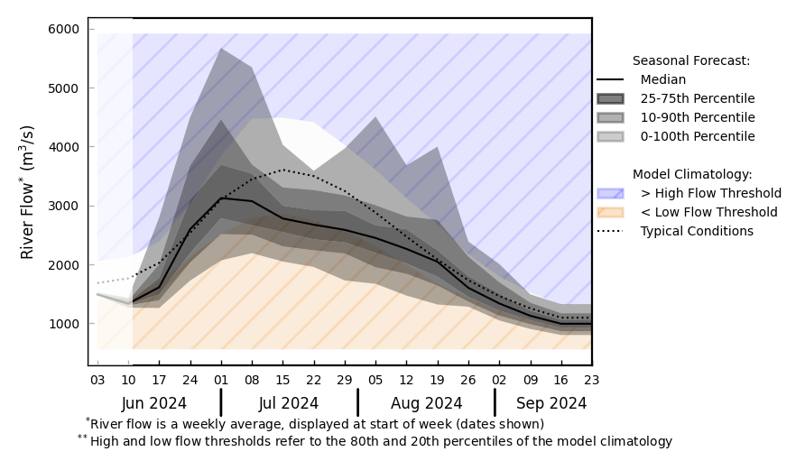
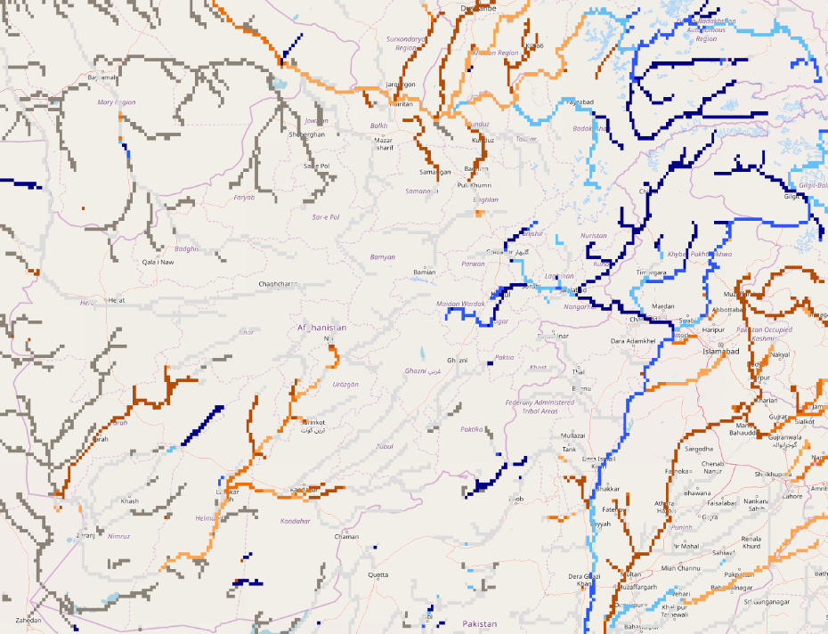
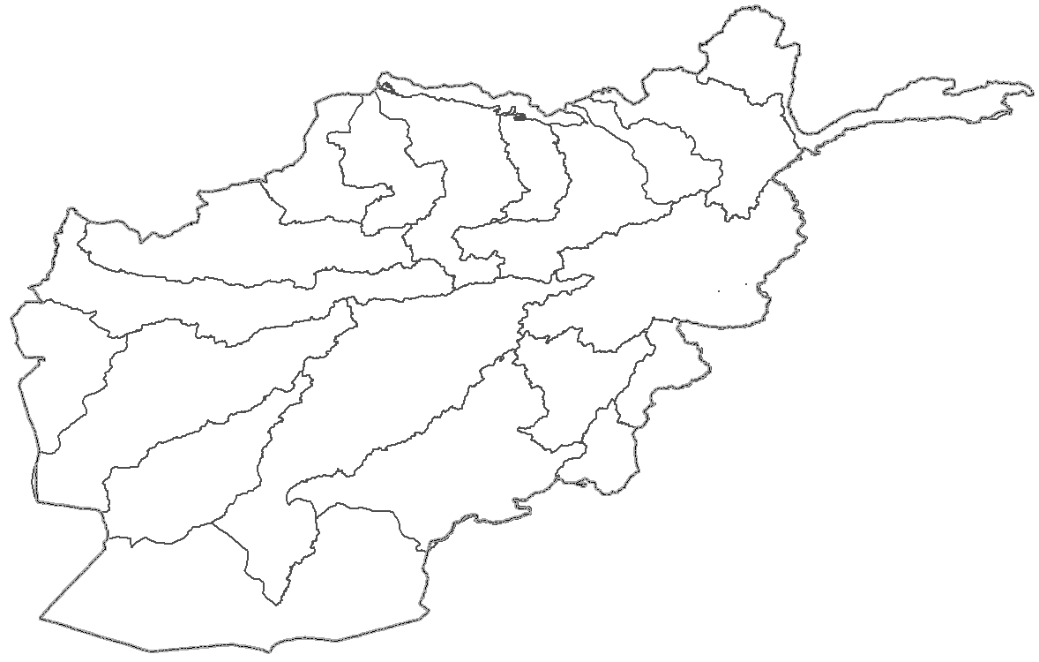
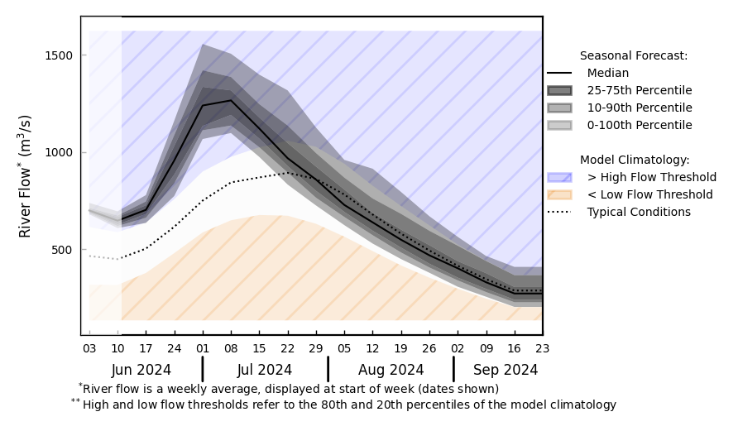
Streamflow Forecast for Afghanistan
@ point A: Amu Darya River
A
B
@ point B: Kabul River
GloFAS seasonal forecast Jun - Sep 2024
Average to below above average discharges are expected across the country except for Kabul River.
GloFAS monthly forecast (Jun – Sep 2024)

