Slide 1
FEWS NET Enhanced Flood Monitoring and Forecast Assumptions-Afghanistan
May 2024 Seasonal Forecast
FEWS NET Science Team:
USGS, NASA, NOAA, UCSB+Regional Scientists

Slide 2
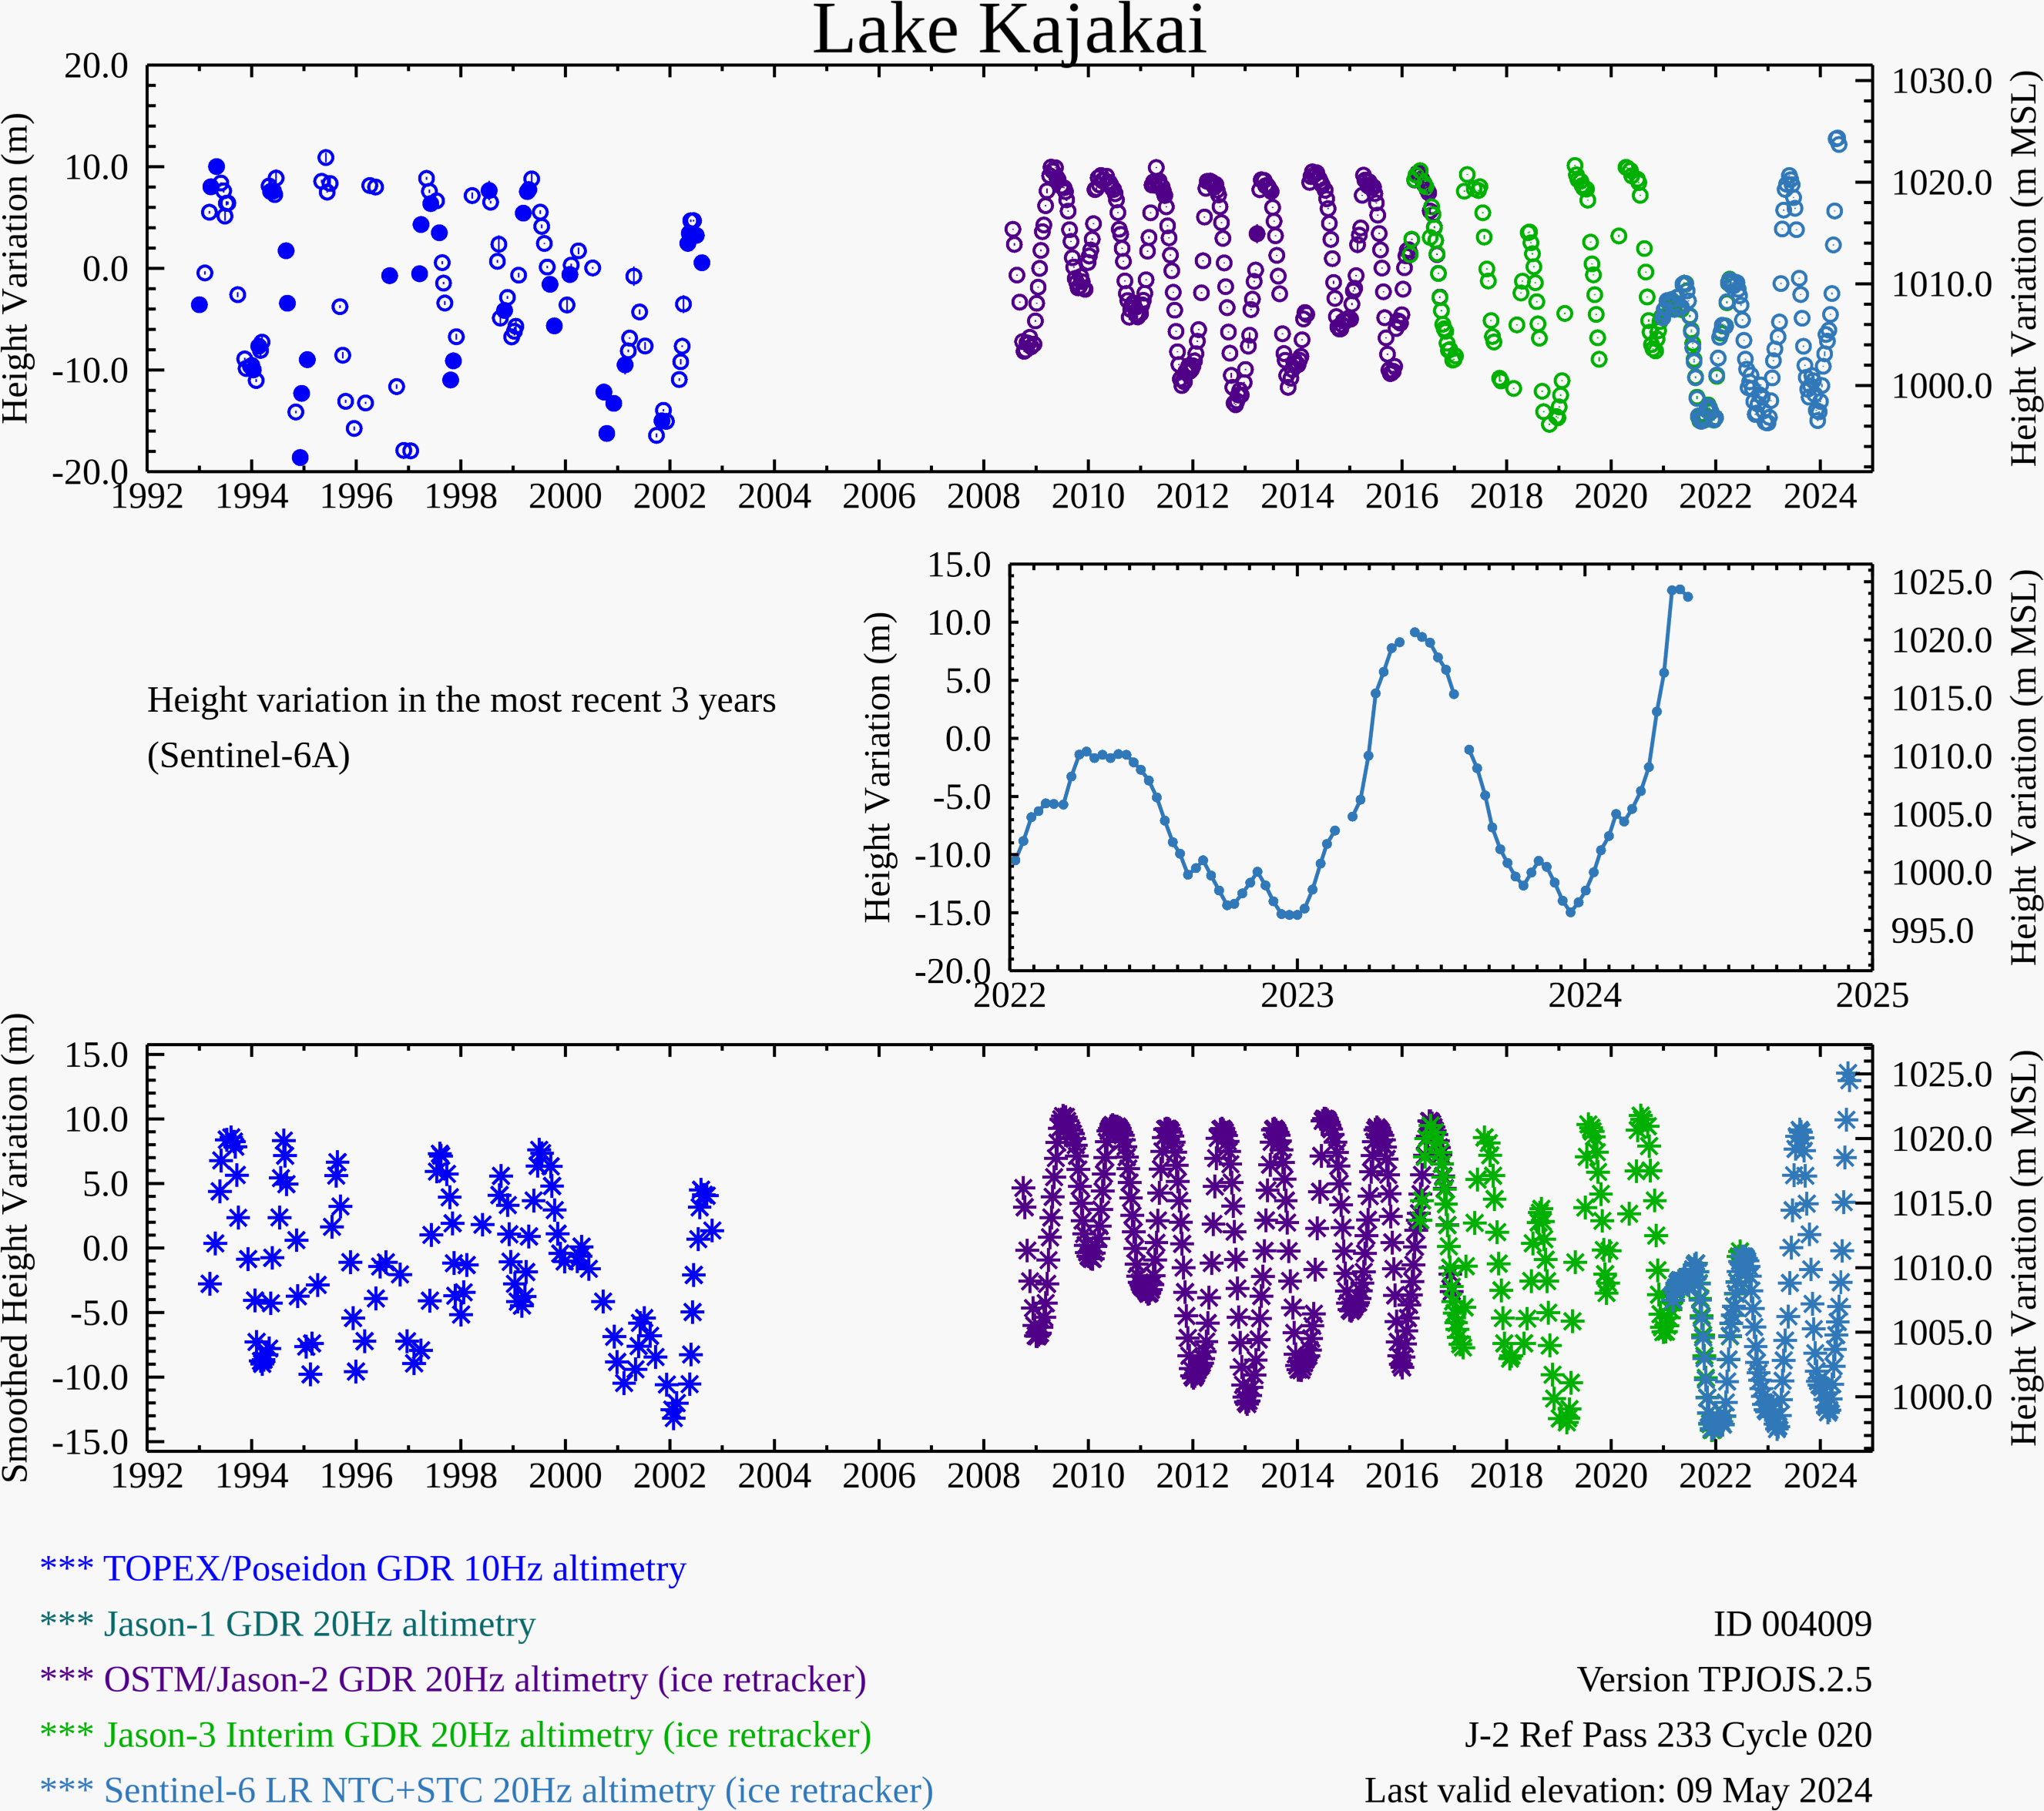
Water Level at the Kajakai Reservoir (as of May 09, 2024)
Zeid
Kajakai
Istadehye
Jehil
Arghandab
USDA monitoring reservoirs
Water level is at record high at the Kajakai reservoir.

Slide 3
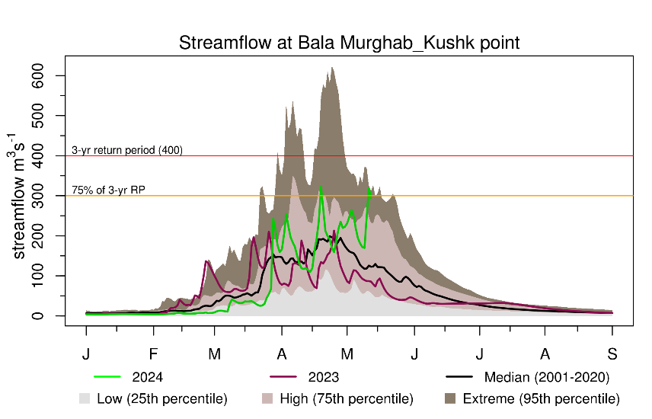
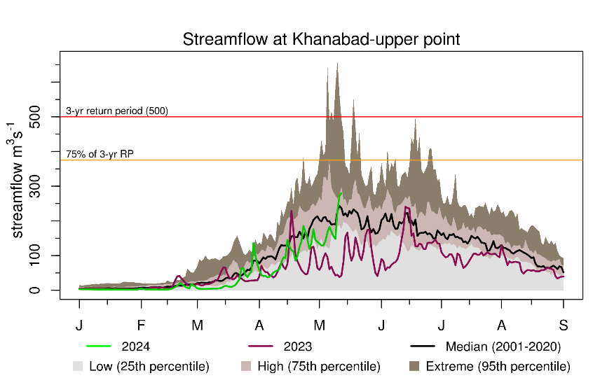
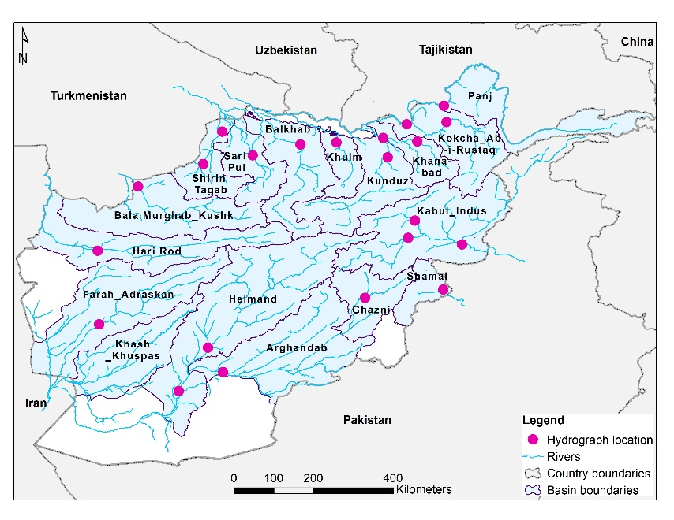
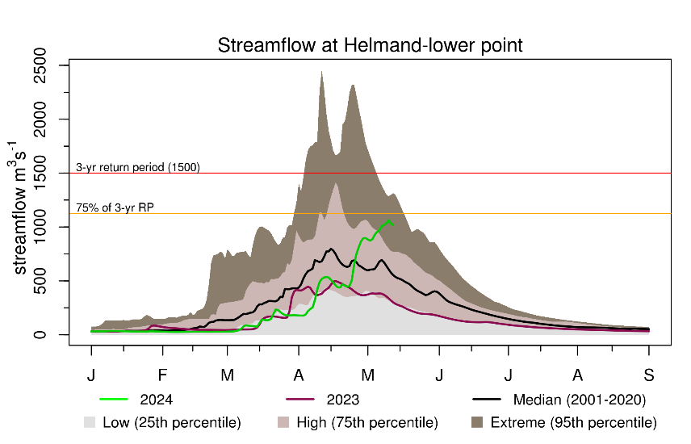
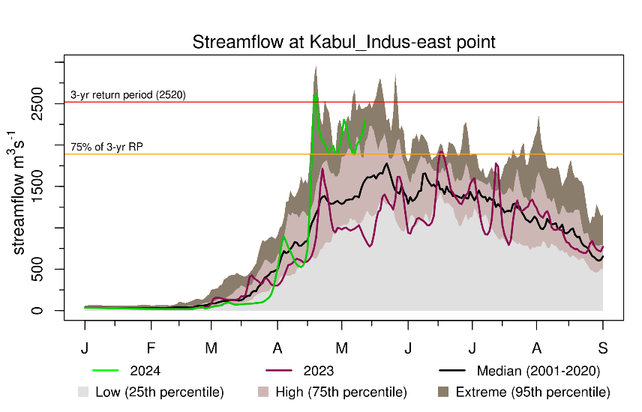
Recent Streamflow
Unusual rise in Streamflow across Afghanistan including northeast.

Slide 4
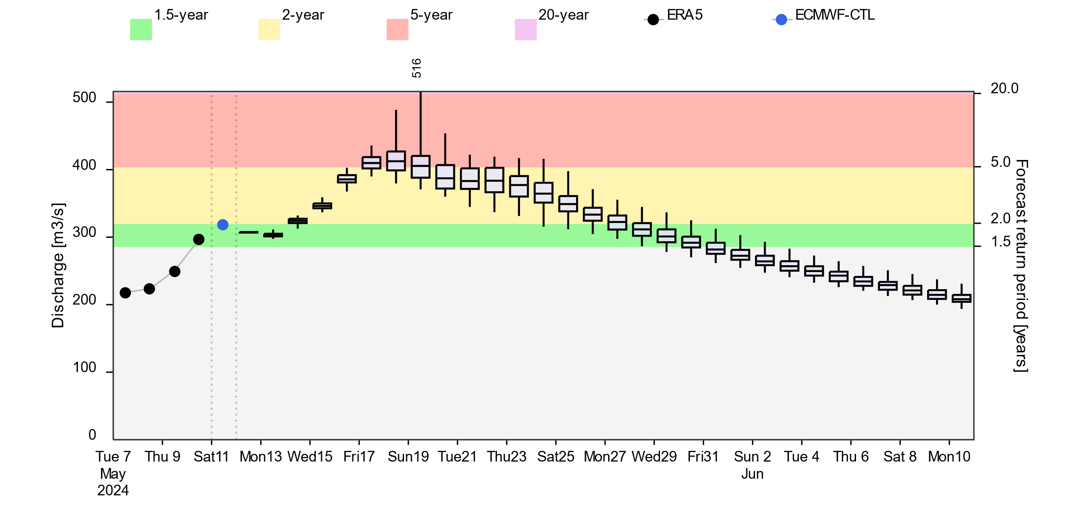
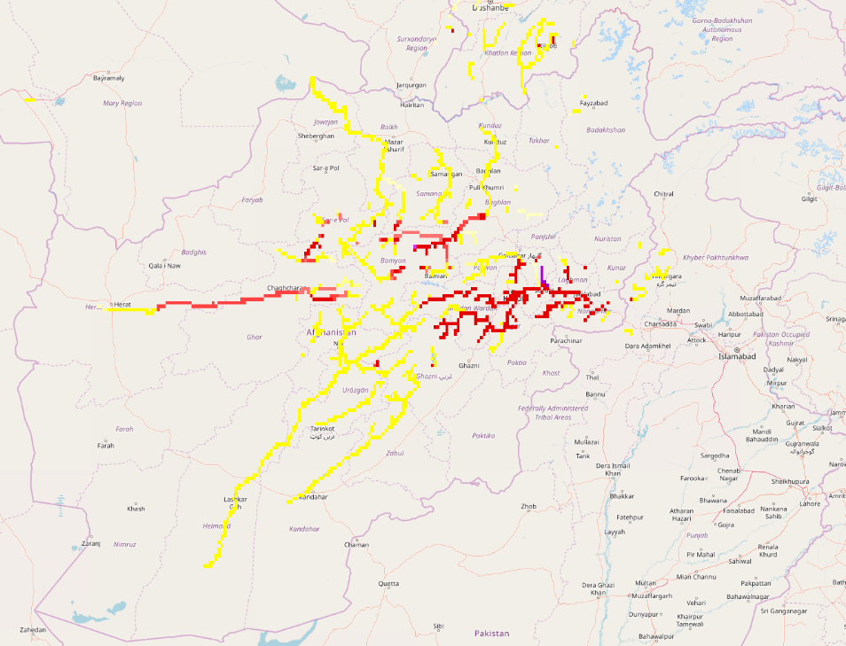
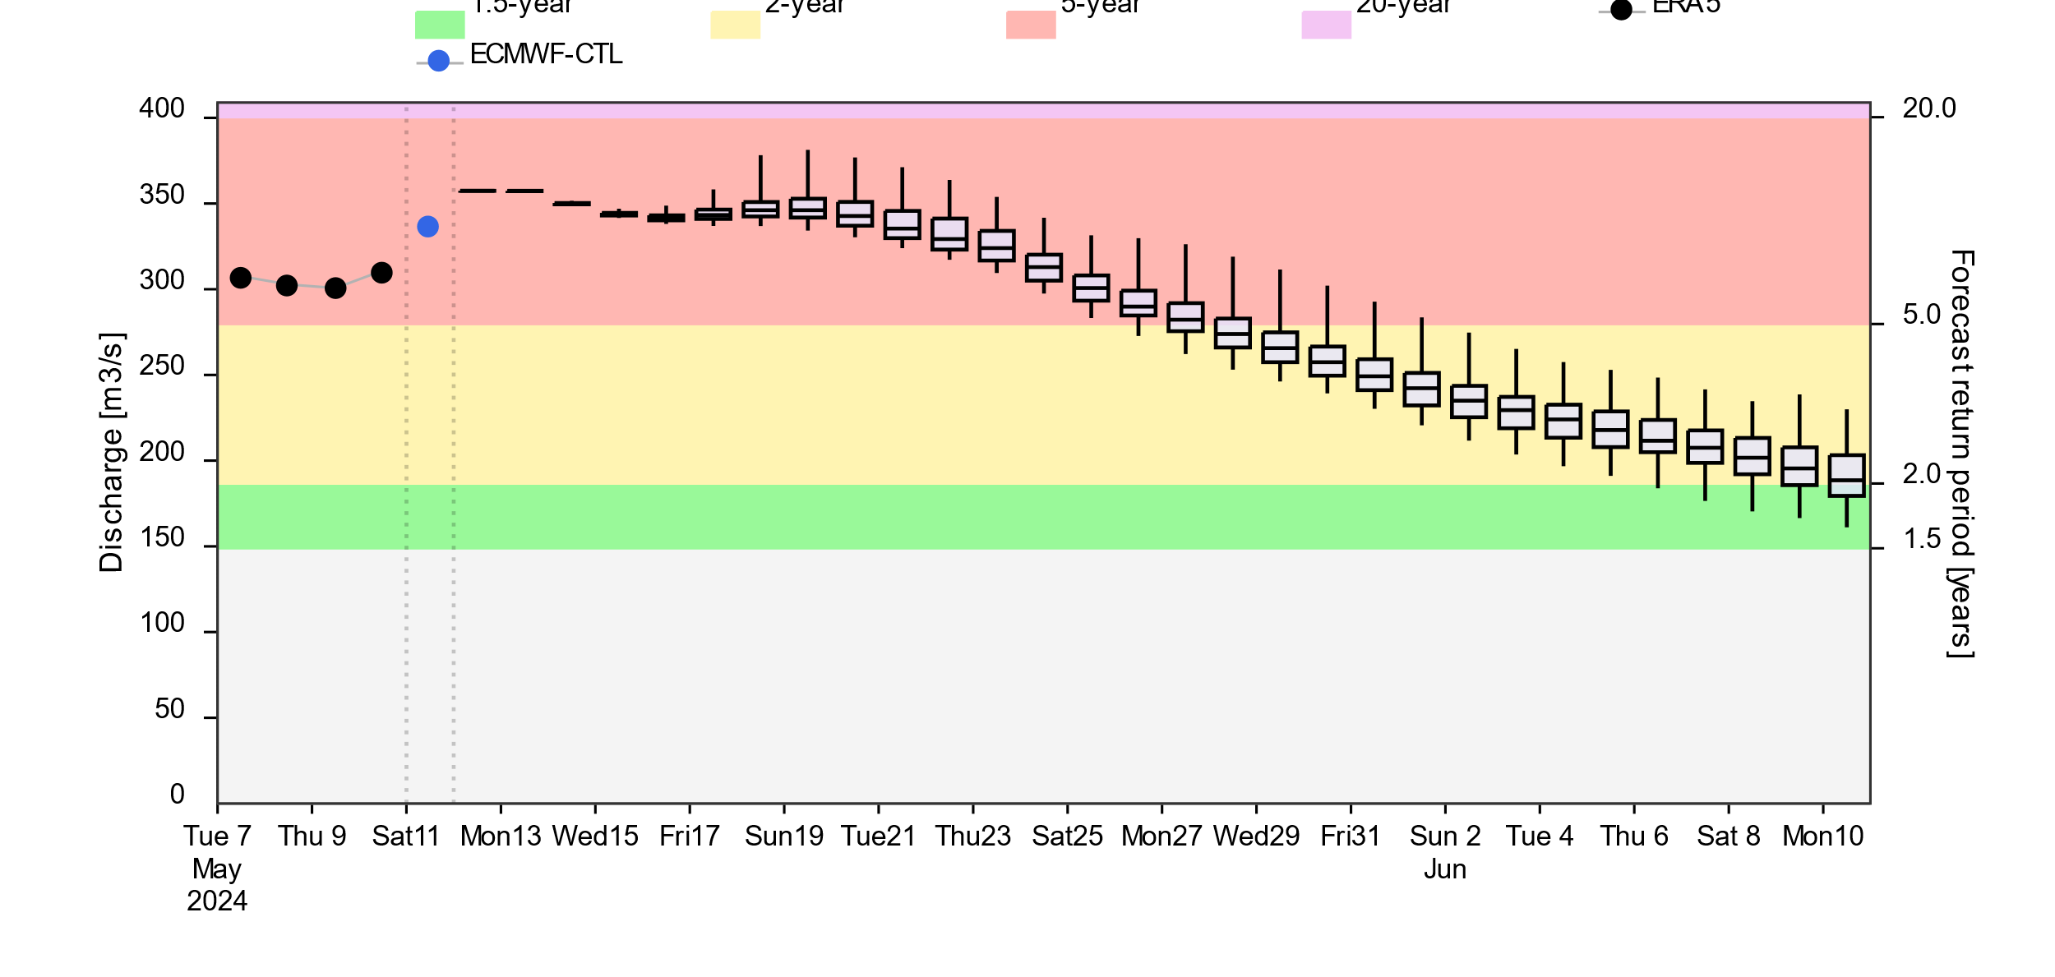
Streamflow Forecast
@point A: Hari Rod River
A
B
@point B: Kabul River
2-yr 5-yr 20-yr
GloFAS forecast: 11 May – 10 Jun 2024
GloFAS forecast: 11 May – 10 Jun 2024
Unseasonably high discharge especially in the west expected to continue until end of May.

Slide 5
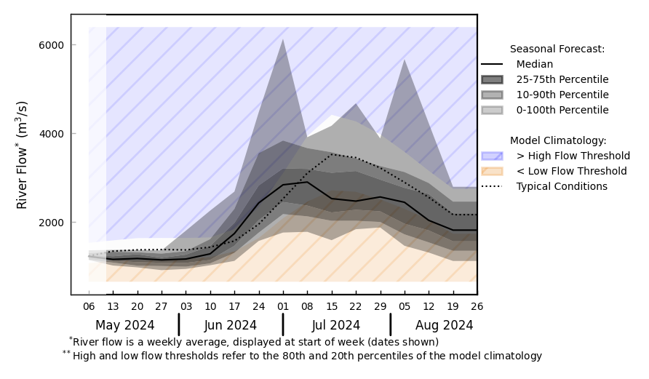
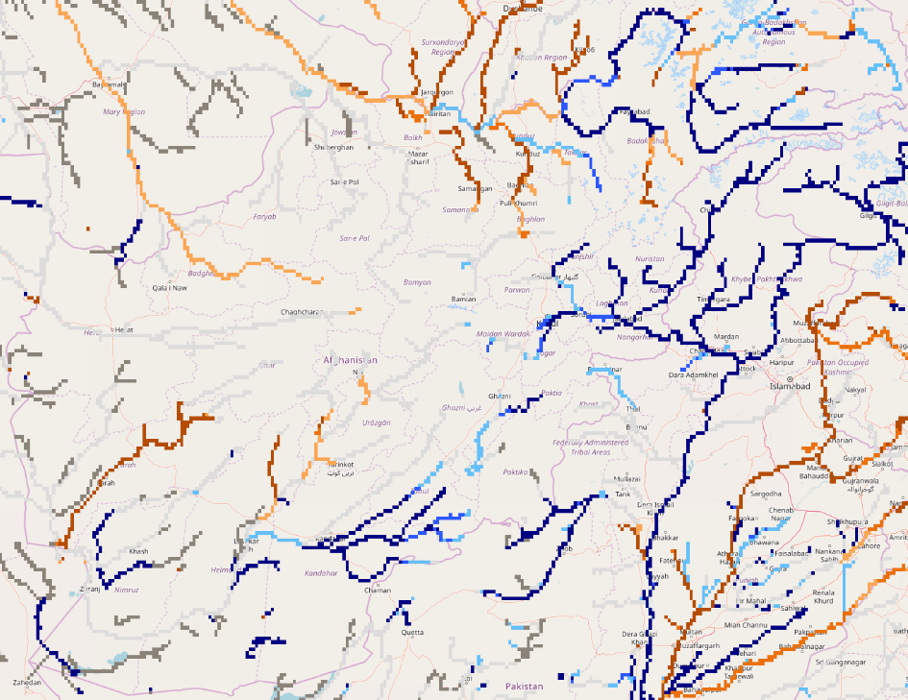
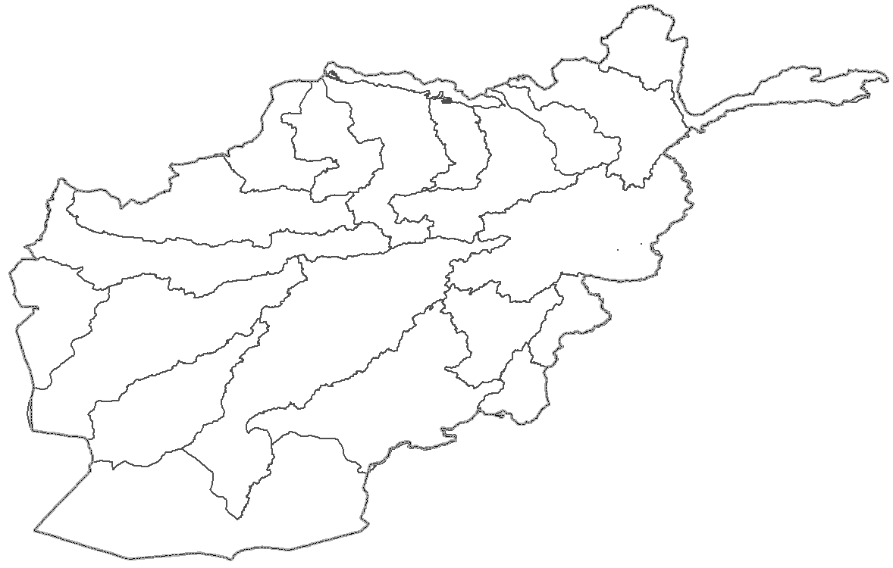
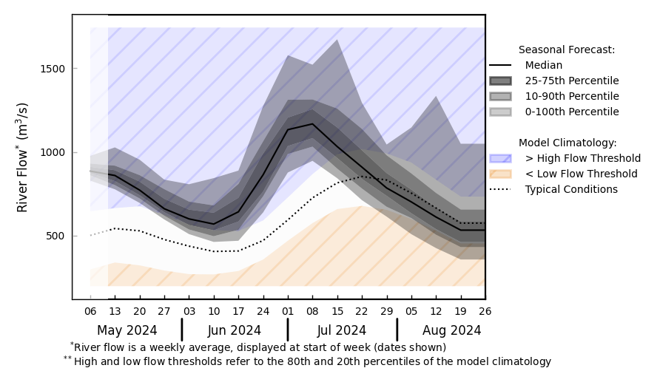
Streamflow Forecast for Afghanistan
@ point A: Amu Darya River
A
B
@ point B: Kabul River
GloFAS seasonal forecast May - Aug 2024
Average to above average discharges are expected across the country.
GloFAS monthly forecast (May – Aug 2024)

