Slide 1
FEWS NET Enhanced Flood Monitoring and Forecast Assumptions-Afghanistan
April 2024 Seasonal Forecast
FEWS NET Science Team:
USGS, NASA, NOAA, UCSB+Regional Scientists

Slide 2
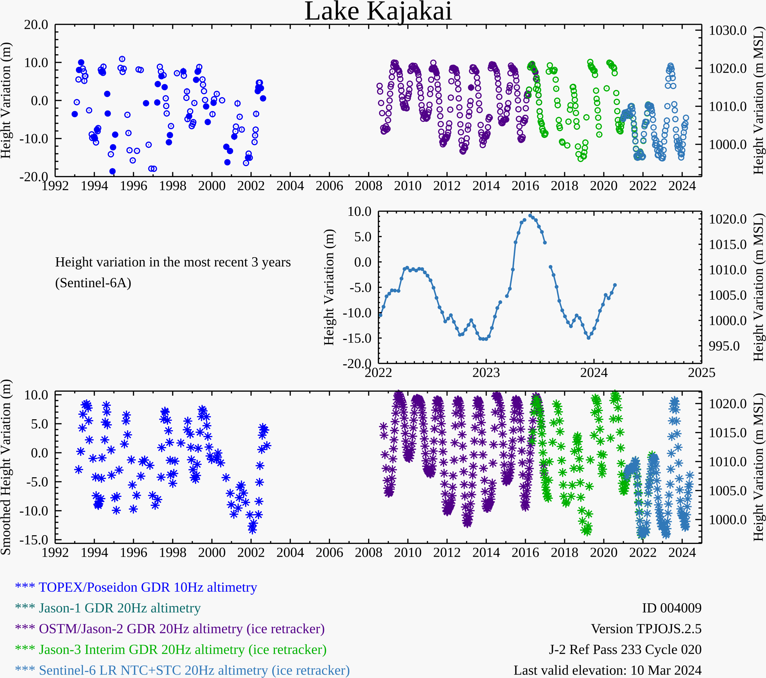
Water Level at Data Processing is on Hold
Zeid
Kajakai
Istadehye
Jehil
Arghandab
USDA monitoring reservoirs
Typical low water level in the Kajakai reservoir during the dry period.

Slide 3
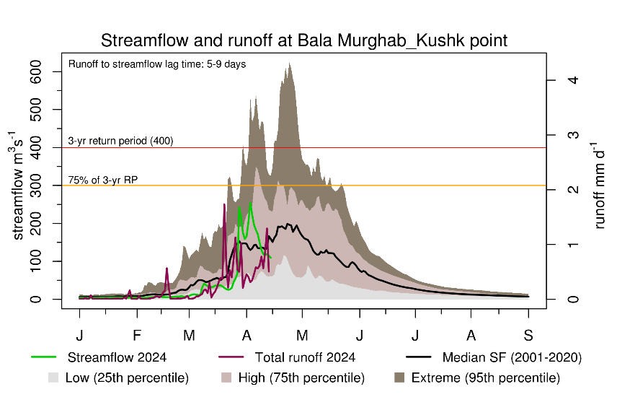
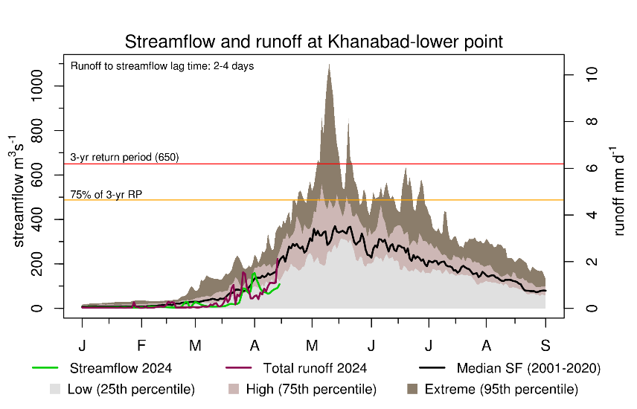
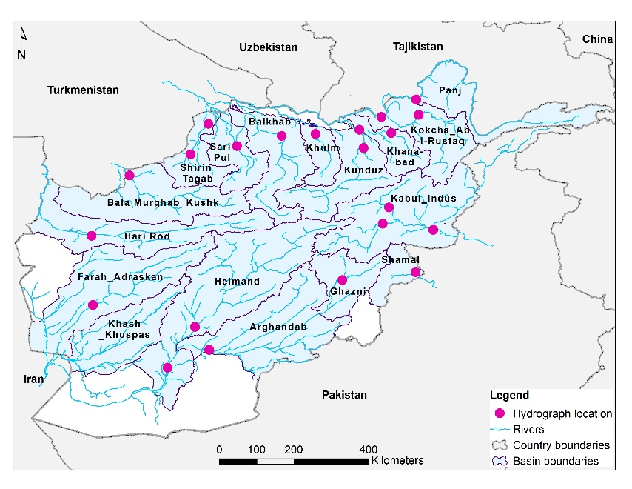
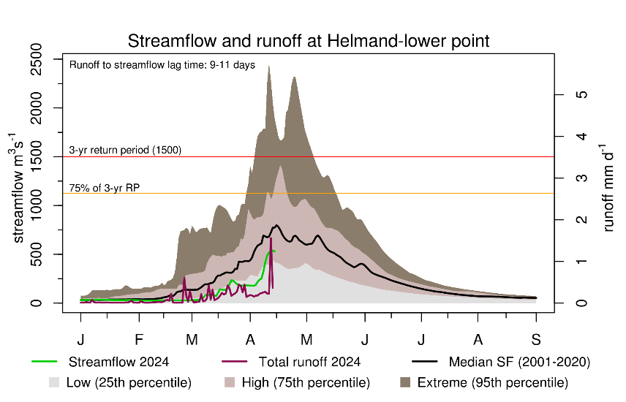
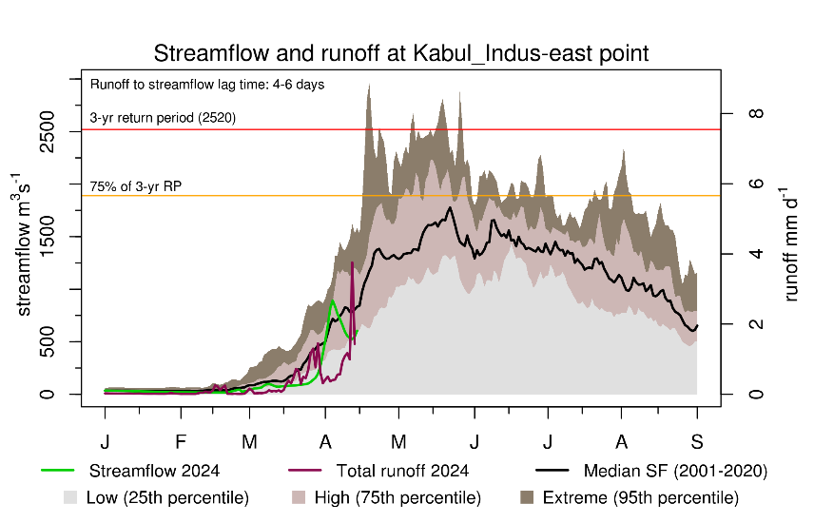
Recent Streamflow and Runoff

Slide 4
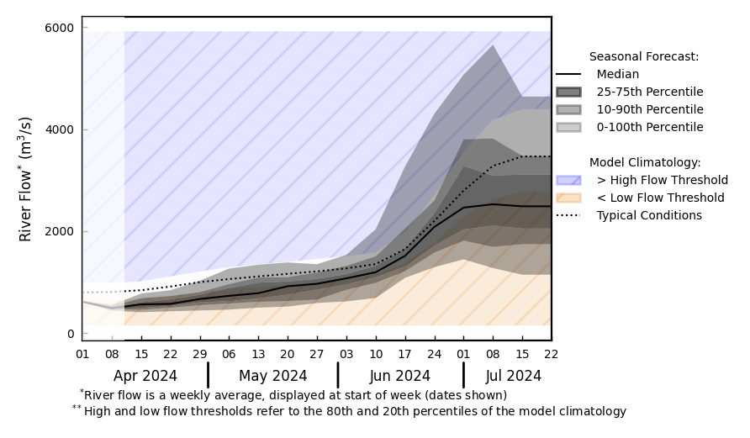
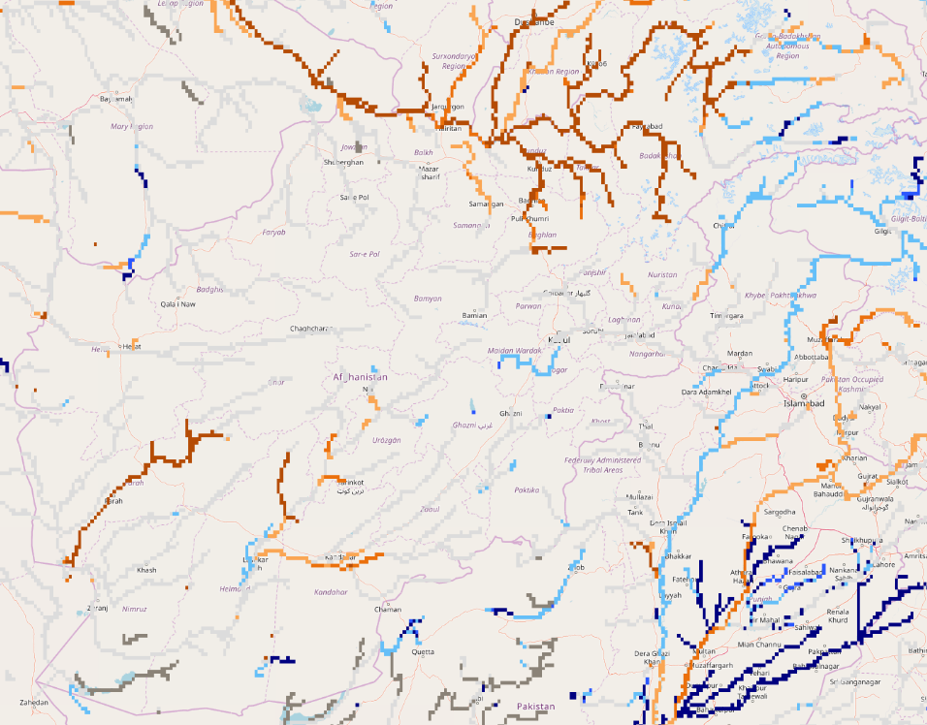
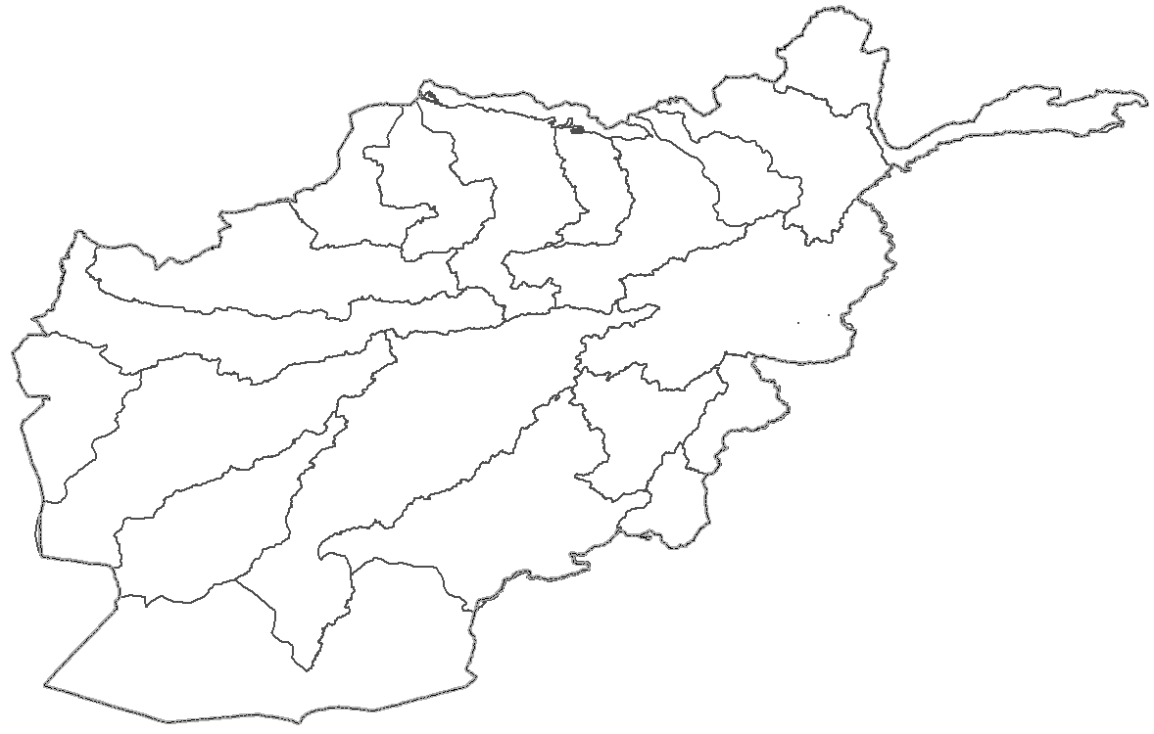
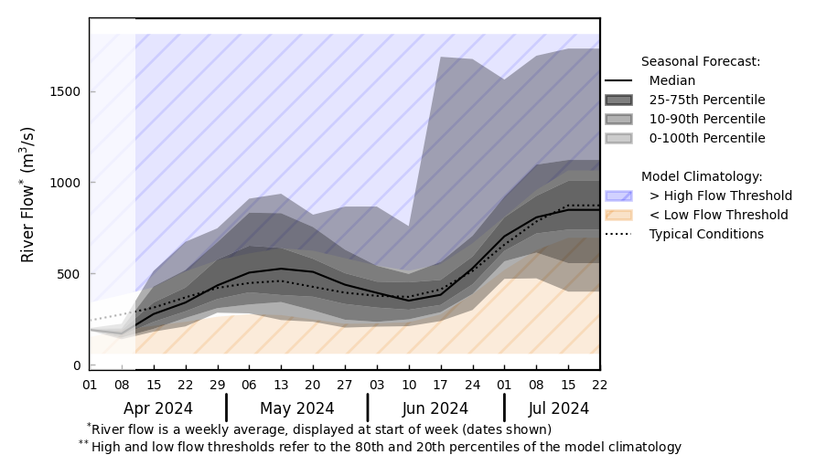
Streamflow Forecast for Afghanistan
@ point A: Amu Darya River
A
B
@ point B: Kabul River
GloFAS seasonal forecast Apr - Jul 2024
Recent spells of precipitation across the country helped river discharge forecast to be at average level across the country except northeast (Amu Darya River).
GloFAS monthly forecast (Apr – Jul 2024)

