Slide 1
East – Africa & Yemen Agro-Climatic Conditions & Outlook
Famine Early Warning Systems Network
FEWS NET/East Africa & Climate Science Partners
(NOAA/CPC, NASA/GFSC ,USGS and CHC Teams)
18 February 2024

Slide 2
Outline
2024/25 Climate drivers outlook
Global, regional and national seasonal forecasts
South Sudan flood-risks scenarios
Revised agro-climatic assumptions

Slide 3
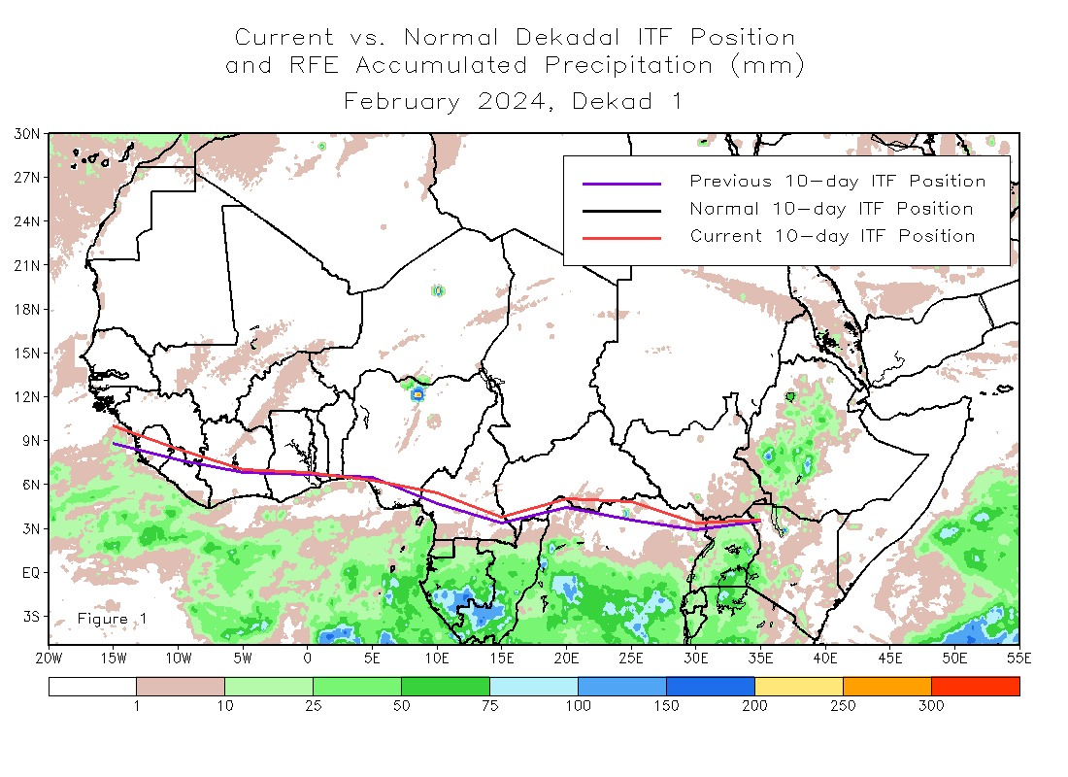
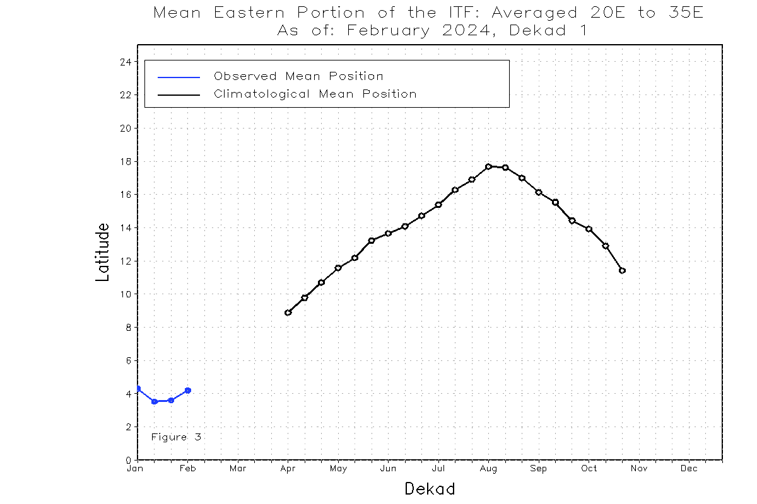
Gradual northward progression of the ITCZ
Evidence of slight northward progression of the seasonal rains into parts of southern and coastal Kenya and Ethiopia/Belg regions.
Mean eastern ARM of ITCZ
MAM

Slide 4
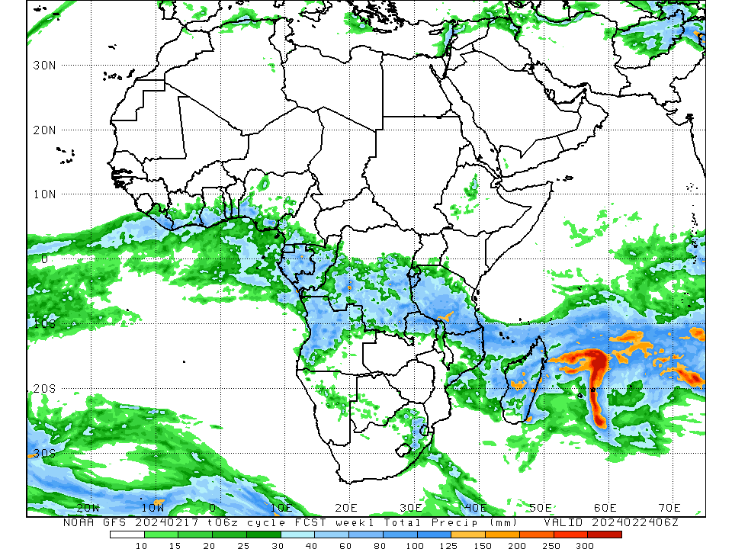
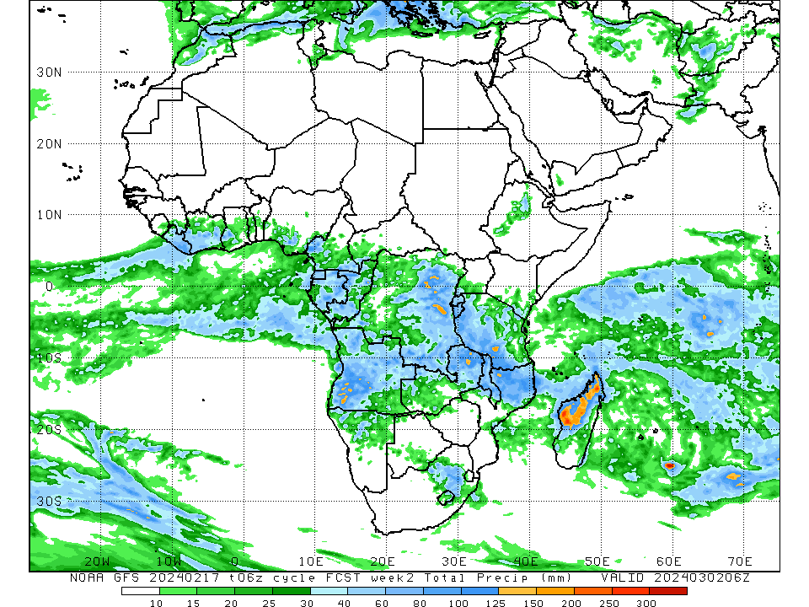
NOAA/GFS Weekly Rainfall Outlook: 17 Feb. – 02 Mar. 2024
Early to timely onset of the Ethiopia/Belg’ rainfall season
Possible early onset of March – May rains over coastal and southern Kenya
Timely onset over Rwanda, Burundi and parts of southern Uganda
GFS Week 1: 17-24 Feb. 2024
GFS Week 2: 25 Feb. – 02 Mar. 2024

Slide 5
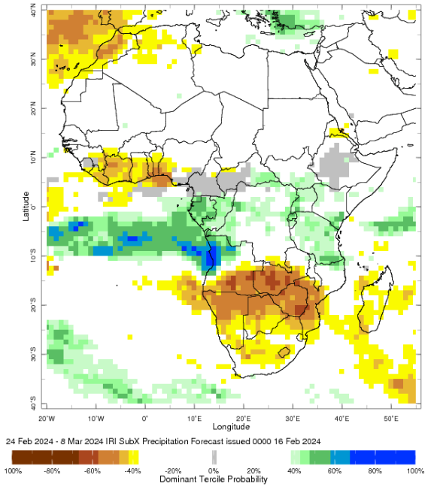
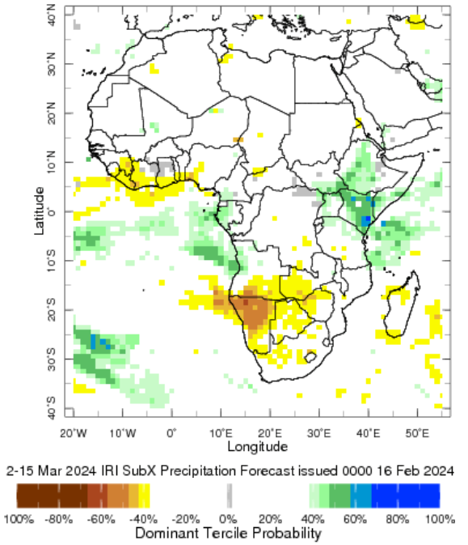
IRI Sub-X Rainfall Outlook
Increased likelihood for an early onset of seasonal rains over eastern Horn in coming weeks

Slide 6
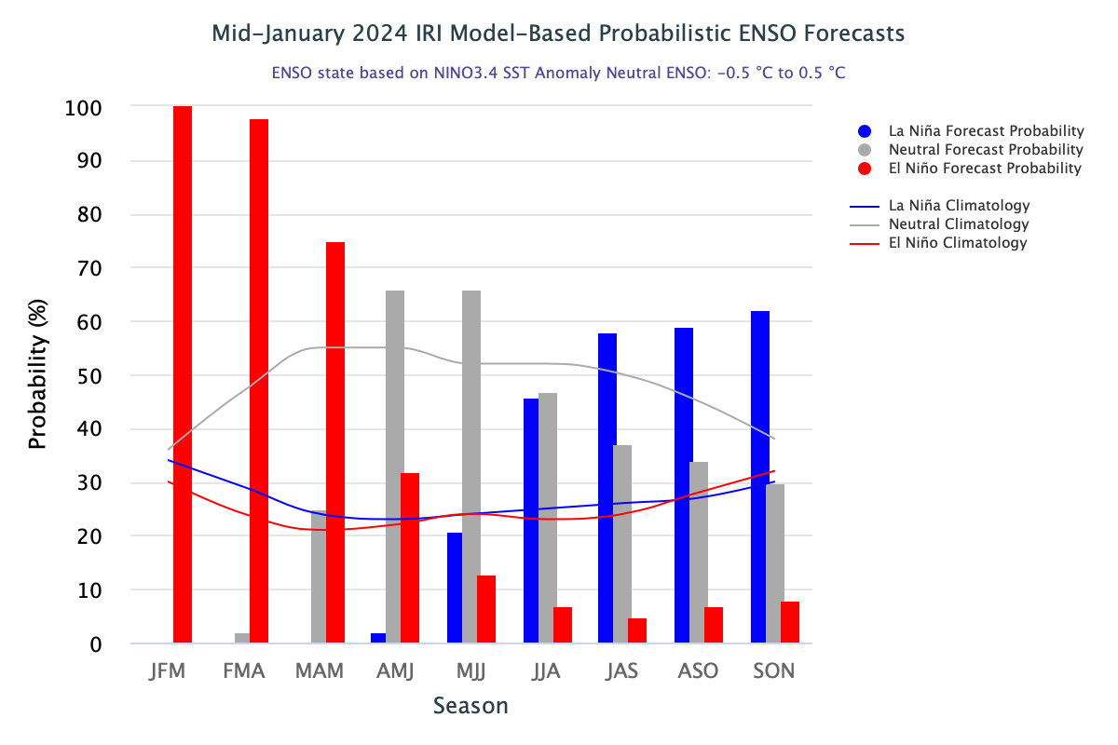
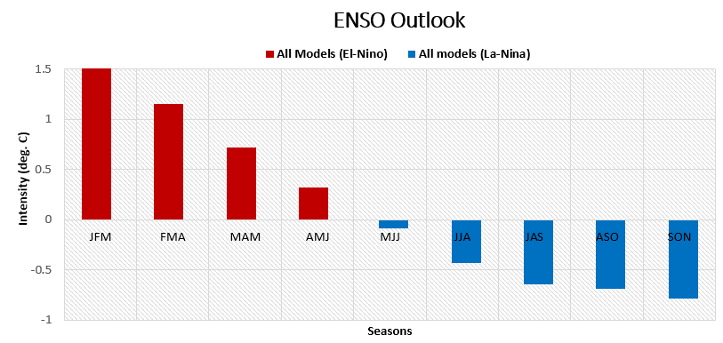
Forecast ENSO Conditions
High probability for El-Nino to continue (97 – 70%) through Gu/long-rains at moderate to weak (> +0.7) intensity.
Period of transition from El-Nino to Neutral mode, during the months of April through June 2024

Slide 7
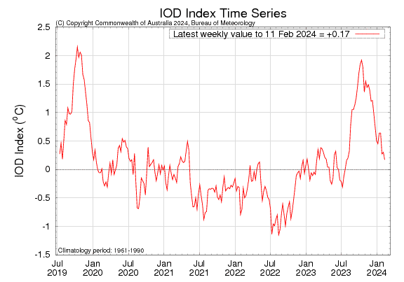
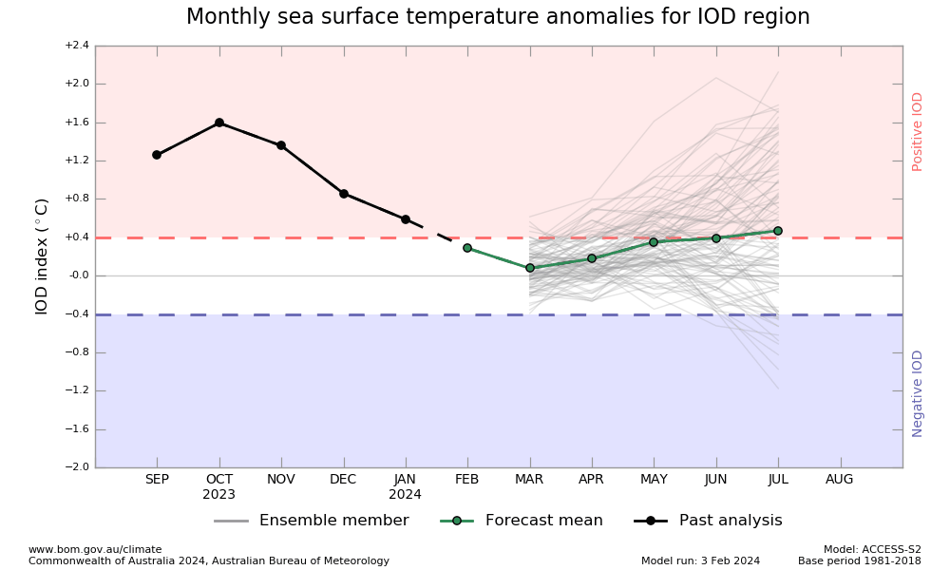
Current and Forecast IOD Conditions
IOD in neutral mode, and likely to persist through July 2024
IOD typically doesn’t influence MAM rainfall season

Slide 8
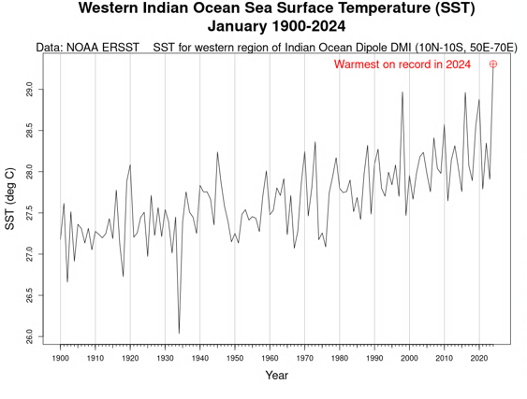
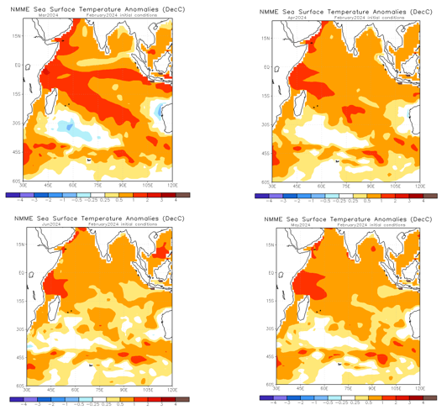
2024 Warmest on record (120-years) over western Indian Ocean (WIO)
SST Anomalies: Mar. – June. 2024
Likely to influence, above-average episodic rainfall patterns over parts of eastern Horn (FMAM’2024)

Slide 9
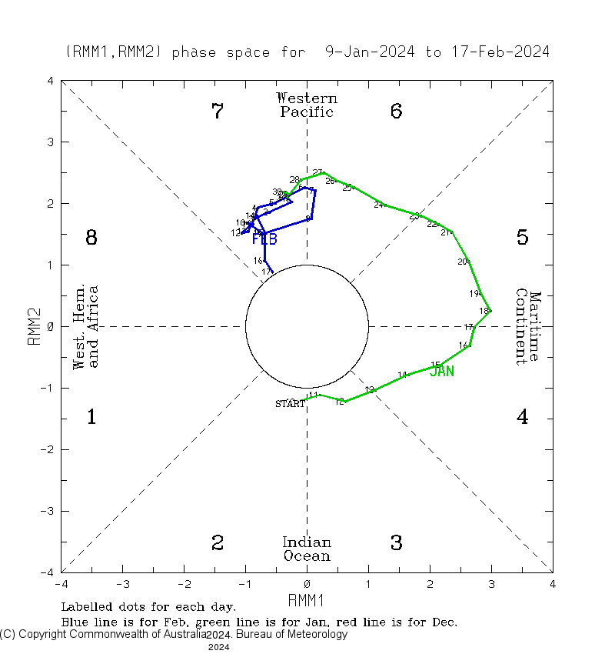
Forecast MJO (phases 6 and 7) indicate an increased likelihood of above-average rainfall over parts of East Africa.
Past 40-days, its been active and indicative of more rains over parts of East Africa in late February 2024

Slide 10
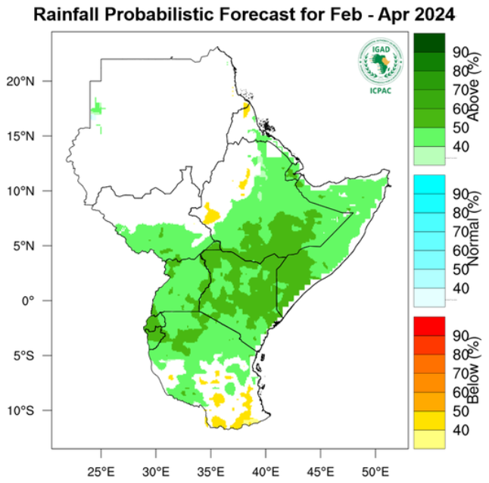
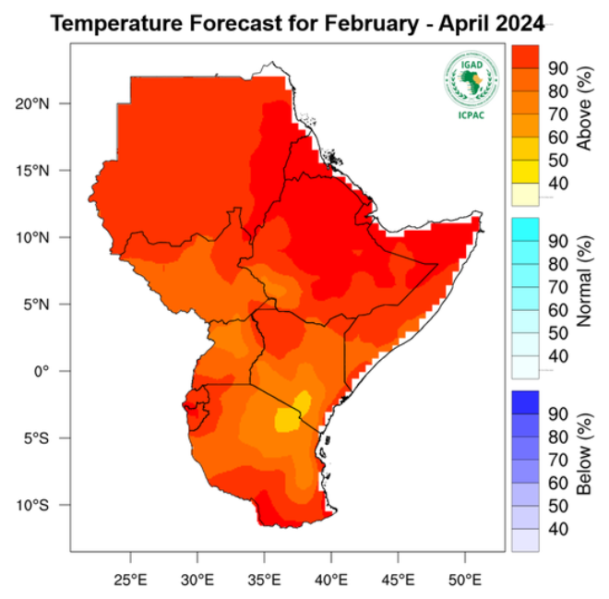
ICPAC Rainfall and Temperature Forecasts (FMA’2024)
Increased likelihood for above-average rains early season rains and hotter-than-normal conditions
Attributed to forecast persistent El-Nino conditions and warmer-than-normal WIO

Slide 11
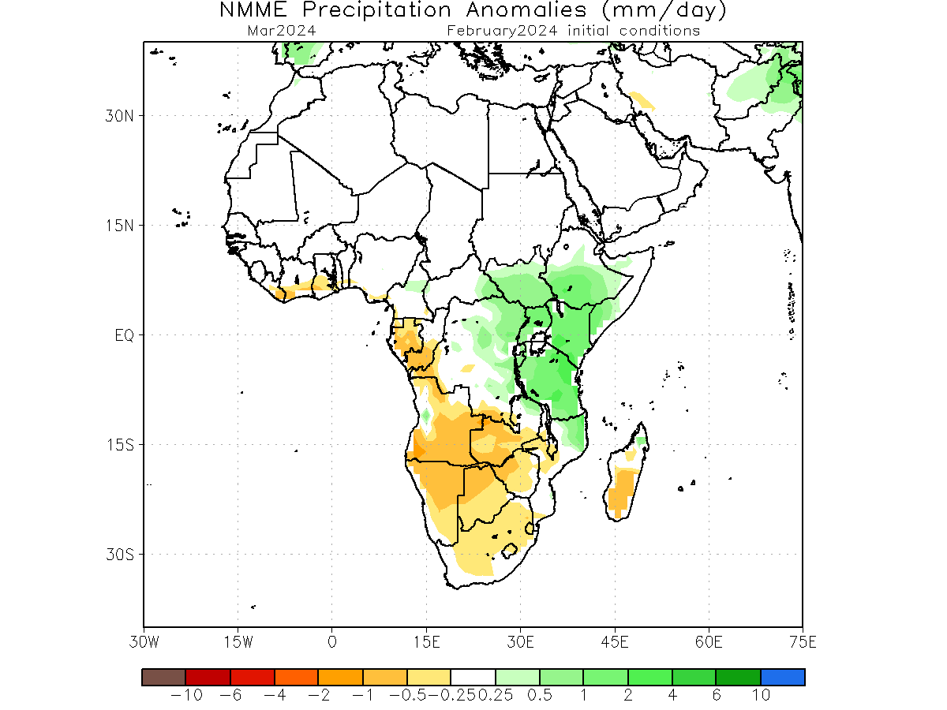
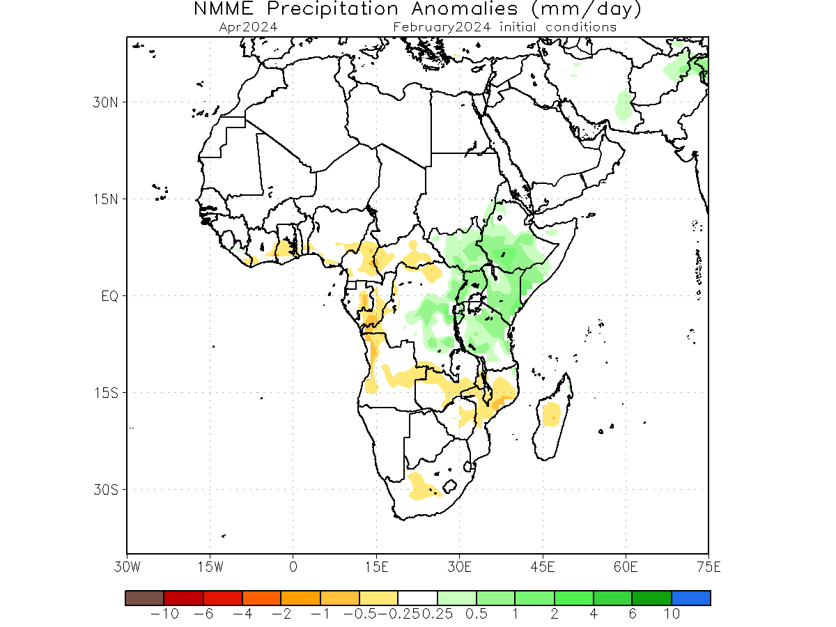
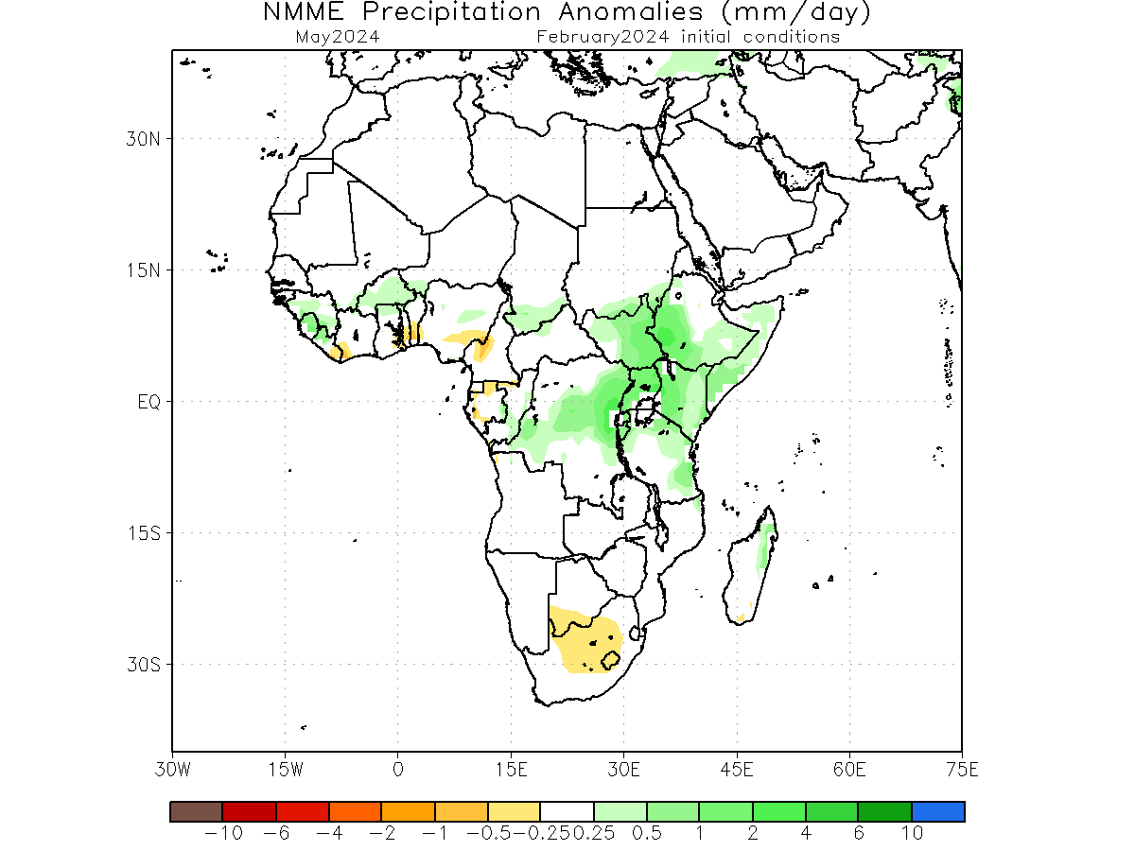
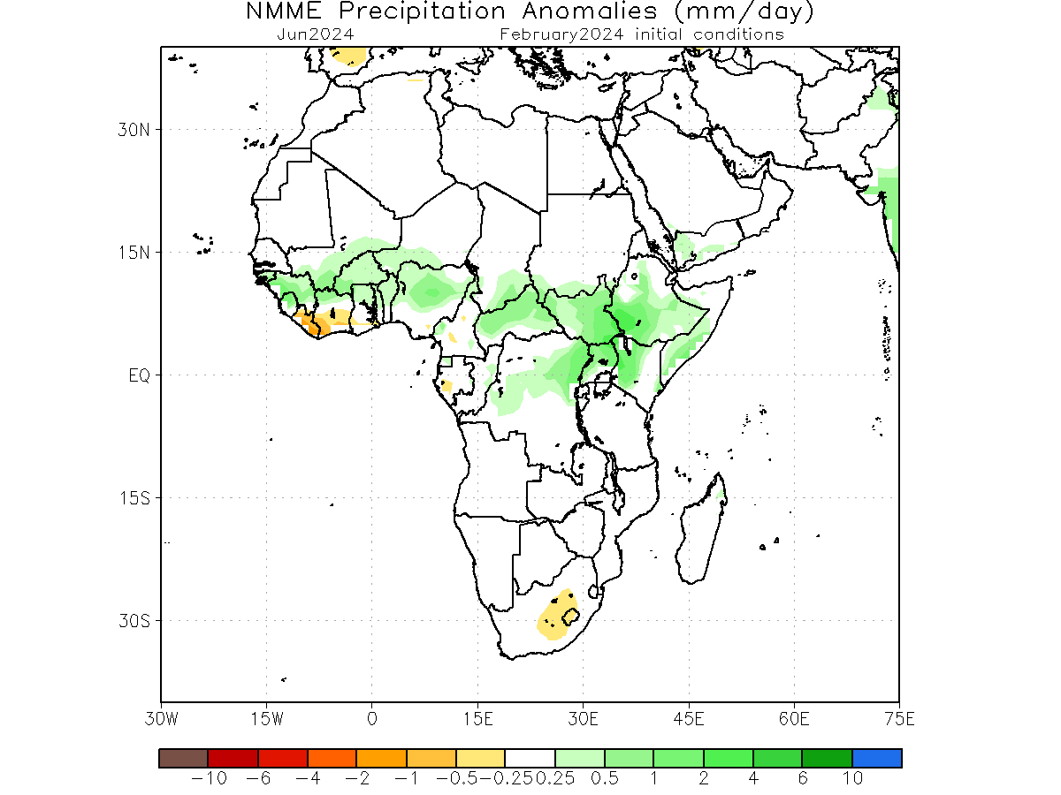
NMME Monthly Rainfall Forecast Anomalies (mm/day)
March, April, May, June2024
Above-average monthly rainfall forecast, with increased likelihood for early onset and timely cessation
Mar. 2024
Apr. 2024
May. 2024
June. 2024

Slide 12
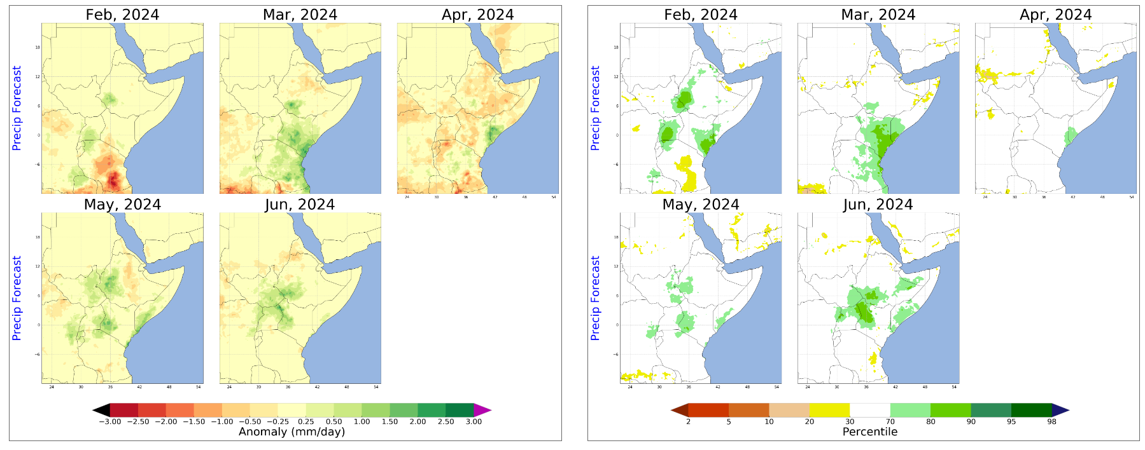
FLDAS Monthly Rainfall Forecast
February, March, April, May and June2024

Slide 13
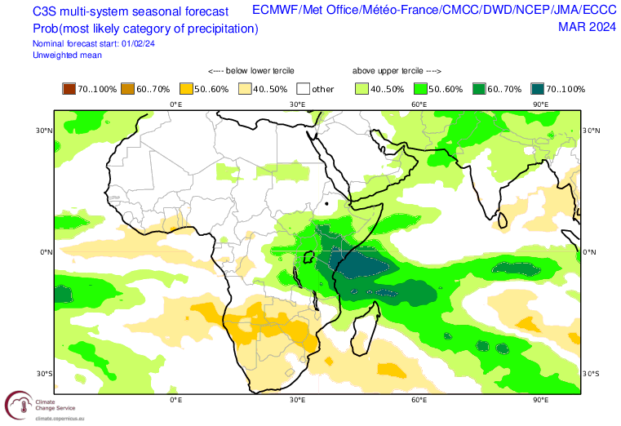
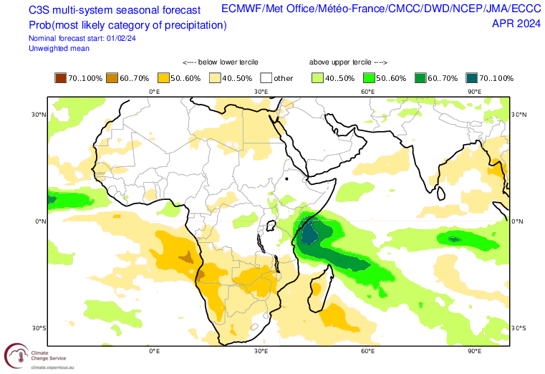
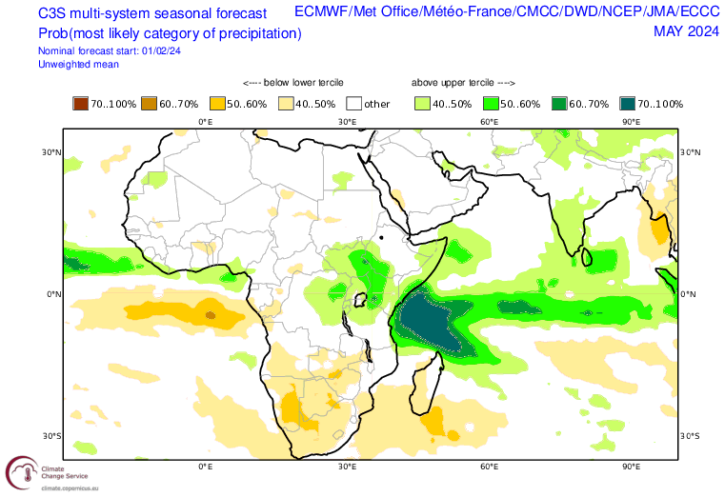
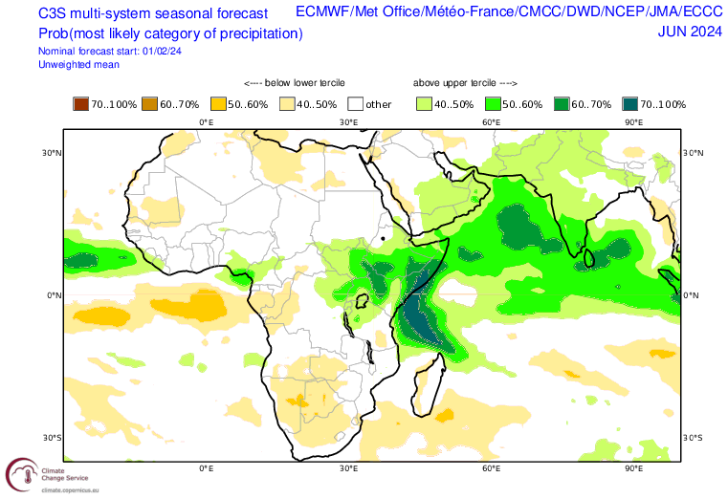
C3S Monthly Rainfall Forecast Anomalies (mm/day)
March, April, May, June2024
Persistently above-average monthly rainfall forecast through MAMJ season over eastern Horn
Mar. 2024
Apr. 2024
May. 2024
June. 2024

Slide 14
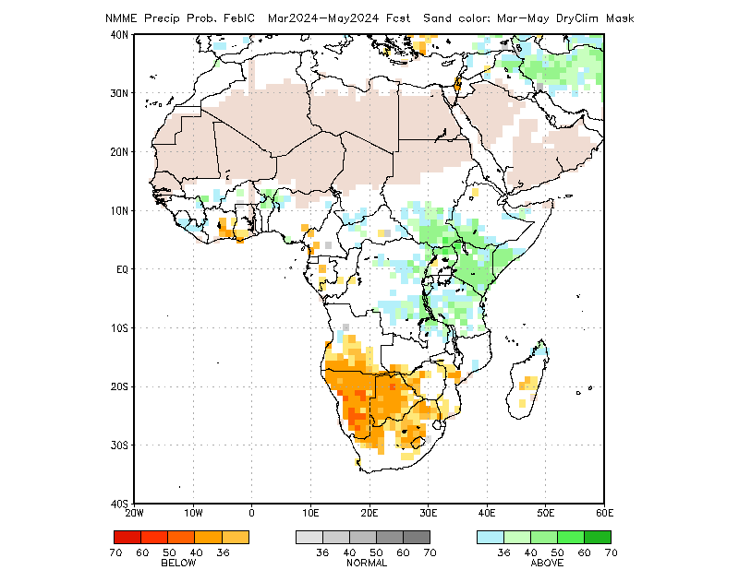
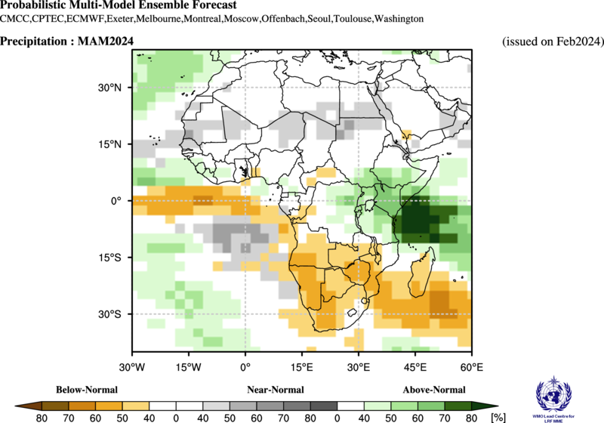
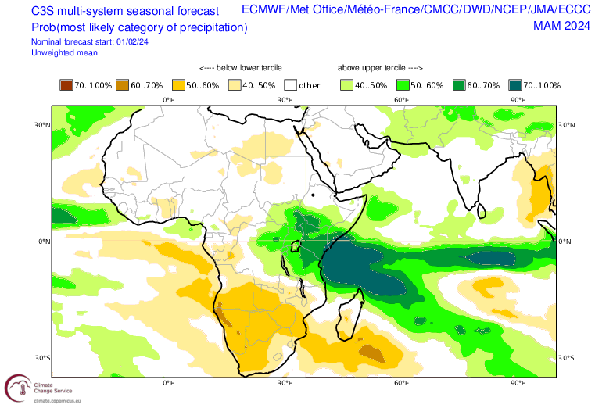
2024 Consensus March - May Seasonal Rainfall Forecast
Strong agreement among Global Climate Centers for above average rainfall forecast for 2024 MAM
NMME
WMO/LRF
C3S
Likely to be driven by the forecast moderately strong El-Nino and warmer-than-normal WIO

Slide 15
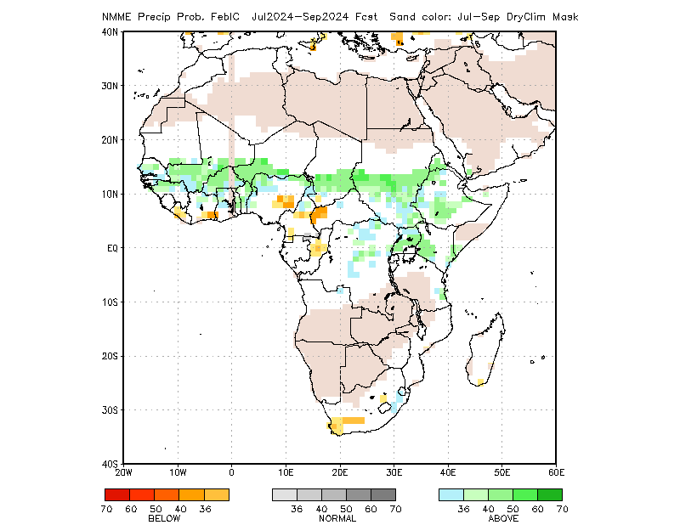
2024 July – September NMME Rainfall Forecast
Above average Kiremt seasonal rains over parts of Ethiopia, Sudan and South Sudan
Similarly, for Uganda and much of western Kenya, with typical conditions over eastern Horn

Slide 16
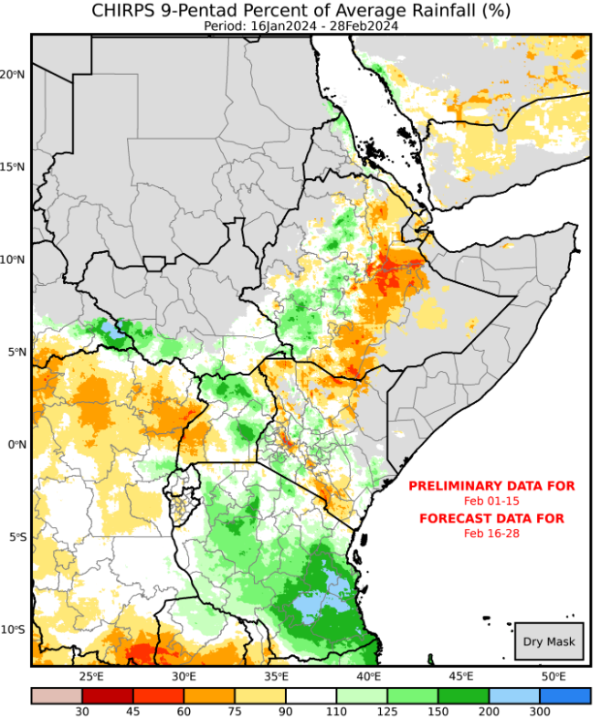
Assumption 1: late 2024 rainfall seasons
1a: The February-May 2024 belg rainy season in Ethiopia is likely to be average with isolated areas receiving above-average rainfall (No Change).
CHIRPS Prelim + GEFS (%)
16 Jan. – 28 Feb. 2024
NMME Rainfall Forecast
March - May. 2024

Slide 17
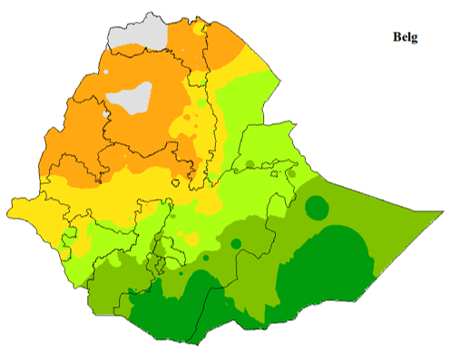
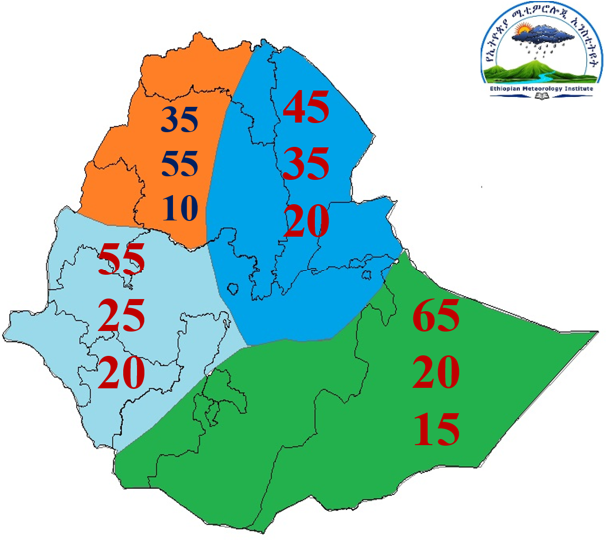
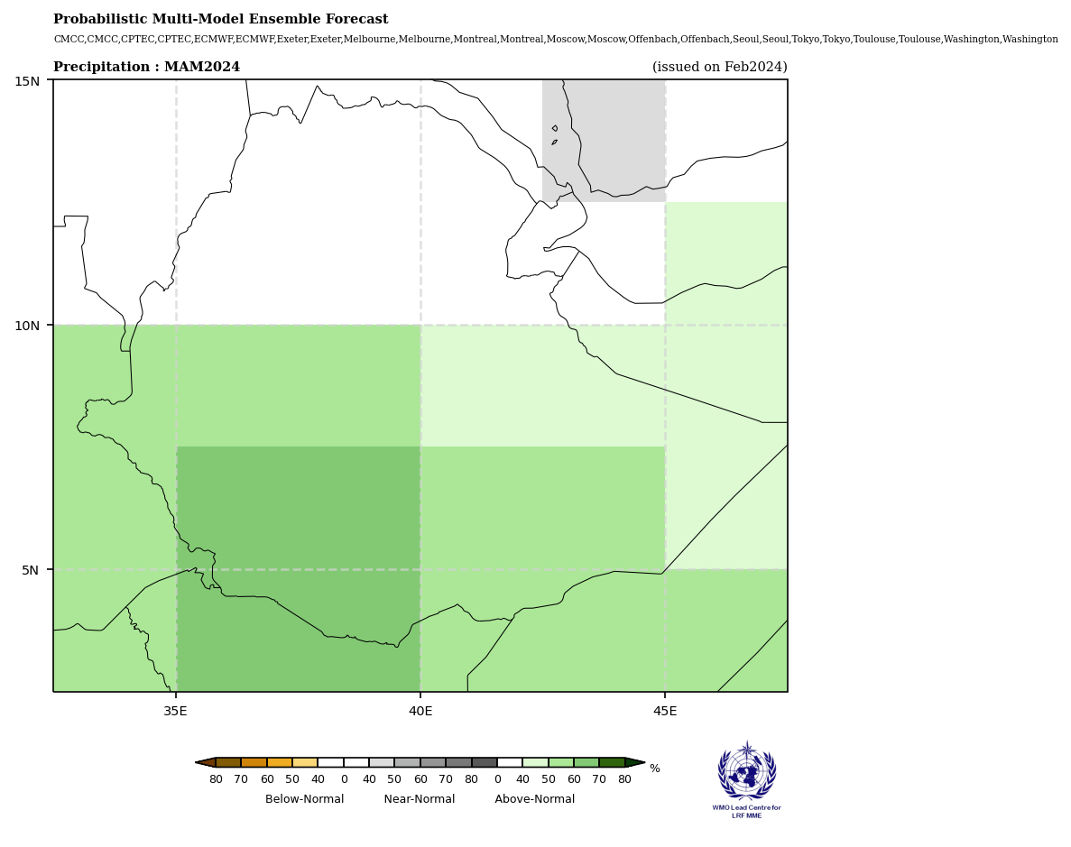
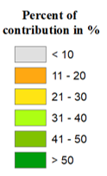
Assumption 1: early 2024 rainy seasons in the Horn
Belg rainfall contribution (%)
2024 Belg rainfall forecast (EMI)
2024 Belg rainfall forecast (WMO/LRF)

Slide 18
Assumption 1: late 2024 rainfall seasons
1b: The March-May 2024 long rains/gu/genna season in northern and eastern Kenya, Somalia, and southern/southeastern Ethiopia is most likely to be largely above average with an early to timely onset, though with localized areas of above-average rainfall. (Change).
NMME
WMO/LRF
C3S
Likely to be driven by the forecast moderately strong El-Nino and warmer-than-normal SWIO conditions at the start of the season, but, could subside into near-average conditions at the end of the season

Slide 19
Assumption 1: late 2024 rainfall seasons
1c. The March-May 2024 diraac/sugum rains in northern pastoral areas of Ethiopia are likely to be average (No Change).

Slide 20
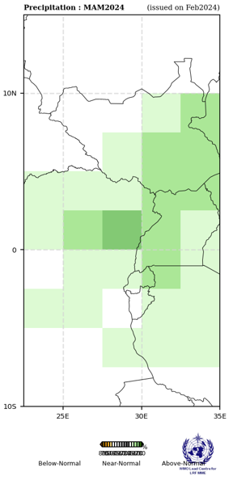
Assumption 1: early 2024 rainy seasons in the Horn
1d. Based on available forecasts, the February-May 2024 main season rains in Burundi are most likely to be above average, with localized areas of average (Change).
1e. Based on ensemble forecasts, the March to May 2024 first-season rains in bimodal Uganda are likely to be above average (No Change).
1f. Based on the ensemble forecasts, the March to May 2024 first-season rains in bimodal South Sudan are likely to be above average (No Change).
South Sudan
Uganda
Rwanda
Burundi

Slide 21
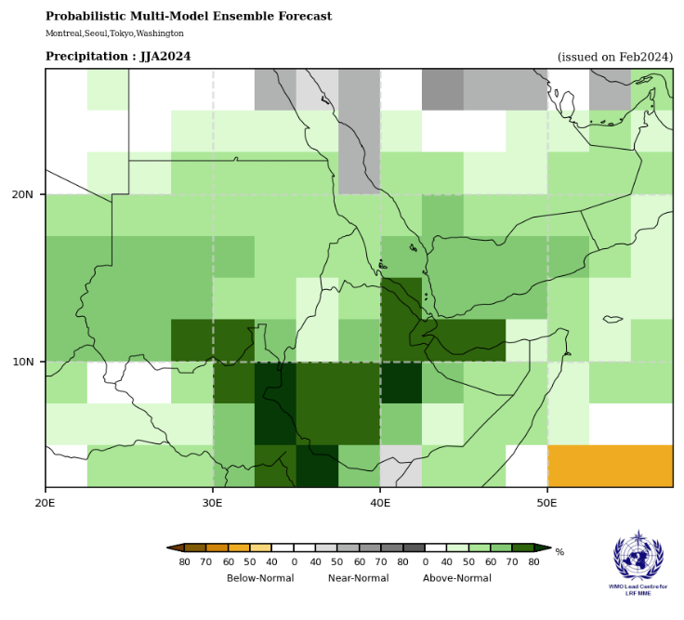
Assumption 2: 2024 rainy season beginning April and beyond
Uganda unimodal, Ethiopia kiremt and karma, Sudan, unimodal South Sudan, Somalia hagaa
July – September 2024
2a. The June to September kiremt rainfall season in Ethiopia is most likely to be above average with isolated areas of above-average rainfall (Change).
2b. The June to September karan/karma rainfall season in northeastern Ethiopia and northwestern Somalia is assumed to be above average. However, notable uncertainty exists given the long lead time, expectations for emerging La Nina conditions, and conflicting ensemble forecasts (Change).
2c. Based on the NMME and WMO forecasts, the start of the June to September rainy season in Sudan is likely to be above average (No Change).

Slide 22
Assumption 2: 2024 rainy season beginning April and beyond
Uganda unimodal, Ethiopia kiremt and karma, Sudan, unimodal South Sudan, Somalia hagaa
2d. Based on NMME and WMO forecast, the start of the June to September rainy season in unimodal South Sudan is likely to be above average. Based on current persistent flood extents, above-normal river water levels projected to remain above-normal over the coming months, and the forecast of above-average rainfall both during the MAM season in the southern bimodal zone and in the main June-September season, there is an increased likelihood that seasonal flood extent will be above normal and similar to recent years of severe flooding (No Change).
2e. Based on the NMME forecast, the April-September 2024 unimodal rainfall season in Karamoja, Uganda, is likely to be slightly above-average, though there is uncertainty given the long-range nature of the forecast (No Change).
July – September 2024

Slide 23
Questions for Science Partners
Question: We’re interested in an analysis of the risk of severe flooding in South Sudan given the combination of factors:
Persistent flood extent levels in February 2024 comparable to those in Feb 2022, which preceded the fourth year of flooding under La Nina conditions, with extents in the JJAS rainy season reaching record high levels;
Of particular concern, the lack of any significant recession in central/northern unity (Rubkona area) over the past dry season period, potentially indicative of compacted soils in this area;
Elevated river and lake water levels due to the above-average rainfall upstream in EA over the OND season
Forecasted above-average rainfall in bimodal areas during MAM and forecasted above-average stream flow levels through the projected window (June per FLDAS)
Correlation of La Nina (now very highly likely – 70%) with above-average rainfall and flooding in South Sudan

Slide 24
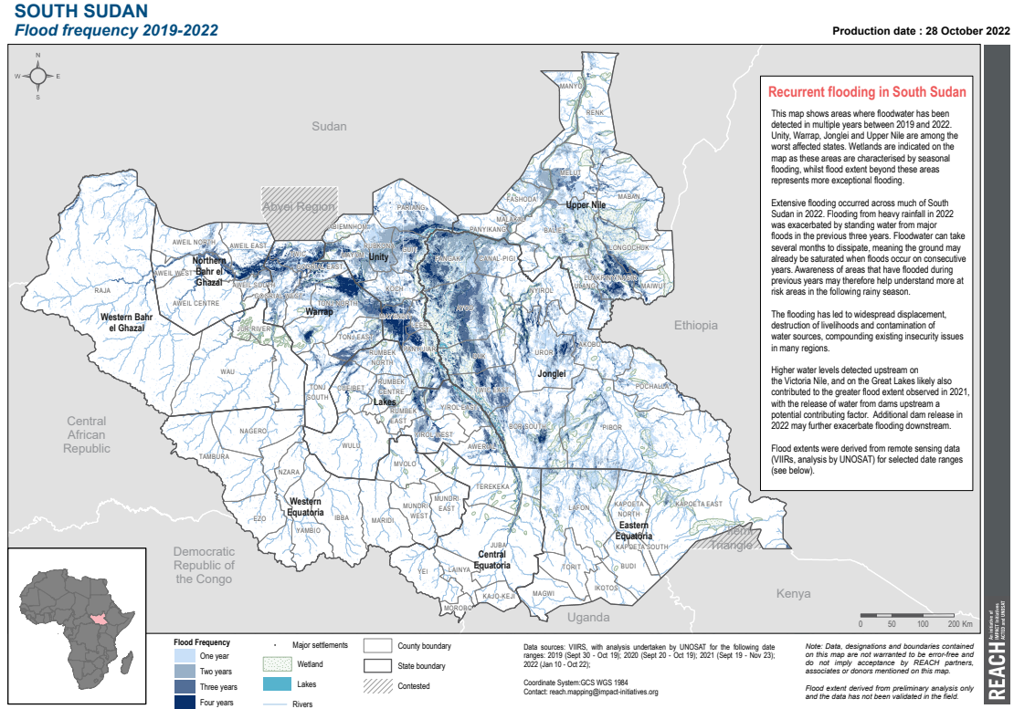
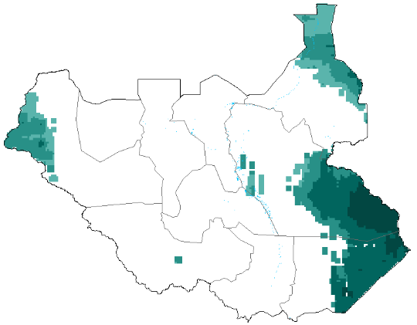
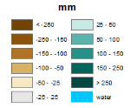
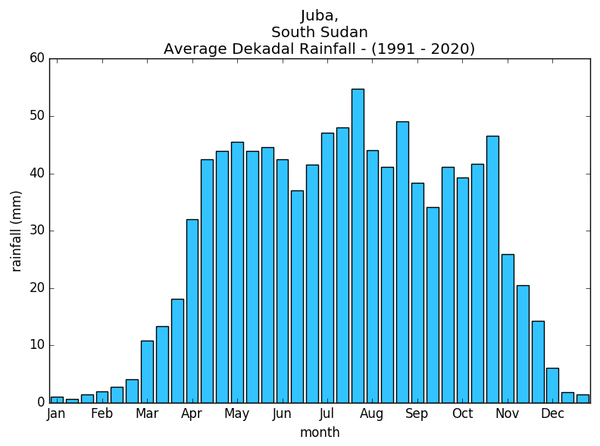
South Sudan Context
Annual Cumulative Rainfall Trends: 1981-2020

Slide 25
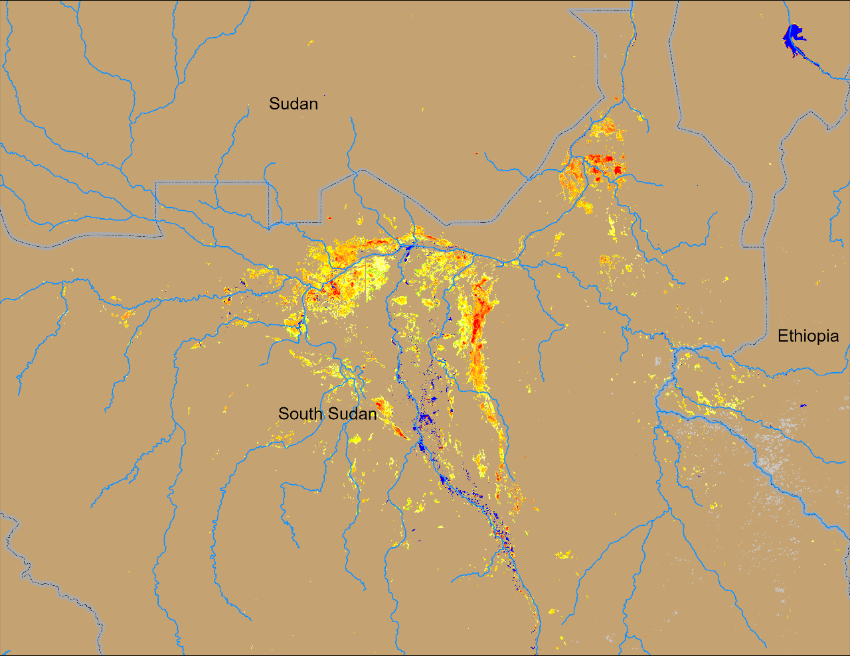
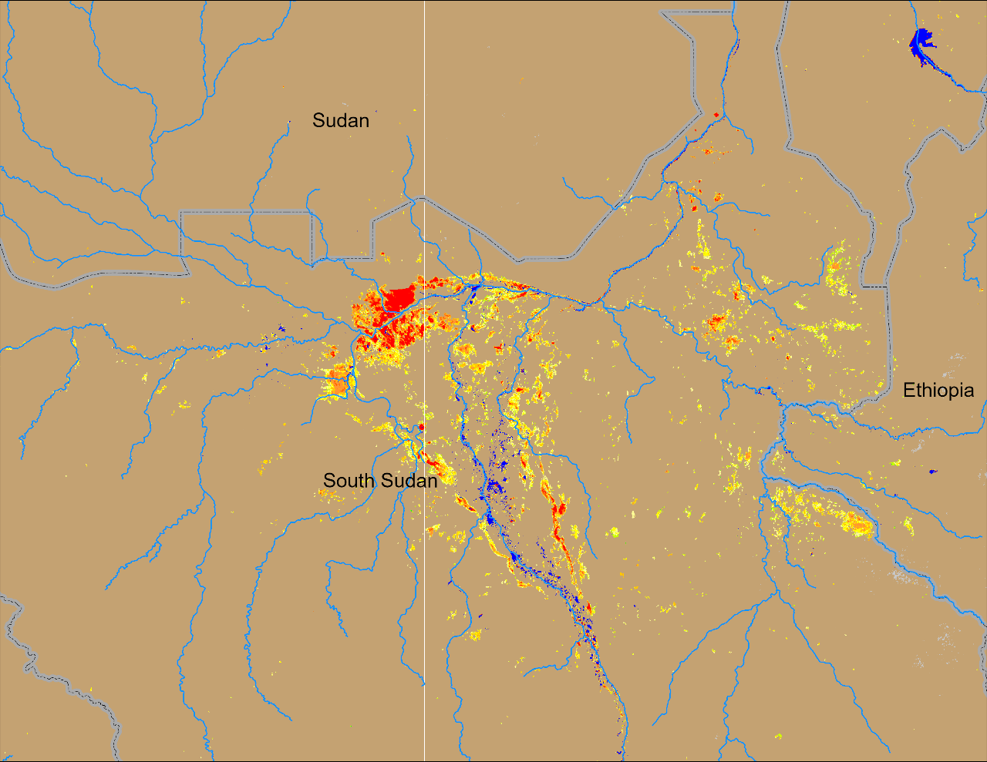
South Sudan Flooding
Sobet
Khawr
Akobo
Pibor
NOAA VIIRS 5-day comp.: 23 – 27 Feb 2022
NOAA VIIRS 5-day comp.: 15 – 19 Feb 2024
Very similar pattern of inundation during Feb of 2022 and 2024. Additionally, there are more areas currently under water in the Khawr, Sobet, and Akobo catchments.

Slide 26
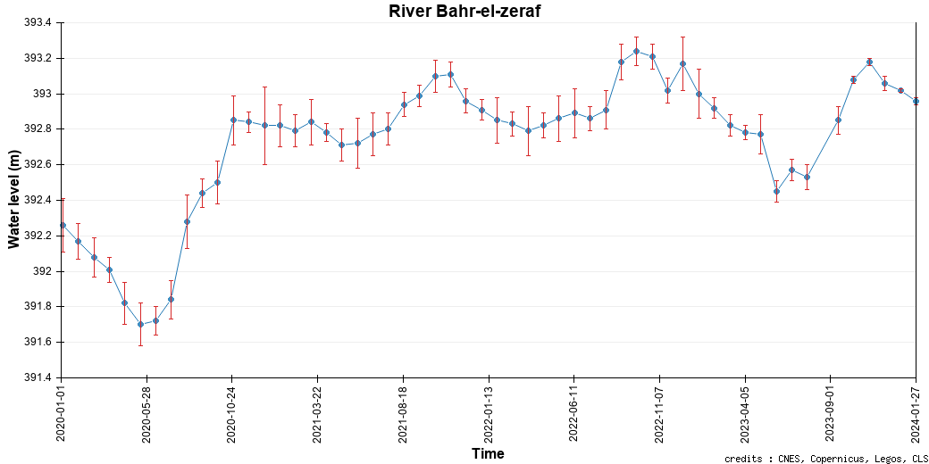
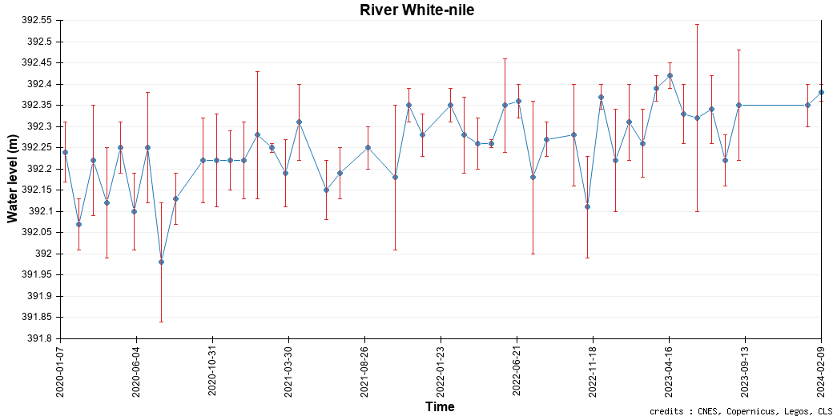
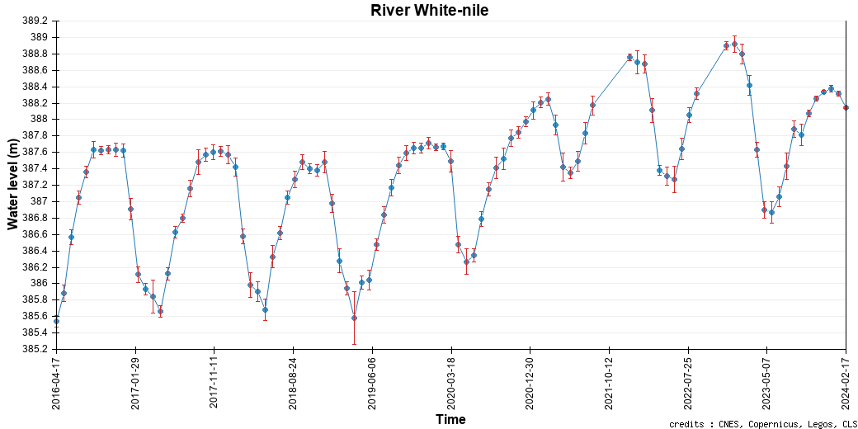
Elevated River Water Levels
@ point B
Feb 2022
C
A
B
@ point A
@ point C
Feb 2022
Feb 2022
Feb 2024 water levels in the Sudd Wetlands are higher compared to the water levels in Feb of 2022.
Persistent high-water levels especially in the White Nile (Point A) through the dry seasons.

Slide 27
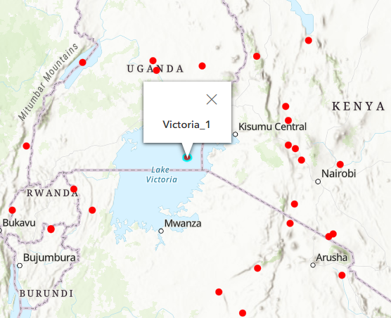
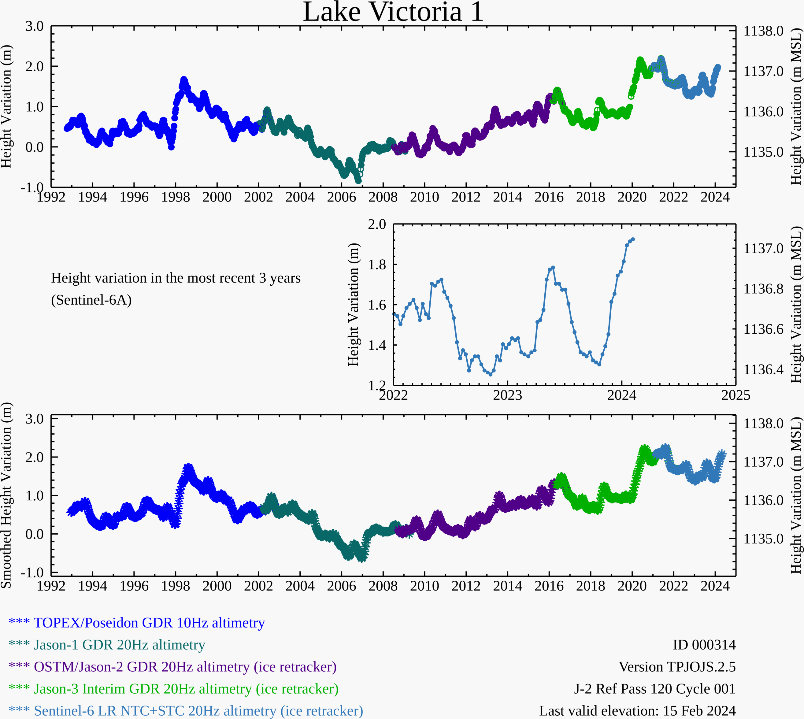
Lake Victoria Water-Level (1992-2024)
Lake Victoria water-levels have remained relatively higher than 1997/98, since 2021.
1997/98
2021/24

Slide 28
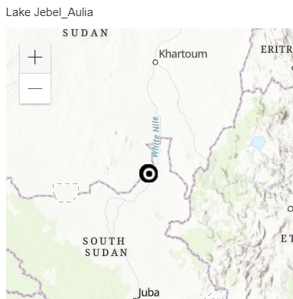
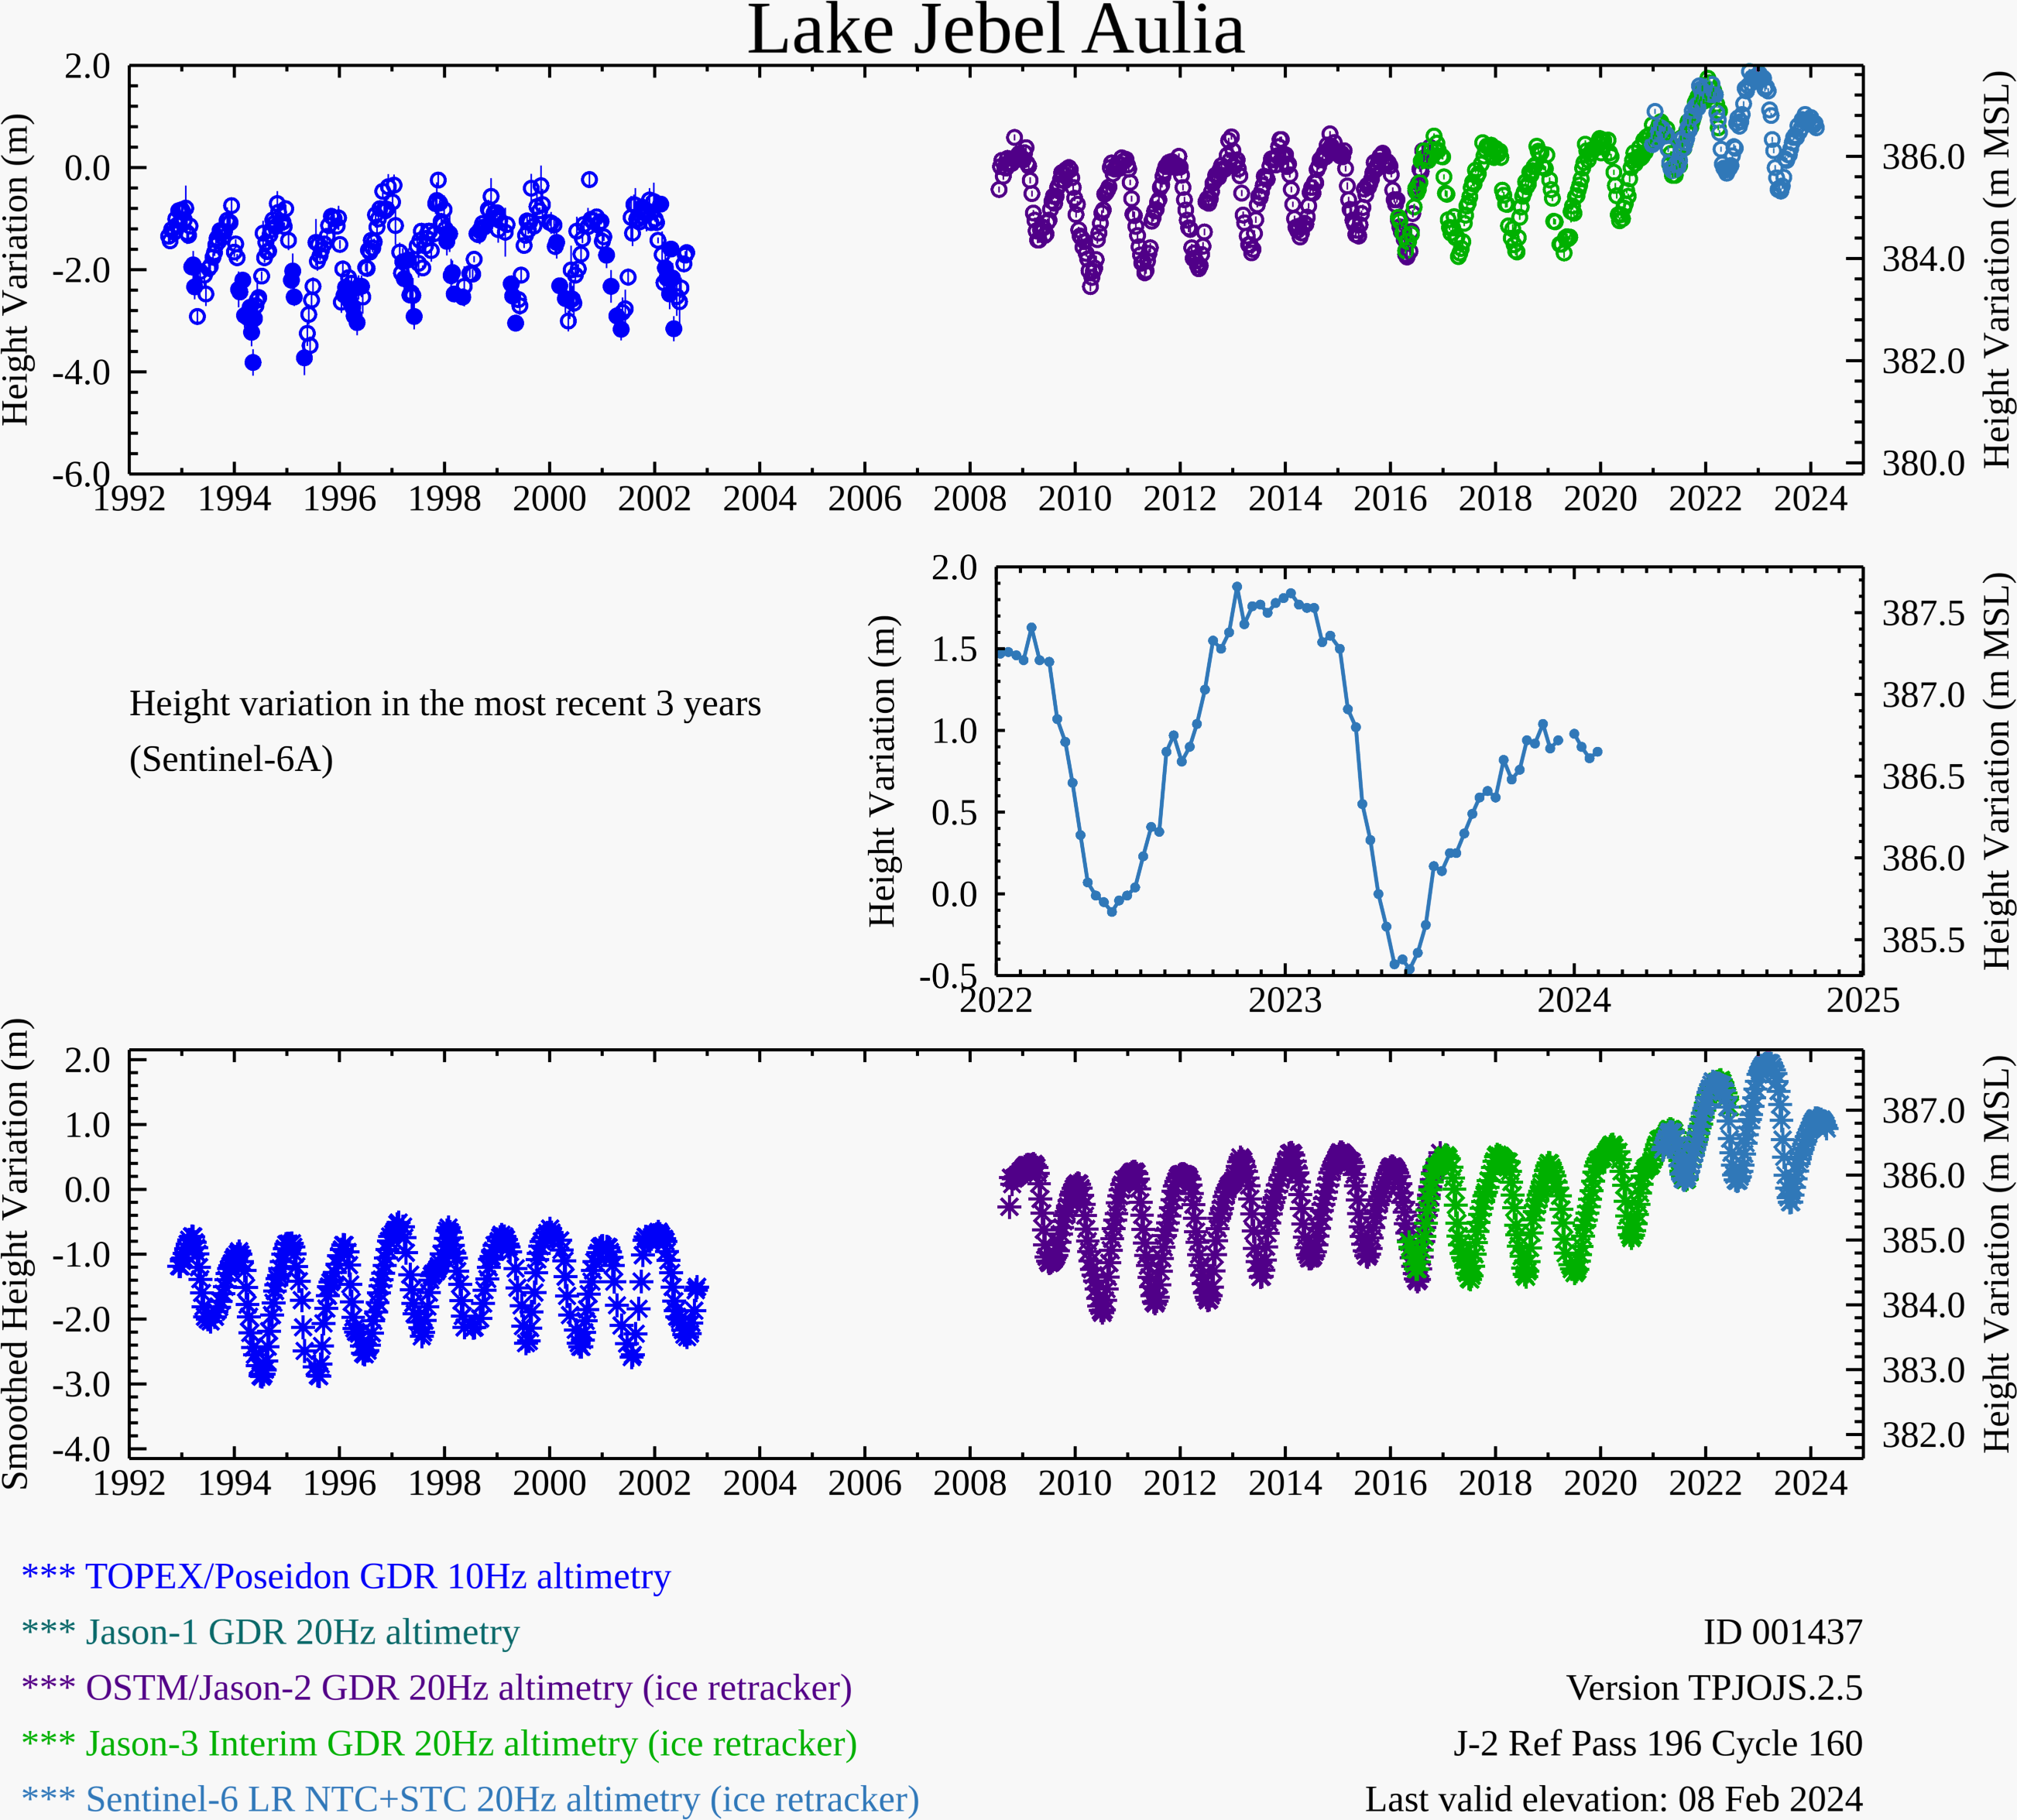
Lake Jebel Aulia Water-Level
1997/98
Lake Jebel Aulia water-levels have also remained relatively higher than 1997/98, since 2010 (sensor changes ? )
2021/24

Slide 29
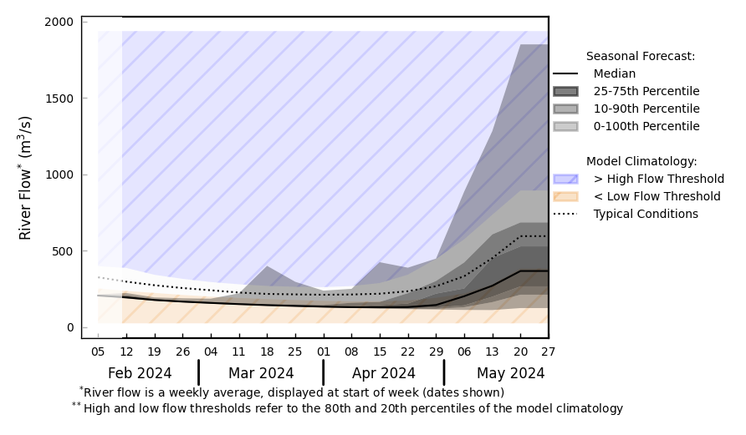
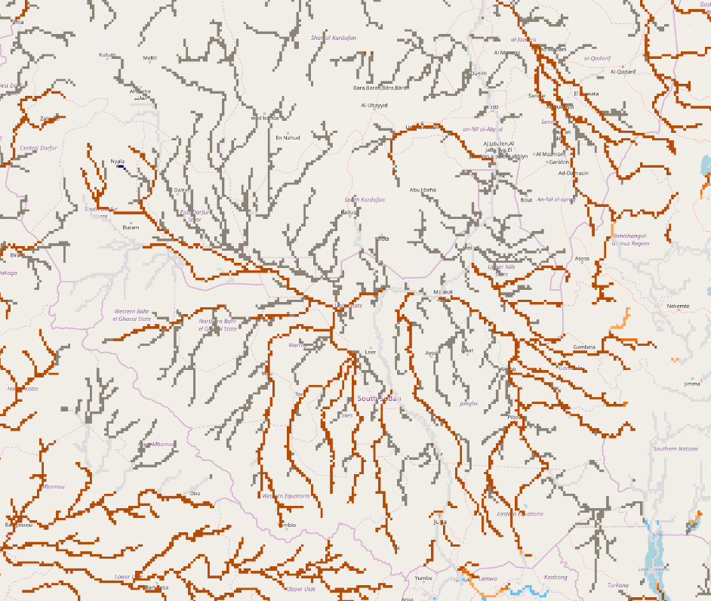
Seasonal Streamflow Forecast
@ point A: central Unity Prv.
B
A
@ point B: northern Unity Prv.
GloFAS streamflow forecast: Feb – May 2024
Feb-Apr still in the dry period, streamflow likely to increase from May.
Its quite early for any conclusive suggestion for flooding potentials.

Slide 30
FLDAS Monthly Rainfall and Streamflow Forecasts

Slide 31
Increased likelihood for La-Nina to persist through 2025
~ 60% probability for weak to moderate La-Nina conditions during the JJAS 2024 rainfall season

Slide 32
2024 June – September Rainfall Outlook Scenario’s
Average to above average rainfall performance over the northern sector of the region
Weak La-Nina Scenario
Moderate La-Nina Scenario
Expect average to above average flood risk over the flood prone regions of South Sudan

Slide 33
2024 June – September Rainfall Outlook Scenario’s
Slight above-average, but, below 2022 cumulative rainfall amounts and flood risks

Slide 34
Assumption 2: 2024 rainy season beginning April and beyond
Uganda unimodal, Ethiopia kiremt and karma, Sudan, unimodal South Sudan, Somalia hagaa
2f. The July to September hagaa rains in southern Somalia are assumed to be largely average. However, notable uncertainty exists given the long lead time, expectations for emerging La Nina conditions, and conflicting ensemble forecasts (Change).
2g. Based on expectation for a transition from El Nino to ENSO Neutral the February to August Long rains in unimodal Kenya are expected to be above average (No Change).
NMME Indian Ocean SST:
July – September, 2024
WMO/LRF Rainfall Forecast:
June - August, 2024

Slide 35
Assumption 3: Non-rainfall assumptions
3a: NMME-based rootzone soil moisture forecasts indicate that soil moisture will be above average in much of the greater horn through at least April 2024, and among the highest on record in parts of Somalia, southeastern Ethiopia, southern Kenya and neighboring north-east coastal regions of Tanzania (Change).
East Africa:
NMME-driven soil moisture forecasts show wet conditions in Somalia, Uganda, and Kenya as well as southern to eastern Ethiopia persist through April 2024. Dry conditions persist across northern Ethiopia, including the Afar region.
Yemen:
NMME-driven soil moisture forecasts show average to wet conditions across the country, with the exception of localized dry conditions in the central-eastern region, through May 2024.

Slide 36
Assumption 3: Non-rainfall assumptions
3b. Above-average temperatures are most likely through at least September 2024, and under high heat-index in South Sudan, and, Kenya’s and southern Somalia coastal strip in coming weeks (Change).

Slide 37
2024 October – December Rainfall Outlook Scenario’s
Below average rainfall performance equatorial sector of the region (especially eastern Horn)
Weak La-Nina Scenario
Moderate La-Nina Scenario

Slide 38
YEMEN
Assumption 1: Based on expectations for El Niño conditions persisting into the spring and available ensemble forecasts, cumulative rainfall in Yemen’s March to May 2024 first rainy season is most likely to be average, though uncertainty exists given diverging forecasts.

Slide 39
Assumption 2: Cumulative rainfall in Yemen’s July to September 2024 second rainy season is assumed to be above average. However, notable uncertainty exists given the long lead time, expectations for emerging La Nina conditions, and conflicting ensemble forecasts (Change).

Slide 40
YEMEN
Assumption 3: Risk of cyclone strikes and associated flooding for Socotra and the southern Aden Gulf coast is highest from mid-April to mid-June and from October to December. In the peak period from mid-April to May 2024, risk of cyclone strikes will likely be above average due to forecast above-average sea surface temperatures in the Arabian Sea, though risk will still be low overall given the rarity of cyclone strikes in Yemen.

Slide 41
YEMEN
Assumption 4: Based on ensemble forecasts through July and historical trends, above-average temperatures are most likely across most of the country through at least September 2024.
.

Slide 42
Assumption 5: Vegetation conditions are largely below average, though anomalies are mixed. Vegetation conditions are expected to continue to seasonally decline through February/March 2024 during the dry period, improve from March to May during the first rainy season, seasonally decline during the dry period through June/July, and then finally improve from July to September 2024 during the second rainy season. Given expectations for above-average temperatures, deterioration during dry periods is likely to be faster than normal. Overall, vegetation conditions are likely to remain mixed compared to the average, though with more areas likely to see below-average vegetation conditions over the course of the projection period due to the above-average temperatures.
Land Surface Temperature Anomalies
January 2024

Slide 43
Thanks ..

