Slide 1
FEWS NET Enhanced Flood Monitoring and Forecast Assumptions-West Africa
October 2023 Seasonal Forecast
FEWS NET Science Team:
USGS, NASA, NOAA, UCSB+Regional Scientists

Slide 2
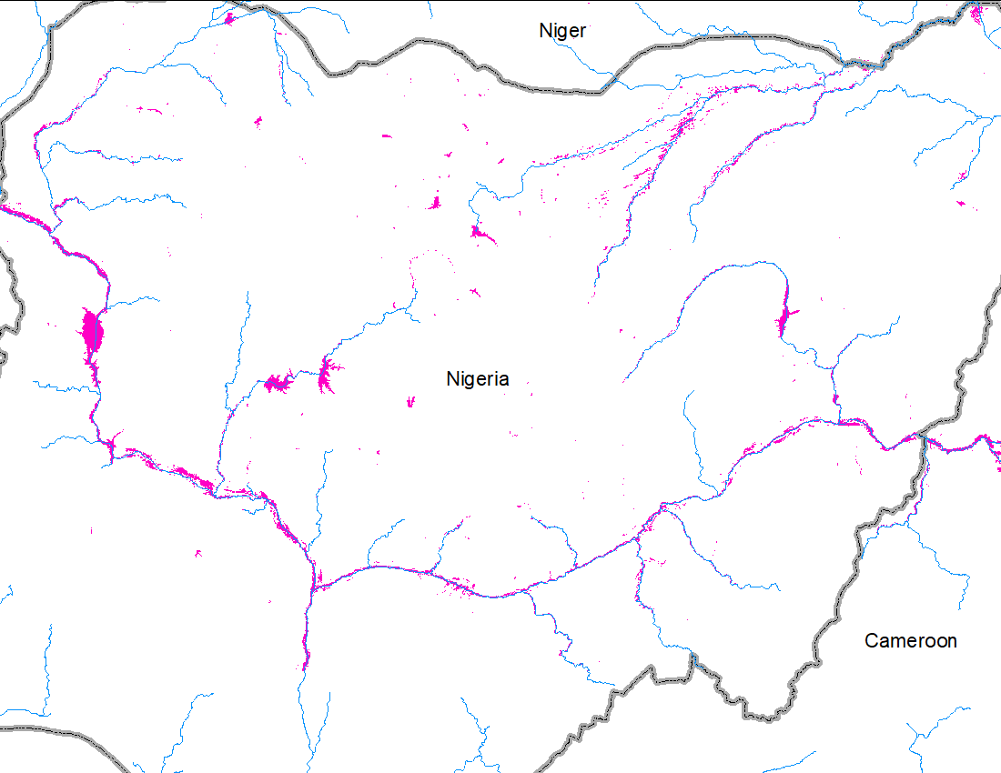
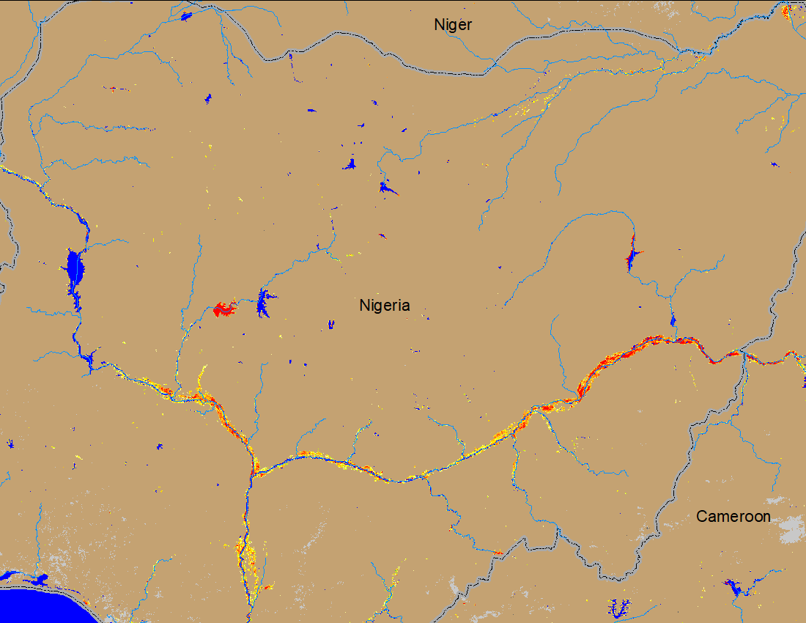
Flooding Conditions in Nigeria
(% of the pixel)
Komadugu
Komadugu
Sokoto
Sokoto
Niger
Benue
Niger
Benue
FloodBase monthly flood map: September 2023
NOAA VIIRS 5-day comp.: 11 – 15 Oct 2023
Flooding conditions have improved along Sokoto and Komadugu catchments but remained unchanged along Niger and Benue Rivers.

Slide 3
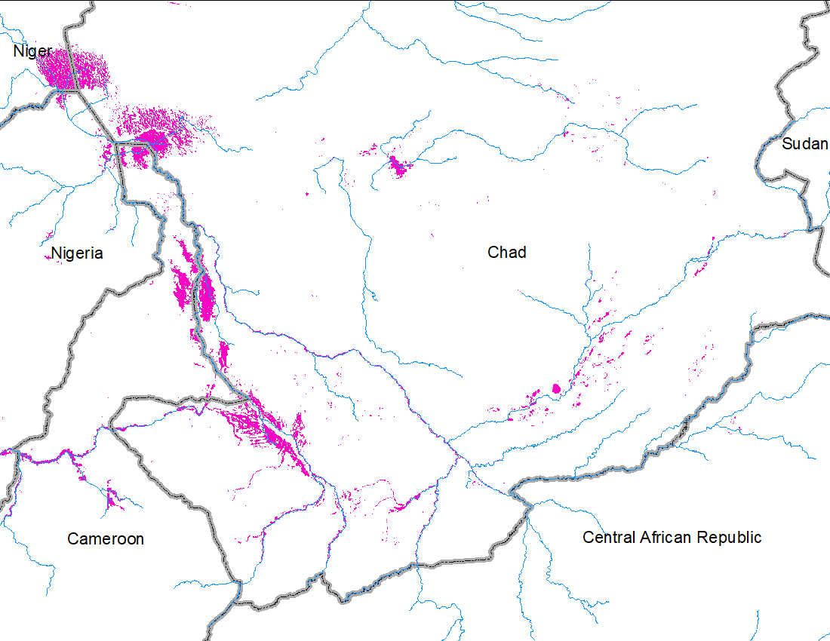
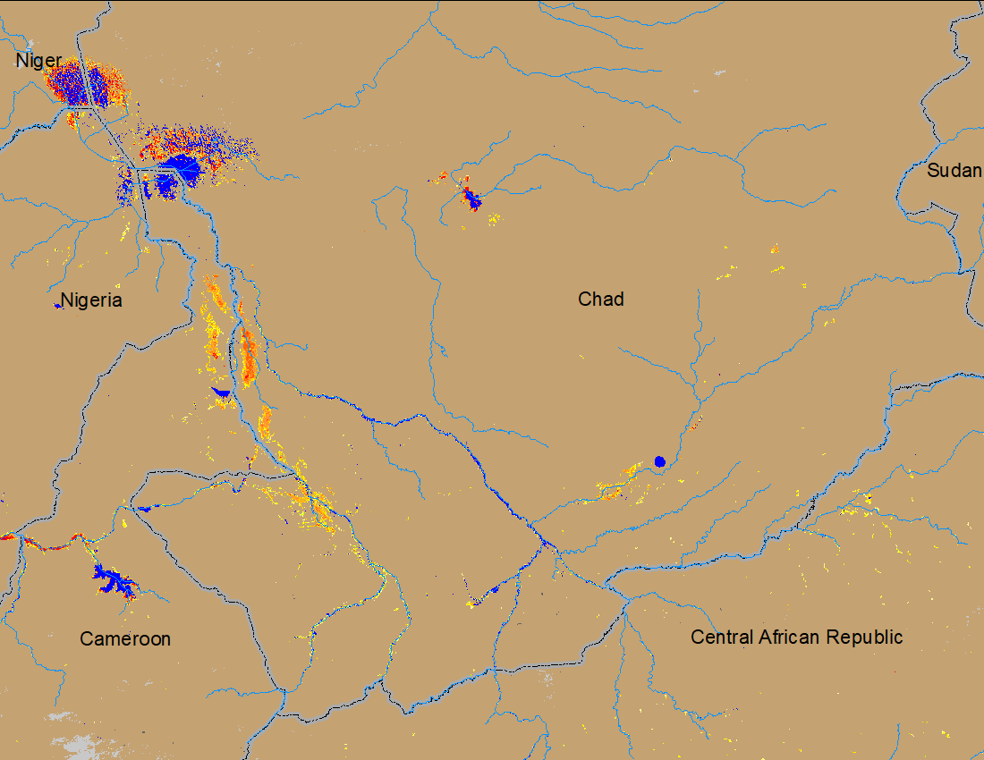
Flooding Conditions in Chad
FloodBase monthly flood map: September 2023
NOAA VIIRS 5-day comp.: 11 – 15 Oct 2023
Flooding conditions are gradually improving across southern Chad.

Slide 4
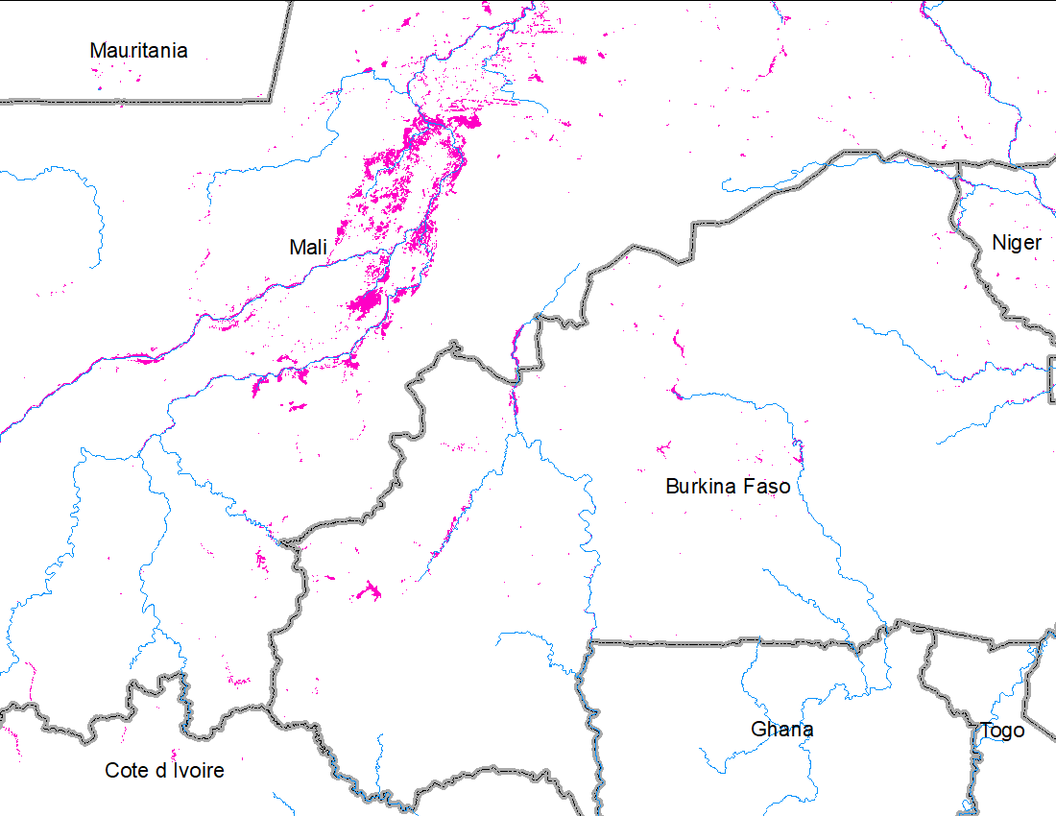
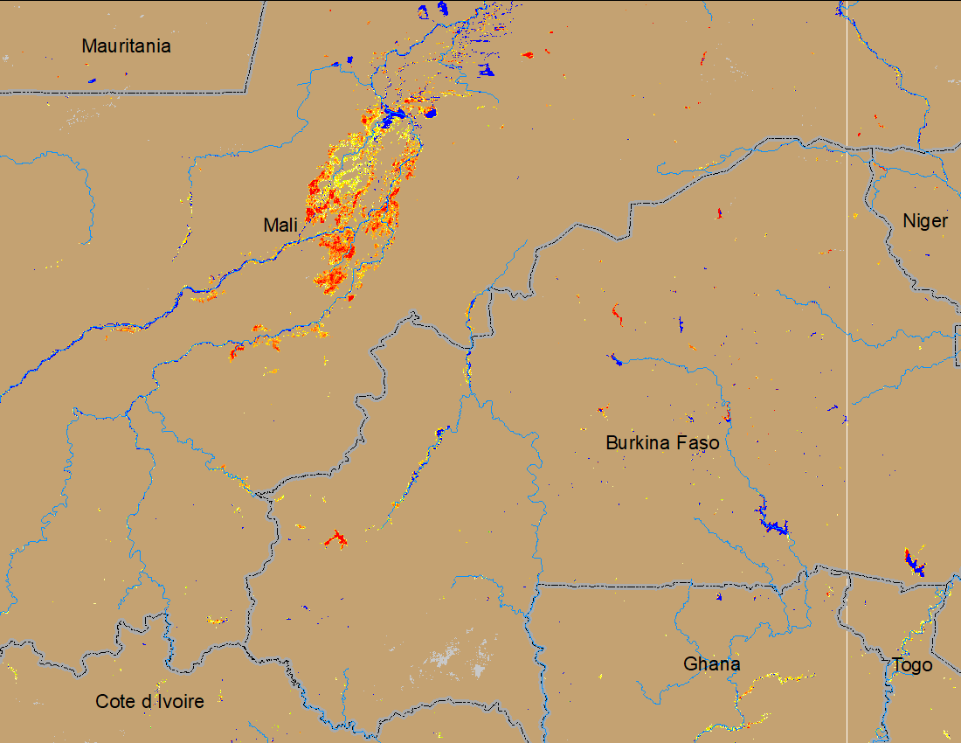
Flooding Conditions in Central Mali
FloodBase monthly flood map: September 2023
NOAA VIIRS 5-day comp.: 11 – 15 Oct 2023
Flooding conditions eased across central Mali, Burkina Faso and Northern Ghana.

Slide 5
Basin Excess Water

Slide 6
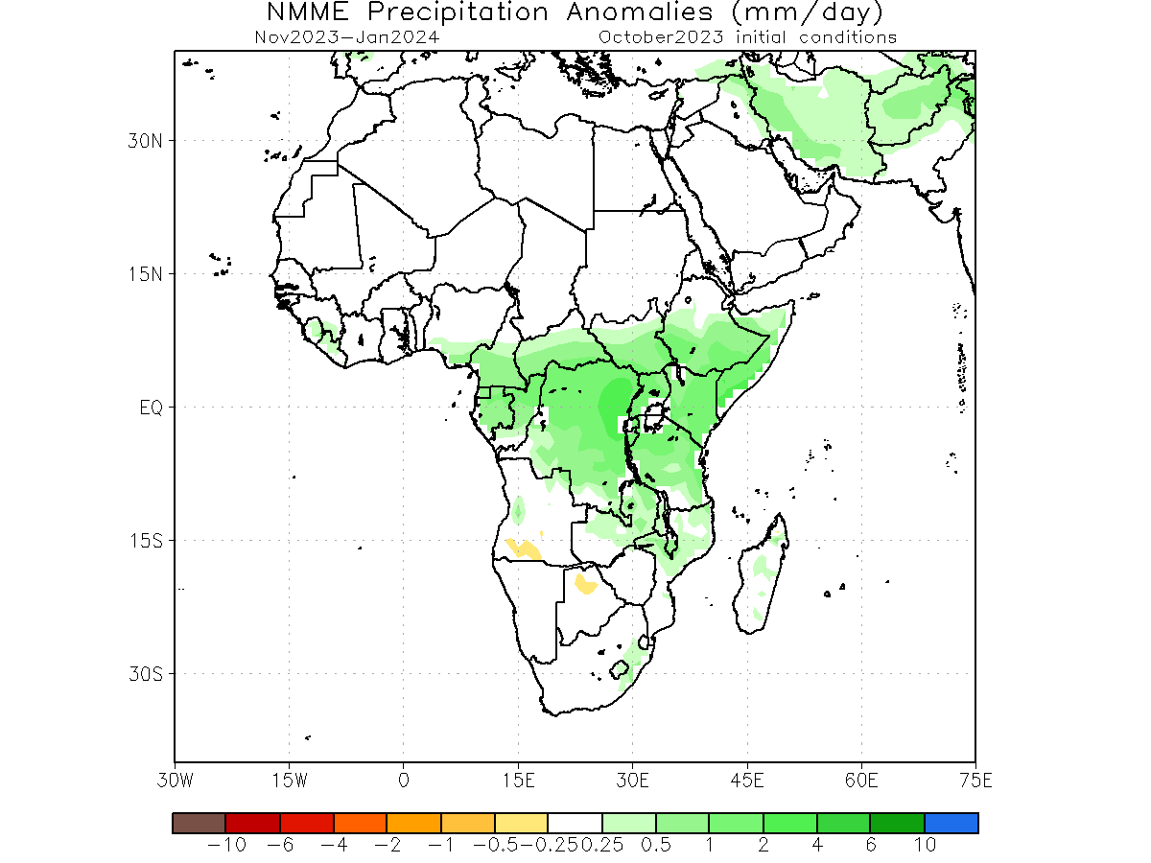
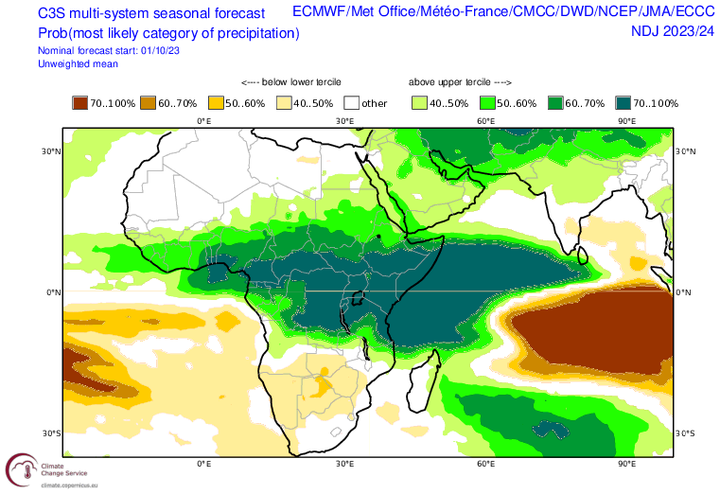
Seasonal Rainfall Forecast
Based on NMME, average rainfall is expected across the Sahel, however C3S predicts much wetter conditions than NMME in the Sahel.

Slide 7
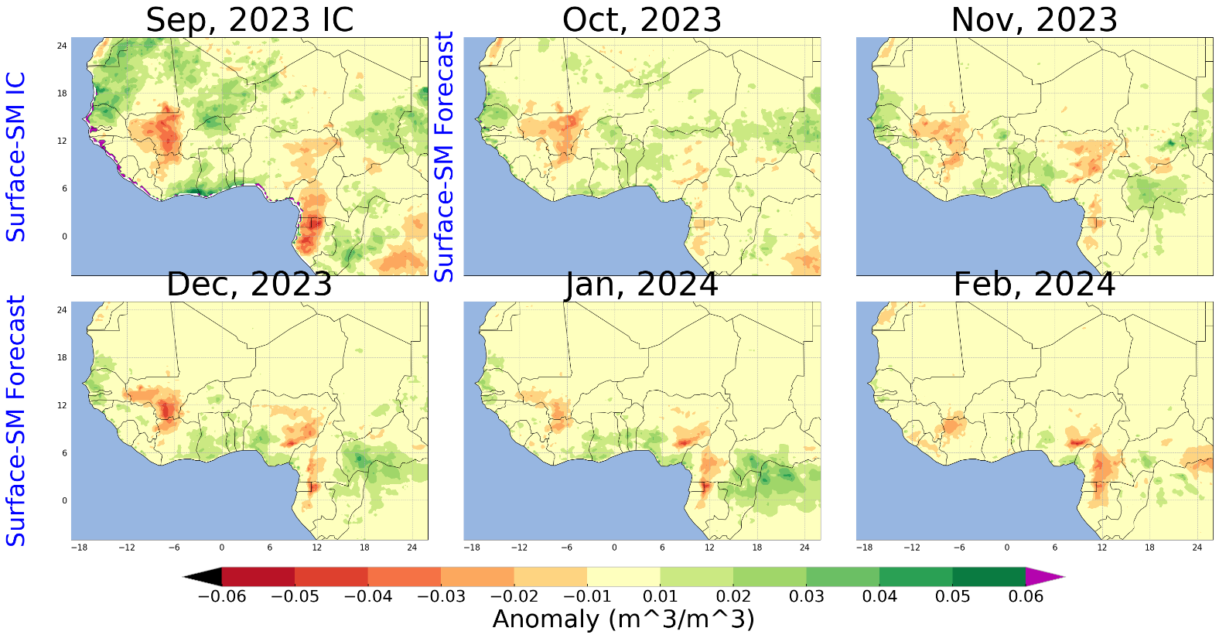
NHyFAS Soil Moisture Forecast
Surface Soil Moisture is expected to be average to below average across the Sahel except in parts of southern Ghana.

Slide 8
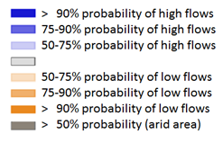
Seasonal Streamflow Forecast
Rivers along the coast as well as across Ghana are expected have average to above average streamflow.
But major rivers such as Niger and Benue along with their secondaries are expected to be average to below average streamflow.
GloFAS streamflow forecast: Oct 2023 – Jan 2024)

Slide 9
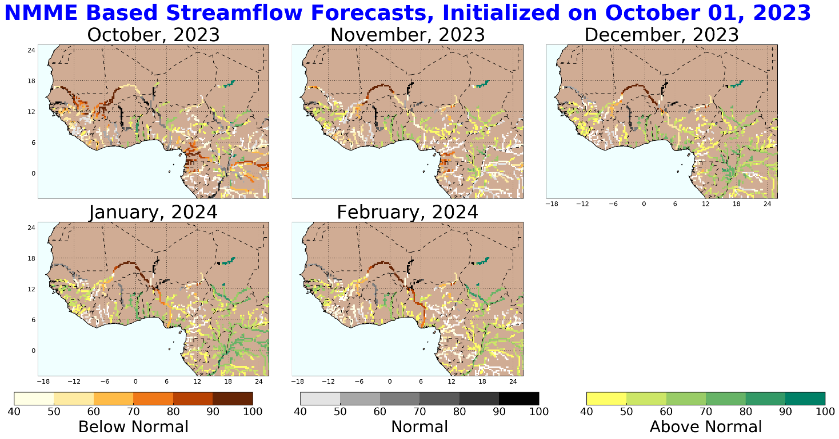
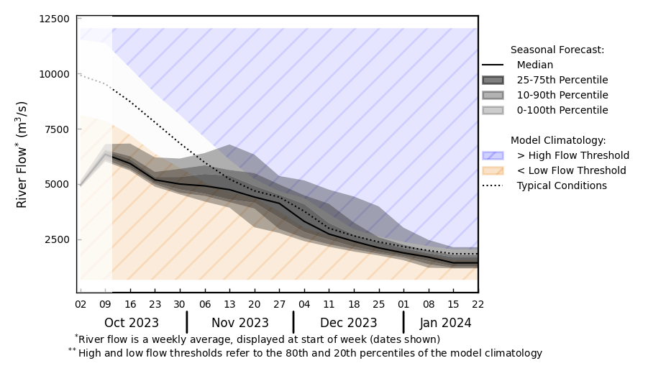
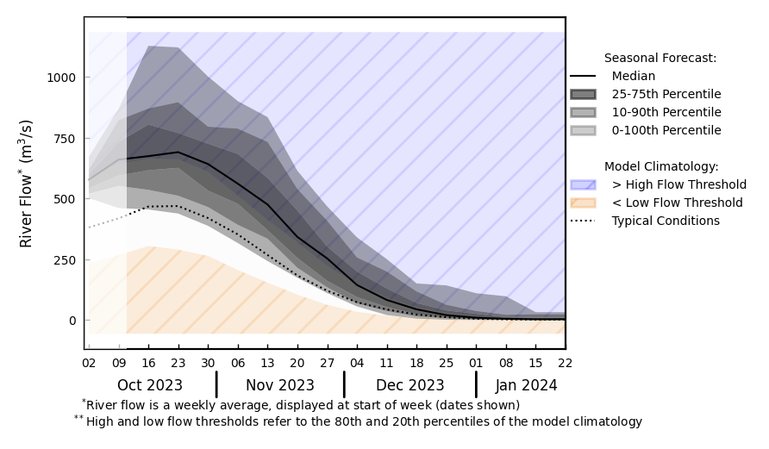
Seasonal Streamflow Forecast
@ A: Niger River in Nigeria
A
B
@ B: Volta River in Ghana
NHyFAS streamflow forecast: Oct 2023 – Feb 2024
October is the peak discharge time across major rivers of West Africa.
Discharges are below average in Niger and Benue in this peak period.
But well above average in Volta River in Ghana.
GloFAS streamflow forecast: Oct 2023 – Jan 2024

Slide 10
Flooding Risk (seasonal forecast)
October is the peak discharge period across West Africa.
Discharges are below average during this peak period in the major rivers in West Africa such as Niger and Benue.
But discharges in Volta in Ghana are above average.
Average to below average streamflow is expected in the major rivers such as Niger, Sokoto, Komadugu, Senegal, and Benue Rivers.
Well above average streamflow is expected in Volta, therefore increased likelihood of flooding along the southern parts of Ghana.

Slide 11
Assumption
Assumption 3:
Based on the above-average rainfall forecast, there is a high likelihood of isolated flooding through October and into November, particularly along the Senegal, Niger, Benue, Sokoto, Logone, and Volta, and Komadugu Rivers.
Change

