Slide 1
FEWS NET Enhanced Flood Monitoring and Forecast Assumptions-West Africa
November 2023 Seasonal Forecast
FEWS NET Science Team:
USGS, NASA, NOAA, UCSB+Regional Scientists

Slide 2
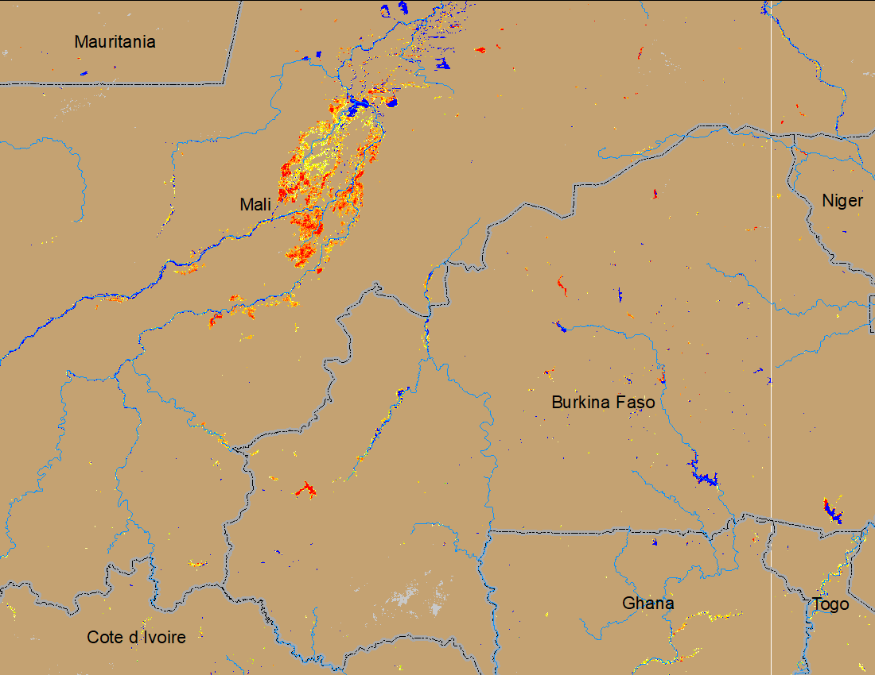
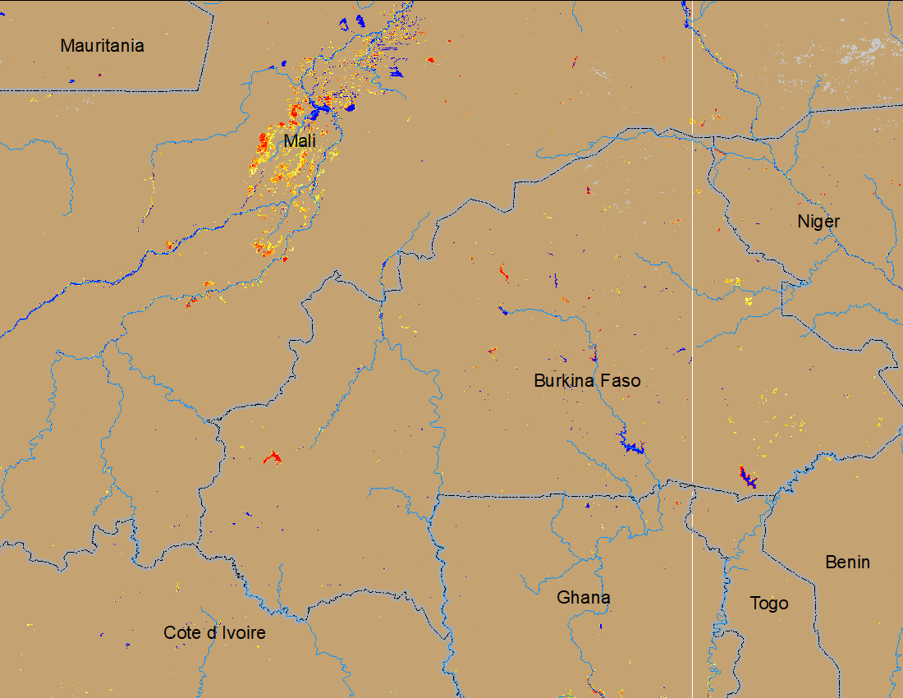
Flooding Conditions in Central Mali
NOAA VIIRS 5-day comp.: 11 – 15 Oct 2023
NOAA VIIRS 5-day comp.: 08 – 12 Nov 2023
Very little area remained inundated in central Mali and Burkina Faso.

Slide 3
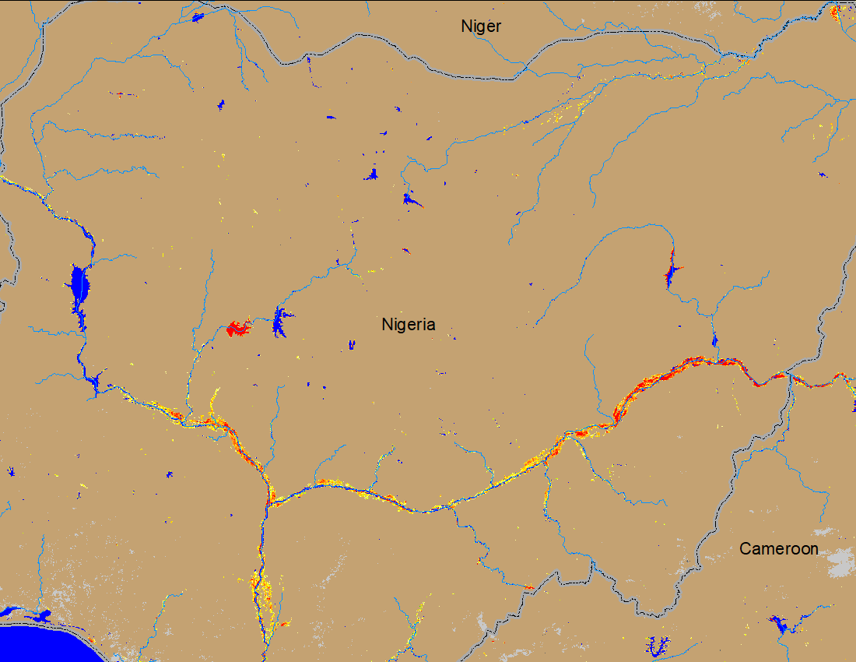
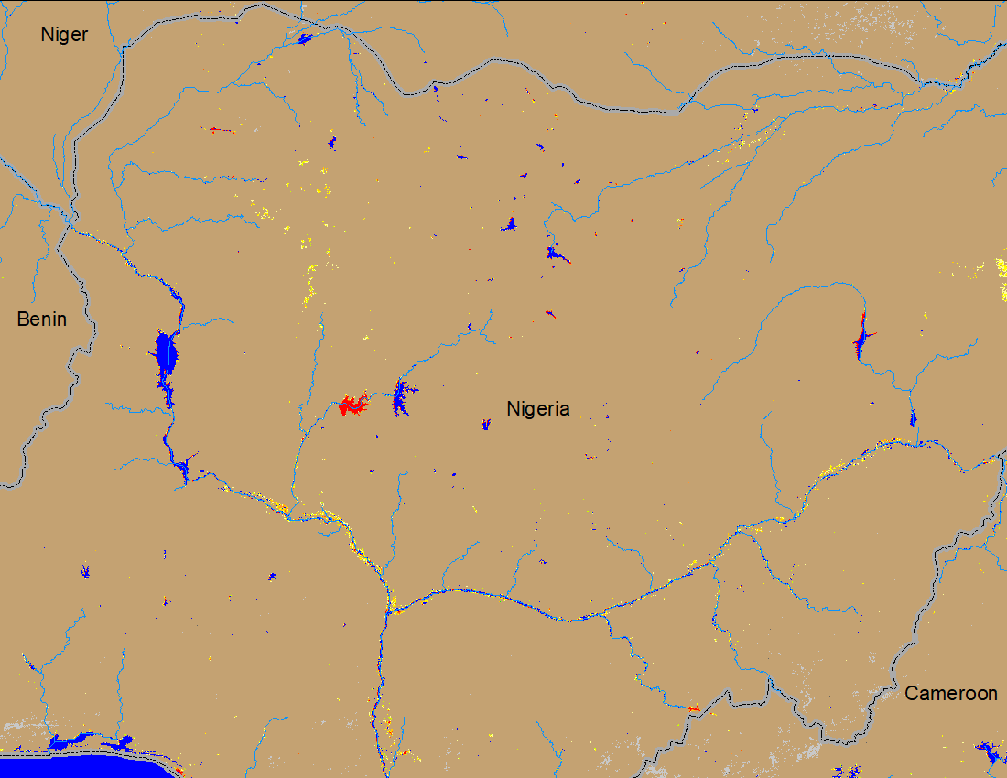
Flooding Conditions in Nigeria
(% of the pixel)
(% of the pixel)
Komadugu
Komadugu
Sokoto
Sokoto
Niger
Benue
Niger
Benue
NOAA VIIRS 5-day comp.: 11 – 15 Oct 2023
NOAA VIIRS 5-day comp.: 08 – 12 Nov 2023
Substantial improvements in flooding conditions across Nigeria.

Slide 4
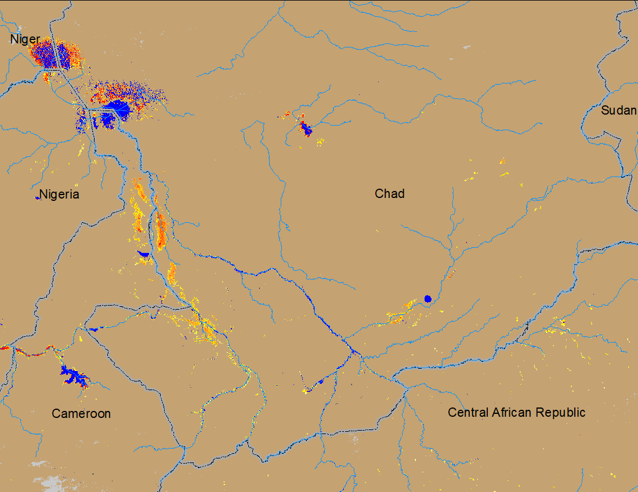
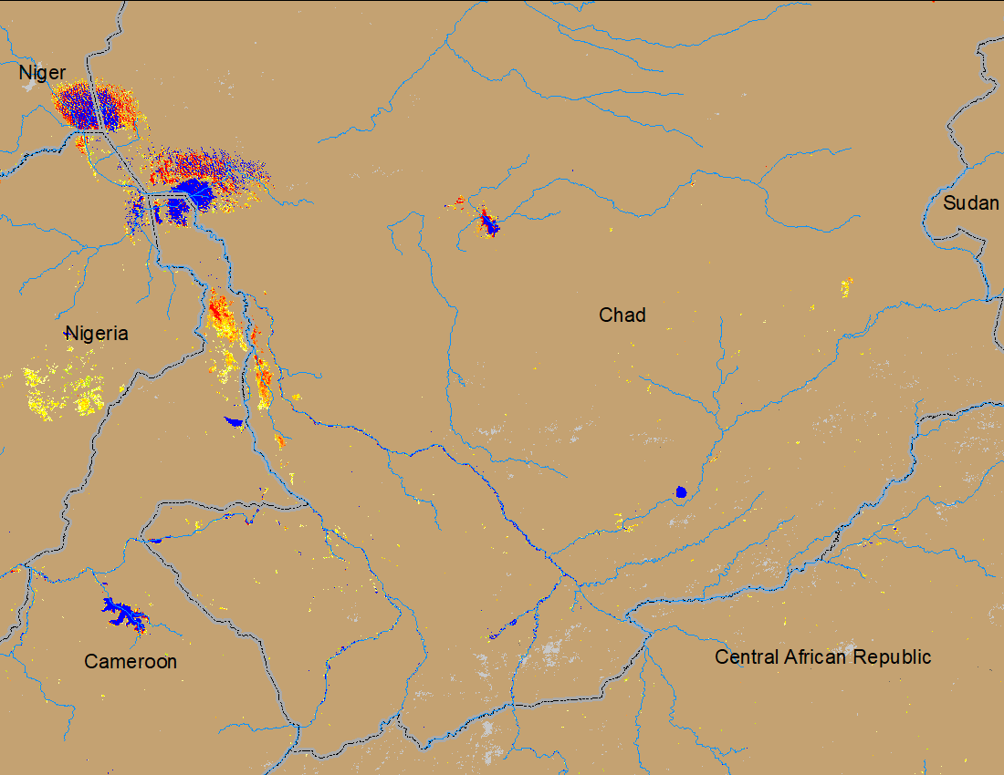
Flooding Conditions in Chad
NOAA VIIRS 5-day comp.: 11 – 15 Oct 2023
NOAA VIIRS 5-day comp.: 08 – 12 Nov 2023
Very little area remained inundated across southern Chad.

Slide 5
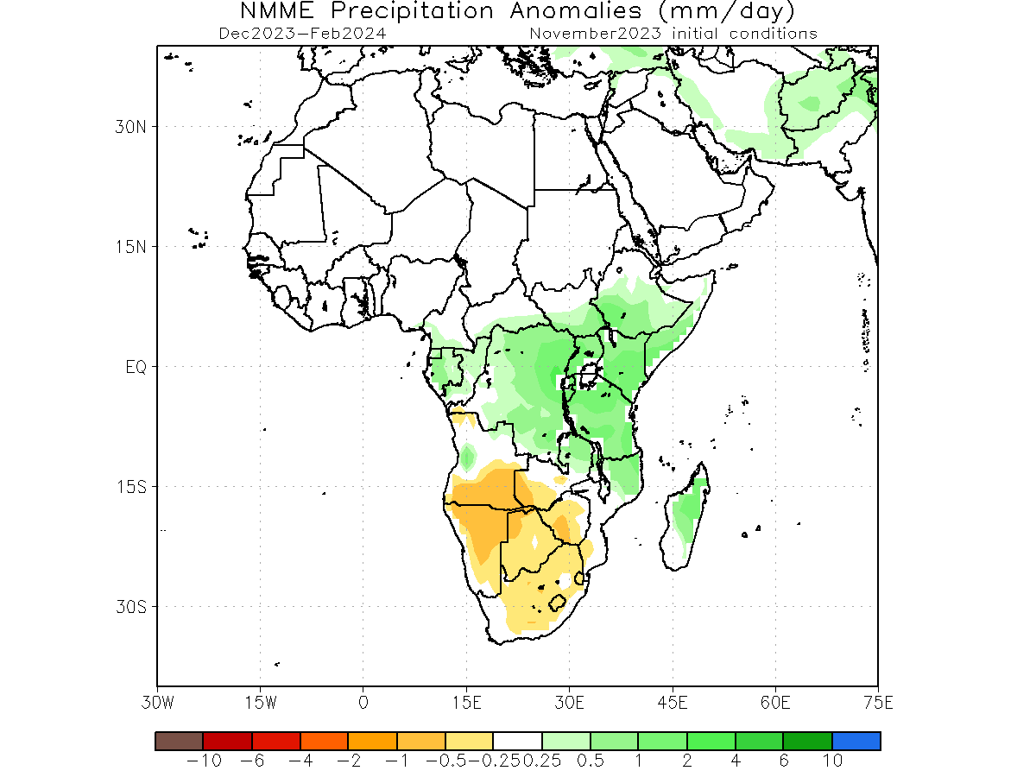
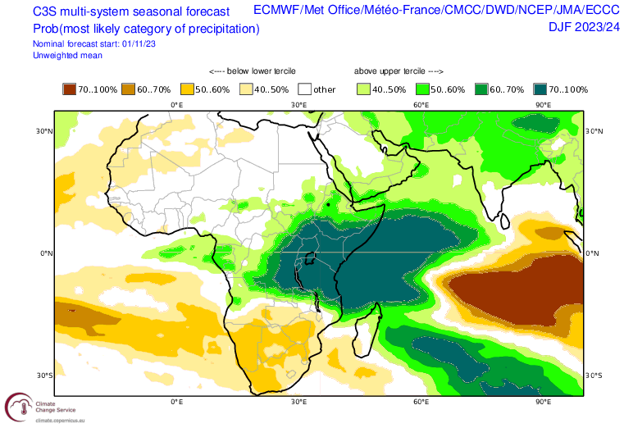
Seasonal Rainfall Forecast
Based on NMME and C3S, average rainfall is expected across the Sahel during Dec-Feb period.

Slide 6
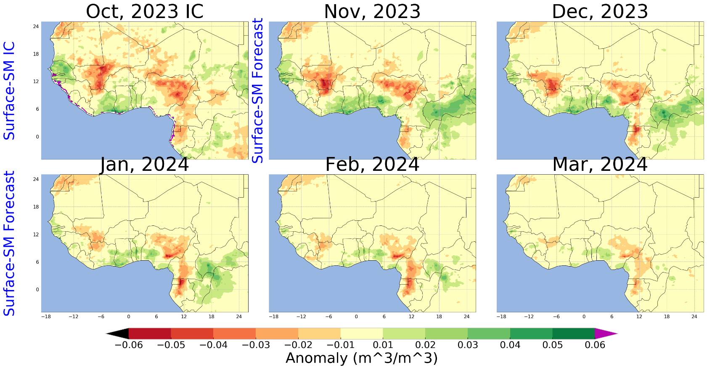
NHyFAS Soil Moisture Forecast
In response to average rainfall, surface Soil Moisture is expected to be average to below average across the Sahel.

Slide 7
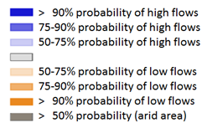
Seasonal Streamflow Forecast
As rainfall season is winding down, rivers across the region are expecting average to below average streamflow.
GloFAS streamflow forecast: (Nov 2023 – Feb 2024)

Slide 8
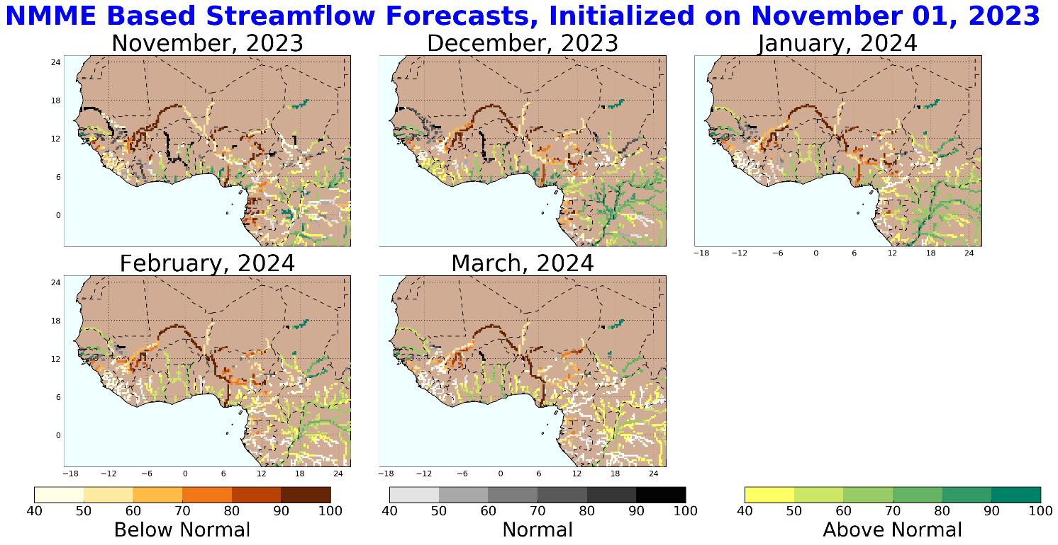
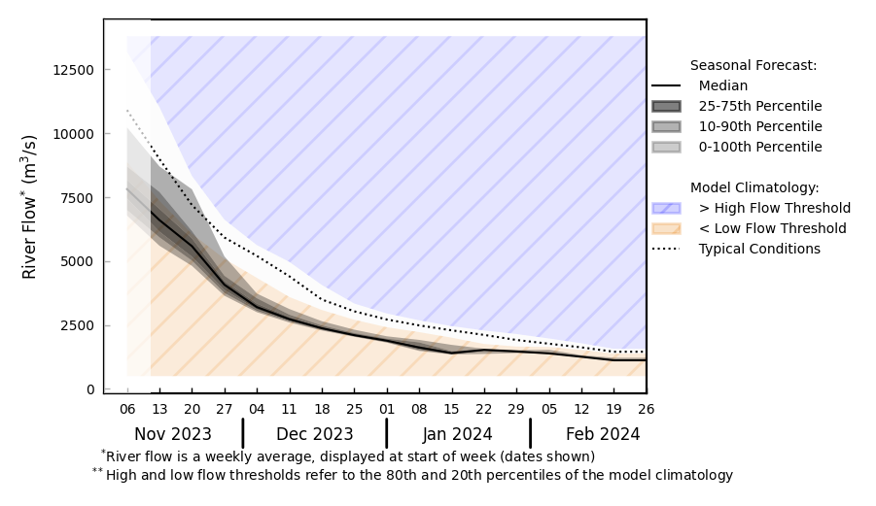
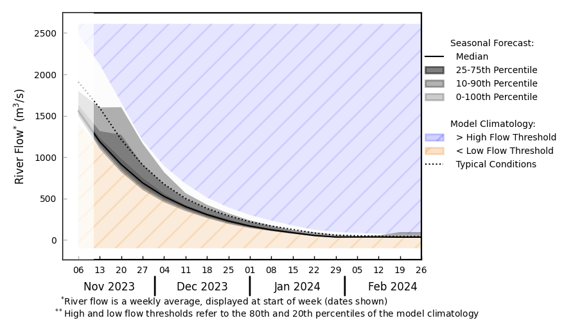
Seasonal Streamflow Forecast
@ A: Niger River in Nigeria
A
B
@ B: Volta River in Ghana
NHyFAS streamflow forecast: Nov 2023 – Mar 2024
Discharges are on the decline in the rivers across the region as rainfall season is winding down.
GloFAS streamflow forecast: Nov 2023 – Feb 2024

Slide 9
Flooding Risk (seasonal forecast)
Substantial improvements in flooding across the region.
Discharges are on the decline as rainfall season is winding down in west Africa.
Average to below average streamflow is expected across the region.
Very low risk of flooding in the region.

