Slide 1
FEWS NET Enhanced Flood Monitoring and Forecast Assumptions-East Africa and Yemen
October 2023 Seasonal Forecast
FEWS NET Science Team:
USGS, NASA, NOAA, UCSB+Regional Scientists

Slide 2
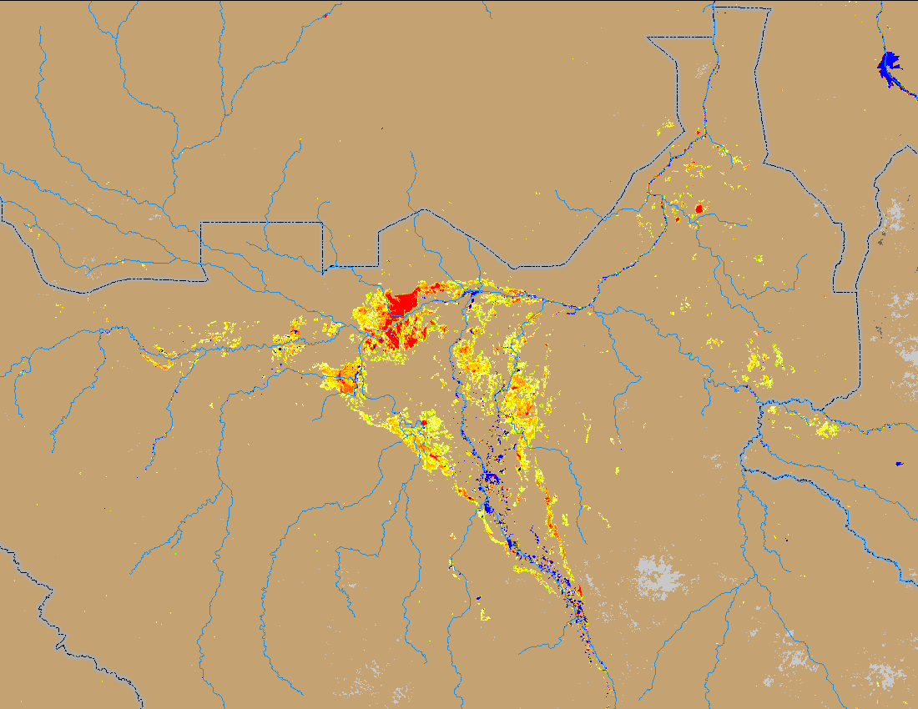
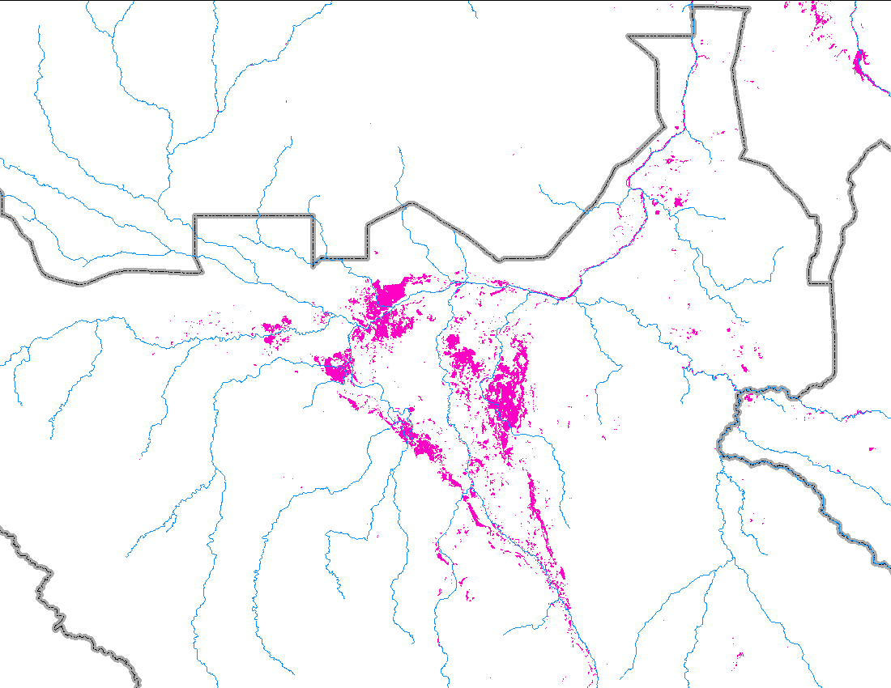
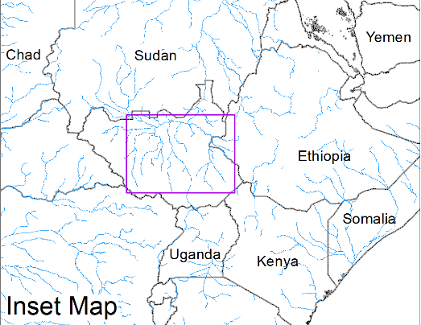
Flooding Conditions in South Sudan
(% of the pixel)
White Nile
Sobet
Akobo
Pibor
FloodBase flood map: September 2023
NOAA VIIRS 5-day comp.: 11 – 15 Oct 2023
Current flood extent remained unchanged by mid-October in South Sudan.

Slide 3
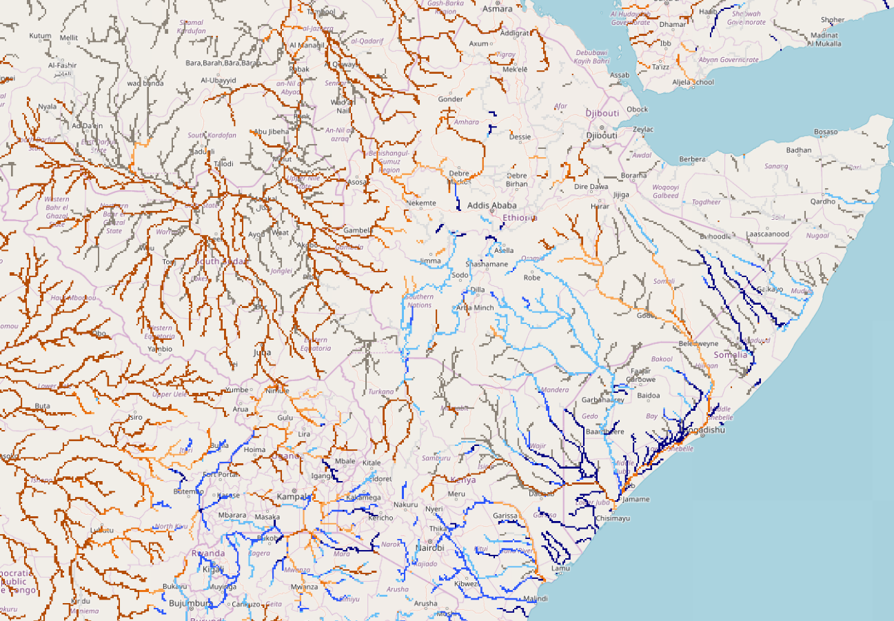
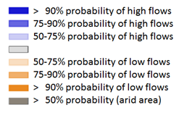
Seasonal Streamflow Forecast
Average to below average streamflow is the forecast along White Nile, Sobet, Akobo, Pibor, and Nile Rivers in South Sudan and Sudan.
Whereas rivers in southern Ethiopia, Kenya, Uganda, and Somalia including Juba are expected to have above average streamflow.
GloFAS streamflow forecast: Oct 2023 – Jan 2024)

Slide 4
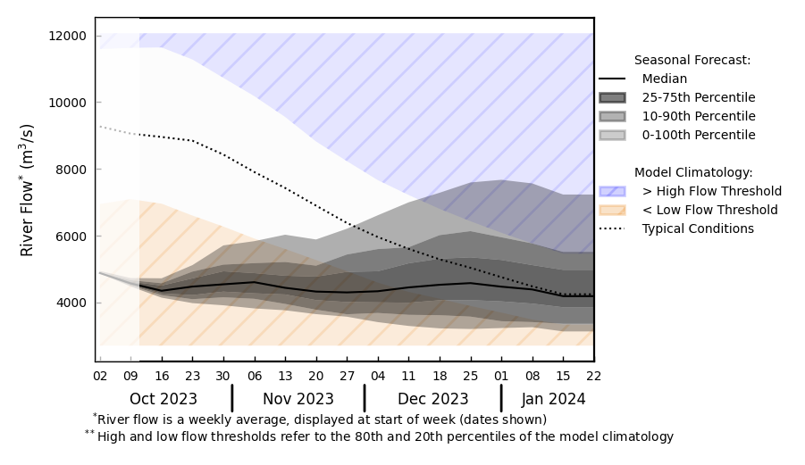
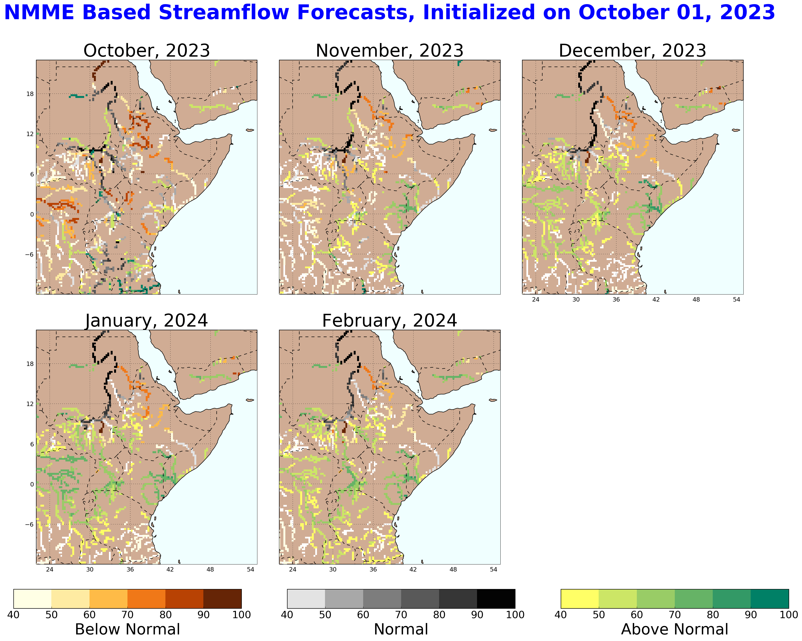
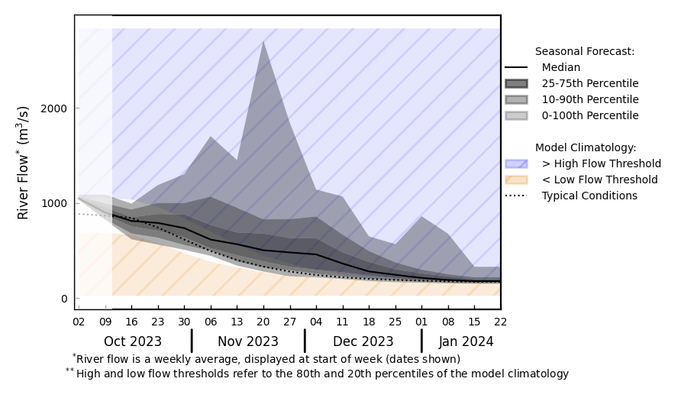
Seasonal Streamflow Forecast
@ point A: White Nile, South Sudan
A
B
@ point B: Juba, Somalia
NHyFAS streamflow forecast: Oct 2023 – Feb 2024
Similarly average to below average streamflow during Oct-Nov but expected to be above average in Dec-Feb over South Sudan and Sudan.
Above average streamflow over Southern Kenya and Somalia.
GloFAS streamflow forecast: Oct 2023 – Jan 2024

Slide 5
Seasonal Streamflow Forecast (Yemen)
NHyFAS streamflow forecast: Oct 2023 – Feb 2024
GloFAS streamflow forecast (Oct 2023 – Jan 2024)
Wadis in western Yemen are expected to have below average streamflow, risk of flooding is relatively low.

Slide 6
Flooding Risk (seasonal forecast)
While average to below average streamflow is the forecast over South Sudan and eastern Sudan, the higher than average September/mid-October extent is concerning to contribute to further devastating flooding with few events of higher than normal rainfall in the region.
Considering bothe GloFAS and NHyFAS seasonal forecast, the risk of flooding in Juba is greater than it is in Shabelle.
Suggested change for 2c. Flooding is likely in northern and eastern Keyna, Somalia, and southern and southeastern Ethiopia associated with the high likelihood of significant rainfall during the short rains/deyr season. High levels of flooding is expected in Ethiopia predominately along riverine areas of the Juba, Shebelle and in the lowlands of the Genale Dawa river catchments and the plains of Boren Zone of Oromia and South regions and southern lowland plains of the Somali Region

