Slide 1
FEWS NET Enhanced Flood Monitoring and Forecast Assumptions-East Africa and Yemen
November 2023 Seasonal Forecast
FEWS NET Science Team:
USGS, NASA, NOAA, UCSB+Regional Scientists

Slide 2
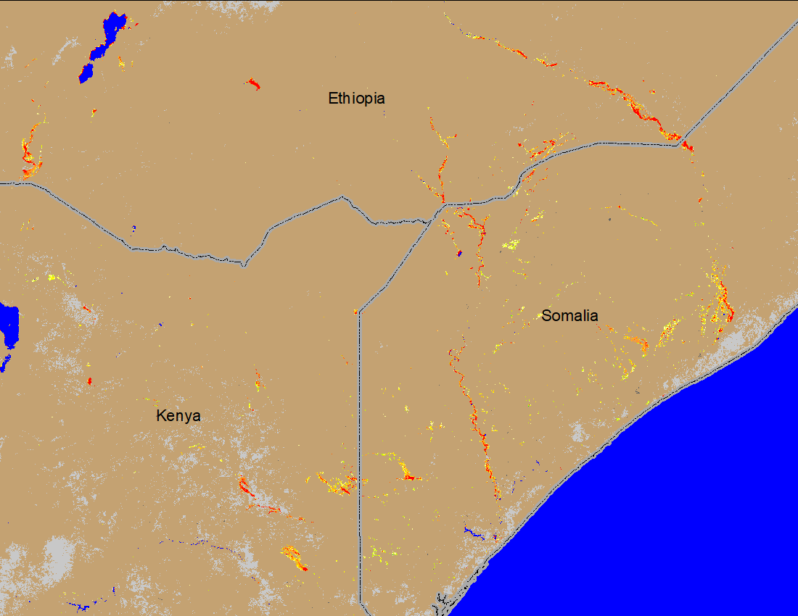
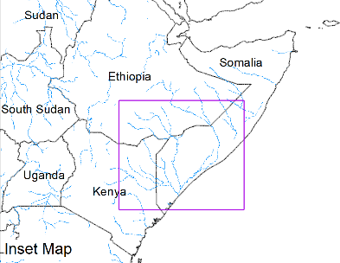
Flooding Conditions in Ethiopia, Kenya, and Somalia
(% of the pixel)
Beletweyne
Dollow
Luuq
Bardheere
Bualle
NOAA VIIRS 5-day comp.: 08 – 12 Nov 2023
SWALIM Observed water levels: 12 November 2023
Widespread flooding in southern Ethiopia, eastern Kenya, and southern Somalia.
Juba River running at bankfull, upper Shabelle is at bankfull as well.

Slide 3
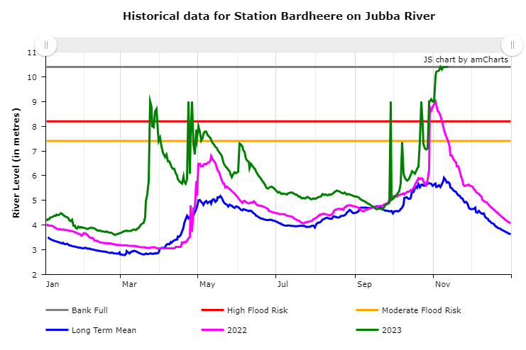
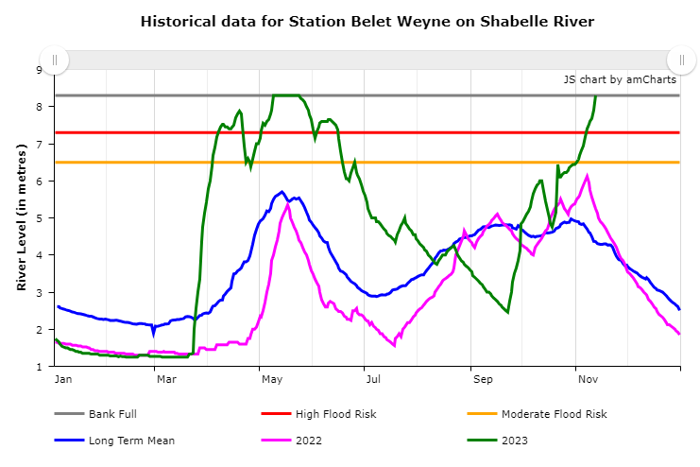
Juba & Shabelle Water Level on Nov 13th, 2023
Juba reached to bankfull few days sooner than Shabelle, currently both Juba and upper Shabelle are at bankfull.

Slide 4
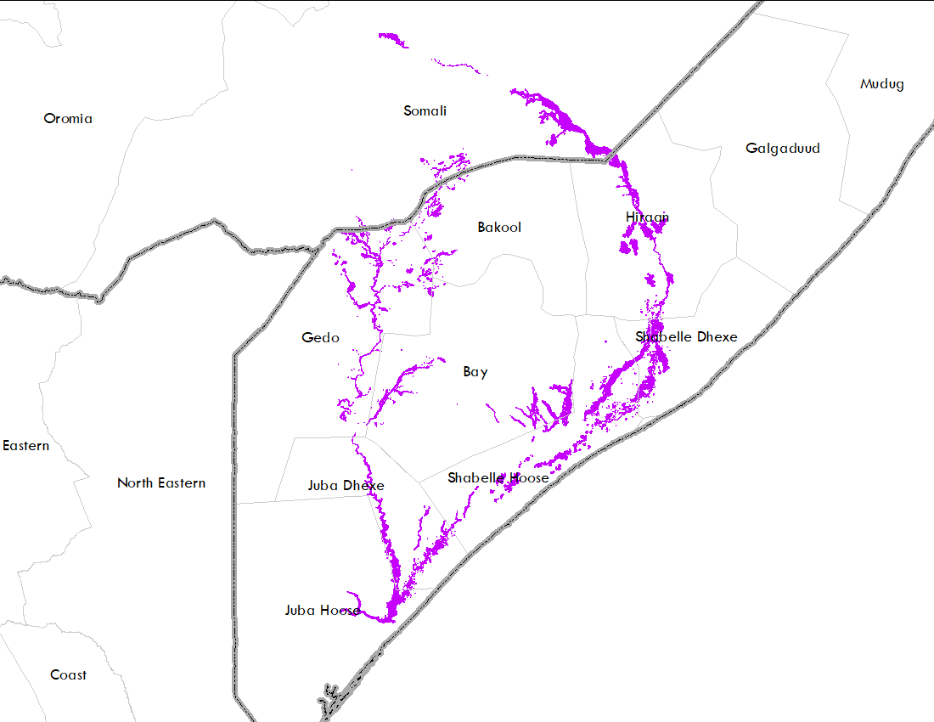
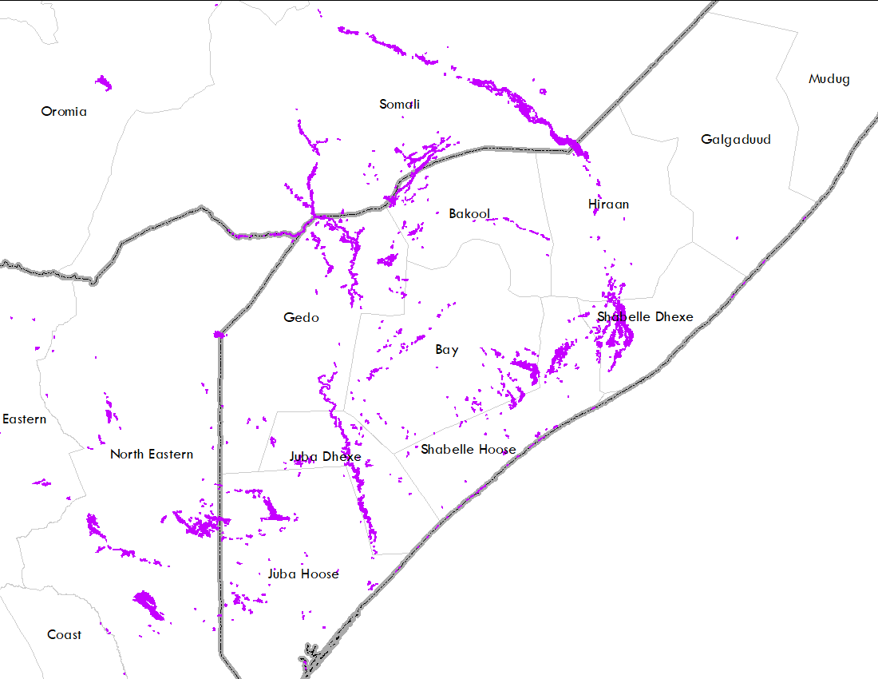
Recent Flooding in Ethiopia & Somalia Compared to 1997
Oct-Dec of 1997
NOAA VIIRS 5-day comp.: 08 – 12 Nov 2023
Current inundation pattern in Ethiopia and Somalia is very similar to Oct-Dec flooding of 1997.

Slide 5
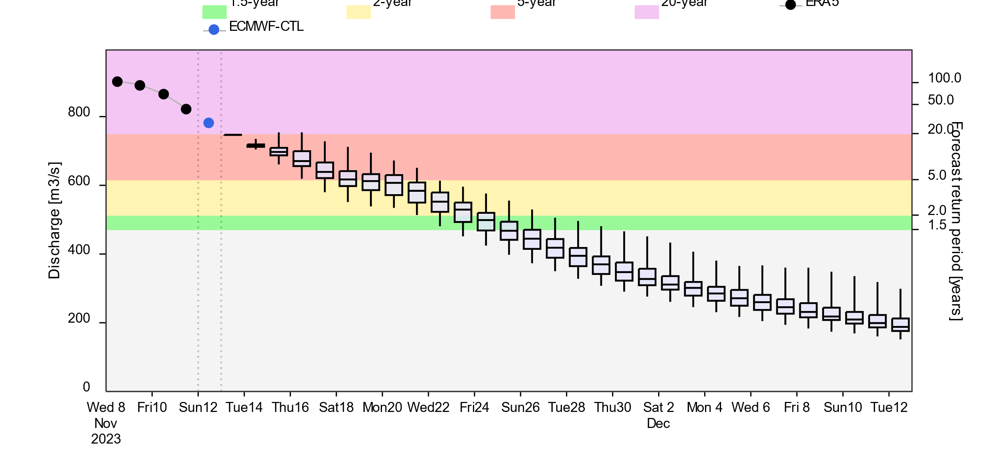
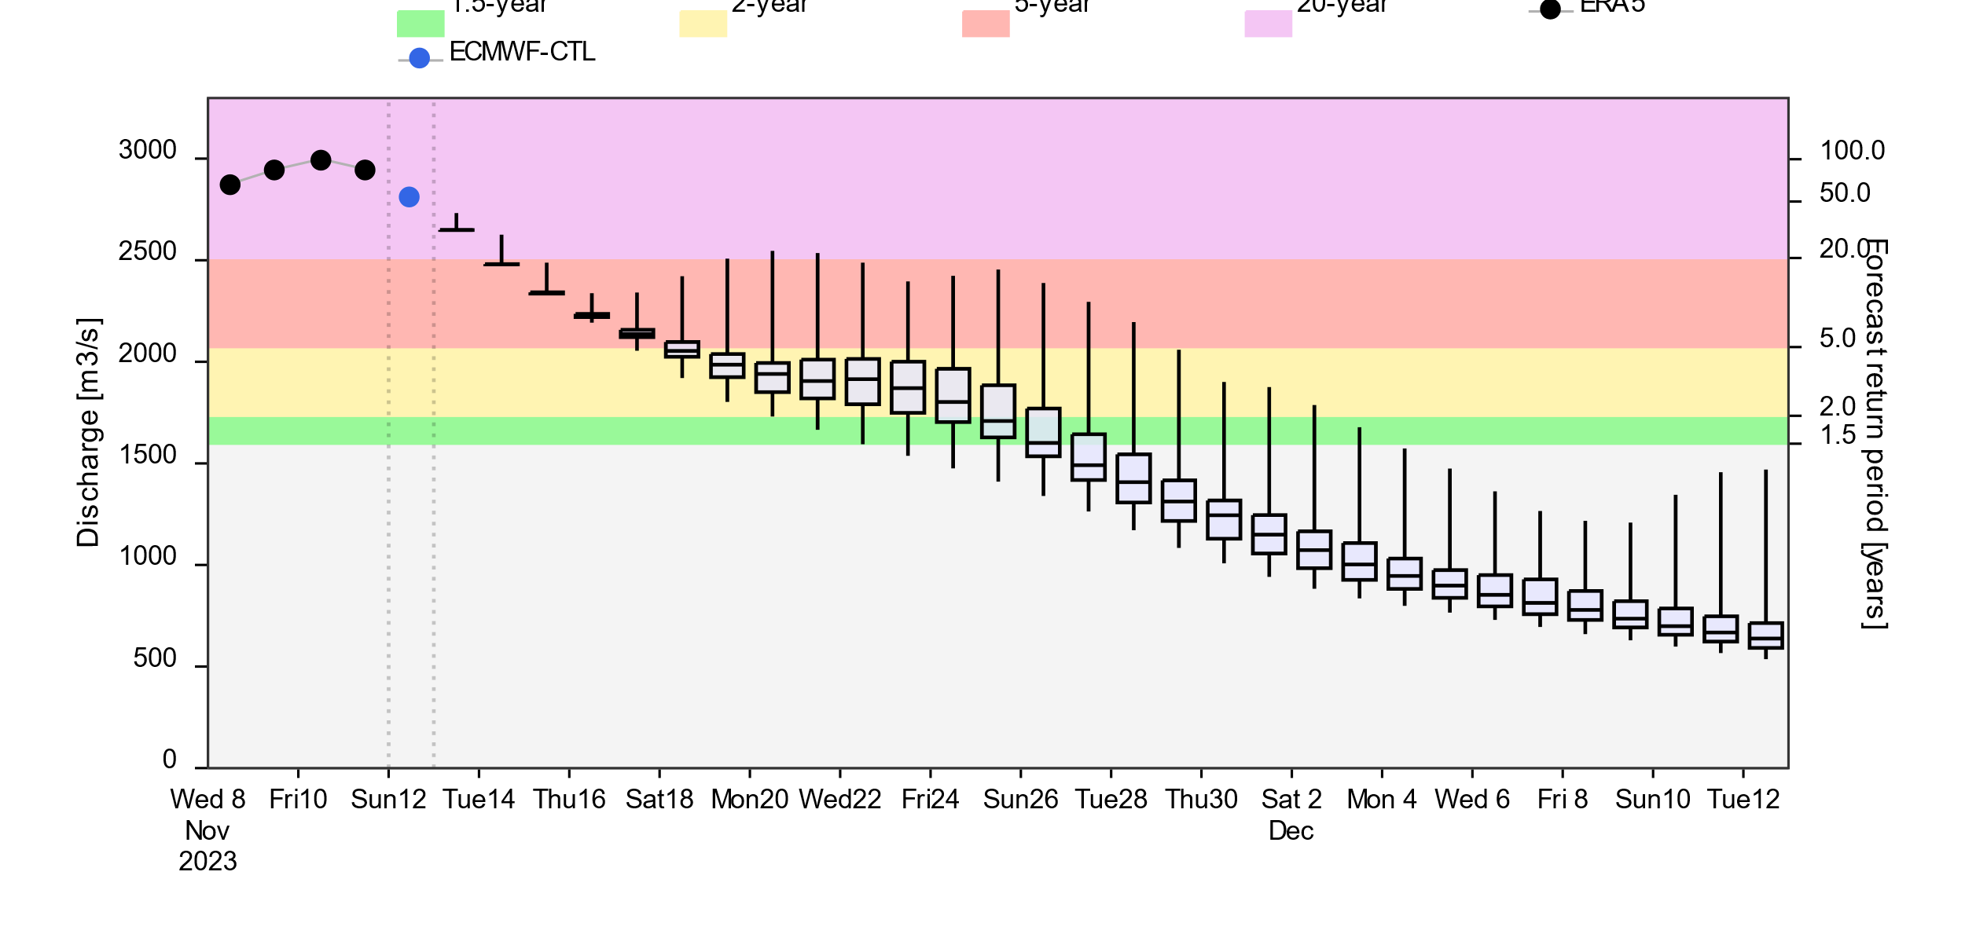
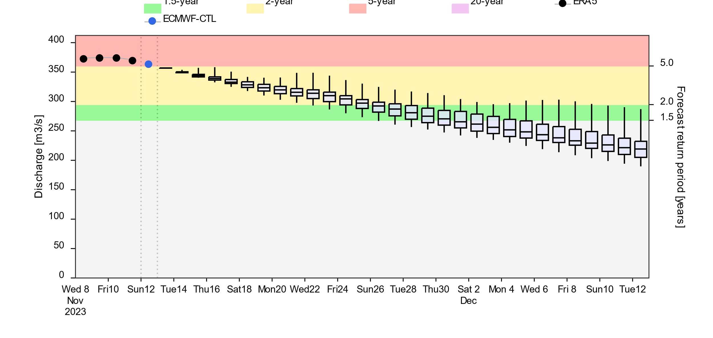
Next One Month Streamflow Forecast
2-yr 5-yr 20-yr
Ethiopia
Uganda
Somalia
GloFAS streamflow forecast: (12 Nov – 12 Dec 2023)
GloFAS streamflow forecast: 12 Nov – 12 Dec 2023)
High likelihood of Juba discharge in Ethiopia and Somalia to be at 5-yr to 20-yr return period level until late November.
River discharges in southeastern Uganda are likely to be at 5-yr return period level as well.

Slide 6
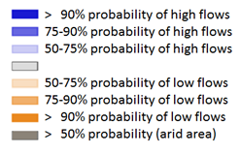
Seasonal Streamflow Forecast
Average to below average streamflow is the forecast along White Nile, Sobet, Akobo, Pibor, and Nile Rivers in South Sudan and Sudan.
Whereas rivers in southern Ethiopia, Kenya, Uganda, Somalia, and eastern DRC are expected to have above average streamflow.
GloFAS streamflow forecast: Nov 2023 – Feb 2024)

Slide 7
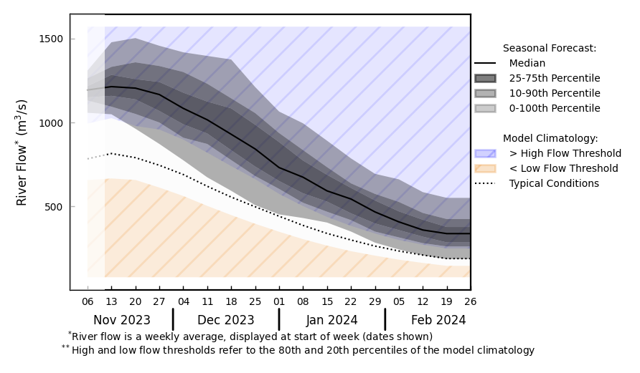
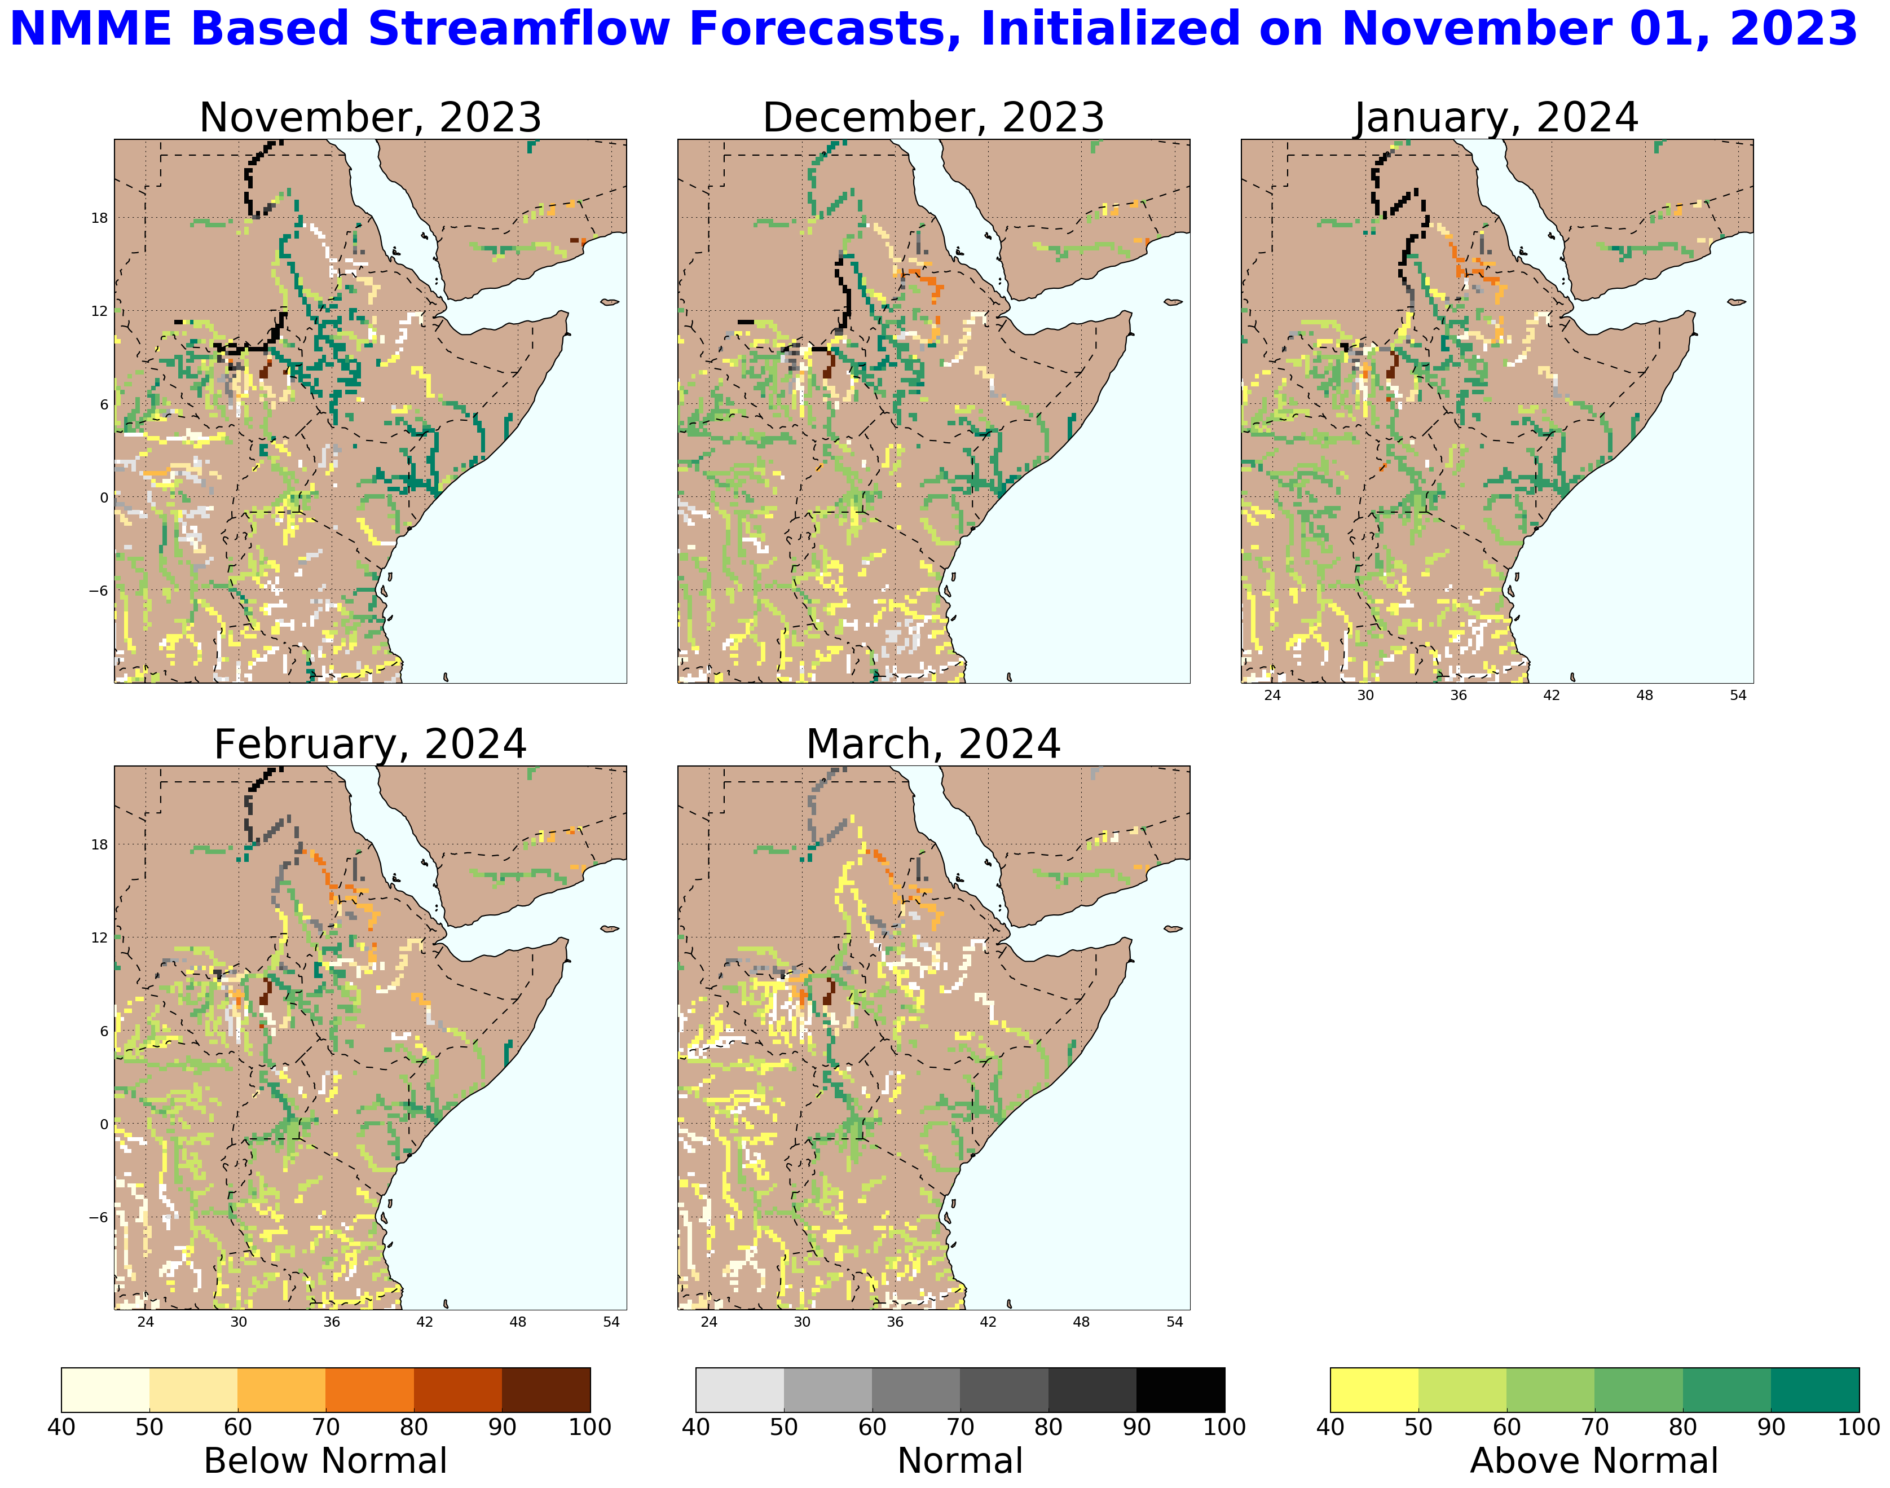
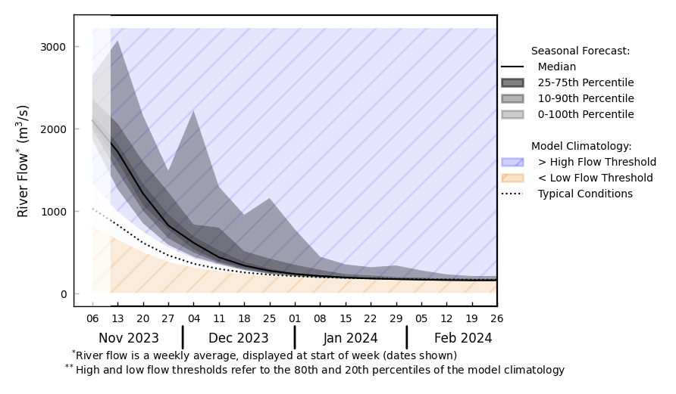
Seasonal Streamflow Forecast
@ point A: Victoria Nile, Uganda
A
B
@ point B: Juba, Somalia
NHyFAS streamflow forecast: Nov 2023 – Mar 2024
Similarly average streamflow during Nov-Dec but expected to be above average in Jan-Feb over South Sudan and Sudan.
Above average streamflow over Uganda, eastern Kenya, southern Ethiopia and Somalia.
GloFAS streamflow forecast: Nov 2023 – Feb 2024

Slide 8
Questions for Science Partners
EAST AFRICA
May we request an additional assumption on most likely flood return period? We saw in this press release a statement that FAO SWALIM projects 1 in 100 year flooding. And we aren’t sure if this accords with the science team’s latest analysis.
Answer:
Based on GloFAS monthly forecast with respect to return periods, discharges in the Juba River in Ethiopia and Somalia are most likely to reach at a 5-year to 20-year return period level. Forecast also suggest widespread flooding is more likely in the Juba catchment (including eastern Kenya) than it is in the Shabelle catchment.

Slide 9
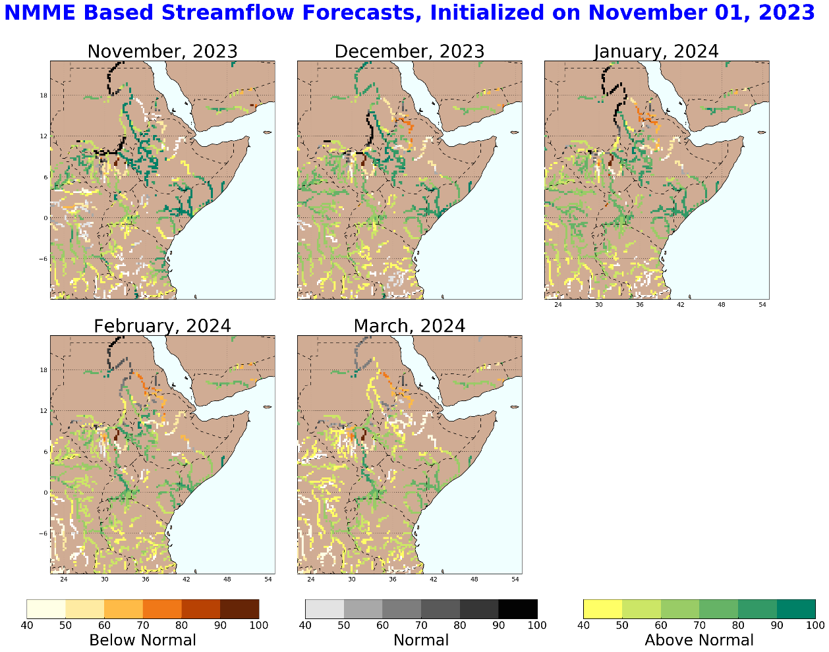
Seasonal Streamflow Forecast (Yemen)
NHyFAS streamflow forecast: Nov 2023 – Mar 2024
GloFAS streamflow forecast (Nov 2023 – Feb 2024)
Wadis in western Yemen are expected to have below average streamflow, risk of flooding is relatively low.

