Slide 1
FEWS NET Enhanced Flood Monitoring and Forecast Assumptions-Afghanistan
October 2023 Seasonal Forecast
FEWS NET Science Team:
USGS, NASA, NOAA, UCSB+Regional Scientists

Slide 2
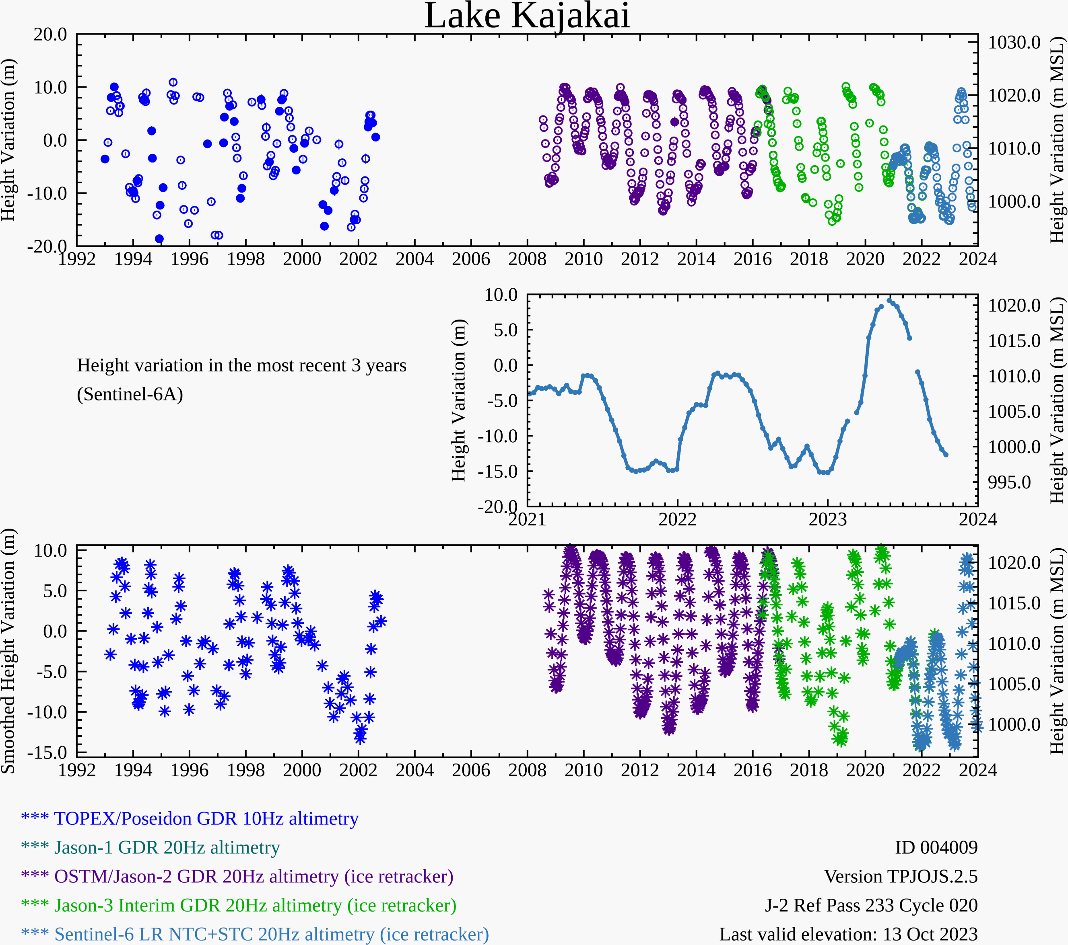
Water Level at Kajakai Reservoir in the Helmand basin (as of Oct 13, 2023)
Zeid
Kajakai
Istadehye
Jehil
Arghandab
USDA monitoring reservoirs
Hydroweb has additional monitoring points along major rivers but none of them matched with the names provided by Fahim
Water level in the Kajakai reservoir are on the decline as expected during the dry period.

Slide 3
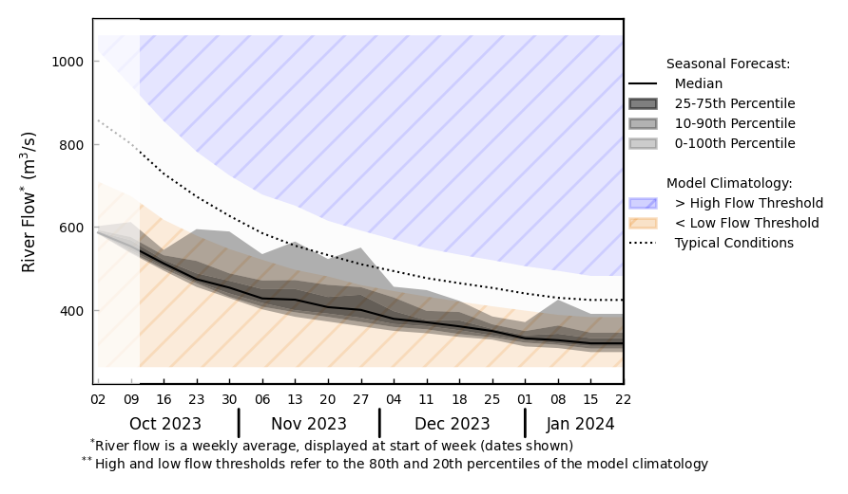
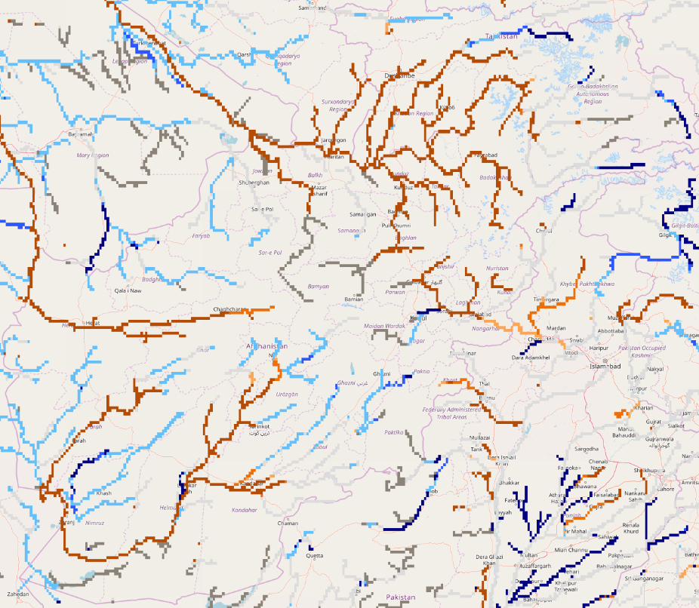
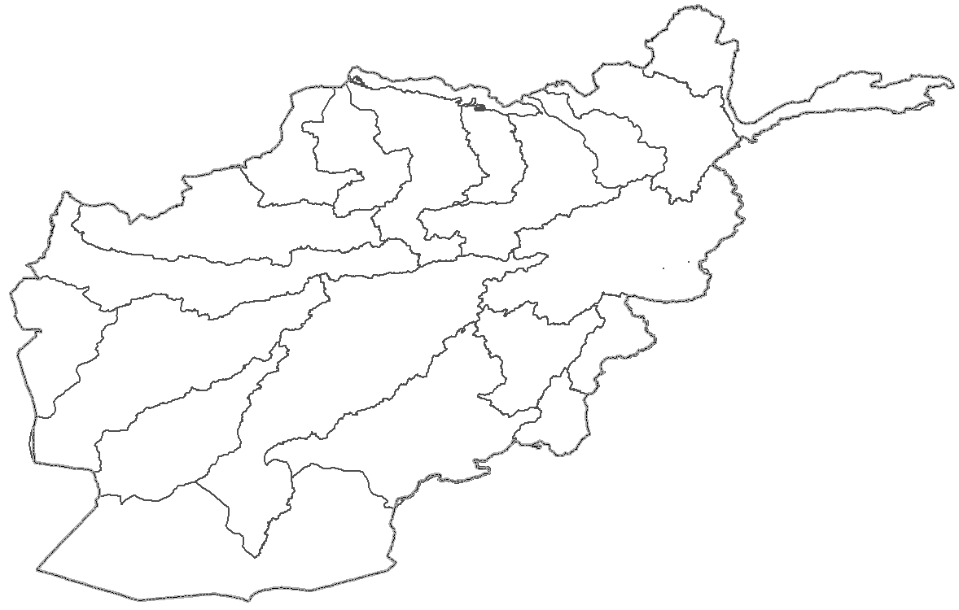
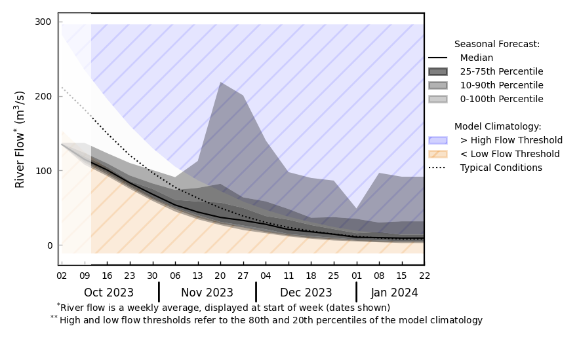
Streamflow Forecast for Afghanistan
@ point A: Amu Darya
A
B
@ point B: Kabul River
GloFAS seasonal forecast Oct 2023 - Jan 2024
Typical dry conditions are expected.
GloFAS monthly forecast (Oct 2023 – Jan 2024)

