Slide 1
FEWS NET Enhanced Flood Monitoring and Forecast Assumptions-Afghanistan
November 2023 Seasonal Forecast
FEWS NET Science Team:
USGS, NASA, NOAA, UCSB+Regional Scientists

Slide 2
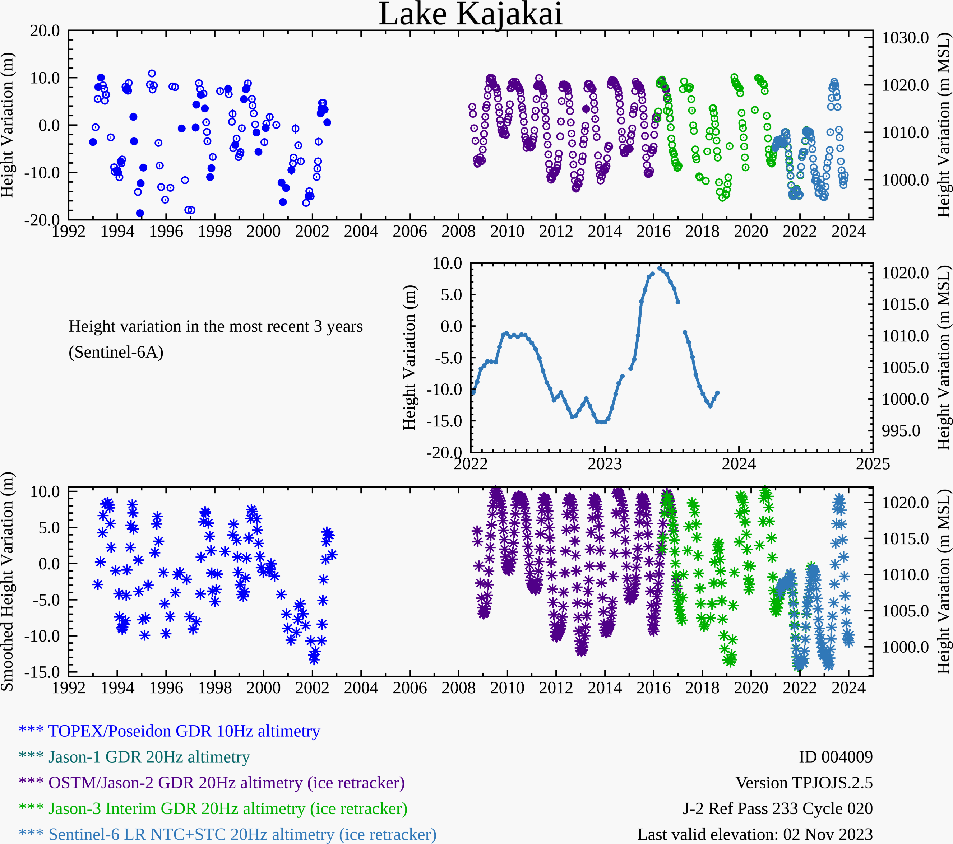
Water Level at Kajakai Reservoir in the Helmand basin (as of Nov 02, 2023)
Zeid
Kajakai
Istadehye
Jehil
Arghandab
USDA monitoring reservoirs
Hydroweb has additional monitoring points along major rivers but none of them matched with the names provided by Fahim
Typical low water level in the Kajakai reservoir during the dry period, but at least better than last two dry seasons.

Slide 3
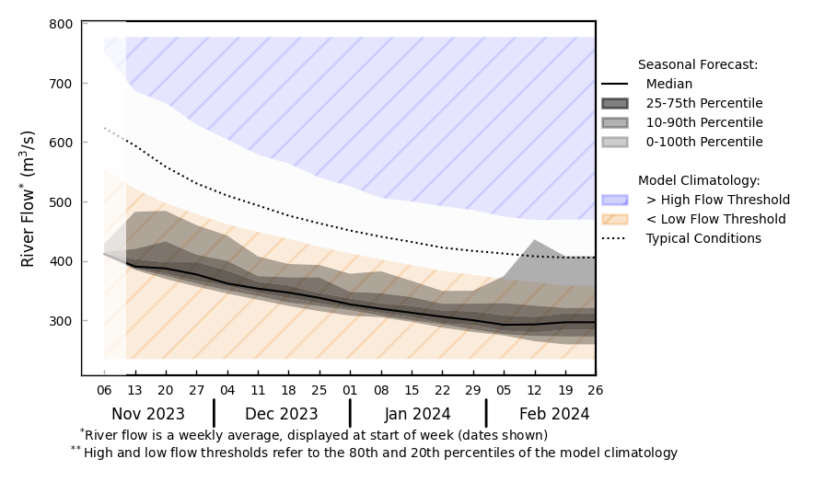
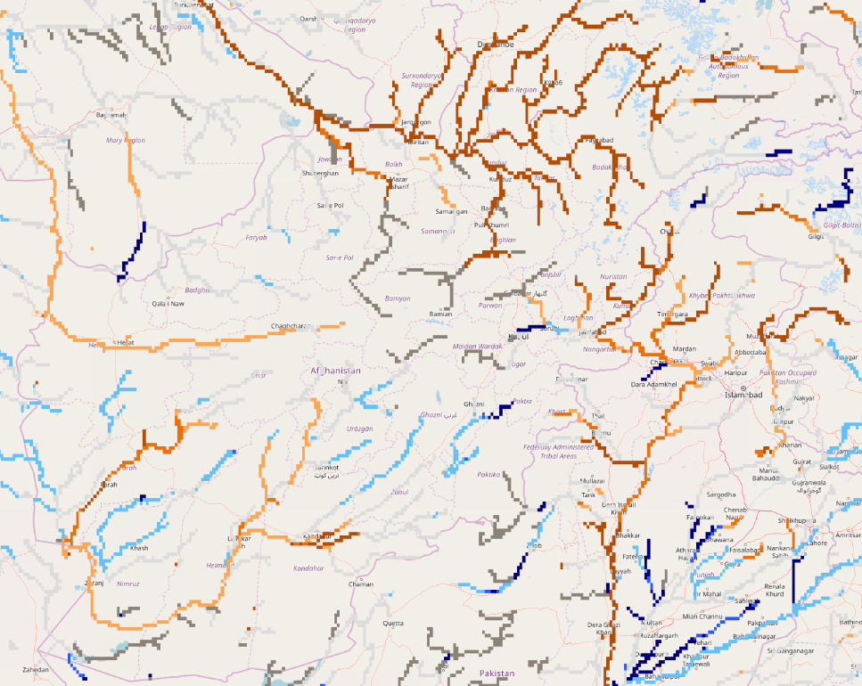
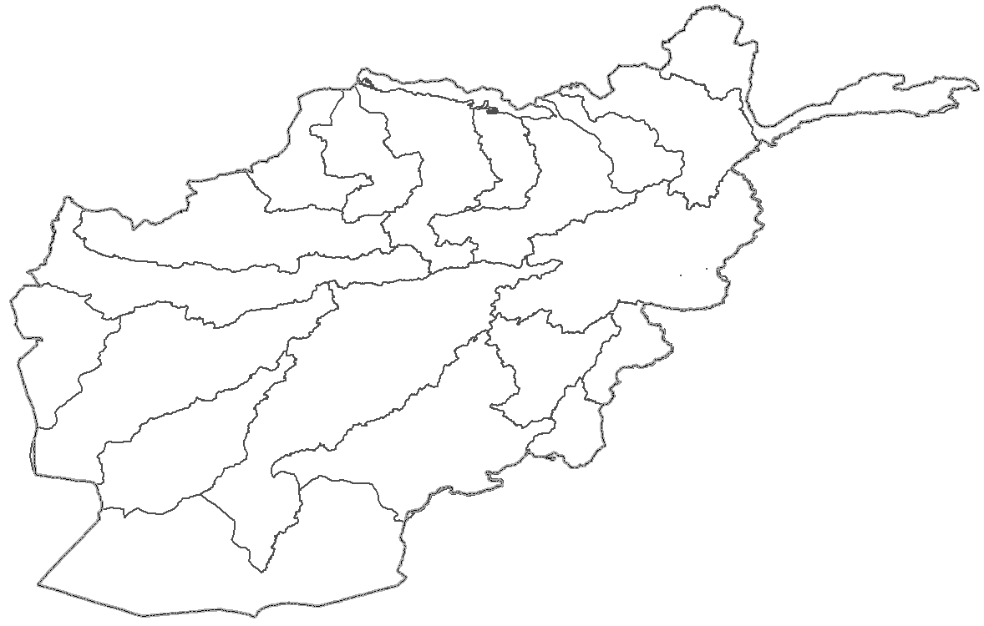
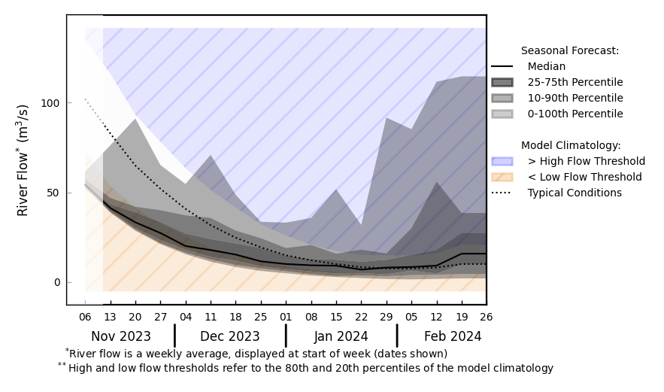
Streamflow Forecast for Afghanistan
@ point A: Amu Darya
A
B
@ point B: Kabul River
GloFAS seasonal forecast Nov 2023 - Feb 2024
Typical dry conditions are expected at least until the end of the year.
GloFAS monthly forecast (Nov 2023 – Feb 2024)

