Slide 1
FEWS NET Enhanced Flood Monitoring and Forecast Assumptions-Afghanistan
December 2023 Seasonal Forecast
FEWS NET Science Team:
USGS, NASA, NOAA, UCSB+Regional Scientists

Slide 2
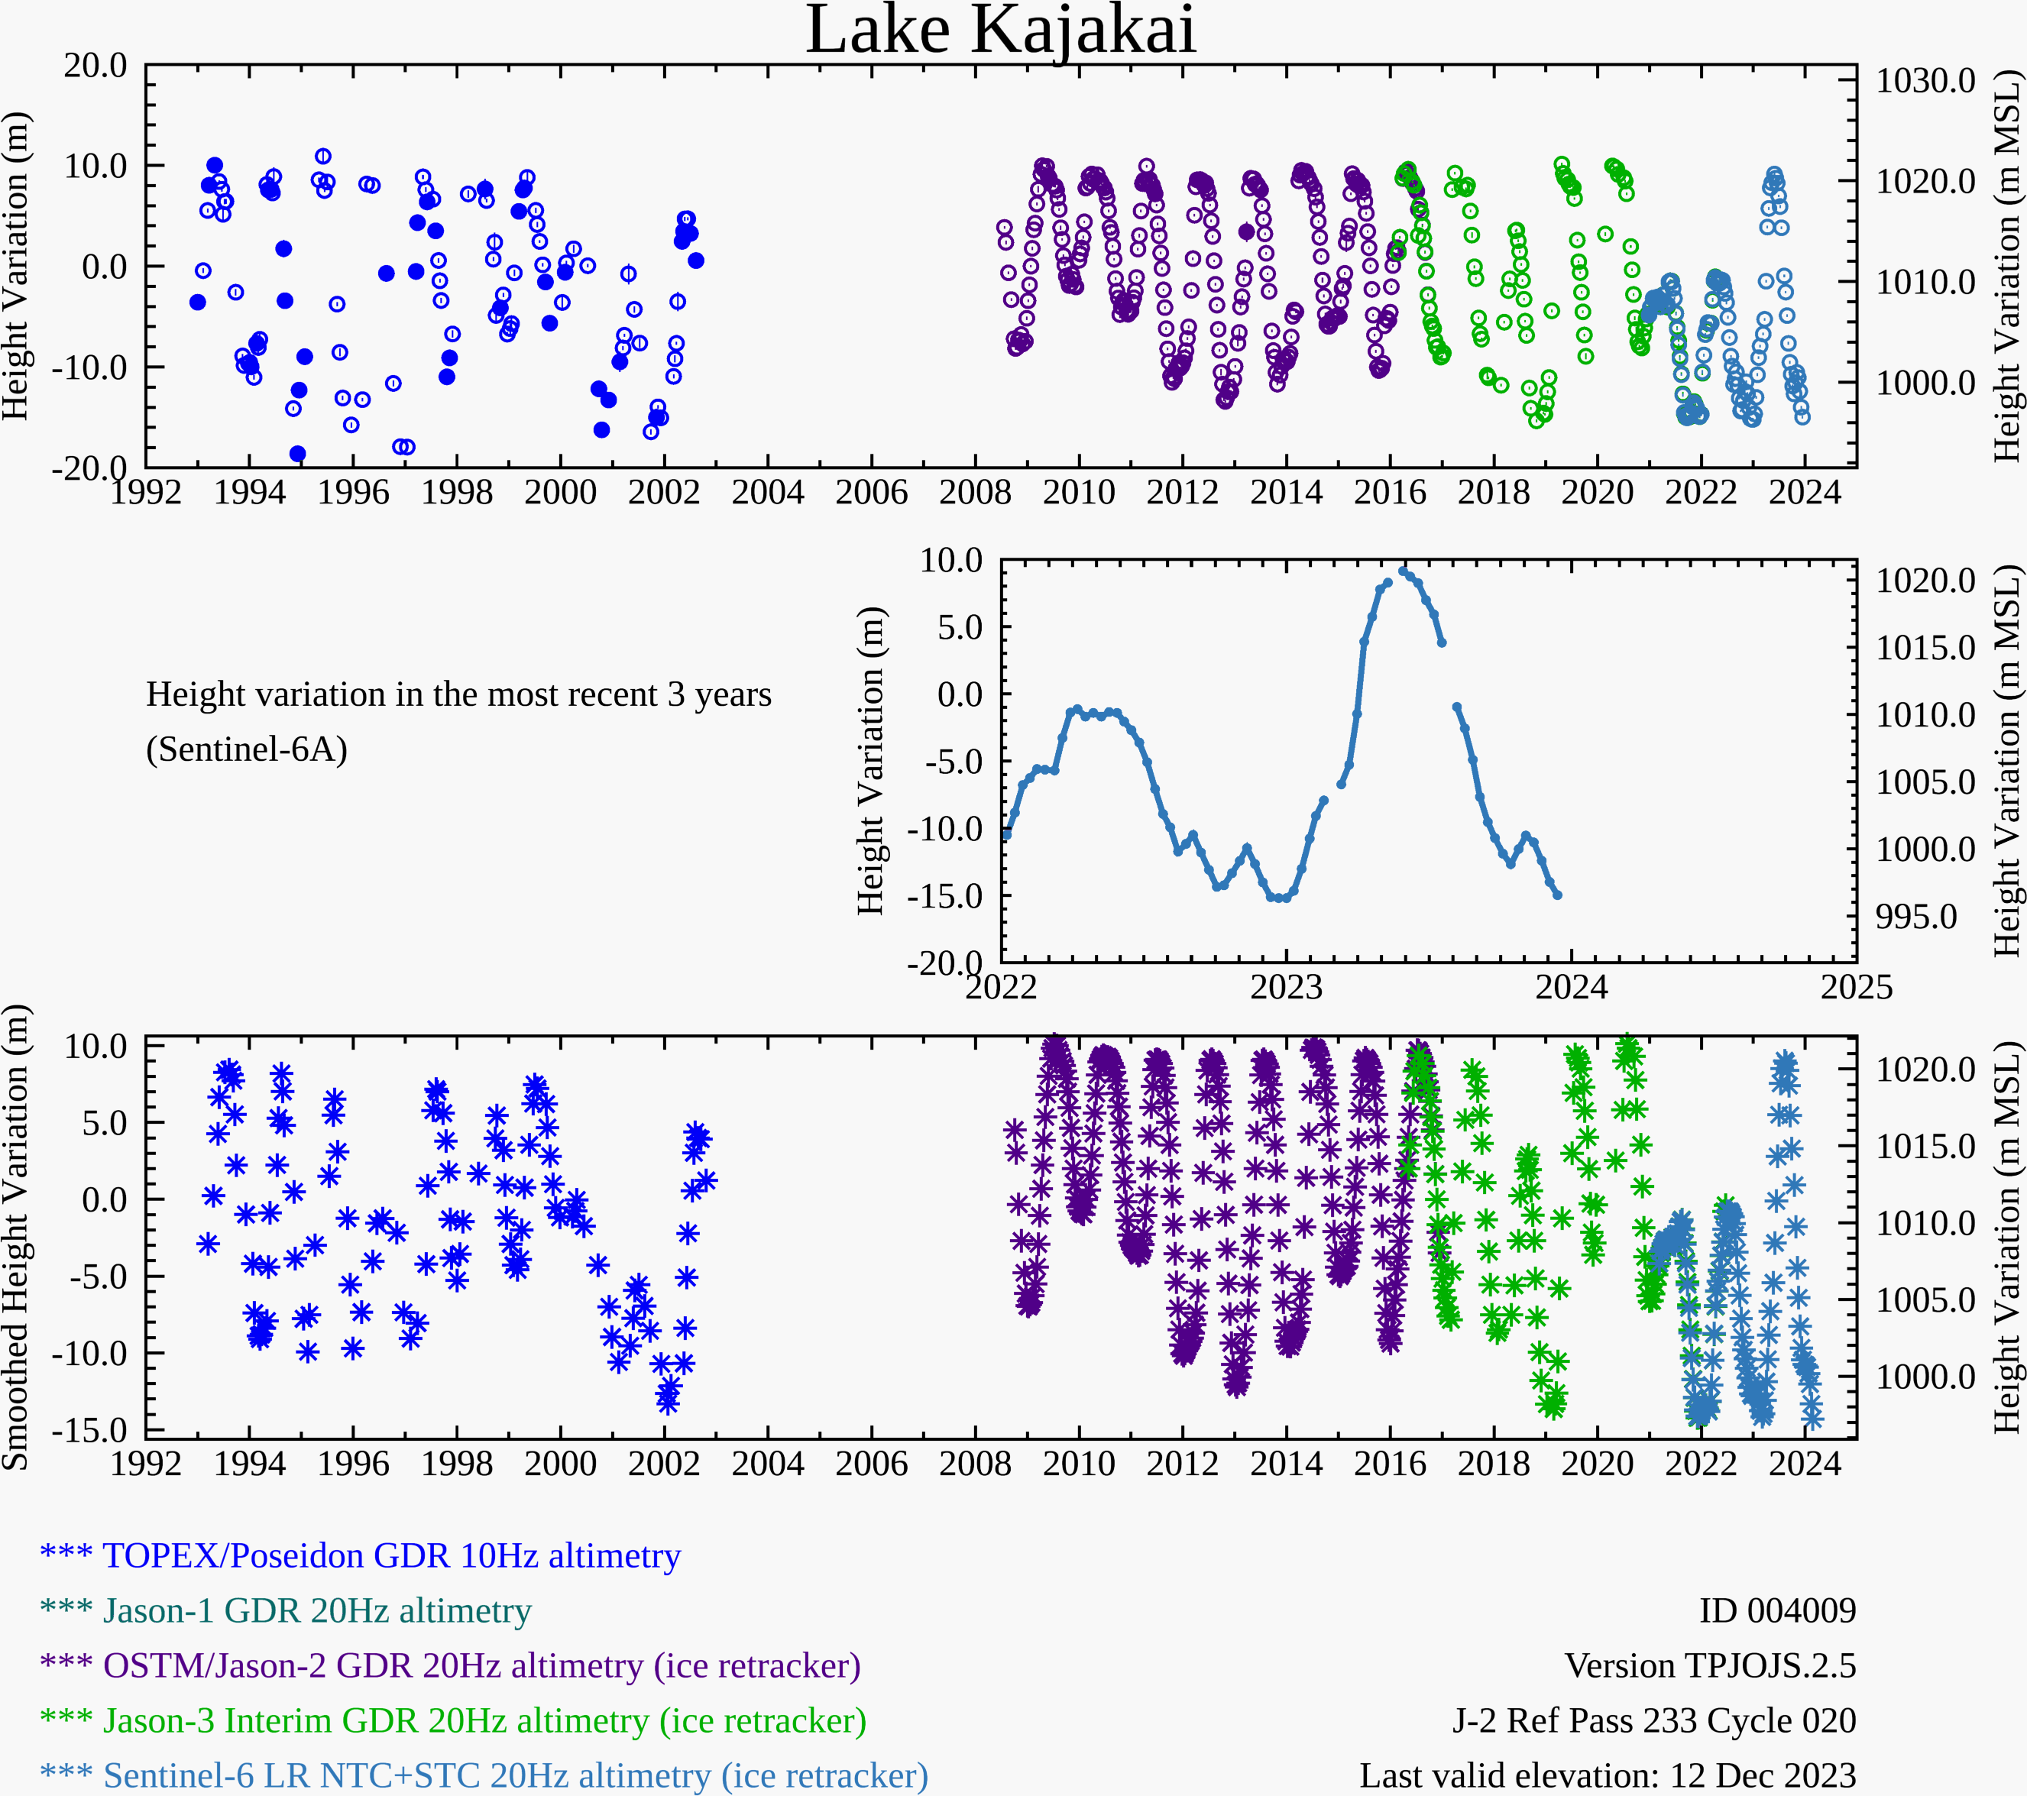
Water Level at Kajakai Reservoir in the Helmand basin (as of Dec 12, 2023)
Zeid
Kajakai
Istadehye
Jehil
Arghandab
USDA monitoring reservoirs
Typical low water level in the Kajakai reservoir during the dry period.

Slide 3
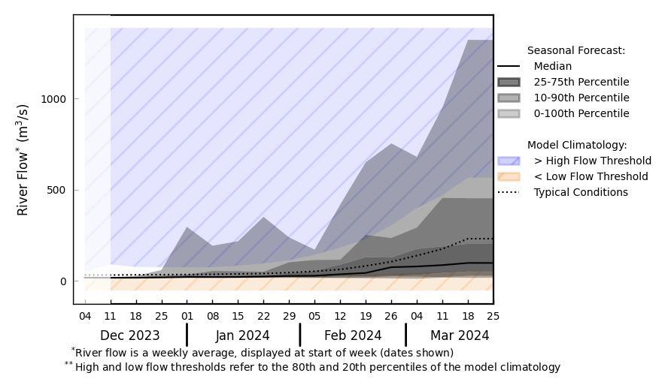
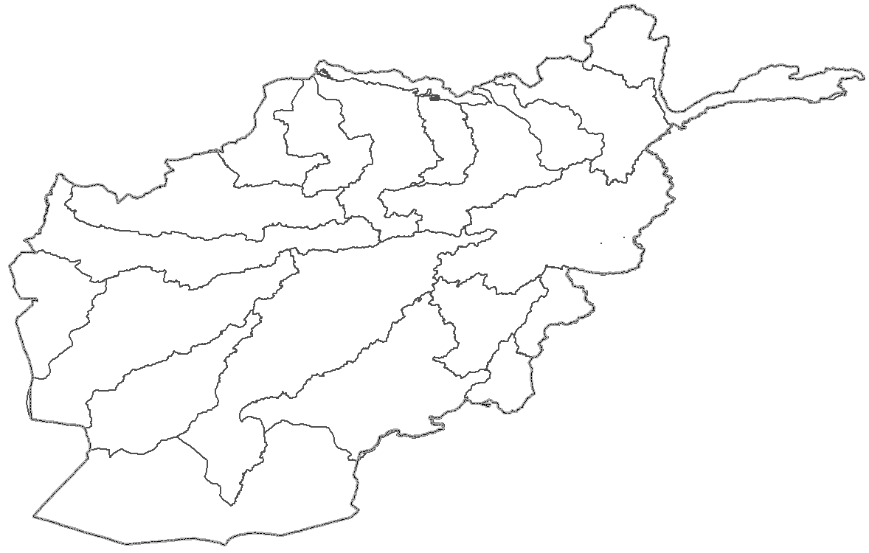
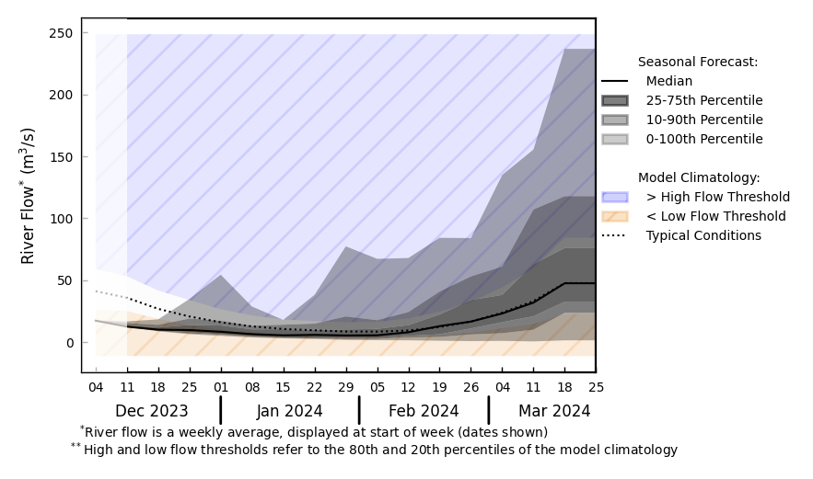
Streamflow Forecast for Afghanistan
@ point A: Helmand River
B
@ point B: Kabul River
A
GloFAS seasonal forecast Dec 2023 - Mar 2024
Low flow continues through the dry season.
Streamflow expected to increase with the spring melt in late January to early February.
GloFAS monthly forecast (Dec 2023 – Mar 2024)

