Slide 1
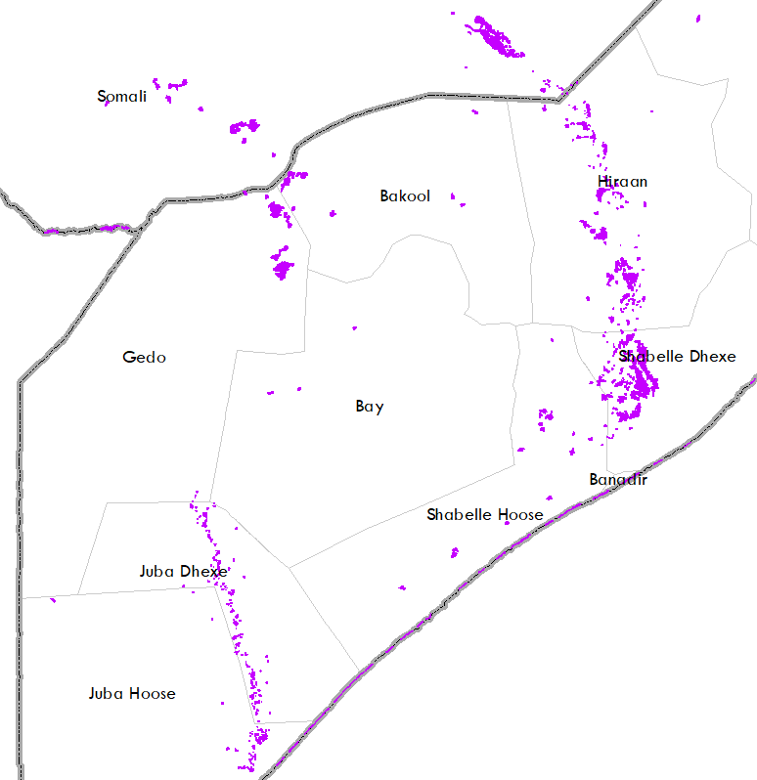
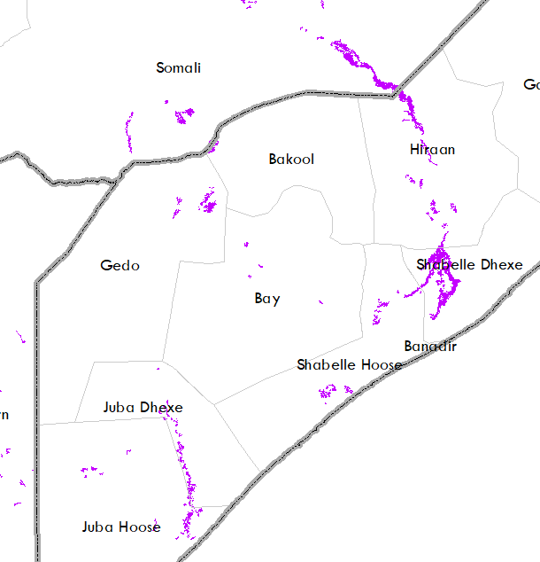
Oct-Dec Analog Year Flooding in Somalia
2015
2019
Derived from VIIRS 375 m data
2 yr & 5 yr return period level streamflow
Area inundated: 2,837 km2
Derived from 375 m data
2 yr return period level streamflow
Area inundated: 4,048 km2
Inundated area stats are also available by admin level 1.
Notes:
1997 flood map is based on Automated Water Extraction Index (AWEI) using 11 Landsat 5 scenes between Nov-Dec of 1997, and 1 scene from January of 1998.
The flooding polygon after the confluence of Juba and Shabelle comes from AVHRR map at 1 km as there were no cloud free images available over that area.
Landsat based map is a binary flood map at 30 m resolution, where as VIIRS maps are based on 20-100% pixel inundation at 375 m resolution.

Slide 2
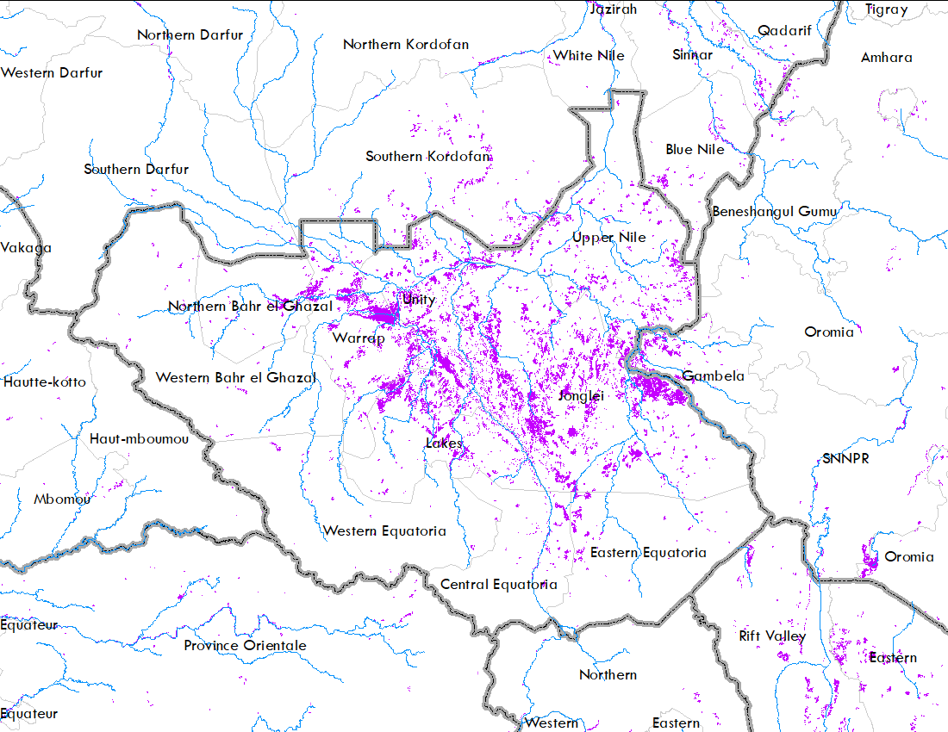
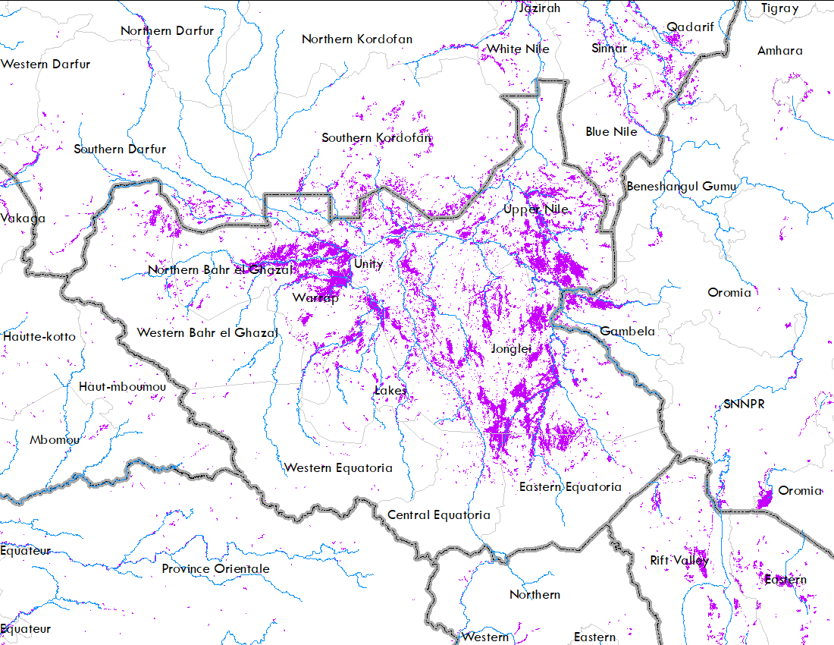
Oct-Dec Analog Year Flooding in Sudan
2015
2019
Derived from VIIRS 375 m res.
Sudan area inundated: 9,266 km2
South Sudan area inundated: 39,299 km2
Drived from VIIRS 375 m res.
Sudan area inundated: 21,055 km2
South Sudan area inundated: 62,487 km2
Inundated area stats are also available by admin level 1.
Notes:
These maps are based on 20-100% pixel flood derived from VIIRS 375 m resolution data.
The 5-day composite for 10th , 20th and , 30th of Oct, Nov, and Dec were combined together to create these maps.

Slide 3
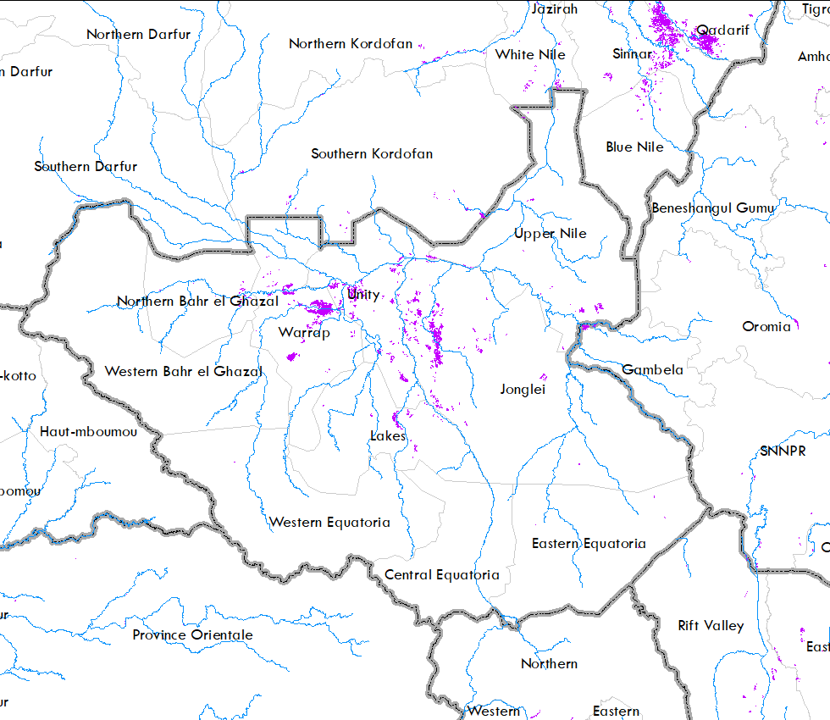
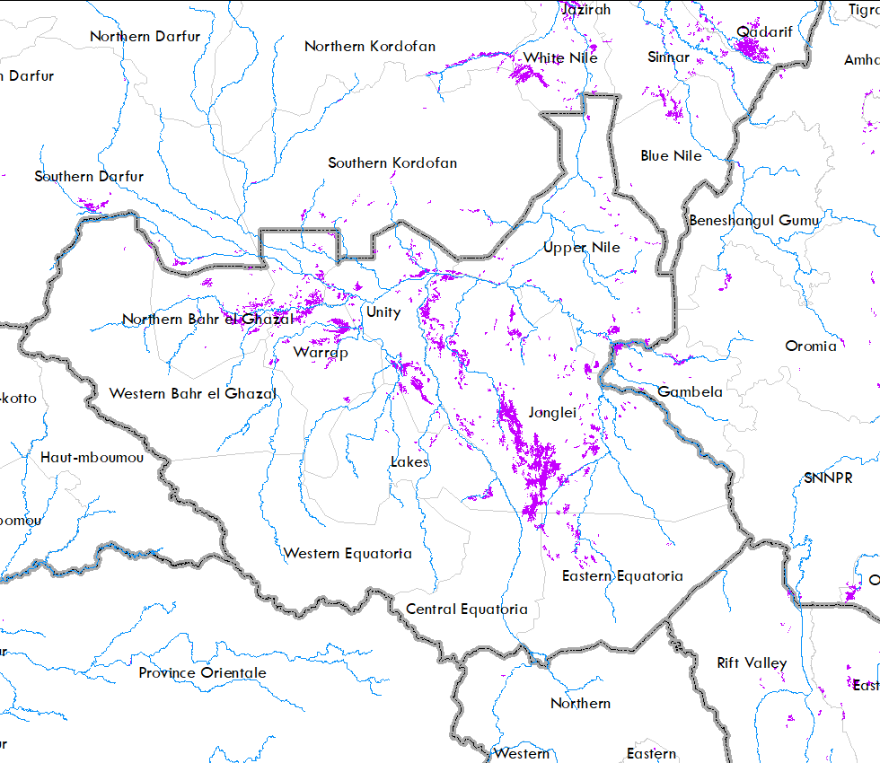
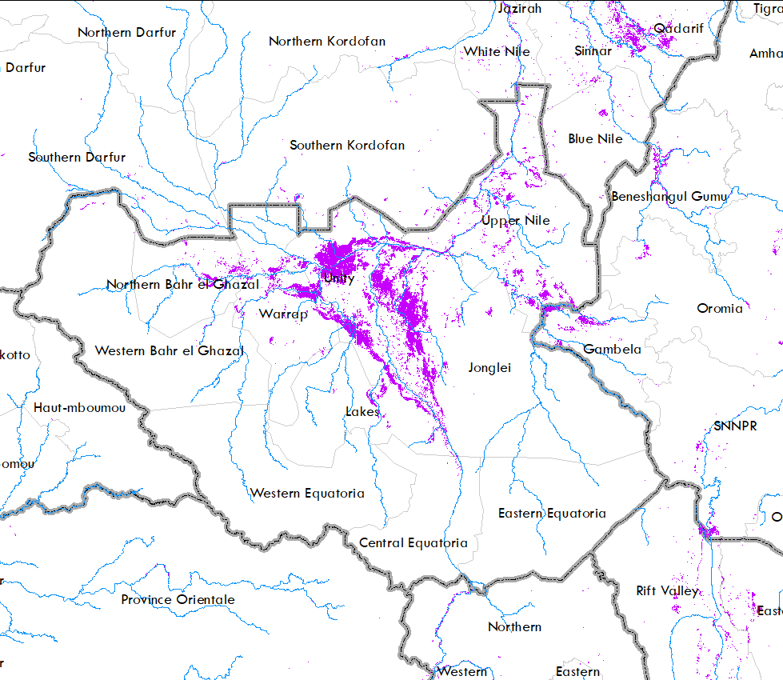
Initial Flooding Conditions
Aug 31,2015
August 31, 2019
August 31, 2023
In the later years, wetland areas are not drying up to its minimum extent during the dry period.
Increasing inundated areas at the beginning of the rainy season.
Notes:
VIIRS 20-100% pixel flood map.
5-day composite for August 31 for the respective years.

Slide 4
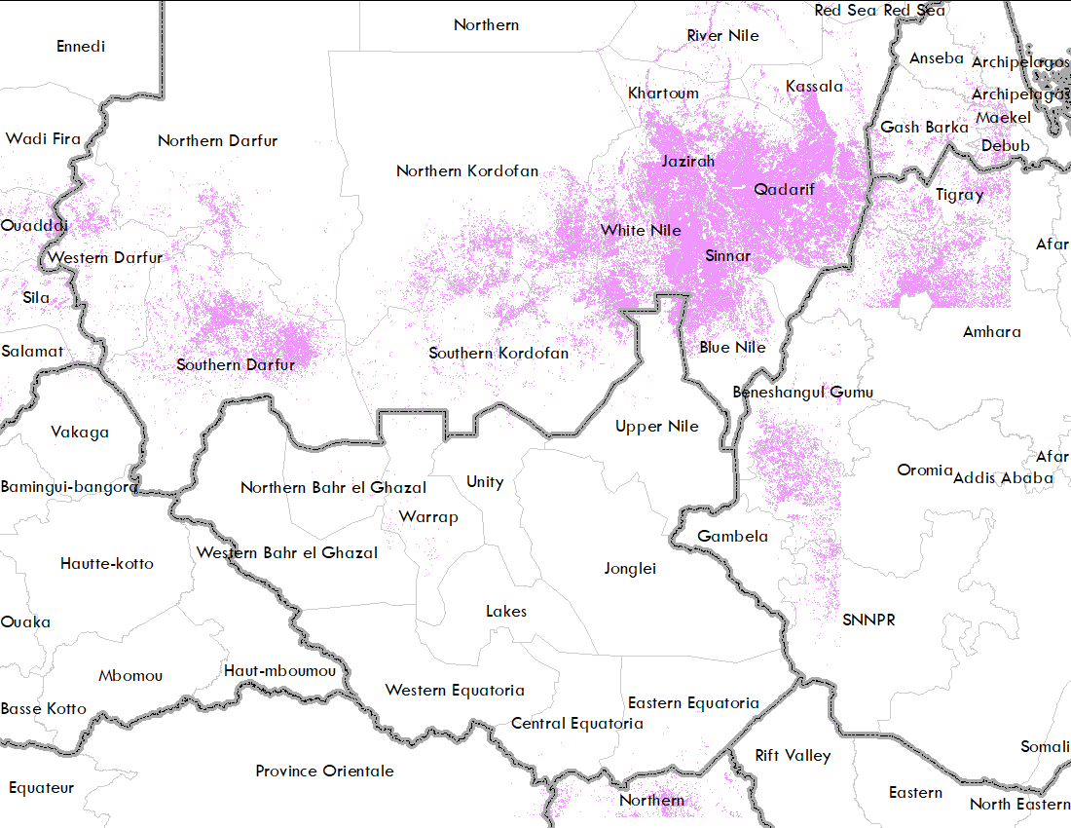
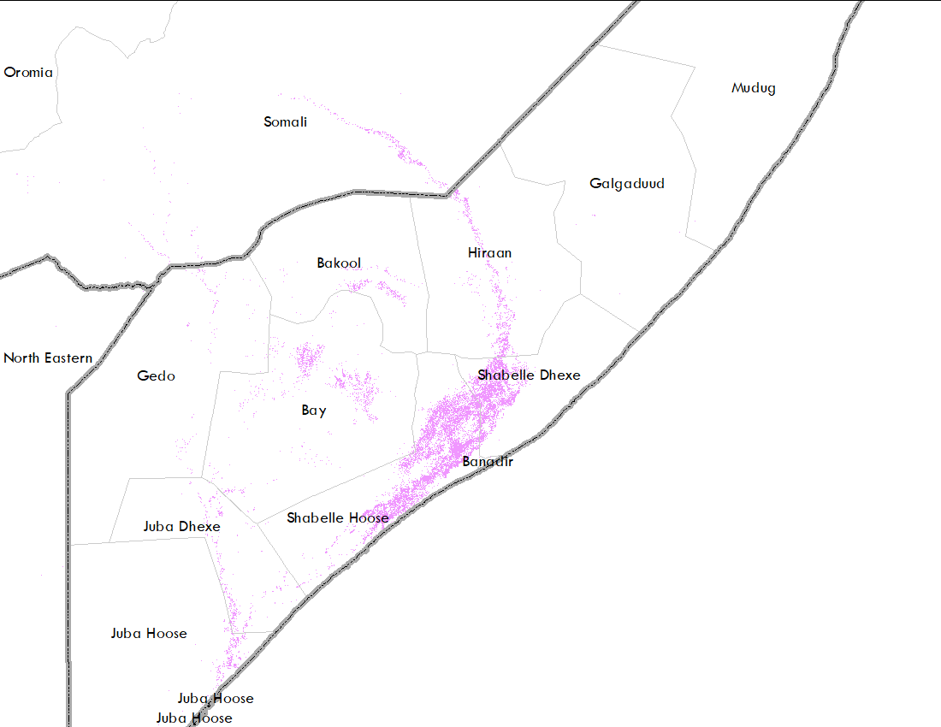
Where Are The Croplands?
ESA WorldCover 2021 at 10 m resolution derived from Sentinel data.

Slide 5
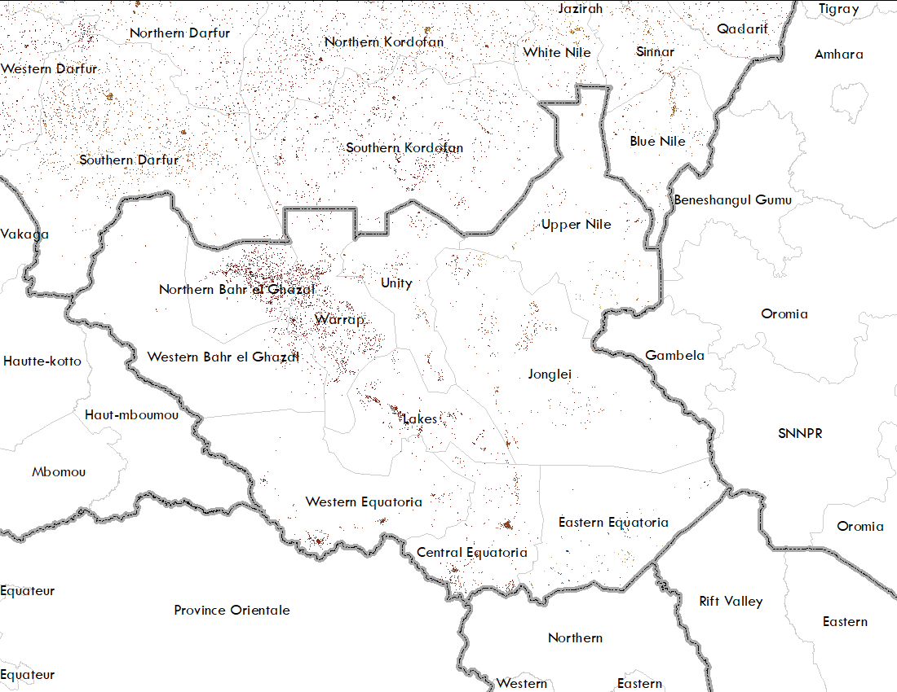
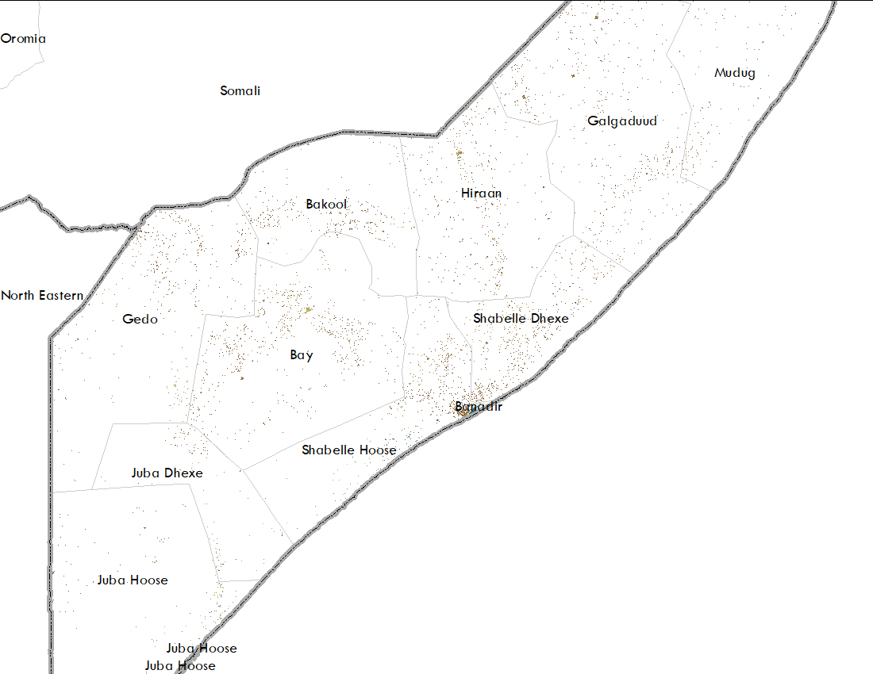
Population
WorldPop 2020 population data at 100 m resolution.

Slide 6
Possible Impacts in South Sudan for 2023
If flooding were to occur at 2015 level
If flooding were to occur at 2019 level
Area inundated
39,299 km2
62,487 km2
Population at risk
110,802
829,032
Cropland at risk
1,235 ha
3,812 ha
Increase in inundation extent is impacting population to a greater extent than it is impacting croplands.
Notes:
These stats are available by Admin Level 1 as well.

Slide 7
Possible Impacts in Sudan for 2023
If flooding were to occur at 2015 level
If flooding were to occur at 2019 level
Area inundated
9,266 km2
21,055 km2
Population at risk
497,572
928,171
Cropland at risk
180,687 ha
416,302 ha
Notes:
Sort of proportional (or close to proportional) increase
These stats are available by Admin Level 1 as well.

Slide 8
Possible Impacts in Somalia for 2023
If flooding were to occur at 1997 level
If flooding were to occur at 2015 level
If flooding were to occur at 2019 level
Area inundated
6,052 km2
2,837 km2
4,048 km2
Population at risk
316,107
193,319
344,204
Cropland at risk
180,932 ha
90,963 ha
160,366 ha
Impacts were more in 2019, despite less flooded area, because there was more flooding in the Shabelle catchment than in the Juba.
In addition, there are more people and croplands in the Shabelle catchment than Juba.
Notes:
These stats are available by Admin Level 1 as well.

