Slide 1
East – Africa & Yemen Agro-Climatic Conditions & Outlook
Famine Early Warning Systems Network
FEWS NET/East Africa & Climate Science Partners
(NOAA/CPC, NASA/GFSC ,USGS and CHC Teams)
19 December 2023

Slide 2
Outline
FEWS NET Partners Questions
Deyr/Short-rains seasonal outlook and impacts
2023/24 Revised climatic assumptions

Slide 3
Questions for Science Partners
EAST AFRICA
Request for science team’s analysis on how the performance of the 2023 October to December deyr/short rains season compares to the 1997 and 2019 analogue years?
As part of this analysis, we are interested in, to the extent possible:
Comparison of rainfall patterns across the three years
Comparison of river water levels across the three years
Can Shahriar and colleagues provide analysis comparing the extent of flooding across the three years?
Any other key indicators of use in comparing the severity of flooding and associated impacts across the three years
Note: We understand from colleagues on the ground that patterns in rainfall aren’t telling the whole story, with flooding more severe in parts of Somalia than in 1997 and 2019 due to open river breakages (more than in past years) and general poor management of infrastructure over the years.

Slide 4
Summarized Responses to the Partners Questions
2023 Deyr/short-rains started in October and peaked in late October into late November. Culminating into well above average (>200%) and comparable to the FEWS NET’s worst-case scenario.
The seasonal rains were ranked among the wettest in CHIRPS 40-years record for several regions of eastern Horn at the peak of the rainfall season; particularly over southern Somalia, southeast Ethiopia, north-east-central Kenya, and East Africa’s coastal strip.
Overall, 2023 October – December was largely wetter-than-2019, but, relatively less than 1997 historic event, in terms of amounts and geographical extent
Interestingly, even in areas that were NOT ranked among the wettest, some observed extremely intense rainstorms (>100mm) with 1-2 days, which caused devastating floods, fatalities, human displacement and infrastructure damage. Example, Msabaha observed 416mm in November!.

Slide 5
Summarized Responses to the Partners Questions
The humanitarian impacts of the on-going short-rains was significantly higher than 1997 and more recent 2019 events. This is attributed to much higher population density (> 200%) living around flood prone riverine regions and urban centres along major river basins. As, a consequence of frequent prolonged severe drought conditions over eastern Horn, in recent decade.
Currently, the bulk of tropical rainfall system accompanied by El-Nino influenced enhanced rains have largely shifted southwards, Therefore, there is decreased likelihood for floods in the northern sector and elevated risks over the southern sector, especially over the East Africa’s coastal strip, south-east Kenya into the western sector, and, especially Tanzania.
The anticipated tropical cyclones activity in coming months are likely to determine the geographical locations and intensity of the forecast extended rains in early 2024

Slide 6
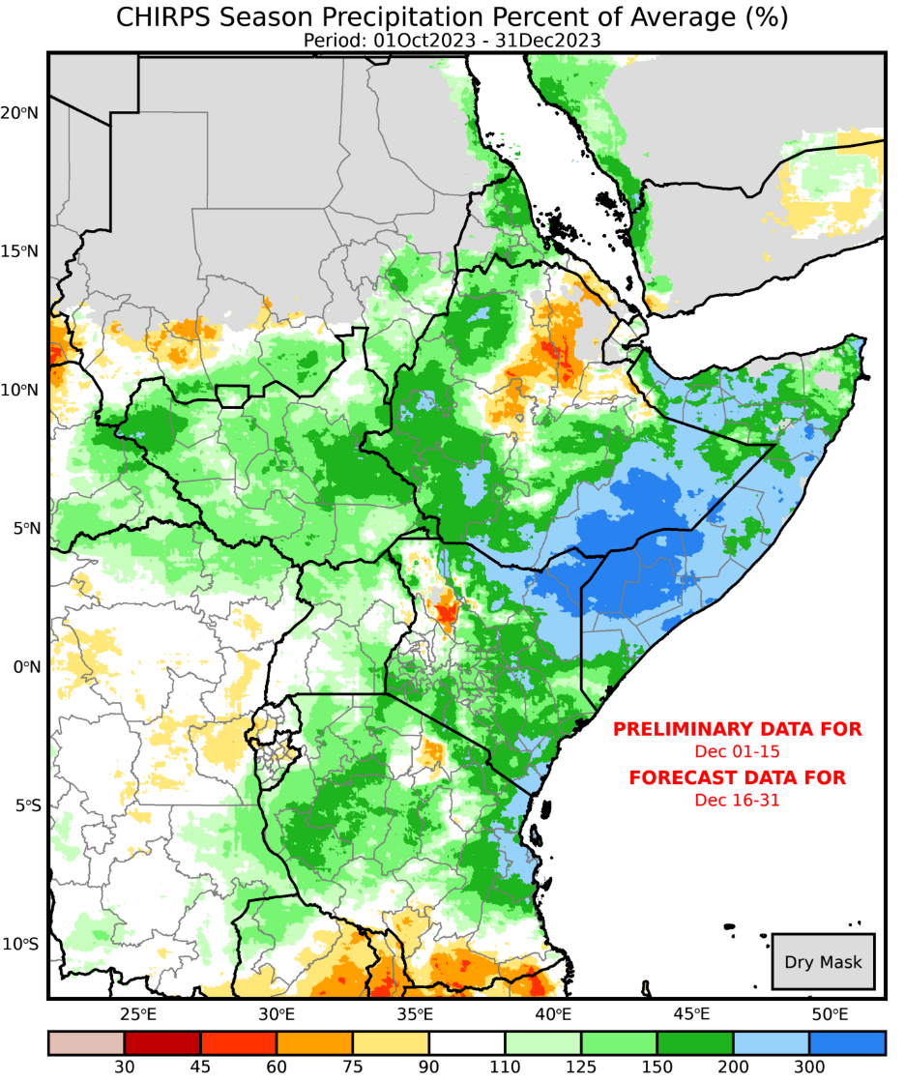
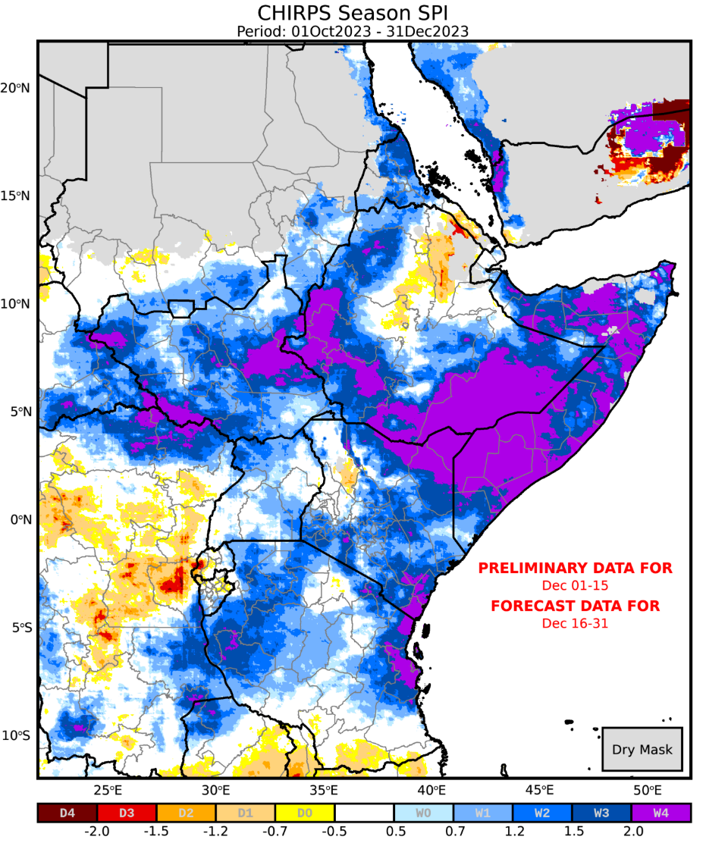
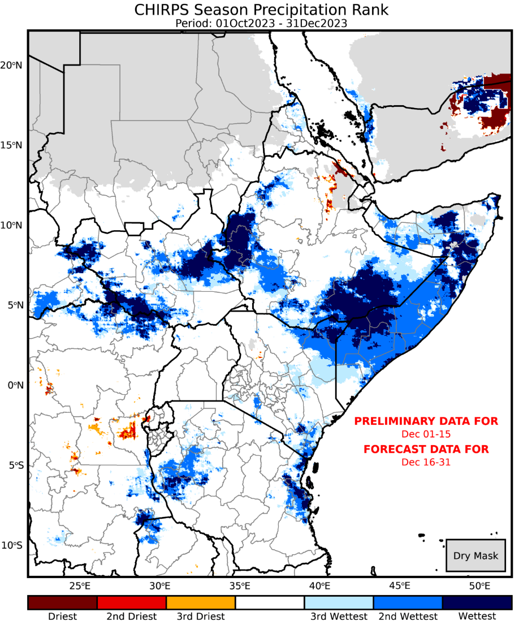
2023 October – December rains among the wettest on 40-years record
2023 Well-above average performance (%).
2023: Extreme rainfall amounts (SPI)
2023: Ranking the seasonal rains

Slide 7
2023 was 2nd most impactful, in terms of the number of locations that received extreme high October-November rainfall

Slide 8
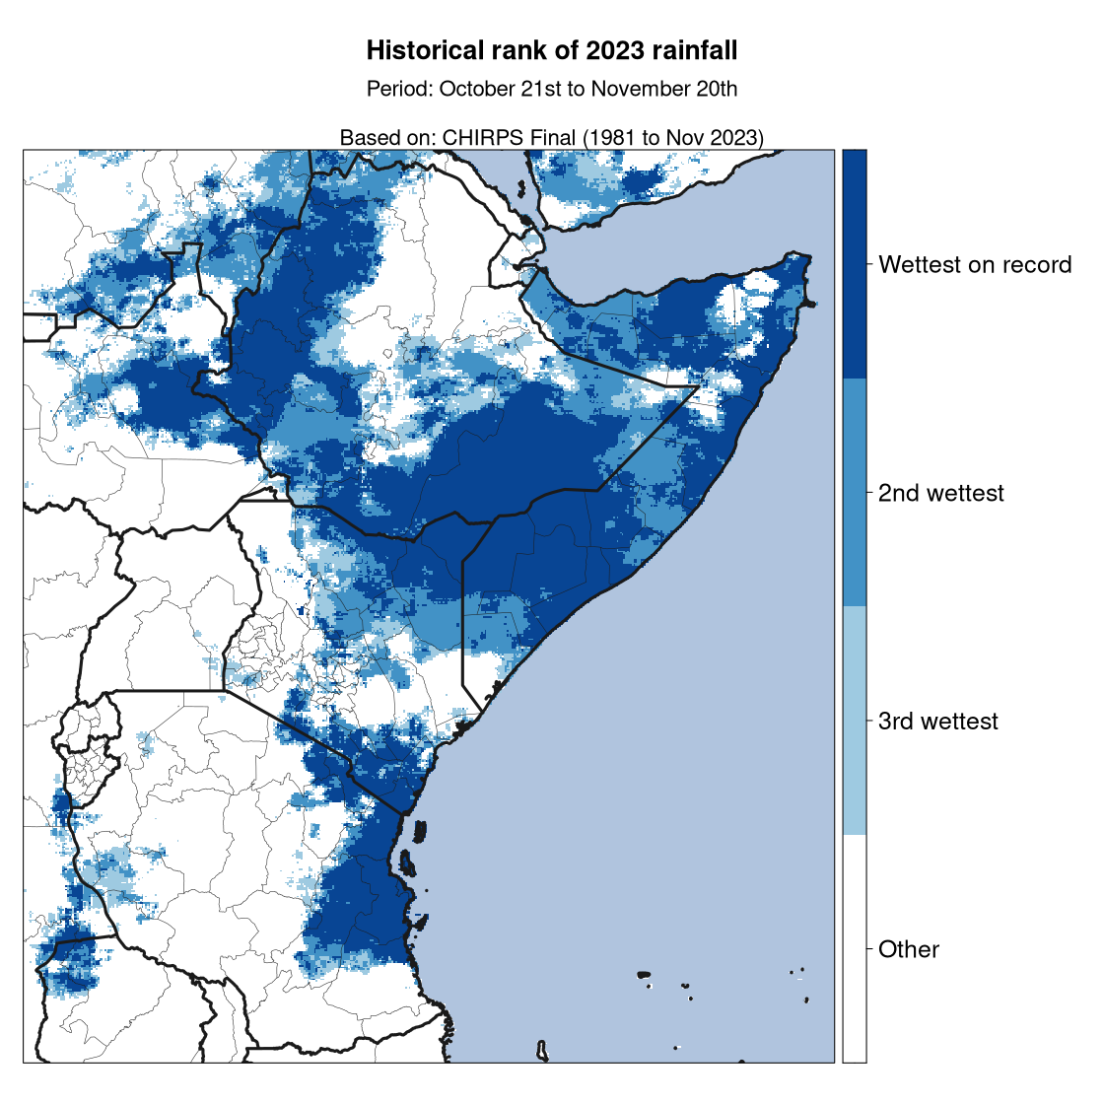
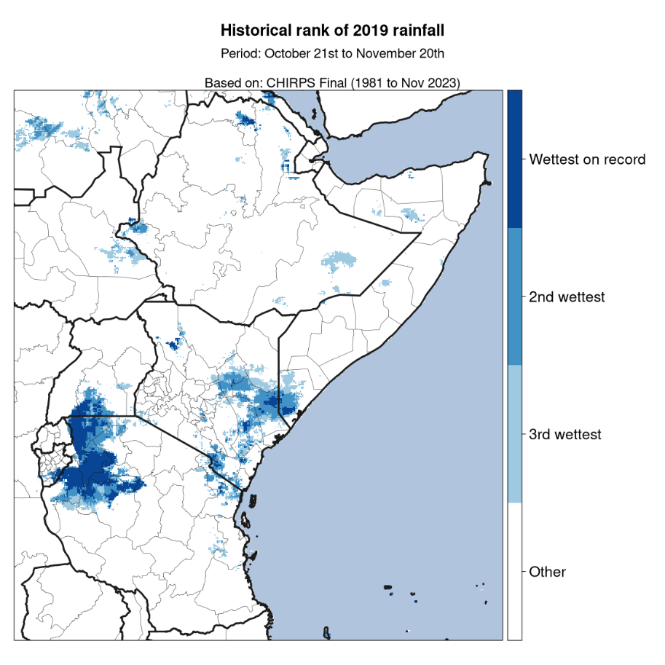
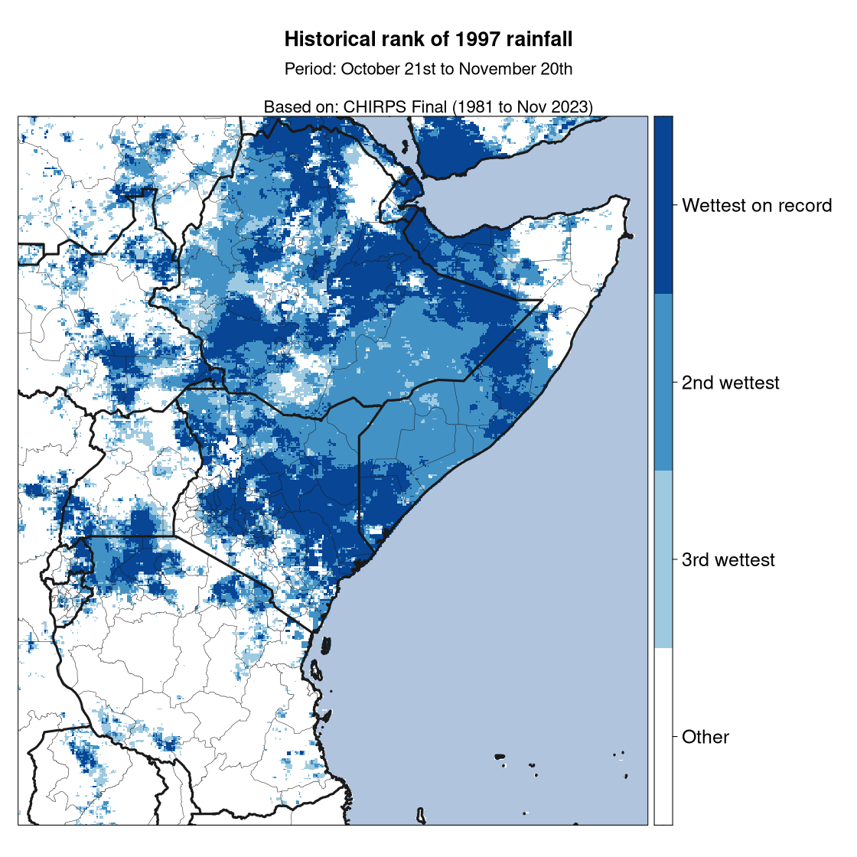
Comparing 2023 vs. 1997 and 2019 at peak period
Period of analysis: 21 October – 20 November
2023: Recorded the worst-in-40 years over parts of eastern Horn
Juba and Shabelle river catchments
1997 worse-than-2023, in terms of geographical extent
2023 worse-than-2019
Source of uncertainty: Absence of in situ reports in Somalia in 1997 in CHIRPS data; possible underestimation of rainfall during that also extreme situation.

Slide 9
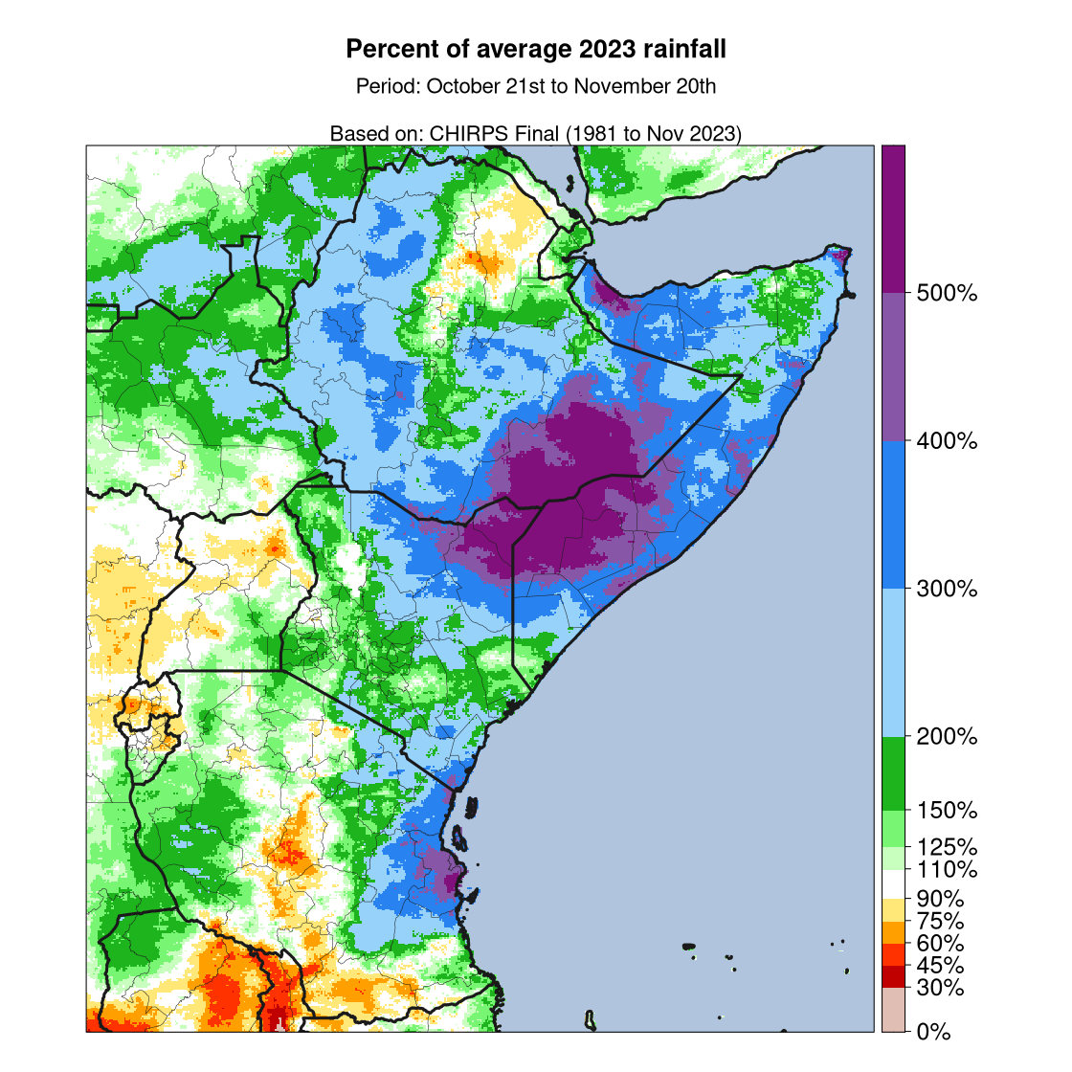
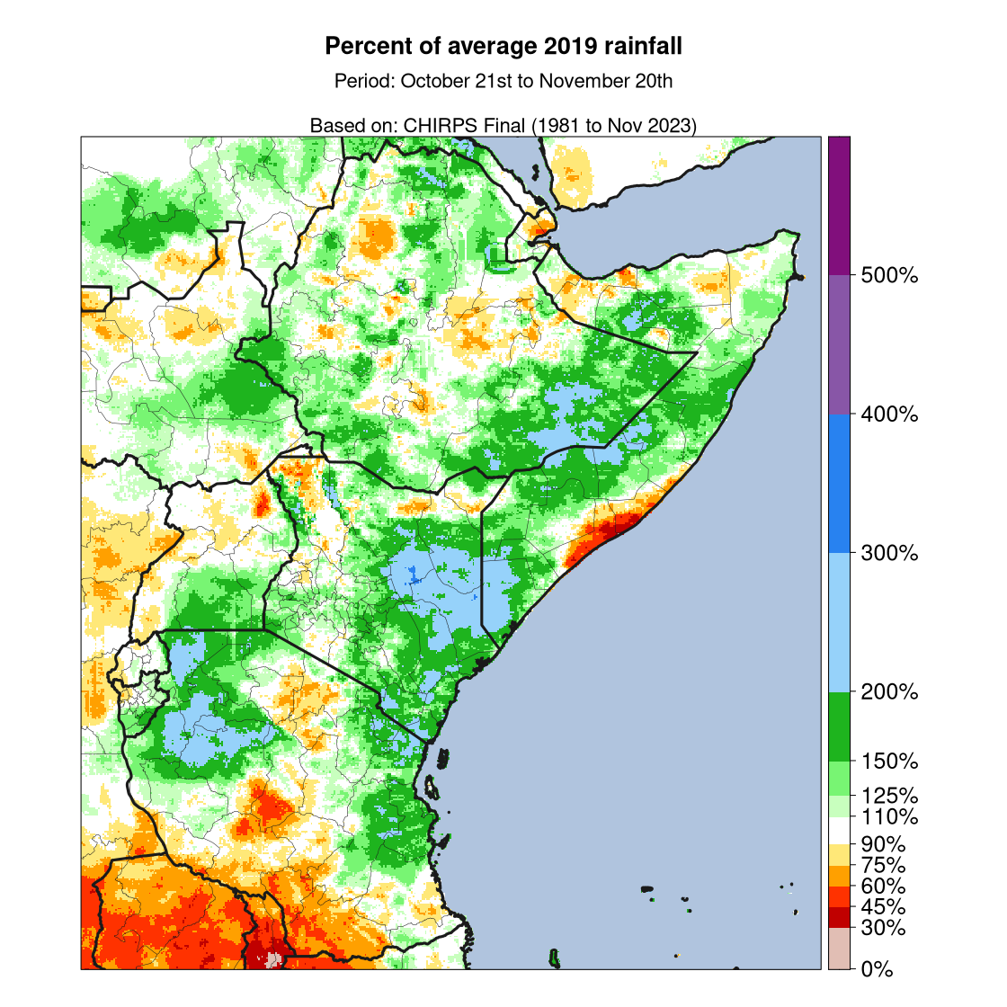
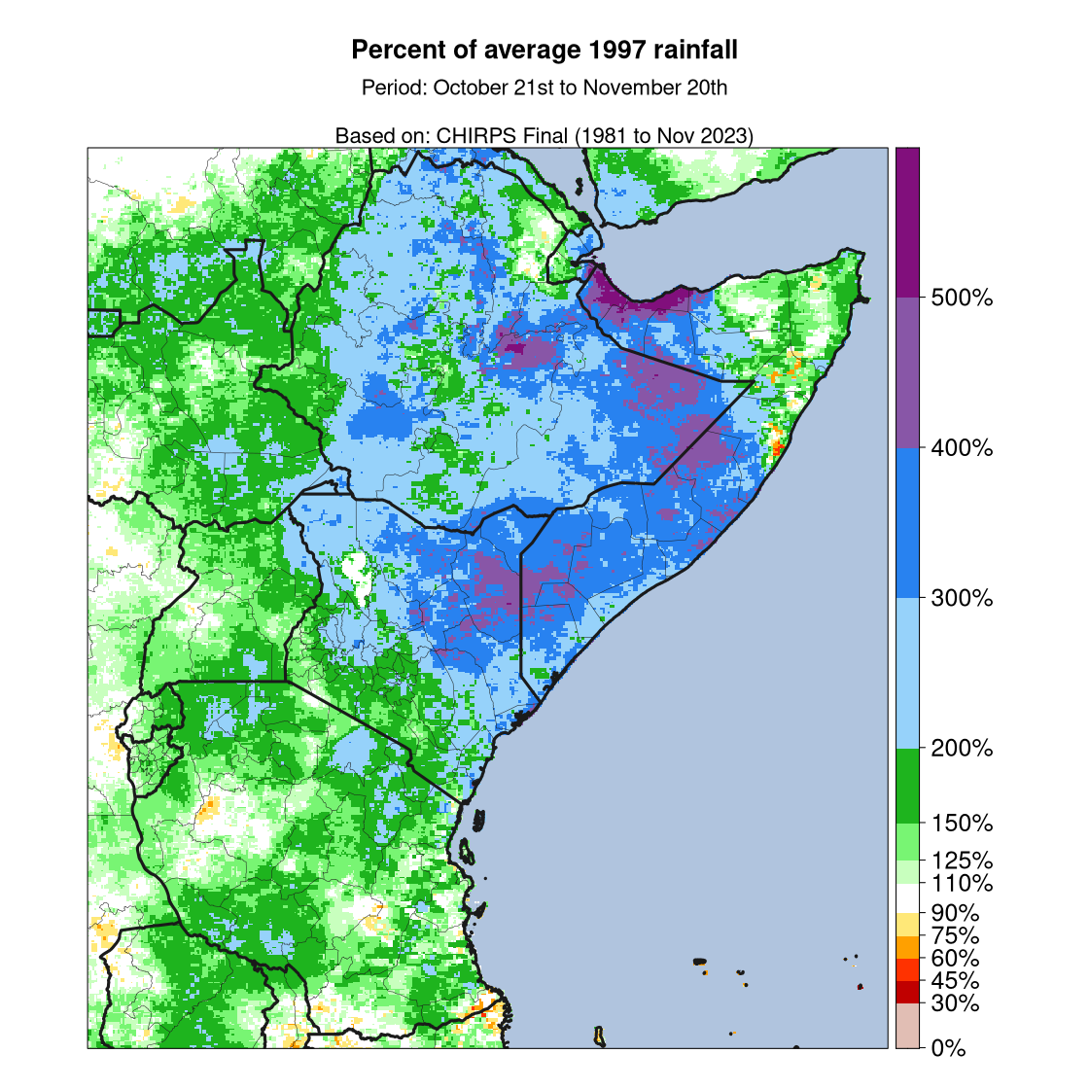
Comparing 2023 vs. 1997 and 2019 at peak period
Period of analysis: 21 October – 20 November
2023: Recorded the worst-in-40 years over parts of eastern Horn
Juba and Shabelle river catchments
1997 worse-than-2023, in terms of geographical extent
2023 worse-than-2019
Source of uncertainty: Absence of in situ reports in Somalia in 1997 in CHIRPS data; possible underestimation of rainfall during that also extreme situation.

Slide 10
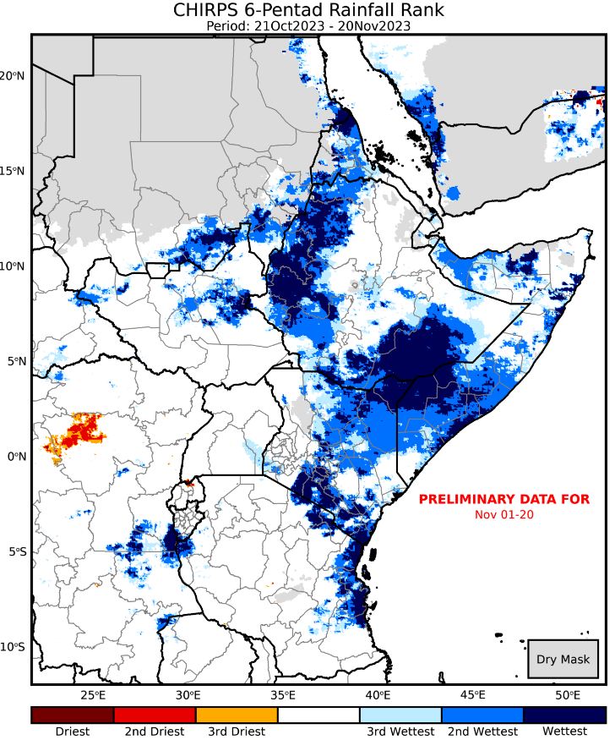
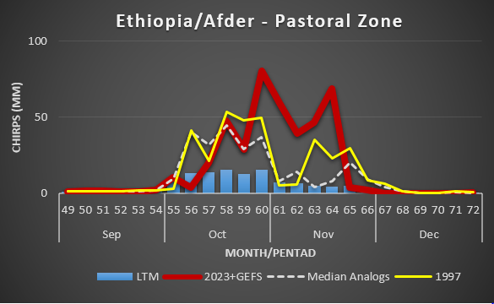
Examples: 2023 Deyr Temporal Comparative Analysis
Needs revision: An updated version of this map will be available ~ 6pm PST 12/19
Gideon, it will be here https://data.chc.ucsb.edu/products/CHIRPS-2.0/moving_06pentad/pngs/africa_east/archive/Rank_06PentAccum_2023_p64.png (thanks to Will Turner)
Well-above average and forecast rainfall scenario
Peaked between 20th October to 20th November
Persistent heavy rains (> 70 mm) per pentad in Upper Shabelle river basin
1
1
2
4
3
5

Slide 11
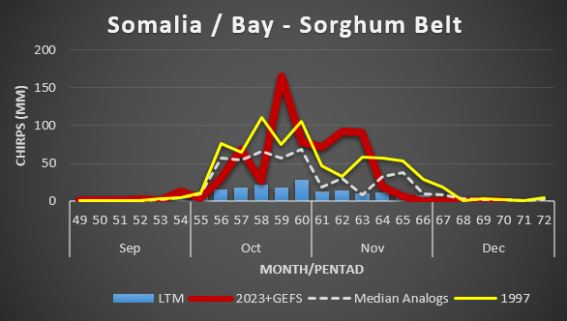
Examples: 2023 Deyr Temporal Comparative Analysis
Well-above average and forecast scenarios
Peaked between 20th October to 20th November
Episodic rainstorms wetter-than-1997 at the peak period
Rainfall peaks > 120mm per pentad with flash-floods reported
2
1
2
4
3
5

Slide 12
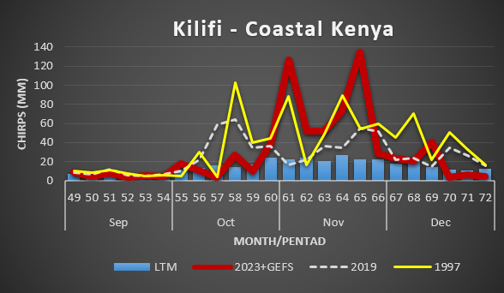
Example: 2023 Short-Rains Temporal Comparative Analysis
Overall, well-above average and the forecast scenarios
Peaked between 20th October to 20th November
2 main peaks > 120mm per pentad with flash-floods reported
Infrastructure damage and roads impassable
3
1
2
4
3
5

Slide 13
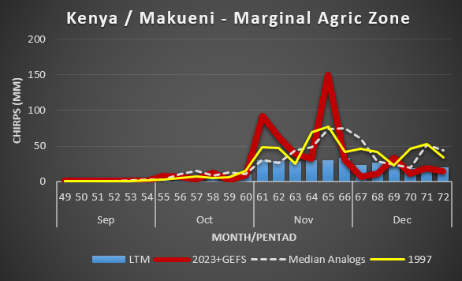
2023 Short-Rains Temporal Analysis
Well-above average and forecast scenarios
Peaked between 20th October to 20th November
2 rainfall peaks > 100mm per pentad with flash-floods reported
Fatalities, property and infrastructure damage
4
1
2
4
3
5

Slide 14
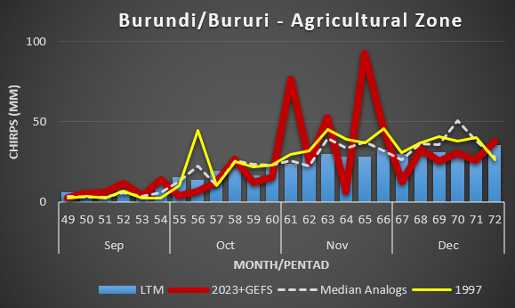
Example: 2023 Season-A Temporal Comparative Analysis
Well-above average and the forecast scenarios
Peaked between 20th October to 20th November
Torrential heavy rains (>50mm) per pentad
Floods on low-lying areas and crop damage (i.e beans, etc)
4
5
1
3
4
2

Slide 15
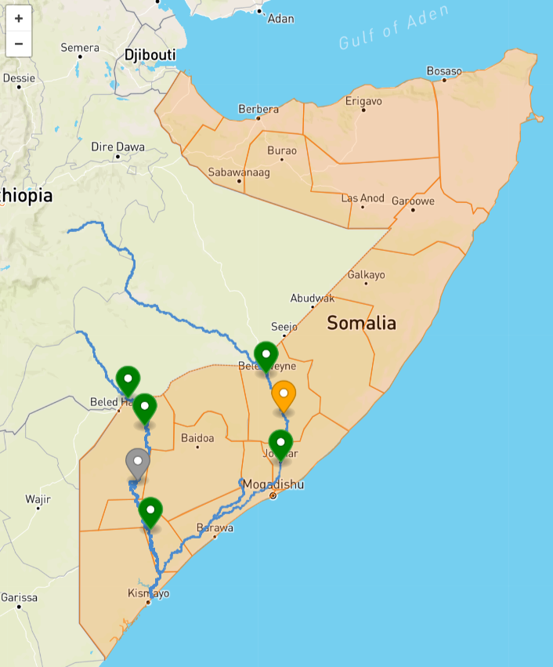
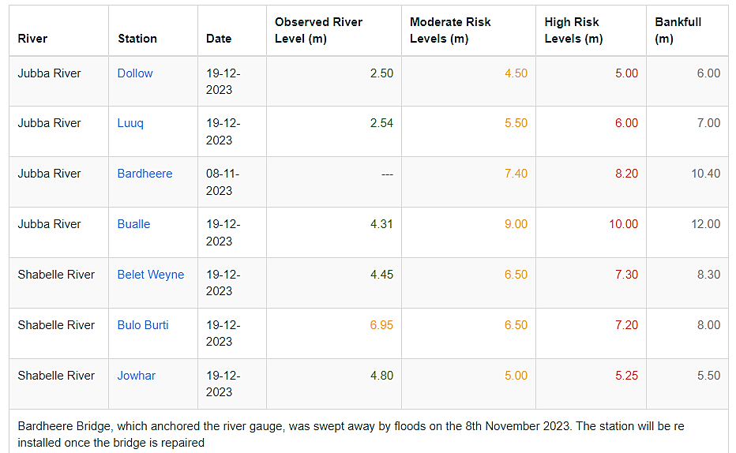
Southern Somalia River Levels (FAO/SWALIM)

Slide 16
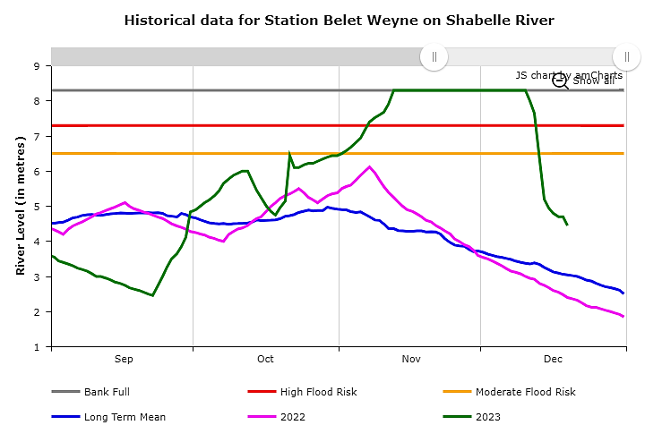
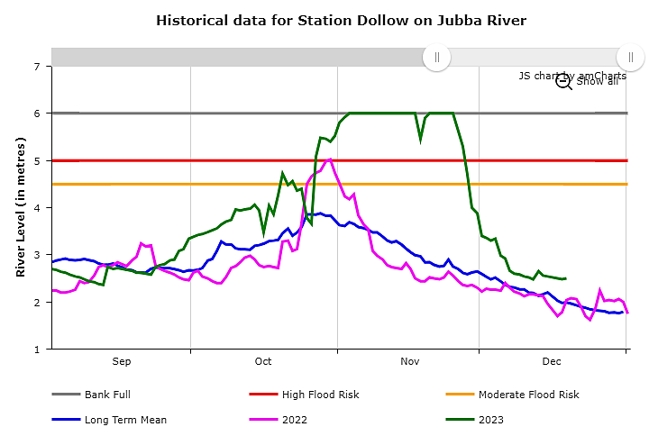
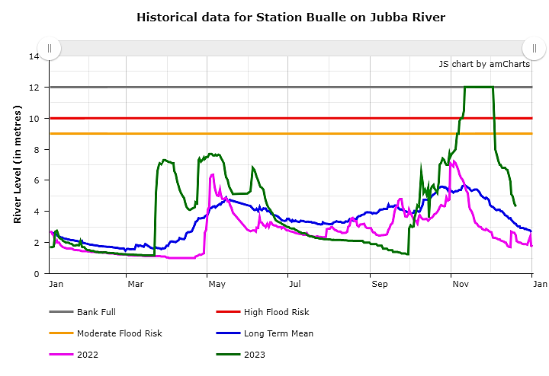
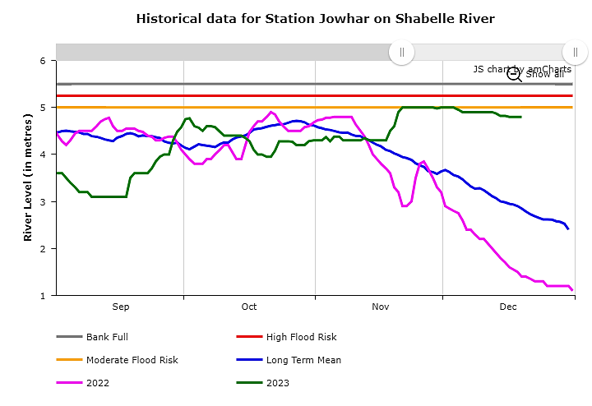
Southern Somalia Bankful River Levels (FAO/SWALIM)

Slide 17
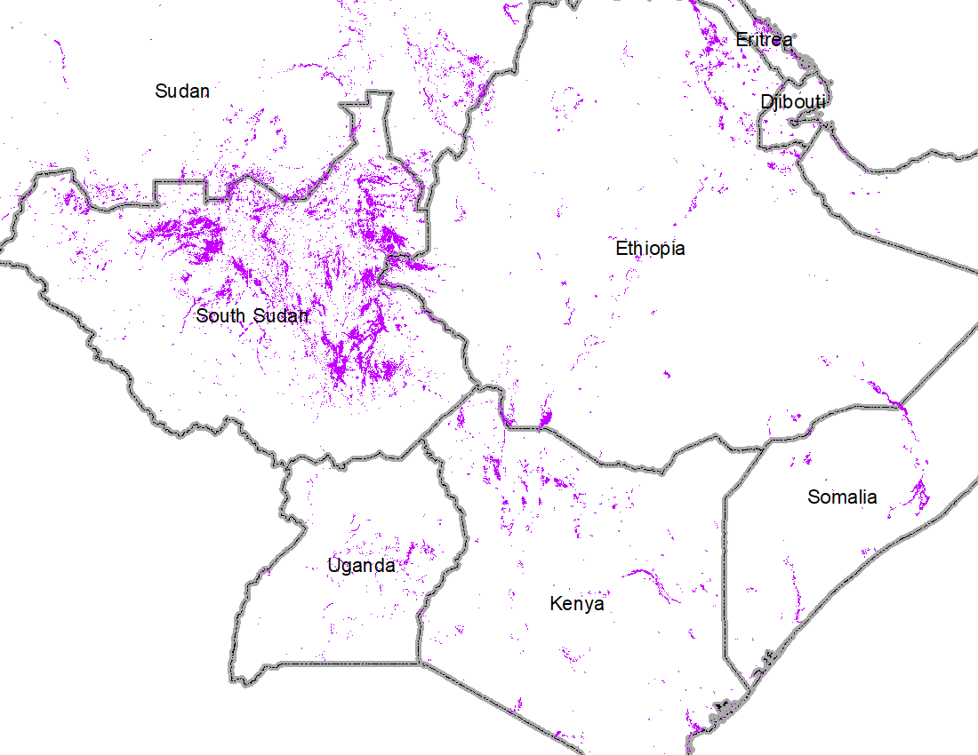
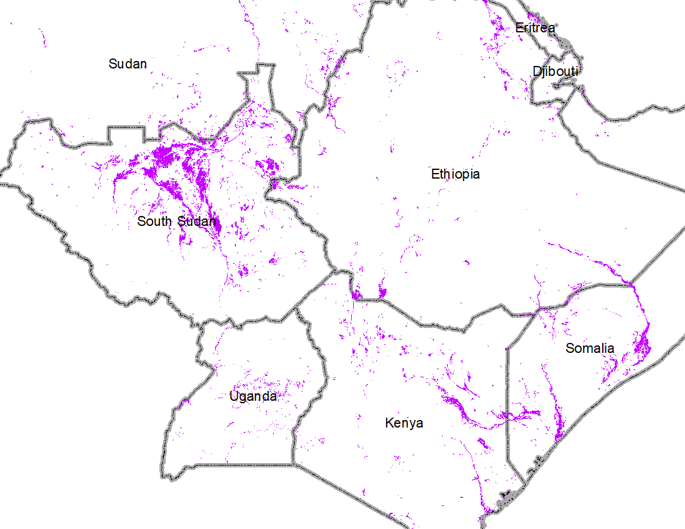
2019 vs 2023 Comparable Extent of Inundated Regions
in East Africa
Oct-Dec of 2019
Oct – Dec 18 of 2023
- Relatively less flooding in South Sudan but more in Kenya and Somalia compared to Oct-Dec flooding of 2019.
- Extensive geographical area over Kenya and Somalia compared to Oct-Dec flooding of 2019

Slide 18
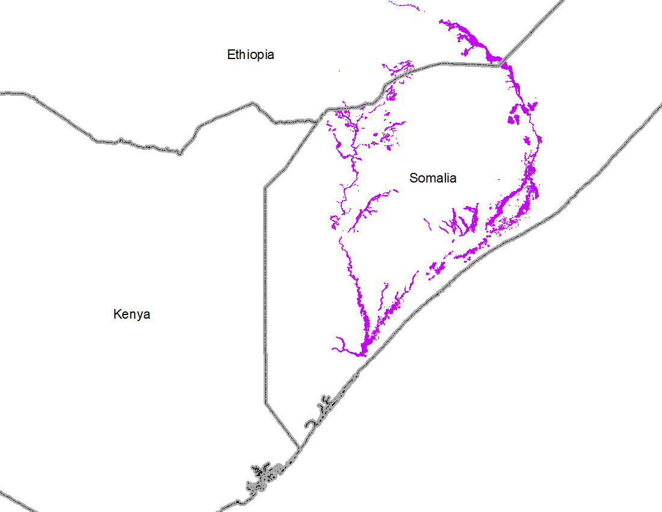
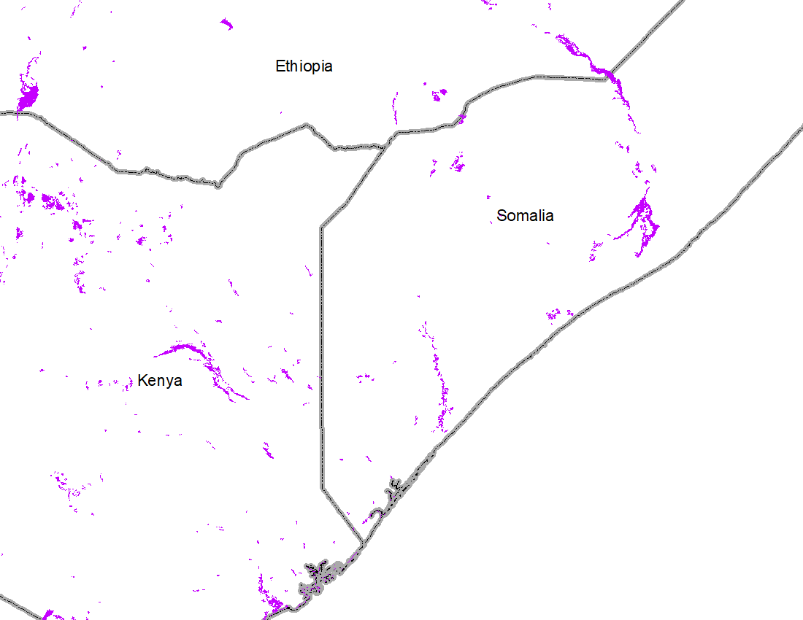
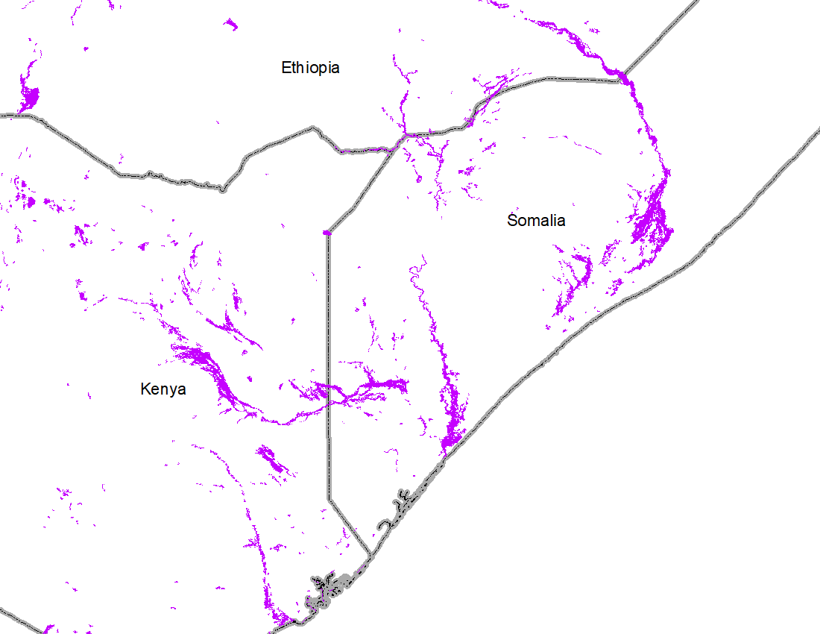
Analog Years Comparable Extent of Inundated Regions
in Kenya and Somalia
Oct-Dec of 1997
Oct-Dec of 2019
Oct – Dec 18 of 2023
- Current inundation pattern in Ethiopia and Somalia is very similar to Oct-Dec flooding of 1997.
- Extensive geographical area compared to Oct-Dec flooding of 1997

Slide 19
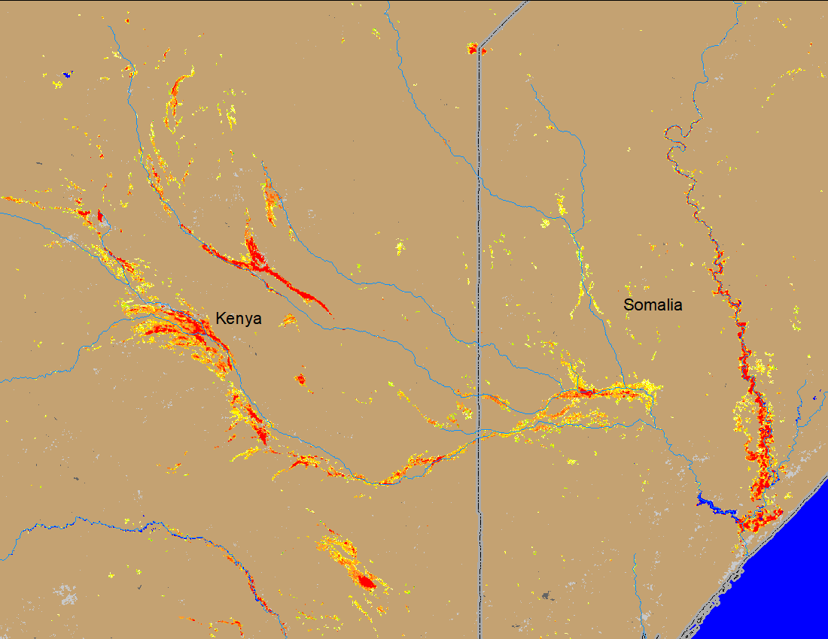
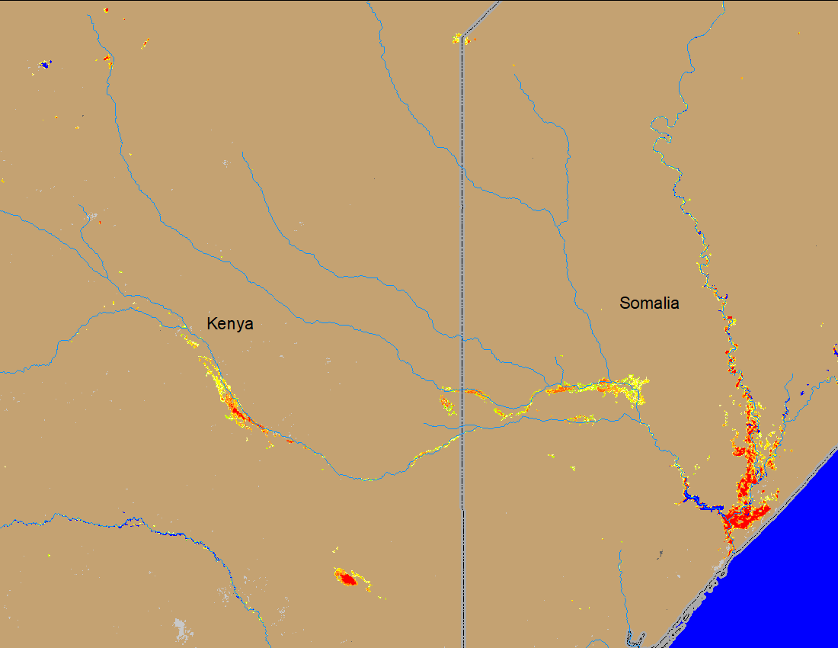
Recent Extent of Inundated Regions
in Kenya and Somalia
NOAA VIIRS 5-day comp.: 22 – 26 Nov 2023
NOAA VIIRS 5-day comp.: 14 – 18 Dec 2023
- Flooding conditions improved substantially from its peak in late November in Kenya and Somalia.

Slide 20
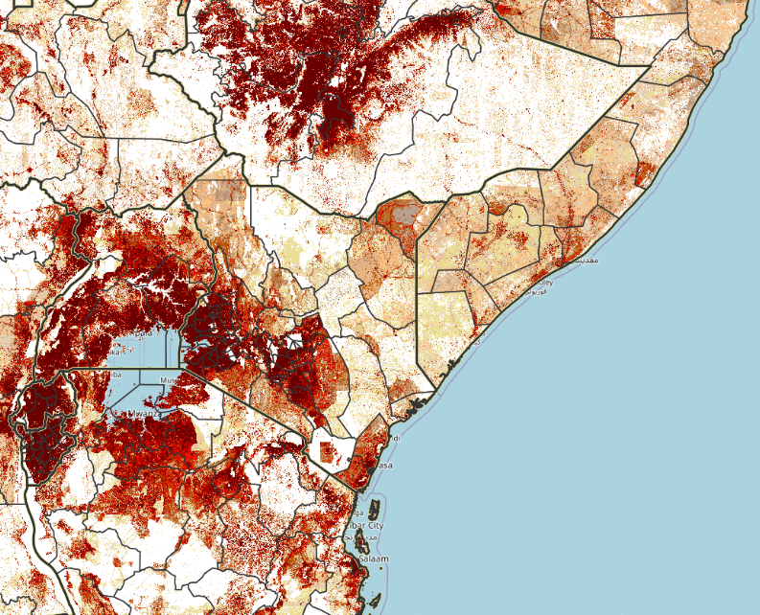
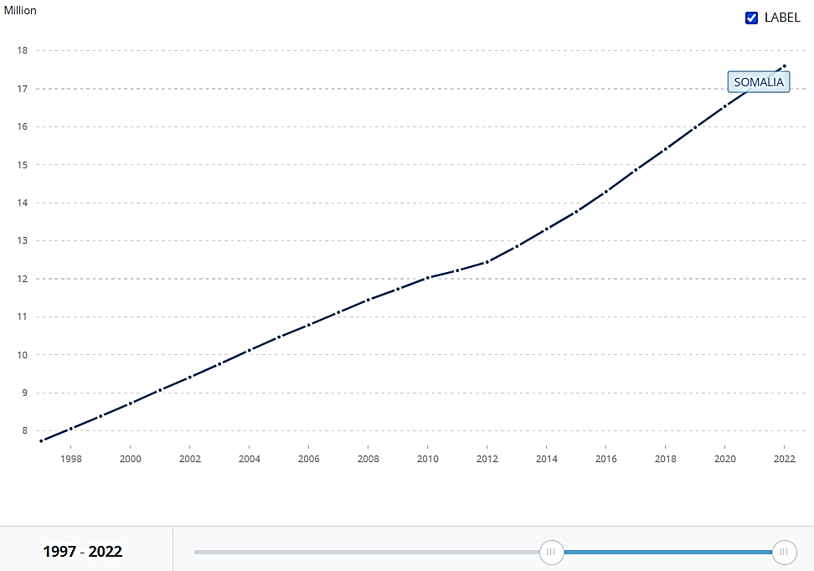
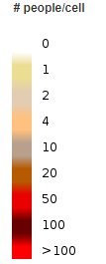
Population density and significant population growth (1997 vs 2023)
16M
SOMALIA
ETHIOPIA
SOMALIA
8M
KENYA
https://data.worldbank.org/indicator/SP.POP.TOTL?end=2022&locations=SO&start=1997&view=chart

Slide 21
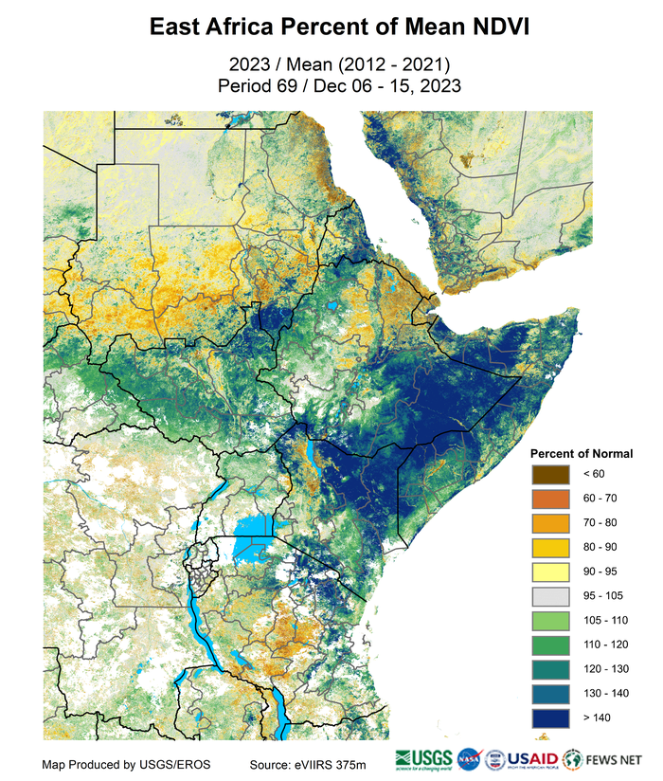
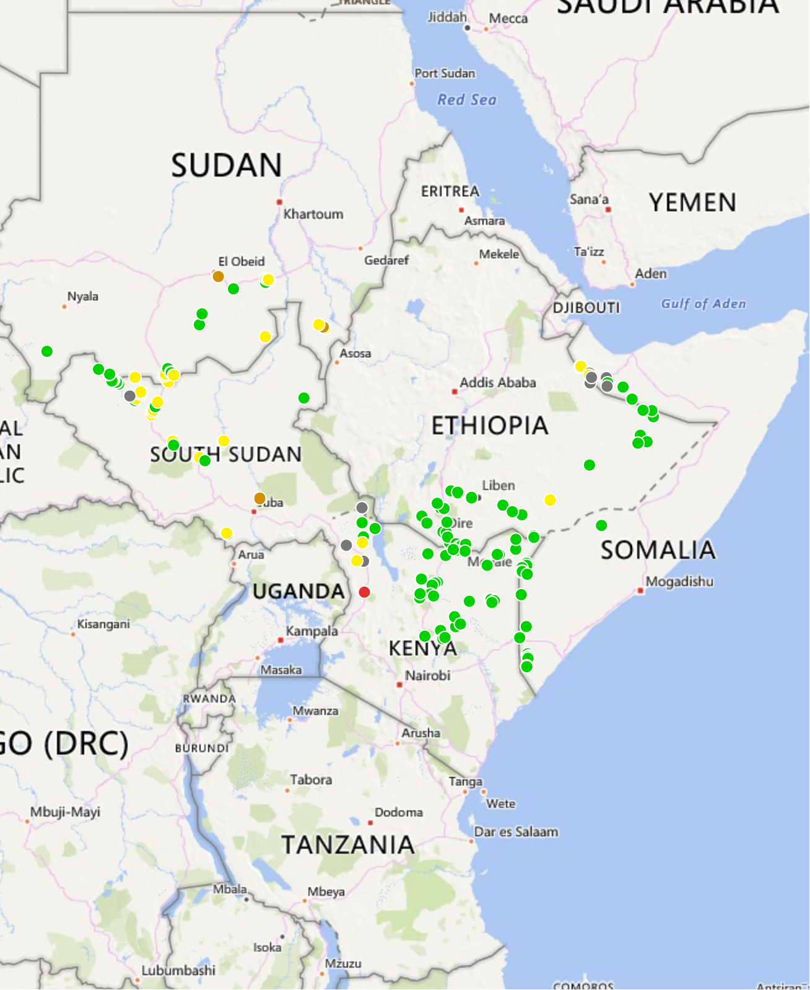
Beneficial Impacts on Rangeland Resources
Surface Water Points (CHIRPS)
As of 10 December 2023

Slide 22
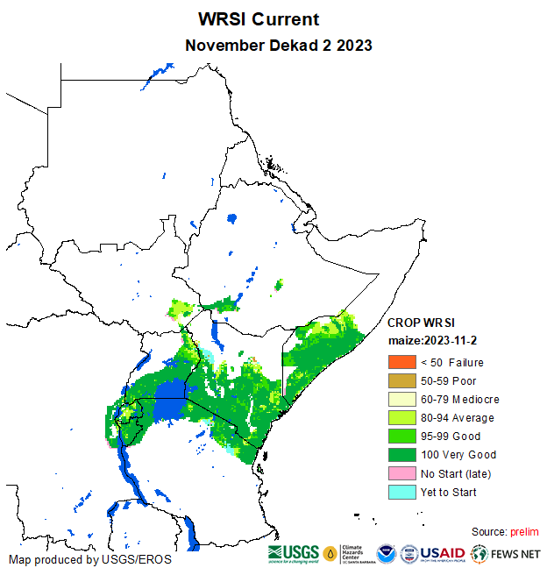
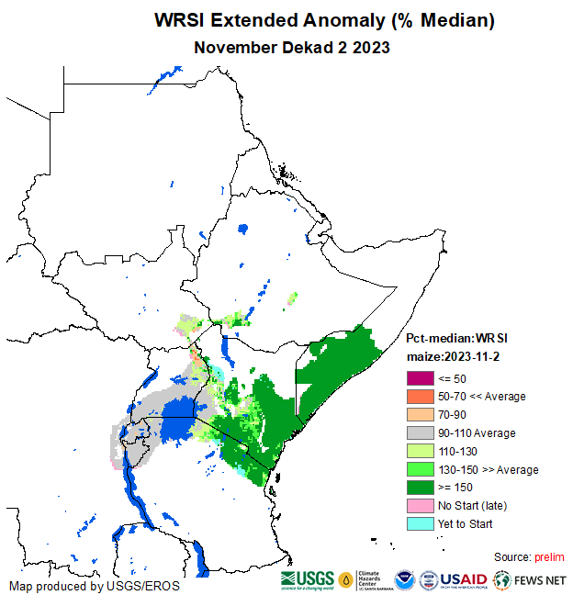
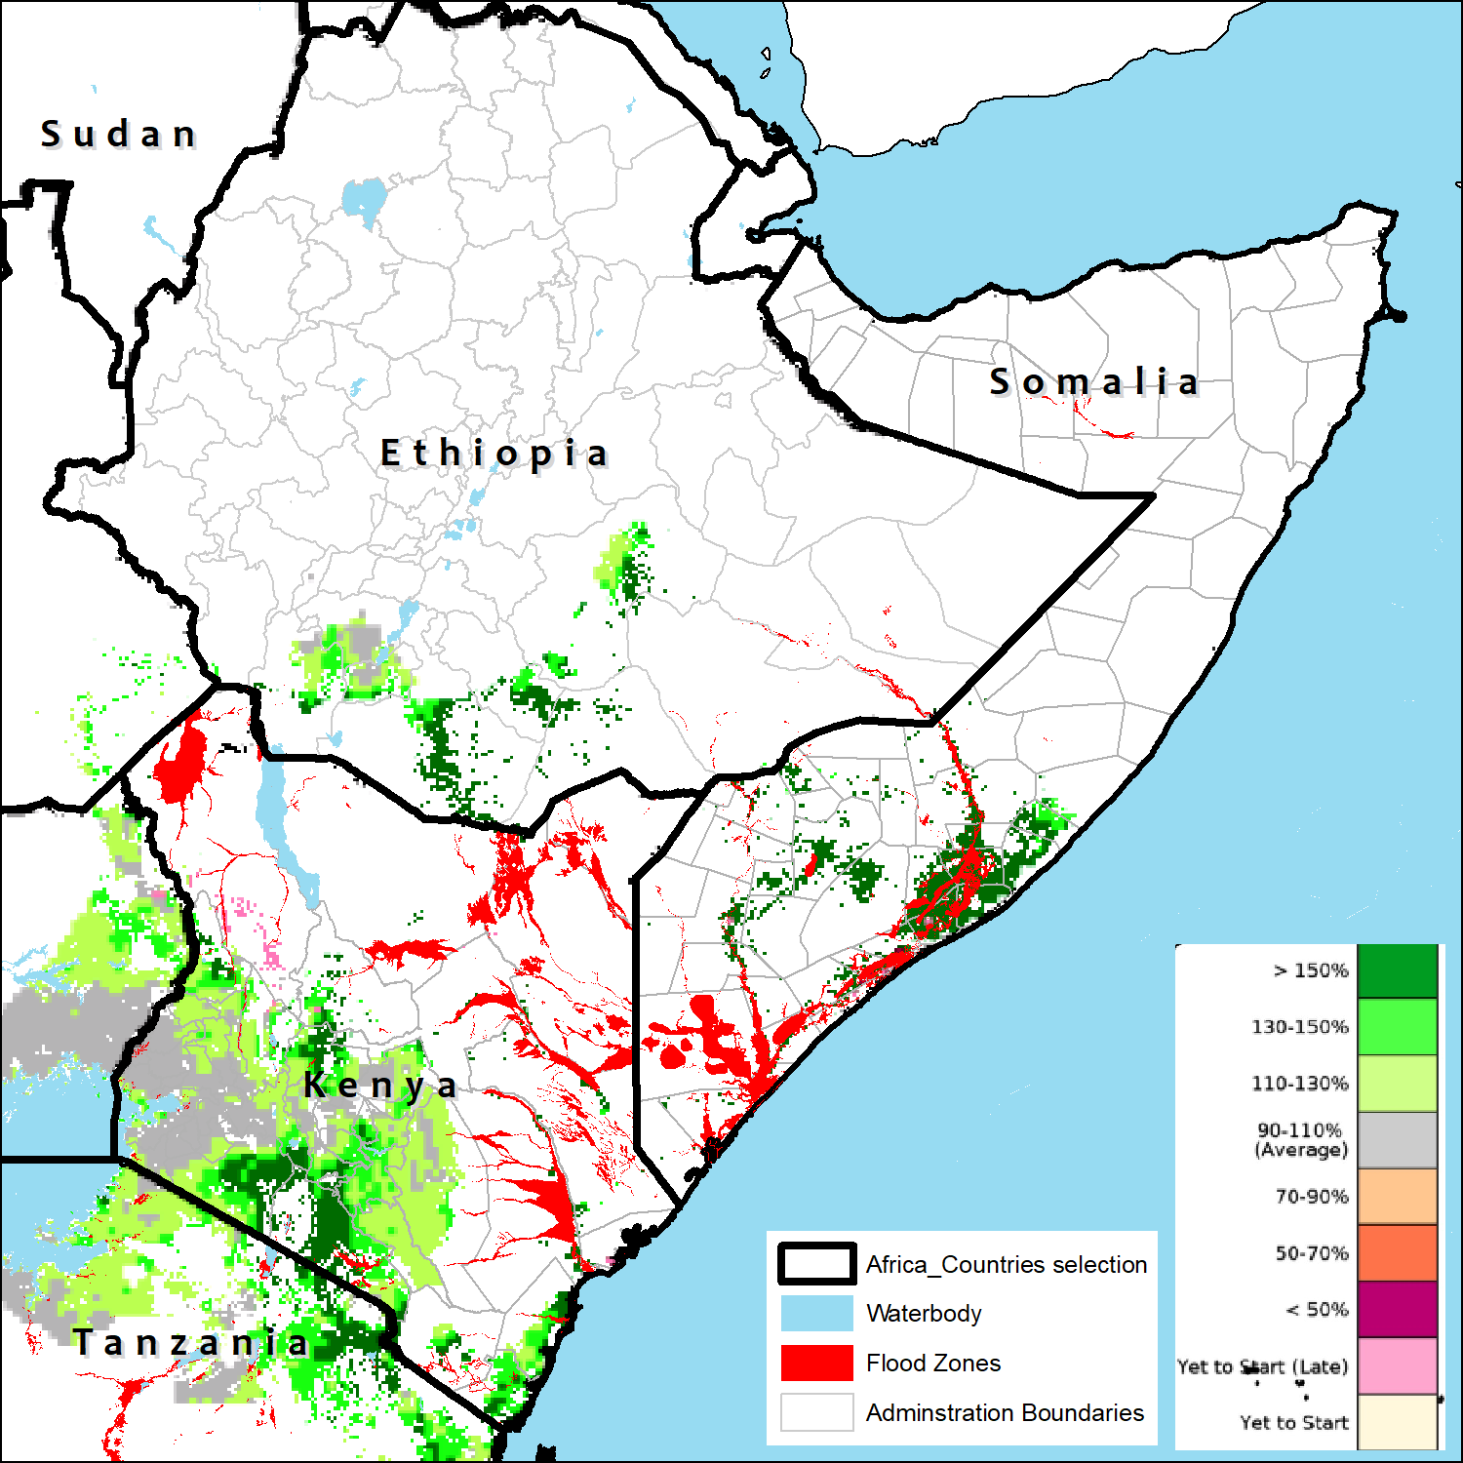
2023 Favorable cropping conditions and outlook
Maize crop in good to very conditions
Maize are varied phenological stages, ranging from vegetative stages to reproductive stages
Above average yield prospects apart from the flood and water-logged damaged crops.
2023/24 Current Crop Conditions and Extended Outlook Anomalies
2023/24 Most-Likely-Scenario

Slide 23
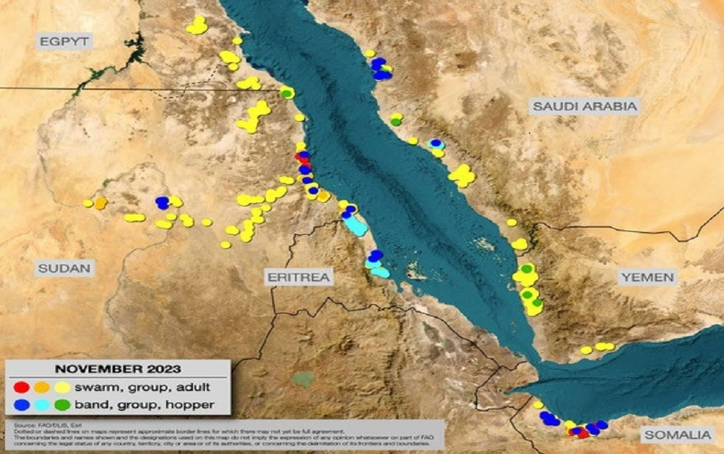
Increasing Risks for Diseases and Pests Outbreak
Current situation:
Outbreaks developed, groups, bands, and breeding:
Eritrea, Saudi Arabia, Somalia, Sudan
Watch:
The first generation of winter season (Nov–Jan) on the Red Sea and the Gulf of Aden coasts
Control:
operations in Eritrea, Mauritania, Saudi Arabia, Somalia, Sudan
November–February:
Above-normal rains and perhaps a second generation of breeding (Feb–Apr) on the Red Sea and the Gulf of Aden coasts
________________________
No significant development is likely in the Western and Eastern Regions.
Locust watch: www.fao.org/ag/locusts

Slide 24
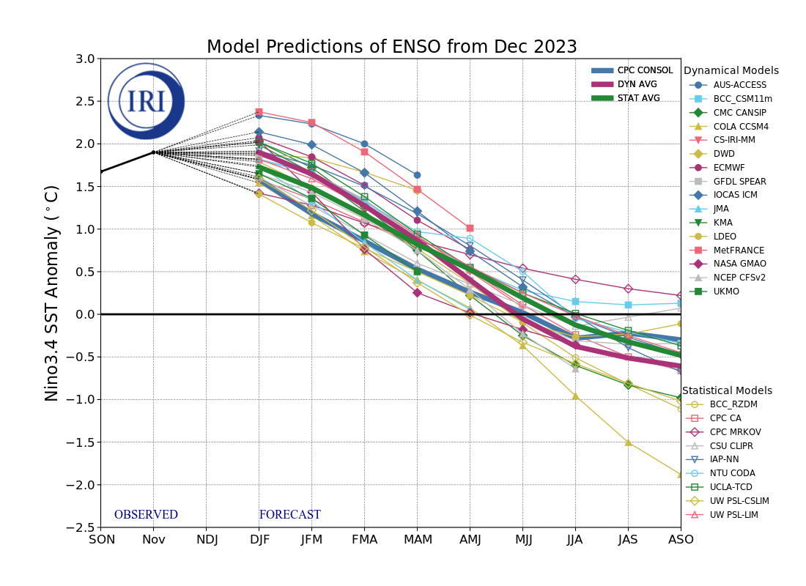
Climate Drivers Current Status and Outlook (Nino3.4)
El Niño is expected to remain the dominant ENSO state into northern hemisphere spring 2024 before transitioning to neutral in mid-2024.
A La Niña event is likely to become the dominant ENSO state in late 2024.
Season | La Niña | Neutral | El Niño
NDJ | 0 | 0 | 100
DJF | 0 | 0 | 100
JFM | 0 | 0 | 100
FMA | 0 | 3 | 97
MAM | 0 | 25 | 75
AMJ | 3 | 60 | 37
MJJ | 15 | 65 | 20
JJA | 32 | 56 | 12
JAS | 44 | 45 | 11

Slide 25
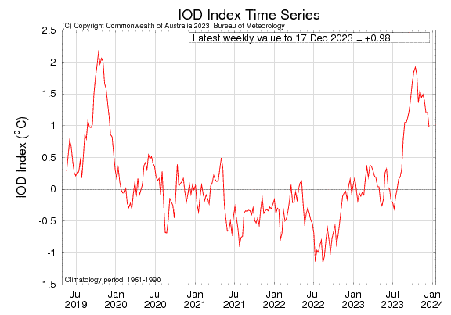
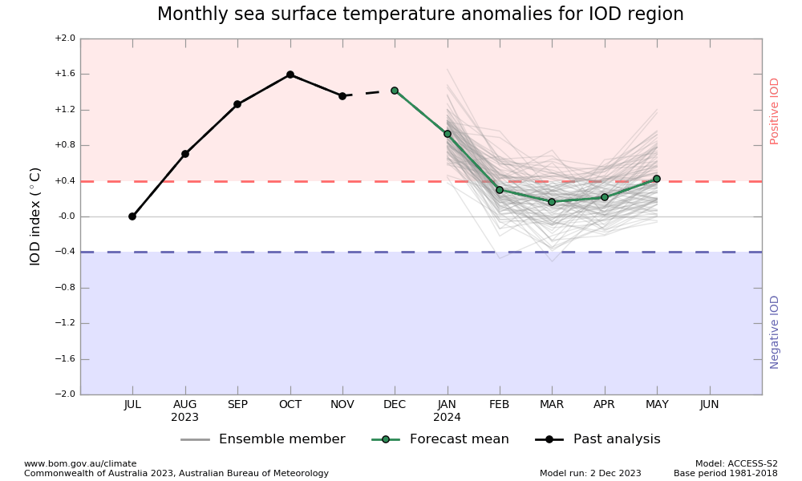
Climate Drivers Current Status and Outlook (PIOD)
The Indian Ocean Dipole (IOD) is positive and expected to remain so into early 2024. The peak intensity of the ongoing IOD event will rival the strongest since 1950. A neutral IOD is expected in northern hemisphere spring 2024.

Slide 26
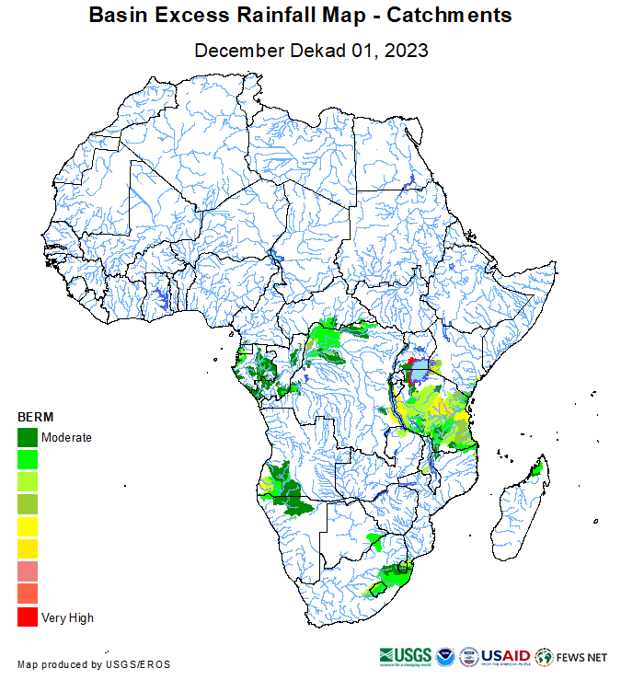
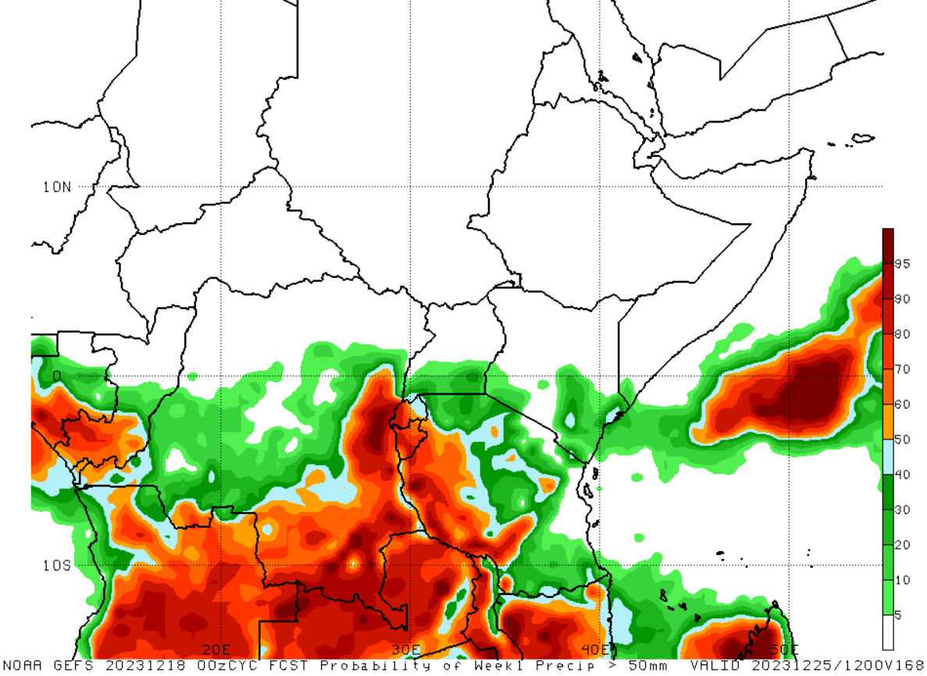
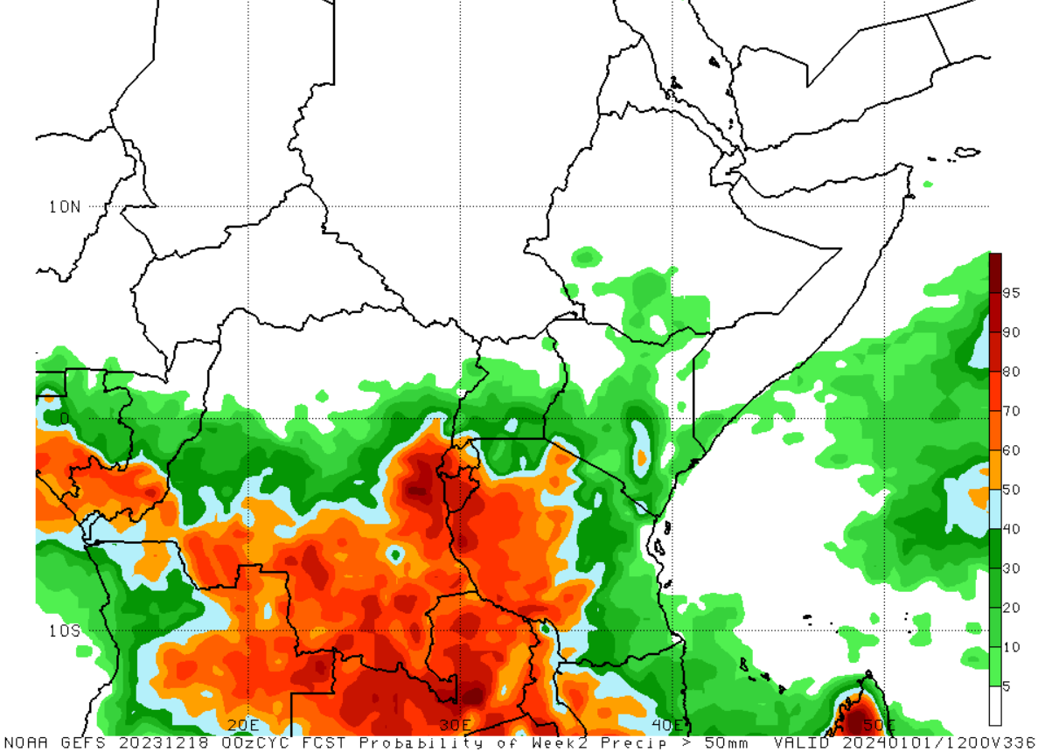
Weekly forecasts and southwards shift in flood risks
Week 1: Valid up to 25 Dec. 2023
Week 2: Valid up to 01 Jan. 2024
Flood risks shifted south and westwards

Slide 27
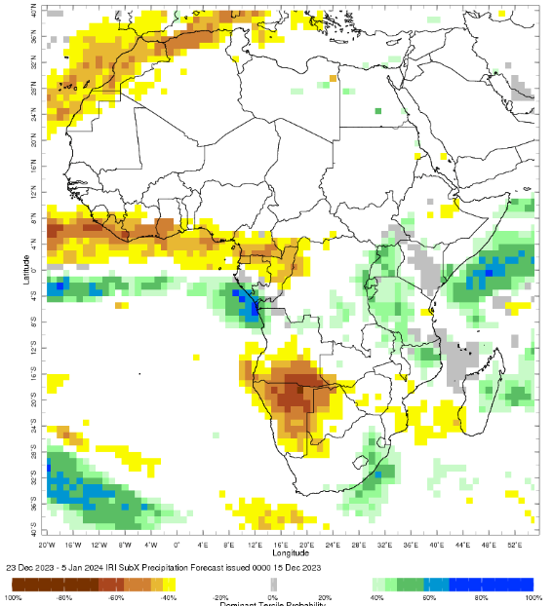
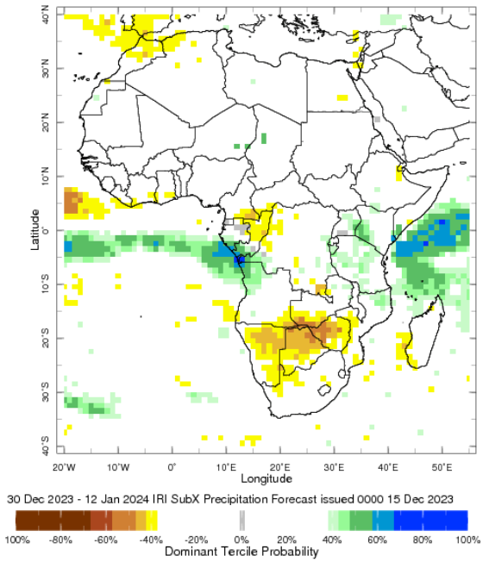
IRI Sub-X Rainfall Forecast: 23 Dec. – 12 Jan. 2024
Above average rainfall amounts likely over EA coastal, western and southern regions

Slide 28
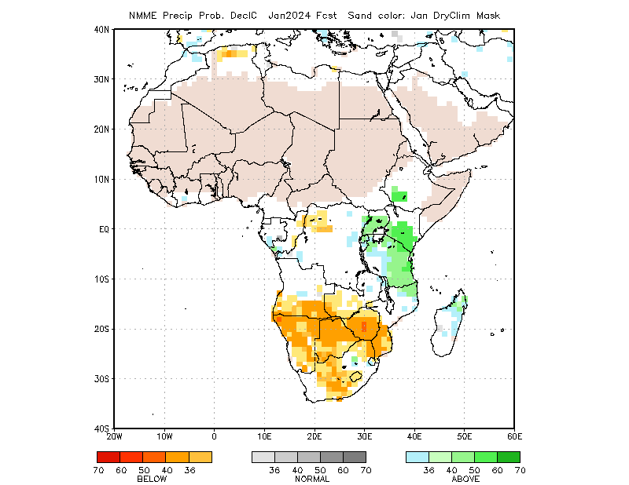
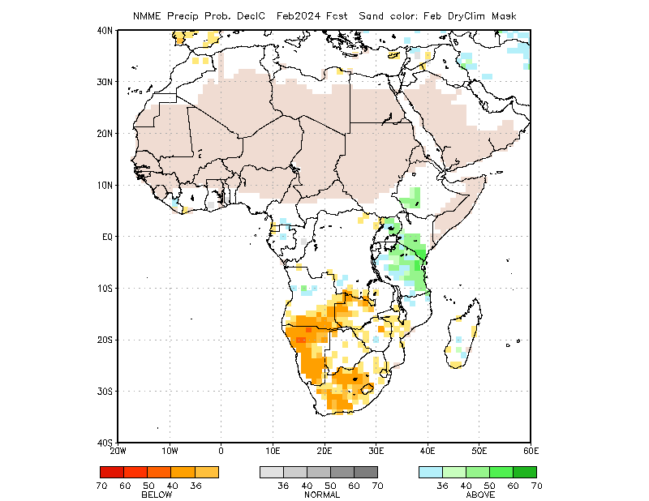
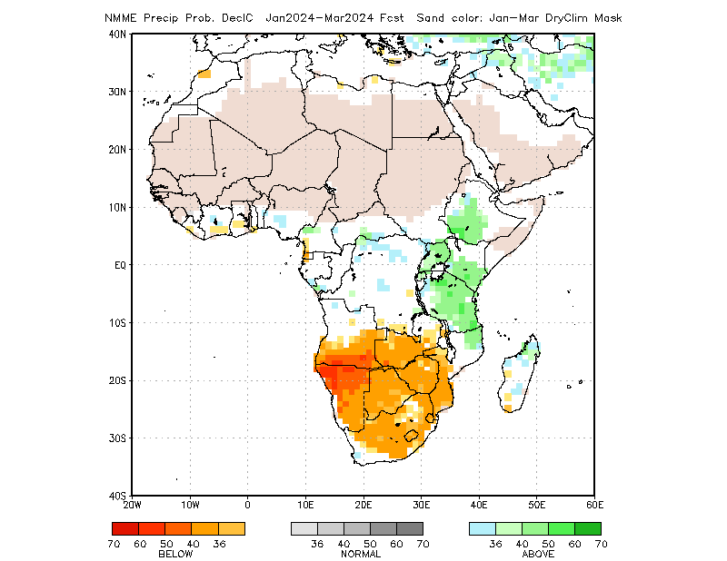
NMME Monthly Rainfall Forecasts
Above average seasonal rainfall amounts likely to continue into early 2024

Slide 29
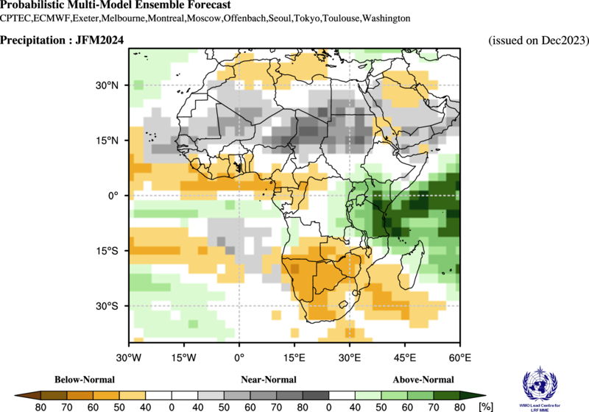
2024 Monthly Outlook for January - March
Above average unseasonal rains likely in January through March over equatorial East Africa

Slide 30
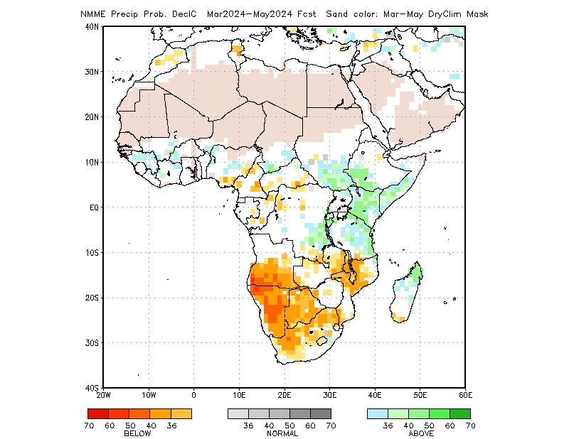
2024 Near-Average Rainfall Outlook for March - May
2024 March – May seasonal rains likely to be above average to average based on NMME, WMO and C3S influenced by weak El-Nino.
2024 March – May seasonal rains likely to be favorable and mostly near-average with geographic variations.
Most-likely rainfall outlook scenario for 2024 March – May

Slide 31
2024 Consensus Hotter-than-Normal Conditions for March - May

Slide 32
Above Average Performance for Western and Northern Sector
May – July, 2024

Slide 33
Assumption 1: late 2023 rainfall seasons
1a. Season A rains in Rwanda and Burundi (August/September to January) are most likely to be largely above average, with flooding expected in low-lying regions (No Change).
CHIRPS Prelim + GEFS (%)
01 Sept – 31 Dec. 2023
NMME Rainfall Forecast
January 2024

Slide 34
Assumption 1: late 2023 rainfall seasons
@ point A
A
B
@ point B
GloFAS streamflow forecast: Dec 2023 – Mar 2024
- Above average streamflow are expected.
GloFAS streamflow forecast: Dec 2023 – Mar 2024

Slide 35
1b. In short rains/deyr receiving areas of northern and eastern Kenya, Somalia, and southern/southeastern Ethiopia, ECMWF and GEFS forecasts indicate that average to below-average rainfall is most likely in the second half of December. A risk of flooding will persist given above-average soil moisture and elevated river water levels, but overall risk of flooding will continue to decline. Overall, the October to December 2023 season will likely conclude with significantly above average rainfall, with cumulative totals among the highest on record in many areas.
CHIRPS Prelim + GEFS (%)
01 Oct. – 31 Dec. 2023
CHIRPS Prelim + GEFS (SPI)
01 Oct. – 31 Dec. 2023
CHIRPS Prelim + GEFS (Rank)
01 Oct. – 31 Dec. 2023

Slide 36
Low Risk of Flooding
@ Point A: Juba, Somalia
A
GloFAS streamflow forecast: Dec 2023 – Mar 2024
GloFAS streamflow forecast: Dec 2023 – Mar 2024
- Although streamflow are expected to be above average in Kenya and southern Somalia, they are declining sharply.

Slide 37
1d. Based on observed precipitation plus GEFS and ECMWF forecasts for the remainder of December, the September to December 2023 rainy season in northeastern and east-central bimodal DRC will most likely conclude with average cumulative rainfall in most areas, though with localized variability.
CHIRPS Prelim + GEFS (%)
01 Sept. – 31 Dec. 2023
CHIRPS Prelim + GEFS (SPI)
01 Sept. – 31 Dec. 2023

Slide 38
1e. The December to January xays showers in northwestern Somalia will most likely be average.

Slide 39
Assumption 2: early 2024 rainy seasons in the Horn
2a: The February-May 2024 belg rainy season in Ethiopia is likely to be average.

Slide 40
Assumption 2: early 2024 rainy seasons in the Horn
2b: The March-May 2024 long rains/gu/genna season in northern and eastern Kenya, Somalia, and southern/southeastern Ethiopia is most likely to be above average with localized variations.
2c. The March-May 2024 diraac/sugum rains in northern pastoral areas of Ethiopia are likely to be average.

Slide 41
Assumption 2: early 2024 rainy seasons in the Horn
2d. Based on available forecasts, the February-May 2024 main season rains in Burundi are most likely to be above average, though there is uncertainty given the long-range nature of the forecast.
2e. Based on ensemble forecasts, the March to May 2024 first season rains in bimodal Uganda are likely to be average, with a slight tilt in the odds towards above average in northern Uganda.
2f. Based on the NMME forecast, the March to May 2024 first season rains in bimodal South Sudan are likely to be above average, though there is uncertainty given the long-range nature of the forecast.

Slide 42
Assumption 3: 2024 rainy season beginning April and beyond
Uganda unimodal, Ethiopia kiremt and karma, Sudan, unimodal South Sudan, Somalia hagaa
3a. Based on expectations for ENSO Neutral conditions, the June to September kiremt rainfall season in western Ethiopia is assumed to be average. However, notable uncertainty exists given the long lead time and the absence of available forecasts.
3b. Based on expectations for ENSO Neutral conditions, the June to September long rains rainfall season in unimodal Kenya is assumed to be average. However, notable uncertainty exists given the long lead time and the absence of available forecasts.
3c. Based on expectations for ENSO Neutral conditions, the June to September karan/karma rainfall season in northeastern Ethiopia and northwestern Somalia is assumed to be average. However, notable uncertainty exists given the long lead time and the absence of available forecasts.
May – July 2024

Slide 43
Assumption 3: 2024 rainy season beginning April and beyond
Uganda unimodal, Ethiopia kiremt and karma, Sudan, unimodal South Sudan, Somalia hagaa
3d. Based on the NMME and WMO forecasts, the start of the June to September rainy season in Sudan is likely to be average, though there is uncertainty given the long-range nature of the forecast.
3e. Based on NMME forecast, the start of the June to September rainy season in unimodal South Sudan is likely to be above average. However, there is uncertainty given the long-range nature of the forecast.

Slide 44
Assumption 3: 2024 rainy season beginning April and beyond
Uganda unimodal, Ethiopia kiremt and karma, Sudan, unimodal South Sudan, Somalia hagaa
3f. Based on the NMME forecast, the April-September 2024 unimodal rainfall season in Karamoja, Uganda, is likely to be average at the start, gradually increasing to above average during the season, though there is uncertainty given the long-range nature of the forecast.

Slide 45
Assumption 3: 2024 rainy season beginning April and beyond
Uganda unimodal, Ethiopia kiremt and karma, Sudan, unimodal South Sudan, Somalia hagaa
3g. Based on expectations for ENSO Neutral conditions, the July to September hagaa rains in southern Somalia are assumed to be average. However, notable uncertainty exists given the long lead time and the absence of available forecasts.

Slide 46
Assumption 4: non-rainfall assumptions
4a: NMME-based rootzone soil moisture forecasts indicate that soil moisture will be above average in much of the greater Horn through at least April 2024, and among the highest on record in parts of Somalia, northeastern Kenya, and southeastern Ethiopia.
East Africa: NMME-driven soil moisture forecasts show the wet conditions in Somalia, Uganda, and Kenya as well as southern to eastern Ethiopia persist through March 2024. Dry conditions persist across northern Ethiopia, including the Afar region.
Yemen: NMME-driven soil moisture forecasts show average to wet conditions across the country, with the exception of localized
dry conditions in the central-eastern region, through April 2024.

Slide 47
Assumption 4: non-rainfall assumptions
4b. Above-average temperatures are most likely through at least September 2024.

Slide 48
YEMEN
Assumption 1: Based on expectations for El Niño conditions in the spring and available ensemble forecasts, cumulative rainfall in Yemen’s March to May 2024 first rainy season is most likely to be average, though uncertainty exists given the long lead time.

Slide 49
Assumption 2: In the absence of available ensemble forecasts and given that ENSO Neutral conditions are most likely by May-July, cumulative rainfall in Yemen’s July to September 2024 second rainy season is assumed to be average, though notable uncertainty exists given the long lead time and absence of available forecasts.

Slide 50
YEMEN
Assumption 3: Risk of cyclone strikes and associated flooding for Socotra and the southern Aden Gulf coast is highest from mid-April to mid-June and from October to December. In the peak periods from October to December 2023 and from mid-April to May 2024, risk of cyclone strikes will likely be above average due to forecast above-average sea surface temperatures in the Arabian Sea, though risk will still be low overall given the rarity of cyclone strikes in Yemen.

Slide 51
YEMEN
Assumption 4: Based on NMME, C3S, and WMO ensemble forecasts and historical trends, above-average temperatures are most likely across most of the country through at least September 2024.

Slide 52
YEMEN
Assumption 5: Vegetation and pasture conditions are currently largely above average, though below-average conditions prevail in southern coastal areas. Vegetation conditions are expected to seasonally decline through February/March 2024 during the dry period, improve from March to May during the first rainy season, seasonally decline during the dry period through June/July, and then finally improve from July to September 2024 during the second rainy season. Given expectations for above-average temperatures, deterioration during dry periods is likely to be faster than normal. Overall, vegetation conditions are likely to remain mixed compared to the average, though with more areas likely to see below-average vegetation conditions over the course of the projection period due to the above-average temperatures.

Slide 53
KEY POINTS • Current situation: Outbreaks developed, groups, bands, and breeding: Eritrea, Saudi Arabia, Somalia, Sudan • Current situation: The first generation of winter season (Nov–Jan) on the Red Sea and the Gulf of Aden coasts • Control: operations in Eritrea, Mauritania, Saudi Arabia, Somalia, Sudan • November–February: above-normal rains and perhaps a second generation of breeding (Feb–Apr) on the Red Sea and the Gulf of Aden coasts ________________________ Central Region outbreaks in November. Four local Desert Locust outbreaks developed during November. The winter season started earlier than normal this year along the Red Sea and Gulf of Aden coasts due to the Indian Ocean Dipole and El Niño in the Horn of Africa. A few swarms laid in Sudan and Somalia while groups occurred in Eritrea and Saudi Arabia. Hatching started and hopper groups and bands increased during the breeding in Sudan, Eritrea, Somalia, and Saudi Arabia where control was done. Yemen had some hoppers and adults while Egypt had a few adults. In the Western Region, low numbers of adults were seen in Mauritania, Niger, Western Sahara, and Algeria. During the forecast, breeding will cause locusts to increase during the first generation along the Red Sea and Gulf of Aden coasts from December and January. The latest weather models predict more rain than normal along both sides of the Gulf of Aden and perhaps the southern Red Sea coast, but the northern Red Sea coast is uncertain. Nevertheless, a second generation of breeding is expected from late January to April which would cause locust numbers to increase further with more groups, bands, and some swarms to form. Control operations should continue. No significant development is likely in the Western and Eastern Regions. See LocustWatch: www.fao.org/ag/locusts

Slide 55
Low Risk of Flooding
@ Point A
A
GloFAS streamflow forecast: Dec 2023 – Mar 2024
GloFAS streamflow forecast: Dec 2023 – Mar 2024

