Slide 1
FEWS NET Enhanced Flood Monitoring and Forecast
FEWS NET Science Team
March 30, 2026
Notes:
Default title slide

Slide 2

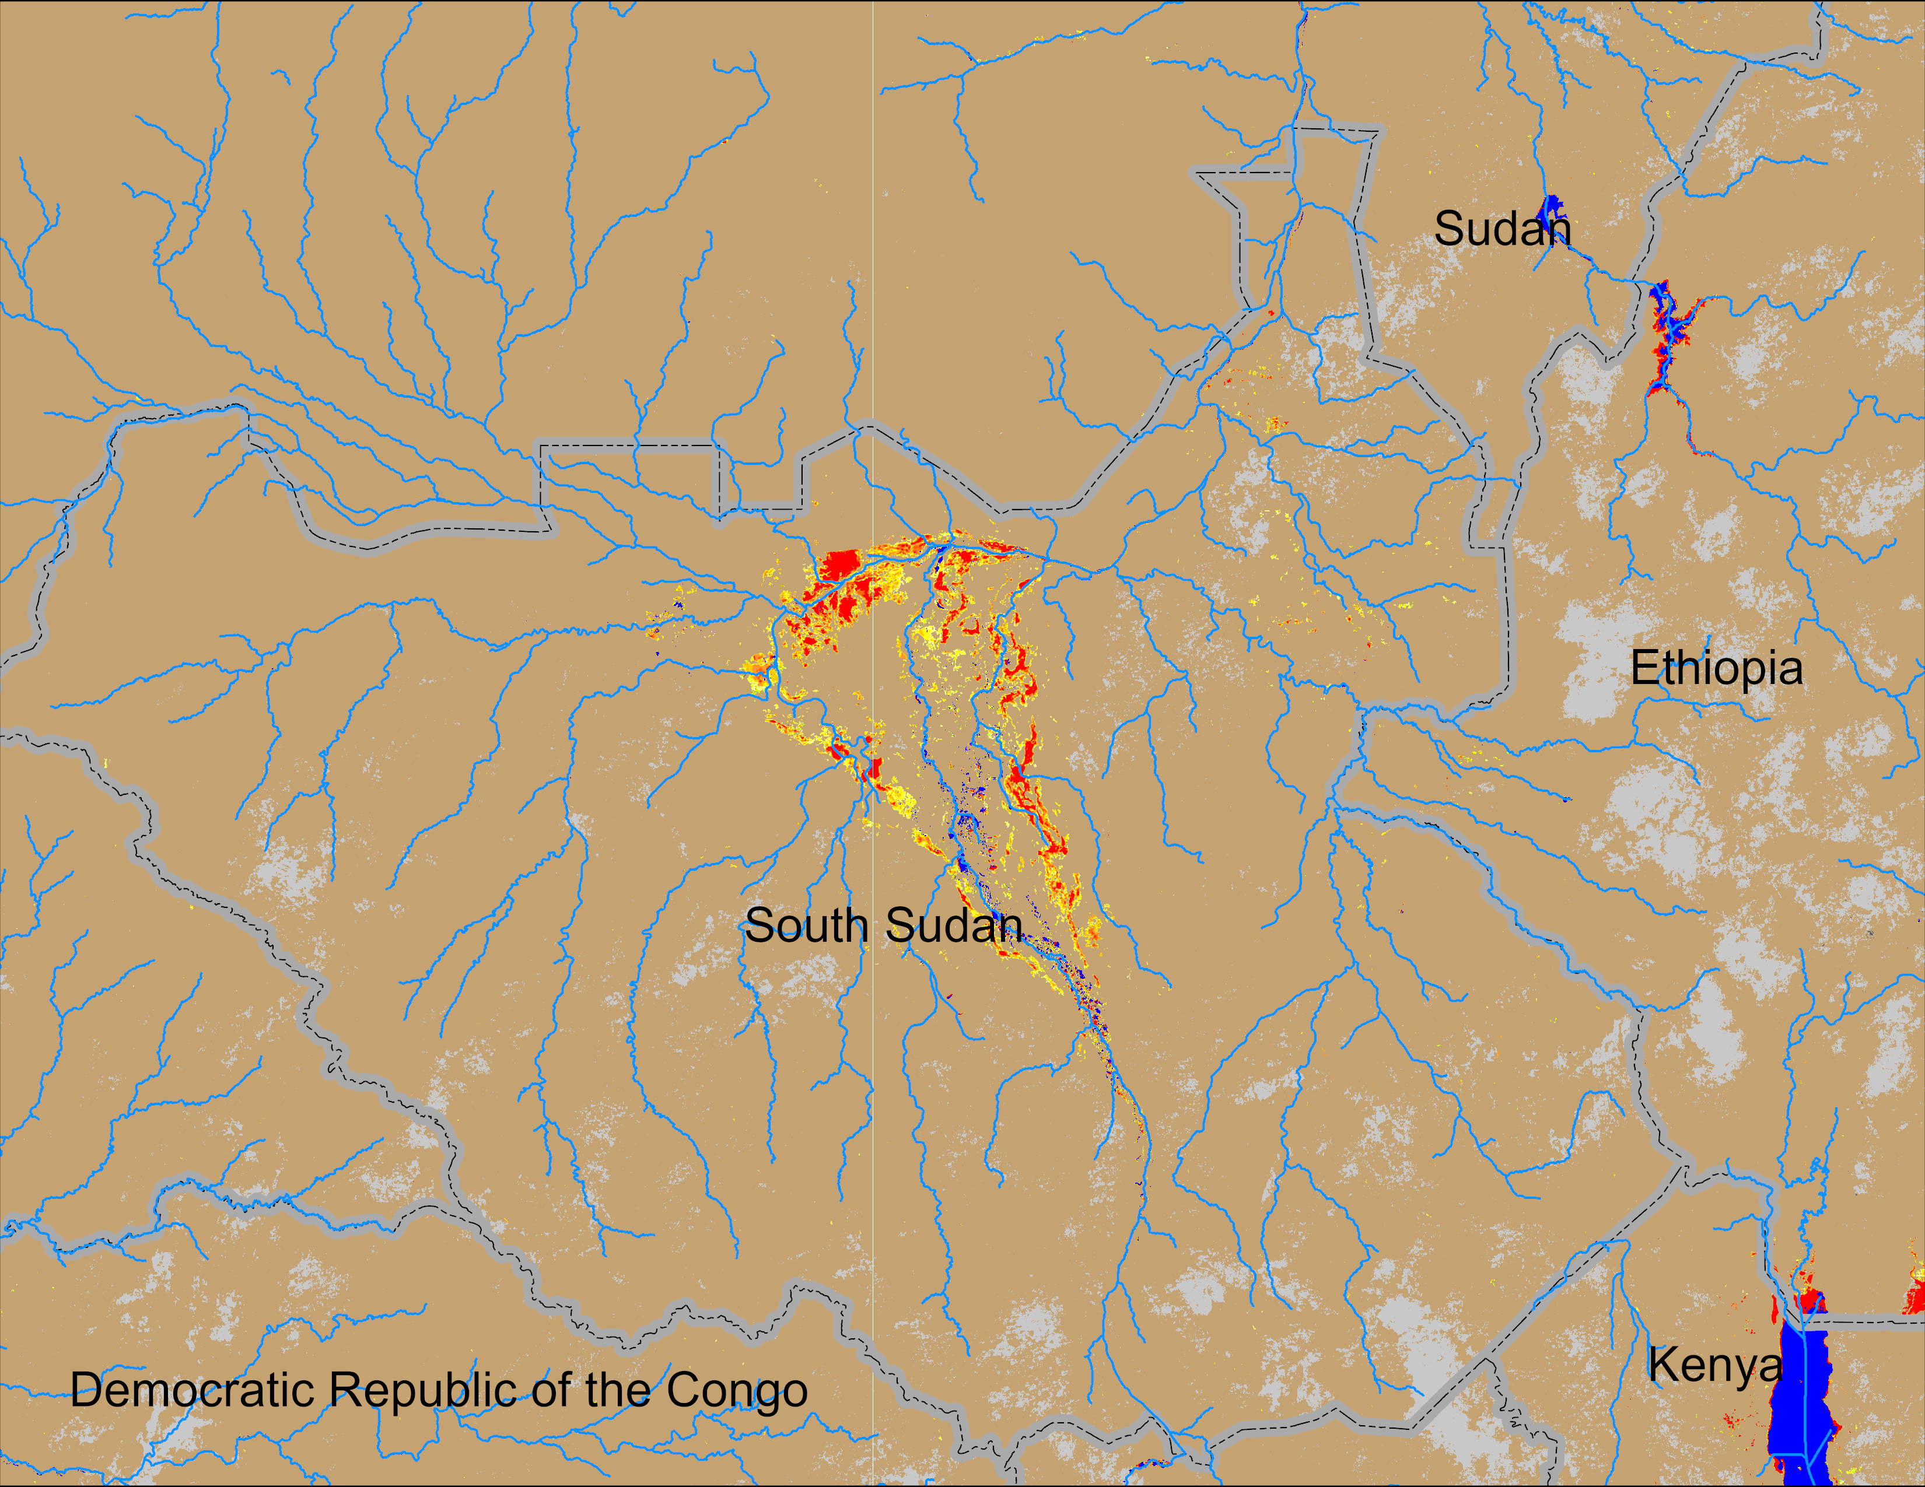
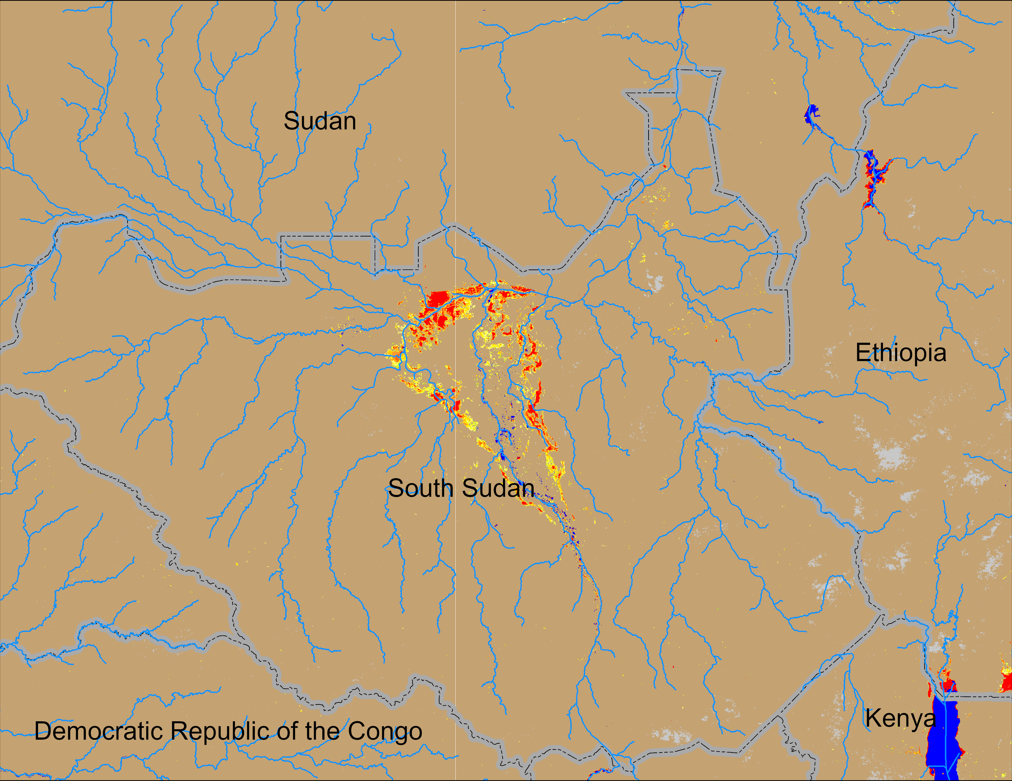
Flooding Conditions in South Sudan
NOAA VIIRS derived map: 18 – 22 Mar 2026
NOAA VIIRS 5-day comp.: 25 – 29 Mar 2026
Inundation remained unchanged in the central South Sudan.

Slide 3
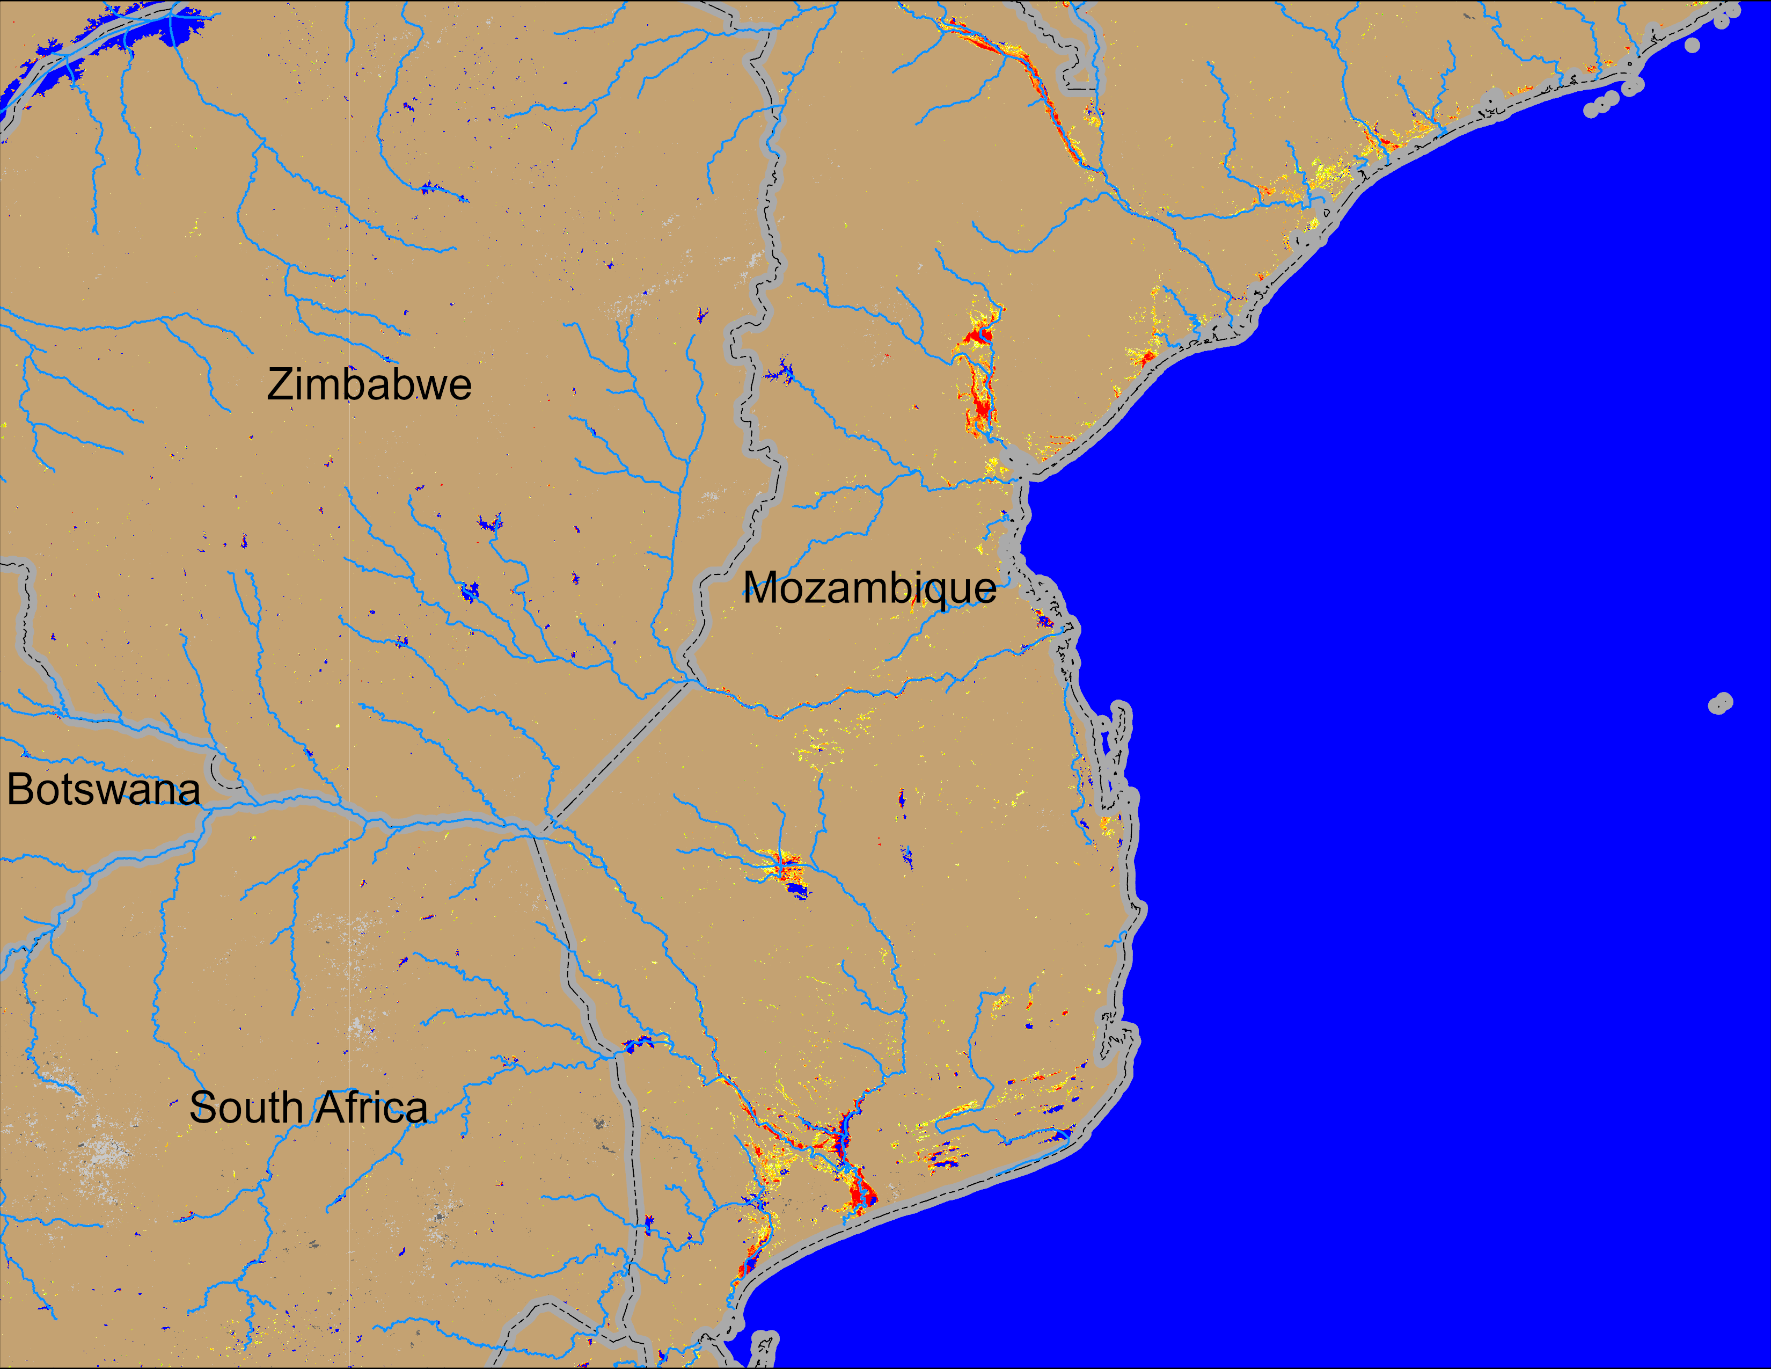
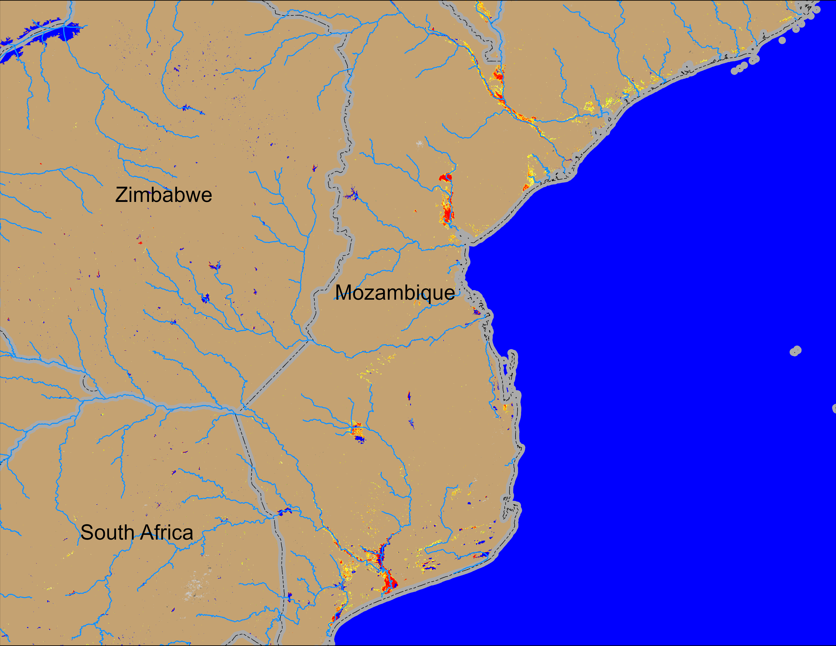
Flooding Conditions in Mozambique
NOAA VIIRS derived map: 18 – 22 Mar 2026
NOAA VIIRS 5-day comp.: 25 – 29 Mar 2026
Flooding conditions slightly improved in central and southern Mozambique.

Slide 4
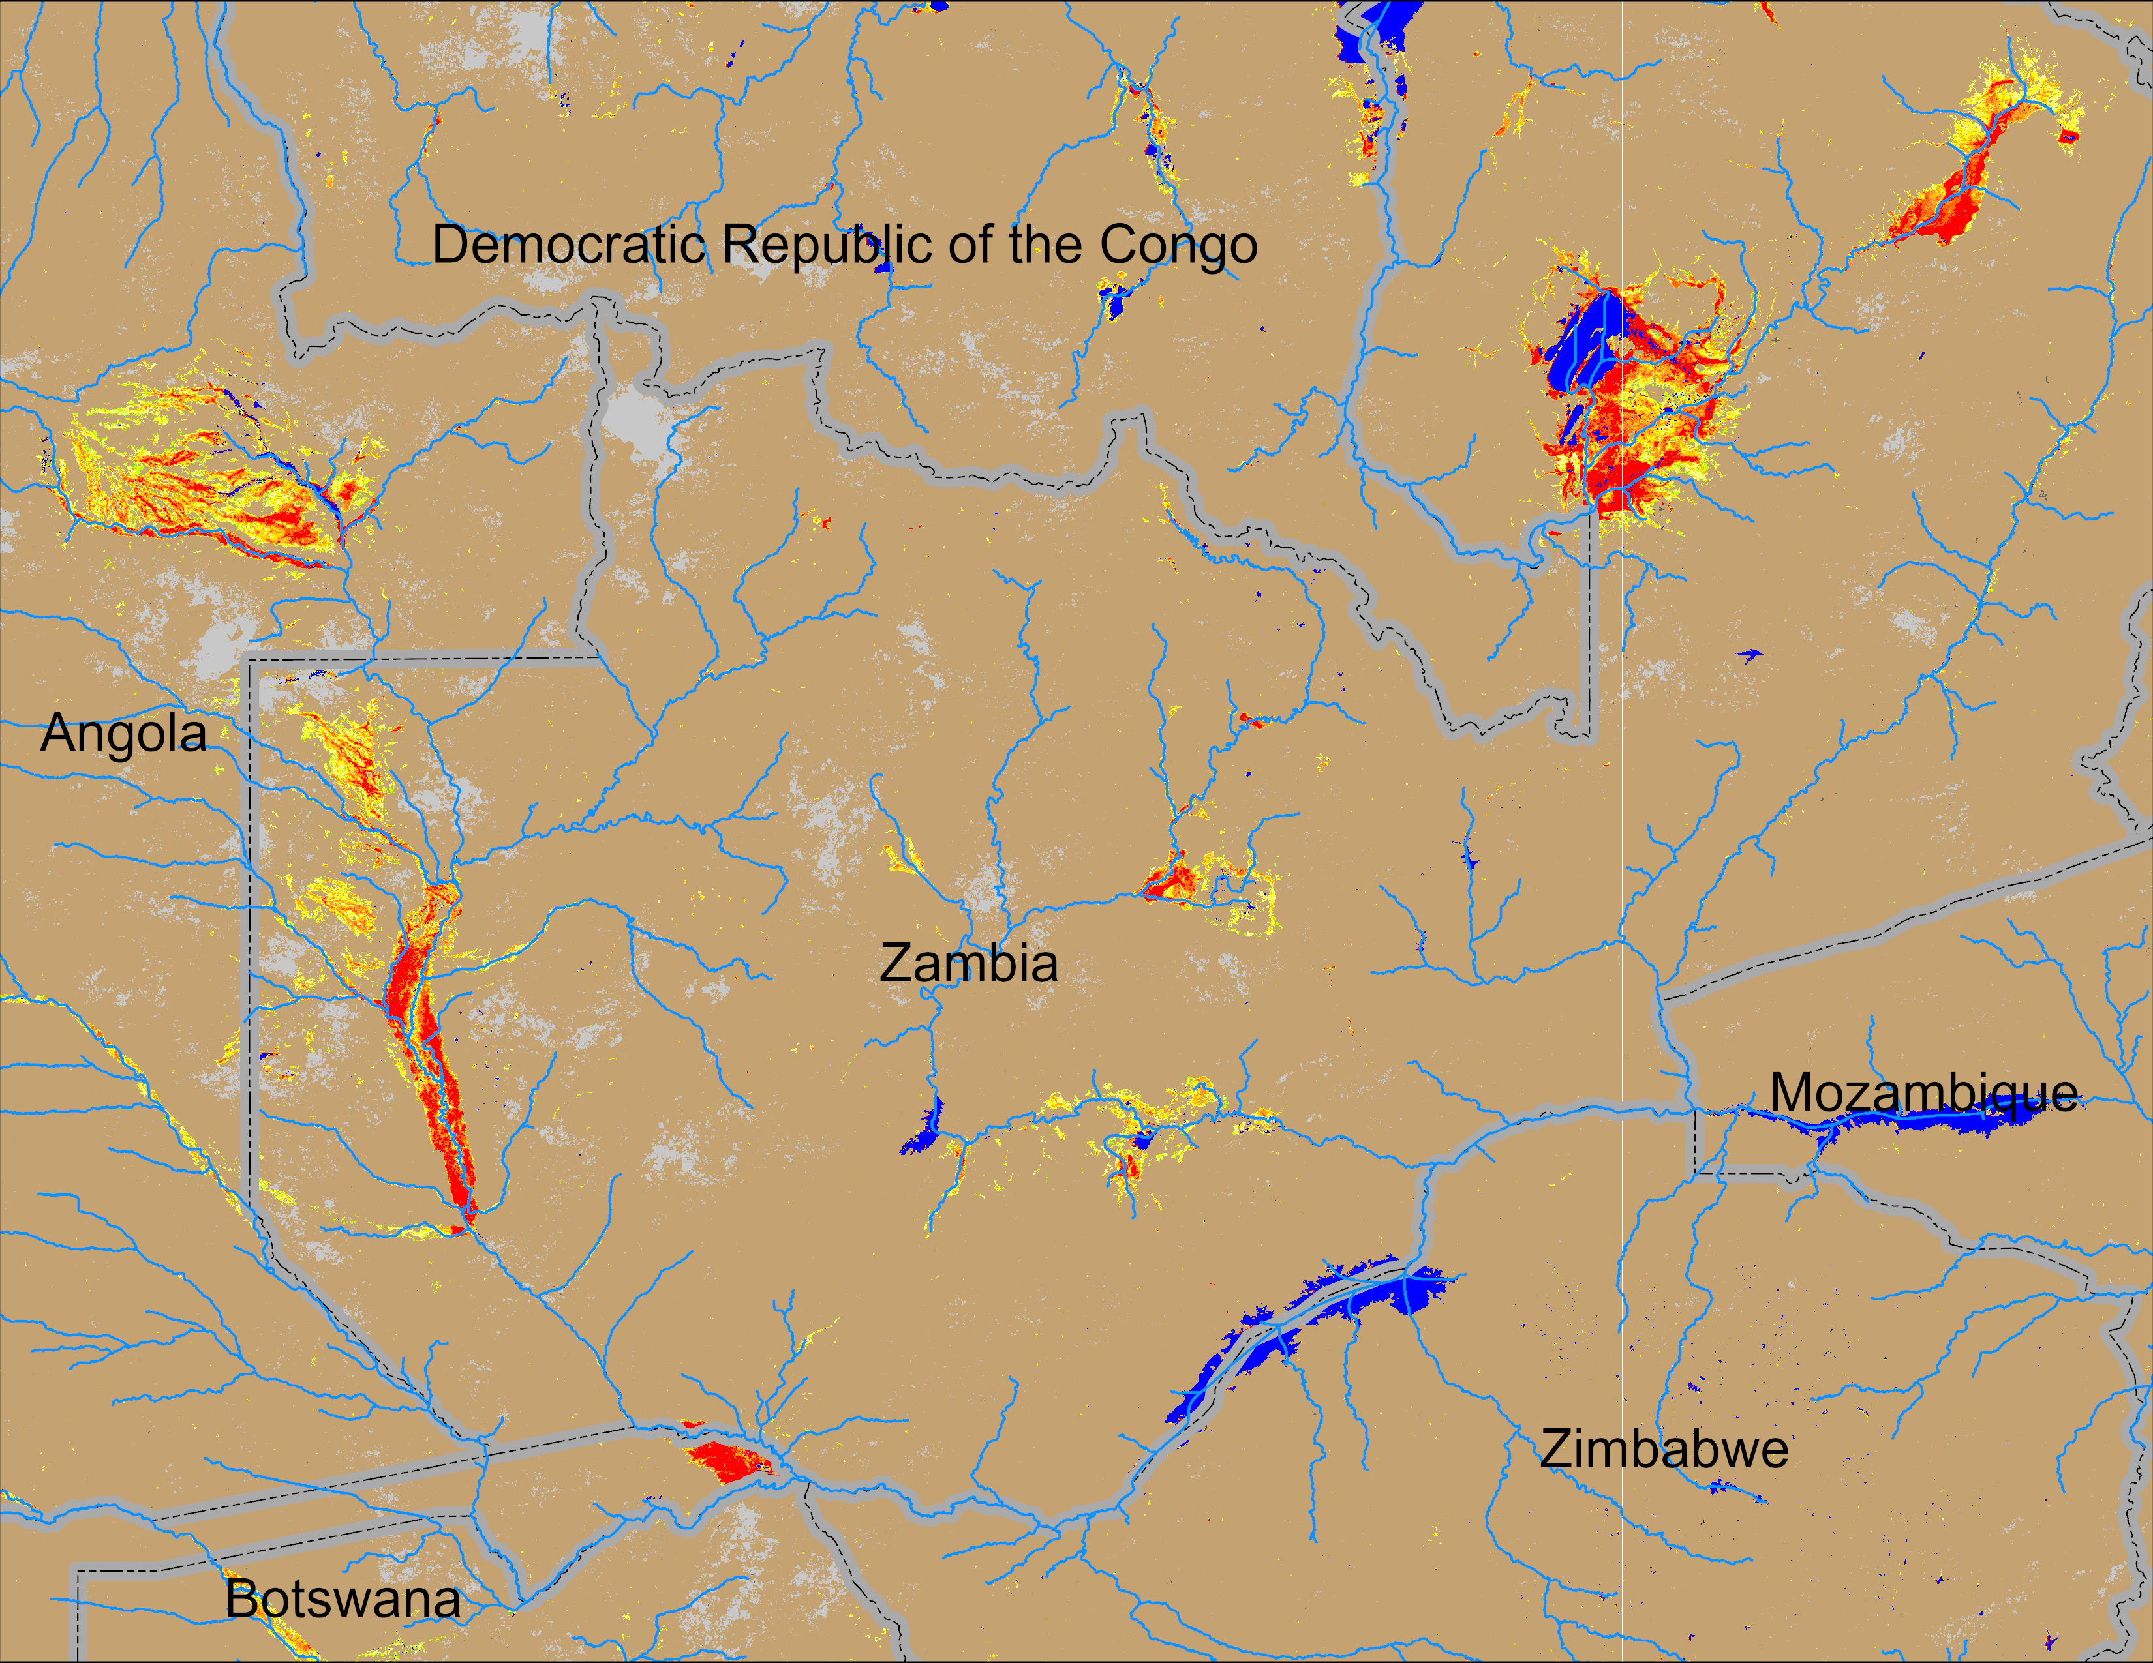
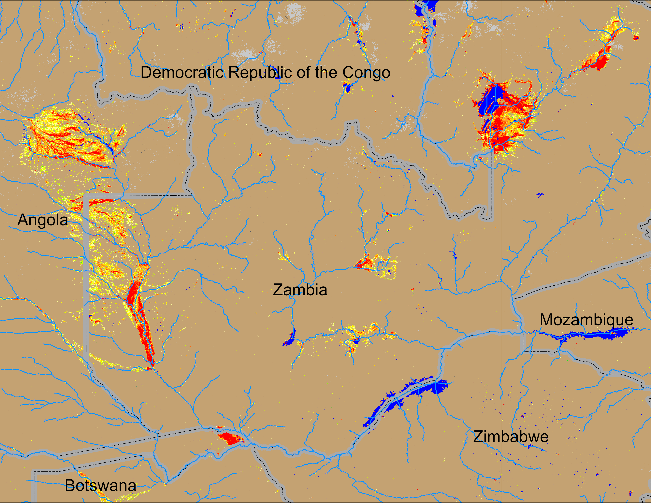
Flooding Conditions in Zambia
NOAA VIIRS derived map: 18 – 22 Mar 2026
NOAA VIIRS 5-day comp.: 25 – 29 Mar 2026
Intensifyed flooding remained unchanged across Zambia.

Slide 5
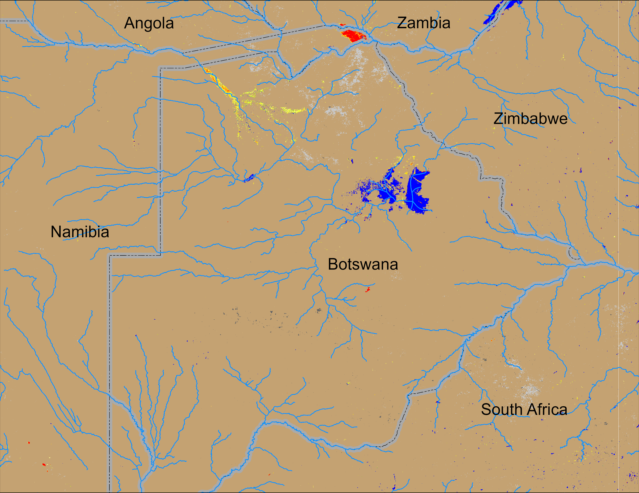
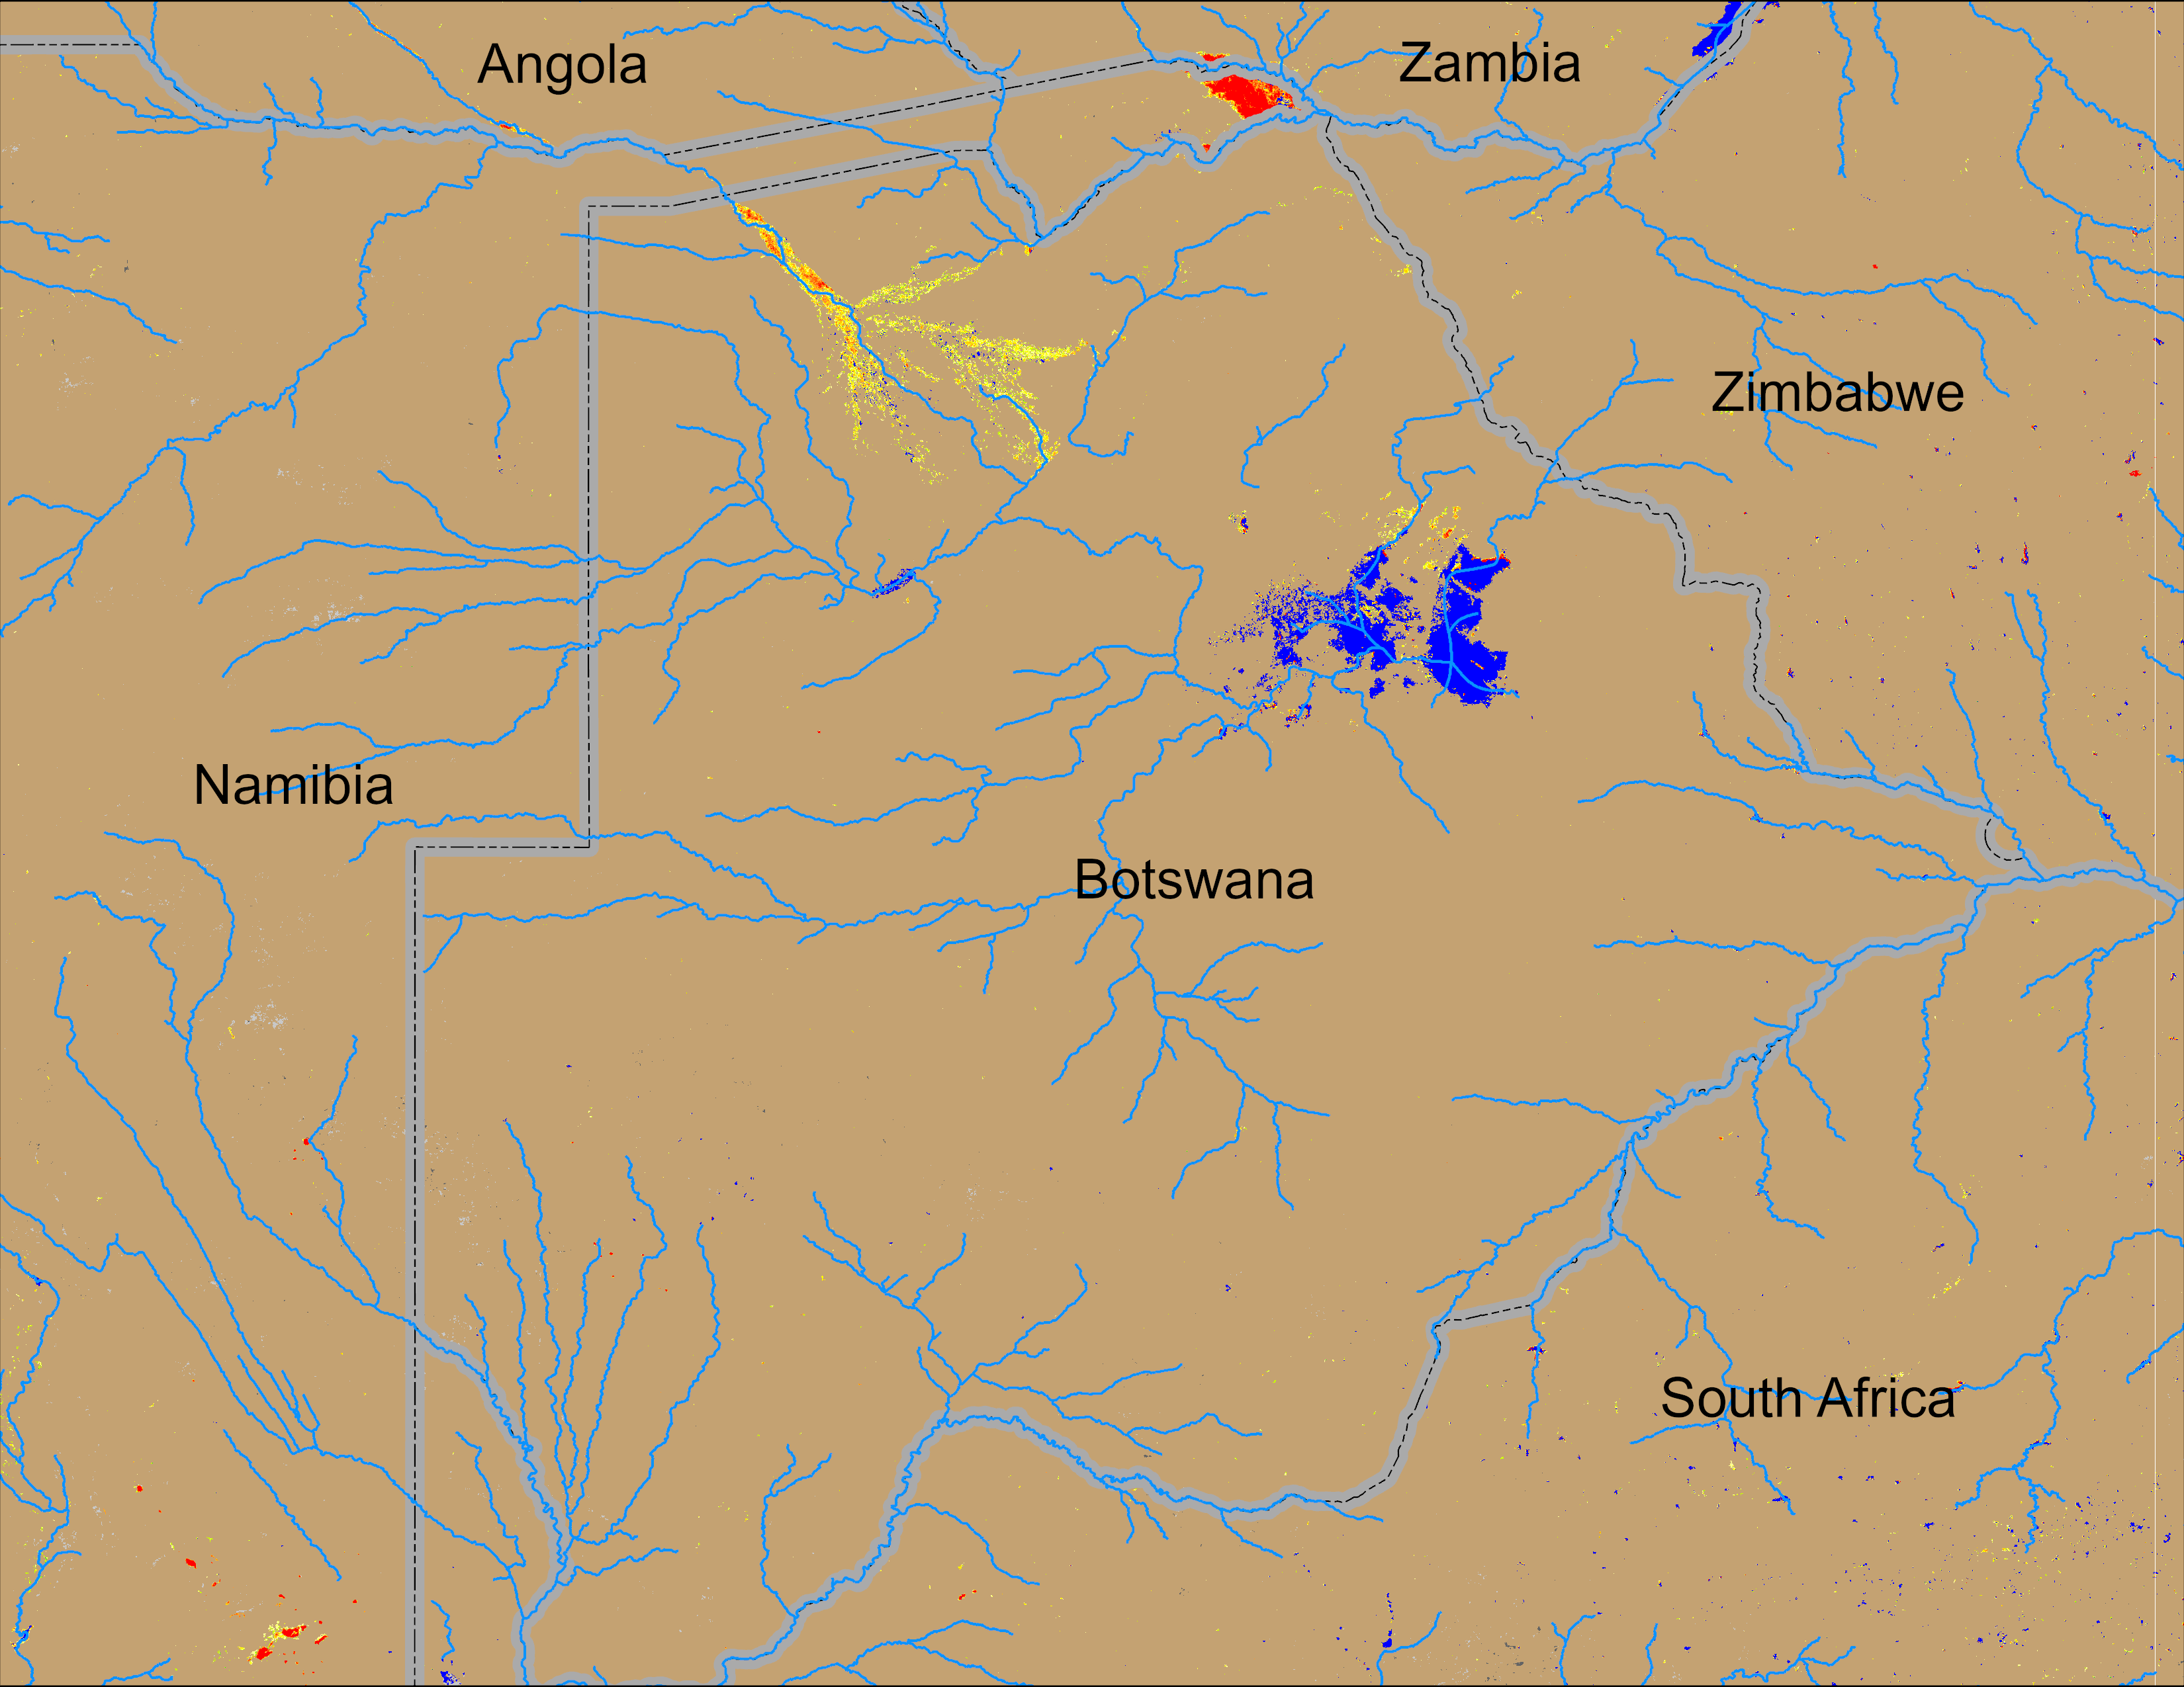
Flooding Conditions in Botswana
NOAA VIIRS derived map: 18 – 22 Mar 2026
NOAA VIIRS 5-day comp.: 25 – 29 Mar 2026
Flooding conditions deteriorated slightly in northern Botswana.

